Slide 1
Declining Birthrates in Singapore
1MS014: Analysis of Time Series Presentation
Presented by: Kyler

Slide 2
Outline
Motivation
Data
Data Exploration
Model
Forecasts
Conclusion

Slide 3
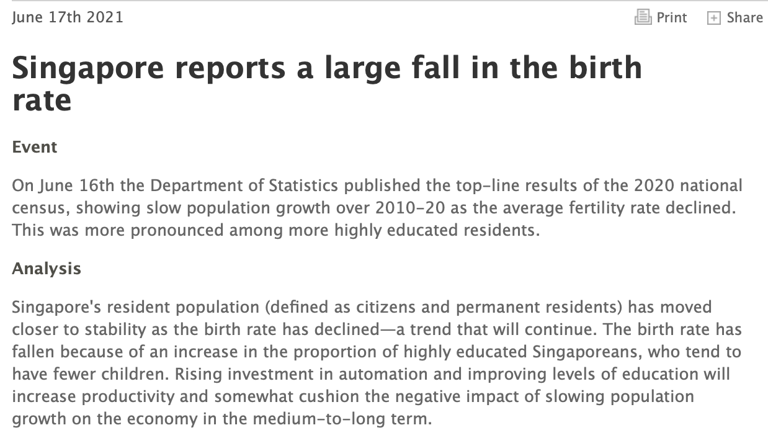

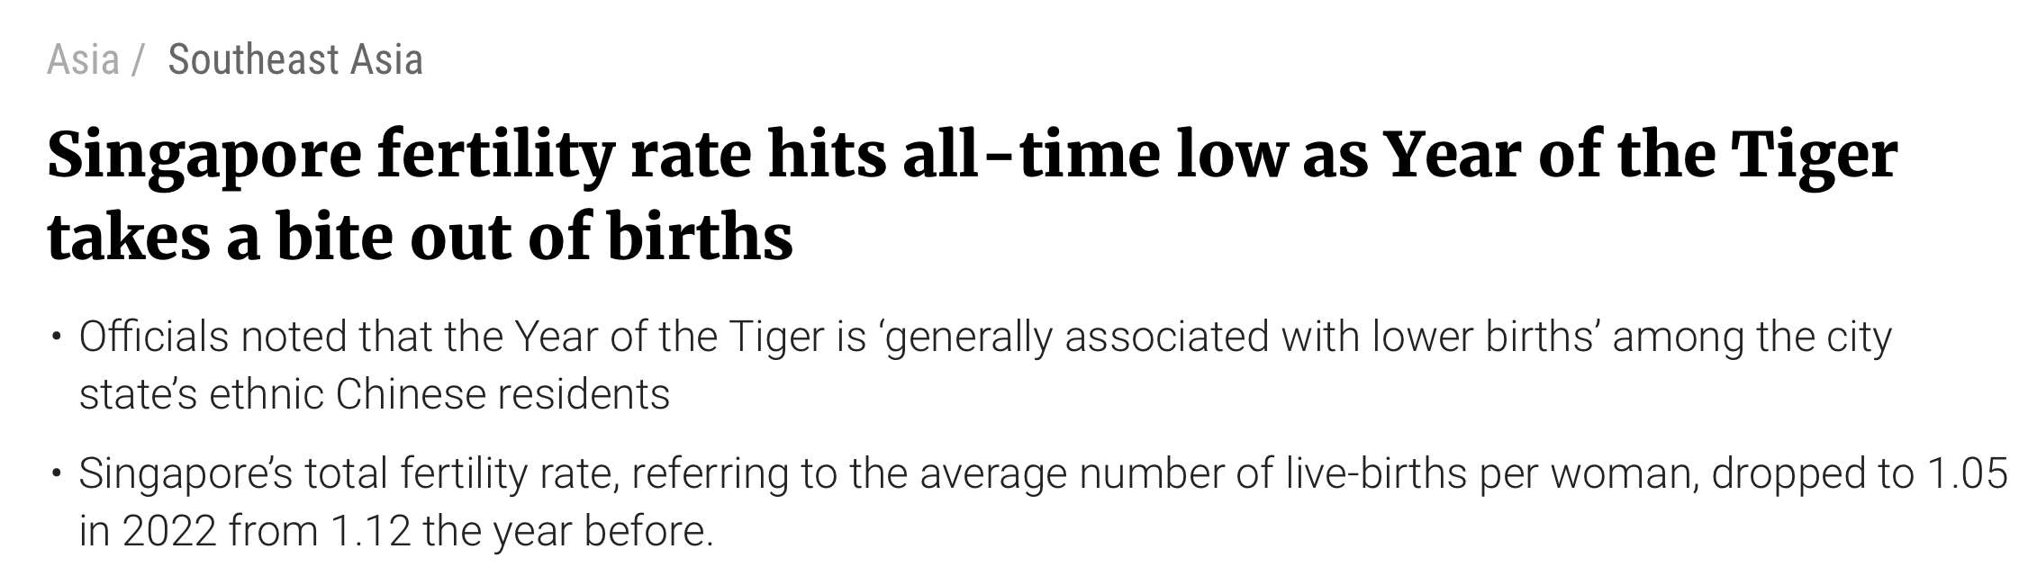
Motivation

Slide 4
Aim
Can I predict the birthrates over the next few years?
From a statistical perspective, what can I say about the birthrate of Singapore?

Slide 5
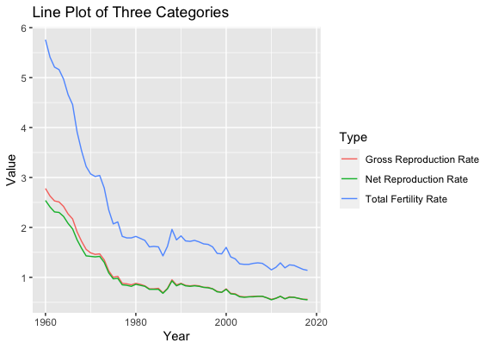
Data
Yearly birthrate in Singapore.
Focus only on Total Fertility Rate
Data from: https://data.gov.sg/dataset/births-and-fertility-annual
* ‘Total Fertility Rate’ is defined as, on average, per female how many children she has.

Slide 6
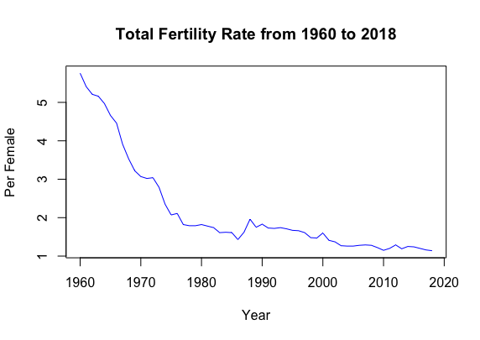
Data Exploration
Trend shows an exponential decrease from 1960 to 1990, after which it flattens out over the next 30 years around 1 to 2 births per female. Mean and variance not constant.

Slide 7
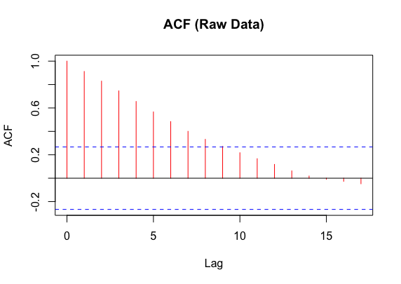
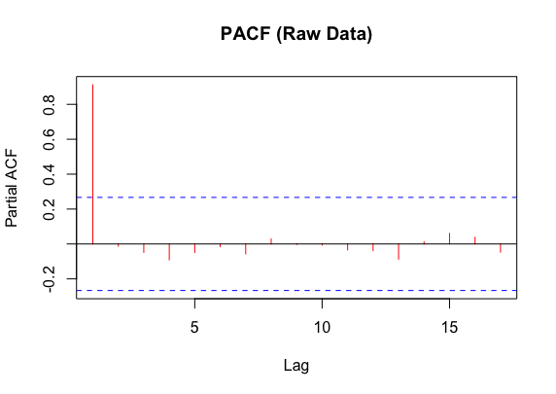
ACF and PACF of raw data
Slow decay of the ACF provides evidence that differencing might help.

Slide 8
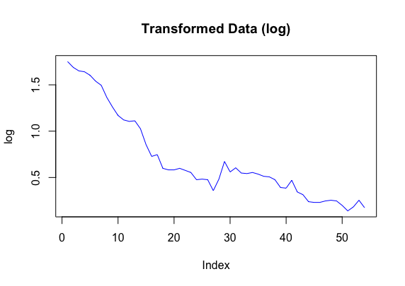
Log Transformation

Slide 9
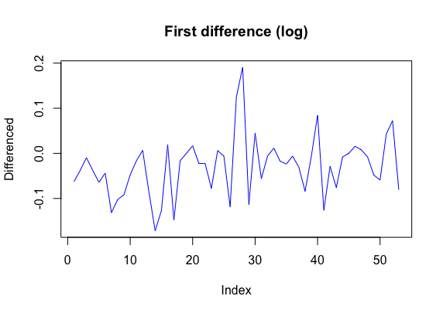
First Difference
Mean looks constant around -0.025. Variance from observation does not look totally constant. Nevertheless, the difference in variance does not seem significant. A formal statistical test for stationarity of the time series should be done.

Slide 10
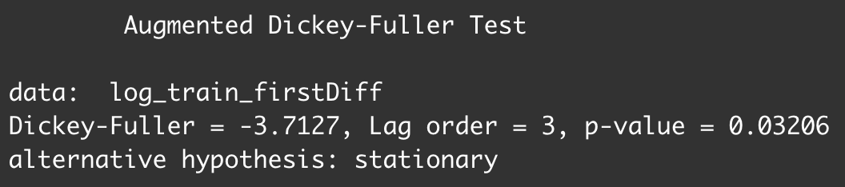
Stationarity of Time Series
P-value of less than 5% significance level suggests the first difference of the log-transformed data is stationary.

Slide 11
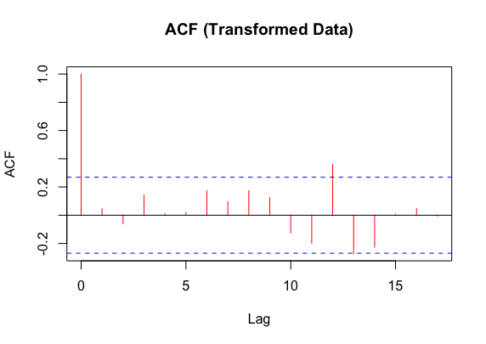
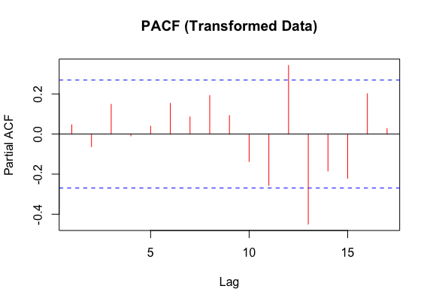
Model – Initial Guess
MA(0), no significant correlation after lag 0. Spike at lag 12 probably due to mass significance.
AR(0), no significant correlation.

Slide 12
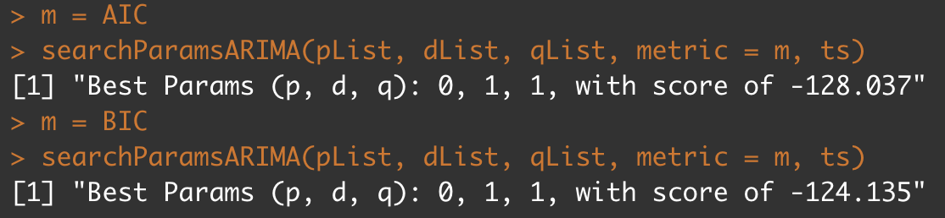
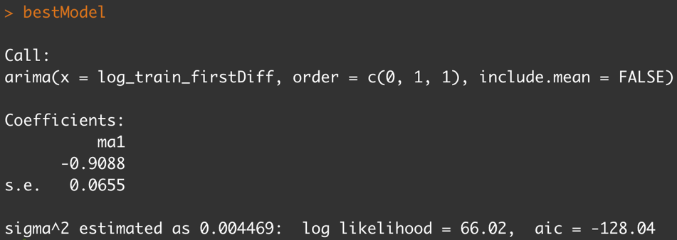
ARIMA Model
p = 0, 1, 2
d = 1
q = 0, 1, 2
Use AIC and BIC as metrics.
Best ARIMA Model = ARIMA(0, 1, 1)

Slide 13
Evaluation
Residual Diagnostics
1. Residual Plot
2. ACF of residuals
3. Ljung-Box Statistic
4. Histogram
5. Q-Q Normality Plot

Slide 14
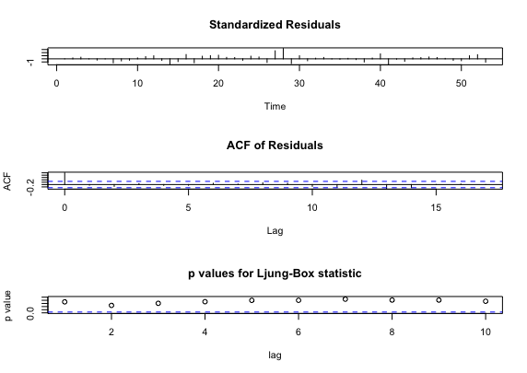
Plots
Residual Plot – Mean is fairly constant, variance is constant, except for spike at time = 28, only outlier, so we ignore it.
ACF of residuals - difficult to see, so evaluate later.
P-values of Ljung-Box statistic - Lies well above the significance threshold. High p-values suggests residuals are no different from white noises.

Slide 15
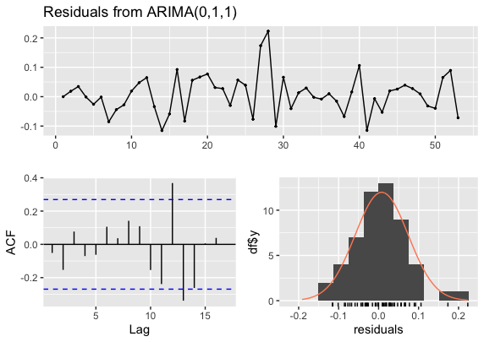
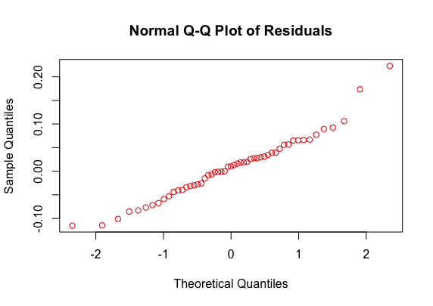
Plots
ACF of residuals – more clearly seen, little to no autocorrelation between the residuals because all within the threshold.
Histogram of residuals and Q-Q plot of normality suggest residuals are normally distributed.

Slide 16
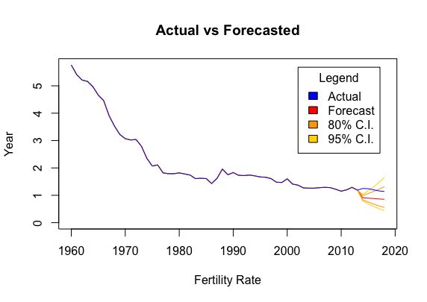
Forecasts - ARIMA
Last 5 years as testing data.

Slide 17
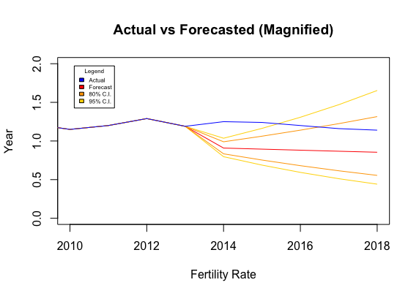
Forecasts - ARIMA
Predicted badly in first 2 years, but next 3 years, model still valid, within range.

Slide 18
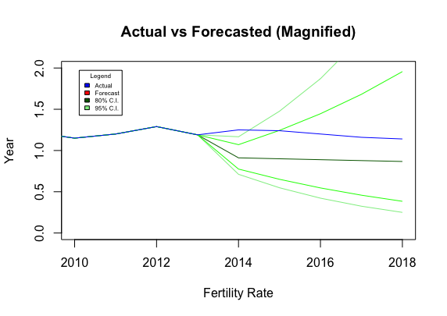
Forecasts – White Noise
Similar to that of ARIMA(0, 1, 1) model, range is wider, correctly predicts 4 out of 5 years.

Slide 19
Forecasts – Comparison
Red is ARIMA(0, 1, 1) , Green is White Noise. ARIMA(0, 1, 1) seems to have a smaller range than white noise.

Slide 20
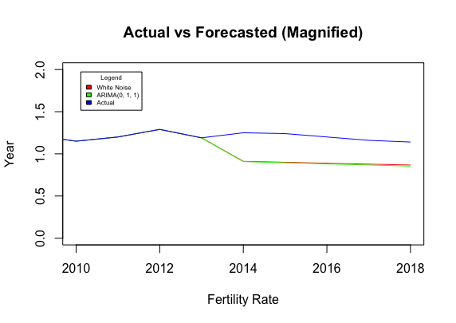
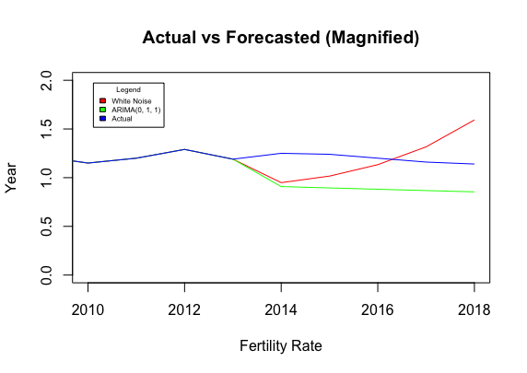
Forecasts - Comparison

Slide 21
Conclusion
Model valid for forecasting in 5 years.
However, as for all time series models, cannot capture contextual knowledge of the problem.
Singapore has been implementing a slew of measures to increase birth rates and things might improve in the future, something which could not be captured in this model.

