Slide 1
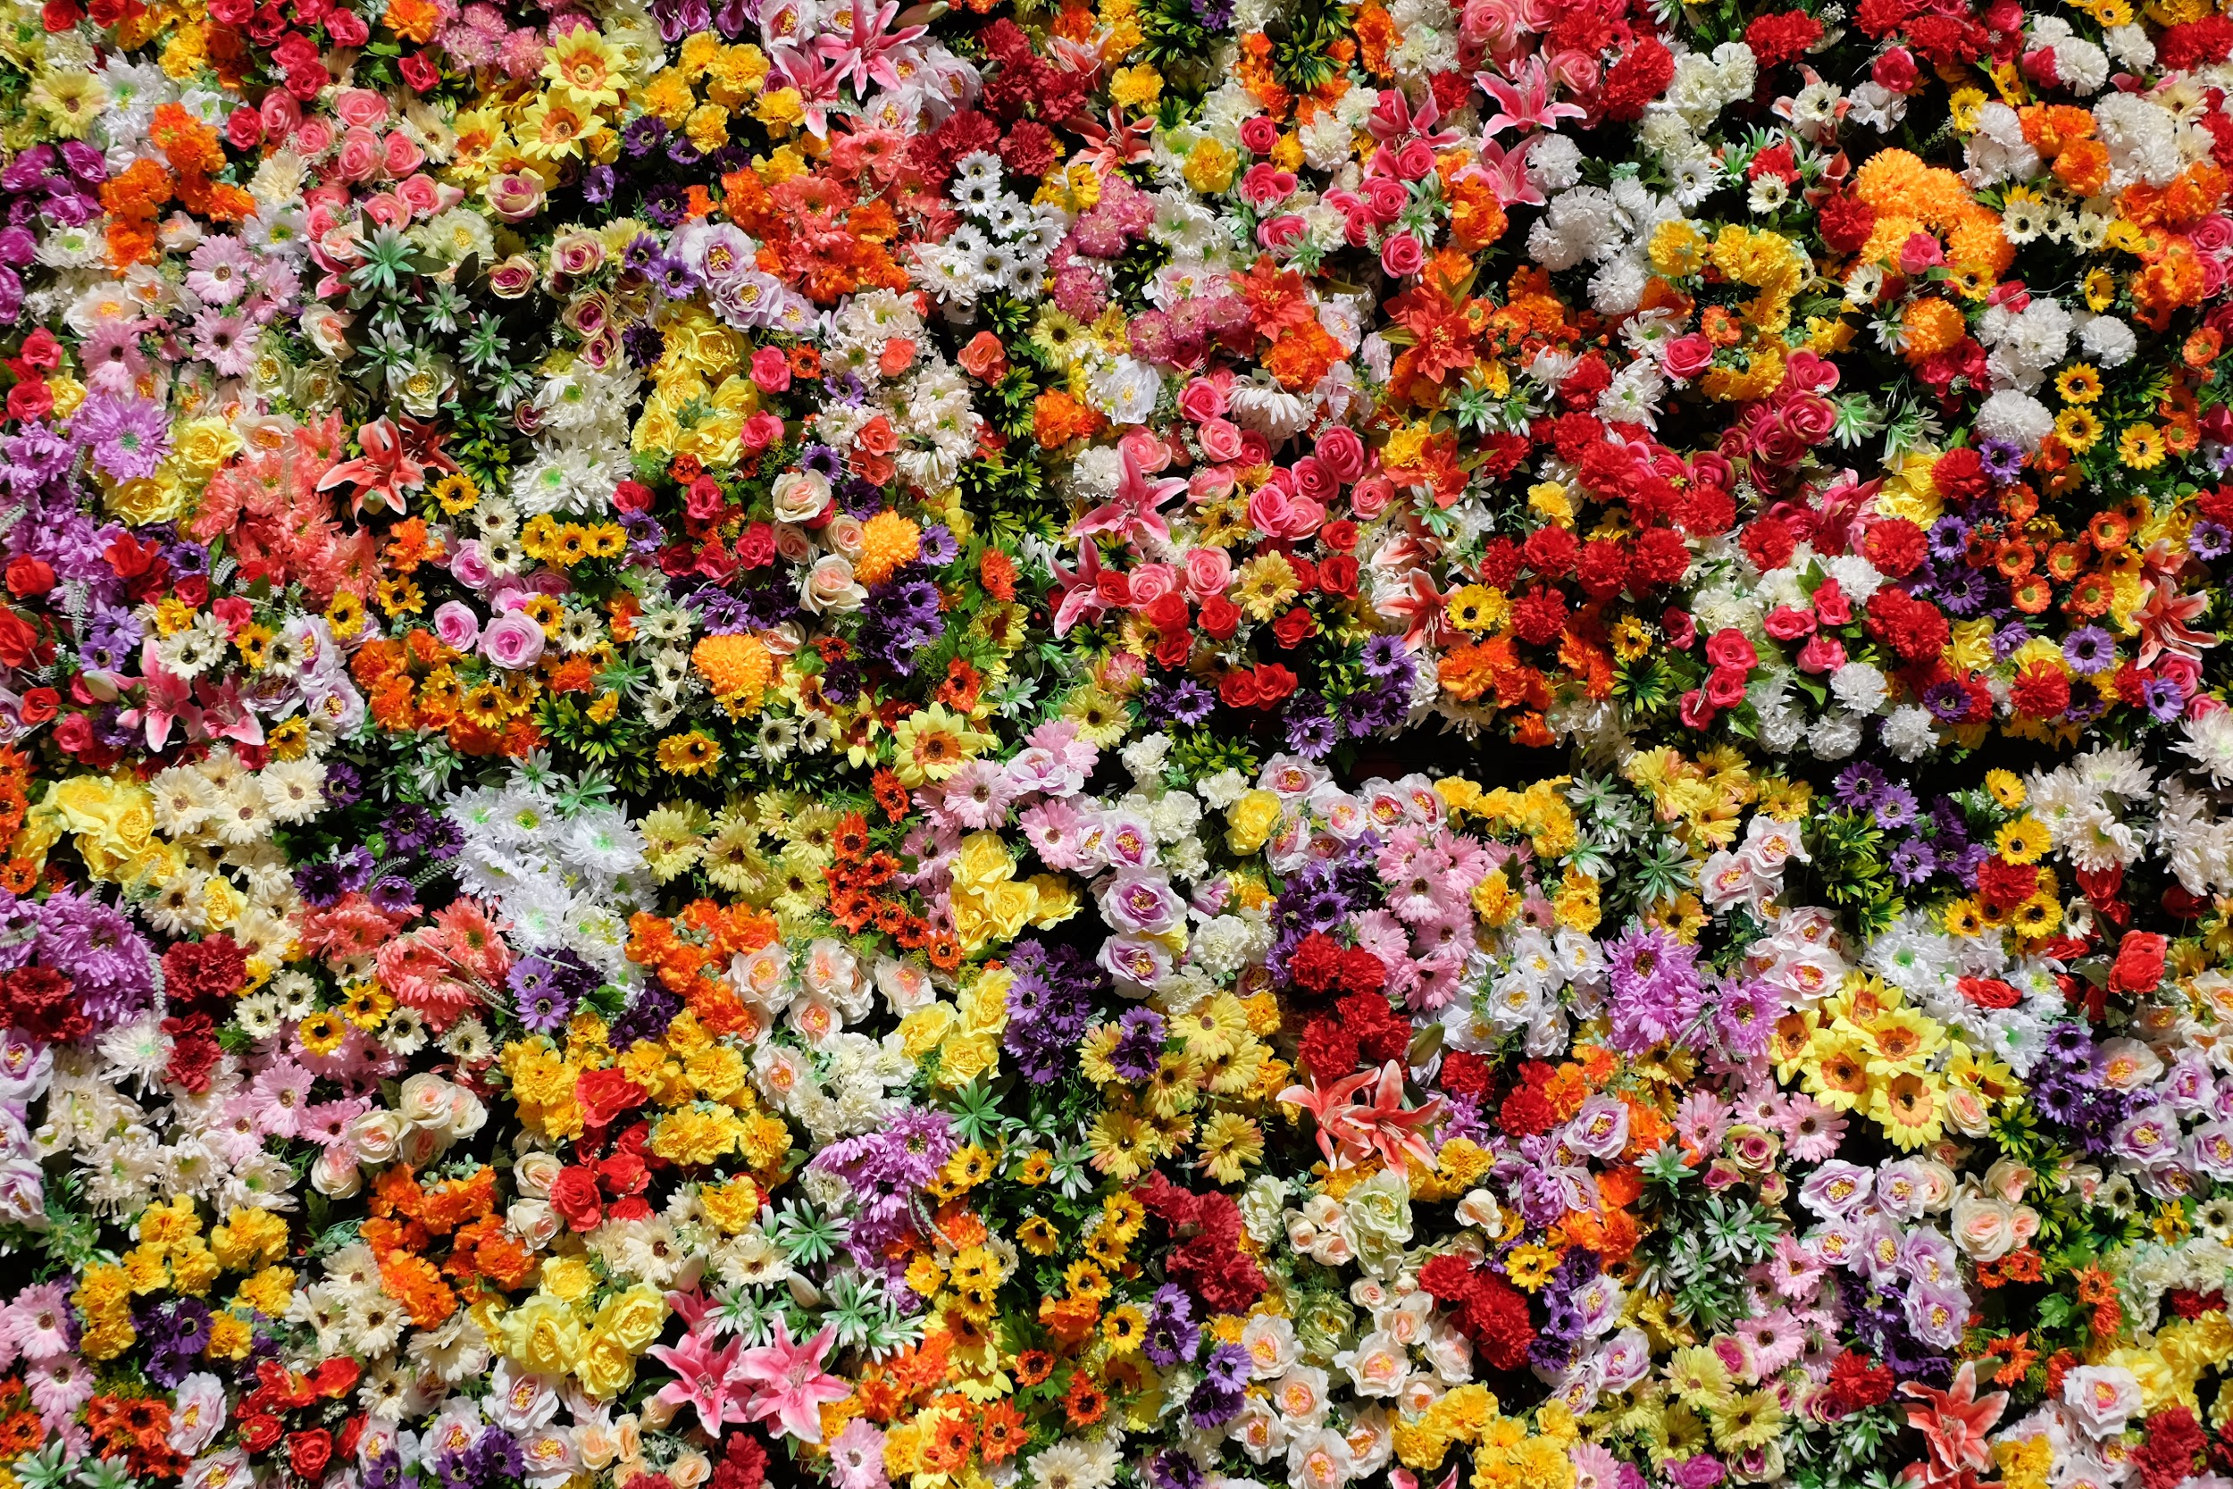
PlantDex
Matthew Belcher, Kristal Concepcion, Jasmine Leal, Chloe Valverde
Notes:
Leal jasmine

Slide 2
SYNOPSIS
We created an image recognition program that will be able to predict whether plants are poisonous or safe segments, it will run the uploaded picture through the database and with confident probability pair it with the correct image and name of the plant and then predict whether that plant is toxic or non toxic for human contact.
Our target audience are botanists and horticulturists so they can easily identify the plants they want to research on. In addition to this, some side target audiences are florists, home gardeners, hikers, and pet owners.
Notes:
Jasime Talk about cnn, keras

Slide 3
RESEARCH QUESTIONS
How accurately can we predict the plant type?
What kind of model is best used/how to improve our model?
Can we determine if they are poisonous?
Notes:
Jasmine

Slide 4
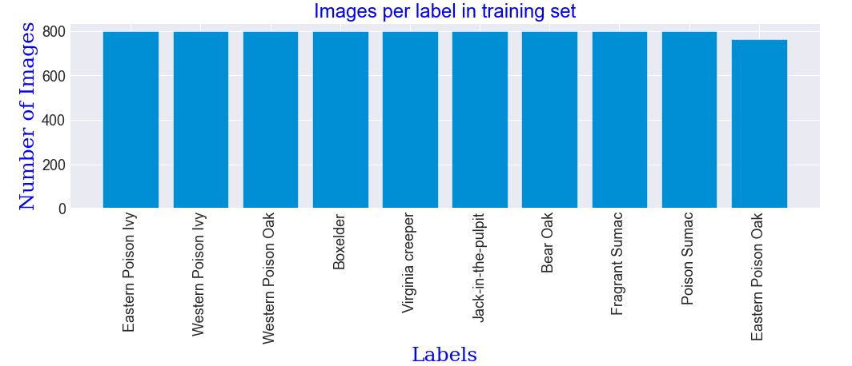
DATA DESCRIPTION
The dataset that was used is of 10,000 images of 8 different plant types.
We also used a separate dataset that provided the scientific name of the plant, toxicity levels, herbarium category, species level, and slang name.
From this data set we were able to clean up the CSV’s and narrow down to Slang name, toxicity level, and path. This helped with improving the time needed to run the prediction.
Notes:
Leal jasmine END

Slide 5
PROCESS AND METHODS
Data Process
Data acquisition - finding a diverse dataset with necessary requirements (picture, name, toxicity)
Data cleaning - cleaning the csv of unnecessary information (scientific name, species label)
Data manipulation - separating the data into the X_train, y_train, X_test, and y_test. These data frames consisted of both the “common name”, the path to specific photo, toxicity level
Once the data was organize and reading for modeling we created a few different methods.
Code Process
makeGen method - this method generates the pictures using tensorflow keras ImageDataGenerator
showImageSample - display a 25x25 grid of random images pulled from the X_train generator
makeModel - creates and trains the models using tensorflow keras
LRask - allows the user to input the number of times they want the code ran, since we used the transfer learning method the more times the code iterate the higher the f1score
trPlot - plots out the results (loss, accuracy, and f1score)
Notes:
Kristal Start Talk about transfer learning, keros with the preprocesses

Slide 6
Transfer Learning
What is Transfer Learning?
Transfer learning is a machine learning method where a model developed for a task is reused as the starting point for a model on a second task.
It focuses on storing knowledge gained while solving one problem and applying it to the next problem
All you need to do is create a class that iterates through the training data whenever you call it, however many times you call it. And it will use the knowledge gained from the previous results and apply it to the next iteration.
Why did we choose this?
For CNN you need to more preprocessing of the images, but with transfer learning you only need to little processing of dataset.
Training a cnn takes a long time, especially with huge datasets, this was a problem we encountered since our data set contained 10,000 images
Conventional machine learning has been traditionally designed to work in isolation. The algorithms are trained to solve specific tasks. While transfer learning is the idea of overcoming the isolated learning problem
Notes:
Kristal END

Slide 7

SUMMARY REPORT
Notes:
Chloe START

Slide 8
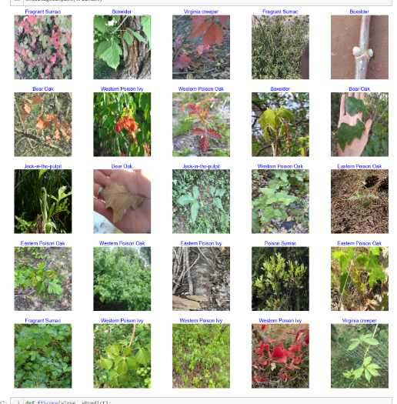
GRID GRAPH
25 sample pictures taken from X-train and X-test code, called from excel herbarium with over 10,000 files
Notes:
Chloe Start generates xtrain, xtest pictures for later pictures, calls from path column in xcel herbarium, generates image
Cell 49 takes xtrain, xtest to array of 25 photos
Cell 50 prints random photos in Xtrain

Slide 9
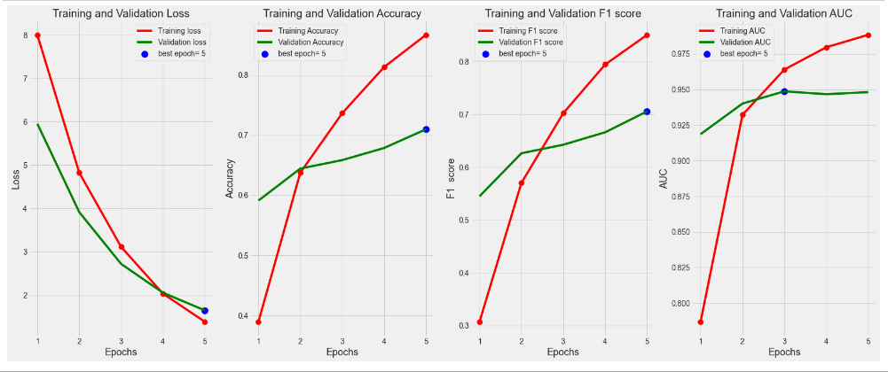
Training and Validation Loss (5 Epochs)
Notes:
Chloe Comparing x-train to x-test, training is x-train, validation loss is x-test
Validation loss: loss goes down down
In general, value moves more slowly
training accuracy: accuracy goes up
training f1 score: f1 goes up
training auc: auc goes up

Slide 10
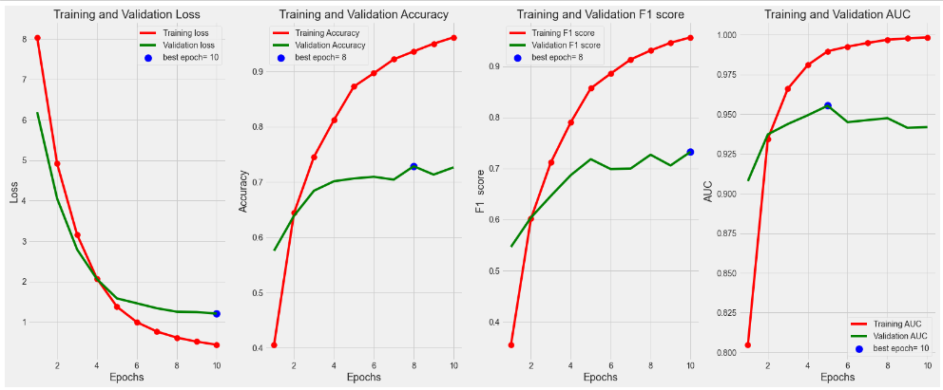
Training and Validation Loss (10 Epochs)
Notes:
Chloe Comparing x-train to x-test, training is x-train, validation loss is x-test
Validation loss: loss goes down down
In general, value moves more slowly
training accuracy: accuracy goes up
training f1 score: f1 goes up
training auc: auc goes up

Slide 11
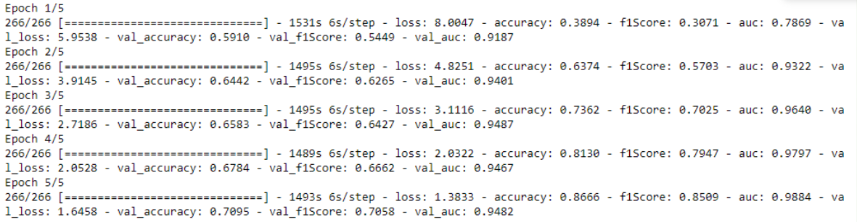
FIRST 5 Epochs
When we ran the the first five epochs, we note that the initial accuracy of our first epoch is about 30%. This is based on our f1Score which determines how accurate the program is functioning in terms of percentage. We note that as we run each epoch, we end up increasing the accuracy of program. We also note that it isn’t until the fifth epoch when we have a program accuracy of about 85%.
Notes:
Matthew START Takes 30 minutes for complete test

Slide 12
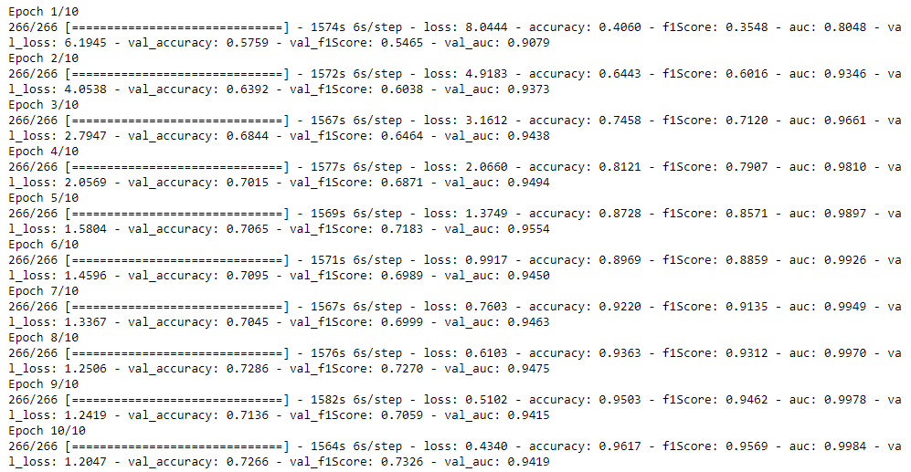
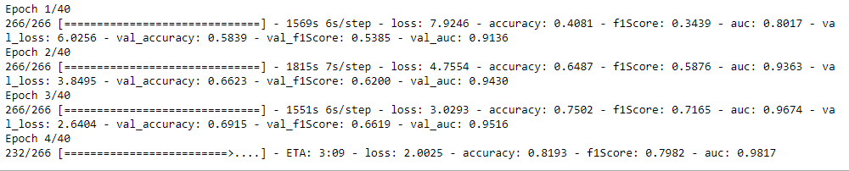
NEW TEST WITH 10 EPOCHS
Here there will be text.
Notes:
Matthew Keros makes loss smaller but not as hard for accuracy, loss priority

Slide 13
BRINGING IT AROUND TOWN,AROUND TOWN
The plants are green, edible, and if not edible, then edible only once.
In conclusion the overall prediction accuracy is up to 96.17 % with 95.69 F1, improving vastly each time the model is run due to the transfer method. Some key takeaways were the trial and errors of different methods and the importance of run times. We hope to in the future to scale this by expanding the dataset and enhancing accuracy and efficiency.
Notes:
Jasmine END Engage the crowd and may they show mercy

Slide 14
Resources/Citations
https://www.kaggle.com/code/aderezapahlevi/starter-flowers-recognition-7123e64e-8/data
https://www.kaggle.com/code/tarunpaparaju/plant-pathology-2020-eda-models/notebook
https://www.kaggle.com/code/rajmehra03/flower-recognition-cnn-keras/notebook
https://www.kaggle.com/datasets/hanselliott/toxic-plant-classification/code
https://machinelearningmastery.com/train-to-the-test-set-in-machine-learning/
https://plants.usda.gov/home
https://plantdatabase.uconn.edu/
Github repo
https://github.com/kconcepcion/flower-identifier-and-almanac
Notes:
End ish

