Slide 1
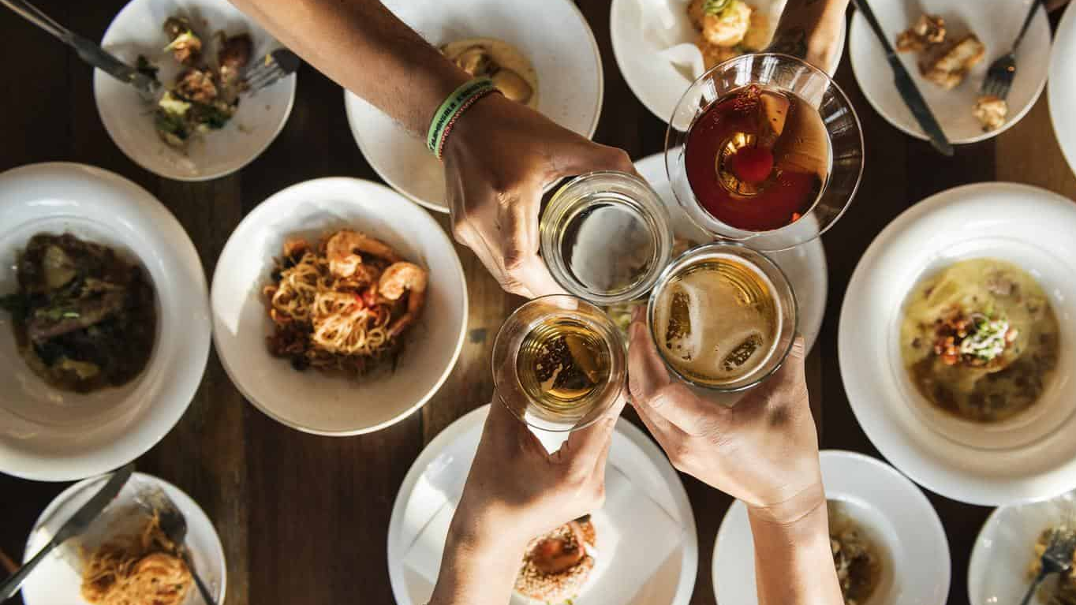
What’s For Dinner?
By: Kobe Matias, Erica Cannedy, and Kyle Cooper

Slide 2

Inspiration
Inspiration
Due to the COVID-19 virus, everyone is stuck at home under quarantine. Since you are stuck at home, we thought that we would make it a little easier for you to decide what you would like for dinner.
Everyone knows that during quarantine most of our time is spent either in the pantry looking for something to eat, or in the liquor cabinet concocting drinks.
We created “What’s for Dinner?” to help you choose what you would like to eat and pair a drink with that meal.

Slide 3
Design Process
Design Process
We first designed our basic UI using Bootstrap.
For the drinks, we used the ”lookup a random cocktail” API from TheCocktailDB in our Javascript to generate 3 random drinks into the window.
For the meals component of the application we used 2 API’s from the TheMealDB.com to display 4 meals according to ingredient type using the “look up by main ingredient” API and the “look up by ID” API to display information about generated meals.
We split the development process into 3 main components:
HTML and CSS by Kobe
TheCocktailDB API Javascript from Kyle
TheMealDB API Javascript from Erica
After writing the basic HTML and merging the Javascript functions, we enhanced the user experience by further modifying the CSS and adding components from animate.css and anime.js.

Slide 4
Technologies used
Technology Used
TheMealDB.com API
An open, crowd-sourced database of meals from around the world. We utilized this API to display 4 random meals according to your protein choice.
TheCocktailDB.com API
An open, crowd-sourced database of drinks and cocktails from around the world. We utilized this API to display 3 random drinks.
Bootstrap
A responsive, mobile first component library. Bootstrap components provide the front-end structure for our application.
Animate.css
CSS library for animations
Anime.js
Javascript library for Javascript Animation

Slide 5
DEMONSTRATION!
Demonstration!

Slide 6
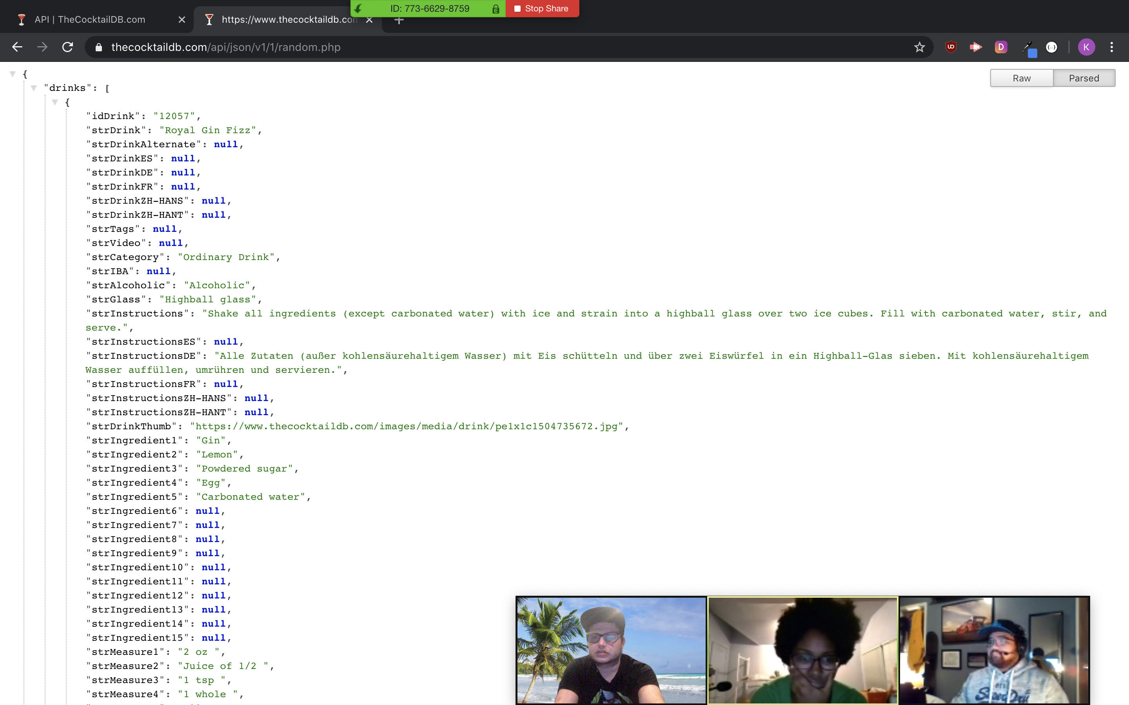
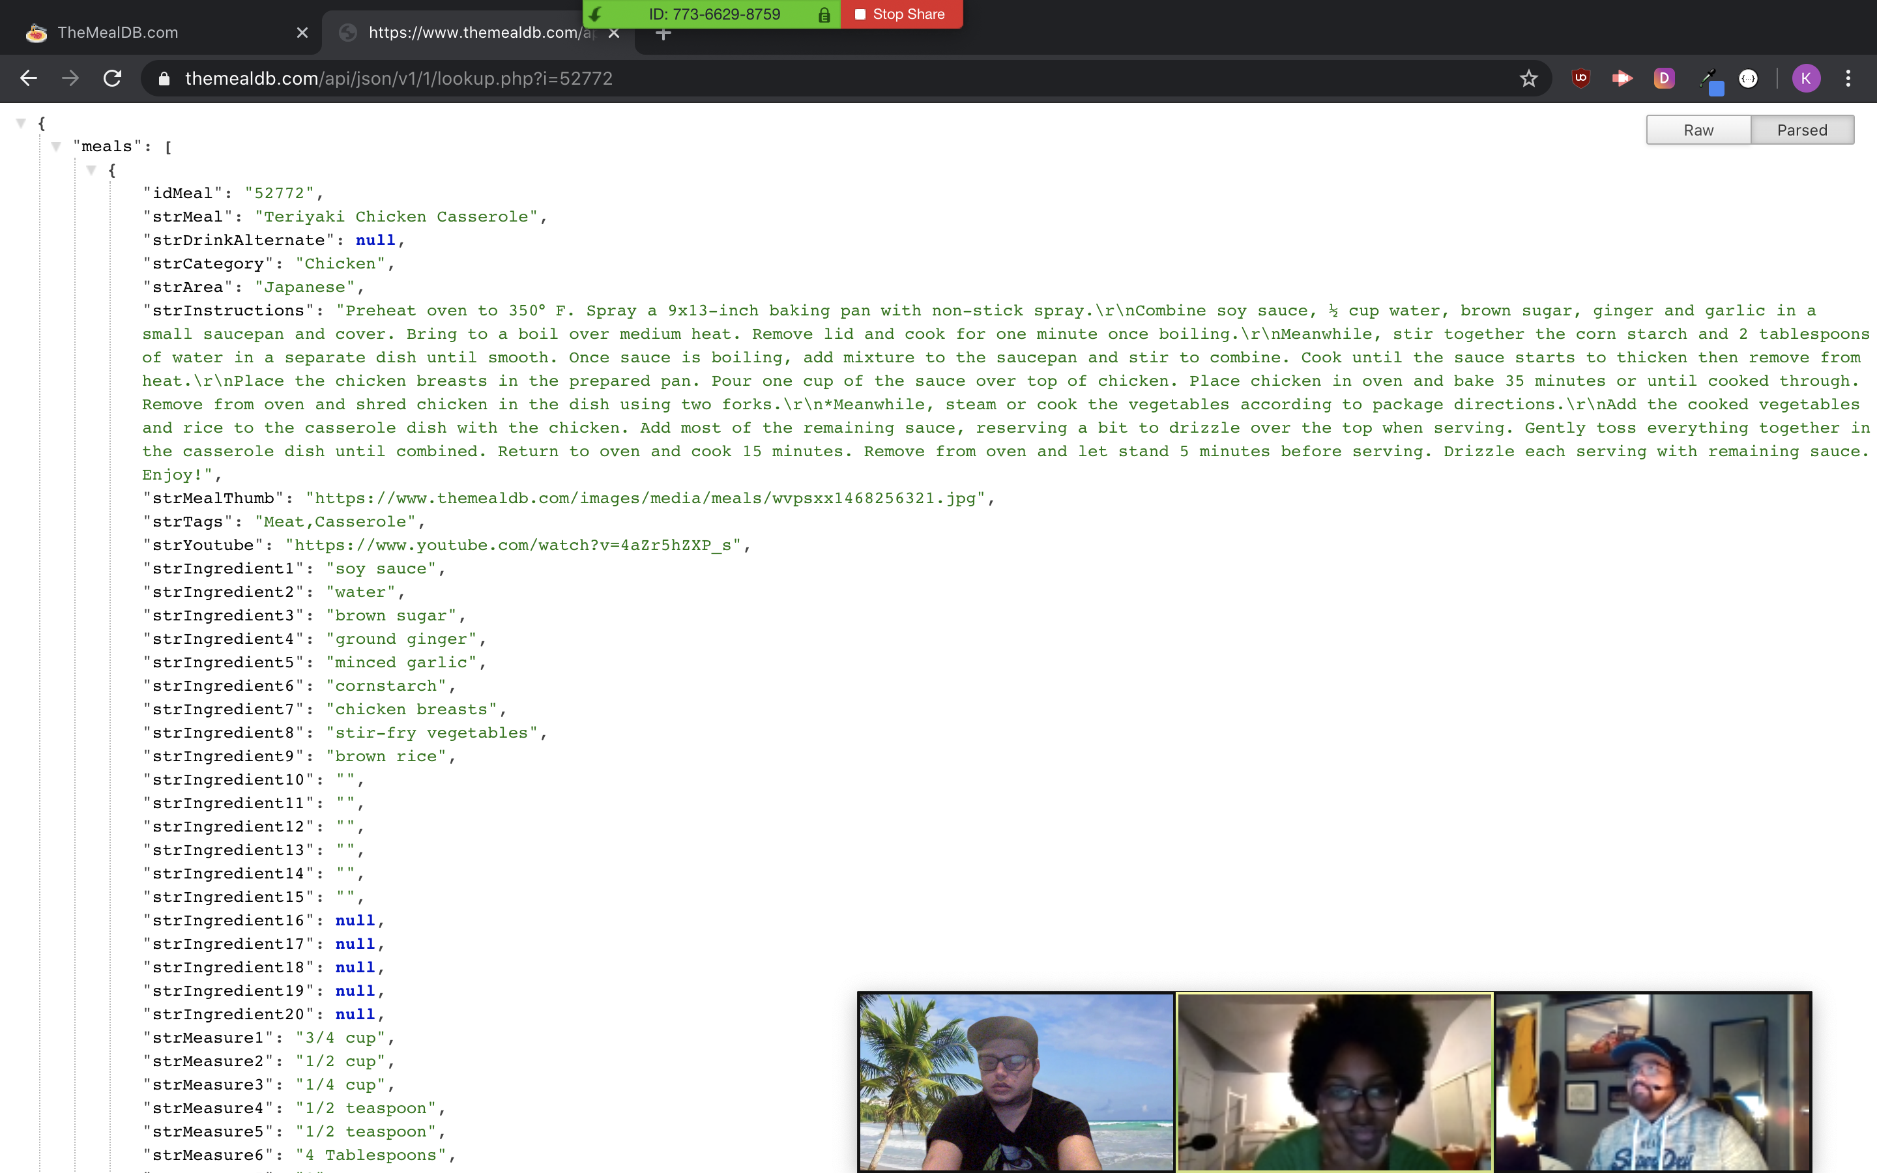
TheCocktailDB.com
TheMealDB.com

Slide 7
Directions for Future Development
Directions for Future Development
Pair Drinks with meals according to alcohol base. For example, pair a specific protein with a specific alcohol base. Selecting beef would automatically display whiskey cocktails.
Allow user to select alcohol base as well as protein base. Display drinks according to alcohol base selection.
Display 4 different meals on the page all with the different protein groups, and 4 drinks matched according to predetermined protein/drink base pairings.
Add in a search option.
Using local storage to store favorite recipes.

Slide 8
Thank you!
Thank you!

