Slide 1
Team 7 – Voice Authentication
By: Josh Corbin, Devin Kloos, Kevin Copper, Patrick Donavan, and Donald Taylor

Slide 2
Requirements
Application Domain: Health care, doctor’s office, hospital
Need: Voice detection is used to authenticate a user (doctor) so that he/she can read out the vitals, data, and information for that patient (from their medical device).
Perform: Doctor inputs voice into device for authentication. If the voice patterns match the user who has access privileges to that medical device, then authenticate that user and begin moving on to the next module (i.e. reading off vitals, data, etc).
Users: People using this software will be the doctor of that patient (HIPPA / privacy).
Deadline: April 27th, 2017
Reliability: Product must be operational 99% of the time or the mean time between failures must be at least 4 months.
Is the software affordable / profitable: Yes. Needed in health care industry.
Glossary: "Confidential Information" means all business-related information, written or oral, that the Customer discloses or makes available to the Developer, directly or indirectly, through any means of communication or observation. "Software" means the programs created/used for the medical device voice detection system, and all associated documentation and other instructions.

Slide 3
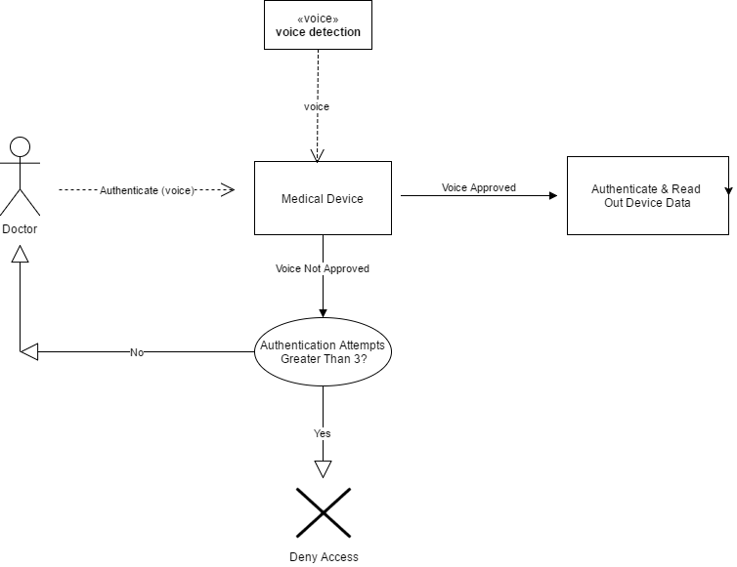
Requirements – Business Model

Slide 4
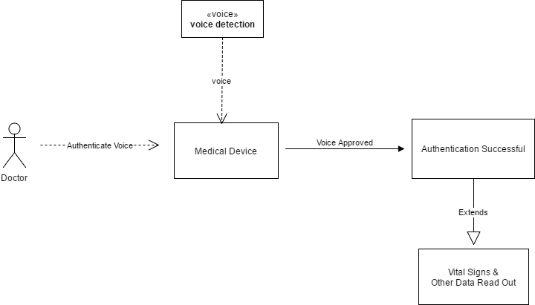
Requirements – Use Case 1
Doctor Successfully Authenticated

Slide 5
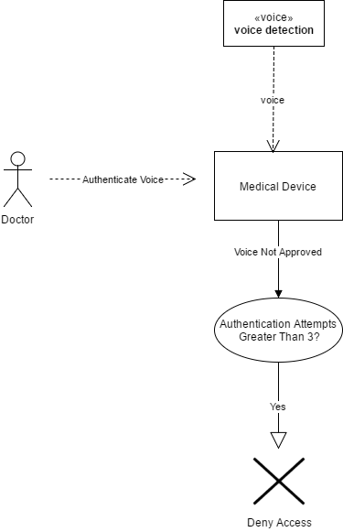
Requirements – Use Case 2
Authentication Failed 3+ Times (Access Denied)

Slide 6
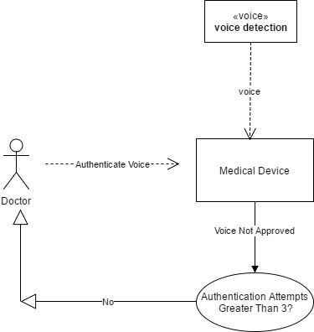
Requirements – Use Case 3
Authentication Failed Less Than 3 Times
(Re-Attempt Authentication)

Slide 7
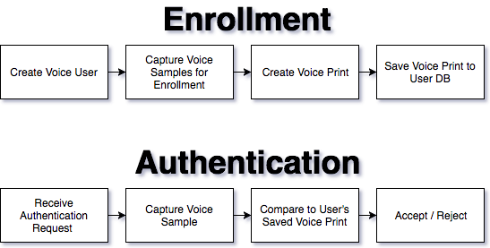
Analysis – Authentication Process

Slide 8
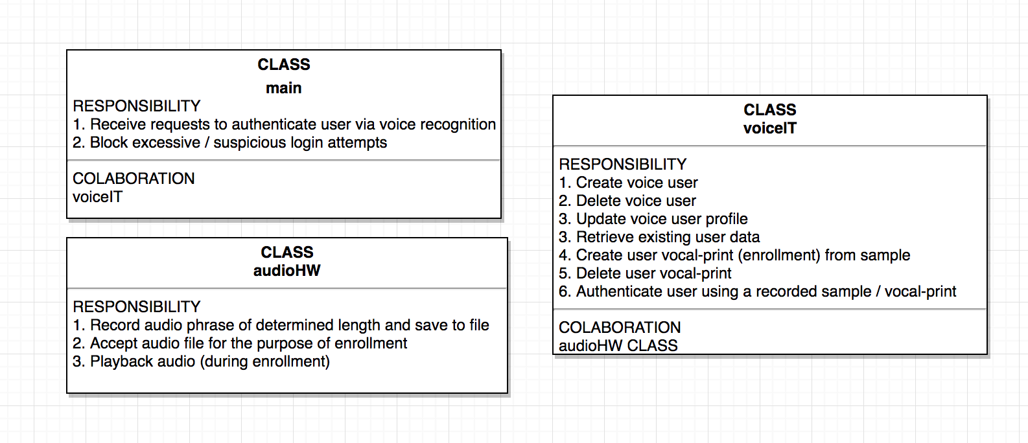
Analysis – Class Requirements

Slide 9
Analysis – Data Flow

Slide 10
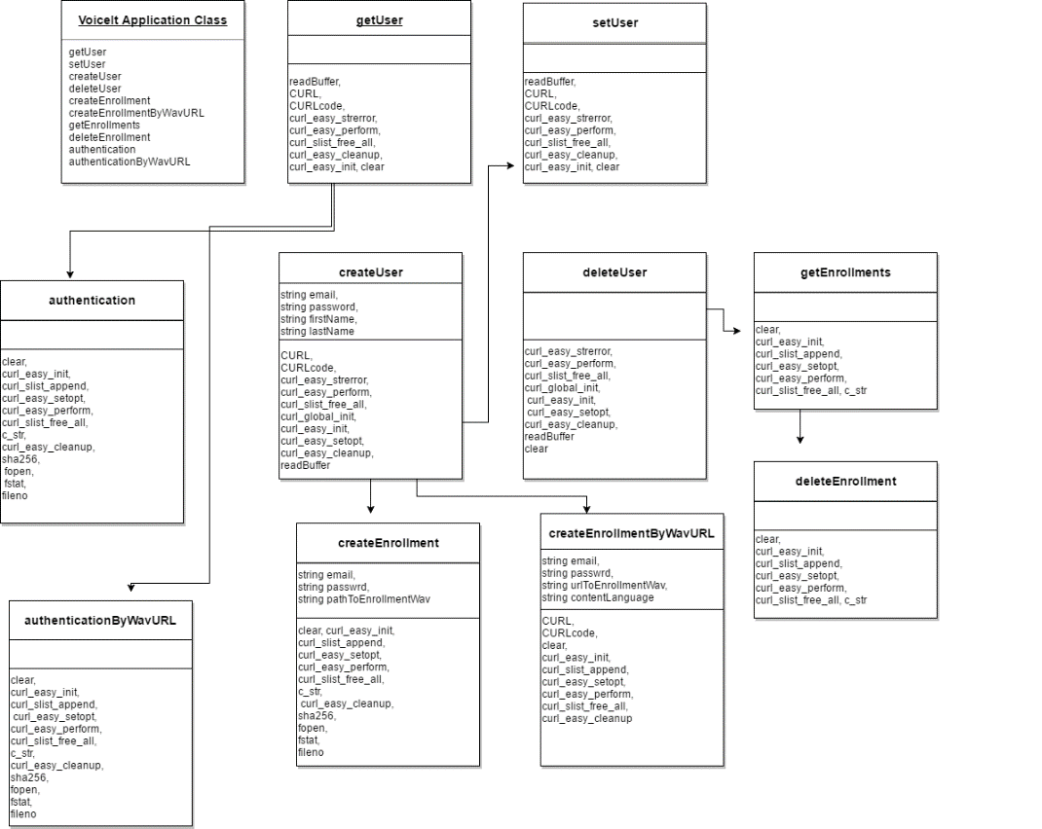
Design – Class Diagram

Slide 11
Implementation
Show code…

Slide 12
Testing
Run test cases…

Slide 13
References
(2016, April 14). VoiceItTech – VoiceIt-cpp. Retrieved April 25, 2017, from https://github.com/voiceittech/voiceit-cpp/blob/master/VoiceIt.h
Schach, Stephen R. Object-Oriented Software Engineering. 1st ed. New York: McGraw-Hill Higher Education, 2008. Print.

