Slide 1
Object-Oriented Programming with C++

Slide 2
COURSE OVERVIEW
What We Will Cover
Introduction to OOP
C++ Programming Concepts
Functions in C++
Classes and Objects
Constructor and Destructor
Operator Overloading
Virtual Functions & Polymorphism
Inheritance
Template and Namespace
Exception handling
File Handling

Slide 3
CHAPTER 1
Introduction to Object-Oriented Programming
Procedural vs OOP · Objects · Classes · Inheritance · Reusability · Polymorphism · Applications

Slide 4
CHAPTER 1
Procedural vs Object-Oriented Programming
Procedural: program = sequence of functions; data is separate and often global
OOP: program = collaborating objects, each bundling its own data + behaviour
Procedural: top-down design | OOP: bottom-up, class-based design
OOP maps naturally onto real-world entities: Car, Account, Employee
Examples — Procedural: C, FORTRAN | OOP: C++, Java, Python
Real-life analogy: Procedural = an open warehouse anyone can walk into. OOP = vending machines — you interact only through their buttons (methods).

Slide 5
CHAPTER 1
Core Characteristics of OOP
Object: a concrete instance with its own state + behaviour (a specific car)
Class: the blueprint that defines what objects of that type will have (the car's design)
Inheritance: a derived class acquires and extends a base class ('is-a')
Reusability: code written once (in a class) is reused via inheritance/composition
Polymorphism & Overloading: same interface, different behaviour depending on type/arguments

Slide 6
CHAPTER 1
Applications of OOP
Graphical user interfaces (windows, buttons, menus)
Simulation & modelling (banking, traffic, games)
CAD/CAM and object-oriented databases
Client-server & distributed systems
Embedded / real-time systems, robotics
Large-scale enterprise software (ERP, banking systems)

Slide 7
CHAPTER 1 — PROGRAM 1.1
A tiny OOP model: BankAccount
class BankAccount {
private:
string owner; double balance; // state
public:
BankAccount(string n, double b) { owner=n; balance=b; }
void deposit(double amt) { balance += amt; } // behaviour
void showBalance() {
cout << owner << "'s balance: " << balance << endl;
}
};
int main() {
BankAccount acc1("Sita", 5000), acc2("Hari", 12000);
acc1.deposit(1500); acc2.deposit(500);
acc1.showBalance(); acc2.showBalance();
}
Output: Sita's balance: 6500 | Hari's balance: 12500

Slide 8
CHAPTER 1 — REVIEW
Practice & Exam-style Questions
Differentiate procedural vs OOP with an example.
Explain any four OOP characteristics with real-life examples.
List 5 application areas of OOP and justify each.
Differentiate class and object with a program.
📋 Probable Exam Question
Q1: What is OOP? Explain any four features with examples. Differentiate OOP from POP. [PU Exam 2022]
Q2: "C++ is a hybrid language." Justify this statement.

Slide 9
CHAPTER 2
C++ Programming Concepts
cin/cout · Operators · Type conversion · Arrays & Pointers · new/delete · Manipulators · const · enum

Slide 10
CHAPTER 2
Introduction to C++
Developed by Bjarne Stroustrup at Bell Labs, starting in 1979.
Originally named "C with Classes" before being renamed C++.
Designed as an extension of the C programming language.
Adds object-oriented programming (OOP) features while retaining C's low-level control and performance.
Every C++ program must have one main() function, which serves as the program's entry point.
Core building blocks include:
Headers (#include)
Namespaces (e.g., using namespace std;)
Statements
Functions
C++ is a compiled language.
It is Statically typed.
“Statically typed" means that the data type of every variable must be known at the time the program is compiled, before the program actually runs.
It supports multiple programming paradigms: procedural, object-oriented, and generic programming.

Slide 11
CHAPTER 2
Introduction to C++
Real-life Analogy
Learning C++ is like learning to cook in a professional, fully-equipped kitchen rather than with just a campfire (C). You get all of C's raw control over your ingredients (memory, pointers) plus organized stations, standardized tools, and recipes (classes, the Standard Library) that let you build far more complex dishes reliably.
#include <iostream> // header for input/output
using namespace std; // avoids writing std:: everywhere
int main() { // program entry point
cout << "Hello, Object Oriented World!" << endl;
return 0; // 0 signals successful execution to the OS
}
Explanation
#include <iostream> brings in the input/output stream library. using namespace std; lets us write cout instead of std::cout. Execution always begins at main(). cout << "..." prints to the console, and return 0; tells the operating system the program finished without errors.

Slide 12
CHAPTER 2
Streams: Extraction (>>) and Insertion (<<)
The extraction operator >> (Input): Reads (extracts) data from an input stream (like cin, the keyboard) into a variable.
cin >> a >> b;
The insertion operator << (stream insertion / output operator) : sends (inserts) data from a variable or literal into an output stream (like cout, the screen).
cout << "City: " << city;
Both are ordinary C++ operators overloaded by the library for streams
#include <iostream> // header for input/output
using namespace std; // avoids writing std:: everywhere
int main() { // program entry point
string name;
int age;
cout << "Enter your name and age: ";
cin >> name >> age; // extracts two values from the input stream
cout << "Hello " << name << ", you are " << age << " years old." << endl;
return 0;
}

Slide 13
CHAPTER 2
Reference Variables
A reference variable is an alias (alternative name) for an existing variable.
It is declared using the ampersand (&) symbol.
Once a reference is initialized to a variable, it cannot be changed to refer to another variable.
References are not separate variables – they directly refer to the memory location of the original variable.
Syntax:
int x = 10;
int &ref = x; // ref is a reference to x

Slide 14
CHAPTER 2
Scope Resolution Operator
The scope resolution operator (::) is used to access global variables, class members, and namespaces.
It allows you to specify the scope in which an identifier belongs.
It is especially useful when a local variable hides a global variable or when defining member functions outside the class.
Key Uses
Access global variables when shadowed by local variables.
Define member functions outside the class definition.
Access static members of a class.
Access namespaces and their members.
Access class constants and enumerations.
Syntax:
scope_name :: identifier
Here,
scope − It can be a class name, namespace, or, global.
identifier − The identifier can be a variable, function, type, or, constant.

Slide 15
CHAPTER 2
Type Conversion
Definition: Automatic (implicit) conversion happens when the compiler silently converts one type to another because they appear together in an expression — usually widening (int to double), so no information is lost. Explicit conversion (a cast) is when the programmer forces a conversion, most safely with static_cast<Type>(value).
implicit
widen
int a = 7
double 7.0
Implicit: double d = someInt; (compiler converts automatically)
Implicit danger: int / int always gives an int result, even if assigned to a double
Explicit (C-style): (double) x — still works, but not type-checked
Explicit (C++): static_cast<double>(x) — checked, clearer intent
Other C++ casts: const_cast, dynamic_cast, reinterpret_cast (advanced use)
int a=7,b=2;
double r = a / b; // r = 3.0 (!)
int/int happens FIRST, then widens — precision already lost
double r =
static_cast<double>(a) / b; // 3.5
Explicit cast BEFORE the division fixes it
Analogy: Implicit conversion is like a shop automatically rounding your change to the nearest coin without asking. An explicit cast is you deliberately asking the cashier for a specific denomination.

Slide 16
CHAPTER 2
Type Conversion
#include <iostream>
using namespace std;
int main() {
int a = 10;
double b = 3.5;
double result = a + b; // automatic (implicit) conversion: a promoted to double
cout << "Implicit: " << result << endl; // 13.5
double pi = 3.14159;
int truncated = static_cast<int>(pi); // explicit cast
cout << "Explicit cast: " << truncated << endl; // 3
return 0;
}

Slide 17
CHAPTER 2
Arrays and Pointers
Definition:
An array is a fixed-size, contiguous block of elements of the same type, accessed by index.
A pointer is a variable that stores a memory address.
An array's name, in most expressions, decays into a pointer to its first element — so arr[i] and *(arr + i) mean the same thing.
56
78
90
45
88
marks[0]
marks[1]
marks[2]
marks[3]
marks[4]
1000
1004
1008
1012
1016
int marks[5]; declares 5 contiguous ints
int *ptr = marks; ptr now holds the address of marks[0]
marks[i] is exactly equivalent to *(marks + i)
Pointer arithmetic moves in units of the pointed-to TYPE's size, not raw bytes
Pointers can also point to dynamically allocated memory (Topic 5)
ptr
ptr = &marks[0] → points at the first element
*(ptr + 2) == marks[2] == 90
Analogy: An array is a street of numbered houses built one after another. A pointer is a slip of paper with just one address on it — you can 'walk' to the next house by adding to that address.

Slide 18
CHAPTER 2
Arrays
An array is a fixed-size, contiguous block of memory.
All elements in an array must be of the same data type.
Elements are accessed using an index, e.g., arr[0], arr[1], and so on.
Definition
An array in C++ is a collection of elements of the same data type, stored in contiguous memory locations. These elements are accessed using an index that starts from 0. C++ arrays provide a structured way to store and manage data, making it easier to work with multiple values of the same type.
Syntax:
data_type array_name[array_size];
#include <iostream>
using namespace std;
int main() {
int numbers[] = {1, 2, 3, 4, 5}; int arraySize = sizeof(numbers) / sizeof(numbers[0]); cout << "Iterating through the array:" << endl; for (int i = 0; i < arraySize; i++) { cout << "Element at index " << i << ": " << numbers[i] << endl; } return 0;
}

Slide 19
CHAPTER 2
Multidimensional Arrays
C++ supports multi-dimensional arrays. A 2D array is essentially an array of arrays, and accessing elements involves specifying both row and column indices.
#include <iostream>
using namespace std;
int main() {
// Defining a 2D array int multiDimArr[3][3] = {{1, 2, 3}, {4, 5, 6}, {7, 8, 9}}; // Iterating through the 2D array and printing its elements cout << "2D Array elements:" << endl;
for (int i = 0; i < 3; ++i) { for (int j = 0; j < 3; ++j) { cout << multiDimArr[i][j] << " "; } cout << endl; } return 0;
}

Slide 20
CHAPTER 2
Pointers
In C++, pointers are used to store the memory addresses of variables, allowing for direct access and manipulation of memory. There are several types of pointers, each serving specific purposes:
Declaring pointers in C++
data_type* pointer_name;
OR
data_type *pointer_name;
When used in a declaration (int* ptr;), it informs the compiler that this variable is a pointer.
When used in an expression (*ptr), it dereferences the pointer—i.e., accesses the value stored at the memory address the pointer
Initializing pointers in C++
Assigning an existing variable’s address
The most common way to initialize a pointer is by storing the address of an already declared variable.
Using nullptr (Modern C++)
declare a pointer in advance, even if we don’t yet have a variable for it to point to
int num = 20;
int* ptr = &num;
cout << *ptr << endl;
*ptr = 30;
cout << num << endl;
int* ptr = nullptr;
if (ptr != nullptr) {
*ptr = 10;
}

Slide 21
CHAPTER 2
Pointers
Null Pointer
A pointer that doesn’t point to any valid memory address. Initialized with nullptr in C++11 or NULL in older C++ standards. Example: int* ptr = nullptr;
Void Pointer (Generic Pointer)
A pointer that can hold the address of any data type. Cannot be dereferenced directly and must be cast to another pointer type before use.
Example:
void* ptr; int a = 10; ptr = &a; // valid assignment
Dangling Pointer
A pointer that points to a memory location that has been freed or deleted.
Accessing a dangling pointer leads to undefined behavior.
Example:
int* ptr = new int(5);
delete ptr;

Slide 22
CHAPTER 2
Pointers
Wild Pointer
A pointer that has not been initialized to a valid address.
Accessing a wild pointer is also undefined and dangerous. Example: int* ptr; // uninitialized pointer, potentially a wild pointer
Smart Pointer
Introduced in C++11 to manage dynamic memory automatically, preventing memory leaks.
Types include:
std::unique_ptr: Exclusive ownership; only one unique_ptr can point to a resource.
std::shared_ptr: Shared ownership; multiple pointers can own the same resource.
std::weak_ptr: Non-owning reference to a resource managed by a shared_ptr.
Function Pointer
A pointer that points to a function instead of a variable.
Allows passing functions as arguments or storing functions in data structures. Example: void (*funcPtr)(int) = &myFunction;

Slide 23
CHAPTER 2
Pointers
Constant Pointer
A pointer whose address cannot be changed after initialization.
Example: int a = 10; int* const ptr = &a; // ptr cannot point to any other address
Pointer to Constant
A pointer that points to a constant value, so the value it points to cannot be modified. Example: const int* ptr = &a;
Constant Pointer to Constant
A pointer that is both constant itself and points to a constant value.
Example: const int* const ptr = &a;
Nullptr (C++11 onwards)
A special type of pointer literal that represents a null pointer, replacing NULL.
Safer and less ambiguous than NULL. Example: int* ptr = nullptr;

Slide 24
CHAPTER 2
Pointers
this Pointer
The this pointer is an implicit pointer available in all non-static member functions of a class.
It holds the memory address of the object that invoked the member function.
When a member function is called on an object, the compiler automatically passes the object's address as a hidden parameter.
This hidden parameter is named this.
The this pointer is not explicitly declared by the programmer—it is provided by the compiler.
It is not available in static member functions, since static functions are not tied to any specific object instance.
Common uses of this include:
Resolving naming conflicts (e.g., when parameter names shadow member variables, using this->member).
Returning the current object from a member function (e.g., return *this;).
Passing the current object to another function (e.g., someFunction(*this);).
The this pointer is a constant pointer (i.e., ClassName* const this), meaning it always points to the same object and cannot be reassigned.
In a const member function, this becomes a pointer to a constant object (i.e., const ClassName* const this), preventing modification of member variables.

Slide 25
CHAPTER 2
Pointers
class Student {
private:
int age;
std::string name;
double gpa;
public:
void regularFunction() {
// this is of type: Student* const
this->age = 20; // Can modify private members
this->name = "John"; // Can modify private members
this->gpa = 3.5; // Can modify private members
}
void constFunction() const {
// this is of type: const Student* const
// this->age = 25; // ERROR: Cannot modify in const function
int currentAge = this->age; // Can read private members
std::string currentName = this->name; // Can read private members
std::cout << "Age: " << this->age << std::endl; // Can access for reading
}
};

Slide 26
CHAPTER 2
Pointers
class Person {
private:
string name;
int age;
public:
Person(const std::string& name, int age) {
this->name = name;
this->age = age;
}
void displayInfo() {
std::cout << "Name: " << this->name << std::endl;
std::cout << "Age: " << this->age << std::endl;
}
void updateAge(int newAge) {
this->age = newAge;
}
};
int main() {
Person person(“Kapil", 19);
person.displayInfo();
person.updateAge(20);
cout << "After updating age:" << endl;
person.displayInfo();
return 0;
}

Slide 27
CHAPTER 2
Arrays and Pointers
int marks[5] = {56, 78, 90, 45, 88};
int *ptr = marks; // ptr holds address of marks[0]
for (int i = 0; i < 5; i++) {
cout << "marks[" << i << "] = " << *(ptr + i) << endl;
}
// *(ptr+i) is exactly equivalent to marks[i]
new / delete: C++-native heap allocation. Always pair new[] with delete[].

Slide 28
CHAPTER 2
Memory Management in C++
Memory in C++ is managed through allocation (reserving memory) and deallocation (releasing memory) for program data and objects.
Static memory allocation occurs at compile-time (e.g., global variables, static variables, stack-allocated local variables).
Dynamic memory allocation occurs at runtime, providing greater flexibility in memory usage.
Dynamic memory is allocated on the heap (also called the free store).
Dynamic allocation uses operators like:
new (C++ style)
malloc() (C style, but still usable in C++)
Memory allocated dynamically persists until explicitly deallocated by the programmer.
Deallocation is done using:
delete (for memory allocated with new)
free() (for memory allocated with malloc())
Dynamic memory requires explicit management to prevent:
Memory leaks (allocated memory that is never freed)
Dangling pointers (pointers pointing to freed memory)
Double deletes (freeing the same memory twice)
Static memory is automatically managed by the compiler and does not require manual deallocation.
Static memory has a fixed size determined at compile time, whereas dynamic memory can be sized at runtime based on program needs.
Dynamic allocation is essential for creating:
Variable-sized data structures
Objects whose lifetime must outlast the scope in which they were created
Dynamic data structures like linked lists, trees, and graphs

Slide 29
CHAPTER 2
New and Delete Operator
new and delete are the C++-native way to manage dynamic (heap) memory. new allocates memory for an object or array and, unlike malloc, also calls the constructor; delete frees the memory and calls the destructor. Every new must be matched by exactly one delete (and new[] by delete[]) to avoid memory leaks.
New Operator
The new operator in C++ is used for dynamic memory allocation.
It allocates memory for a variable or an array of variables at runtime.
Dynamic allocation with new provides flexibility in managing memory during program execution.
Memory allocated with new persists until it is explicitly deallocated by the programmer.
To free memory allocated with new, the delete operator must be used.
If memory allocated with new is not deallocated, it leads to a memory leak.
Using new is essential when the size of data is not known at compile-time.
new returns a pointer to the starting address of the allocated memory block.
For arrays, new[] is used, and delete[] must be used to deallocate them properly.
<data_type pointer_name> = new <data_type>

Slide 30
CHAPTER 2
New and Delete Operator
#include <iostream>
using namespace std;
int main() {
cout << "\nPointer with new keyword" << endl;
cout << "-------------------------" << endl;
int *ptr = new int; // dynamically allocating memory for an integer
*ptr = 42; // assigning a value to the allocated memory
cout << "Value of *ptr: " << *ptr << endl;
delete ptr; // deallocating the memory
return 0;
}

Slide 31
CHAPTER 2
New and Delete Operator
delete Operator
The programmer is responsible for deallocating dynamically allocated memory when it is no longer needed.
When a dynamically allocated variable is no longer required, the programmer can free its memory using the delete operator.
The delete operator releases the memory back to the free store (heap) for reuse.
This process is known as memory deallocation.
Deallocating memory returns it to the operating system for future use.
Even if the programmer forgets to deallocate, the memory is automatically deallocated when the program terminates.
Proper use of delete helps prevent memory leaks and ensures efficient memory management.
For dynamically allocated arrays, the delete[] operator must be used to deallocate memory correctly.
delete pointer_variable;

Slide 32
CHAPTER 2
New and Delete Operator
#include <iostream>
using namespace std;
int main() {
int* arr = new int[5]; // Allocates memory for an array of 5 integers
for(int i = 0; i < 5; ++i) {
arr[i] = i + 1; // Assigns values to the array
}
for(int i = 0; i < 5; ++i) {
std::cout << arr[i] << " ";
}
std::cout << std::endl;
delete[] arr; // Deallocates the memory for the array
return 0;
}

Slide 33
CHAPTER 2
Manipulator
Manipulators are functions used to control the formatting of input/output streams in C++.
They are declared in the <iomanip> header (some basic ones are also available in <iostream>).
Manipulators are applied using the insertion operator (<<) alongside the stream.
They change the formatting state of the stream, affecting how subsequent data is displayed.
Common manipulators include:
endl – Inserts a newline character and flushes the output buffer.
setw(n) – Sets the field width to n characters for the next item only.
setprecision(n) – Sets the number of digits shown for floating-point numbers.
fixed – Forces floating-point numbers to be displayed in fixed-point notation (e.g., 123.45 instead of 1.2345e+02).
setfill(c) – Sets the padding character to c when the output field width is larger than the content.
Some manipulators (like fixed and endl) are sticky – they remain in effect until changed.
Others (like setw) are non-sticky – they apply only to the very next output operation.
#include <iostream>
#include <iomanip>
using namespace std;
int main() {
double pi = 3.14159265;
cout << fixed << setprecision(2);
cout << setw(10) << "Pi is" << setw(8) << pi << endl;
return 0;
}

Slide 34
CHAPTER 2
Constant
The const keyword in C++ is a type qualifier that makes a variable or object immutable (read-only). It's a promise to the compiler that the value won't change after initialization.
Why Use const?
Benefit | Explanation
Safety | Prevents accidental modification
Clarity | Documents intent in code
Optimization | Enables compiler optimizations
Correctness | Enforces design constraints
Thread Safety | Immutable objects are thread-safe
Basic Syntax
const int MAX_SIZE = 100;
const float PI = 3.14159;
const string NAME = "Saroj Dahal";
Must be initialized
const int x; // ❌ ERROR: uninitialized const
const int y = 10; // ✅ Correct: initialized

Slide 35
CHAPTER 2
Constant
#include <iostream>
using namespace std;
class student {
public:
int n;
// Constructor
student(int a) : n(a) {}
// Const member function to display n
void show() const {
cout << n << endl;
}
// Modify function (corrected logic)
void modify(int a) {
n = a; // Assuming 'q' was meant to be 'n'
}
};
int main() {
// Create student object with value 50
student s1(10);
s1.modify(20); // Modify n to 20
student s2(30); // Const object can only call const functions
s2.show();
return 0;
}

Slide 36
CHAPTER 2
Enumeration
An enumeration (enum) is a user-defined data type that consists of a set of named integral constants.
It allows you to assign meaningful names to integer values, making code more readable and maintainable.
Enums are defined using the enum keyword.
Syntax
enum EnumName {
CONSTANT1,
CONSTANT2,
CONSTANT3
};
Important Characteristics
By default, the first enumerator has the value 0, and each subsequent one increases by 1.
You can explicitly assign values to enumerators.
Enumerators are compile-time constants.
Enumeration types are distinct types in C++ (stronger type checking than in C).
Enums can be used in switch statements, loops, and as function parameters.

Slide 37
CHAPTER 2
Enumeration
#include <iostream>
using namespace std;
// Define an enumeration for days of the week
enum Days {
Monday, // 0
Tuesday, // 1
Wednesday, // 2
Thursday, // 3
Friday, // 4
Saturday, // 5
Sunday // 6
};
int main() {
// Declare a variable of type Days
Days today = Wednesday;
cout << "Today is: " << today << endl; // Outputs integer value (2)
cout << "Wednesday has value: " << Wednesday << endl;
// Using enum in a loop
for (int i = Monday; i <= Sunday; i++) {
cout << "Day " << i << endl;
}
return 0;
}

Slide 38
CHAPTER 2 — REVIEW
Practice & Exam-style Questions
Explain implicit vs explicit type conversion with an example.
Explain new and delete with a program; compare to malloc/free.
What is the relationship between arrays and pointers in C++? Demonstrate with a program that reverses an array using pointer arithmetic only (no indexing).
Differentiate #define and const.
Explain any three manipulators with examples.
📋 Probable Exam Question
Q1: What is type casting? Explain with an example the difference between implicit and explicit type conversion.
Q2: Explain reference variables and scope resolution operator with examples. Write a program using setw, setprecision, and setfill. [PU Exam 2021]

Slide 39
CHAPTER 3
Functions Used in C++
Passing arguments · Return by reference · Overloading · Default arguments · Inline

Slide 40
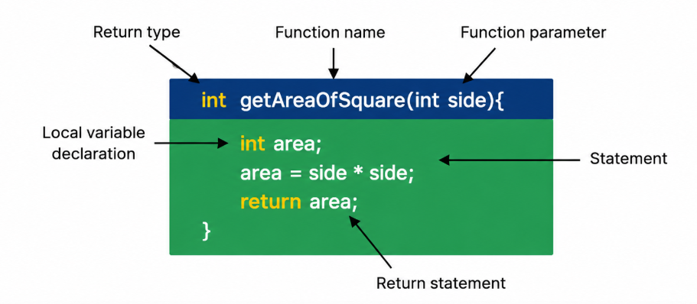
CHAPTER 3
Functions
A function is a group of statements that together perform a task. Every C++ program has at least one function, main(), which is the starting point of the program. Functions can be defined by the user or provided by libraries.
Why Use Functions?
Modularity: Break down complex problems into smaller, manageable pieces.
Reusability: Write code once and use it multiple times, even in different programs.
Organization: Make the code more organized and easier to read and maintain.
Syntax:
returnType functionName(parameterList) { // body of the function }
Here,
returnType: The data type of the value the function returns. If the function does not return a value, this is specified as void.
functionName: The name of the function.
parameterList: A list of parameters (arguments) that the function takes, enclosed in parentheses. This is optional; a function may have no parameters.

Slide 41
CHAPTER 3
Functions
Methods To Call A C++ Function
There are two primary ways to call the C++ function inside a program with access.
call-by-value
call-by-reference
Call-By-Value
The call-by-value technique allows the arguments to be sent to a C++ function by making a duplicate of the values and giving them to the function.
void increment(int num) {
num++; // Increment the local copy of num
}
int main() {
int value = 5;
std::cout << "Before function call: " << value << std::endl;
increment(value); // Call the function by value
std::cout << "After function call: " << value << std::endl;
return 0;
}

Slide 42
CHAPTER 3
Functions
Call-By-Reference
The call-by-reference way of passing arguments to a C++ function is when the function is called by supplying the memory location (reference) of the variables to be utilized inside the function.
#include <iostream>
using namespace std;
void increment(int& num) {
num++; // Increment the original value referred to by num
}
int main() {
int value = 5;
std::cout << "Before function call: " << value << std::endl;
increment(value); // Call the function by reference
std::cout << "After function call: " << value << std::endl;
return 0;
}

Slide 43
CHAPTER 3
Functions
Types of Function:
Standard Functions
Standard functions are those provided by C++ libraries, such as std::cout for output and std::cin for input
User-Defined Functions
User-defined functions are written by the programmer to perform specific tasks. The example above illustrates a simple user-defined function.
Function Components
Return Type
A function may return a value. The return type is the type of value the function sends back to the caller. If a function does not return a value, its return type is void.
Parameters
Parameters (or arguments) are the values passed to the function. They are optional; a function can have none. Parameters allow you to pass data into a function.
Pass-by-value
Pass-by-reference
Function Body
The function body contains the statements that define what the function does. It’s enclosed in curly braces {}.

Slide 44
CHAPTER 3
Functions
Passing Parameters to a function
Pass-by-Value Approach For C++ Function
When we are passing parameters to a function using the pass-by-value approach, a copy of the argument is provided to the function. The clone of the argument is used by the function, and any changes performed there have no impact on the original argument.
#include <iostream>
using namespace std;
void increment(int num) {
num++;
}
int main() {
int value = 7;
std::cout << "Before function call: " << value << std::endl;
increment(value);
std::cout << "After function call: " << value << std::endl;
return 0;

Slide 45
CHAPTER 3
Functions
Passing Parameters to a function
Pass-by-Reference Approach For C++ Function
Under the pass-by-reference, a reference to the argument is supplied to the C++ function. The original parameter can be directly accessed and changed by the C++ function. The ampersand (&) is used in function declarations to denote a reference before an argument
#include <iostream>
using namespace std;
void increment(int& num) {
num++;
}
int main() {
int value = 8;
std::cout << "Before function call: " << value << std::endl;
increment(value);
std::cout << "After function call: " << value << std::endl;
return 0;
}

Slide 46
CHAPTER 3
Functions
Swap by Reference
#include <iostream>
using namespace std;
void swapNumbers(int &a, int &b)
{
int temp = a;
a = b;
b = temp;
}
int main()
{
int x = 10;
int y = 20;
cout << "Before swapping:" << endl;
cout << "x = " << x << ", y = " << y << endl;
swapNumbers(x, y);
cout << "After swapping:" << endl;
cout << "x = " << x << ", y = " << y << endl;
return 0;
}

Slide 47
CHAPTER 3
Functions
Function Parameters: The Basics
When a function is called, often data are provided for function to work with. These data are passed as parameters to the function.
Arguments: The actual values passed in the function call.
Parameters: The variables defined in the function that receive the arguments.
Parameters act as placeholders that hold the values passed from the calling code.
The data flows from arguments (caller) to parameters (function) when the function is invoked.
Parameters are local to the function and exist only within its scope.
The number and type of arguments must match the number and type of parameters declared in the function.
Arguments can be passed as values, references, or pointers depending on the function definition.

Slide 48
CHAPTER 3
Functions
Default Argument:
Default arguments allow us to specify default values for function parameters in C++.
These default values are used automatically when the corresponding argument is omitted in the function call.
Default arguments enhance function flexibility by accommodating multiple usage scenarios.
They simplify function calls by reducing the number of arguments that must be explicitly passed.
Default arguments maintain code clarity by minimizing the need for multiple overloaded functions.
They are defined in the function declaration (prototype), not in the definition.
Default arguments must be specified from the rightmost parameter (trailing parameters) towards the left.
Once a parameter has a default value, all subsequent parameters must also have default values.
They are useful when a function has commonly used values but still allows customization.
Default arguments reduce code duplication by eliminating the need for separate functions for different use cases.
Syntax:
returnType functionName(parameterType1 parameterName1 = defaultValue1, ...);

Slide 49
CHAPTER 3
Functions
#include <iostream>
using namespace std;
// defining the default arguments
void display(char c = '*', int count = 3) {
for(int i = 1; i <= count; ++i) {
cout << c;
}
cout << endl;
}
int main() {
int count = 5;
cout << "No argument passed: ";
display();
cout << "First argument passed: ";
display('#');
cout << "Both argument passed: ";
display('$', count);
return 0;
}

Slide 50
class Rectangle {
private:
int width;
int height;
public:
Rectangle(int w = 0, int h = 0) : width(w), height(h) {
cout << "Constructor called" << endl;
}
Rectangle(const Rectangle& other) {
width = other.width;
height = other.height;
cout << "Copy constructor called!" << endl;
}
int area() const {
return width * height;
}
void setWidth(int w) {
width = w;
}
};
// Function that takes Rectangle by value (creates a copy)
void modifyRectangleByValue(Rectangle r) {
r.setWidth(20); // Modifies the copy, not the original
cout << "Inside function area: " << r.area() << endl;
}
int main() {
Rectangle rect(5, 10);
cout << "Original area: " << rect.area() << endl;
modifyRectangleByValue(rect); // Copy is created
cout << "Original area after function: " << rect.area() << endl;
return 0;
}

Slide 51
CHAPTER 3
Functions Overloading
Multiple Functions with same name but different parameters
Function overloading is a feature in C++ that allows multiple functions to have the same name but with different parameters (either in type, number, or both). This capability enhances the expressiveness and readability of the programming language, allowing functions to be used in various contexts with different types of input.
Explanation of Program:
double area(double radius) {
This version of the area function calculates the area of a circle. It takes one double parameter representing the radius of the circle and returns its area as a double.
double area(double length, double width) {
This version calculates the area of a rectangle. It is overloaded to take two double parameters representing the length and width of the rectangle, respectively, and returns the calculated area.
cout << "Area of circle (r=5): " << area(5.0) << endl;
Calls the first version of the area function with a single argument to calculate the area of a circle.
cout << "Area of rectangle (4x5): " << area(4.0, 5.0) << endl;
Calls the second version of the area function with two arguments to calculate the area of a rectangle.
#include <iostream>
using namespace std;
// Overloaded functions to calculate the area double area(double radius) { // For circle return 3.14159 * radius * radius; } double area(double length, double width) { // For rectangle return length * width; } int main() { cout << "Area of circle (r=5): " << area(5.0) << endl; cout << "Area of rectangle (4x5): " << area(4.0, 5.0) << endl; return 0; }

Slide 52
CHAPTER 3
Functions Overloading
Use Cases
Handling Different Data Types: Overloaded functions can perform analogous operations on different types of data. For example, you might have a print function that accepts both int and float types, displaying numbers in an appropriate format.
Different Implementations Based on Parameters: You can overload functions to provide different implementations based on the number or types of arguments passed. This is useful in mathematical operations, where the formula might differ based on input dimensions or types.
Improving Code Readability: Using the same function name for similar operations on different data types makes the code more intuitive and easier to understand.
Advantages
Cleaner Code: Function overloading leads to cleaner code by reducing the number of distinct function names for similar operations, making the code easier to read and maintain.
Intuitive Usage: Overloading allows functions to be called in a way that feels natural and intuitive, closely mimicking the versatility seen in human languages.
Compile-Time Polymorphism: It provides a form of polymorphism where the appropriate function is selected at compile time based on the argument types, improving performance by avoiding runtime decision-making.

Slide 53
CHAPTER 3
Inline Function
Inline functions are functions in C++ that are expanded in-line at the point of each call, replacing the function call with the actual function code, thereby eliminating the overhead of a traditional function call.
Inline functions are a performance optimization feature designed to improve execution speed.
They are most effective for small, frequently called functions.
By marking a function with the inline keyword, the programmer gives a hint to the compiler to embed the function's body directly at each call site.
Instead of a traditional function call (which involves stack operations, jump, and return), the compiler replaces the call with the function code itself.
This eliminates the overhead of function call mechanisms (saving time and resources).
Inline functions originated from C's macro feature but provide type safety and better debugging support.
They are particularly useful for getter/setter functions, mathematical operations, and small utility functions.
The inline keyword is only a request, not a command – the compiler may ignore it if the function is too large or complex.
Potential risks include:
Code bloat – excessive inlining can increase the size of the executable significantly.
Cache misses – larger code size may reduce CPU cache efficiency.
Increased compilation time – due to repeated expansion of code.
Debugging difficulty – as the function call stack may not reflect actual calls.
Overuse can lead to diminished performance rather than improvement.

Slide 54
CHAPTER 3
Inline Function
#include <iostream>
using namespace std;
inline int square(int x) {
return x * x;
}
int main() {
int result = square(5); // Compiler may replace this with: int result = 5 * 5;
return 0;
}

Slide 55
CHAPTER 3 — REVIEW
Practice & Exam-style Questions
What is function overloading? Overload add() for int and float.
Explain call-by-value vs call-by-reference with an example.
What are default arguments? Explain the rules.
Define inline function. Why and when is it used?
📋 Probable Exam Question
Q1: What are inline functions? Write a C++ program demonstrating function overloading and default arguments. [PU Exam 2023]

Slide 56
Lab Work
Scenario 1:Smart Calculator
Problem Statement
Develop a calculator program that can perform addition on different types of inputs.
Requirements
Create overloaded functions named add() for:
Two integers
Two floating-point numbers
Three integers
Create an inline function square() that returns the square of a number.
Display the result of each operation.
Concepts needed to implement
Function Overloading
Inline Function
Basic Arithmetic Operations

Slide 57
Lab Work
Scenario 2: Employee Salary Management
Problem Statement
A company wants a salary calculation system for different categories of employees.
Requirements
Overload a function calculateSalary() for:
Full-time employee (basic salary)
Employee with bonus
Employee with bonus and overtime
Create an inline function taxDeduction() that calculates 10% tax.
Display gross salary and net salary.
Concepts needed to implement
Function Overloading with different parameter lists
Inline Functions
Real-world business application

Slide 58
Lab Work
Scenario 3: Student Result Processing
Problem Statement
Create a result-processing system for students.
Requirements
Overload a function calculateAverage() for:
Two subjects
Three subjects
Five subjects
Create an inline function isPass() that returns true if average ≥ 40.
Display average marks and pass/fail status.
Concepts needed to implement
Function Overloading with different parameter lists
Inline Functions
Real-world business application

Slide 59
CHAPTER 4
Classes and Objects
Access specifiers · this pointer · Constructors & destructors · Static members · Friend functions

Slide 60
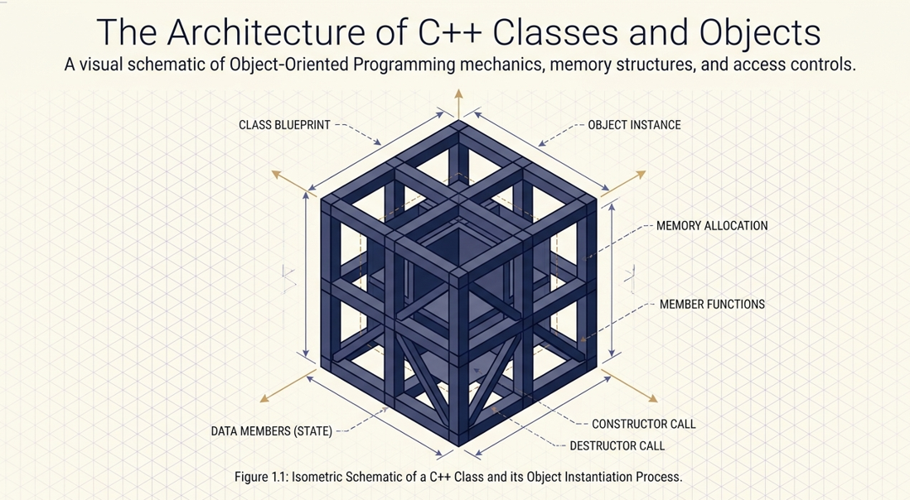

Slide 61
CHAPTER 4
Introduction
Objects and Classes are key to understand the Object-Oriented Programming Language (OOPL)/Object-Oriented Technique. Object-Oriented Programming Languages are based on the concept of abstraction modeled by classes and objects.
Classes and objects are the cornerstones of Object-Oriented Programming (OOP) in C++. They enable programmers to create modular, reusable, and maintainable code. In this article, we will dive deep into understanding what classes and objects are, explore their functionalities, and learn how to implement them in C++ effectively.
Classification is one of the important concepts of Object-Oriented philosophy including identity, abstraction, encapsulation, inheritance, polymorphism, and persistence.
Object-Oriented uses classification to group objects that have attributes and behaviors in common and classify them into bigger entities. The bigger entity is called a “class”. Thus, a class defines a group of objects with similar attributes, common operations, a common relationship to the other objects in the class, and common semantics

Slide 62
CHAPTER 4
Class
A class is set of objects that shares a common definition described by data and methods.
According to the Webster’s New World dictionary, a class is defined as:
“ A number of people or things grouped together because of certain likeness; kind; sort”. In other words, we can say that class is an object template. Every object under that class has the same data format, definition and responds in the same manner to an operation.
A class in C++ is a user-defined data type that encapsulates data members (variables) and member functions (methods) within a single unit. Think of a class as a blueprint or template that defines the structure and behavior of objects. Classes are the foundation of OOP and facilitate encapsulation, abstraction, and data hiding.

Slide 63
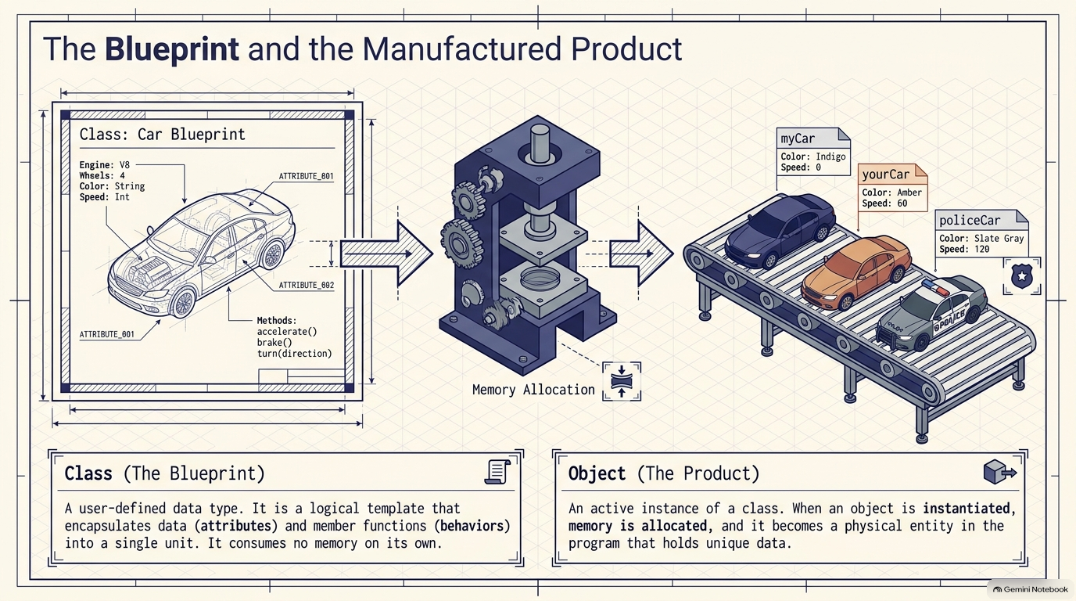

Slide 64
CHAPTER 4
Class
Analogy of Classes:
Imagine a class of cars. Cars can have different names, models, and brands, yet they all share common properties like having four wheels, a speed limit, and mileage. In this analogy:
The Car represents the class.
The common properties such as wheels, speed limits, and mileage are the data members.
Actions like accelerating, braking, and honking are the member functions.
Defining a Class in C++
A class in C++ is defined using the class keyword followed by the class name. The body of the class contains the data members and member functions, enclosed in curly braces {}.
Example
Class: Expensive Cars Objects: Mercedes, BMW, Toyota Data Member: Price, Speed, Wheels, Mileage, Model, Color Member Function: brakes(), speed(), start(), stop(), etc.

Slide 65
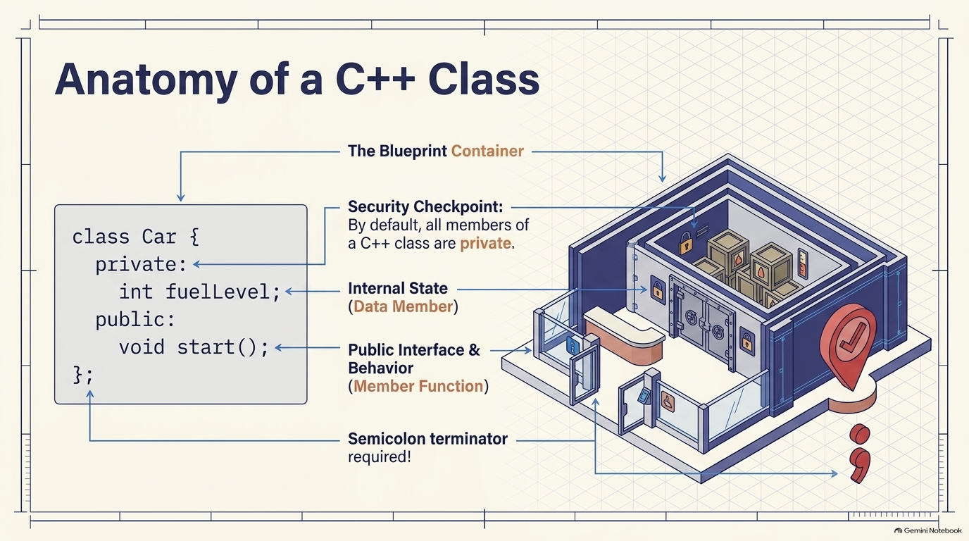

Slide 66
CHAPTER 4
Class
Syntax:
class ClassName { access_specifier: // Data_members;
// Member_Functions() };
The keyword class is used to define a class in C++, where the class identifier is given by ClassName.
The access_specifier is the access controller which defines the visibility of class members. It can be private, public, and protected; we will elaborate on these in a later section.
Data_members are the variables that hold data related to an object of the class.
Member_functions() are class methods that define what operations can be performed on objects and how.

Slide 67
CHAPTER 4
Objects
An object is anything in the real world that has a distinct identity, observable characteristics, and defined behaviors.
Think of it like a smartphone:
State (Attributes): Brand, model, color, battery level.
Behavior (Methods): Making a call, sending a text, or opening an app.
According to the Webster’s New World dictionary, an Object is defined as:
“A thing that can be seen or touched; material thing; a person or thing to which action, thought or feeling is directed”.
An object is an instance of a class. When an object is created, a real-world entity is created that has the properties and behaviors defined by the class. While a class only defines what an object will be, an object is an actual instance that occupies memory and can be manipulated.
Creating an Object:
To use the data members and functions of a class, you need to create an object. When you create an object, memory is allocated for it, allowing you to access and manipulate the data members and functions defined in the class.
Syntax:
ClassName ObjectName; //Creating an object
Class_name: It is the name of the class for which the object is created
Object_name: It is the name of the object. Note that having a meaningful object name enhances code readability

Slide 68
CHAPTER 4
Objects
Declare and Define a Class in C++ Program: The first step is to create a class, as mentioned in the syntax given above. The C++ class definition must specify-
Data members, i.e., the attributes or member variables of objects in C++.
Member functions, i.e., C++ class methods that define how we can manipulate the data stored in the member variables to full required tasks.
Create an Object in C++ Program: After a class has been defined, an object of that class can be declared by writing the class name and then the object name. The memory for the object is assigned after this declaration.
The creation of a C++ class object is usually done in the main() part of the program.
Once declared and initialized, the C++ class object can be used to invoke special functions in the class.
#include <iostream>
using namespace std;
// Define a class called 'Car'
class Car {
public: // Access specifier
string brand; // Data member
int speed; // Data member
void display() { // Member function
cout << "Brand: " << brand << ", Speed: " << speed << " km/h" << endl;
}
};
int main() {
// Creating an object of the Car class
Car myCar;
// Setting values for the object's data members
myCar.brand = "Toyota"; // Assign brand name
myCar.speed = 120; // Assign speed value
// Displaying the car details
myCar.display(); // Call the display function to output car information
return 0; // Indicate successful program completion
}

Slide 69
CHAPTER 4
Data Member
A data member is a variable declared within a class or struct that holds data (state) for objects of that class type. It represents the attributes or properties of the class.
Formal Definition
A data member (also called a field, attribute, or instance variable) is a non-function member of a class that stores data. It can be of any type, including fundamental types, pointers, references, arrays, or other class types. Each data member has storage associated with it for each object instance (except static members, which are shared).
#include <iostream>
class ClassName {
// Data member declaration syntax:
[access_specifier:] [modifiers] type name [= initializer];
private:
int age; // simple data member
std::string name; // object data member
static int count; // static data member
const double PI = 3.14159; // const data member
int* ptr; // pointer data member
int& ref; // reference data member (must be initialized)
mutable int cache; // mutable data member
int arr[10]; // array data member
std::vector<int> scores; // container data member
};

Slide 70
CHAPTER 4
Data Member
Type of Data Member
Type | Declaration | Storage | Example
Instance | type name; | Per object | int x;
Static | static type name; | Shared across all objects | static int count;
Const | const type name; | Per object, cannot modify | const int id;
Reference | type& name; | Per object, must bind | int& ref;
Mutable | mutable type name; | Can modify in const methods | mutable int cache;
Bit-field | type name : bits; | Space-efficient | int flag : 1;

Slide 71
CHAPTER 4
Member Function
A function that is defined as a class member is known as a member function in C++ programming.
Characteristics of Member Function
Member functions are functions defined within a class.
They can access the values of the data members and can also carry out operations on the data members.
Their definition may be included in or excluded from the class body. A member function in C++ can access both public and private class members.
Member function makes the program modular by increasing code reusability and making it easier to understand, hence making the code maintainable.
Member functions also provide the ability to restrict access to the data of members of the class. This can be done by making specific functions private, thus ensuring that only the class itself may access or modify sensitive data.
Member functions are essential in C++ as they encapsulate the behavior and functionality of objects. They enable objects to interact with their data and serve as a means for other components of the program to modify the data.
// Member function declaration returnType functionName (arguments) {
//function body };
The functionName refers to the name of the function, with the returnType specifying the data type of its return value.
The arguments refer to the parameters the member function can take.
The curly brackets {} contain the function body, i.e., the operations that are performed on the data members of the class.

Slide 72
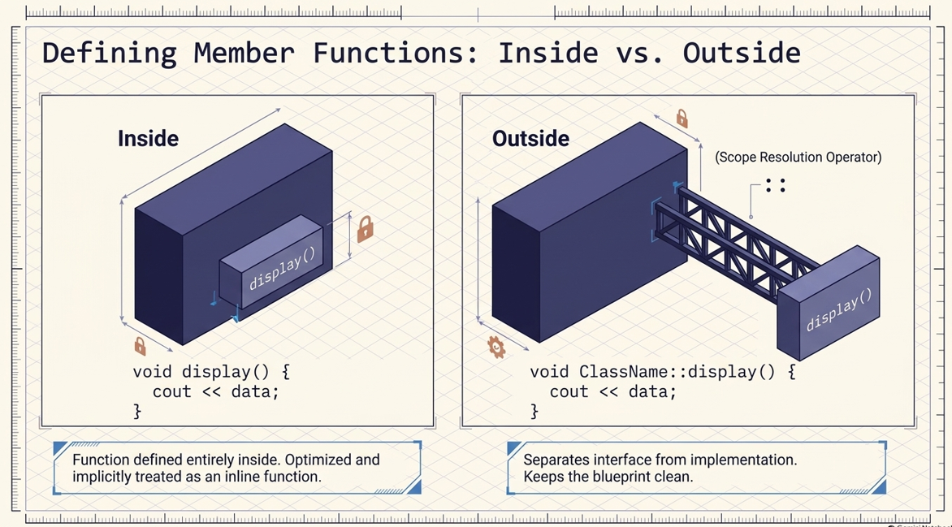
CHAPTER 4
Member Function
Defining a Function in C++
There are mainly two ways to define a member function in C++.
Inside the class definition
Outside the class definition.

Slide 73
CHAPTER 4
Member Function
Defining a Function in C++ Inside The Class Definition
A member function can be both declared and defined within a class itself. When a member function is defined within a class, it is referred to as an inline function. All of the constraints and limitations that apply to inline functions also apply to functions declared within a class.
class MyClass{ private: //Data Members variables
public: //Member Function returnType functionName(argument){ //Function Definition }
};

Slide 74
CHAPTER 4
Member Function
#include <iostream>
using namespace std;
class Circle{
private:
//Data Members
float rad;
public:
//Member Function
void getradius(){
cout<<"Enter Radius"<<endl;
cin>>rad;}
void calc_area(){
float a;
a = 3.14*rad*rad;
cout<<"The Area of the Circle is = "<<a<<endl;
}
};
int main(){
Circle c;
c.getradius();
c.calc_area();
return 0;
}
Circle class is defined , which has a private data member called rad (of float type).
In the class is the member function called getradius(), which prompts the user to enter the radius of the circle using cout, stores it in the rad data member, and reads the input using the cin command.
Also, another void member function called calc_area within the Circle class. It calculates the area of the circle using the formula a = 3.14*rad*rad and displays it on the console.
In the main() function, we first create an object c of the Circle class.
We then call the getradius() member function on the c object, which prompts the user for input and stores the radius in the rad data member. The calc_area() member function then calculates the area of the circle and displays it on the console.

Slide 75
CHAPTER 4
Member Function
Defining a Function in C++ Outside The Class Definition
In this case, the declaration and definition of the member function are not made together. That is, while the functions are declared inside the class, their definition is given outside.
However, the definitions of member functions are very similar to those of normal functions. They should have a function header and body. Unlike a normal function, a member function includes a membership identity label in the header. The identity label is used to indicate that the function belongs to a particular class.
return_type class_name :: function-name (argument declaration){ //Function body }
The class_name is the membership label or the name of the class to which the member function belongs.
The function_name and the double colon (::) are the name of the function and the scope resolution operator, which tells the compiler that the function belongs to the class_name.
The arguments and the return_type refer to the parameters the function takes and the data type of its return value, respectively.

Slide 76
CHAPTER 4
Member Function
#include <iostream>
using namespace std;
class Circle{
private:
float rad; //Data Members
public:
void getradius(); //Member Function
void calc_area(); //Member Function
};
void Circle :: getradius(){
cout<<"Enter Radius ";
cin>>rad;}
void Circle :: calc_area(){
float a;
a = 3.14*rad*rad;
cout<<"The Area of the Circle is = "<<a<<endl;}
int main(){
Circle c;
c.getradius();
c.calc_area();
return 0;
}
Circle class is defined , which has a private data member called rad (of float type).
It contains the member functions called getradius(), calc_area() which are defined outside the class using scope resolution operators (::)
In the main() function, we first create an object c of the Circle class.
We then call the getradius() member function on the c object, which prompts the user for input and stores the radius in the rad data member. The calc_area() member function then calculates the area of the circle and displays it on the console.

Slide 77
CHAPTER 4
Static Data Member
Introduction
Declared using the keyword static inside the class.
Must be defined outside the class .
Shared by all the objects of the class.
Accessed using the class name followed by the scope resolution operator(::).
Can initialize a static data member in C++ programs using a constant expression or a compile-time constant
A static data member in C++ refers to a member of a class that is common to all its objects. In other words, it is associated with the class as a whole. These members are created using the static keyword.
Static Data Member In C++?
The static data member in C++ programming is a special type of class member that is associated with the class rather than with an individual object of a class. It means that all instances of the class share the same static data member. In other words, unlike regular (non-static members) data members, which have separate copies for each object, static data members are shared among all objects of the class.
class ClassName { access_specifier: static data_type data_member_name; };
The ClassName and data_member_name refer to the names of the class and the data member we are creating.
An access specifier indicates the visibility of the class member, which can be private, public or protected.
The static keyword indicates that the respective member is of a static nature and the type of data it stores is given by data_type.

Slide 78
CHAPTER 4
Static Data Member
#include <iostream>
using namespace std;
class Mercedes {
public:
// Declaration of static data member.Static members belong to the class itself, not to individual objects
static int modelCount;
// Constructor - automatically called when a Mercedes object is created
Mercedes() {
// Increment modelCount for each object created.modelCount is static, it keeps its value across all objects
modelCount++;
}
};
// Definition and initialization of static data member outside the class
// This allocates memory for the static variable
// Must be done exactly once in exactly one source file
int Mercedes::modelCount = 0;
int main() {
// Creating Mercedes objects - each triggers the constructor
Mercedes m1; // Creates first Mercedes object → modelCount becomes 1
Mercedes m2; // Creates second Mercedes object → modelCount becomes 2
Mercedes m3; // Creates third Mercedes object → modelCount becomes 3
// Static members can be accessed even without creating any objects
cout << "Total Mercedes models: " << Mercedes::modelCount << endl;
return 0;
}

Slide 79
Lab Work
Context: Student count using Static Data Member
Problem Statement
1. Needed a Program that will output the total number of students(object) recorded
2. Also demonstrate the difference with normal Data Member

Slide 80
CHAPTER 4
Access Specifiers & this Pointer
private — accessible only inside the class's own member functions
public — the class's external interface, accessible from anywhere
protected — like private, but also accessible to derived classes
this — hidden pointer to the current object; resolves name clashes, enables chaining
Real-life analogy: private is the room safe, protected is a connecting door for family (derived classes), public is the front door.

Slide 81
CHAPTER 4
Constructors & Destructors
Constructor — same name as class, no return type, runs automatically on creation
Destructor (~ClassName) — runs automatically on destruction; releases resources
Default constructor — takes no arguments
Parameterized constructor — takes arguments to set initial state
Copy constructor — ClassName(const ClassName&); deep copy needed if class holds pointers

Slide 82
CHAPTER 4 — PROGRAM 4.3
Copy Constructor — Why Deep Copy Matters
class Name {
char *text;
public:
Name(const char *s){ text=new char[strlen(s)+1]; strcpy(text,s); }
Name(const Name &src) { // DEEP copy
text = new char[strlen(src.text)+1]; // NEW memory
strcpy(text, src.text);
}
~Name() { delete[] text; }
};
// Without a hand-written copy ctor, two objects would share
// ONE pointer -> delete[] runs twice -> undefined behaviour

Slide 83
CHAPTER 4
Static Members & Friend Functions
static data member — ONE copy shared by every object of the class
static member function — called via ClassName::func(); no 'this' pointer
friend function — NOT a member, but explicitly granted access to private data
friend class — every member function of that class gets the same access
Real-life analogy: A friend function is like giving your accountant a key to your private filing cabinet — trusted by name, not automatic.

Slide 84
CHAPTER 4 — REVIEW
Practice & Exam-style Questions
What is a constructor? Explain its types with examples.
What is a copy constructor? Why is it needed?
Explain static data members and static functions with an example.
What is a friend function? Write a program using one.

Slide 85
CHAPTER 5
Operator Overloading
Rules & restrictions · Unary/binary operators · Friend operators · Type conversion

Slide 86
CHAPTER 5
Rules & Restrictions
operator keyword redefines what +, -, ==, [], << mean for your class
At least one operand must be a user-defined type
Cannot overload: :: . .* ?: sizeof — and cannot change precedence/arity
Member function: left operand = this. Friend function: both operands explicit

Slide 87
CHAPTER 5 — PROGRAM 5.1
Overloading + and == (Complex numbers)
class Complex {
double real, imag;
public:
Complex(double r=0,double i=0){real=r;imag=i;}
Complex operator+(const Complex &c) {
return Complex(real+c.real, imag+c.imag);
}
bool operator==(const Complex &c) {
return real==c.real && imag==c.imag;
}
};
// Complex c = a + b; -> compiler rewrites as a.operator+(b)

Slide 88
CHAPTER 5
Friend Operators & Data Conversion
10 + complexObj needs a FRIEND operator+ (left operand isn't the class type)
operator<< as a friend enables cout << myObject
Basic -> Object: a single-argument constructor acts as implicit conversion
Object -> Basic: operator TargetType() const { ... } (no return type, no params)
Object -> different Object: a constructor in the destination class OR a conversion operator in the source class

Slide 89
CHAPTER 5 — REVIEW
Practice & Exam-style Questions
State the general rules for overloading operators.
Overload + to add two complex numbers (member function).
Explain unary vs binary operator overloading with examples.
Explain type conversion between basic types and class objects.

Slide 90
CHAPTER 6
Virtual Functions and Polymorphism
Early vs late binding · Virtual functions · Pure virtual & abstract classes · Virtual base classes

Slide 91
CHAPTER 6
Early Binding vs Late Binding
Early (static) binding — compiler decides which function to call, at compile time
Late (dynamic) binding — decided at RUN TIME, based on the object's real type
C++ implements late binding through virtual functions (conceptually via a vtable)
Real-life analogy: Early binding = a letter addressed to 'Room 5'. Late binding = a letter addressed to 'the current Manager'.

Slide 92
CHAPTER 6 — PROGRAM 6.1
Virtual Functions in Action
class Shape {
public: virtual void identify() {
cout << "generic shape"; }
};
class Circle : public Shape {
public: void identify() override {
cout << "I am a Circle"; }
};
Shape *s = new Circle();
s->identify(); // calls Circle::identify — decided at RUN TIME

Slide 93
CHAPTER 6
Pure Virtual Functions, Abstract Classes, Virtual Base Classes
Pure virtual: virtual double area() = 0; (no body in base class)
A class with >=1 pure virtual function is ABSTRACT — cannot be instantiated
Forces every derived class to implement that function
Virtual base class (virtual public Base) — solves the 'diamond' duplicate-copy problem

Slide 94
CHAPTER 6 — REVIEW
Practice & Exam-style Questions
What is a virtual function? Why is it needed?
Differentiate compile-time vs run-time polymorphism.
What is an abstract class? Can it be instantiated?
Explain virtual base class with a diamond-inheritance example.

Slide 95
CHAPTER 7
Inheritance
Types of inheritance · Constructor/destructor order · Public/private/protected · Ambiguity · Containership

Slide 96
CHAPTER 7
Types of Inheritance
Single — one base, one derived
Multiple — one derived, two or more base classes
Multilevel — a chain: A -> B -> C
Hierarchical — several derived classes share one base
Hybrid — a combination (often produces the 'diamond' shape)

Slide 97
CHAPTER 7
Construction Order & Access Modes
Constructors run BASE first, then DERIVED
Destructors run in REVERSE: DERIVED first, then BASE
public inheritance — models a true 'is-a' relationship (most common)
private inheritance — models 'is-implemented-in-terms-of', not 'is-a'
Base-class private members are NEVER directly reachable from a derived class

Slide 98
CHAPTER 7 — PROGRAM 7.3
Ambiguity in Multiple Inheritance
class Printer { public: void status(){cout<<"Printer ready";} };
class Scanner { public: void status(){cout<<"Scanner ready";} };
class AllInOne : public Printer, public Scanner {};
AllInOne m;
// m.status(); // ERROR: ambiguous!
m.Printer::status(); // resolved explicitly
m.Scanner::status();
Containership ('has-a'): a class holds an object of another class as a data member — an alternative to inheritance.

Slide 99
CHAPTER 7 — REVIEW
Practice & Exam-style Questions
Explain the types of inheritance with examples.
Differentiate public, private, and protected inheritance.
What is ambiguity in multiple inheritance? How is it resolved?
Differentiate inheritance and containership with an example.

Slide 100
CHAPTER 9
Templates and STL
Function templates · Class templates · Containers · Iterators · Algorithms

Slide 101
CHAPTER 9
Function & Class Templates
template <typename T> — one piece of code, compiler fills in the real type
Function template: T maximum(T a, T b) works for int, double, char, ...
Class template: Stack<T> can become Stack<int>, Stack<string>, ...
Templates give reusability at the TYPE-SYSTEM level
Real-life analogy: A template is a cookie cutter — one shape, pressed into different doughs (types) to produce different cookies.

Slide 102
CHAPTER 9
STL: Containers, Iterators, Algorithms
Containers — vector (dynamic array), list (linked list), map (key-value, sorted), set
Iterators — generalised pointers; begin() / end() traverse any container uniformly
Algorithms — sort(), find(), count(), for_each() operate on [begin, end) ranges
Same sort() works on vector<int> AND vector<string> — that's the STL's power

Slide 103
CHAPTER 9 — PROGRAM 9.3
Vector + Iterator + Algorithm Together
vector<int> marks = {56, 90, 45, 78, 88};
sort(marks.begin(), marks.end());
for (auto it = marks.begin(); it != marks.end(); ++it)
cout << *it << " ";
// Output: 45 56 78 88 90

Slide 104
CHAPTER 9 — REVIEW
Practice & Exam-style Questions
Differentiate function template and class template.
What is STL? Explain its components.
Explain iterators and their role in STL.
Sort a vector of integers using STL sort().

Slide 105
CHAPTER 10
Namespaces
Scope resolution operator · The using keyword

Slide 106
CHAPTER 10
Why Namespaces? Using Them
A namespace gives a distinct scope to names, preventing naming collisions
The entire C++ standard library lives inside namespace std
Namespace::member — explicit, always safe, more to type
using namespace X; — imports every name from X (convenient, but risks collisions)
using X::specificName; — imports only ONE name (safer, targeted)
Real-life analogy: A namespace is like a surname: many 'Ram's in a village, but 'Ram Shrestha' vs 'Ram Thapa' never gets confused.

Slide 107
CHAPTER 10 — PROGRAM 10.1
Declaring and Using Namespaces
namespace College { int studentCount = 250; }
namespace Company { int studentCount = 40; } // no conflict
cout << College::studentCount; // 250
cout << Company::studentCount; // 40

Slide 108
CHAPTER 10 — REVIEW
Practice & Exam-style Questions
What is a namespace? Why is it used in C++?
Differentiate 'using namespace std;' vs 'std::cout'.
Write a program demonstrating user-defined namespaces.

Slide 109
CHAPTER 10
Exception Handling
try / catch / throw · Multiple catch blocks · User-defined exceptions

Slide 110
CHAPTER 11
The Exception Handling Model
Exception — an unusual/error condition arising at run time
try — marks a block where an exception might occur
throw — signals an exceptional condition, hands over an exception object
catch — a handler that receives a matching thrown object
Control jumps DIRECTLY from throw to a matching catch — skips remaining try code
Real-life analogy: A fire alarm: whoever notices the fire (throw) doesn't fight it themselves — the fire brigade (catch), positioned separately, handles it.

Slide 111
CHAPTER 11 — PROGRAM 11.1
Basic try / throw / catch
double divide(double a, double b) {
if (b == 0)
throw runtime_error("Division by zero!");
return a / b;
}
try {
cout << divide(10, 0);
} catch (runtime_error &e) {
cout << "Caught: " << e.what();
}

Slide 112
CHAPTER 11
Multiple catch Blocks & User-defined Exceptions
Several catch handlers may follow one try, tried top to bottom
catch (...) — catch-all safety net, usually placed last
User-defined exceptions typically derive from std::exception
Override what() (virtual in std::exception) to describe the error

Slide 113
CHAPTER 11 — REVIEW
Practice & Exam-style Questions
Explain try, catch, throw with a program.
Write a program to handle division-by-zero.
What is a user-defined exception? Write a program.
Differentiate exception handling from return-code error handling.

Slide 114
CHAPTER 11
File Handling
ofstream/ifstream/fstream · File modes · seekg/seekp/tellg/tellp · Reading & writing objects

Slide 115
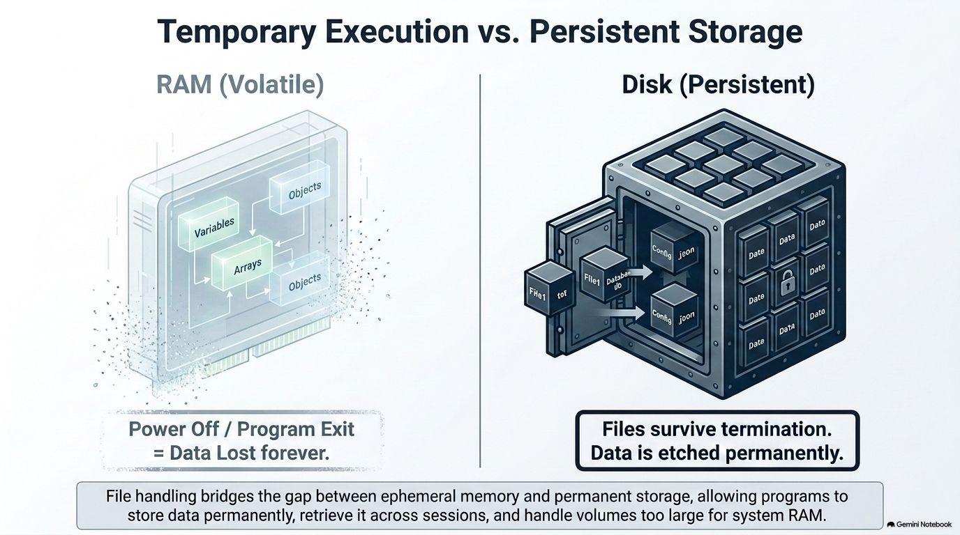

Slide 116
CHAPTER 11
File Handling
File handling is the mechanism by which a C++ program creates, opens, reads, writes, and closes files stored on secondary storage (disk), using stream classes from the <fstream> header so that data can persist beyond the program's lifetime.
RAM (variables, arrays, objects) is volatile — its contents disappear the instant the program terminates.
A disk file is persistent — it survives program exit, system reboot, and can be shared between programs.
C++ treats every source of input and every destination of output — keyboard, screen, or file — uniformly as a stream of bytes.
The header <fstream> supplies three classes: ifstream (input/read), ofstream (output/write), and fstream (both).
RAM vs. DISK
RAM (Program Memory)
int, float, arrays, class objects
⚡ Fast ✘ Erased when program ends
fstream / ifstream / ofstream
Disk (Secondary Storage)
data.txt, students.dat, ...
💾 Slower ✓ Persists after program ends

Slide 117
THE BIG ANALOGY
The Library Analogy
Keep this picture in your head for the entire lecture — every function we meet maps onto it.
YOU
📚
📖
🔖
The Program
The Librarian
The Book
The Bookmark
You want to read or record information, but you never touch the shelves yourself.
The stream object (ifstream / ofstream / fstream) — the only one allowed to fetch, place or return books.
The disk file itself — pages of data sitting on a shelf (the disk) until someone requests it.
The file pointer — marks exactly which page/word you'll read or write next.
Opening a file
The librarian walks to the shelf, retrieves the book, and lays it open on your desk — you may now use it.
Closing a file
The librarian saves any notes you made, then returns the book to the shelf. Skip this and notes can be lost.
seekg() / seekp()
You tell the librarian: “flip directly to page 50” — jump the bookmark anywhere instead of reading in order.
tellg() / tellp()
You ask: “what page is my bookmark on right now?” — the librarian reports the exact position.
get() / put()
Reading or writing one word at a time, in natural order, exactly where the bookmark currently sits.
read() / write() of an object
Photocopying an entire filled-in form in one motion — every field, byte-for-byte — instead of retyping it.
Notes:
This is the anchor slide for the whole lecture — spend real time here. Walk through the four actors first as a short story: 'Imagine you (the program) walk into a library. You are not allowed to pull books off the shelves yourself — house rules. Instead you talk to a librarian (the stream object). You tell the librarian which book you want; the librarian fetches it from the shelf (the disk) and places it open on the desk in front of you — that's opening the file. Inside the book, a bookmark tracks exactly where you're currently reading or writing.' Then go row by row through the mapping table and explicitly connect each C++ function name to the story: seekg/seekp are like flipping directly to a chosen page instead of reading front-to-back; tellg/tellp are like asking what page the bookmark is on; get/put are reading or writing one word at a time in natural order; and read/write of a whole object is like photocopying an entire filled-in form instead of retyping every field individually — fast, exact, but only readable by someone who has the same blank form (i.e. the same class definition) to interpret the copy. Tell students that whenever they forget what a function does during the lecture, they should mentally replay this library scene rather than memorizing syntax in isolation.

Slide 118
CHAPTER 11
File Handling
FOUNDATIONS
The fstream Family of Classes
#include <fstream>
SIMPLIFIED CLASS HIERARCHY
ifstream : “input file stream”. Derived for reading data FROM a file. Default mode: ios::in.
ofstream : “output file stream”. Derived for writing data TO a file. Default mode: ios::out (truncates existing content).
fstream : combines both; can read AND write the same file, useful for random-access/update operations.
All three inherit stream-formatting behaviour from ios, so the familiar << (insertion) and >> (extraction) operators work exactly as they do with cout and cin.
ios / istream / ostream
ifstream
ofstream
fstream
read-only stream write-only stream read + write stream
Notes:
This slide gives the structural picture behind the analogy: three librarian 'roles'. ifstream can only fetch books for reading, ofstream can only place books for writing, and fstream can do both, which is what we'll need later for random-access editing with seekg/seekp on the same open file. Mention that all three ultimately derive from the same ios/istream/ostream machinery that cin and cout use — that's WHY << and >> work identically on file streams; there is nothing new to learn about formatting, only about the source/destination changing from console to disk. Point out ofstream's default behavior of truncating (erasing) an existing file on open — this surprises many beginners and we will revisit it explicitly on the modes slide.

Slide 119
CHAPTER 11
File Handling
Opening and Closing a File — The Big Picture
“Opening” a file means associating a stream object (ifstream/ofstream/fstream) with a physical file on disk, so that operations on the object act on that file.
C++ gives two ways to open a file: via the constructor (at the moment the object is created) or via the open() member function (after the object already exists).
A file MUST be closed with close() when you're done. Closing flushes any buffered data to disk and releases the operating-system file handle.
Forgetting to close a file can lose buffered (not-yet-written) data, or leave the file locked/inaccessible to other programs.
Always verify the file actually opened — test the stream object in a boolean context: if (!file) { /* failed */ }.
FILE LIFECYCLE
1
Declare stream object
2
Open (constructor or open())
3
Check it opened successfully
4
Read and/or write data
5
Close the file (close())
Notes:
This slide gives the structural picture behind the analogy: three librarian 'roles'. ifstream can only fetch books for reading, ofstream can only place books for writing, and fstream can do both, which is what we'll need later for random-access editing with seekg/seekp on the same open file. Mention that all three ultimately derive from the same ios/istream/ostream machinery that cin and cout use — that's WHY << and >> work identically on file streams; there is nothing new to learn about formatting, only about the source/destination changing from console to disk. Point out ofstream's default behavior of truncating (erasing) an existing file on open — this surprises many beginners and we will revisit it explicitly on the modes slide.

Slide 120
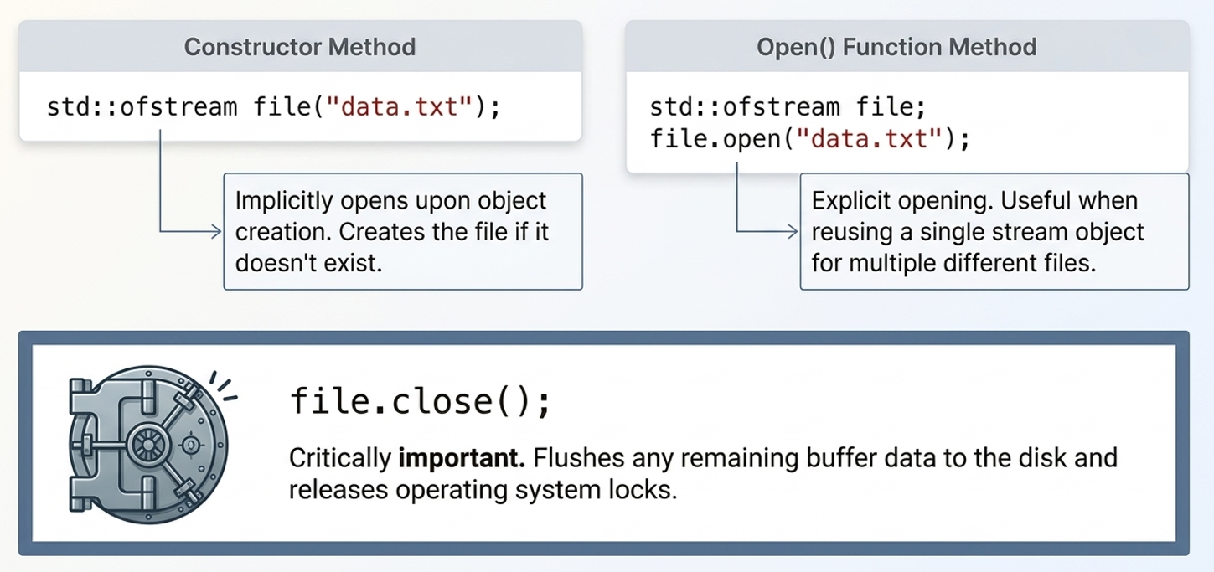
CHAPTER 11
Streams and File Modes
ofstream — write to a file | ifstream — read from a file | fstream — both
Open via constructor: ofstream fout("data.txt");
Open via .open(name, mode): ios::in, ios::out, ios::app, ios::ate, ios::trunc, ios::binary
Always .close() a file when finished, to flush buffered data
Real-life analogy: cin/cout are a live conversation. File streams are like posting a letter (write) or opening one already sent (read).

Slide 121
CHAPTER 11
Streams and File Modes
Opening a File Using the Constructor
#include <iostream>
#include <fstream>
using namespace std;
int main() {
// Constructor opens the file directly -
// no separate open() call is needed
ofstream outFile("data.txt"); // mode: ios::out
ifstream inFile("data.txt"); // mode: ios::in
outFile << "Created using constructor!";
outFile.close();
// Always verify the constructor actually
// succeeded in opening the file
if (!inFile) {
cout << "File could not be opened!";
}
inFile.close();
return 0;
}
Pass the filename (and optionally, the mode) directly to the stream object's constructor at the moment it is declared.
Syntax:
ClassName streamObj("filename", mode);
Most concise option — ideal when you know the exact file you need right away and won't need to reuse the object for another file.
If the mode is omitted, ifstream defaults to ios::in and ofstream defaults to ios::out.
Limitation: you cannot re-open a different file with the same object this way — for that, use open() instead (next slide).

Slide 122
CHAPTER 11
Streams and File Modes
#include <iostream>
#include <fstream>
using namespace std;
int main() {
fstream file; // no file yet
// Bind it to report.txt, allow reading,
// writing, and always append new writes
file.open("report.txt",ios::in | ios::out | ios::app);
if (!file) { return 1; } // safety check
file << "New entry logged." << endl;
file.close();
// Reuse the SAME object for another file
file.open("log.txt", ios::out | ios::trunc);
file << "Fresh log started.";
file.close();
return 0;
}
Opening a File Using open()
First declare the stream object with no file (default constructor), then bind it to a file later using open().
Syntax:
streamObj.open("filename", mode);
Lets you decide the filename at runtime (e.g., from user input) rather than hard-coding it at declaration.
The SAME object can be reused: close() one file, then open() another — useful inside loops that process many files.
The second argument (mode) can combine multiple flags with the bitwise-OR operator |, e.g. ios::in | ios::out | ios::app.

Slide 123
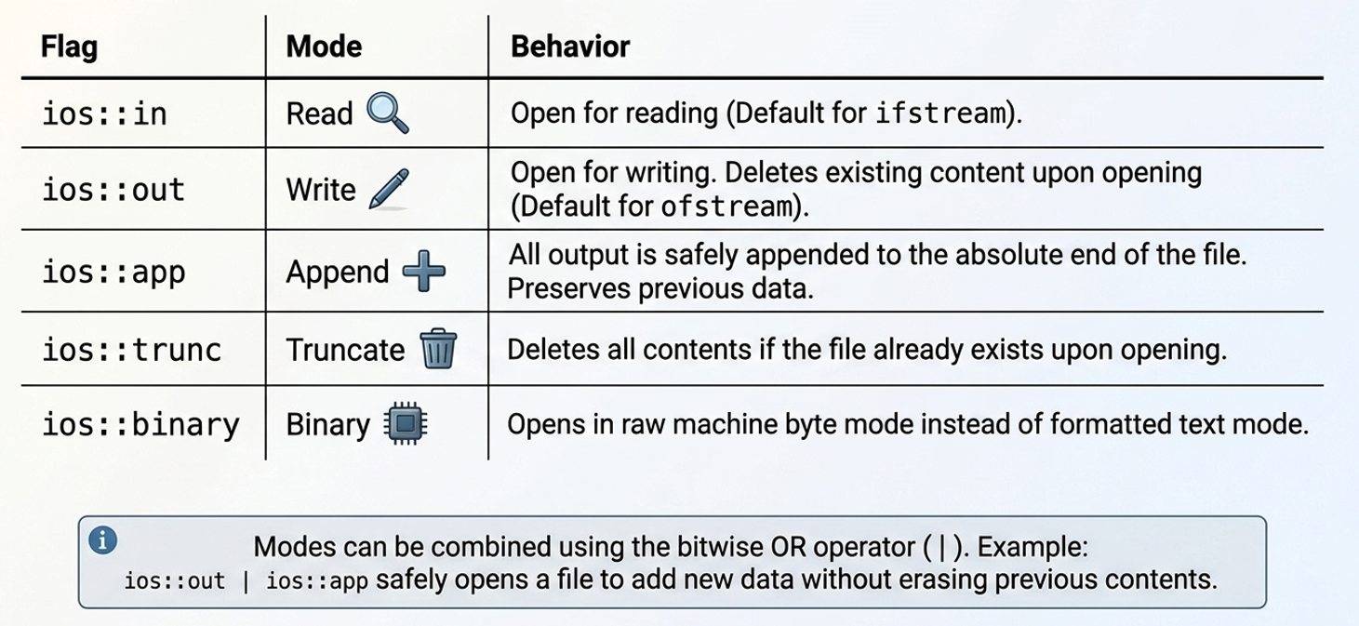
CHAPTER 11
File Opening Modes(ios::)
ios::in → Open for reading (input). Fails if the file does not exist (for ifstream).
ios::out → Open for writing (output). Creates the file if absent; truncates (empties) it if present.
ios::app → Append. Every write goes to the end of the file, no matter where the pointer is
ios::ate → “At End”. Pointer starts at end-of-file on open, but writes may still occur anywhere.
ios::trunc → Truncate. If the file exists, discard all its previous contents immediately.
ios::binary → Open in binary mode — bytes are transferred exactly as stored, no text translation.

Slide 124
CHAPTER 11
Formatted I/O
Formatted I/O means data is read or written according to its data type and representation.
C++ converts data between its internal representation and a human-readable textual representation.
The most familiar formatted I/O operators are:
<< // insertion operator
>> // extraction operator
These above operators are used with:
cout
cin
ofstream
ifstream
fstream
int main() {
iofstream file("student1.txt");
int age = 20;
double marks = 85.5;
string name = "Ram";
file << name << " " << age << " " << marks;
file.close();
return 0;
}

Slide 125
Formatted I/O
class Student{
private:
string name;
int age;
float marks;
public:
// Function to assign student data
void setData(string n, int a, float m){
name = n;
age = a;
marks = m;
}
// Function to display student data
void display(){
cout << "Name : " << name << endl;
cout << "Age : " << age << endl;
cout << "Marks : " << marks << endl;
}
// Formatted File Output
void writeFormatted(){
ofstream file("student2.txt");
file << name << " " << age << " " << marks << endl;
file.close();
}
// Formatted File Input
void readFormatted(){
ifstream file("student2.txt"); file >> name >> age>> marks;
file.close();
}
};
int main(){
Student s;
// Store data in object
s.setData("Ram", 20, 85.5);
// -----------------------------
// FORMATTED OUTPUT
// -----------------------------
s.writeFormatted();
// Clear/change object data
s.setData("", 0, 0);
// -----------------------------
// FORMATTED INPUT
// -----------------------------
s.readFormatted();
cout << "Formatted Input:" << endl;
s.display();
return 0;
}

Slide 126
#include <iostream>
#include <fstream>
#include <string>
using namespace std;
int main() {
// Step 1: open file in write mode
ofstream outFile;
outFile.open("student.txt", ios::out);
if (!outFile) {
cout << "Error opening file!";
return 1;
}
// Step 2: write data (text I/O)
outFile << "Roll No: 101" << endl;
outFile << "Name: Aarav Sharma" << endl;
outFile << "Marks: 87.5" << endl;
outFile.close(); // Step 3
// Step 4: reopen the SAME file,
// this time for reading
ifstream inFile;
inFile.open("student.txt", ios::in);
if (!inFile) {
cout << "Error reading file!";
return 1;
}
// Step 5: read and display,
// line by line
string line;
cout << "----- File Contents -----" << endl;
while (getline(inFile, line)) {
cout << line << endl;
}
inFile.close(); // Step 6
return 0;
}
Step 1 : outFile.open("student.txt", ios::out) creates the file if it doesn't exist. Because mode is ios::out, any old content is discarded first.
Step 2: outFile << "Roll No: 101" << endl; sends characters through the stream's insertion operator — identical syntax to cout, different destination.
Step 3:Flushes the buffer to disk and releases the handle. Skipping this risks losing the last unflushed bytes and can block reopening.
Step 4: A NEW ifstream object opens the same filename with ios::in. Two different objects — one only ever writes, one only ever reads.
Step 5: Reads up to the next '\n' each call, returns the stream so the while condition becomes false automatically at end-of-file

Slide 127
CHAPTER 11
Positioning & Object I/O
tellg()/tellp() : report current read/write position
seekg()/seekp()(offset, direction) : move the position; ios::beg / ios::cur / ios::end
put()/get() : single character I/O
write()/read() : raw bytes; used to store WHOLE OBJECTS in binary mode
Only classes with no raw pointers can be safely written/read as whole objects

Slide 128
CHAPTER 11
File Pointer
Think of a file as a sequence of characters/bytes:
student.txt
R a m K u m a r
↑
File Pointer
The file pointer indicates the current position from which the next read or write operation will take place.
For example:
R a m K u m a r
↑
0
If the pointer moves forward:
R a m K u m a r
↑
3
the next operation starts from position 3.
Notes:
tellg/tellp answer the question 'what page is my bookmark on right now?' from the library analogy — they never move anything, they only report. This pairs naturally with seekg/seekp: you typically tellg() to REMEMBER a spot, do something else, then seekg() back to it later; or you seekg(0, ios::end) purely to put the pointer somewhere useful and then tellg() to read off a byte count. Point out the classic file-size idiom in the code: since ios::end places the get-pointer exactly at end-of-file, calling tellg() immediately afterward yields the total size of the file in bytes — a very common technique before more convenient filesystem APIs existed, and still perfectly valid. Clarify the return type streampos — it behaves like an integer (can be printed, compared, subtracted) but technically also encodes state information; for teaching purposes at this level, treating it as 'a byte offset, essentially an int' is accurate enough. Mention that tellg() on a stream that has entered a fail state (e.g., after reading past end-of-file without clearing the error) returns -1, which is worth checking for in more defensive code.

Slide 129
CHAPTER 11
File Pointer
Every stream keeps two internal position markers
'get' pointer (for reading)
'put' pointer (for writing)
For C++ file handling, there are four functions:
Function | Purpose
seekg() | Move the get/read pointer
seekp() | Move the put/write pointer
tellg() | Find the current get/read position
tellp() | Find the current put/write position
The easiest way to remember:
g → get → reading
p → put → writing
Therefore:
seekg() → move read pointer
seekp() → move write pointer
tellg() → tell read position
tellp() → tell write position
Notes:
tellg/tellp answer the question 'what page is my bookmark on right now?' from the library analogy — they never move anything, they only report. This pairs naturally with seekg/seekp: you typically tellg() to REMEMBER a spot, do something else, then seekg() back to it later; or you seekg(0, ios::end) purely to put the pointer somewhere useful and then tellg() to read off a byte count. Point out the classic file-size idiom in the code: since ios::end places the get-pointer exactly at end-of-file, calling tellg() immediately afterward yields the total size of the file in bytes — a very common technique before more convenient filesystem APIs existed, and still perfectly valid. Clarify the return type streampos — it behaves like an integer (can be printed, compared, subtracted) but technically also encodes state information; for teaching purposes at this level, treating it as 'a byte offset, essentially an int' is accurate enough. Mention that tellg() on a stream that has entered a fail state (e.g., after reading past end-of-file without clearing the error) returns -1, which is worth checking for in more defensive code.

Slide 130
CHAPTER 11
Positioning the File Pointer
tellg() - Find Read Position
tellg() tells us the current position of the get pointer.
int main() {
ifstream file("student.txt");
cout << "Current position: " << file.tellg();
file.close();
}
tellp() - Find Write Position
tellp() tells us the current position of the put pointer
int main() {
ofstream file("data.txt");
cout << "Position: " << file.tellp();
file.close();
}
Notes:
tellg/tellp answer the question 'what page is my bookmark on right now?' from the library analogy — they never move anything, they only report. This pairs naturally with seekg/seekp: you typically tellg() to REMEMBER a spot, do something else, then seekg() back to it later; or you seekg(0, ios::end) purely to put the pointer somewhere useful and then tellg() to read off a byte count. Point out the classic file-size idiom in the code: since ios::end places the get-pointer exactly at end-of-file, calling tellg() immediately afterward yields the total size of the file in bytes — a very common technique before more convenient filesystem APIs existed, and still perfectly valid. Clarify the return type streampos — it behaves like an integer (can be printed, compared, subtracted) but technically also encodes state information; for teaching purposes at this level, treating it as 'a byte offset, essentially an int' is accurate enough. Mention that tellg() on a stream that has entered a fail state (e.g., after reading past end-of-file without clearing the error) returns -1, which is worth checking for in more defensive code.

Slide 131
int main() {
fstream file;
//open file sample_TP.txt in and Write mode
file.open("sample_TP.txt",ios::out);
if(!file){
cout<<"Error in creating file!!!";
return 0;
}
//write A to Z
file<<"ABCDEFGHIJKLMNOPQRSTUVWXYZ";
//print the position
cout<<"Current position is: "<<file.tellp()<<endl;
file.close();
//Again open file in read mode
file.open("sample_TP.txt",ios::in);
if(!file){
cout<<"Error in opening file!!!";
return 0;
}
cout<<"After opening file position is: "<<file.tellg()<<endl;
//read characters untill end of file is not found
char ch;
while(!file.eof()){
cout<<"At position : "<<file.tellg(); //current position
file>>ch; //read character from file
cout<<" Character \""<<ch<<"\""<<endl;
}
//close the file
file.close();
return 0;
}
CHAPTER 11
Positioning the File Pointer
tellg() and tellp()
tellg() returns the CURRENT position of the GET (read) pointer, as an integer byte offset from the start of the file.
tellp() returns the CURRENT position of the PUT (write) pointer, in the same way.
Both take no arguments and return a value of type streampos (safely convertible to a plain integer for display or arithmetic).
Typical uses:
measuring the total size of a file — seekg(0, ios::end) then tellg()
remembering a position to seekg() back to later
confirming how many bytes were just written, via tellp()
Notes:
tellg/tellp answer the question 'what page is my bookmark on right now?' from the library analogy — they never move anything, they only report. This pairs naturally with seekg/seekp: you typically tellg() to REMEMBER a spot, do something else, then seekg() back to it later; or you seekg(0, ios::end) purely to put the pointer somewhere useful and then tellg() to read off a byte count. Point out the classic file-size idiom in the code: since ios::end places the get-pointer exactly at end-of-file, calling tellg() immediately afterward yields the total size of the file in bytes — a very common technique before more convenient filesystem APIs existed, and still perfectly valid. Clarify the return type streampos — it behaves like an integer (can be printed, compared, subtracted) but technically also encodes state information; for teaching purposes at this level, treating it as 'a byte offset, essentially an int' is accurate enough. Mention that tellg() on a stream that has entered a fail state (e.g., after reading past end-of-file without clearing the error) returns -1, which is worth checking for in more defensive code.

Slide 132
CHAPTER 11
Positioning the File Pointer
seekg() - Move Read Position
seekg() in C++ is a function that helps to get an arbitrary file position in the iostream library. It is present in the fstream header file and is also a part of file handling, used to extract from the input stream by placing the pointer to the next character that is desired.
Suppose:
ABCDEFGH
01234567
We want to start reading from position 4.
file.seekg(4);
A B C D E F G H
↑
4
The next character read will be: E
int main() {
ifstream file("data.txt"); file.seekg(4);
char ch;
file.get(ch);
cout << "Character: " << ch; file.close();
return 0;
}
If data.txt contains:
ABCDEFGH
Output:
E
Notes:
tellg/tellp answer the question 'what page is my bookmark on right now?' from the library analogy — they never move anything, they only report. This pairs naturally with seekg/seekp: you typically tellg() to REMEMBER a spot, do something else, then seekg() back to it later; or you seekg(0, ios::end) purely to put the pointer somewhere useful and then tellg() to read off a byte count. Point out the classic file-size idiom in the code: since ios::end places the get-pointer exactly at end-of-file, calling tellg() immediately afterward yields the total size of the file in bytes — a very common technique before more convenient filesystem APIs existed, and still perfectly valid. Clarify the return type streampos — it behaves like an integer (can be printed, compared, subtracted) but technically also encodes state information; for teaching purposes at this level, treating it as 'a byte offset, essentially an int' is accurate enough. Mention that tellg() on a stream that has entered a fail state (e.g., after reading past end-of-file without clearing the error) returns -1, which is worth checking for in more defensive code.

Slide 133
CHAPTER 11
Positioning the File Pointer
seekp() - Move Write Position
seekp() is used with an output file stream to move the put/write position.
Suppose:
ABCDEFGH
01234567
We want to start reading from position 4.
ofstream file("data.txt"); file.seekp(4); file.put('X’);
Before:
A B C D E F G H
↑
4
After: A B C D X F G H
The character at position 4 has been replaced.
int main() {
fstream file("data.txt", ios::in | ios::out);
file.seekp(4);
file.put('X’);
file.close();
return 0;
}
If data.txt contains:
ABCDEFGH
After Execution:
ABCDXFGH
Notes:
tellg/tellp answer the question 'what page is my bookmark on right now?' from the library analogy — they never move anything, they only report. This pairs naturally with seekg/seekp: you typically tellg() to REMEMBER a spot, do something else, then seekg() back to it later; or you seekg(0, ios::end) purely to put the pointer somewhere useful and then tellg() to read off a byte count. Point out the classic file-size idiom in the code: since ios::end places the get-pointer exactly at end-of-file, calling tellg() immediately afterward yields the total size of the file in bytes — a very common technique before more convenient filesystem APIs existed, and still perfectly valid. Clarify the return type streampos — it behaves like an integer (can be printed, compared, subtracted) but technically also encodes state information; for teaching purposes at this level, treating it as 'a byte offset, essentially an int' is accurate enough. Mention that tellg() on a stream that has entered a fail state (e.g., after reading past end-of-file without clearing the error) returns -1, which is worth checking for in more defensive code.

Slide 134
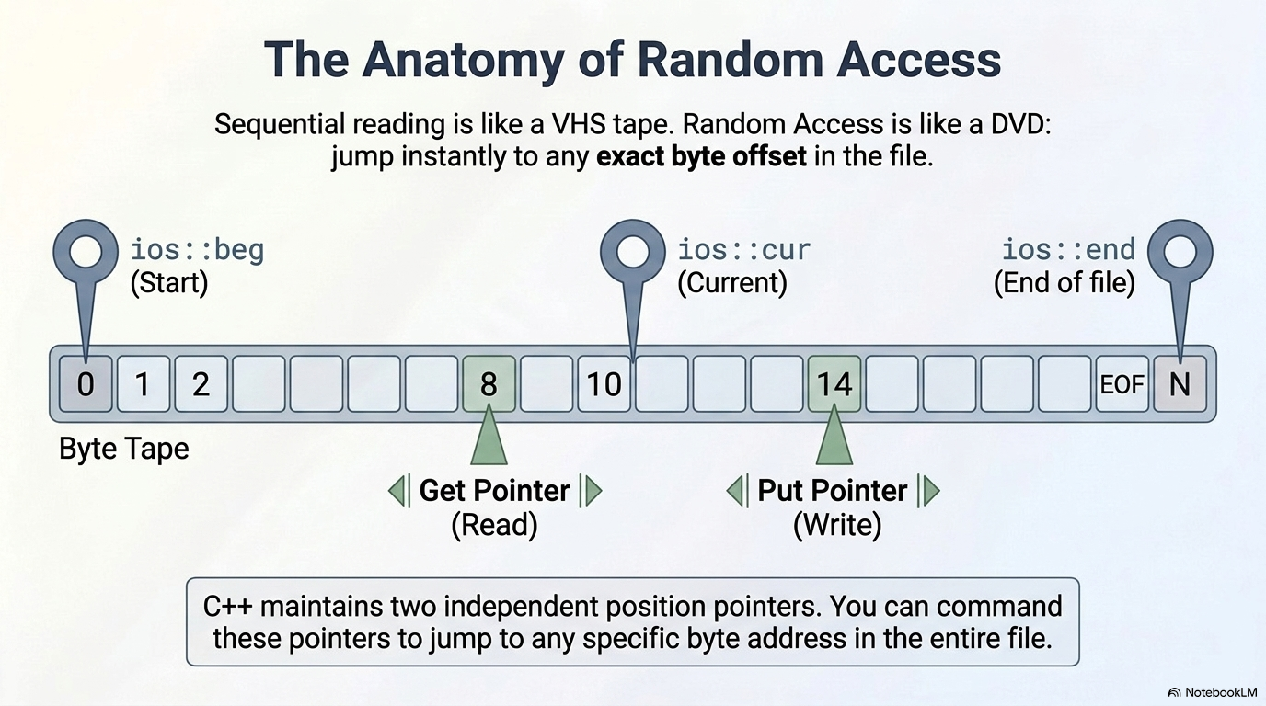

Slide 135
CHAPTER 11
Positioning the File Pointer
seekg() and seekp()
#include <iostream>
#include <fstream>
using namespace std;
int main() {
fstream file;
file.open("alphabet.txt", ios::in | ios::out);
file.seekg(4, ios::beg);
// -> jump the READ pointer to byte index 4
// (the 5th character, 0-indexed)
file.seekp(0, ios::beg);
// -> jump the WRITE pointer back to the start
file.seekg(-1, ios::cur);
// -> step the READ pointer 1 byte backwards
// from wherever it currently is
file.seekg(-2, ios::end);
// -> position READ pointer 2 bytes before EOF
}
Every open file keeps two internal position markers: a GET pointer (for reading) and a PUT pointer (for writing).
seekg(offset, direction) — moves the GET pointer. Think: “seek for get.”
seekp(offset, direction) — moves the PUT pointer. Think: “seek for put.”
direction is one of three anchors:
ios::beg — offset counted from the beginning of the file
ios::cur — offset counted from the CURRENT position
ios::end — offset counted backwards from the end of file
offset can be negative when combined with ios::cur or ios::end, to move backwards.
Notes:
tellg/tellp answer the question 'what page is my bookmark on right now?' from the library analogy — they never move anything, they only report. This pairs naturally with seekg/seekp: you typically tellg() to REMEMBER a spot, do something else, then seekg() back to it later; or you seekg(0, ios::end) purely to put the pointer somewhere useful and then tellg() to read off a byte count. Point out the classic file-size idiom in the code: since ios::end places the get-pointer exactly at end-of-file, calling tellg() immediately afterward yields the total size of the file in bytes — a very common technique before more convenient filesystem APIs existed, and still perfectly valid. Clarify the return type streampos — it behaves like an integer (can be printed, compared, subtracted) but technically also encodes state information; for teaching purposes at this level, treating it as 'a byte offset, essentially an int' is accurate enough. Mention that tellg() on a stream that has entered a fail state (e.g., after reading past end-of-file without clearing the error) returns -1, which is worth checking for in more defensive code.

Slide 136
CHAPTER 11
Unformatted I/O
Unformatted I/O transfers characters or blocks of data without performing the usual type-based formatting/conversion.
Common unformatted functions include:
get()
getline()
put()
read()
write()
peek()
ignore()
int main() {
iofstream file("student1.txt");
int age = 20;
double marks = 85.5;
string name = "Ram";
file << name << " " << age << " " << marks;
file.close();
return 0;
}

Slide 137
CHAPTER 11
get() - Find One character
int main() {
ifstream file("student.txt");
char ch;
while (file.get(ch)) { cout << ch; }
file.close();
}
put() - Write One character
int main() {
ifstream file("output.txt");
file.put('A’);
file.put('B’);
file.close();
}
getline() - Read an Entire Line
int main() {
ifstream file("student.txt");
string line;
getline(file, line);
cout << line;
file.close();
}
Notes:
tellg/tellp answer the question 'what page is my bookmark on right now?' from the library analogy — they never move anything, they only report. This pairs naturally with seekg/seekp: you typically tellg() to REMEMBER a spot, do something else, then seekg() back to it later; or you seekg(0, ios::end) purely to put the pointer somewhere useful and then tellg() to read off a byte count. Point out the classic file-size idiom in the code: since ios::end places the get-pointer exactly at end-of-file, calling tellg() immediately afterward yields the total size of the file in bytes — a very common technique before more convenient filesystem APIs existed, and still perfectly valid. Clarify the return type streampos — it behaves like an integer (can be printed, compared, subtracted) but technically also encodes state information; for teaching purposes at this level, treating it as 'a byte offset, essentially an int' is accurate enough. Mention that tellg() on a stream that has entered a fail state (e.g., after reading past end-of-file without clearing the error) returns -1, which is worth checking for in more defensive code.

Slide 138
CHAPTER 11
read() and write() - Block I/O
class Student{
public:
int id;
char name[20];
float marks;
};
int main()
{
Student s = {101, "Ram", 85.5};
ofstream file("student.dat", ios::binary);
file.write((char*)&s, sizeof(s));
file.close();
return 0;
}
These are especially important when dealing with binary files.
write() : Writes a block of bytes.
file.write((char*)&student, sizeof(student));
read() : Reads a block of bytes.
file.read((char*)&student, sizeof(student));
Notes:
tellg/tellp answer the question 'what page is my bookmark on right now?' from the library analogy — they never move anything, they only report. This pairs naturally with seekg/seekp: you typically tellg() to REMEMBER a spot, do something else, then seekg() back to it later; or you seekg(0, ios::end) purely to put the pointer somewhere useful and then tellg() to read off a byte count. Point out the classic file-size idiom in the code: since ios::end places the get-pointer exactly at end-of-file, calling tellg() immediately afterward yields the total size of the file in bytes — a very common technique before more convenient filesystem APIs existed, and still perfectly valid. Clarify the return type streampos — it behaves like an integer (can be printed, compared, subtracted) but technically also encodes state information; for teaching purposes at this level, treating it as 'a byte offset, essentially an int' is accurate enough. Mention that tellg() on a stream that has entered a fail state (e.g., after reading past end-of-file without clearing the error) returns -1, which is worth checking for in more defensive code.

Slide 139
CHAPTER 11
Writing/Reading a Whole Object (Binary)
#include <iostream>
#include <fstream>
using namespace std;
class Student {
int rollNo;
char name[30];
float marks;
public:
void getData() {
cout << "Roll, Name, Marks: ";
cin >> rollNo >> name >> marks;
}
void showData() {
cout << rollNo << "\t" << name << "\t" << marks << endl;
}
};
int main() {
Student s1;
s1.getData();
ofstream outFile("students.dat",ios::out | ios::binary);
outFile.write(reinterpret_cast<char*>(&s1), sizeof(Student));
outFile.close();
Student s2; // empty, untouched object
ifstream inFile("students.dat",ios::in | ios::binary);
inFile.read(reinterpret_cast<char*>(&s2),sizeof(Student));
inFile.close();
cout << "\nRead back from file:\n";
s2.showData();
return 0;
}

Slide 140
CHAPTER 11 — REVIEW
Practice & Exam-style Questions
Explain the different file opening modes in C++.
Explain seekg(), seekp(), tellg(), tellp() with an example.
How are class objects read from/written to files?
Differentiate ios::app and ios::ate.
📋 Probable Exam Question
Q1: Write a C++ program to read student records from a file, search by roll number, and display the result. Explain file pointer manipulation functions with examples. [PU Exam 2022]

Slide 141
Thank You

