Slide 1
Introduction to Cloud Computing
Prepared by Sethu Raj
05/19/2017

Slide 2
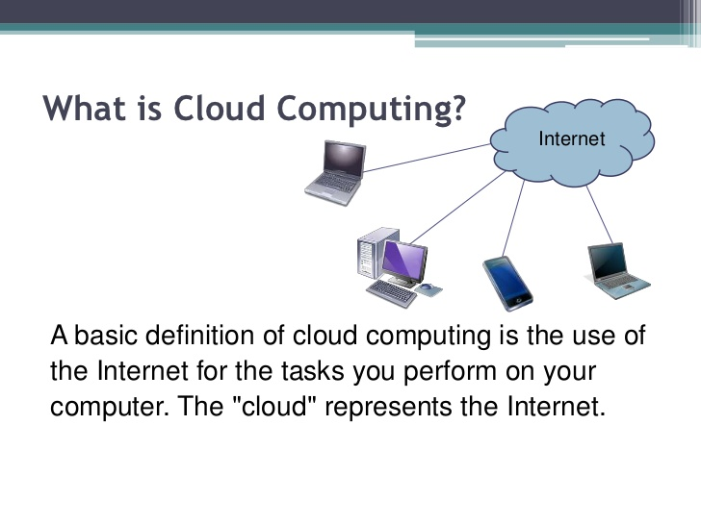
INTRODUCTION

Slide 3
Cont...
The term Cloud refers to a Network or Internet. In other words, we can say that Cloud is something, which is present at remote location.
Cloud can provide services over network, i.e., on public networks or on private networks, i.e., WAN, LAN or VPN.
Applications such as e-mail, web conferencing, customer relationship management (CRM), all run in cloud.
Cloud Computing refers to manipulating,configuring, and accessing the applications online. It offers online data storage, infrastructure and application.
Cloud Computing is both a combination of software and hardware based computing resources delivered as a network service.

Slide 4
Cont.…
In 2009, the availability of high-capacity networks, low-cost computers and storage devices as well as the widespread adoption of hardware virtualization, service-oriented architecture led to a growth in cloud computing.
In 2013, it was reported that cloud computing had become a highly demanded service or utility due to the advantages of high computing power, cheap cost of services, high performance, scalability, accessibility as well as availability.

Slide 5
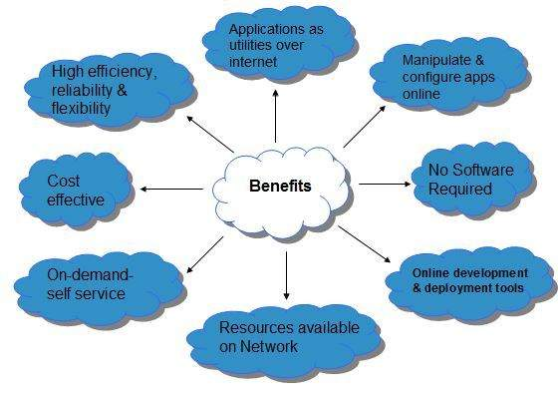
Why Cloud Computing

Slide 6
Architecture

Slide 7
Basic Concepts
There are certain services and models working behind the scene making the cloud computing feasible and accessible to end users. Following are the working models for cloud computing:
Deployment Models
Cloud hosting deployment models represent the exact category of cloud environment and are mainly distinguished by the proprietorship, size and access. It tells about the purpose and the nature of the cloud. Most of the organizations are willing to implement cloud as it reduces the capital expenditure and controls operating cost. In order to know which deployment model matches your website requirements it is necessary to know the four deployment models.

Slide 8
Deployment Model
Deployment models define the type of access to the cloud, i.e., how the cloud is located? Cloud can have any of the four types of access: Public, Private, Hybrid and Community.

Slide 9
PUBLIC CLOUD : The Public Cloud allows systems and services to be easily accessible to the general public. Public cloud may be less secure because of its openness, e.g., e-mail. PRIVATE CLOUD : The Private Cloud allows systems and services to be accessible within an organization. It offers increased security because of its private nature. COMMUNITY CLOUD : The Community Cloud allows systems and services to be accessible by group of organizations. HYBRID CLOUD : The Hybrid Cloud is mixture of public and private cloud. However, the critical activities are performed using private cloud while the non-critical activities are performed using public cloud.

Slide 10
Service Models
Service Models are the reference models on which the Cloud Computing is based. Though service-oriented architecture advocates "everything as a service" cloud-computing providers offer their "services" according to different models, of which the three standard models .
These can be categorized into three basic service models as listed below:
Infrastructure as a Service (IaaS)
Platform as a Service (PaaS)
Software as a Service (SaaS)

Slide 11
Cloud Service Models - Definition
Software as a Service (SaaS)
Platform as a Service (PaaS)
Infrastructure as a Service (IaaS)
IaaS is the delivery of technology infrastructure as an on demand scalable service.
PaaS provides all of the facilities required to support the complete life cycle of building and delivering web applications and services entirely from the Internet.
SaaS is a software delivery methodology that provides licensed multi-tenant access to software and its functions remotely as a Web-based service.

Slide 12
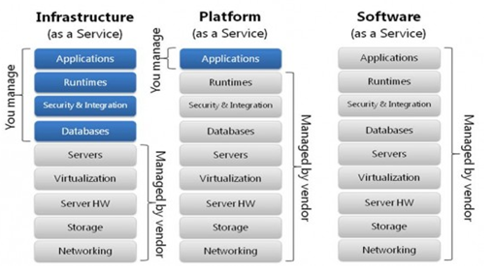

Slide 13
Cloud Service models - Characteristics
Software as a Service (SaaS)
Platform as a Service (PaaS)
Infrastructure as a Service (IaaS)
Offers full control of a company’s infrastructure; not confined to applications or restrictive instances
Highly scalable; multi-tier architecture; Multi tenant environments
Scalable; Multi-tenant; Metadata driven configurability
Sometimes free; easy to use; good consumer adoption; proven business models
Developers can upload a configured applications and it “runs” within the platform’s framework
Sometimes comes with a price premium; can be complex to build, manage and maintain

Slide 14
Cloud Service models - Containing
Software as a Service (SaaS)
Platform as a Service (PaaS)
Infrastructure as a Service (IaaS)
Email
Business Processes
Industry Applications
CRM/ERP/HR
Middleware
Web 2.0 Application Runtime
Development Tooling
Database
Java Runtime
Servers
Networking
Storage
Data Center Fabric
Firewalls, load balancers

Slide 15
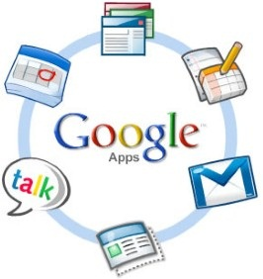
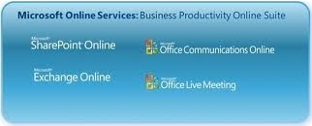








Cloud Service models - Examples
Software as a Service (SaaS)
Platform as a Service (PaaS)
Infrastructure as a Service (IaaS)

Slide 16
Disadvantages of Cloud Computing
Downtime
Security & Privacy
Vulnerability to attack
Vendor Lock IN
Limited Control & flexibility

Slide 17
Reference
https://en.wikipedia.org/wiki/Cloud_computing
http://www.tutorialspoint.com/cloud_computing/
Also in linked IN slide share there are very good articles on Cloud computing which are worth
reading .
https://www.slideshare.net/search/slideshow?searchfrom=header&q=introduction+to+cloud+computing

Slide 18
Thank You!

