Slide 1


Research Methodology
Ch1
Ch2
Ch3
Ch4
Ch5
Ch6
Welcome
Lit. Review
Methodology
Design
Results
Introduction & Conclusions
Findings
3rd part of the guided research track (GRT)
Experiment
RRSG Seminar
Prepared by Dr. Simon Winberg
Objective
Notes:
This presentation was prepared for the ‘guided research track’ (GRT) for new grad students

Slide 2
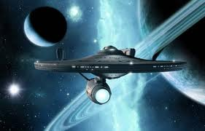
Q: What is Research?
Before explaining the concept of a research methodology… consider:
A:
Discovering new things *
Reporting on the discoveries
Building on knowledge and facts that have been independently verified by other professionals
Research: noun. “Studious inquiry or examination; especially investigation or experimentation aimed at the discovery and interpretation of facts, revision of accepted theories or laws in the light of new facts, or practical application of such new or revised theories or laws” -- Merriam-Webster’s Dictionary 2011
Discovering new things
* Discovering new things for yourself; applying existing techniques (BSc level). Handing a complex problem & tools (MSc level). Discovering new things for the world at large (PhD level).
Ideally “to go where no one has gone before” – but that’s usually only in the area of PhD.

Slide 3
What is a Research Methodology?
It explains how you are going to do the research
Research Methodology:
“A documented process for management of projects that contains procedures, definitions and explanations of techniques used to collect, store, analyze and present information as part of a research process in a given discipline.”*
* Source: http://en.wikipedia.org/wiki/Research_methodology

Slide 4

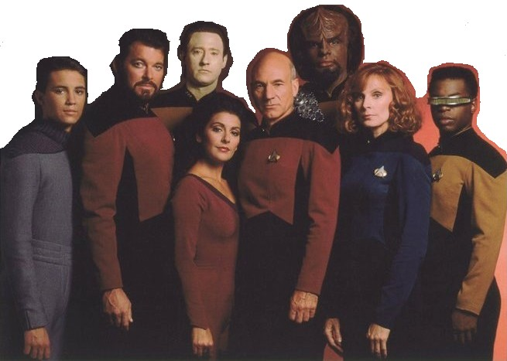

Becoming Part of a Research Community
Some communities
RRSG 4th years
RRSG postgrads
UCT EE Dept.
Societies IEEE etc.
Members of a ‘research community’…
Practitioners at large
Use the same language and terminology
Use the ‘scientific method’ in doing research
Contribute to the community in an open and explanatory manner
Adhere to similar ethical principles
Acknowledge work of others
The active & established crowd
The old guard &
founders
The newbie (you) who needs to prove himself building on what the community has already done
These young whippersnappers still using my ideas!

Slide 5
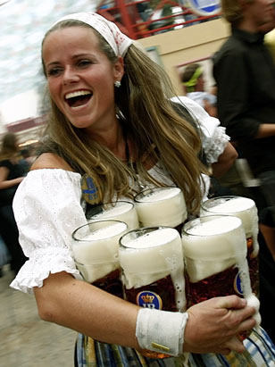
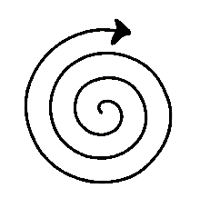
Stages in the Research Process
START
Define the
Problem
Celebrate!
Prost und
Glückwunsch
…
Planning a
Research Design
Reporting results and
conclusions
Planning the
Experiment or the
Event(s) to Sample
i.e. similarities to Boehm [1988] classic spiral model
Process and
Analyse Data
Building things,
Setup experiments
(if needed)
Gather Data

Slide 6

Documenting the Methodology
Outline
Phases / steps to be taken
Things to setup and/or build
Experiment(s)
Data Collection methods
Analysis and interpretation method

Slide 7
Outline section of Methodology
Clarify the issue to be researched
Indicate research method(s) to employ
Phases of the research project
Overview diagram ← some examples follow
Proceed with further sections for the details of the various phases (each might make use of further methods)

Slide 8
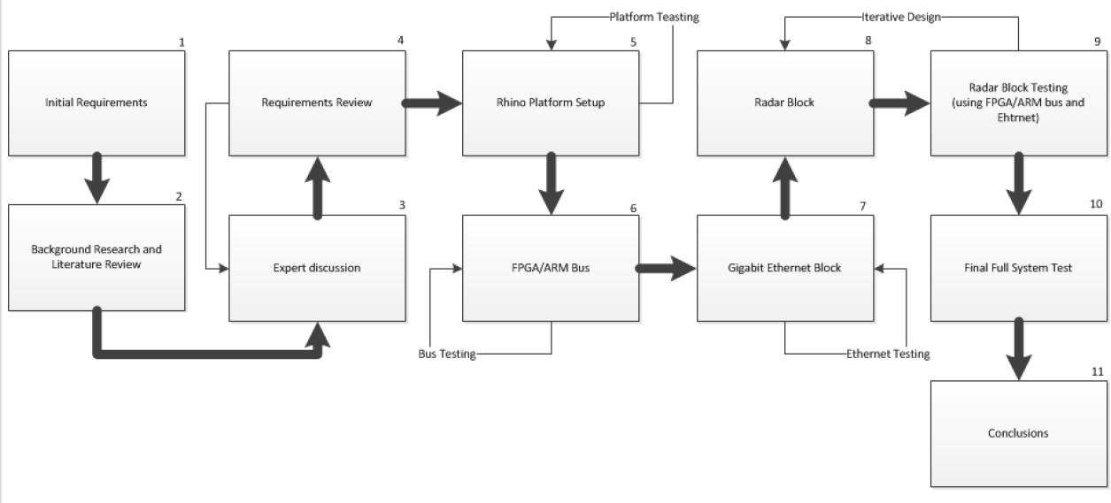
Example methodology overview diagram
Note things like: numbering the phases, arrows showing dependencies / sequencing, etc.
(This particular project had 11 phases – too many and too much detail for a BSc project)

Slide 9
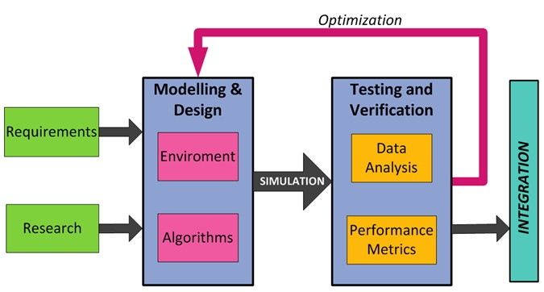
Ex. methodology overview diagram
(1)
Literature
Research
(2)
(5)
(3)
(4)
Note things like: This gives a clear view summarizing the research activities done.
Text explaining the image then goes on to highlight particular aspects/phases using the numbers

Slide 10
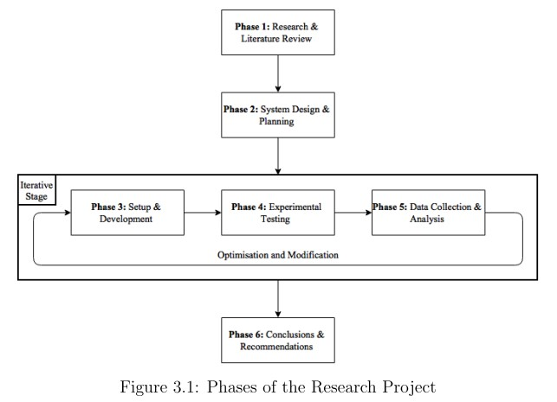
Example methodology overview diagram
Excerpt from BSc Thesis by Alexander Cohen, October 2015

Slide 11
Brief View and Recap of process models…
GRT

Slide 12
Process Models
Spiral Model
Waterfall Model
V-Model
A process model helps in planning the methodology for your project, the major phases of the project and considering the linkages between the different phases.
We recommend considering the V-Model which has a tight connection between design stages and validation stages.

Slide 13
Spiral Model
Also known as the Boehm’s Spiral Model, Introduced by Boehm 1988
The development process is viewed as a series of iterative cycles
Good model to use for prototyping.
As you progress outwards from the origin of the spiral, the system becomes progressively more complete
Sequence of repeated activities for each quadrant that the spiral traverses (see next slide)
After sufficiently many cycles the objective (final version) of the project is reached

Slide 14
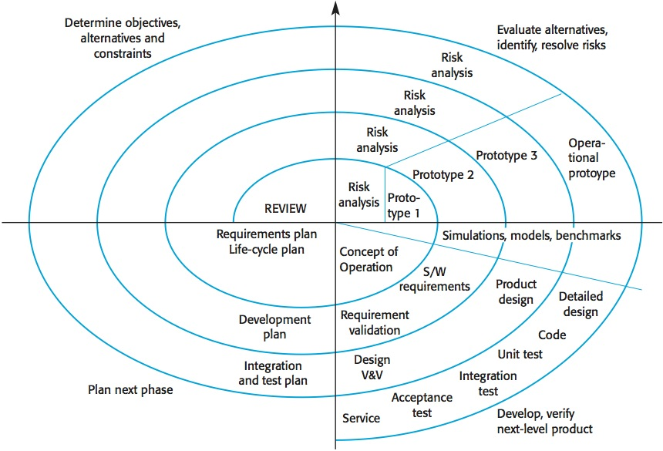
Spiral Model
Image Source: http://iansommerville.com/software-engineering-book/files/2014/07/Spiral-model.jpg

Slide 15
Waterfall Model
The waterfall model by Royce 1970. Also called “Classic Life Cycle model”
A progression of 7 phases of a transformation-based life cycle for the product developed
Shows a sequence of major stages carried out during a development process

Slide 16
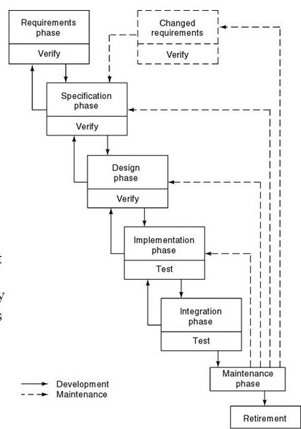
Waterfall Model
Characteristics of Waterfall model:
Sequence of phases from requirements to retirement
Feedback loops showing maintenance activities and phases repeated
Sequential operation and completion of each phase before the next one starts generally not possible, mainly overlay of the general progression.

Slide 17
V-Model
A systems engineering development model that connects
design stages with validation (or process checking) stages.

Slide 18
V-Model
The V-Model can be considered a variation of the Waterfall model – Waterfall is “pulled” to a ‘V’ at implementation phase
Viewed as several horizontal process layers
Each phase, except for implementation, has process checking mechanisms (horizontal connections between the sides of the V)
Detailed design validated by unit/module tests
High level design validated by component integration test

Slide 19
V-Model
Each layer of the V:
A level of abstraction
With three process partitions, each one represents a class of project activity…
Classes of project activity (which should technically be documented):
Creation
Evaluation
Operation

Slide 20
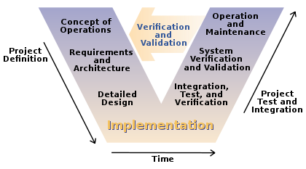
V-Model
https://en.wikipedia.org/wiki/V-Model

Slide 21
Main principals in documenting the methodology for your project
GRT

Slide 22

Explaining the Phases / Steps
Breaking things down, done in sequence of steps
Elaborate what each step involves
Each step might address one particular sub-objective or research question
And don’t forget to…
Keep your eye on the ball objectives
connect with the objectives & requirements described in the introduction

Slide 23
Things to set up
(Development Environment / Test Environment)
Examples:
Explaining what the simulation environment comprises and how it is set up
Describing what measurement instrumentation is needed, and how it is connected up
etc.

Slide 24
Things to build
(things needed to carry out the experiments)
Most (all!?) of the projects involve building something
In this part you’d outline steps on what is to be build, but you don’t go into design details – put all the design details into the Design chapter

Slide 25
Experiments
What tests are going to be done
These should focus on investigating or testing your research questions/hypotheses
(not discussing tests of the software or devices built to do testing of the hypotheses – unless the main research focus is on building the device)

Slide 26

Data Collection
But what is DATA?
It is a term that has existed for a long time…
For much longer than computers have been about.
The term has sometimes been abused in the context
of computers and programming.

Slide 27

The Data – Information – Knowledge (D-I-K) Hierarchy
Knowledge is information
combined with understanding
I have a credit balance so I can withdraw cash
Knowledge
and capability:
John uses his understanding of
bank statements, to interpret
.
the information contained in the
document, thereby deciding an
action to perform.
John
A Bank
Information is data in context:
Statement for 04/06
The numbers are put into
Account: 1234567
labeled columns. A heading
debit
credit
balance
Information
is provided according to the
context. Additional data is
$0
$0
$50
added relating to the context
$0
$100
$150
concerned, such as the bank
name, date and account
$20
$0
$130
number.
$10
$0
$120
Data exists:
20
0
50
Twelve numbers exist, ranging
Data
from 0 to 150.
0
10
150
0
130
0
‘Data’ is typically considered a plural noun by researchers as it should exist in copious amounts. One datum is an individual element of data (i.e. in isolation from its body of data).
120
0
100
Based on theories presented by: Groff, T. & Jones, T. [2003]. Introduction to knowledge management: KM in business. Amsterdam, The Netherlands: Butterworth-Heinemann.

Slide 28


Data Collection
Data are needed to prepare information used to build knowledge about the research focus
The data provide recorded samples of events that occurred in the experiment
The data are analyzed to make (evidence-based) conclusions about the research questions
This section of the Methodology Chapter explains how are you will obtain and then record data from experiments
Experiment
Data Collection
(sometimes data collection details might be better explained as part of the experiment description; but there should be a distinction between what is experiment procedures and

Slide 29

Data Analysis
I love to draw graphs. Says so on my facebook profile.
What is done to make sense of the data
How the data is analysed to
Produce results, Make decisions, and Answer questions
This section should explain how you represent the data as useful information that can be later interpreted to make decisions about the research objectives
Note: The way you interpret the graphs and other tools used to make sense of the data goes into the discussion of the Results and the Conclusion chapters (the Conclusion often explains how you broadly interpret the various lower-level results in the results section).

Slide 30
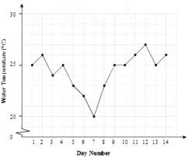
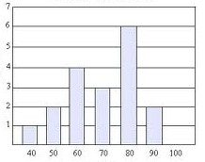
Where Data Analysis Fits In
OBJECTIVE
… experiment plans etc …
DATA CAPTURE
Conclusions and decisions about the objectives
FINDINGS & CONCLUSIONS
DATA
Interpretation of results
DATA ANALYSIS
RESULTS

Slide 31
Planning your report to an academic journal/conference paper
There is much scope for turning your BSc report into a journal/conference paper
This does depends on the topic, novelty and aspects of experiments and investigations done
It helps to plan the methodology and the writing of the report accordingly
Methodology is an important aspect of an academic papers, explaining how the investigation is carried out
Where could one send such a paper?..

Slide 32
Where BSc projects could be published
IEEE Potentials
This is an IEEE society magazine tailored towards undergraduate students and young researchers
https://www.ieee.org/membership_services/membership/students/potentials.html
Conferences
Local ones such as SAICSIT
Regular track, or some have student papers track
Local or international journals such as ones listed on the DHET
Open Access journals
Directory of Open Access Journals (DOAJ)
But some are not free to submit to

Slide 33
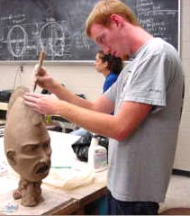
Conclusions
The methodology is the way you are performing your research
It should be done after an initial literature review so that you
Understand the practices and expectations of the ‘research community’
Have an inkling of what has been done and what to built upon
The methodology strongly influences project planning, therefore it is good to make a start on the methodology before getting too engrossed with the implementation and experimentation details
The methodology is typically honed and reworked throughout the research project (first attempt rarely what you actually need)
method

Slide 34
Checklist for methodology (ch3)
Did you remind the reader about previous chapter and prepare/tell them about this chapter?
Did you explain the methodology (diagrams are useful!) & motivate the approach followed (reference the literature)
Did you explain and motivate for site selection, tools, experiments, etc.
Did you explain and motivate for data collection methods/instruments?
Did you explain and motivate for data analysis methods?
Did you explain any ethical issues?
Did you summarize the methods (a table is useful – see next slide!)
Did you prepare the reader/examiner for the next chapter?
Note: this chapter usually has lots of appendices: permissions letters, sample questionnaires, interview schedules, etc.

Slide 35
Research methodology (summary table)
Research question/sub-problem 1 | Site/ participant selection | Data collection methods | Data analysis methods | Appendix reference
Research question/sub-problem 1 | Site/ participant selection | Data collection methods | Data analysis methods | Appendix reference
Research question/sub-problem 1 | Site/ participant selection | Data collection methods | Data analysis methods | Appendix reference
Note that your questions / sub-questions need to correspond back to the introductions where you initially presented the objectives, research questions, etc.

Slide 36

Now over to you

Slide 37
ELO Forms
Now over to you
Peer Review of ELO forms
Suggested order of doing the ELOS:
Repeat:
1. Select next ELO
2. Swap forms;
2. Read over colleague's input;
3. Swap forms;
4. Discuss your entry with one another;
Supervisors will come round to discuss, approve & offer suggestions
ELO2
ELO10
ELO8
ELO6
ELO4*
* Probably can only Finish ELO4 later After the main design phase is done

Slide 38

Assignment
Prepare an outline of your research methodology
A one page (minimum) description
Can be entirely point form
Can include (rough) figures to illustrate your methodology

Slide 39

Ch1
Ch2
Ch3
Ch4
Ch5
Ch6
Welcome
Lit. Review
Methodology
Design
Results
Introduction & Conclusions
Questions?

