Slide 1
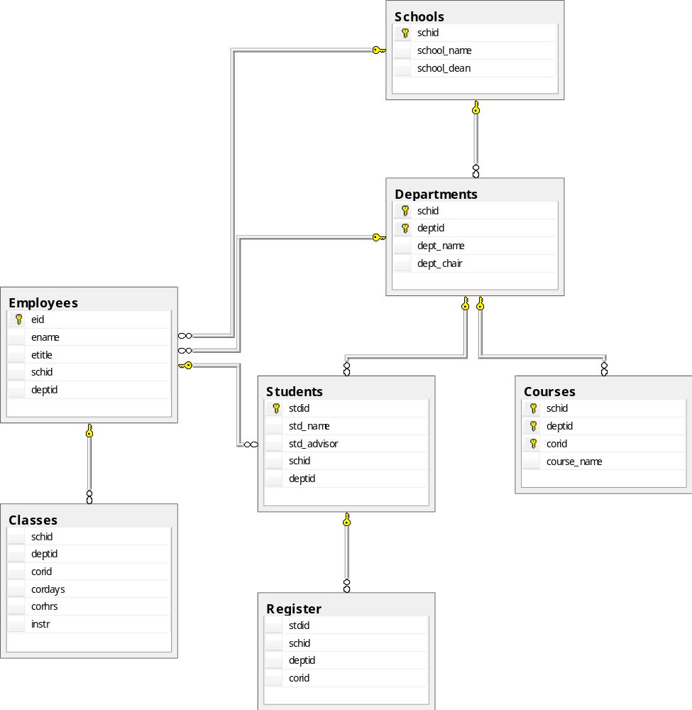
Digital Community College DB Diagram

