Slide 1
Azure Governance Challenge Workshop

Slide 2
Agenda
9 – 9:30 AM: Kickoff & Introductions
9:30 – 10:15 AM: Azure Governance Overview Presentation
10:15 - 10:30 AM: Break
10:30 – 11:30 AM: Management Groups and RBAC Challenge
11:30 AM – Noon: Azure Policy Challenge
Noon – 1 PM: Lunch
1 – 2 PM: Azure Policy Challenge (continued)
2 – 3 PM Azure Blueprint Challenge
3 – 3:15 PM: Break
3:15 – 4 PM Azure Cost Management Challenge
4 – 4:45 PM Azure Resource Graph Challenge
4:45 - 5 PM: Wrap up

Slide 3
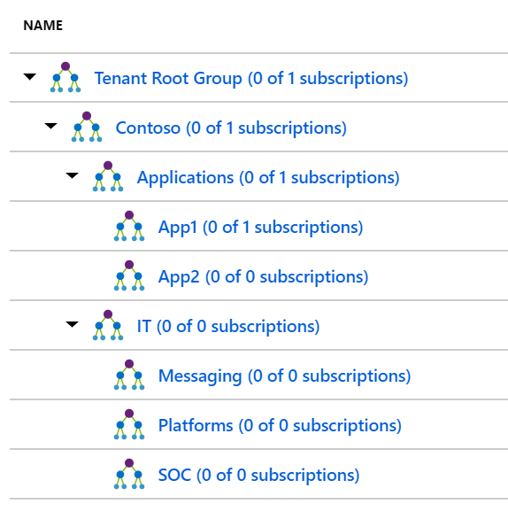
Management Groups and RBAC Challenge
Create a Management Group org structure that matches the sample on the slide
Create an AD User called App1User1 and a make them a member of then a Group called App1DevAccess
Grant the Group Website Contributor Access only at the App1 Management group level
Create a custom role at the subscription level that grants all permissions to Resource Group and assign the custom role to the group App1DevAccess
Log in to the Azure portal as App1User1 and create a resource group call rgroletest
First team to send me a screen shot of the newly created resource group from the App1User1 login and the App1User1 assignments wins the challenge!!
Good luck!

Slide 4
Azure Policy Challenge
Assign the Audit VMs that do not use managed disks policy at the Contoso Management Group Level
First team to email me a screenshot of the breakdown of VMs for the “Audit VMs that do not use managed disks” compliance wins part 1!!
Create a custom policy that denies the users ability to deploy G series VM SKU at the Applications Management Group Level
The policy rules/conditions, in this case – VM SKU size equal to G series
The policy effect, in this case – Deny.
Attempt to deploy a G series VM and find the deployment error in the Azure Activity Log Hint: try to do the deployment in US East 2
First team to email me a screenshot of the Azure Activity Log with the Deployment message that calls out a failure do to Azure Policy wins the challenge
Good luck!

Slide 5
Azure Blueprints Challenge
Create a Blueprint in the Contoso Management Group that has the following Artifacts (dynamic):
Role assignment for Contributor
Policy Assignment for ‘Apply tag and its default value to resource group’
Resource Group
Azure Resource Management Template for StorageAccount Note: Json for template is in the notes on this slide
It should look like the screenshot on the next slide
Add a description, publish and assign this Blueprint to the Free Trial Subscription. Make sure to use the App1DevAccess Group for role assignment Contributor. Set Tag Name to CostCenter and Tag Value to ContosoIT.
First person to send me a screen shot of the deployed resources wins the challenge
Notes:
{ "$schema": "https://schema.management.azure.com/schemas/2015-01-01/deploymentTemplate.json#", "contentVersion": "1.0.0.0", "parameters": { "storageAccountType": { "type": "string", "defaultValue": "Standard_LRS", "allowedValues": [ "Standard_LRS", "Standard_GRS", "Standard_ZRS", "Premium_LRS" ], "metadata": { "description": "Storage Account type" } } }, "variables": { "storageAccountName": "[concat(uniquestring(resourceGroup().id), 'standardsa')]" }, "resources": [{ "type": "Microsoft.Storage/storageAccounts", "name": "[variables('storageAccountName')]", "apiVersion": "2016-01-01", "location": "[resourceGroup().location]", "sku": { "name": "[parameters('storageAccountType')]" }, "kind": "Storage", "properties": {} }], "outputs": { "storageAccountName": { "type": "string", "value": "[variables('storageAccountName')]" } } }

Slide 6
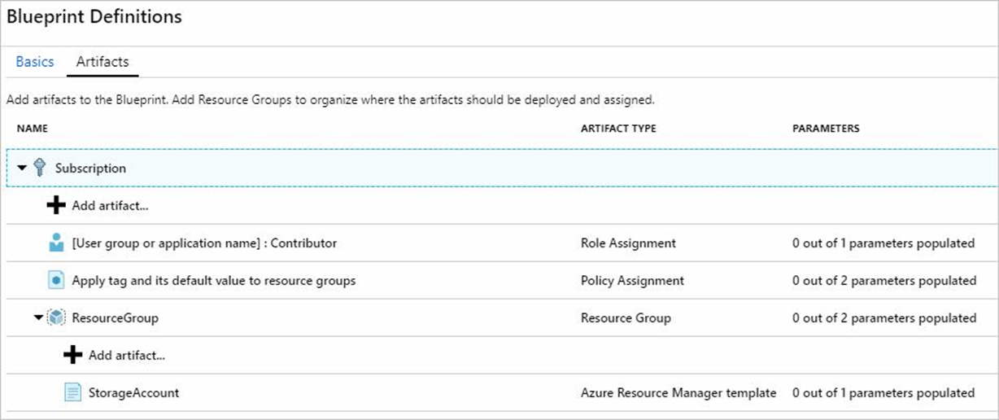
Blueprint Challenge Screenshot

Slide 7
Cost Management Challenge
Create a Monthly Cost report to determine which Resource type is costing the most
Create a monthly budget of $200 per month, set an alert when it reached 75% of budget, add an email address
Create an CSV export for the “Quarterly Cost by resource" for the Free Trial Subscription
First person to email me the quarterly report wins the challenge. Good luck

Slide 8
Resource Graph Challenge
Using Resource Graph Explorer (preview)
List out a summery count of resources
List out all resources and only show name, type and location. Sort by name in ascending order
List the distinct values of compute size in the Free Trial Subscription
First Team to email me a screenshot of the distinct values wins the challenge. Good luck

