Slide 1

Twitter Sentiment Analysis
Final Capstone Project
Thinkful
Kristof Csaba

Slide 2
Sentiment analysis
Rule-based sentiment analysis
Monitoring public opinion
Detecting emotions from text
Notes:
Sentiment Analysis is the process of determining whether a piece of writing is positive, negative or neutral. A sentiment analysis system for text analysis combines natural language processing (NLP) and machine learning techniques to assign weighted sentiment scores to the entities, topics, themes and categories within a sentence or phrase
Sentiment analysis is extremely useful in social media monitoring as it allows us to gain an overview of the wider public opinion behind certain topics. ... Being able to quickly see the sentiment behind everything from forum posts to news articles means being better able to strategise and plan for the future

Slide 3
Twitter
How does Twitter work?
How can Twitter be used to improve businesses?
Notes:
Twitter is a social media and online news platform where people communicate in short messages – up to 240 characters long – called tweets
\With the right marketing plan, businesses can use this platform to create successful social media campaigns to increase sales, boost brand recognition and increase customer service

Slide 4

Positive and negative feedback
Notes:
Positive feedback indicates the things that the company does well and should be used to improve operations.
On the other hand, negative feedback in a customer service setting can help the company to understand shortcomings in the product development, the customer service process and the marketing.

Slide 5
Dataset
Found on Kaggle
Dates
4 major tech company
Has over 5000 tweets
Notes:
I found this data frame on Kaggle for this project it is an ideal dataset since it has already been labeled for sentiments,
#and the tweets are about tech Companies

Slide 6
Data cleaning
Removing irrelevant tweets
Applied NLTK
Created functions
Notes:
Orginally the dataset had about 1000 tweets labeled irrelevant, which only meant they were written in Spanish so I just filtered the dataframe to remove those irrelevant tweets
I used natural langulet toolkit to remove stopwords and removie mentions
and finally I created functions for stemming, and normalization

Slide 7
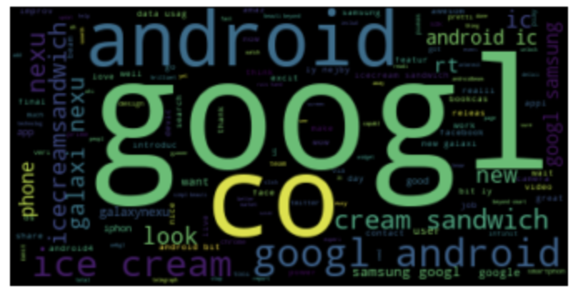
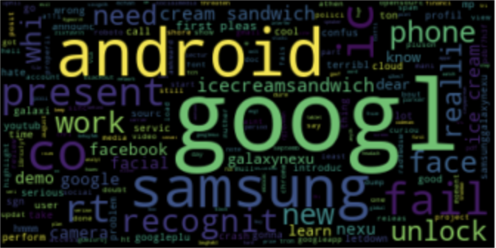
Data exploration
Positive
Negative
Created two WordClouds
Notes:
First I created a filtered dataframe , I filetered the positive sentimetns and google company from the alredy cleaned dataset, then I put the new df into a list with tolist() function, then I saved that into a new variable, then I joined all the text with the .join function and then just put that into a wordcluod , and then generated the wordcloud, then I did the same with google negative feedbacks as well
a visual representation of a text, in which the words appear bigger the more often they are mentioned. Word clouds are great for visualizing unstructured text data and getting insights on trends and patterns. Both os these wordcluods were filtered for google, one of them is positive and negative feedbacks.

Slide 8
Data engineering
Train test split
TfidfVectorizer
Notes:
Before I started any vectorization split my dataset into traingn and test.
TFIDF transforms text to feature vectors that can be used as input to estimator
Relative to the dataset how important each individual word is, more frequently mentioned words have greater weights

Slide 9
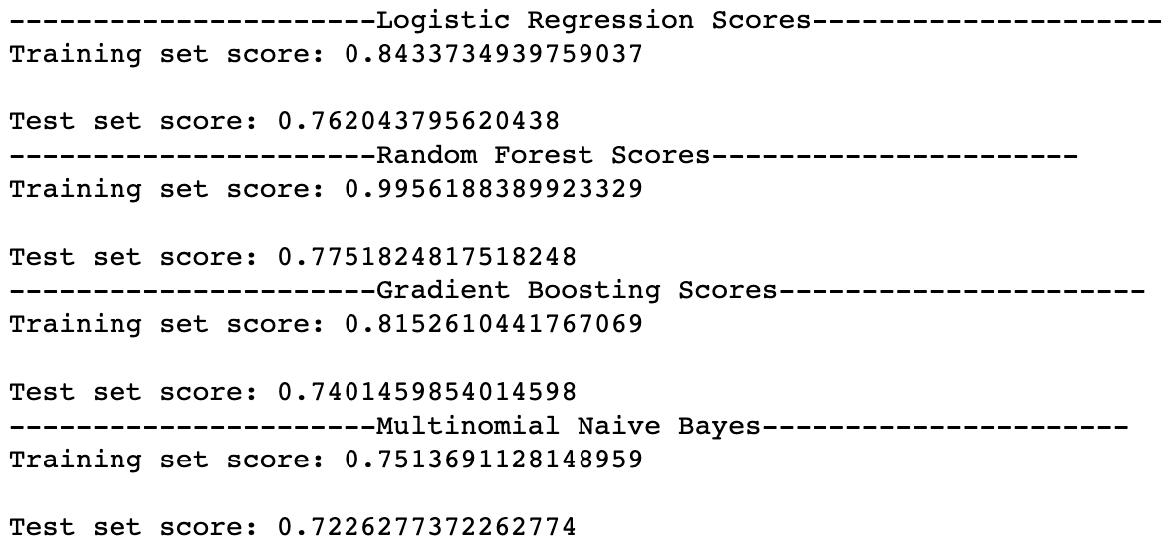
Applying machine learning models
Multiclassification task
Notes:
Bias and variance tradeoff

Slide 10

Evaluating the models
Determine business goal
Plotting confusion matrix
Print classification report
Notes:
In this case, you probably want to make sure that your classifier has high recall, so that as many diabetics as possible are correctly detected. Take another example — say you are building a video recommendation system, and your classifier predicts Positive for a relevant video and Negative for non-relevant video. You want to make sure that almost all of the recommended videos are relevant to the user, so you want high precision.
# The goal is to find the model which produces the highest precision at postive and negative feedback,
# beacuse we want to identify as much potiive and negative feedbacks as possible. The reason for that
# we want to identify positive and negative beacause they can help organizations to understand what their customer
# want and need.

Slide 11
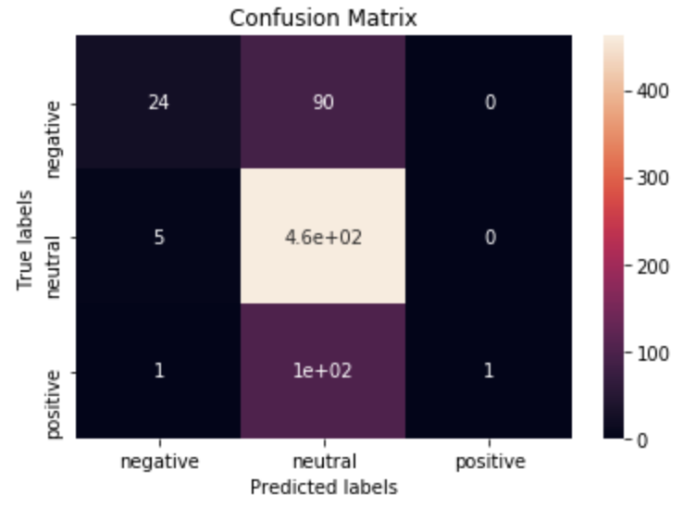
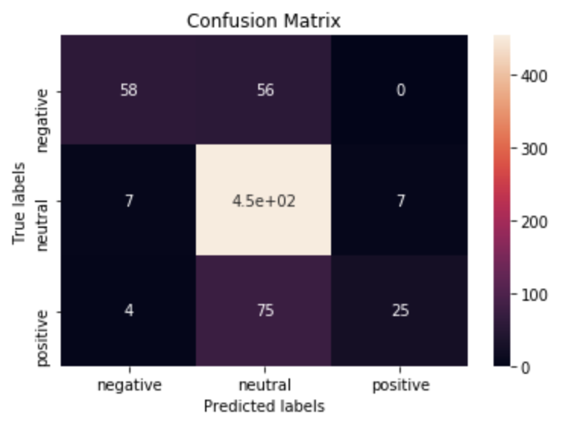
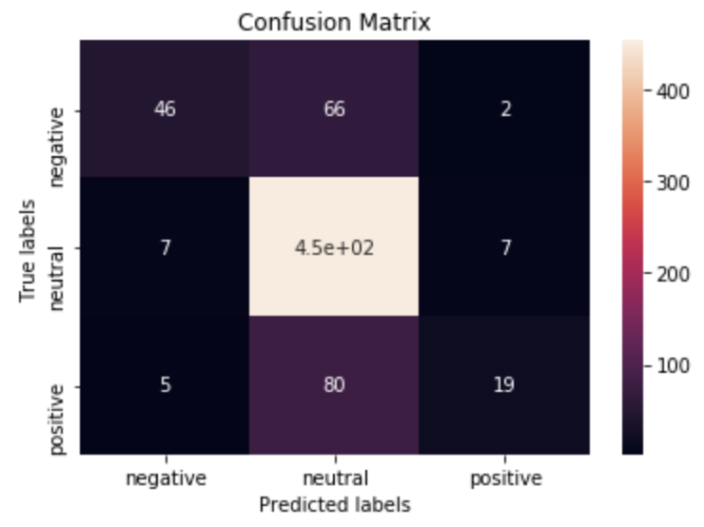
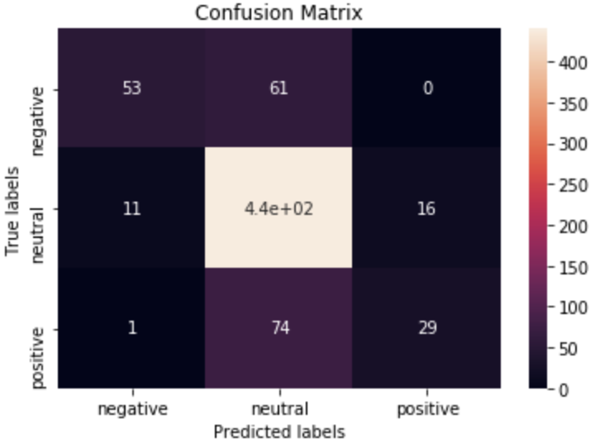
Confusion Matrixes
Logistic Regression
Random Forest Classifier
Gradient Boosting
Multinomial Naïve Bayes

Slide 12
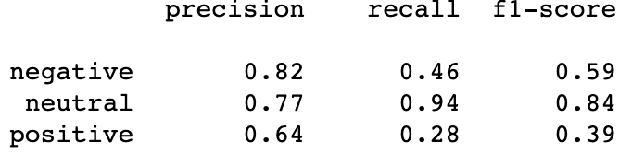
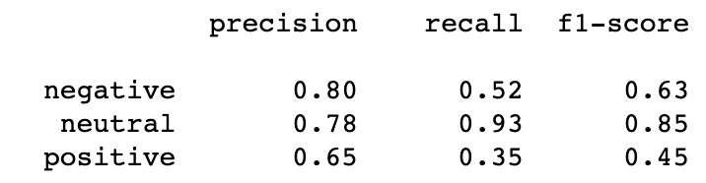
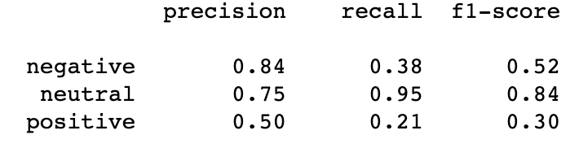
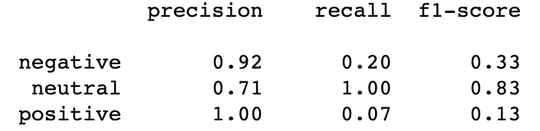
Classification reports
Logistic Regression
Random Forest Classifier
Gradient Boosting
Multinomial Naïve Bayes

Slide 13
Applications
Create a web-application
Get insights about products and companies from customers
Use results to increase productivity

Slide 14

limitations
Certain words may create noise in data
Notes:
What I mean by this is that looking at the google example, both negative and positive feedbacks had google as the most frequently used word. One way to address this problem is wordcloud once we learn that the most frequently used words are identical in both negative and positive feedbacks, we can remove those words from the data

Slide 15
Future research
Spanish text
Time

Slide 16

Conclusion
Utilizing sentiment analysis to gain insights about customer feedbacks
Marketing analysts can use this tool to increase productivity
Potentially can lead to discover new trends

Slide 17

Any question?

Slide 18

Thank you for your time!

