Slide 1

Image Captioning Using Deep Learning: A Comparative Study of Vanilla, Attention, and Transformer Models

Slide 2
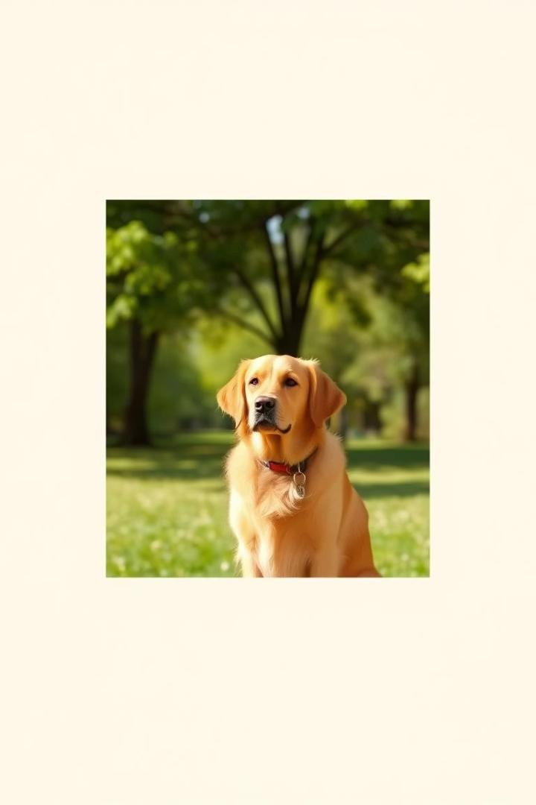
Introduction & Objectives
Image Captioning
Applications
Generate descriptive sentences for images using AI
Accessibility, AI assistants, content analysis
Objective
Compare Vanilla, Attention, and Transformer-based models

Slide 3
Dataset & Preprocessing
Dataset
Image Processing
Flickr8k with diverse natural images
Feature extraction via CNN (e.g., ResNet)
Text Processing
Encodes visual content into vectors
Tokenization
Vocabulary building
Start/end tokens and padding

Slide 4
Model 1 – Vanilla Encoder-Decoder
Architecture
Limitations
CNN extracts fixed feature vector
Fixed context vector limits flexibility
RNN decoder generates caption
No capacity to focus dynamically on image parts
Uses static word embeddings
Lower accuracy and explainability

Slide 5
Model 2 – Attention-Based Decoder
Enhancements
Benefits
Bahdanau attention mechanism
Improved caption accuracy
Focus shifts to relevant image parts
Better interpretability and explainability

Slide 6




Model 3 – Transformer Decoder (Self-Attention)
CNN Encoder
Extracts image features
Positional Encoding
Injects word order information
Multi-head Attention
Captures long dependencies efficiently
Advantages: parallel training, better sequence modeling

Slide 7
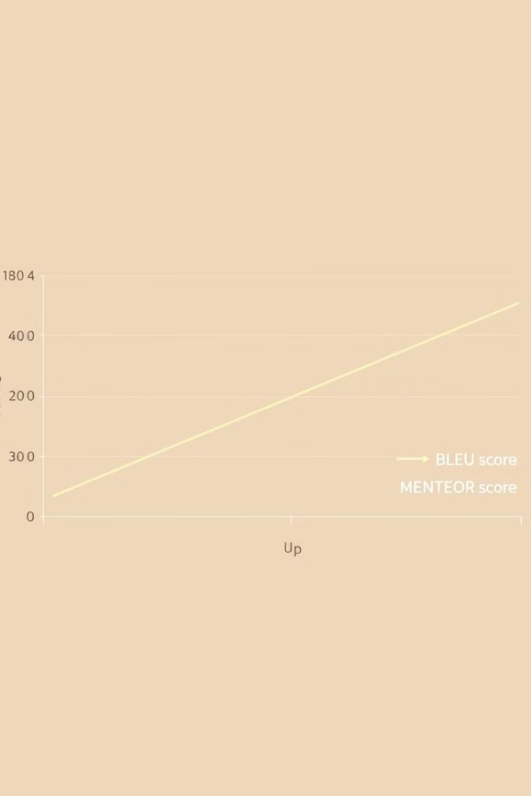
Results & Evaluation
0.65
0.42
BLEU Score
METEOR Score
Measures n-gram overlap with references
Evaluates alignment and synonyms
0.58
Transformer Best
Highest scores among models

Slide 8
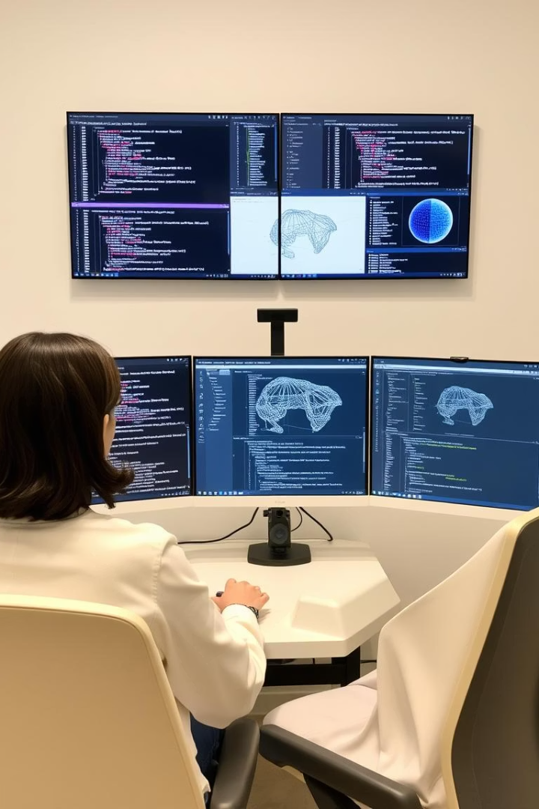
Summary & Next Steps
Vanilla Model
Simple but limited context handling
Attention Model
Dynamic focus improves captions
Transformer Model
Best performance; supports parallelism
Future Work
Explore multimodal transformers, larger datasets

