Slide 1
Cyber Crime Investigation
Group8
Team Members:
- Srividya Kuppa - Kiran Shettar - Syed Raihan

Slide 2
OverView:
Getting access to VM’s
Connecting to Database (PostgreSQL)
Attacking Methods
Detections
Remote logging
Link for demo (Website)

Slide 3
How we got into our VM?
Logged into putty software
ssh to cs_username@mercury.cs.uml.edu gateway
ssh to –p 5300 student@cs.uml.edu gateway
ssh to root@KaliX gateway
ssh to metasexploitX (version2) gateway
We have used both vi and nano editors

Slide 4
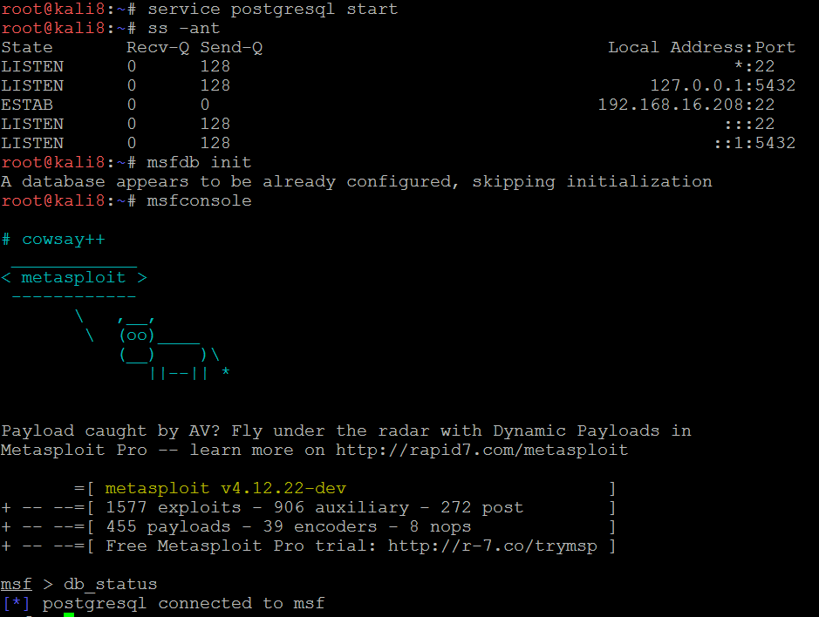
Connecting to database
Metasploit uses PostgreSQL as it’s database which has to be launched initially
COMMANDS: > service postgresql start > ss -ant
Now we make sure that port 5432 is listening
Initialise the Metasploit PostgreSQL Database
Verify database connectivity using the command below
msf > db_status

Slide 5
ATTACKING METHODS
irc – use exploit/unix/irc/unreal_ircd_3281_backdoor
ftp – use exploit/unix/ftp/vsftpd_234_backdoor
misc – use exploit/linux/misc/drb_remote_codeexec
misc – use exploit/linux/misc/distcc_exec
smb – use auxiliary/admin/smb/samba_symlink_traversal
http – use exploit/multi/http/php_cgi_arg_injection

Slide 6
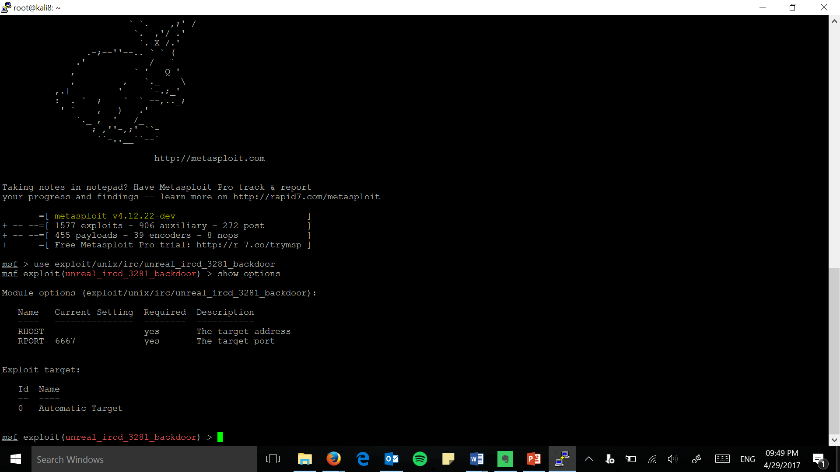
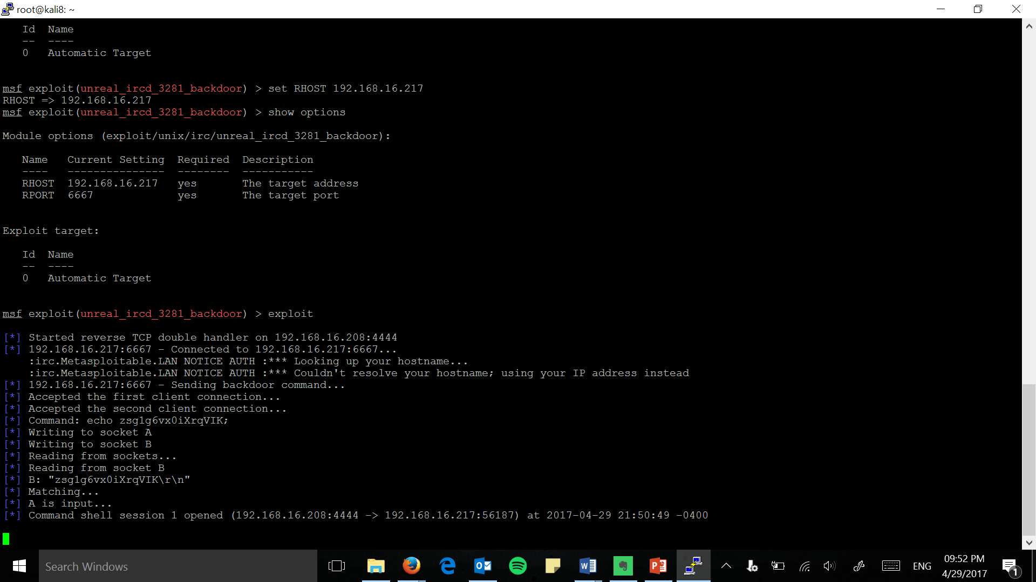
irc - unreal_ircd_3281_backdoor

Slide 7
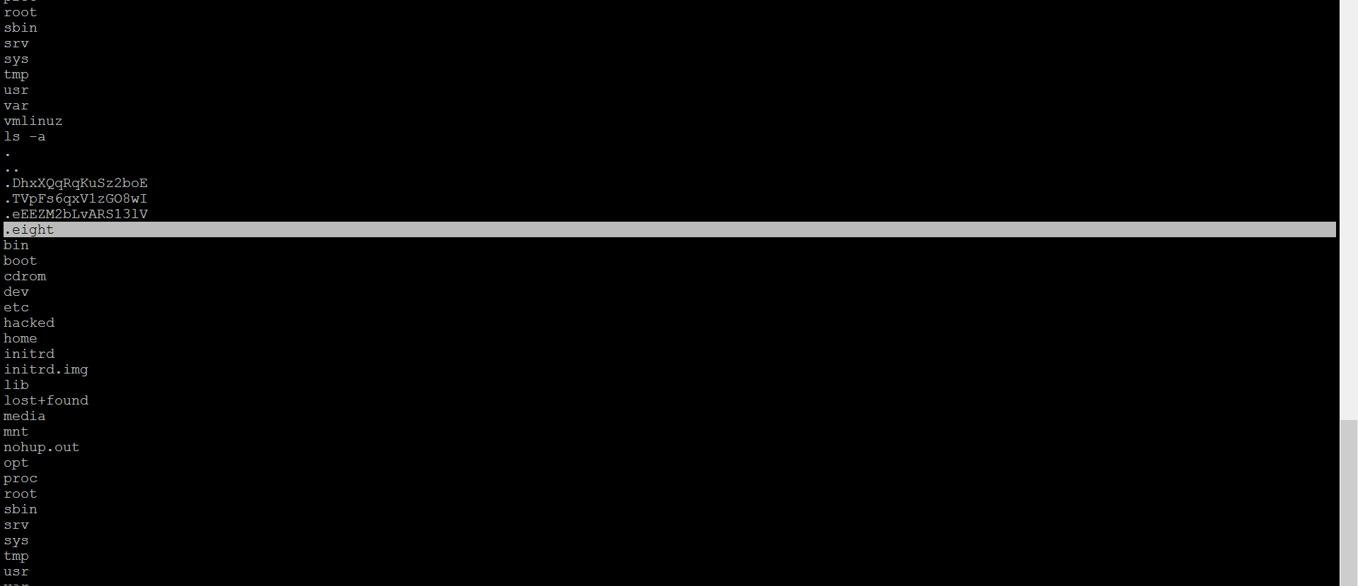
A hidden file is created at the Host Machine
“.eight” – Filename (A hidden file is created so that the host will not find it easily)

Slide 8
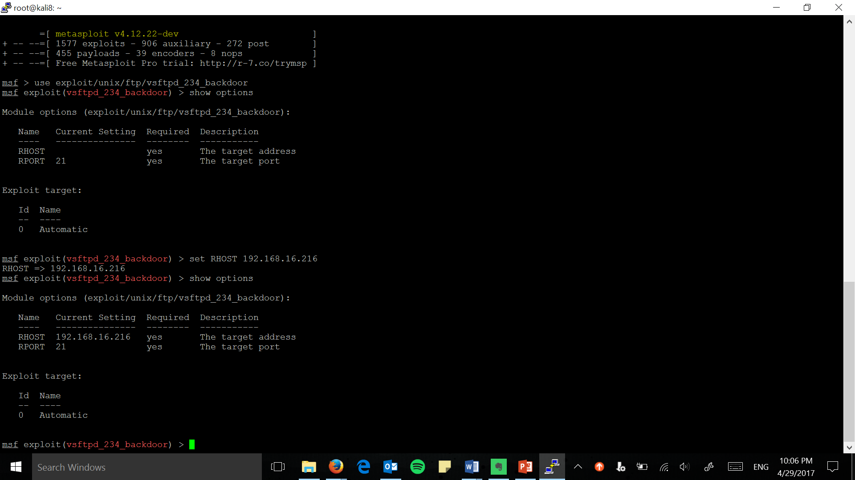
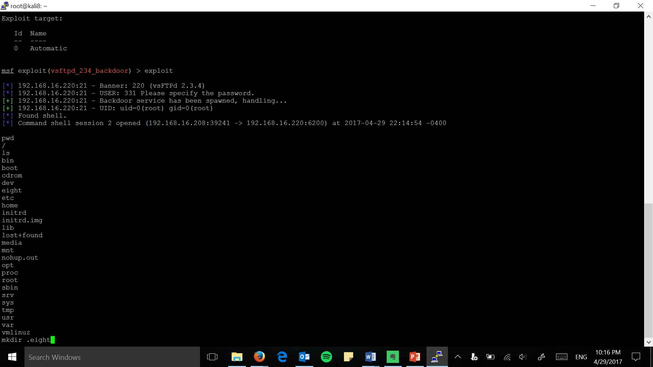
ftp – vsftpd_234_backdoor

Slide 9
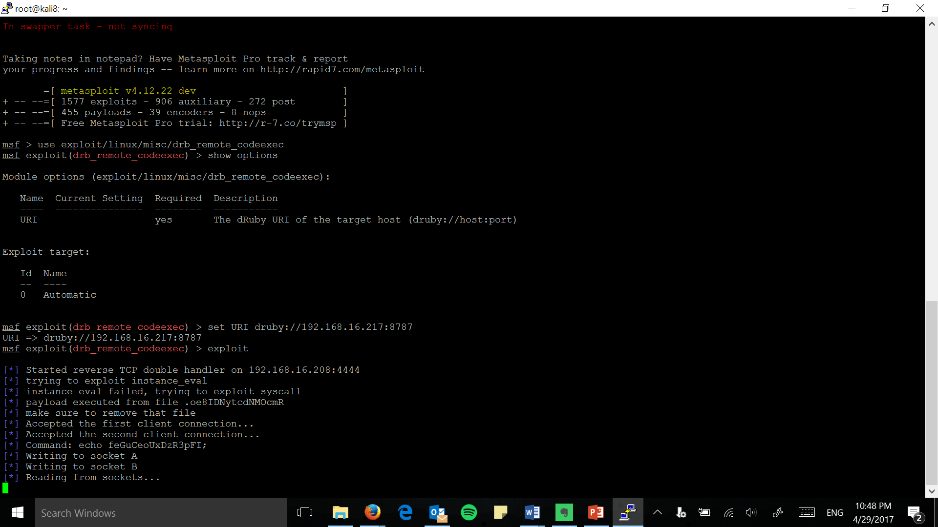
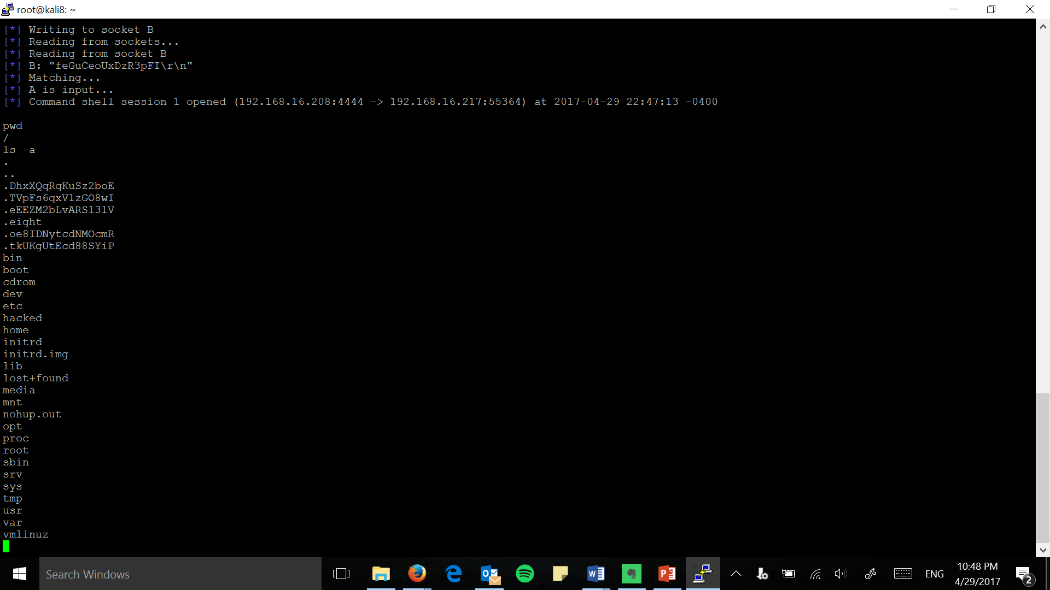
misc – drb_remote_codeexec

Slide 10
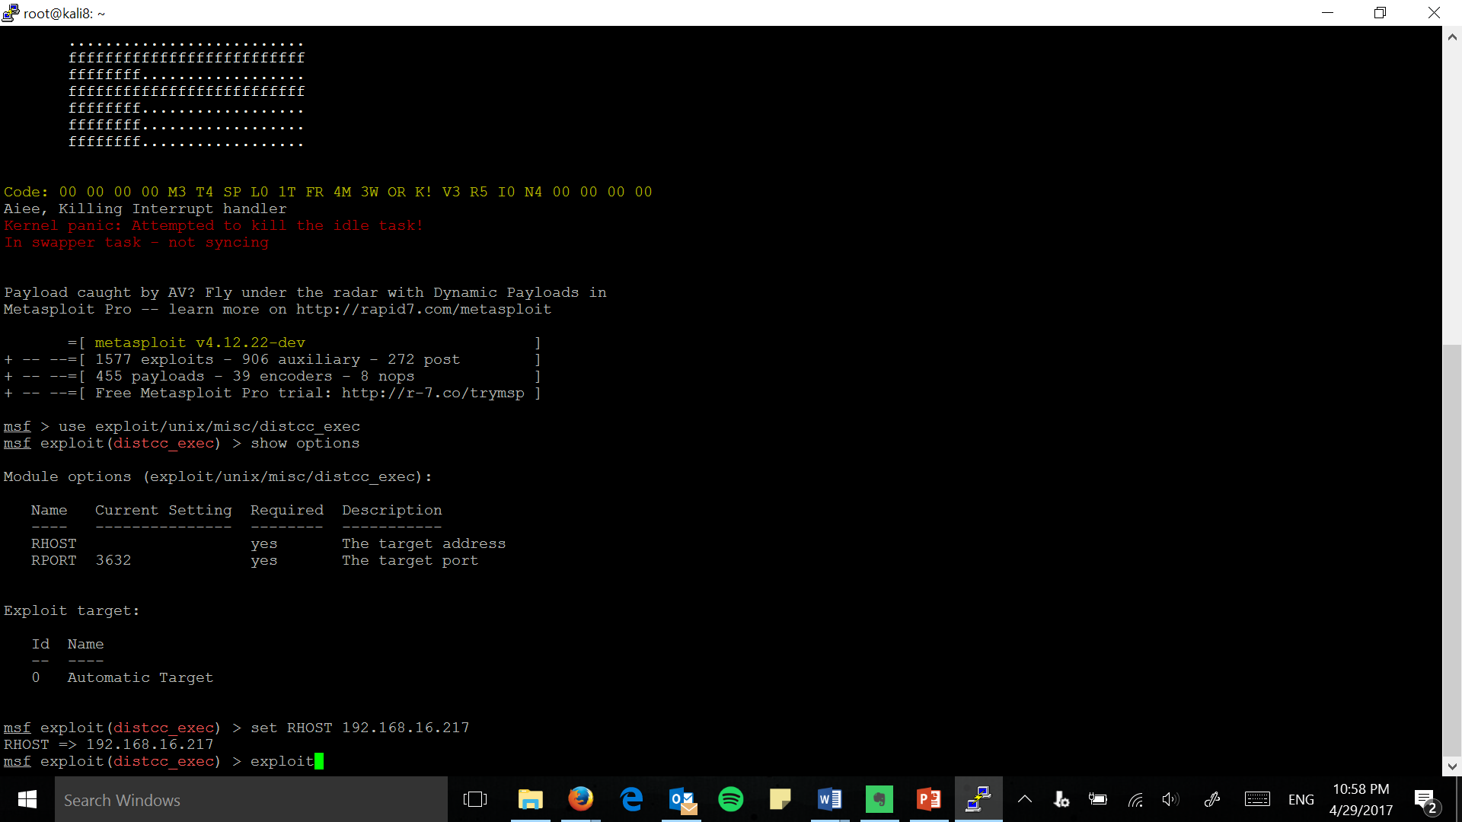
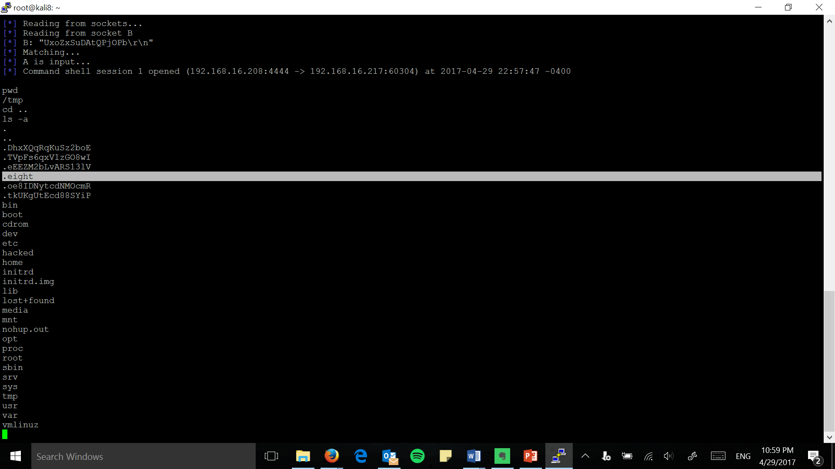
misc – distcc_exec

Slide 11
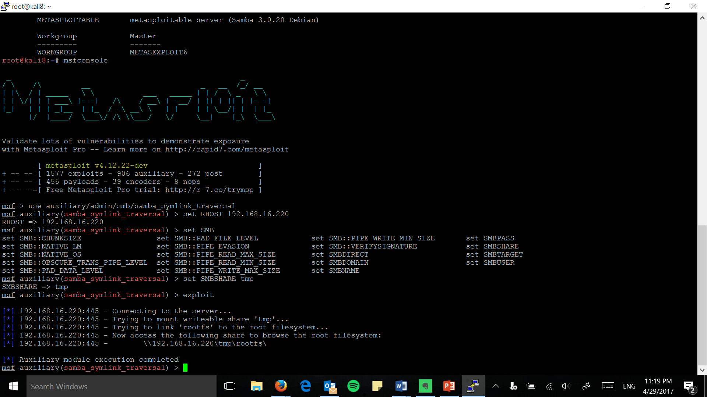
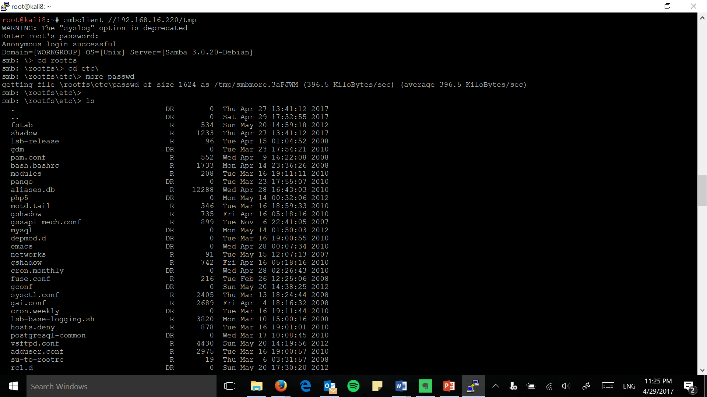
sbm – samba_symlink_traversal

Slide 12
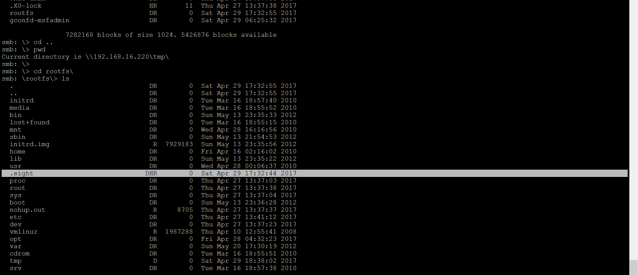
Check for the hidden file created earlier at the Host Machine
“.eight” – Filename (A hidden file is created so that the host will not find it easily)

Slide 13
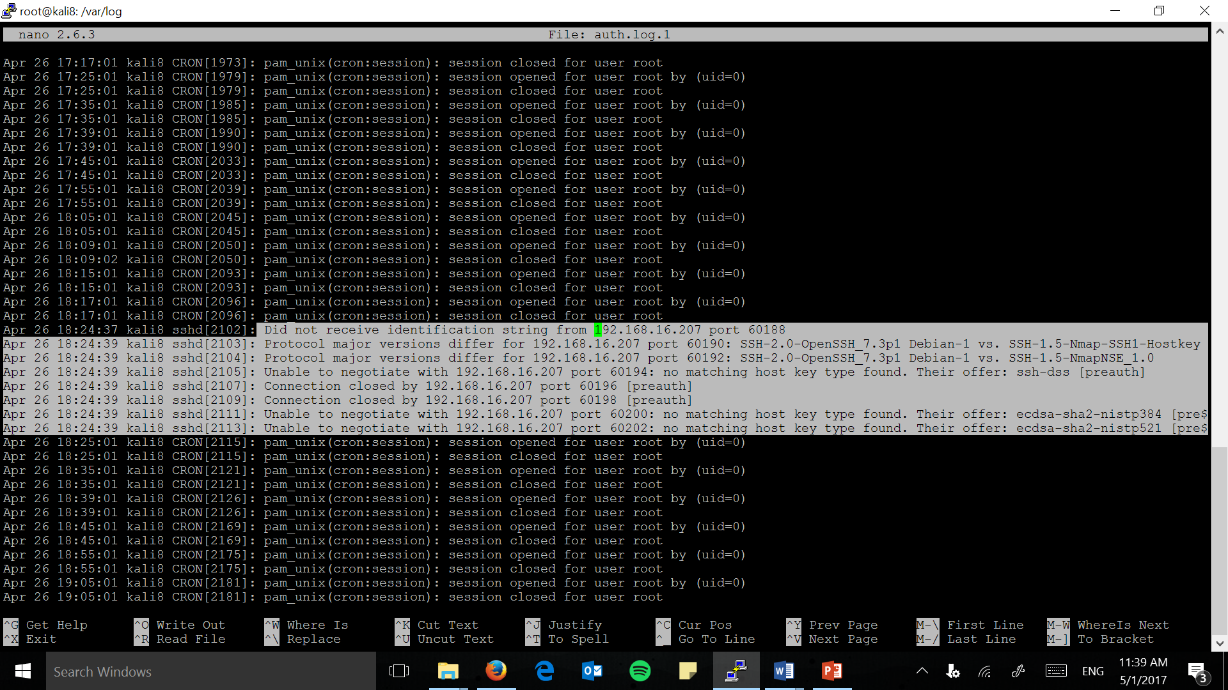
Detections

Slide 14
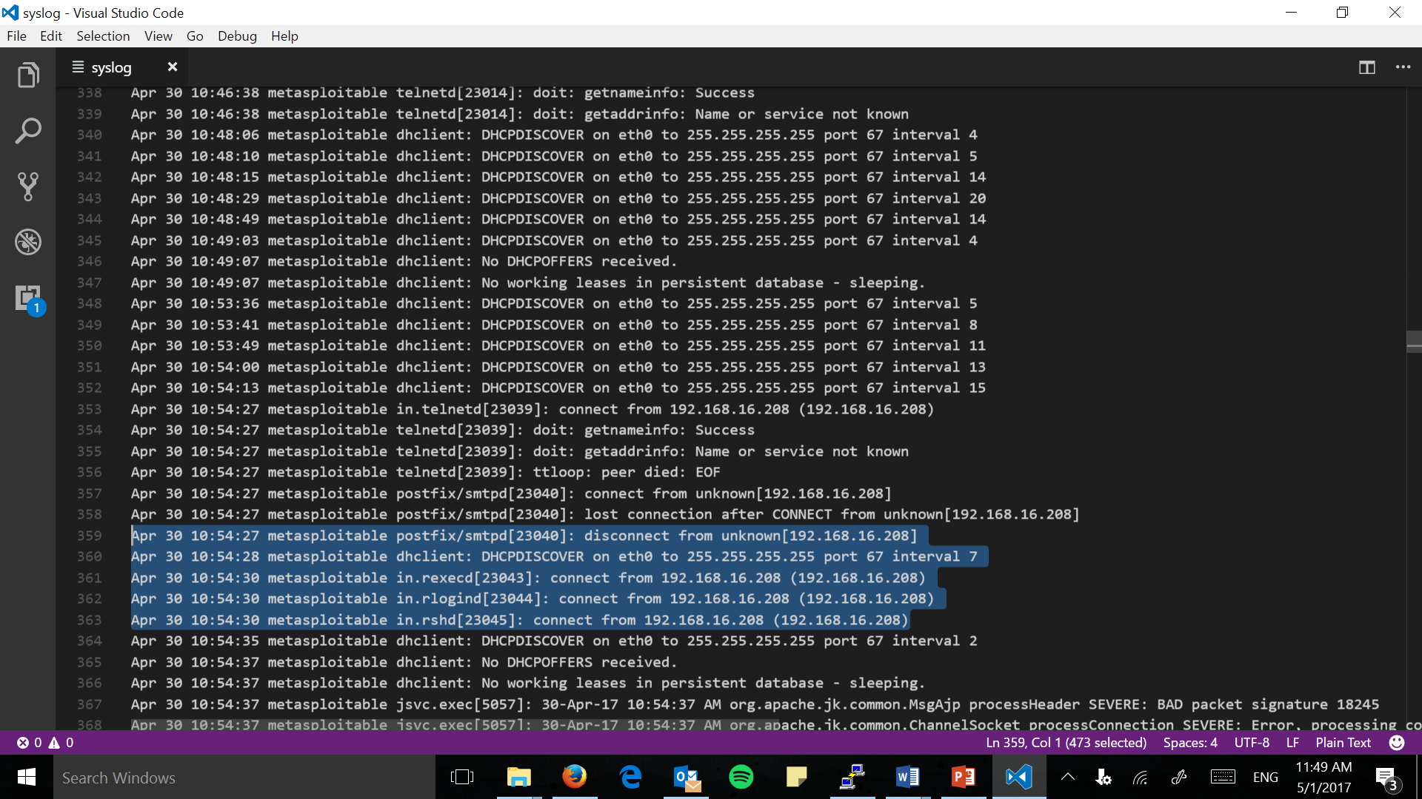

Slide 15
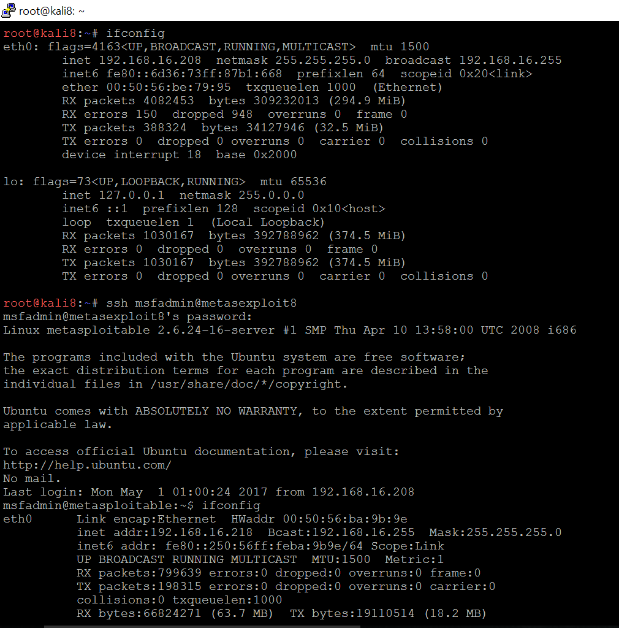
Remote logging to Kali VM from Metasploitable8 VM > ipconfig - Kali8 VM - Metasploit8 VM

Slide 16
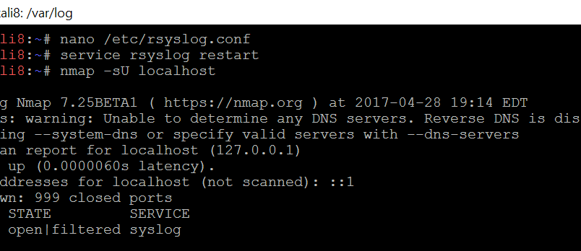
Navigate to rsyslog.conf file and modify it
> nano /etc/rsyslog.conf

Slide 17
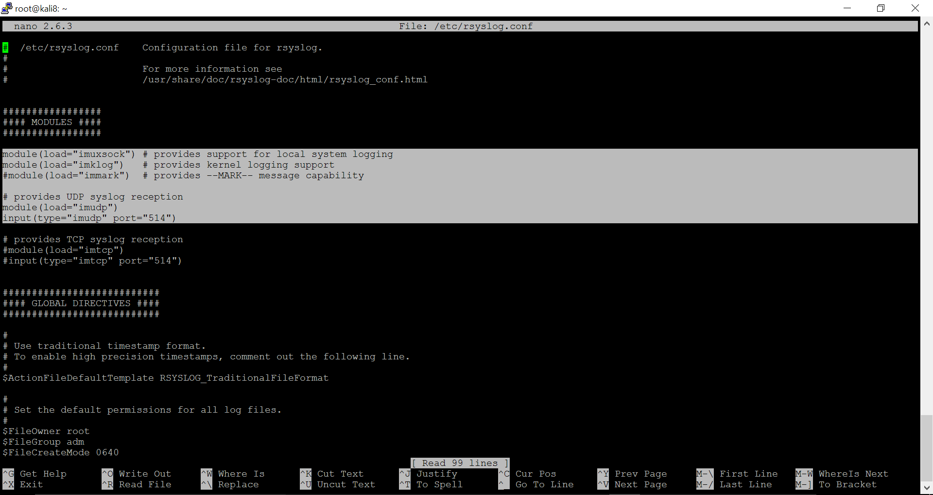

Slide 18
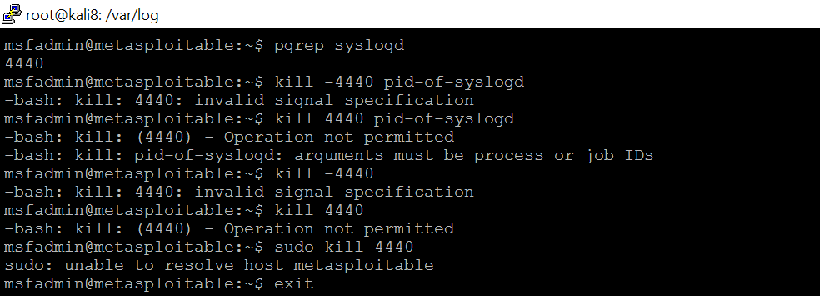
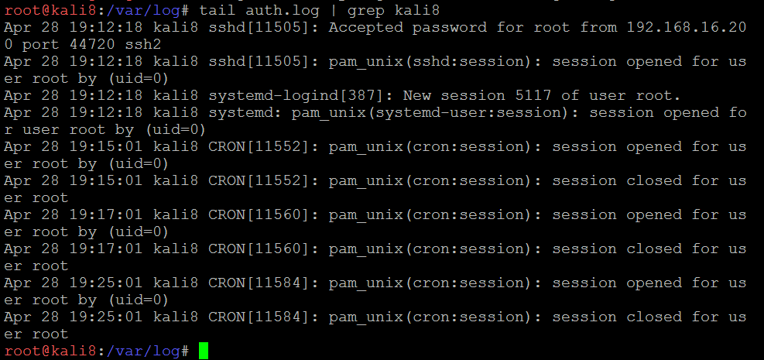
LATER:
Then we use the below commands:
> service rsyslog restart
> nmap -sU localhost
Later ssh to metasploitable8 VM and use the commands below
> pgrep syslogd
We will kill the pid-of-syslogd as shown below.
The process is 4440.

Slide 19
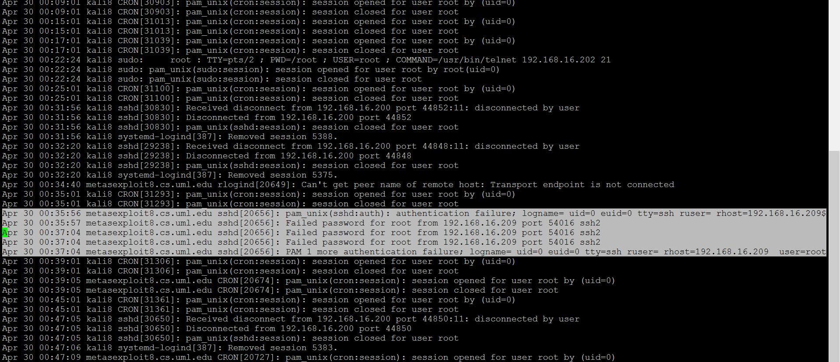
Check the auth.log file from the Kali8 VM and we confirm the set-up of remote logging
So, the logs can be sent from the team’s metasploitable 2 VM to the team’s Kali VM

Slide 20
THANK YOU http://www.cs.uml.edu/~sraihan/cci/

