Slide 1
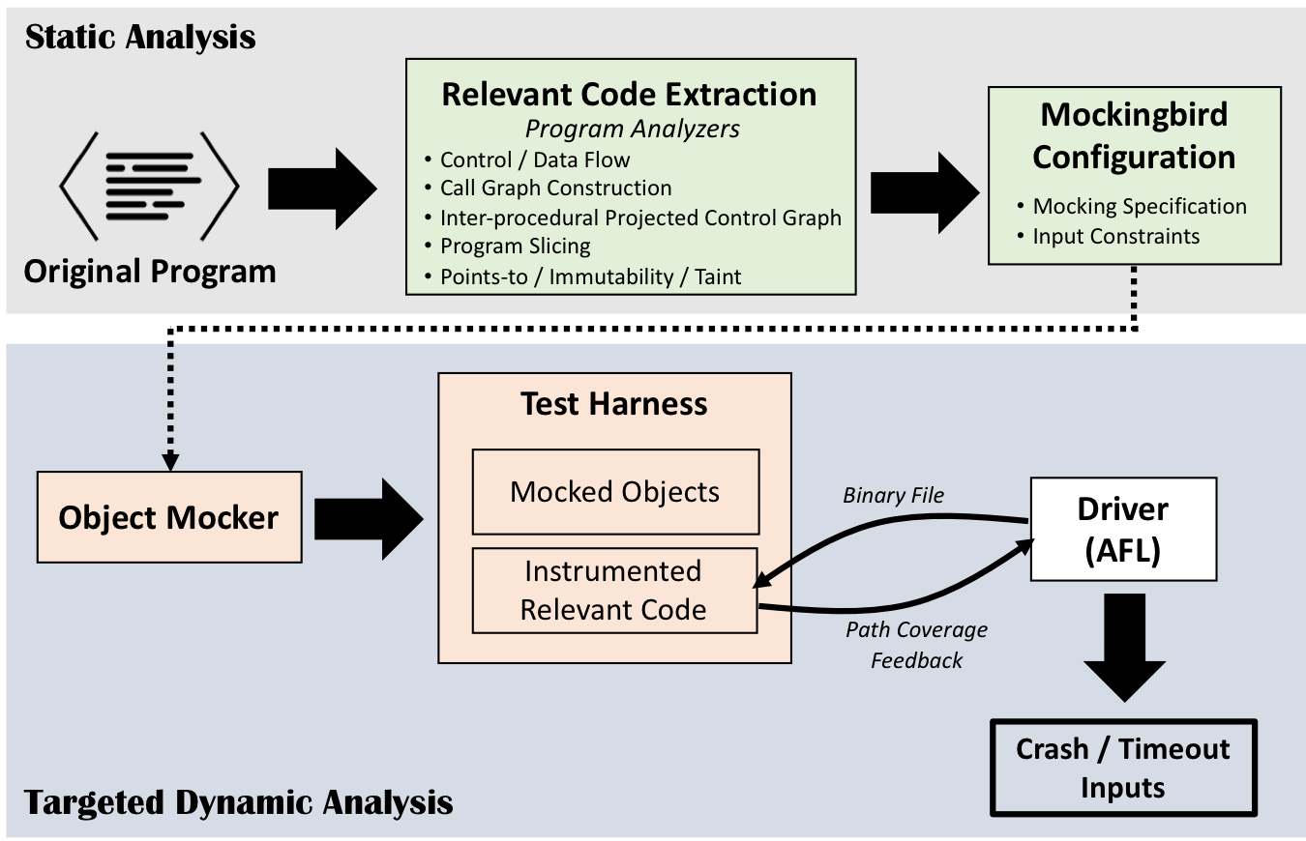
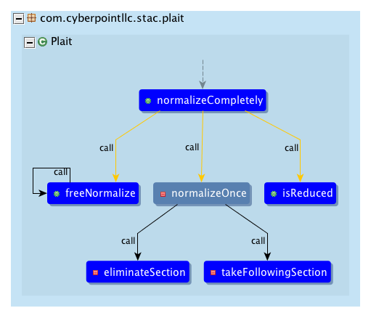
Computer Engineering
Association or meeting title
Date
Principal investigators
Mockingbird: A Framework for Enabling Targeted Dynamic Analysis of Java Programs
About
Problem Statement: Leverage the power of dynamic analysis with statically informed knowledge
This tool is used to enable the use of dynamic analysis in an efficient and easy to use manner for Java programs. The tool does this by leveraging statically informed knowledge about the program to develop a relevant code segment that is then run using outside fuzzers or manual input fuzzers. There are two intended uses for this tool. The first one being an automatic way to provide a configuration file that gives the statically informed knowledge to the tool and then runs the fuzzer known as AFL on this developed code segment. The second intended use is to use the API side of the tool to create manual fuzzers that are fast to create and easy to use.
Acknowledgements

