Slide 1
Knowledge Content Summarizer
Kenn Daniel Chang So

Slide 2
There’s so much information
It is difficult to track new events and trends daily
Consultants & market researchers take hours, even days, to do preliminary research about a recent trend or topic

Slide 3
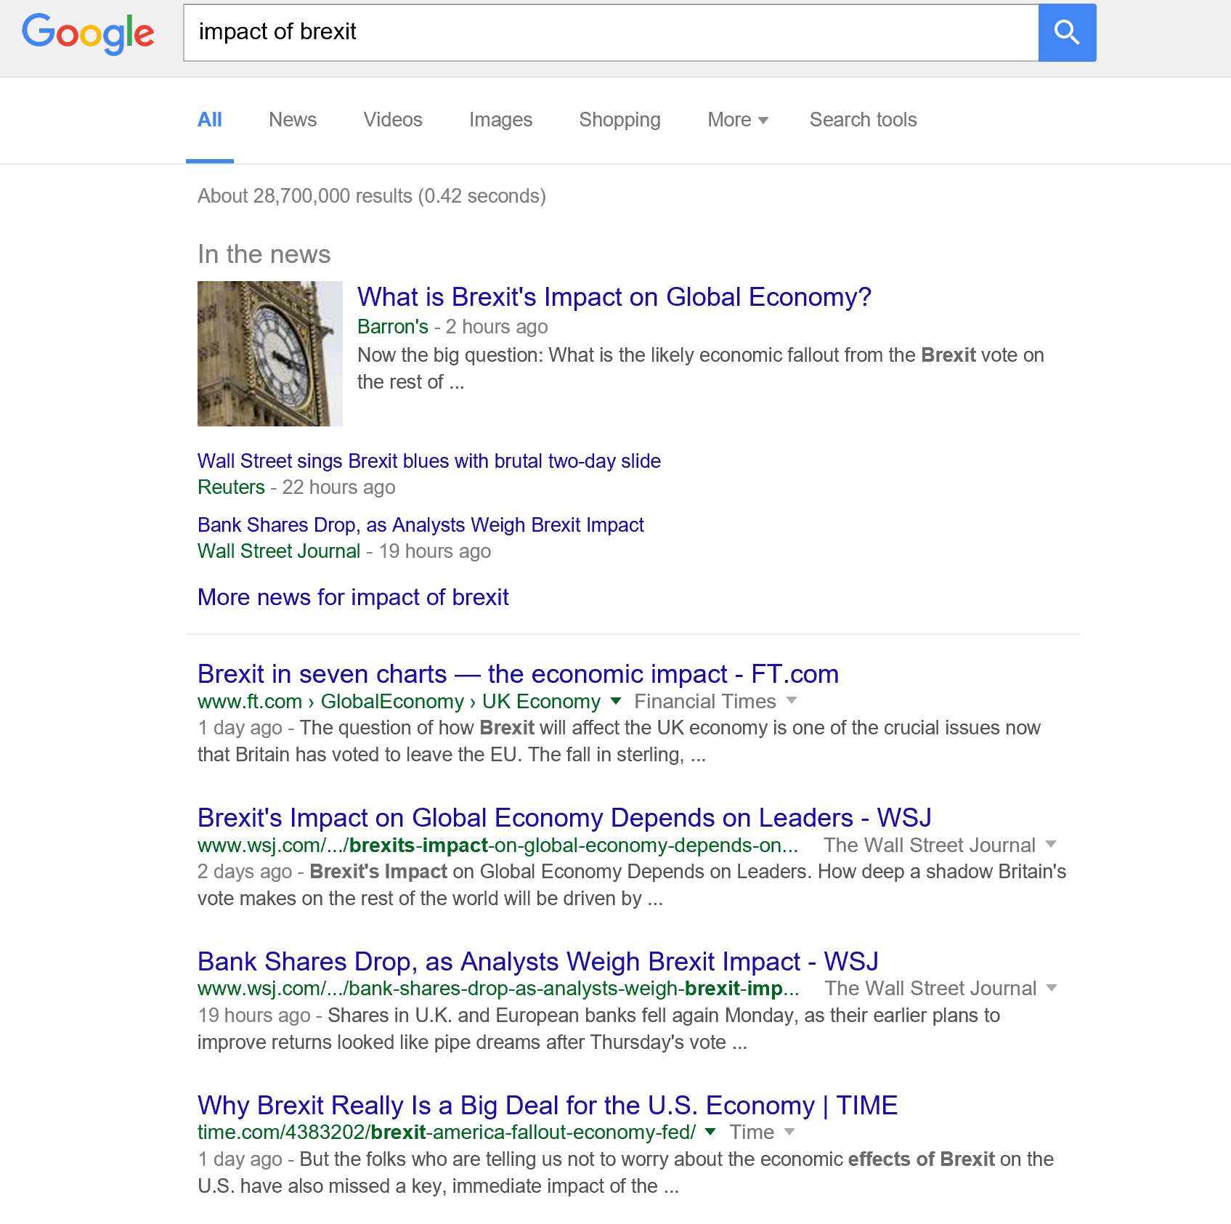

Slide 4
Is there a better way to organize & consume information?

Slide 5
Introducing sdfsdfsdf
KCS
Intelligently mining the world’s knowledge

Slide 6
In a way…a search engine
KCS Knowledge Database
User Query
Query
Results
Document 1
Document 1
Document 2
Document 2
Document 3
Document 4
Document 3
Document 5

Slide 7
How is it different?
KCS
Traditional
web search engine
Knowledge Base
Curated by user or client
Websites, commercial databases, your own data
Public world wide web
Querying
Fast and scalable through ElasticSearch
Can handle complex queries
Very fast
Can handle complex queries
Consumption
Document summarization to identify key points
Full-text easily accessible
1-2 lines of text preview on search results page
Open links in multiple tabs and read full-text
Organization
Document clustering based to identify sub-topics
User has to read and somehow organize everything after poring through numerous documents
Visualization
Visually map sub-topics, show individual document details and summary
Made for knowledge professionals
Google trends?

Slide 8






Source
Data Collection & Storage
Scraper / Aggregator
Amazon
ElasticSearch
Source
Data used for prototype:
> 10,000 Op-Eds of thought leaders
BeautifulSoup
RoboBrowser
Store as searchable JSON
documents
Querying & Analysis
Flask-based querying
Document summarization
Document clustering
Queries and filters data based on query terms and date
Sentiment analysis
Text pre-processing & TFIDF
TextRank summarizer
Generate knowledge graph
Articles as nodes and cosine similarity as edges
Louvain modularity clustering
Visualization
Amazon
RDS
Visualization
Store data frame in RDS for direct connection to Tableau
Visualize in Tableau

Slide 9
Source
Data Collection & Storage
Scraper / Aggregator
Amazon
ElasticSearch
Source
Data used for prototype:
> 10,000 Op-Eds of thought leaders
BeautifulSoup
RoboBrowser
Store as searchable JSON
documents
Querying & Analysis
Flask-based querying
Document summarization
Document clustering
Queries and filters data based on query terms and date
Sentiment analysis
Text pre-processing & TFIDF
TextRank summarizer
Generate knowledge graph
Articles as nodes and cosine similarity as edges
Louvain modularity clustering
Visualization
Amazon
RDS
Visualization
Store data frame in RDS for direct connection to Tableau
Visualize in Tableau

Slide 10
Text summarization of single documents using TextRank algorithm
Separate document into sentences and set each as a node
Connect sentences based on how many words they share
Representative sentences can be used for summaries
Document
Rank 1
Sentence 1
Sentence 1
Sentence 1
Sentence 1
Rank 2
Sentence 3
Sentence 2
Sentence 3
Sentence 5
Sentence 2
Sentence 5
Sentence 2
Rank 3
Sentence 5
Sentence 4
Rank 4
Sentence 4
Sentence 5
Sentence 4
Sentence 3
Sentence 4
Sentence 3
Rank 5
Sentence 2

Slide 11
Knowledge organization (document clustering) using Louvain modularity algorithm
Separate query results into documents and set each as a node
Connect documents based on how many words they share
Cluster similar documents
Query Results
Document 1
Document 1
Brexit Europe
Document 1
Brexit Europe
Document 1
Brexit Europe
Document 2
Document 3
Document 5
US Europe
Document 2
Europe UK
Document 5
US Europe
Document 2
Europe UK
Document 5
US Europe
Document 2
Europe UK
Document 4
Document 5
Document 4
US
Document 3
Brexit Scotland
Document 4
US
Document 3
Brexit Scotland
Document 4
US
Document 3
Brexit Scotland

Slide 12
Knowledge organization (document clustering) using Louvain modularity algorithm
Low modularity
Medium modularity
High modularity
Document 1
Brexit Europe
Document 1
Brexit Europe
Document 1
Brexit Europe
Document 5
US Europe
Document 2
Europe UK
Document 5
US Europe
Document 2
Europe UK
Document 5
US Europe
Document 2
Europe UK
Document 4
US
Document 3
Brexit Scotland
Document 4
US
Document 3
Brexit Scotland
Document 4
US
Document 3
Brexit Scotland

Slide 13
World User Perspective
KCS

Slide 14
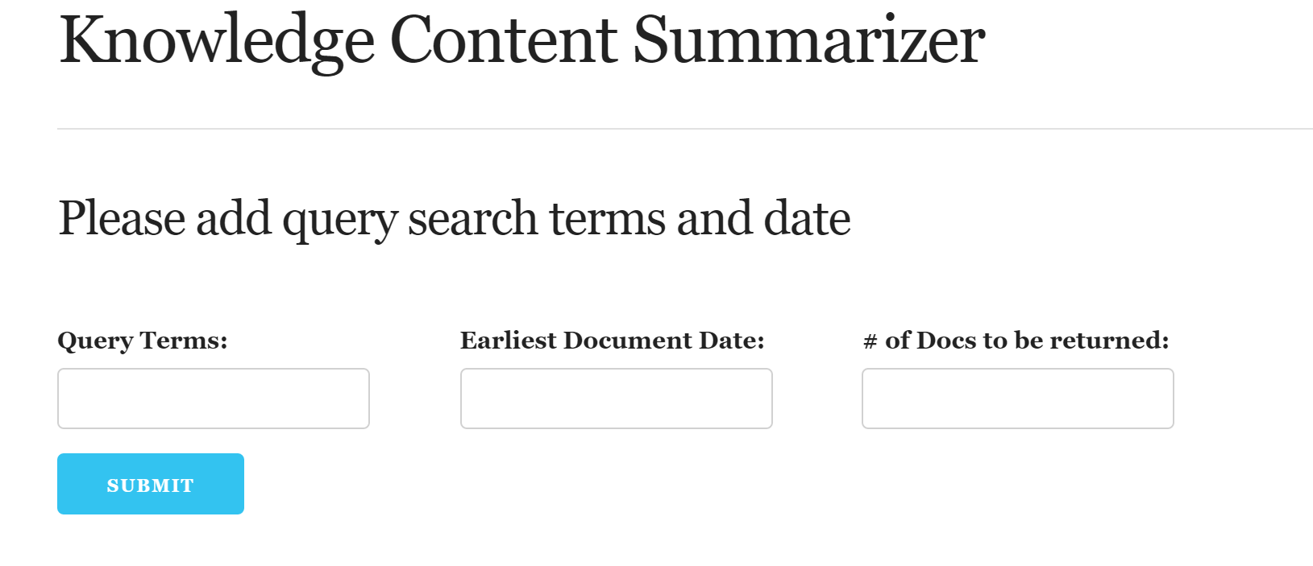
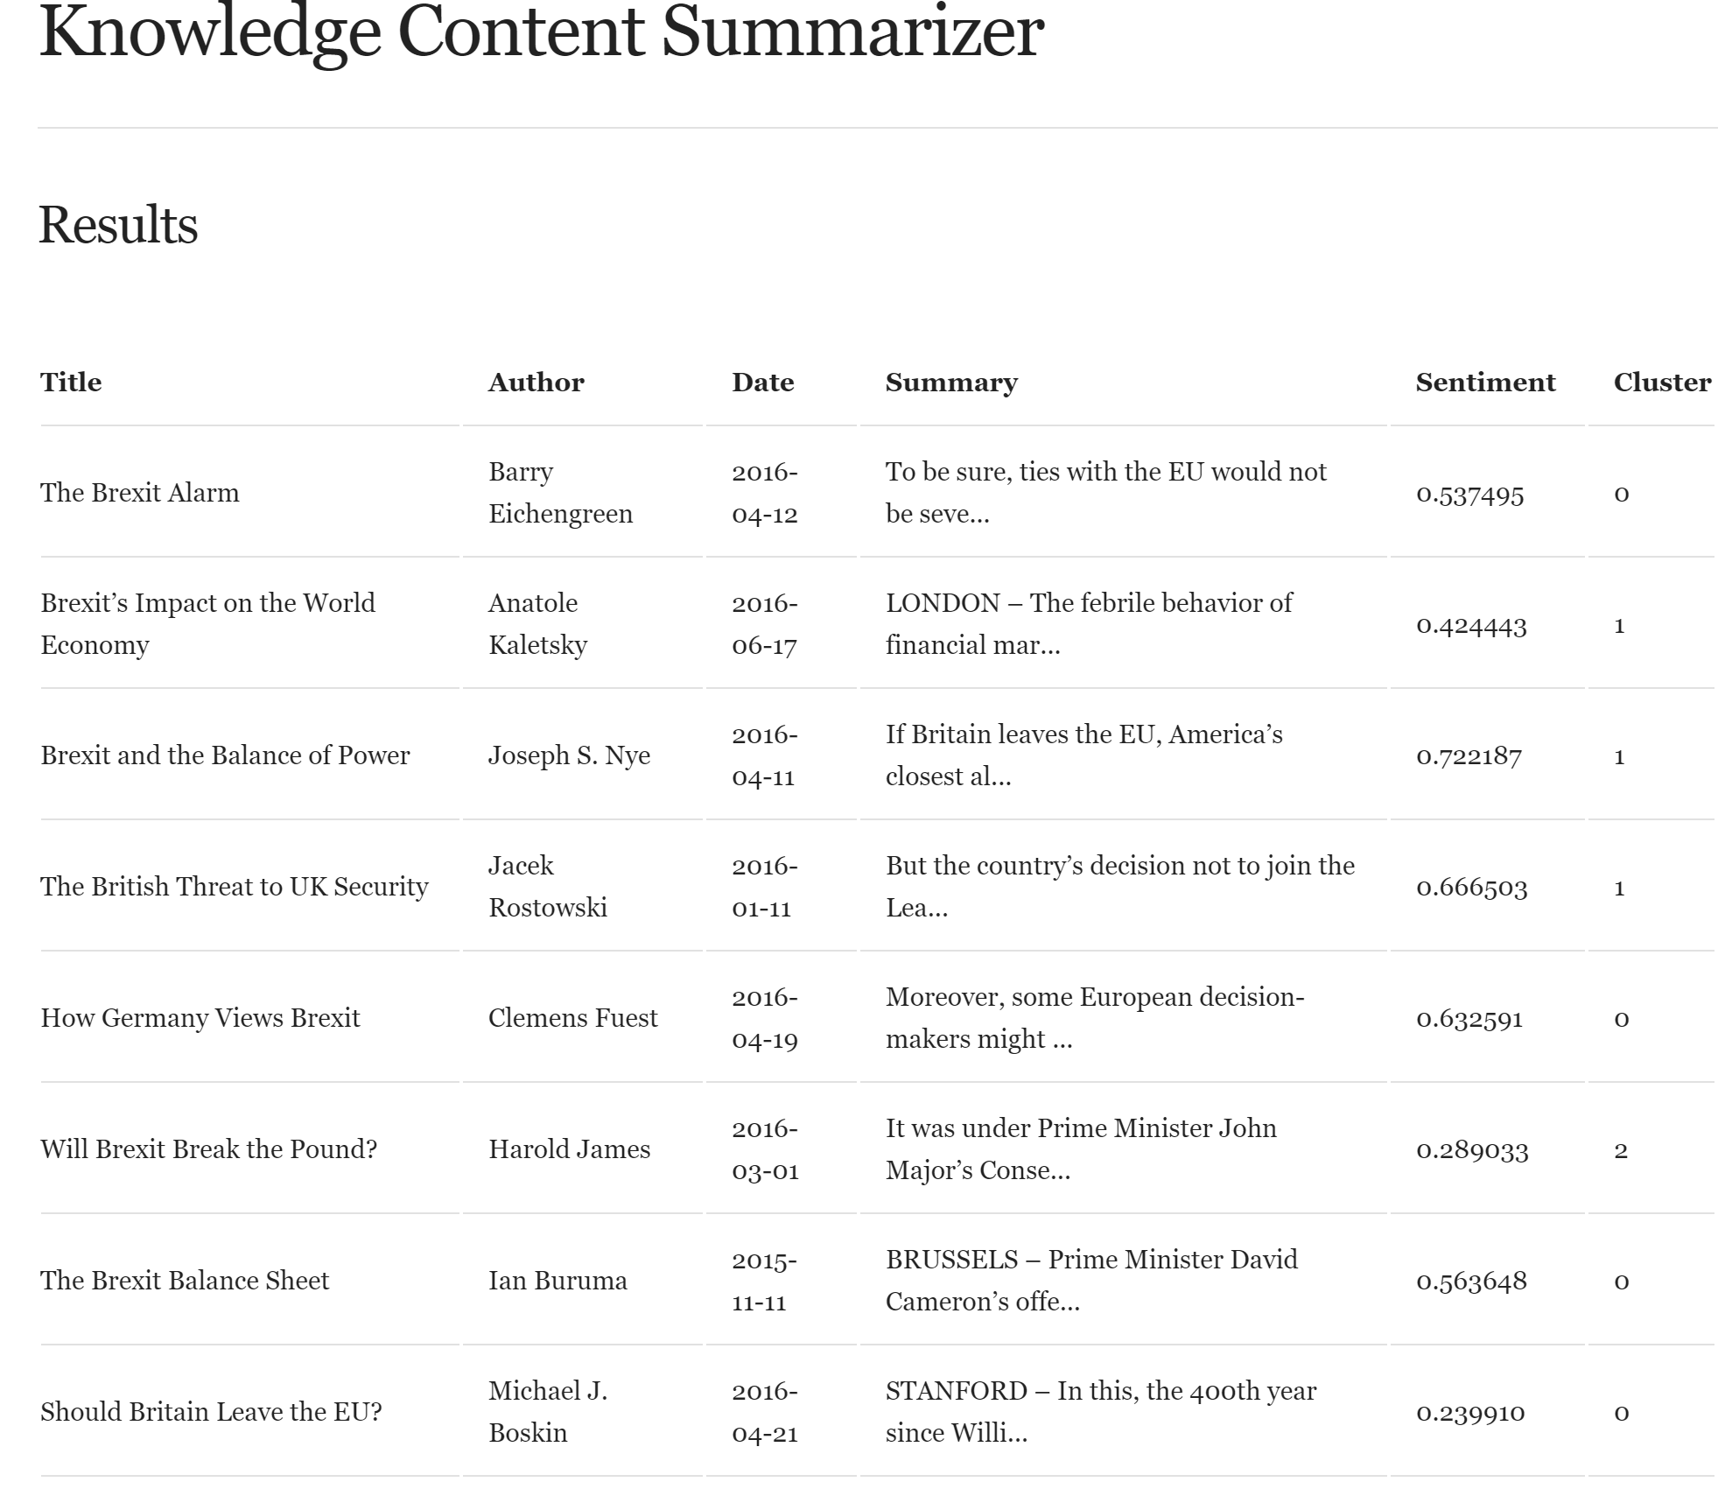
Querying & Results

Slide 15
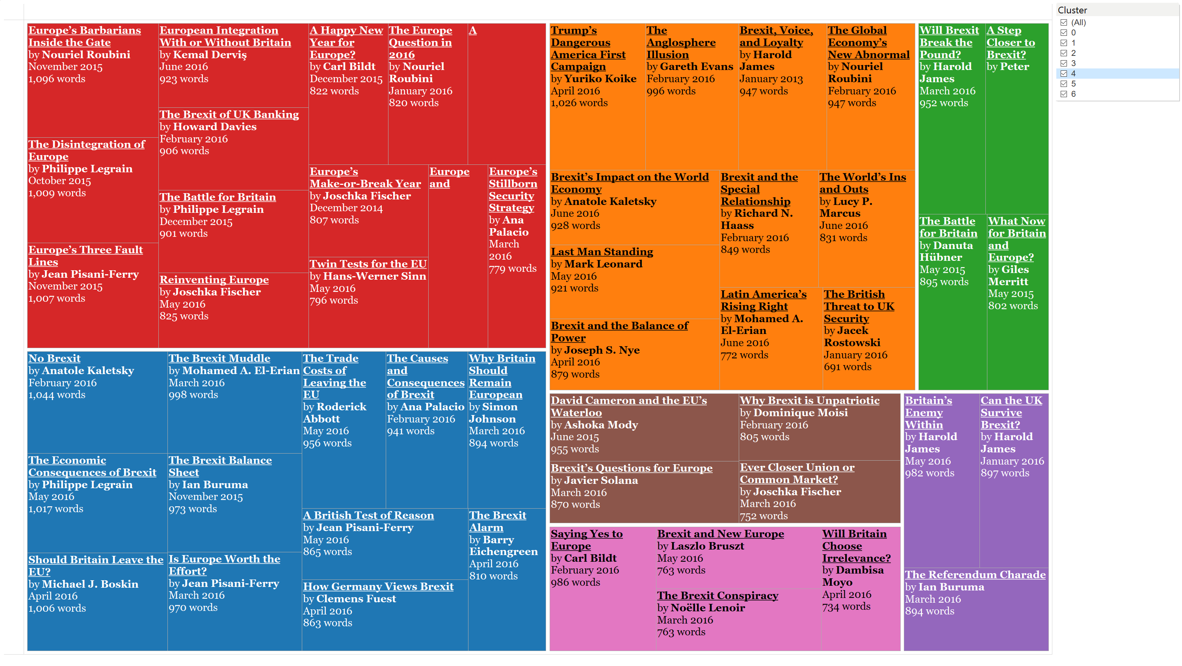
App demo
KCS

Slide 16
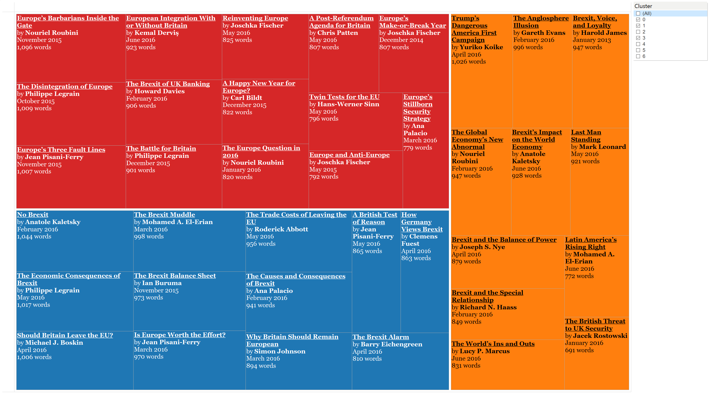
App demo
KCS

Slide 17
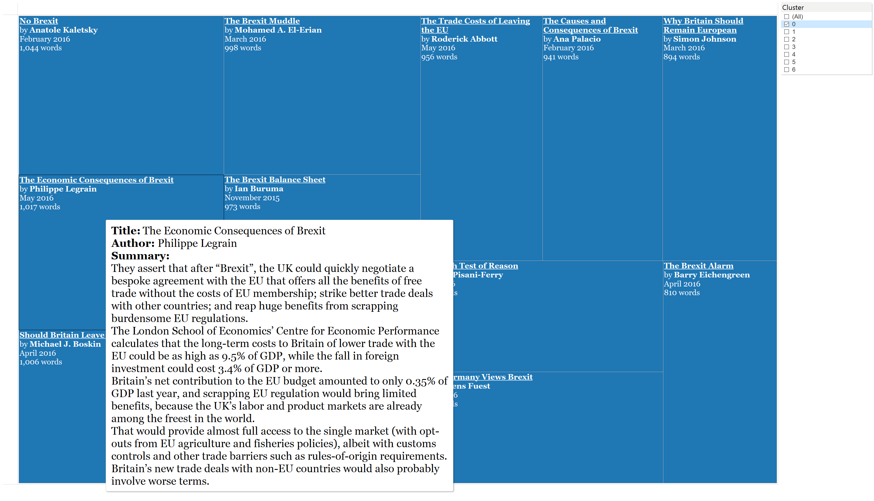
App demo
KCS

Slide 18
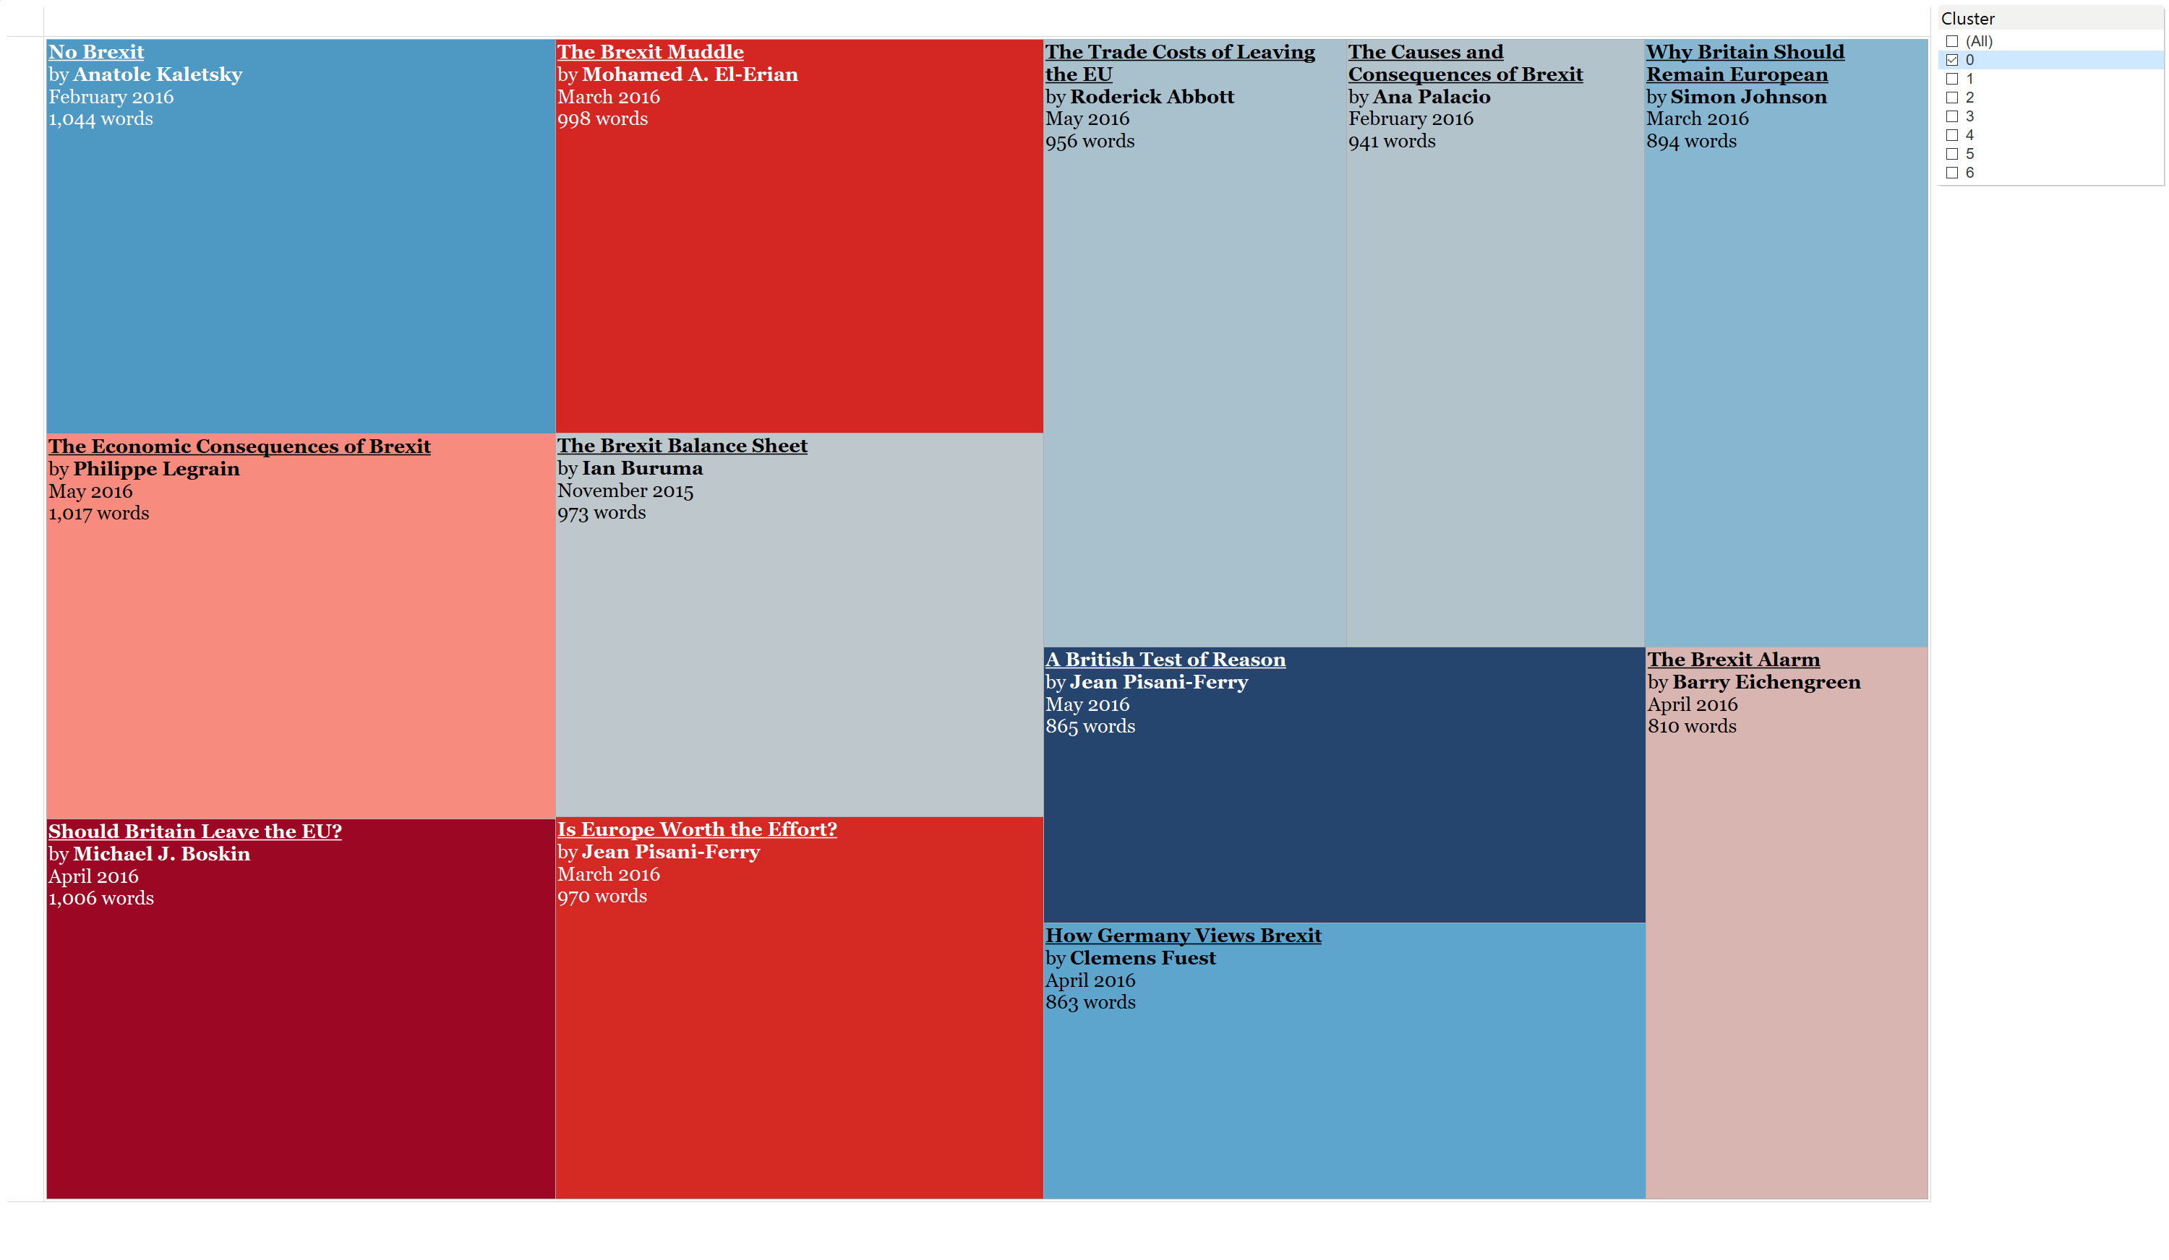
App demo
Negative
Neutral
Positive
KCS

Slide 19
Further development
Multi-document summarization (MDS) by document clusters using abstractive summarization methods like shortest path word graphs
Using extractive summarization methods, like TextRank, for MDS does not produce reader-friendly summaries
Function to generate reader-friendly print-ready document cluster summarizations / reports
Beta KCS
Scale infrastructure, strike non-profit deals with data sources

Slide 20

Thanks!
Kenn Daniel Chang So
Loves to explore cities by foot
Former Consultant and Investment Banker
Github & LinkedIn handles: kenndanielso
E-mail: kenndanielso@gmail.com

