Slide 1

Hystrix to Prevent Hysterix
Dallas Monson
Architecture and Software Consultant
Keyhole Software

Slide 2
Quick Shout Outs!
Who is to blame for this?

Slide 3

Quick Shout Outs!
Who is to blame for this?
Garmin
Thanks for Hosting

Slide 4

Quick Shout Outs!
Who is to blame for this?
Garmin
Thanks for Hosting
Pivotal
Thanks for Spring Users Group

Slide 5
Quick Shout Outs!
Who is to blame for this?
Garmin
Thanks for Hosting
Pivotal
Thanks for Spring Users Group
Keyhole Software
Thanks for Sponsoring

Slide 6
DEMO TIME!

Slide 7
DEMO TIME!
This is the live demo
You are looking for…

Slide 8
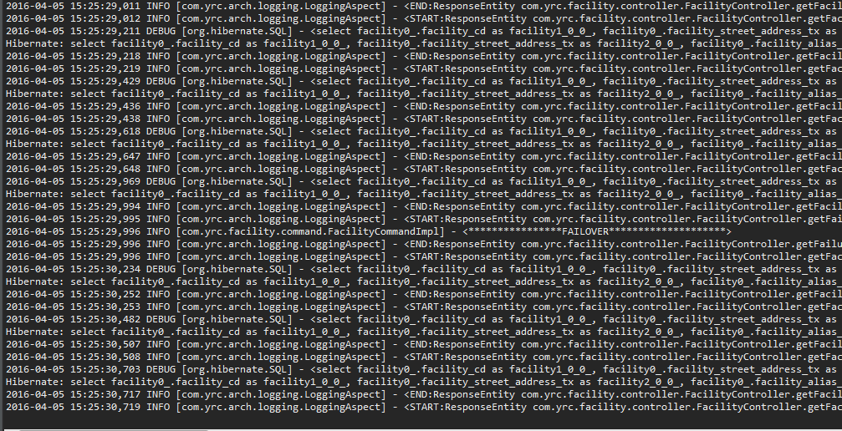
Not Really – but sort of…
Normal Payload - Log

Slide 9
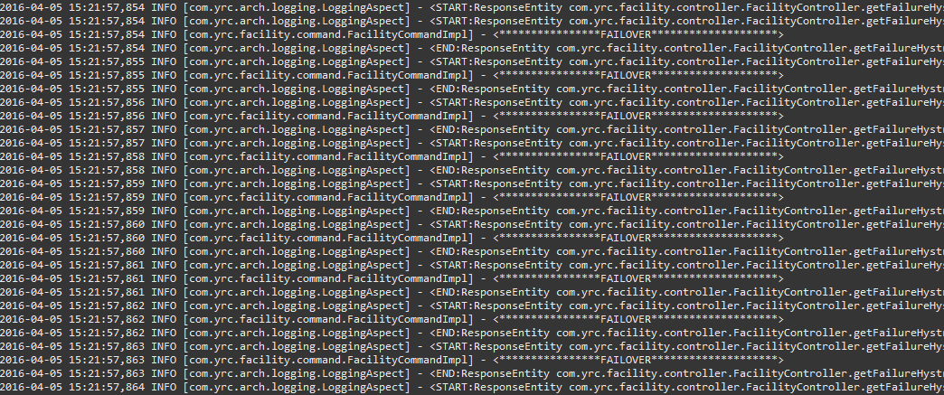
Not Really – but sort of…
Failover - Log

Slide 10
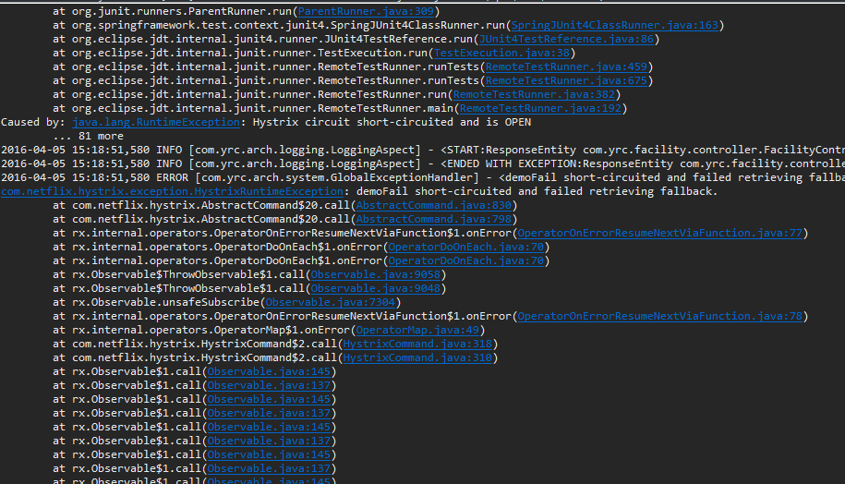
Not Really – but sort of…
Open Circuit - Log

Slide 11
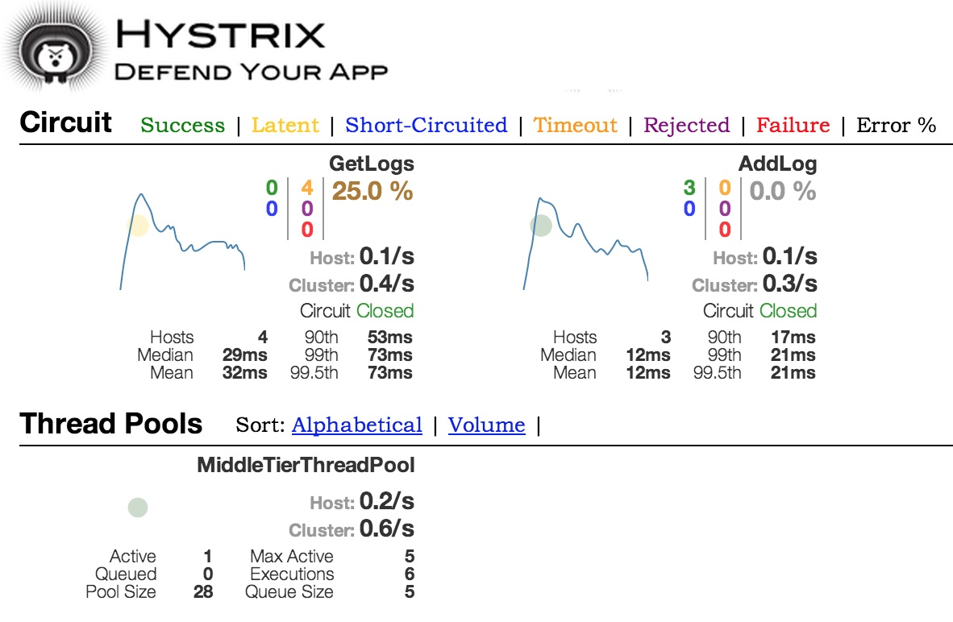
Not Really – but sort of…
Closed Circuit Dashboard

Slide 12
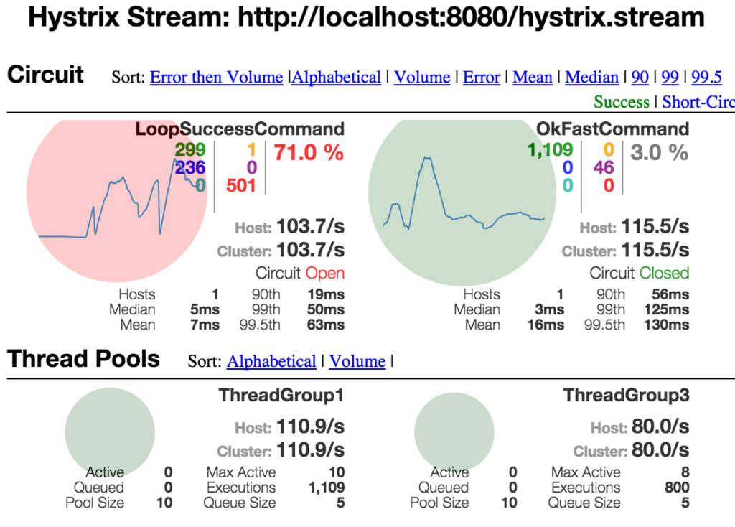
Not Really – but sort of…
Open Circuit Dashboard

Slide 13
Outline
Demo - Already Done!
Introduction and Level Set
What is Hystrix?
Taxonomy around Hystrix and SOA
What design patterns drive Hystrix
Configuring a Spring application for Hystrix
Sample Code
Summary and Considerations

Slide 14
Introductions

Slide 15
About me
Software Engineering and Architecture for 17 yrs.

Slide 16

About me
Software Engineering and Architecture for 17 yrs.
Software and Architecture Consultant at Keyhole
Currently placed as Technical Architect at YRC

Slide 17
About me
Software Engineering and Architecture for 17 yrs.
Software and Architecture Consultant at Keyhole
Currently placed as Technical Architect at YRC
Employed as all flavor of Architect
UI, Solution, Technical, Enterprise, Lead

Slide 18
About me
Software Engineering and Architecture for 17 yrs.
Software and Architecture Consultant at Keyhole
Currently placed as Technical Architect at YRC
Employed as all flavor of Architect
UI, Solution, Technical, Enterprise, Lead
Favorite OS:
Linux Mint

Slide 19
About me
Software Engineering and Architecture for 17 yrs.
Software and Architecture Consultant at Keyhole
Currently placed as Technical Architect at YRC
Employed as all flavor of Architect
UI, Solution, Technical, Enterprise, Lead
Favorite OS:
Linux Mint
Favorite IDE:
Visual Studio

Slide 20
About me
Software Engineering and Architecture for 17 yrs.
Software and Architecture Consultant at Keyhole
Currently placed as Technical Architect at YRC
Employed as all flavor of Architect
UI, Solution, Technical, Enterprise, Lead
Favorite OS:
Linux Mint
Favorite IDE:
Visual Studio
Favorite Food:
Norwegian Meatballs

Slide 21
Level Set
Assumptions I am making:

Slide 22
Level Set
Assumptions I am making:
Everyone understands Dependency Injection

Slide 23
Level Set
Assumptions I am making:
Everyone understands Dependency Injection
Everyone understands Maven

Slide 24
Level Set
Assumptions I am making:
Everyone understands Dependency Injection
Everyone understands Maven
Everyone understands Spring Annotations

Slide 25
Level Set
Assumptions I am making:
Everyone understands Dependency Injection
Everyone understands Maven
Everyone understands Spring Annotations
If you do not understand any of the above, then you are pretending that you do or you are already asleep and dreaming of kittens

Slide 26
So, why demo first?
Demos always are a crap shoot

Slide 27
So, why demo first?
Demos always are a crap shoot
If it fails then the expectations are set nice and low

Slide 28
So, why demo first?
Demos always are a crap shoot
If it fails then the expectations are set nice and low
With that over, I can focus on the engineering

Slide 29
So, why demo first?
Demos always are a crap shoot
If it fails then the expectations are set nice and low
With that over, I can focus on the engineering
Most people are only interested in the demo anyway so my job is done and I am going out on a high note!

Slide 30
I thought Hystrix was for kids,
silly rabbit?

Slide 31
I thought Hystrix was for kids,
silly rabbit?
Hystrix is a collection of open source projects developed by Netflix that specifically focus on durability and reducing latency.

Slide 32
I thought Hystrix was for kids,
silly rabbit?
Hystrix is a collection of open source projects developed by Netflix that specifically focus on durability and reducing latency.
It does this by a combination of three key design patterns:
Circuit Breaker
Command
Chain of Responsibility

Slide 33
I thought Hystrix was for kids,
silly rabbit?
Hystrix is a collection of open source projects developed by Netflix that specifically focus on durability and reducing latency.
It does this by a combination of three key design patterns:
Circuit Breaker
Command
Chain of Responsibility
Before we get into that, lets cover some taxonomy

Slide 34
Taxonomy
SOA: Service Oriented Architecture and at a high level, defines some frameworks and patterns for services to communicate via messaging protocols.

Slide 35
Taxonomy
SOA: Service Oriented Architecture and at a high level, defines some frameworks and patterns for services to communicate via messaging protocols.
Service: Services are activities that an application performs, for example maintaining a list of user and their permissions. In this example, this would be done by a user service that executes those actions to maintain the list (CRUD).

Slide 36
Taxonomy
Microservices: A variant on SOA that emphasizes smaller, decoupled services to focus on one activity in contrast to legacy, monolithic applications that perform all activities for an entire application in a single, tightly coupled code base.

Slide 37
Taxonomy
Microservices: A variant on SOA that emphasizes smaller, decoupled services to focus on one activity in contrast to legacy, monolithic applications that perform all activities for an entire application in a single, tightly coupled code base.
Spring-Cloud Hystrix-Javanica: A Spring implementation of the Hystrix library that brings along annotation support, easy configuration and support in Spring.

Slide 38
Command Pattern
How does this pertain to me and my life?

Slide 39
Command Pattern
How does this pertain to me and my life?
The Spring Hystrix implementation first leverages the command pattern for performance

Slide 40
Command Pattern
How does this pertain to me and my life?
The Spring Hystrix implementation first leverages the command pattern for performance
Command pattern basically allows for service/repository/dependency calls to be wrapped in a method so that it is decoupled from the implementing code

Slide 41
Command Pattern
How does this pertain to me and my life?
The Spring Hystrix implementation first leverages the command pattern for performance
Command pattern basically allows for service/repository/dependency calls to be wrapped in a method so that it is decoupled from the implementing code
Fire and Forget!

Slide 42
Circuit Breaker Pattern
Johnny 5 is Alive!

Slide 43
Circuit Breaker Pattern
Johnny 5 is Alive!
Circuit Breaker is a Microservices design pattern that helps applications be more resilient and durable, especially under heavy load and with several dependencies.

Slide 44
Circuit Breaker Pattern
Johnny 5 is Alive!
Circuit Breaker is a Microservices design pattern that helps applications be more resilient and durable, especially under heavy load and with several dependencies.
The circuit breaker has a failure threshold that it tracks these failures against.
Once the threshold is reached, the circuit opens. This prevents any further requests to the dependency

Slide 45
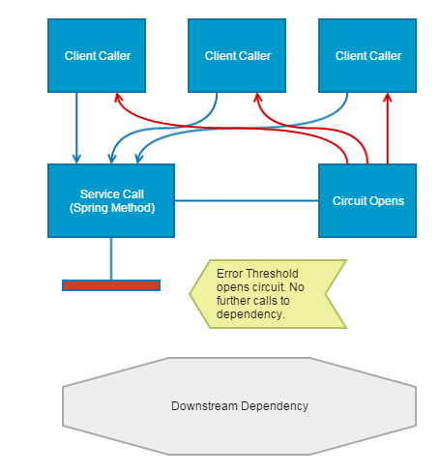
Circuit Breaker Pattern

Slide 46
Chain of Responsibility
The Hystrix project also allows us to implement a fallback method that gets triggered before the circuit opens, and allows the application to recover from latency issues.

Slide 47
Chain of Responsibility
The Hystrix project also allows us to implement a fallback method that gets triggered before the circuit opens, and allows the application to recover from latency issues.
This fallback method is an implementation of the Chain of Responsibility pattern that allows a series of commands to hand off tasks when one is unable to complete it.

Slide 48
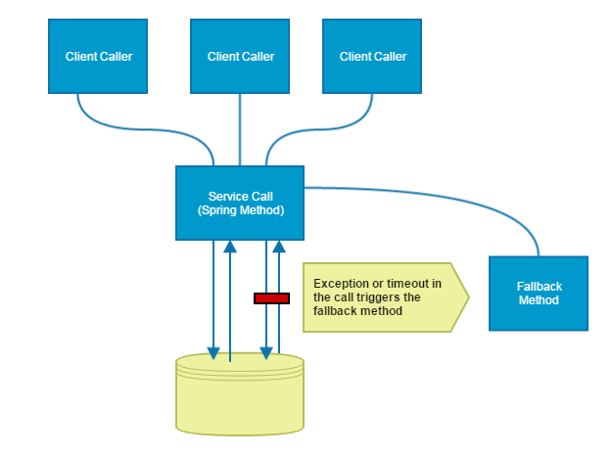
Chain of Responsibility

Slide 49
Configuration for Hystrix
Get ready, because this is a long, arduous journey…

Slide 50
Configuration for Hystrix
Get ready, because this is a long, arduous journey…
1. Add the following dependency to your pom.xml:
<dependency>
<groupId>org.springframework.cloud</groupId>
<artifactId>spring-cloud-starter-hystrix</artifactId>
<version>1.0.0.RELEASE</version>
</dependency>

Slide 51
Configuration for Hystrix
2. Add the following annotations to your AppConfig.java on the AppConfig class:
@EnableHystrix
@EnableCircuitBreaker

Slide 52
Configuration for Hystrix
2. Add the following annotations to your AppConfig.java on the AppConfig class:
@EnableHystrix
@EnableCircuitBreaker
Whew – that was
rough!

Slide 53
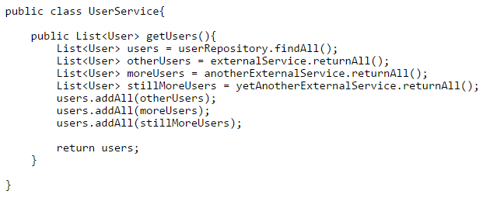
Sample Code
Fake it till you make it! Our Fake Service:

Slide 54
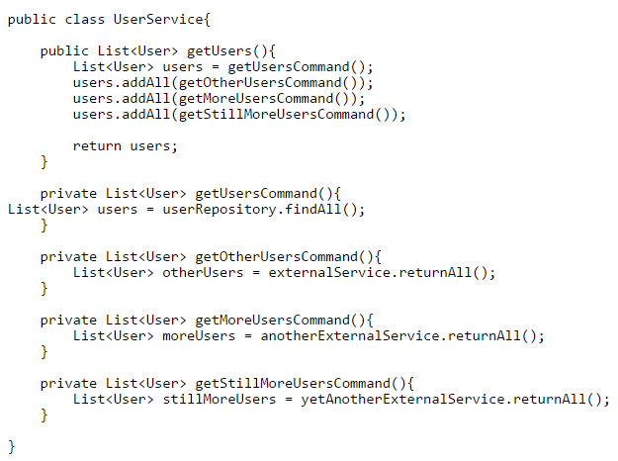
Separate Out Commands

Slide 55
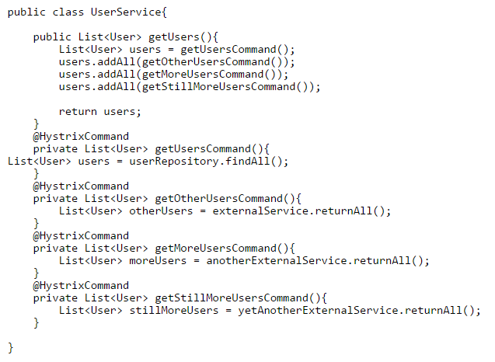
Annotate Commands

Slide 56
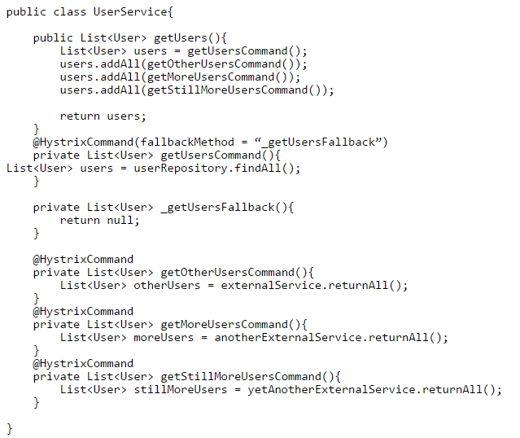
Fallback Methods

Slide 57
Considerations

Slide 58
Considerations
Convention on fallback names

Slide 59
Considerations
Convention on fallback names
Microservices in order to use Hystrix?

Slide 60
Considerations
Convention on fallback names
Microservices in order to use Hystrix?
Service that will not die

Slide 61
With Great Power Comes...

Slide 62
With Great Power Comes...
…Gold chains and Escalades!

Slide 63
Summary
Demo
Definition of Hystrix
Taxonomy around Hystrix and SOA
Design patterns that make up Hystrix
Configuring a Spring application for Hystrix
Sample Code
Considerations

Slide 64
Questions?

Slide 65
Questions?
Why did this take so long?

Slide 66
Questions?
Why did this take so long?
Where are the rest rooms?

Slide 67
Questions?
Why did this take so long?
Where are the rest rooms?
I thought beer was provided?

Slide 68
Questions?
Why did this take so long?
Where are the rest rooms?
I thought beer was provided?
Where can I get me more Hystrix?

Slide 69
Resources
http://cloud.spring.io/spring-cloud-netflix/spring-cloud-netflix.html
https://github.com/Netflix/Hystrix/wiki/Configuration
https://keyholesoftware.com/2016/02/01/hystrix-to-prevent-hysterix/

Slide 70
Hystrix to Prevent Hysterix
Fin.
dmonson@keyholesoftware.com

