Slide 1

Don’t Hate the HATEOAS
Or How I Learned To Stop Worrying And Love The HATEOAS
Kansas City Spring User Group
March 2, 2016
Billy Korando, Software Consultant bkorando@keyholesoftware.com

Slide 2
REST is more than GET /resource
A success story in constraint

Slide 3
Keys To REST’s Success
Client-Server
Stateless
Cacheable
Uniform Interface
Layered Architecture

Slide 4
Client-Server
Independent evolvability
Scalability

Slide 5
Stateless
Durability
Scalability
Client maintains state (not server)
Heavier network load

Slide 6
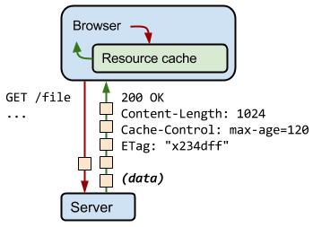
Cacheable
Request can be cached by the client to increase client perceived performance and decrease server workload

Slide 7
Uniform Interface
Where the look and feel of REST
Resources are identified in the URI
Resources are manipulated
Messages are self-descriptive
Hypermedia as the engine of application state (more on that later)
Basically this is setting up what a REST request and response looks like

Slide 8

Layered Architecture
Encapsulation of legacy processes
Sharing of resources (i.e. a cache)
Load balancing

Slide 9
The Richardson Maturity Model
Level 0 - The Swamp of POX
Level 1 - Resources
Level 2 - Proper use of HTTP mechanics
Level 3 - Hypermedia Controls

Slide 10
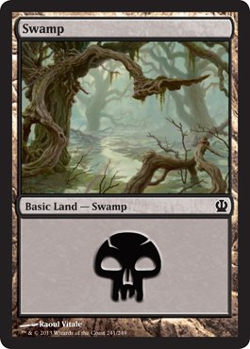
The “Swamp” of POX
Using HTTP as a tunneling mechanism
POST: /viewItem
{
“id”: “1234”
}
Response:
{
“id” : 1234,
“description” : “TV”
}
POST: /orderItem
{
“id” : 1,
“item” : {
“id” : 1234
}
}

Slide 11
Resources
Entities now have their own dedicated endpoint
Interacting with the RESTful service is done by manipulating a resource

Slide 12
POST: /items/1234
{}
Response:
HTTP 1.1 200
{
“id” : 1234,
“description” : “TV”
}
POST: /order/1
{
“item” : {
“id” : 1234
}
}
Response:
HTTP 1.1 200
{
“id” : 1,
“items” : [
“item” : {
“id” : 1234
}
]
}

Slide 13
HTTP
Using the HTTP specification as it has been defined
Requests will now use the correct HTTP “verb” (method type)
Server will respond with the correct status code

Slide 14
HTTP Verbs
 | SAFE | NOT SAFE
IDEMPOTENT | GET, OPTIONS | DELETE, PUT
NOT IDEMPOTENT |  | POST

Slide 15
GET: /items/1234 Response: { “id” : 1234, “description” : “TV” } GET: /items/NotReal Response: HTTP 1.1 404 | PUT: /orders/1 { “items” : [ “item” : { “id” : 1234 } ] } | Response: HTTP 1.1 226 { “items” : [ “item” : { “id” : 1234 } ] }

Slide 16
Why HTTP Isn’t Enough
Client needs to understand state
Changes to how state is determined need to be made in multiple locations
Creates deployment dependencies

Slide 17
Hypermedia Controls
The server tells us what we can do next

Slide 18
GET: /items/1234 Response: HTTP 1.1 200 { “id” : 1234, “description” : “FooBar TV”, “image” : “fooBarTv.jpg”, “price” : 50.00, “link” : { “rel” : “next”, “href” : “/orders” } } POST: /orders { “id” : 1, “items” : [ { “id” : 1234 } ] } | Response: HTTP 1.1 201: { “id” : 1, “items” : [ { “id” : 1234 } ], links : [ { “rel” : “next”, “href” : “/orders/1/payment” }, { “rel” : “self”, “href” : “/orders/1” } ] }

Slide 19
What HATEOAS Isn’t
HATEOAS isn’t REST’s equivalent of SOAP’s WSDL
A client won’t be able to automatically step through/understand a HATEOAS service (i.e. autogen code)

Slide 20

Implementing HATEOAS With Spring-HATEOAS

Slide 21
Sources for this talk:
This talk in blog form:
https://keyholesoftware.com/2016/02/29/dont-hate-the-hateoas/
Code:
https://github.com/wkorando/sug-hateoas-demo

Slide 22
Keep in touch
@KorandoBilly
bkorando@keyholesoftware.com

Slide 23
Sources
https://www.ics.uci.edu/~fielding/pubs/dissertation/top.htm
http://martinfowler.com/articles/richardsonMaturityModel.html
http://www.infoq.com/articles/webber-rest-workflow
https://www.jeffknupp.com/blog/2014/06/03/why-i-hate-hateoas/
https://www.w3.org/Protocols/rfc2616/rfc2616-sec9.html

