Slide 1

Vanguard Equipment Presentation
By Kevin Truong, Nick Cohenour, and Angel Mendoza

Slide 2
Problem

Slide 3

Solution
Building a responsive web application to ….
A web application will allow any user with internet access to access the website and to rent equipment.
We can always add a mobile version of the web app in the future.
This can be done, cross platform, using Flutter.

Slide 4
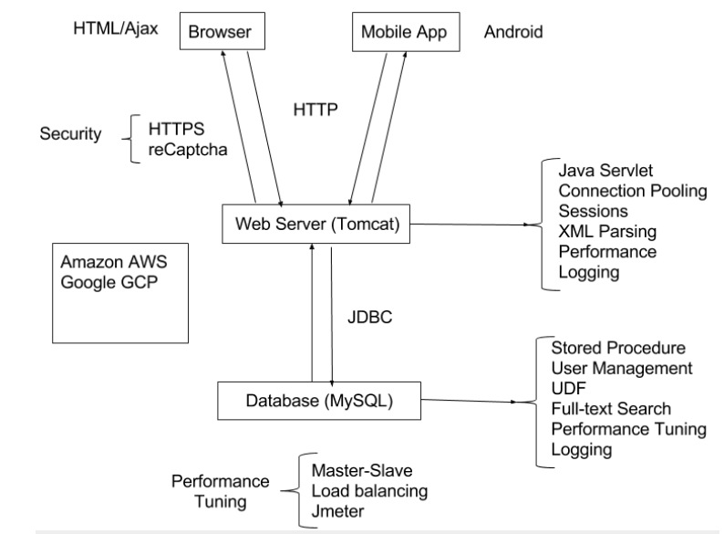
How It’s Being Built
Using Front end and Back end Separation.
Front end is being built using HTML, CSS, and JavaScript.
Using Boot Strap/React/Angular Frameworks for responsive design.
Back end is being built using Java Servlets and communicating with a MySQL database using JDBC.
Java Servlets will be on a Tomcat server. This can be deployed to AWS or Google Cloud Platform for Production.

Slide 5

Who We Are and What We’re Doing(we can talk about the previous projects that we’ve worked on here)
Kevin Truong
Student Studying Computer Science and Mathematics at University of California, Irvine.
Will be working on the back end of the web application.
Angel Mendoza
Nick Cohenour

Slide 6
Logistics
Timeline: 13 weeks
Cost: $3000

