Slide 1

Deno
A Javascript Runtime

Slide 2
Deno Background
Ryan Dahl’s regrets with Node
No Promises (at the start)
Node JS and Web JS had a different experience
Huge Bundles (node_module sizes)
Thus Deno was Created

Slide 3
Deno Runtime
Built In Rust (Using the V8 Engine)
JavaScript, TypeScript, and WebAssembly runtime with secure defaults
Also created by Ryan Dahl (Creator of Node)
Provides web platform functionality and adopts web platform standards
Supports TypeScript out of the box
Has a set of reviewed (audited) standard modules that are guaranteed to work with Deno (deno.land/std)
Can bundle scripts into a single JavaScript file or executable

Slide 4
Install & Create New App
curl -fsSL https://deno.land/install.sh | sh – Bash
brew install deno – Homebrew
deno init

Slide 5
Deno Tooling
Provided built-in development tooling
Linter - deno lint
Test Runner - deno test
Formatter - deno fmt
Language server for your editor

Slide 6
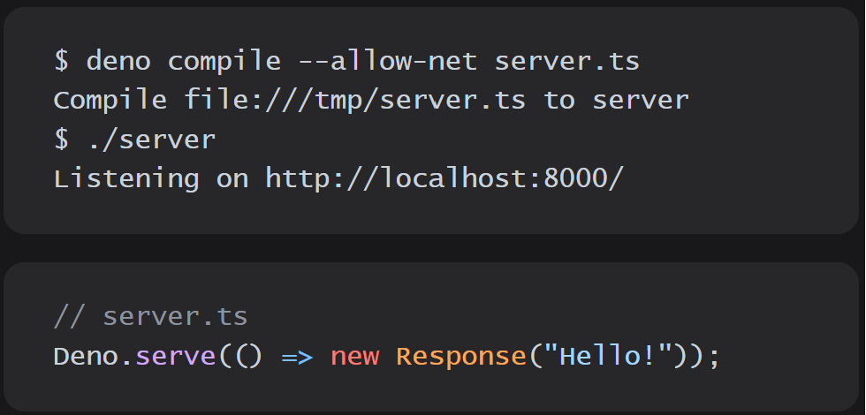
Simple Server in Deno
deno run --allow-net server.js

Slide 7
Gotchas
With Deno being secure by default, there is a tendency to run deno with a command like,
deno run --unstable -A somefile.ts
deno run --unstable -A somefile.js
Deno-Node compatibility mode was removed in version 1.25
NPM compatibility can still be used for frontend apps

Slide 8
Node vs. Deno Cheat Sheet
Node | Deno
node file.js | deno run file.js
npm i -g | deno install
npm run | deno task
package.json | deno.json
eslint | deno lint
prettier | deno fmt
jest/mocha/chai/etc | deno test

Slide 9

Questions

Slide 10
Connect with Me
linkedin.com/in/kctolli
developer@ktolliver.org
ktolliver.org

