Slide 1
Families of Functions
Transformations of the Parent Graphs

Slide 2
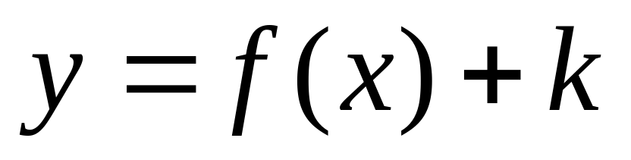

Vertical Translation
Notes:
The +𝑘 affects the y-values and shifts the graph up or down. This transformation is always done last.

Slide 3
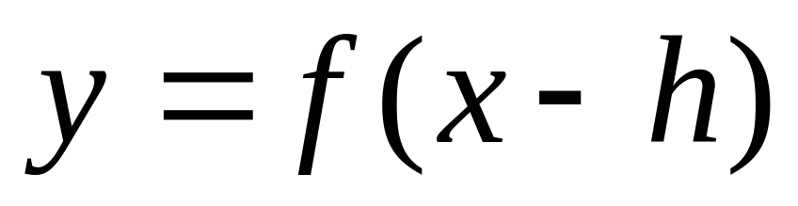

Horizontal Translation
Notes:
The −ℎ affects the x-value and moves the graph right or left. Remember that it moves in the opposite direction of the sign. Thus, if it is x+3 then it moves 3 units to the left and if it is x-4 it moves 4 units to the right.

Slide 4
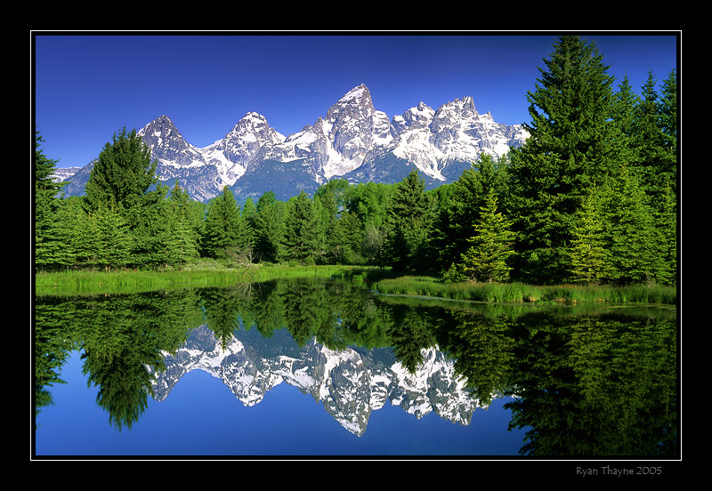
Reflection
http://www.trekearth.com/gallery/North_America/United_States/photo382896.htm

Slide 5
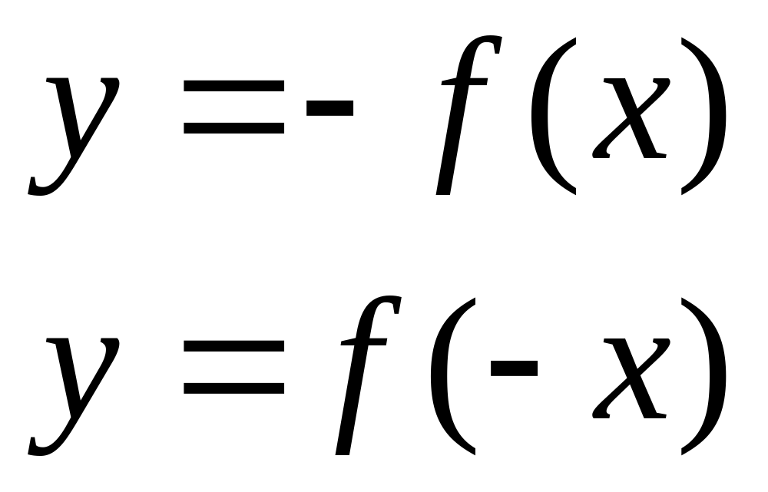
Reflection
http://www.trekearth.com/gallery/North_America/United_States/photo382896.htm
Notes:
The most common reflection is the reflection over the x-axis which is done by 𝑦=−𝑓(𝑥). The 𝑦=𝑓(−𝑥) reflects the graph over the y-axis.

Slide 6

Stretching/Shrinking

Slide 7





Stretching/Shrinking
Where
Where
Notes:
Notice the stretching and shrinking affect the y-value. You stretch/shrink a graph by multiplying each y-value by the a value. At this point you should also notice that the a-value does two transformations: reflection over the x-axis and stretch/shrink of the y-values.

Slide 8
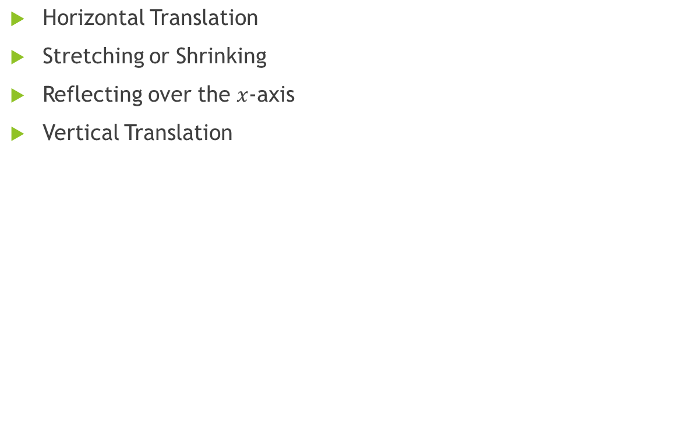
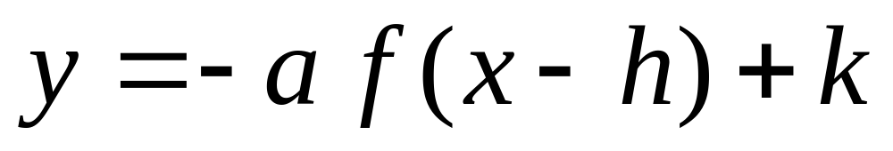
Order of Transformations

Slide 9
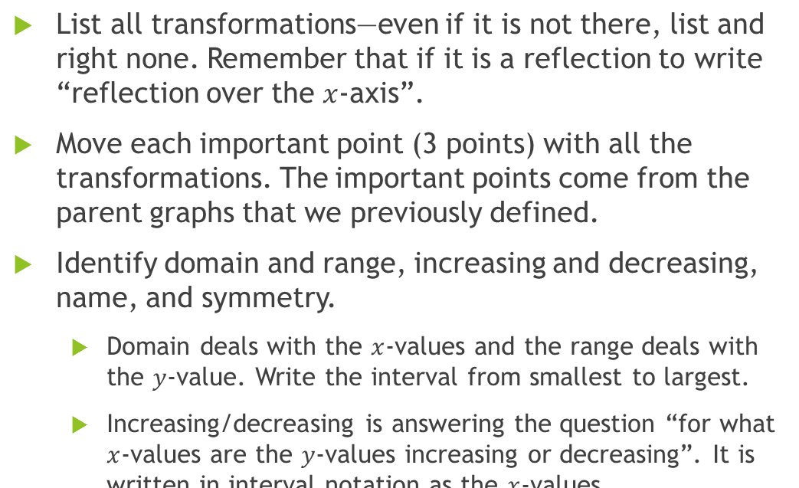
How to graph a function with transformations?

Slide 10
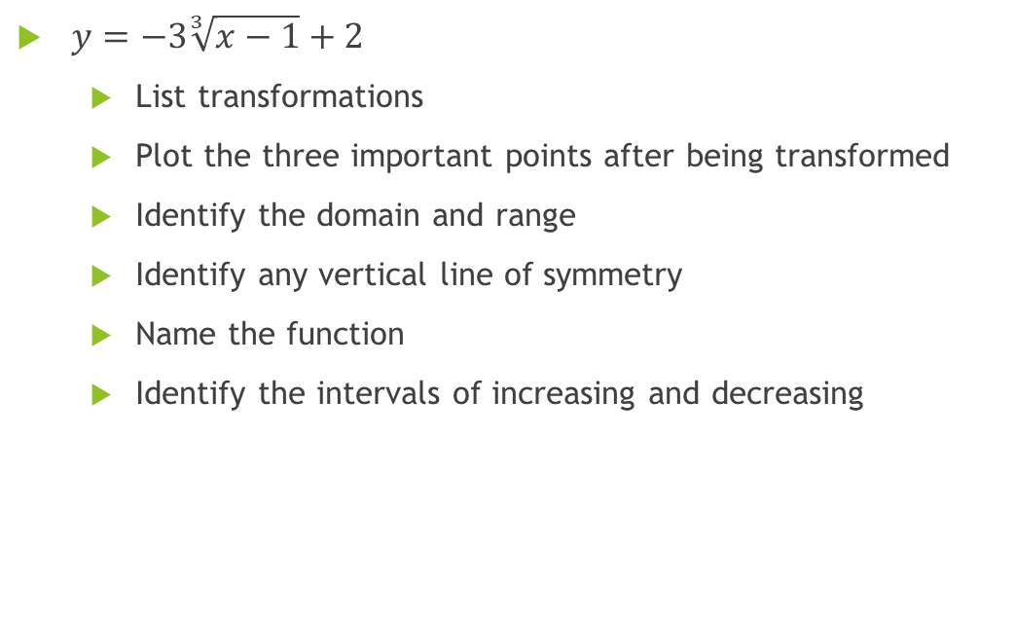
Lets try one!

