Slide 1
SSA Side Side Angle
Using the Law of Sines to solve oblique triangles
The Ambiguous Case

Slide 2
SSA
We know two sides and one angle
but the angle is NOT between the sides
We know the length of this side (not drawn).
It is opposite of the angle we know.
We know the length of this side
This is the height. We don’t know it but we can find out using right triangle trig.
This is the only angle we know
We don’t know the length of this side.

Slide 3
SSA
Let’s add numbers!
We know the length of this side (not drawn).
It is opposite of the angle we know.
We know the length of this side
This is the height. We don’t know it but we can find out using right triangle trig.
This is the only angle we know
We don’t know the length of this side.

Slide 4
SSA
Let’s add numbers!
We know the length of this side (not drawn).
It is opposite of the angle we know.
4
This is the height. We don’t know it but we can find out using right triangle trig.
This is the only angle we know
We don’t know the length of this side.

Slide 5
SSA
Let’s add numbers!
We know the length of this side (not drawn).
It is opposite of the angle we know.
4
This is the height. We don’t know it but we can find out using right triangle trig.
30˚
We don’t know the length of this side.

Slide 6
SSA
Let’s add numbers!
2
We know the length of this side.
It is opposite of the angle we know.
We know the length of this side opposite of the angle we know.
(It is not drawn yet because we don’t know the angle.)
4
This is the height. We don’t know it but we can find out using right triangle trig.
30˚
We don’t know the length of this side.

Slide 7
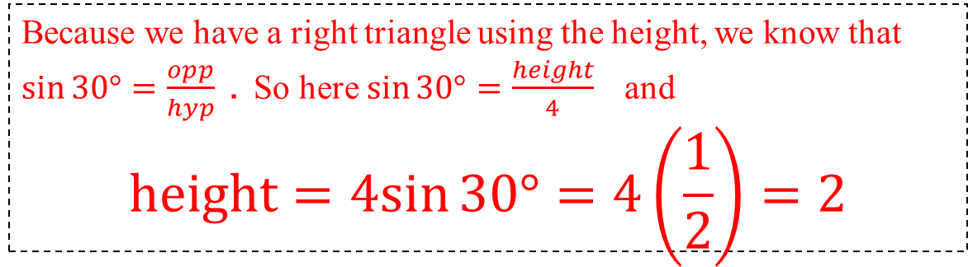
SSA
We need to find the height!
2
We know the length of this side.
It is opposite of the angle we know.
We know the length of this side opposite of the angle we know.
(It is not drawn yet because we don’t know the angle.)
4
height
30˚
We don’t know the length of this side.
Because we have a right triangle using the height, we know that $\sin{30°=\frac{opp}{hyp}}$ . So here $\sin{30°=\frac{height}{4}}$ and
$$height=4sin{30°}=4\left(\frac{1}{2}\right)=2$$

Slide 8
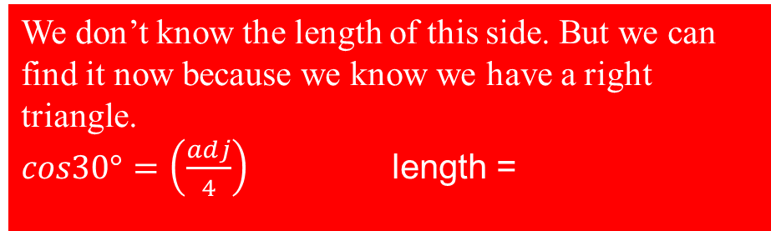
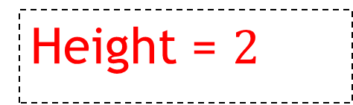
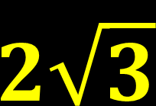
SSA
We have only one possibility for a triangle
Because the length = height
A RIGHT TRIANGLE!
2
We know the length of this side.
It is opposite of the angle we know.
4
Height = $2$
30˚
We don’t know the length of this side.
We don’t know the length of this side. But we can find it now because we know we have a right triangle.
$cos30°=\left(\frac{adj}{4}\right)$ length =
$$2\sqrt{3}$$

Slide 9

SSA
What if the length of the side were SMALLER than the height?
1
We know the length of this side.
It is opposite of the angle we know.
We know the length of this side opposite of the angle we know.
(It is not drawn yet because we don’t know the angle.)
4
30˚
Height = $2$
We don’t know the length of this side.

Slide 10

SSA
What if the length of the side were smaller than the height?
1
We know the length of this side.
It is opposite of the angle we know.
4
There can be NO TRIANGLE because it is too short to touch the third side!
30˚
Height = $2$
We don’t know the length of this side.

Slide 11
SSA
What if the length of the side were larger than the height but smaller than the other known side?
3
We know the length of this side.
It is opposite of the angle we know.
4
30˚
Height = $2$
We don’t know the length of this side.

Slide 12
SSA
What if the length of the side were larger than the height but smaller than the other known side?
3
We know the length of this side.
It is opposite of the angle we know.
4
30˚
Height = $2$
We don’t know the length of this side.

Slide 13
SSA
What if the length of the side were larger than the height but smaller than the other known side?
3
We know the length of this side.
It is opposite of the angle we know.
4
There is One small TRIANGLE!
3
And One larger TRIANGLE!
30˚
Height = $2$
So TWO possible TRIANGLES!
We don’t know the length of this side.

Slide 14

SSA
What if the length of the side were larger than the height but smaller than the other known side?
The Law of Sines will give us the larger triangle
4
3
There is One small TRIANGLE!
And One larger TRIANGLE!
30˚
Height = $2$
We don’t know the length of this side.
Find the angle opposite the known side using the Law of Sines
$$α$$

Slide 15

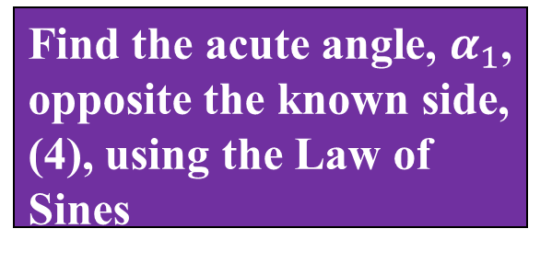
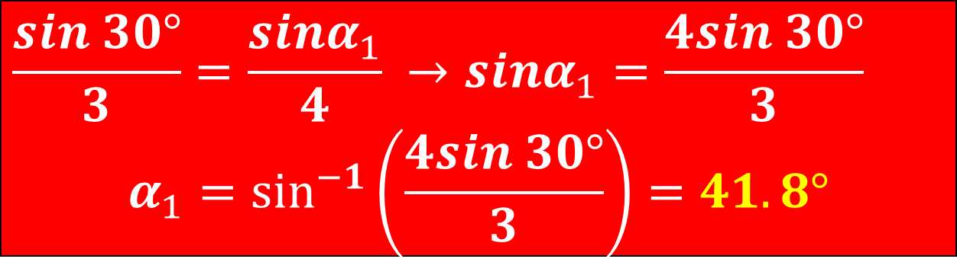
SSA
What if the length of the side were larger than the height but smaller than the other known side?
The Law of Sines will give us the larger triangle with an acute angle
4
3
Find the acute angle, $α_{1}$, opposite the known side, (4), using the Law of Sines
30˚
$$α_{1}$$
$$\frac{sin 30°}{3}=\frac{sinα_{1}}{4} →sinα_{1}=\frac{4sin 30°}{3}$$
$$α_{1}=\sin^{−1}\left(\frac{4sin 30°}{3}\right)=41.8°$$
We don’t know the length of this side.

Slide 16

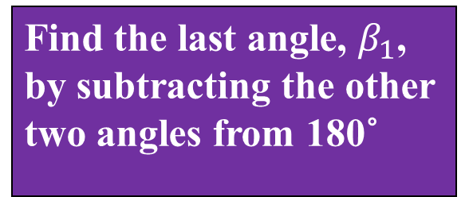

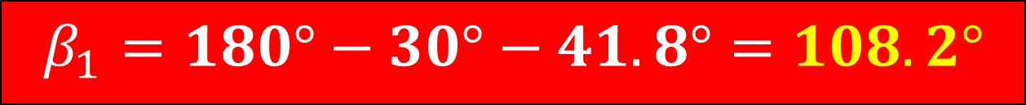

SSA
What if the length of the side were larger than the height but smaller than the other known side?
$$β_{1}$$
Find the last angle, $β_{1}$, by subtracting the other two angles from 180˚
4
3
30˚
$$41.8°$$
We don’t know the length of this side.
$$β_{1}=180°−30°−41.8°=108.2°$$
$$108.2°$$

Slide 17
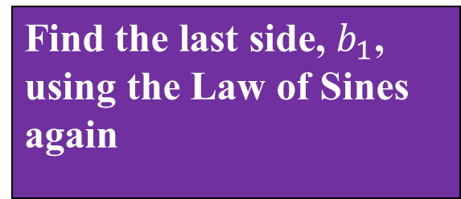


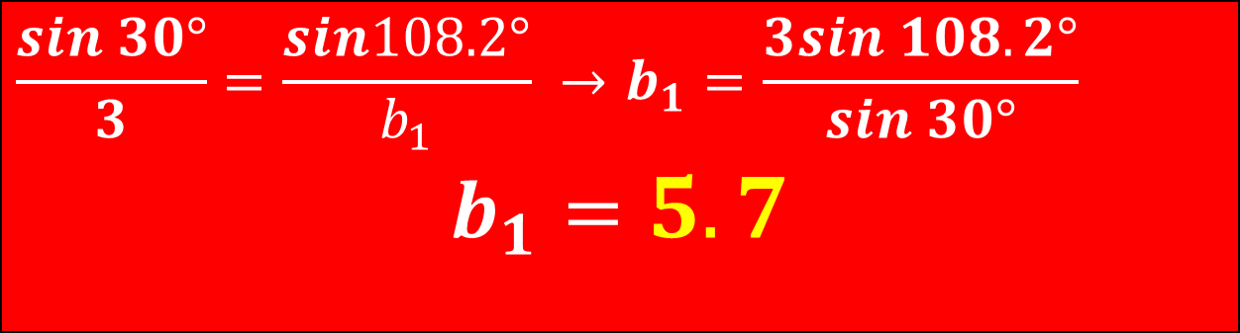

SSA
What if the length of the side were larger than the height but smaller than the other known side?
$$b_{1}$$
Find the last side, $b_{1}$, using the Law of Sines again
4
$$108.2°$$
3
30˚
$$41.8°$$
$$5.7$$
$$\frac{sin 30°}{3}=\frac{sin108.2°}{b_{1}} →b_{1}=\frac{3sin 108.2°}{sin 30°}$$
$$b_{1}=5.7$$

Slide 18


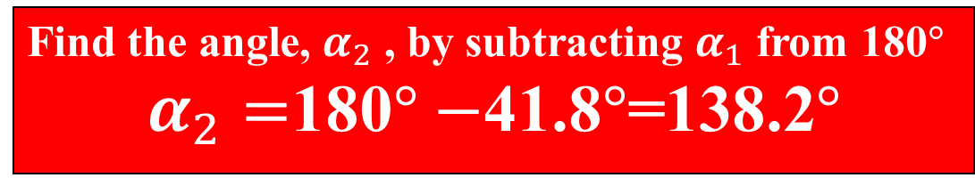
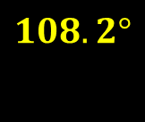


SSA
What if the length of the side were larger than the height but smaller than the other known side?
Now we can solve the Smaller Triangle
4
$$108.2°$$
3
There is One small TRIANGLE!
3
And One larger TRIANGLE!
30˚
$$41.8°$$
$$α_{2}$$
$$α_{1}$$
138.2$°$
$$5.7$$
Find the angle, $α_{2}$ , by subtracting $α_{1}$ from 180$°$
$α_{2}=$180$°−$41.8$°$=138.2$°$

Slide 19

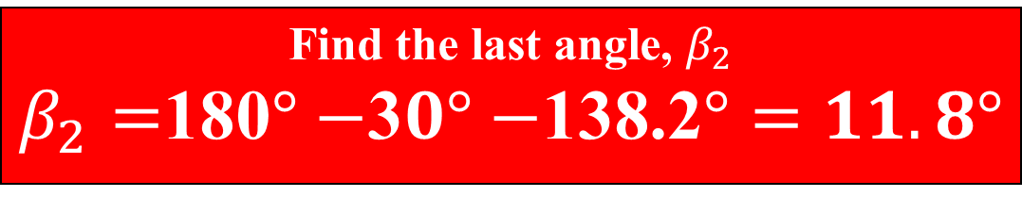
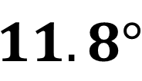
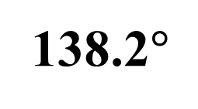
SSA
What if the length of the side were larger than the height but smaller than the other known side?
$$11.8°$$
4
3
3
30˚
$$α_{2}$$
138.2$°$
Find the last angle, $β_{2}$ $β_{2}=$180$°−$3$0°−$138.2$°=11.8°$

Slide 20

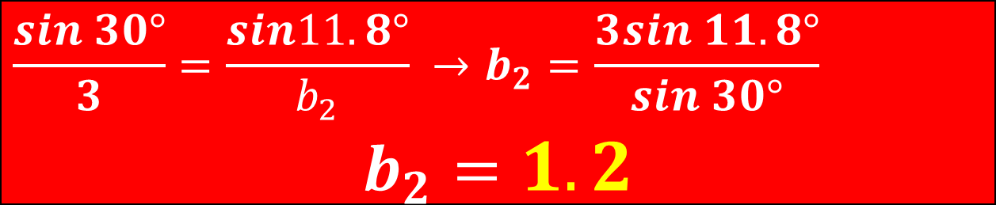

SSA
What if the length of the side were larger than the height but smaller than the other known side?
Find the last side, $b_{2}$, using the Law of Sines again
$$11.8°$$
4
3
3
30˚
$$α_{2}$$
138.2$°$
$$1.2$$
$$\frac{sin 30°}{3}=\frac{sin11.8°}{b_{2}} →b_{2}=\frac{3sin 11.8°}{sin 30°}$$
$$b_{2}=1.2$$

Slide 21
SSA
What if the length of the side were larger than the height and larger than the other known side?
5
We know the length of this side.
It is opposite of the angle we know.
4
30˚
Height = $2$
We don’t know the length of this side.

Slide 22
SSA
What if the length of the side were larger than the height and larger than the other known side?
5
We know the length of this side.
It is opposite of the angle we know.
4
30˚
Height = $2$
We don’t know the length of this side.

Slide 23
SSA
What if the length of the side were larger than the height and larger than the other known side?
5
We know the length of this side.
It is opposite of the angle we know.
4
It is too long to make a
small TRIANGLE!
30˚
Height = $2$
We don’t know the length of this side.

Slide 24
SSA
What if the length of the side were larger than the height and larger than the other known side?
5
We know the length of this side.
It is opposite of the angle we know.
4
So it can make only ONE
large TRIANGLE!
30˚
Height = $2$
We don’t know the length of this side.

Slide 25

SSA
What if the length of the side were larger than the height and larger than the other known side?
5
We know the length of this side.
It is opposite of the angle we know.
4
So it can make only ONE
large TRIANGLE!
30˚
Height = $2$
We don’t know the length of this side.
Find the angle opposite the known side using the Law of Sines
$$α$$

Slide 26



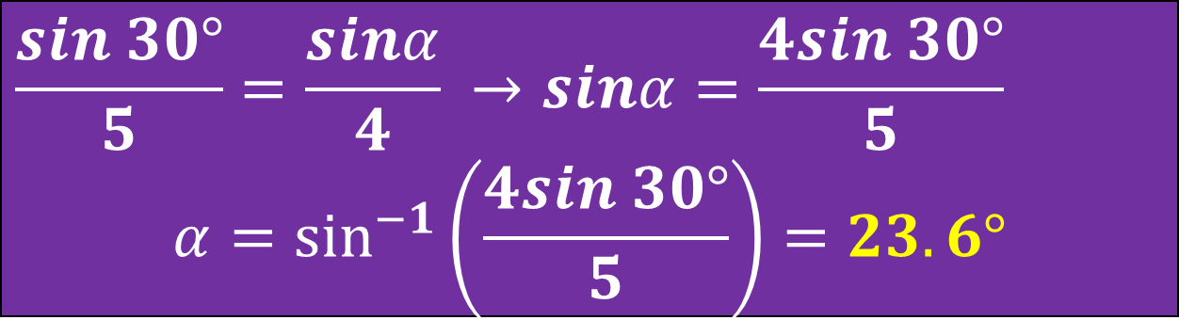
SSA
What if the length of the side were larger than the height and larger than the other known side?
Find the angle, $α$, opposite the known side, (4), using the Law of Sines
5
4
30˚
Height = $2$
$$α$$
$$23.6°$$
$$\frac{sin 30°}{5}=\frac{sinα}{4} →sinα=\frac{4sin 30°}{5}$$
$$α=\sin^{−1}\left(\frac{4sin 30°}{5}\right)=23.6°$$
We don’t know the length of this side.

Slide 27

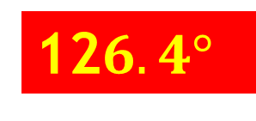
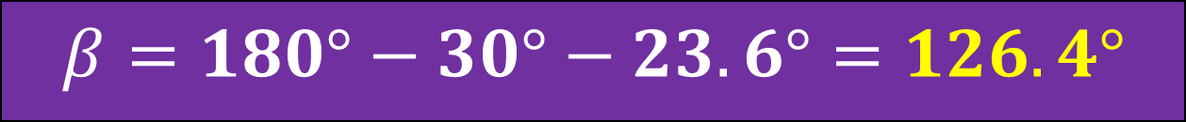
SSA
What if the length of the side were larger than the height and larger than the other known side?
Find the last angle, $β$, by subtracting the other two angles from 180˚
4
5
12$6.4°$
30˚
Height = $2$
$$α$$
$$23.6°$$
$$β=180°−30°−23.6°=126.4°$$
We don’t know the length of this side.

Slide 28
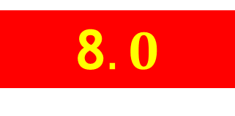
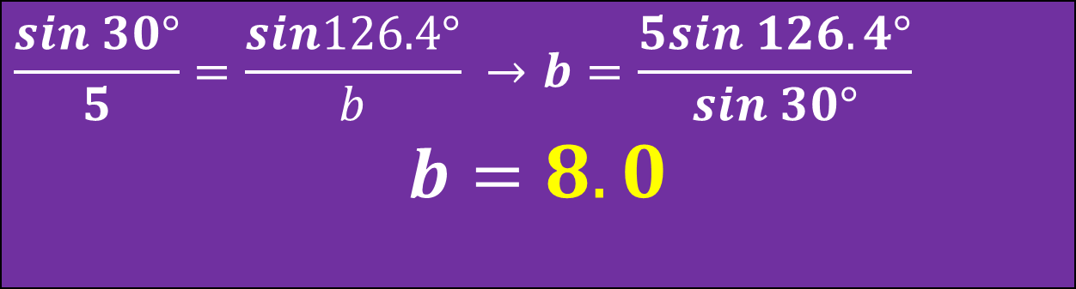


SSA
What if the length of the side were larger than the height and larger than the other known side?
Find the last side, $b$, using the Law of Sines again
5
4
1$26.4°$
30˚
Height = $2$
8$.0$
$$α$$
$$23.6°$$
$$\frac{sin 30°}{5}=\frac{sin126.4°}{b} →b=\frac{5sin 126.4°}{sin 30°}$$
$$b=8.0$$
We don’t know the length of this side.

Slide 29
Test Yourself!!!

Slide 30
SSA
TEST YOURSELF
3.7
We know the length of this side.
It is opposite of the angle we know.
18.4
39.6˚
We don’t know the length of this side.
How many triangles can have the given parts?

Slide 31
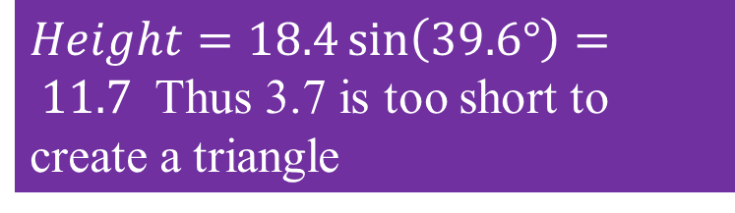
SSA
TEST YOURSELF
3.7
We know the length of this side.
It is opposite of the angle we know.
18.4
Zero
$Height=18.4\sin\left(39.6°\right)= 11.7$ Thus 3.7 is too short to create a triangle
39.6˚
We don’t know the length of this side.
How many triangles can have the given parts?

Slide 32
SSA
TEST YOURSELF
12.4
We know the length of this side.
It is opposite of the angle we know.
9.8
75.3˚
We don’t know the length of this side.
How many triangles can have the given parts?

Slide 33
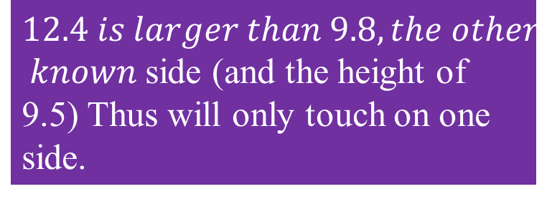
SSA
TEST YOURSELF
12.4
We know the length of this side.
It is opposite of the angle we know.
9.8
One
$$12.4 is larger than 9.8, the other$$
$known$ side (and the height of 9.5) Thus will only touch on one side.
75.3˚
We don’t know the length of this side.
How many triangles can have the given parts?

Slide 34
SSA
TEST YOURSELF
8.1
We know the length of this side.
It is opposite of the angle we know.
10.6
41.2˚
We don’t know the length of this side.
How many triangles can have the given parts?

Slide 35
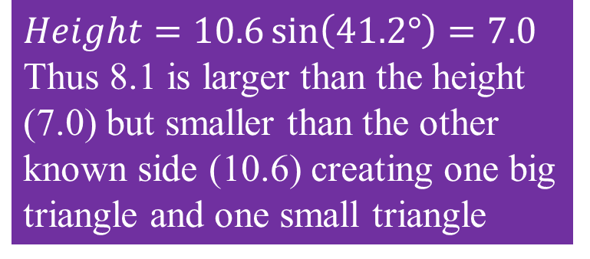
SSA
TEST YOURSELF
8.1
We know the length of this side.
It is opposite of the angle we know.
10.6
Two!
$Height=10.6\sin\left(41.2°\right)=7.0$ Thus 8.1 is larger than the height (7.0) but smaller than the other known side (10.6) creating one big triangle and one small triangle
41.2˚
We don’t know the length of this side.
How many triangles can have the given parts?

