Slide 1
SPICE
Simulation Program with Integrated Circuit Emphasis
Originally developed at EE Berkeley
Uses mathematical models to describe circuit elements
SPICE3 is the latest variant.
- It allows DC and time transient analysis of nonlinear circuits (transistors, diodes, capacitors, etc., also digital circuitry)
- Command line driven interface
- Available in public domain (written in C)
- Has become de-facto the industry standard
- Many spin-offs exist (use modified SPICE2 or SPICE3 as their engine), such as HSPICE, PSPICE, WinSPICE (commercial)

Slide 2
LTspice
A freeware circuit simulator (Windows or *nix/Wine)
Mac users: install http://winebottler.kronenberg.org/
Netlist syntax is powerful but hard to visualize
LTspice has schematic capture and is much easier to use than traditional text-based SPICE. The user can enter a circuit to be simulated via a graphical user interface
Has virtual scope, makes Bode plots, performs FFT, etc.
Worth learning about
It is fast, expandable, powerful, and free
Most widely used noncommercial CAD electronics software

Slide 3
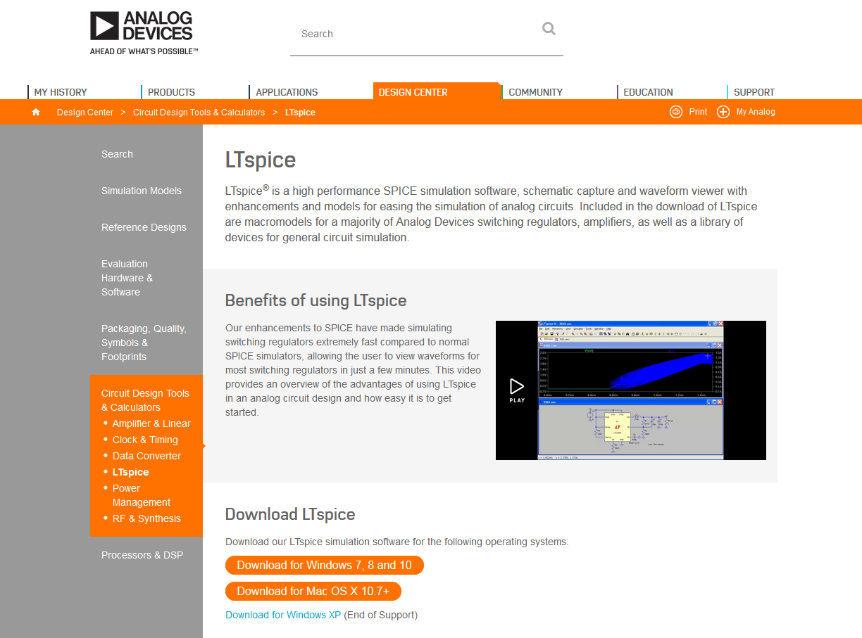
Analog Devices (www.analog.com)

Slide 4
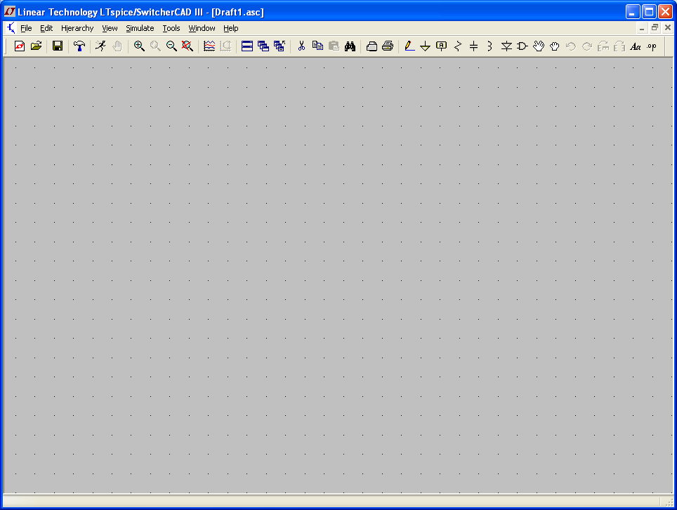
To begin drawing the circuit, click New Schematic, or Ctrl+N
Enable grid if not shown by clicking Ctrl+G

Slide 5
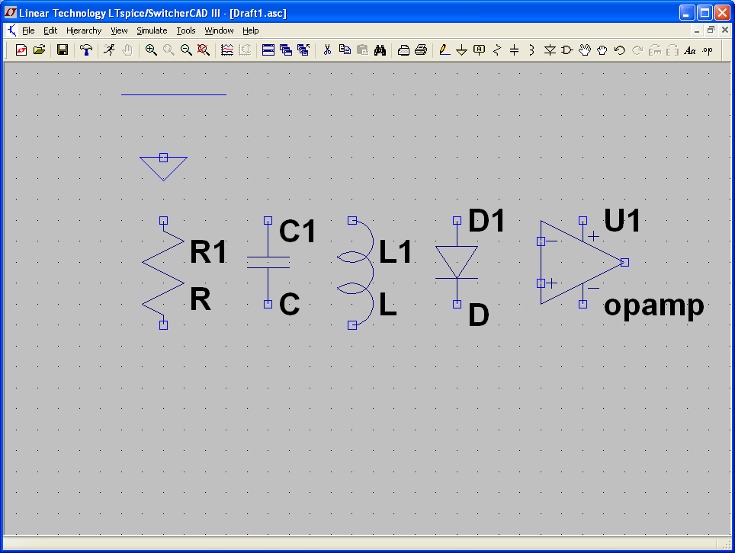
wire
“Component”
ground (required)
To add a component, click on the corresponding icon
Component button contains slew of predefined components: voltage and current sources; transistors; opamps; gates; user-defined stuff
You can Delete (F5 or Ctrl-X) and Move (F7) components, as well as Drag (F8) them (keep the wires connected)

Slide 6
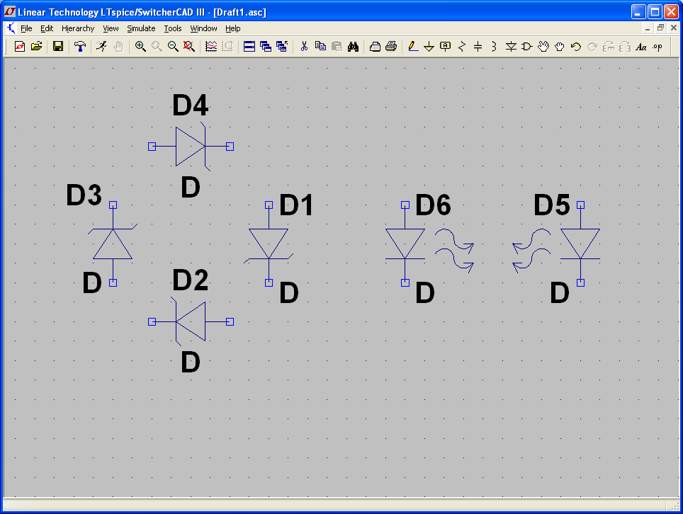
To rotate the component prior to placing press Ctrl-R
To mirror the component prior to placing press Ctrl-E

Slide 7
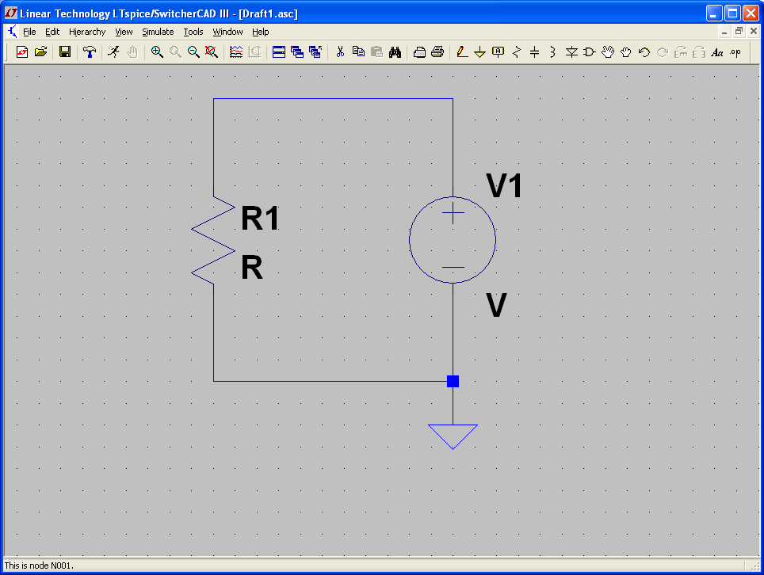
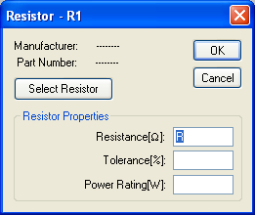
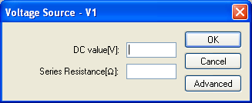
Right-click to enter component value

Slide 8
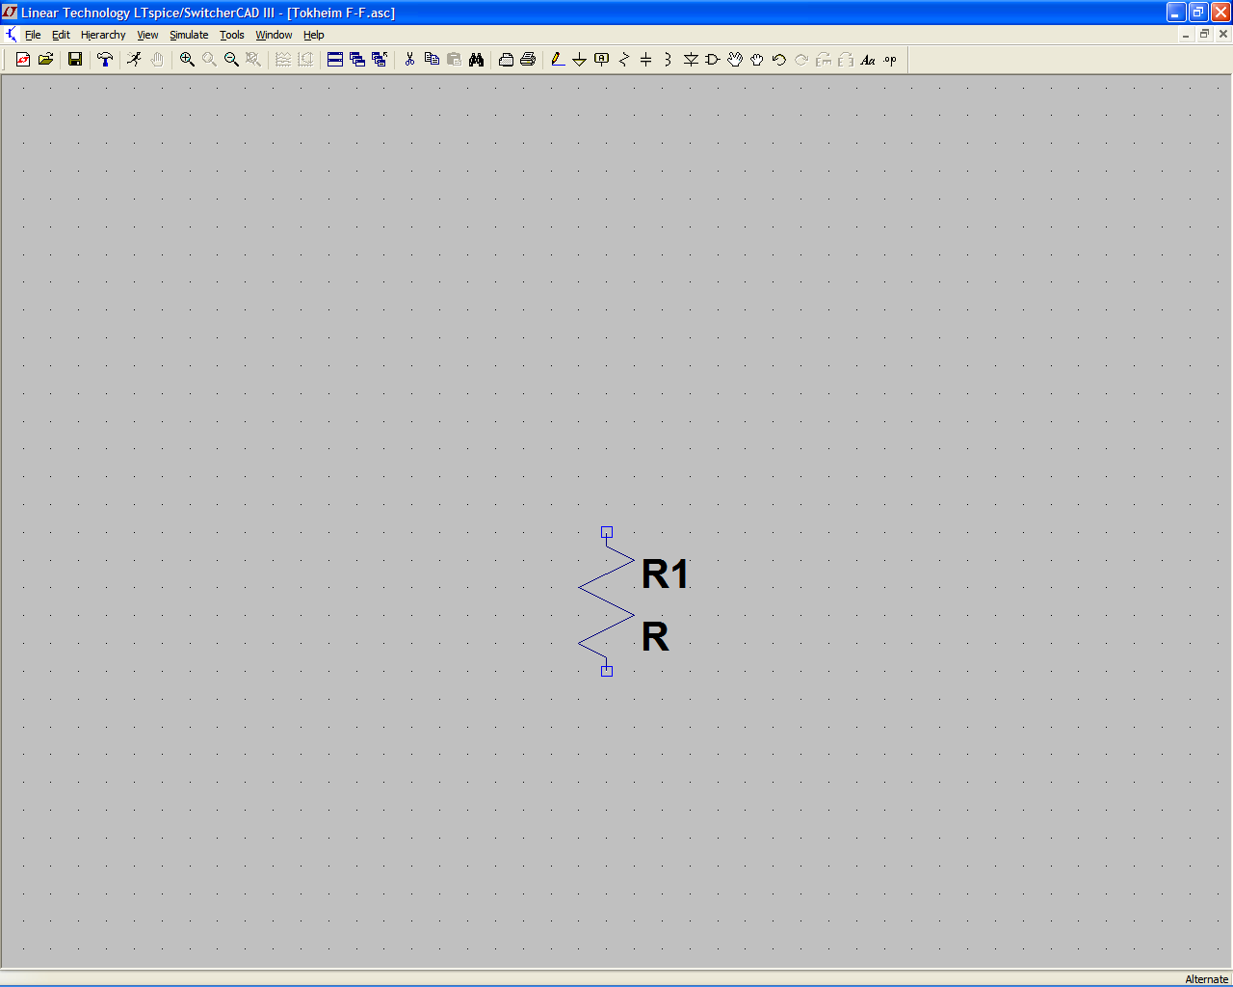
Toolbar Summary
Place Diode
Place Inductor
Place Capacitor
Place Resistor
Label Node
Place Circuit Element
Place Ground
Draw Wire
Simulate
Move
Zoom In
Drag
Pan
Undo
Zoom Out
Find
Auto Scale
Redo
Delete
Rotate
Copy
Mirror
Paste
Place Comment
Place SPICE Directive

Slide 9
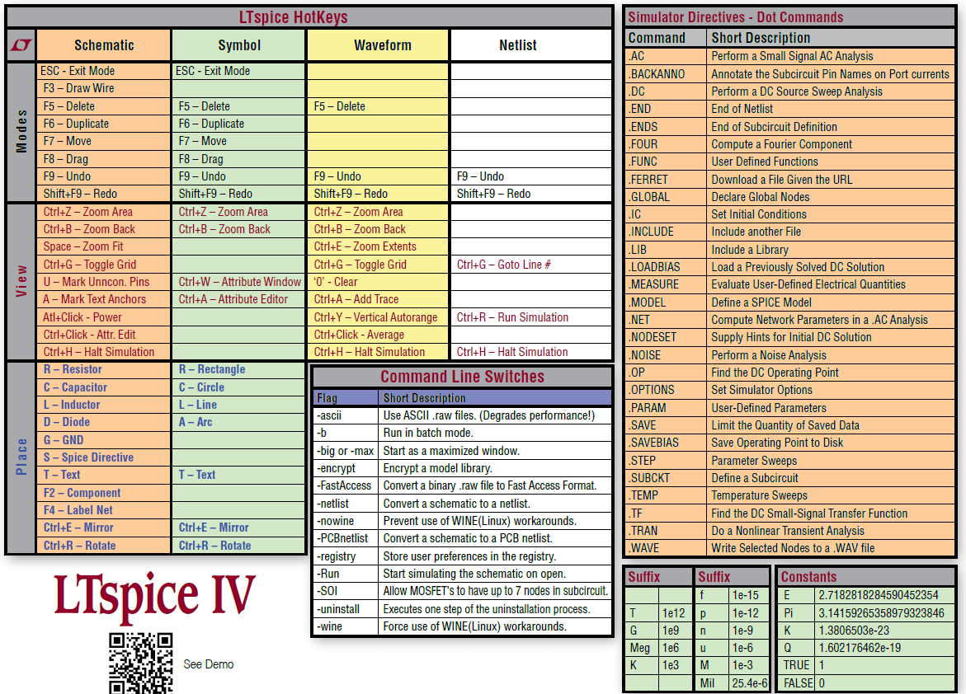
Prompt Sheet from LTspiceIV_flyer.pdf

Slide 10
Prefixes are case insensitive: T = t, G = g, and so on
T = terra = 10¹²
G = giga = 10⁹
MEG = meg = 10⁶
K = kilo = 10³
M = milli = 10⁻³
U = micro = 10⁻⁶
N = nano = 10⁻⁹
P = pico = 10⁻¹²
F = femto = 10⁻¹⁵
No need to enter units, they are assumed (e.g. “1M” is 1mV if entered for voltage, 1ms if entered for time, etc.)

Slide 11

Few gotchas
“M” and “m” are interpreted the same by SPICE. Thus, a resistor value of 10M is the same as 10m (ten milliohms)
Use 10MEG (or 10E6) to specify ten megohms
Do not enter “1F” or “1f” as the capacitance for a one-farad capacitor (enter “1”). “F” and “f” designate the prefix femto (10⁻¹⁵)
When simulating astable circuits (multivibrator), specify some small nonzero initial voltage in the positive feedback to seed the oscillations
Initial conditions SPICE directive

Slide 12
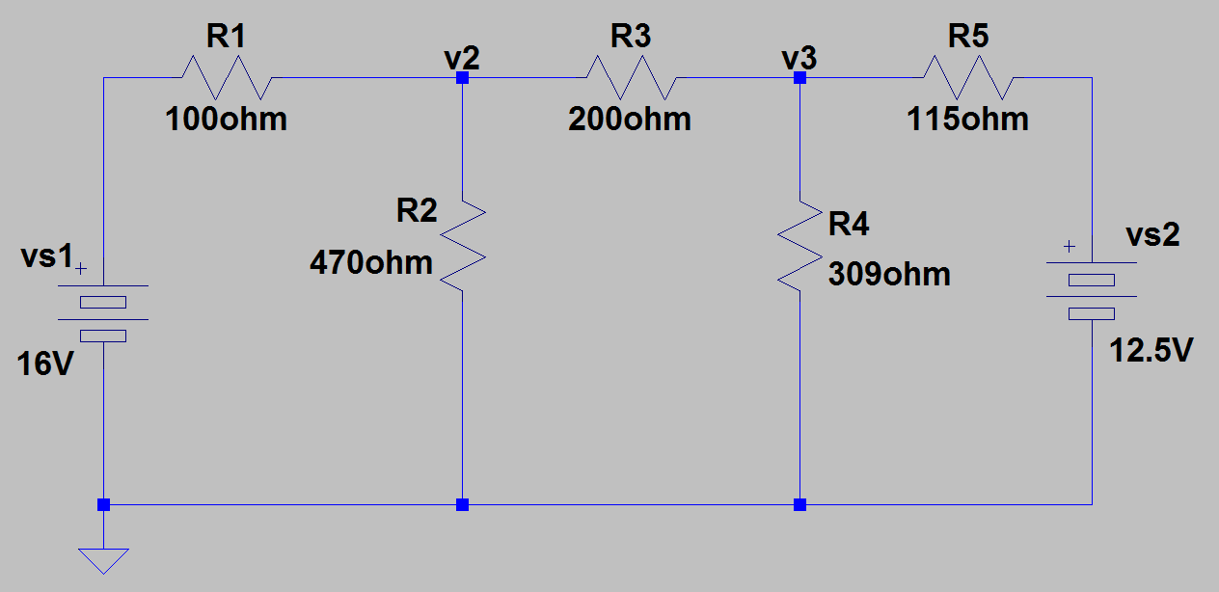
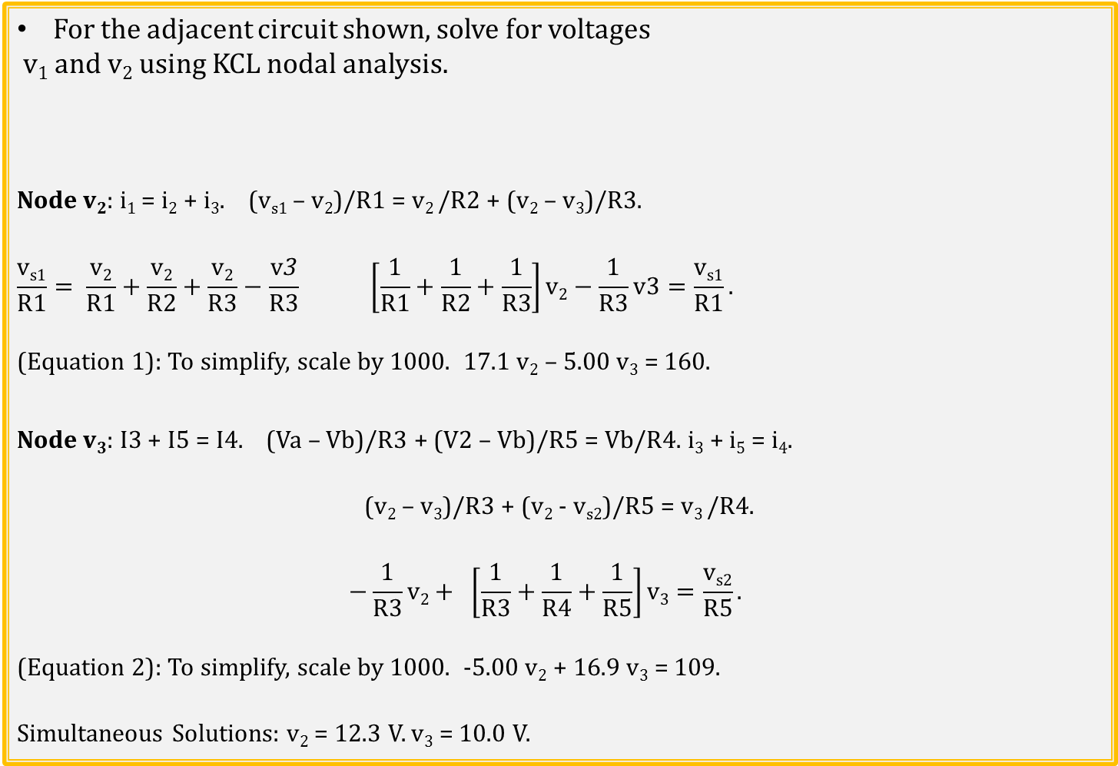
Nodal Analysis Example
For the adjacent circuit shown, solve for voltages
v₁ and v₂ using KCL nodal analysis.
Node v₂: i₁ = i₂ + i₃. (v_{s1} – v₂)/R1 = v₂ /R2 + (v₂ – v₃)/R3.
$$\frac{\text{v}\text{s}\text{1}}{R1}= \frac{\text{v}\text{2}}{R1}+\frac{\text{v}\text{2}}{R2}+\frac{\text{v}\text{2}}{R3}−\frac{\text{v}\text{3}}{R3} \left[\frac{1}{R1}+\frac{1}{R2}+\frac{1}{R3}\right]\text{v}\text{2}−\frac{1}{R3}\text{v}\text{3}=\frac{\text{v}\text{s}\text{1}}{R1}.$$
(Equation 1): To simplify, scale by 1000. 17.1 v₂ – 5.00 v₃ = 160.
Node v₃: I3 + I5 = I4. (Va – Vb)/R3 + (V2 – Vb)/R5 = Vb/R4. i₃ + i₅ = i₄.
(v₂ – v₃)/R3 + (v₂ - v_{s2})/R5 = v₃ /R4.
$$−\frac{1}{R3}\text{v}\text{2}+ \left[\frac{1}{R3}+\frac{1}{R4}+\frac{1}{R5}\right]\text{v}3=\frac{\text{v}s2}{R5}.$$
(Equation 2): To simplify, scale by 1000. -5.00 v₂ + 16.9 v₃ = 109.
Simultaneous Solutions: v₂ = 12.3 V. v₃ = 10.0 V.
Notes:
Image by instructor

Slide 13
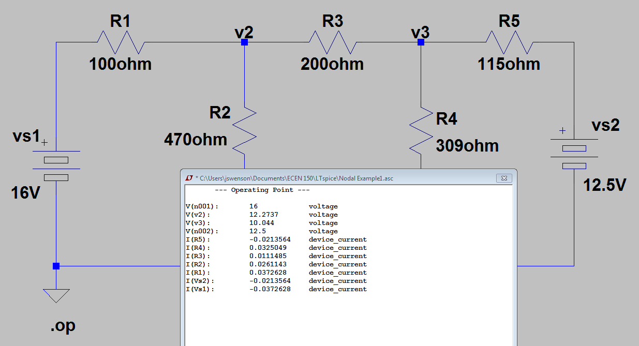
Nodal Analysis Example (Continued)
LTspice .op (Operating Point) analysis solves for all voltages and currents in < 2 seconds.
Notes:
Image by instructor

Slide 14
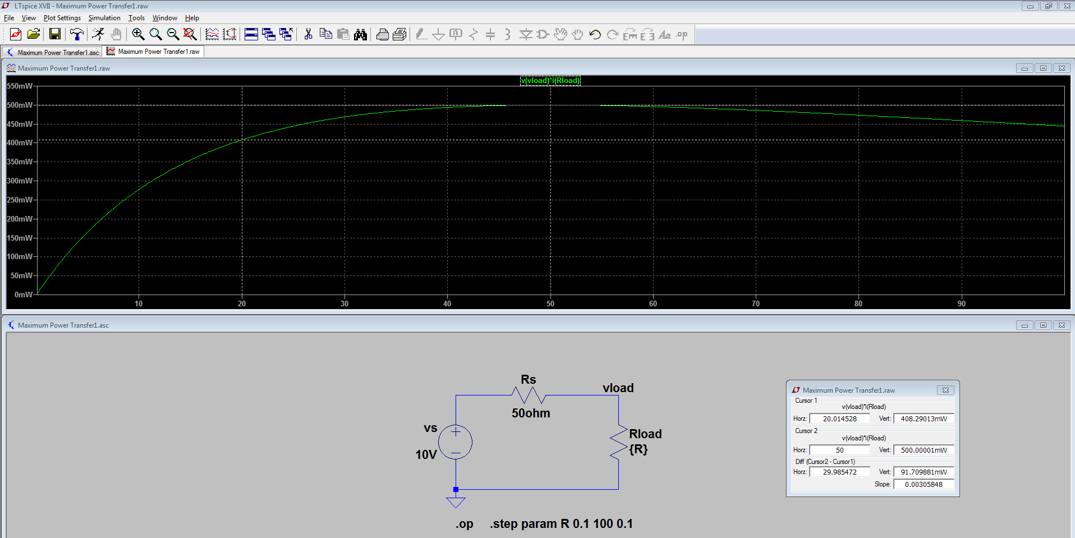
LTspice DC Sweep
LTspice .step param, sweeps parameter R from 0.1 Ω to 100 Ω in 0.1 Ω steps, determining voltages and currents at each R value.
Plot pane allows viewing of all voltages and currents, and expressions, which is the above example is p = v_{load}i_{load}.
Cursors allow reading of data point values and differences between data point values.
Notes:
Image by instructor

Slide 15
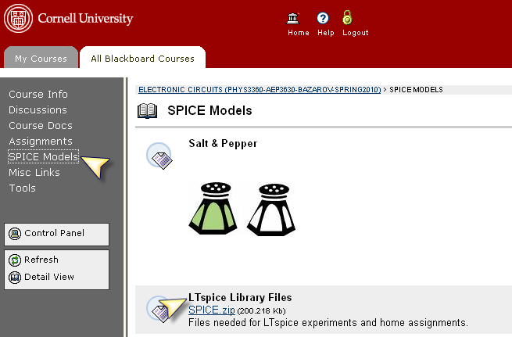
Two examples
We will look at how to setup two examples
Example1: crossover corrected push-pull amp (ex6.10)
Example2: active filter
Any additional files not included with LTspice but required for this course are found under Spice models on the Blackboard.

Slide 16
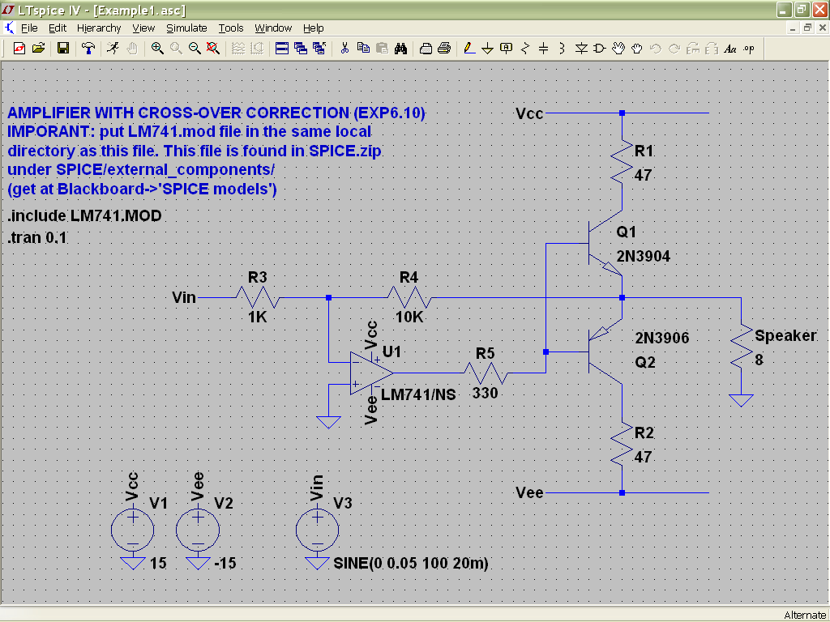
First example demonstrates transient analysis
Next, specify component values for resistors, DC voltages by right-clicking on the elements (be careful, sometimes you may click on the name thinking you are changing the value).
First, create the circuit (you may want to use Ctrl-E, Ctrl-R to mirror and rotate the symbols for best orientation)

Slide 17
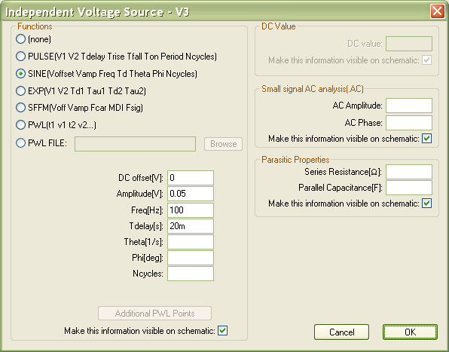
Assigning Vin
Right-click on Vin, then click Advanced. You will see a window like this. Choose SINE Function.
Enter:
DC offset[V] : 0
Amplitudep[V]: 0.05
Freq[Hz]: 100
Tdelay[s]: 20m

Slide 18
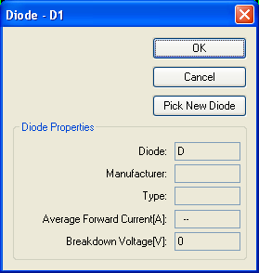
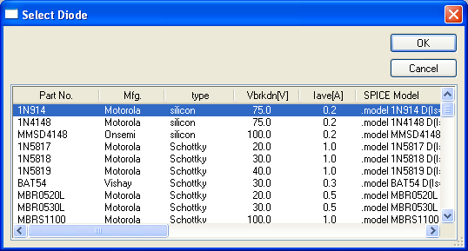
Assigning Diodes and Transistors
If you do not assign diode and transistors, LTspice will use some default models. It may be OK for a simple circuit like the one we are looking at. Real-life situations require more accurate model specific to the actual component being used. E.g. to assign a specific diode model, right-click on it, then click “Pick New Diode” and choose IN914.

Slide 19
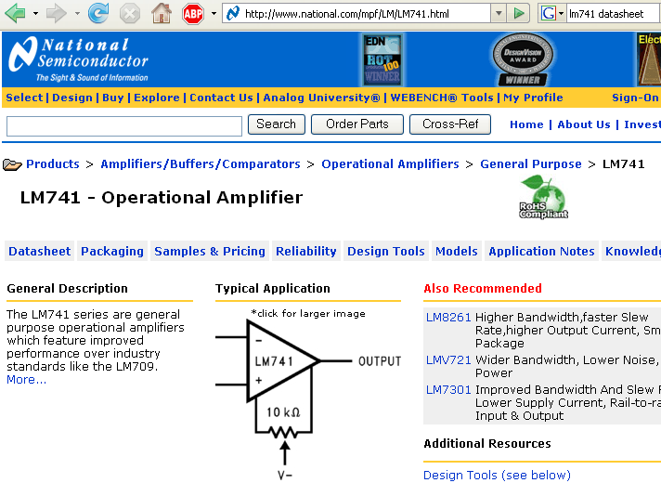
Assigning Transistors and opamp
Similarly, assign the transistors to be 2N3904 and 2N3906
Note: you will find some familiar components missing (e.g. LM741 op-amp); you have to add them to LTspice
All major manufacturers will have SPICE model files online

Slide 20
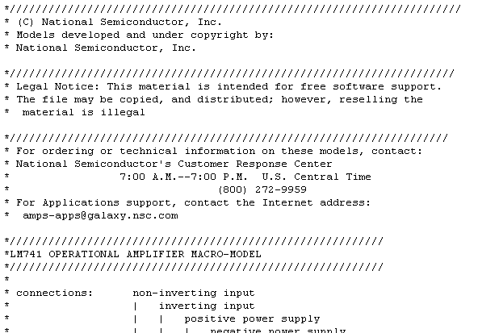
How to add LM741
Google for LM741, you will get to the manufacturer’s web-site with link to Model file LM741.MOD
Download it, it is an ASCII file in SPICE format:
it comes from National Semiconductor
component model describes frequency response, input and output impedance, etc. can be a subcircuit that includes other elements

Slide 21
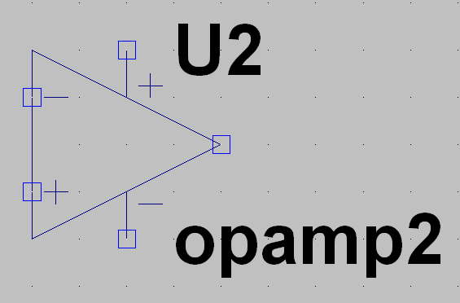
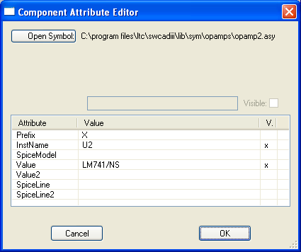

How to add LM741
Place this file where LTspice will look for it, preferably in the local directory (where you circuit file is saved)
Add generic opamp (opamp2) to your circuit
Right-click on the symbol to invoke Component Attribute Editor
Enter Value = LM741/NS (must match the first line in LM741.MOD file, which is not a comment, i.e. not preceded by *, something like .SUBCKT LM741/NS …)
Add SPICE directive

Slide 22
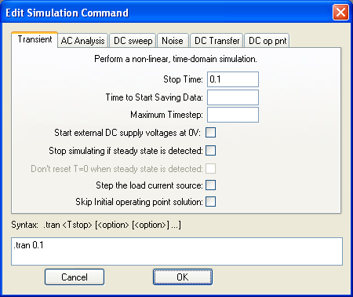

Time Transient Analysis
Choose Simulate → Edit Simulation Cmd
Indicate Stop Time of 0.1 s
Click OK and place SPICE directive somewhere on your circuit
Ready to go!

Slide 23
Looking at the result
LTspice has nice tools to look at the waveforms, voltages or currents, FFT (Fourier Analysis), gain amplitude and phase (in AC analysis)
You can open multiple panes, plot signals versus time or signal versus another signal
You can zoom in, zoom out, also activate scope-like cursor(s) for more accurate measurements on waveforms
By default the mouse cursor transforms into voltage probe , however, when hovering over a component (or pressing Alt over wire), it transforms into current probe
Pressing Alt over an element will report instantaneous power drawn by the element (thermometer icon)

Slide 24
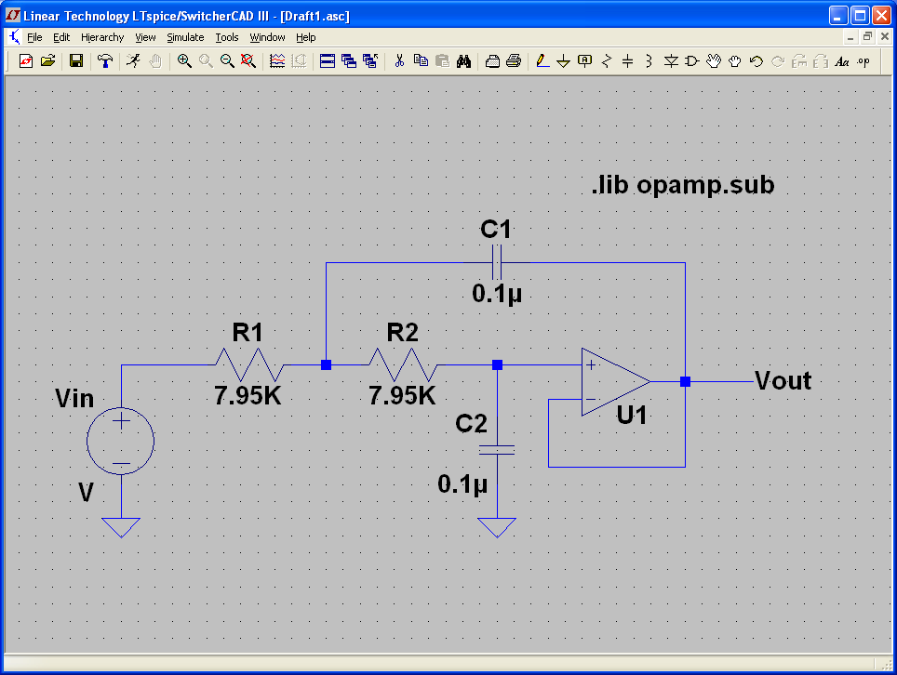
Second example will demonstrate AC analysis
Must include with this opamp!
Use ideal opamp from the list of components

Slide 25
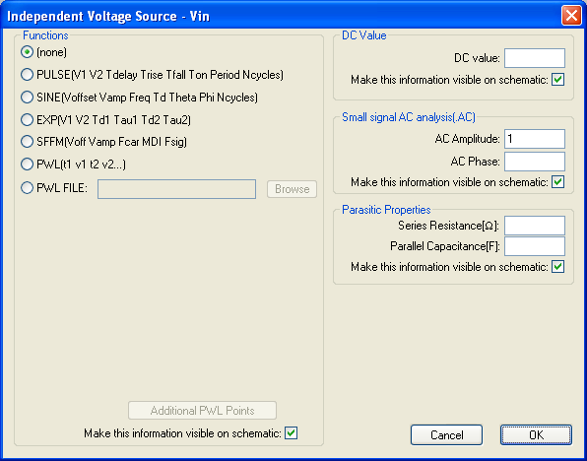
Assigning Vin
Right-click on Vin, then click Advanced. Use Small signal AC analysis section.
AC amplitude 1 volt

Slide 26
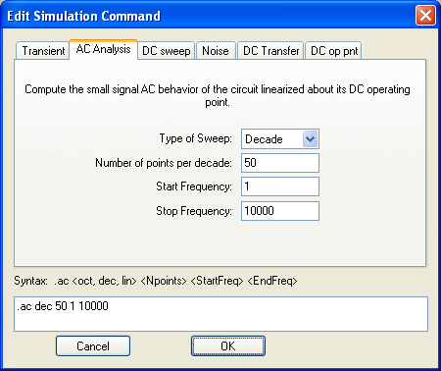

AC Analysis
Choose Simulate → Edit Simulation Cmd
On AC analysis tab specify type of sweep (decade), number of points per decade, initial and final frequencies
Click OK, plant SPICE directive somewhere
Ready to go!

Slide 27
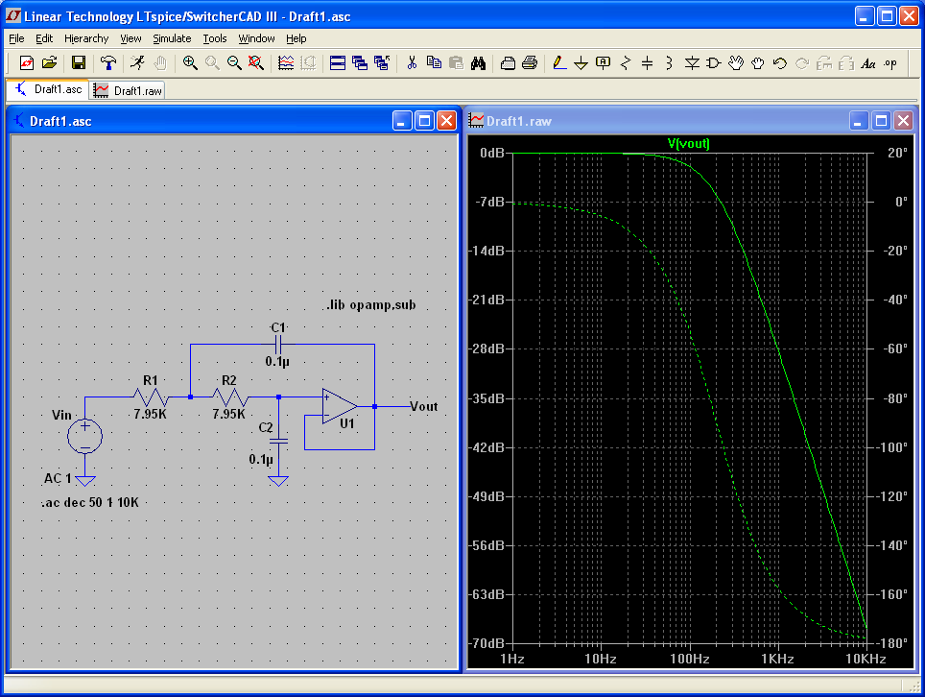
Click on Vout to display Bode plot

Slide 28
Additional resources
Yahoo! LTspice group (great resource, kept active by many thousands of users)

