Slide 1
ECEN 350 Electronic Devices and Circuits
CMOS – Complementary MOS

Slide 2
ECEN 350 – Topics
Semiconductor Physics
IC Op-Amps
Rectifiers
Zeners
Diodes
BJTs
MOSFETs
CMOS
LEDs
Transistor Biasing
Small-Signal Analysis
Amplifier Gain Stages
Frequency Response

Slide 3
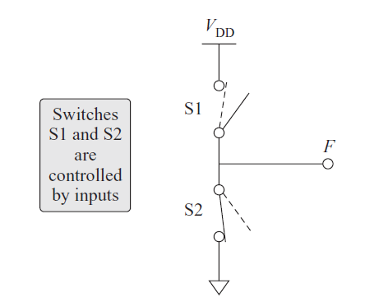
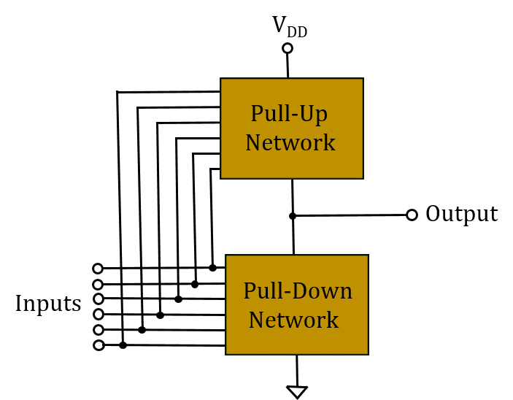
Ideal Digital Logic Gates
Ideal logic inverter has only one switch closed at a time resulting in no
Static power dissipation.
Want the largest possible voltage difference between 1 and 0 level
resulting in the best noise immunity.
Ideal “1” level = V_{DD}.
Ideal “0” level = Gnd (Sometimes referred to a V_{ss} ).
For low-power, want pull-down network transistors off, when pull-up
network transistors are on and vice-versa. (Conduction complements.)
Therefore, need active devices (transistors), rather than passive
resistors for both pull-up and pull-down networks.
Digital CMOS utilizing enhancement mode PMOS and NMOS transitors
satifies all of the above requirements for ideal digital logic gates.
General Purspose
Digital Logic Gate

Slide 4
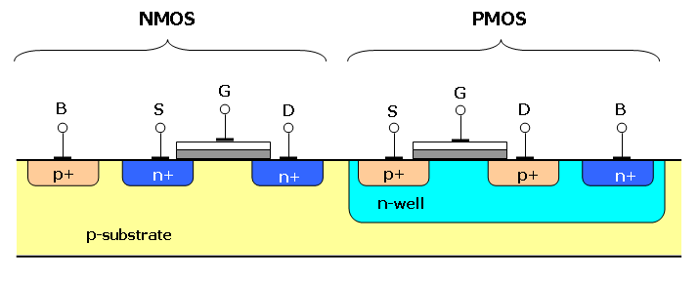
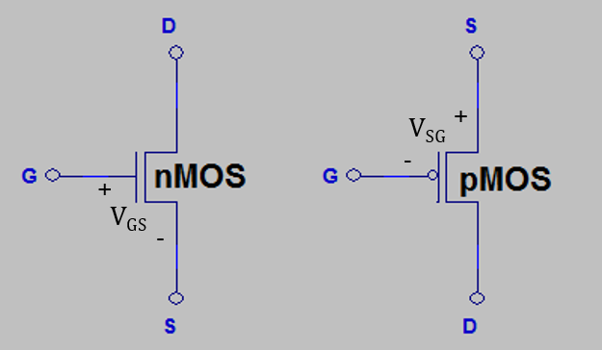
CMOS – Complementary MOS
CMOS uses both p-channel and n-channel MOSFETs on the same substrate as shown below.
CMOS is presently the dominant approach for digital logic in VLSI.
The above schematic symbols are used for n and p – channel Enhancement Mode MOSFETs in VLSI design.
The substrate, which is usually connected to the source, is not illustrated in these simplified symbols for VLSI design.
Need V_{GS} ≥ V_{T} and V_{DS} > 0 V for conventional current flow through an n-channel MOSFET. Hence, it is best to connect the source to a low voltage, ideally ground, for an n-channel MOSFET, making them good pull-down transitors.
Need V_{SG} ≥ |V_{T}| and V_{SD} > 0 V for conventional current flow through a p-channel MOSFET. Hence, it is best to connect the source to a high voltage, ideally V_{DD}, for a p-channel MOSFET, making them good pull-up transistors.
V_{SS}
V_{DD}

Slide 5
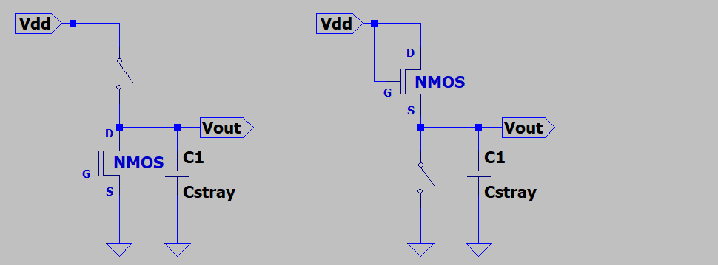
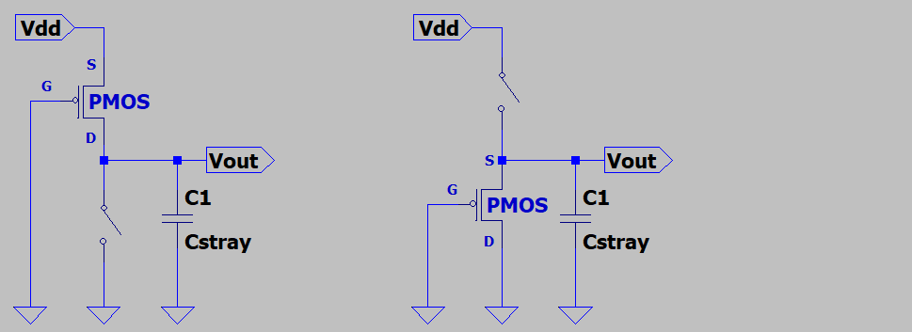
CMOS Pull-Up and Pull-Down Transistors
NMOS transistors make good pull-down
transistors, but poor pull-up transistors.
Why a poor pull-up transistor?
Because the NMOS transistor enters
cutoff as V_{out} increases to V_{dd} – V_{T}.
Hence V_{out_max} = V_{dd} – V_{T}, which is referred
to as a poor “1” level since V_{out_max} < V_{dd} for
an NMOS pull-up transistor.
PMOS transistors make good pull-up
transistors, but poor pull-down transistors.
Why a poor pull-down transistor?
Because the PMOS transistor enters
cutoff as V_{out} decreases to |V_{T}|.
Hence V_{out_min} = |V_{T}|, which is referred
to as a poor “0” level since V_{out_min} > Gnd for a PMOS pull-down transistor.
V_{GS} = V_{DD} which is >> V_{T}.
V_{GS} decreases as V_{out} increases.
Poor pull-up transistor.
V_{out_max} = V_{dd} – V_{T} < V_{dd}.
Poor 1 level.
Good pull-down transistor
V_{out} = 0 V.
V_{SG} = V_{DD} which is >> |V_{T}|.
V_{SG} decreases as V_{out} decreases.
Good pull-up transistor.
V_{out} = V_{dd}.
Poor pull-down transistor.
V_{out_min} = |V_{T}|.
Poor 0 level.

Slide 6
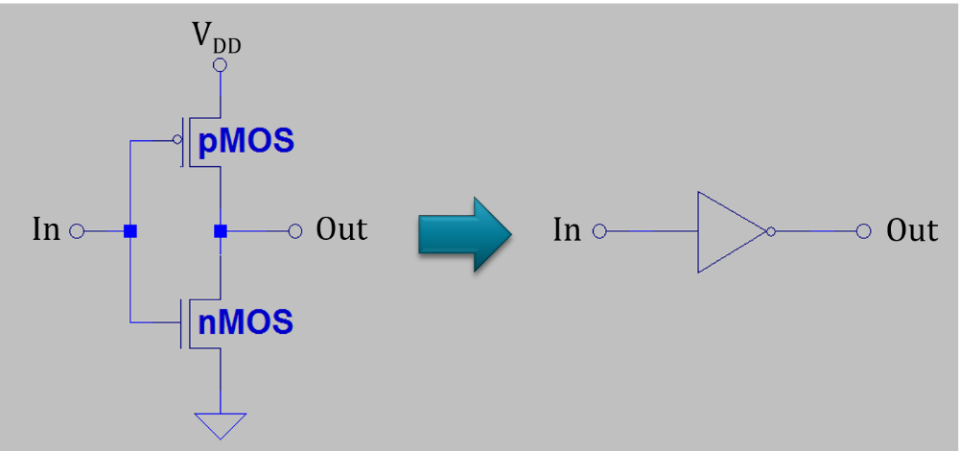
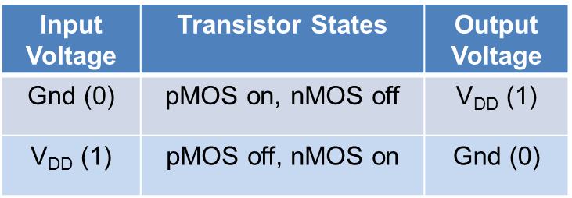
Standard CMOS Logic Inverter
Assuming V_{DD} >> V_{Tn} and |V_{Tp}|.
Input Voltage | Transistor States | Output Voltage
Gnd (0)
V_{DD} (1)

Slide 7
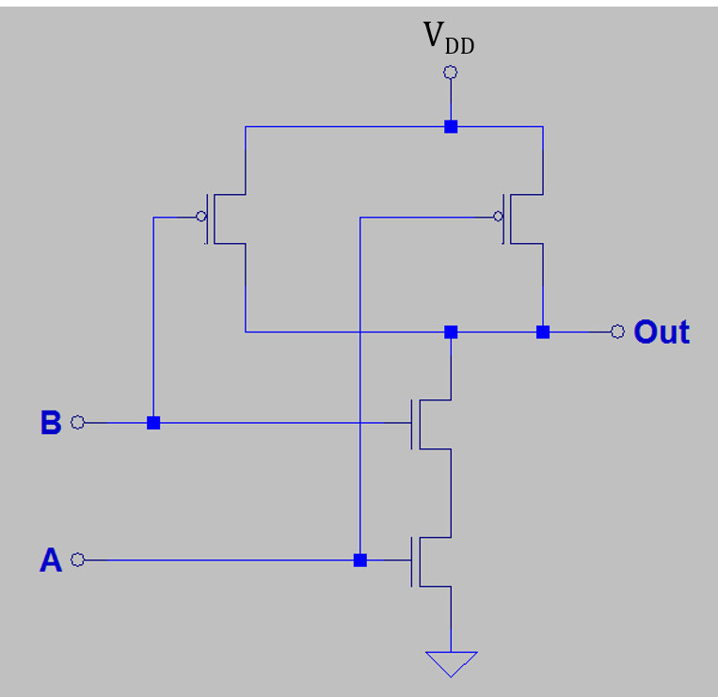
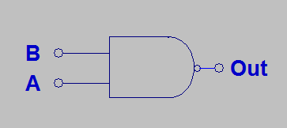
CMOS Digital Logic (Continued)
Truth Table
2 – Input NAND Gate
B | A | Out
0 | 0
0 | 1
1 | 0
1 | 1
1
1
1
0

Slide 8
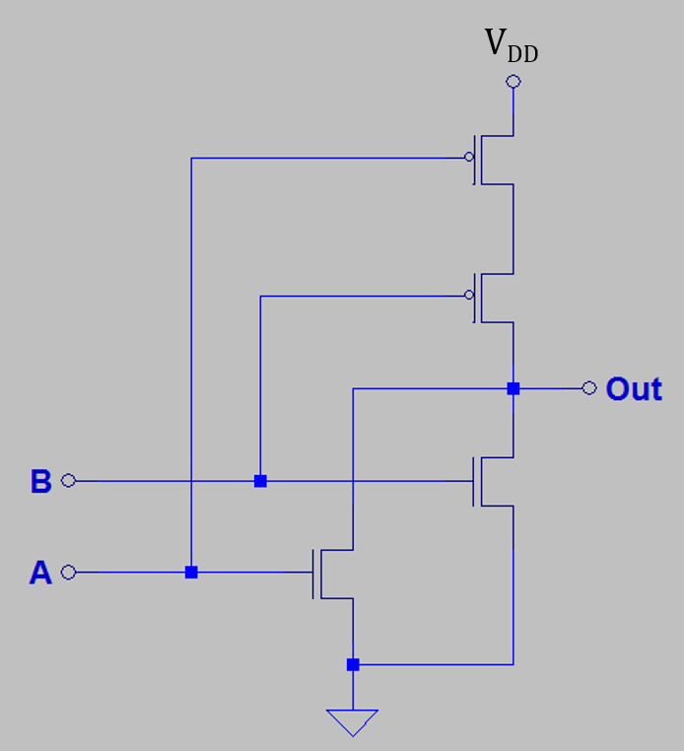
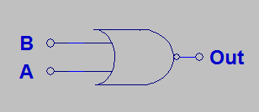
CMOS Digital Logic (Continued)
Truth Table
2 – Input NOR Gate
B | A | Out
0 | 0
0 | 1
1 | 0
1 | 1
1
0
0
0

Slide 9
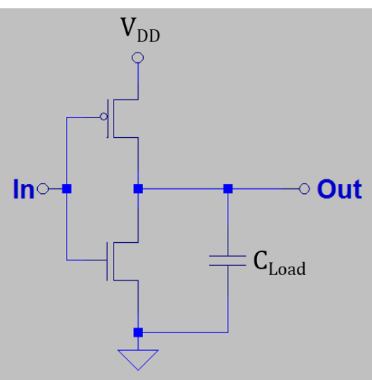
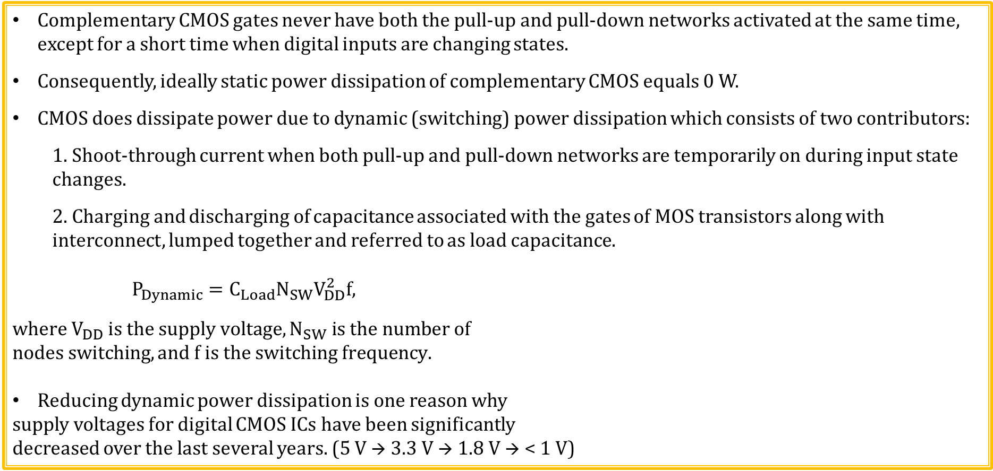
CMOS Power Dissipation
Complementary CMOS gates never have both the pull-up and pull-down networks activated at the same time, except for a short time when digital inputs are changing states.
Consequently, ideally static power dissipation of complementary CMOS equals 0 W.
CMOS does dissipate power due to dynamic (switching) power dissipation which consists of two contributors:
1. Shoot-through current when both pull-up and pull-down networks are temporarily on during input state changes.
2. Charging and discharging of capacitance associated with the gates of MOS transistors along with interconnect, lumped together and referred to as load capacitance.
$$P_{Dynamic}=C_{Load}N_{SW}V_{DD}^{2}f,$$
$$where V_{DD} is the supply voltage, N_{SW} is the number of$$
$$nodes switching, and f is the switching frequency.$$
Reducing dynamic power dissipation is one reason why
supply voltages for digital CMOS ICs have been significantly
decreased over the last several years. (5 V → 3.3 V → 1.8 V → < 1 V)

Slide 10
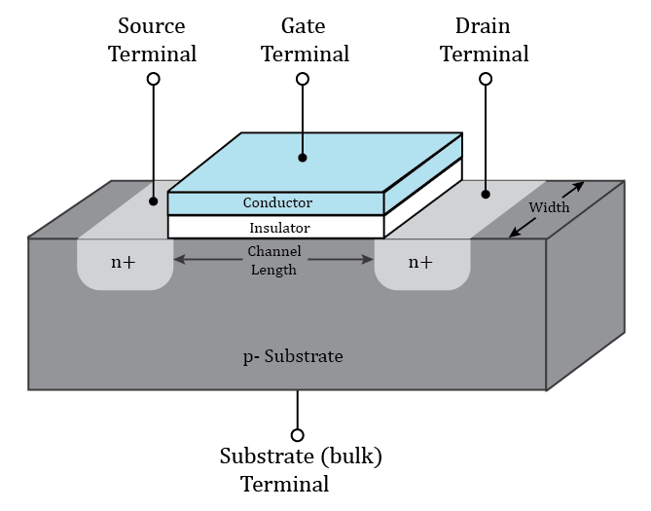
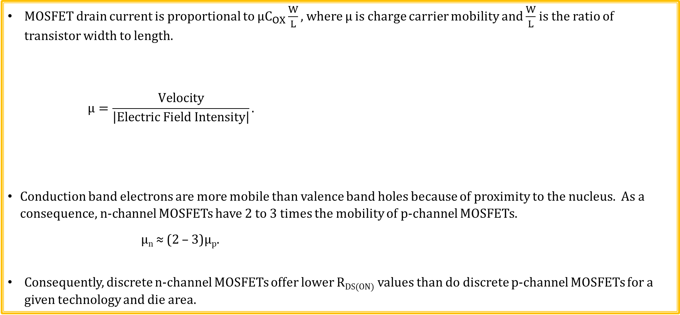
Charge Carrier Mobility - µ
MOSFET drain current is proportional to $μC_{OX}\frac{W}{L},$ where µ is charge carrier mobility and $\frac{W}{L}$ is the ratio of transistor width to length.
$$μ=\frac{Velocity}{\left|Electric Field Intensity\right|}.$$
Conduction band electrons are more mobile than valence band holes because of proximity to the nucleus. As a consequence, n-channel MOSFETs have 2 to 3 times the mobility of p-channel MOSFETs.
µ_{n} ≈ (2 – 3)µ_{p}.
Consequently, discrete n-channel MOSFETs offer lower R_{DS(ON)} values than do discrete p-channel MOSFETs for a given technology and die area.
Poll Questions

Slide 11
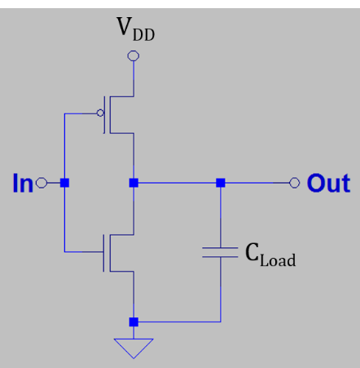
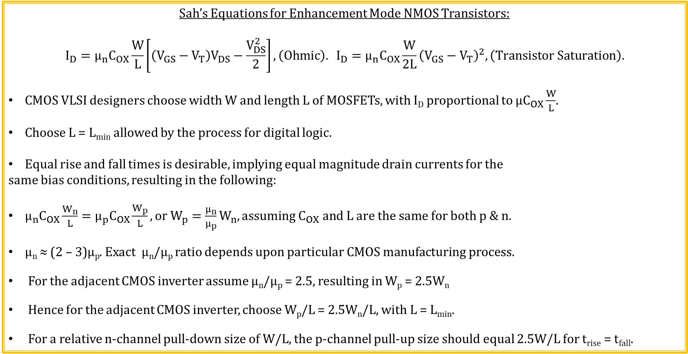


Transistor Sizing for CMOS Digital Logic
Sah’s Equations for Enhancement Mode NMOS Transistors:
$$I_{D}=μ_{n}C_{OX}\frac{W}{L}\left[\left(V_{GS}−V_{T}\right)V_{DS}−\frac{V_{DS}^{2}}{2}\right],\left(Ohmic\right). I_{D}=μ_{n}C_{OX}\frac{W}{2L}{\left(V_{GS}−V_{T}\right)}^{2},\left(Transistor Saturation\right).$$
CMOS VLSI designers choose width W and length L of MOSFETs, with I_{D} proportional to $μC_{OX}\frac{W}{L}$.
Choose L = L_{min} allowed by the process for digital logic.
Equal rise and fall times is desirable, implying equal magnitude drain currents for the
same bias conditions, resulting in the following:
$μ_{n}C_{OX}\frac{W_{n}}{L}=μ_{p}C_{OX}\frac{W_{p}}{L}, or W_{p}=\frac{μ_{n}}{μ_{p}}W_{n}, assuming C_{OX} and L are the same for both p \& n.$
$\text{µ}\text{n}\text{ ≈ (2 – 3)µ}\text{p}$. Exact µ_{n}/µ_{p} ratio depends upon particular CMOS manufacturing process.
For the adjacent CMOS inverter assume µ_{n}/µ_{p} = 2.5, resulting in W_{p} = 2.5W_{n}
Hence for the adjacent CMOS inverter, choose W_{p}/L = 2.5W_{n}/L, with L = L_{min}.
For a relative n-channel pull-down size of W/L, the p-channel pull-up size should equal 2.5W/L for t_{rise} = t_{fall}.
$$\frac{2.5W}{L}$$
$$\frac{W}{L}$$

Slide 12
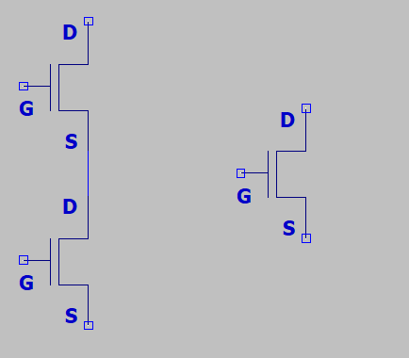
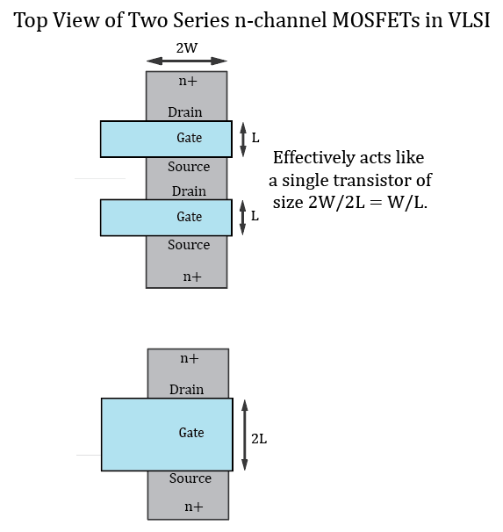



Transistor Sizing for Digital CMOS Logic (Continued)
NANDs, NORs and complex gates require width adjustment because of series transistors.
For example, a 2-NAND having two series n-channel transistors of size 2W/L effectively results in a single transistor of width 2W with twice the length, resulting in an effectively size of 2W/2L = W/L.
What about transistors in parallel?
Worst-case is with only one transistor turned on, so can’t always count
on parallel size advantage. So size as if there were just a single pull-down.
Transistor lengths essentially add for series MOSFETs, which can be compensated for by increasing the transistor widths.
Double the widths for two transistors in series, triple the widths for three transistors in series, etc.
$$\frac{2W}{L}$$
$$\frac{2W}{2L}=\frac{W}{L}$$
$$\frac{2W}{L}$$

Slide 13
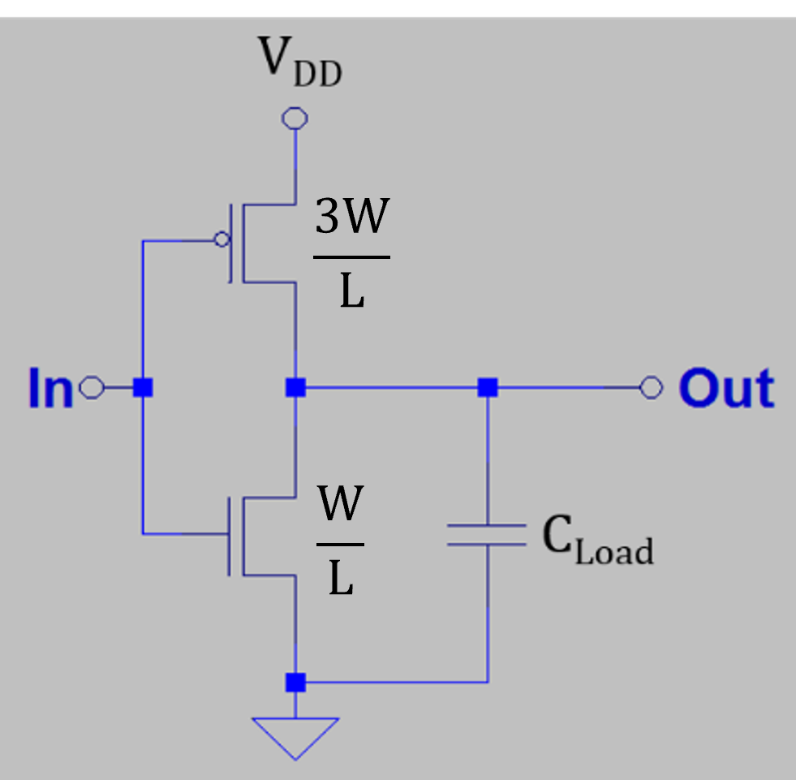
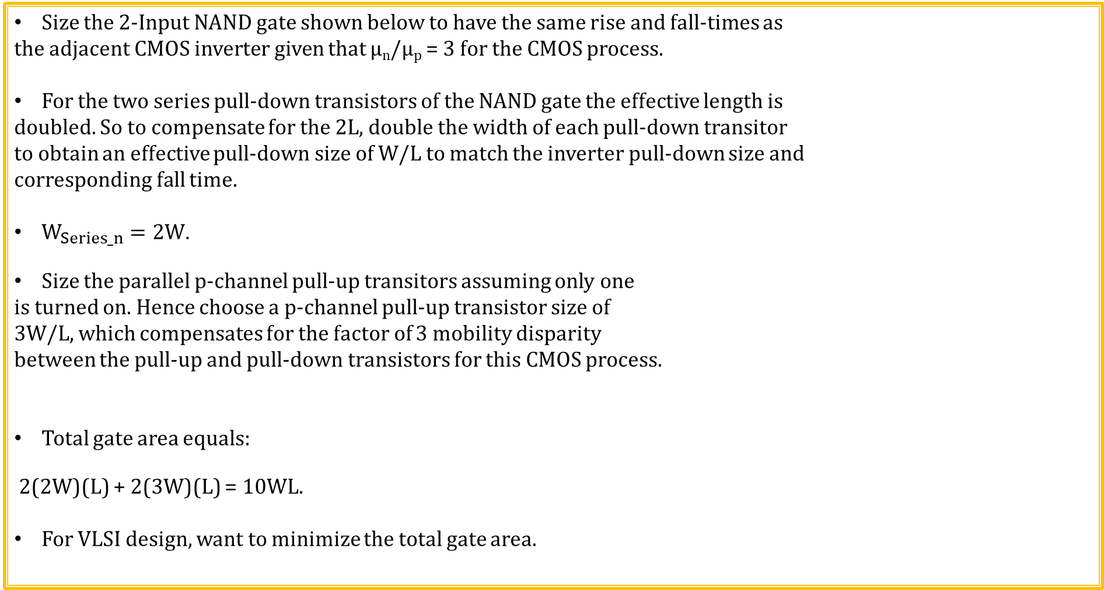
Digital CMOS Transistor Sizing for 2-NAND
Size the 2-Input NAND gate shown below to have the same rise and fall-times as
the adjacent CMOS inverter given that µ_{n}/µ_{p} = 3 for the CMOS process.
For the two series pull-down transistors of the NAND gate the effective length is
doubled. So to compensate for the 2L, double the width of each pull-down transitor
to obtain an effective pull-down size of W/L to match the inverter pull-down size and
corresponding fall time.
$W_{Series_n}=2W$.
Size the parallel p-channel pull-up transitors assuming only one
is turned on. Hence choose a p-channel pull-up transistor size of
3W/L, which compensates for the factor of 3 mobility disparity
between the pull-up and pull-down transistors for this CMOS process.
Total gate area equals:
2(2W)(L) + 2(3W)(L) = 10WL.
For VLSI design, want to minimize the total gate area.
3W/L
3W/L
2W/L
2W/L

Slide 14
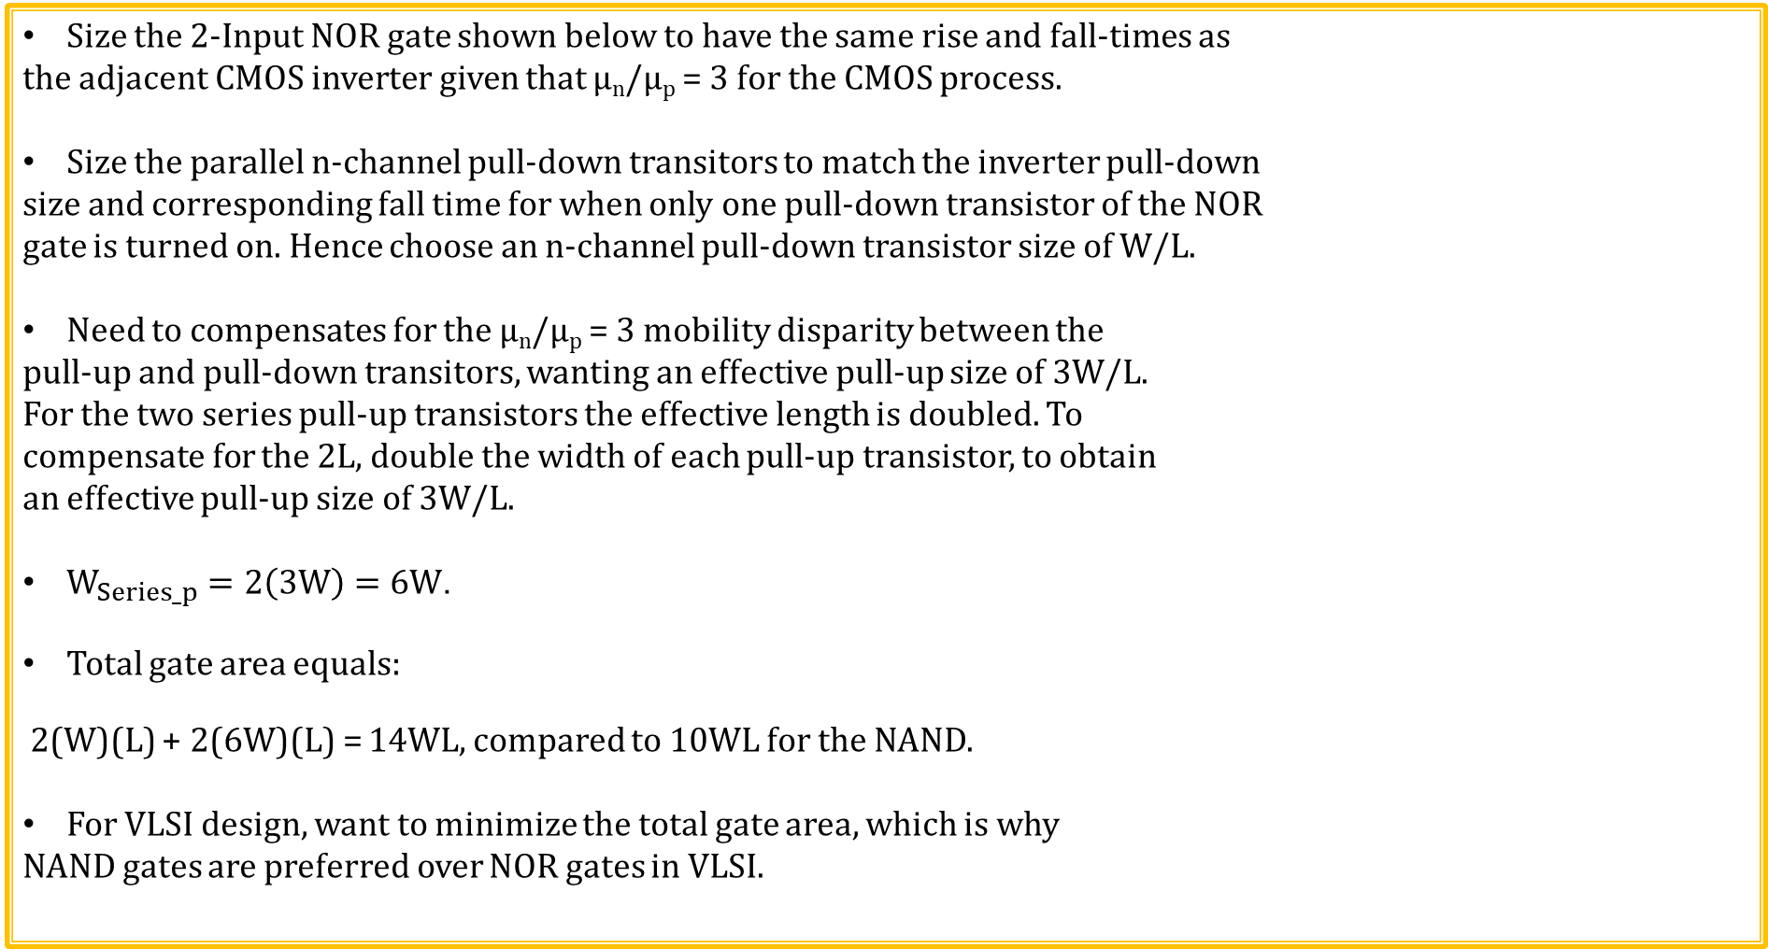
Digital CMOS Transistor Sizing for 2-NOR
Size the 2-Input NOR gate shown below to have the same rise and fall-times as
the adjacent CMOS inverter given that µ_{n}/µ_{p} = 3 for the CMOS process.
Size the parallel n-channel pull-down transitors to match the inverter pull-down
size and corresponding fall time for when only one pull-down transistor of the NOR
gate is turned on. Hence choose an n-channel pull-down transistor size of W/L.
Need to compensates for the µ_{n}/µ_{p} = 3 mobility disparity between the
pull-up and pull-down transitors, wanting an effective pull-up size of 3W/L.
For the two series pull-up transistors the effective length is doubled. To
compensate for the 2L, double the width of each pull-up transistor, to obtain
an effective pull-up size of 3W/L.
$W_{Series_p}=2\left(3W\right)=6W$.
Total gate area equals:
2(W)(L) + 2(6W)(L) = 14WL, compared to 10WL for the NAND.
For VLSI design, want to minimize the total gate area, which is why
NAND gates are preferred over NOR gates in VLSI.
6W/L
6W/L
W/L
W/L

Slide 15
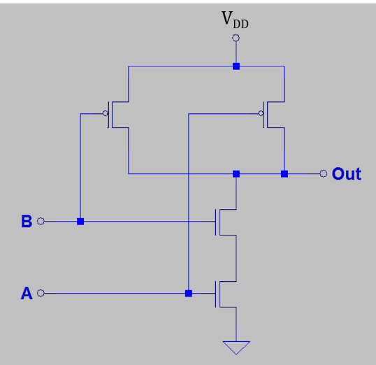
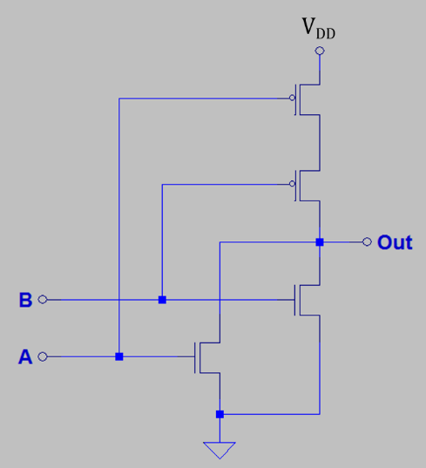
Conduction Complement
Complementary CMOS gates always produce 0 or 1.
NAND Gate:
Series nMOS pull-downs: Out = 0 only when all inputs are 1.
Because of parallel pMOS pull-ups, Out = 1 when any input is 0.
NOR Gate:
Series pMOS pull-ups: Out = 1 only when all inputs are 0.
Because of parallel nMOS pull-downs, Out = 0 when any input is 1.
Rule of Conduction Complements:
Pull-up network is complement of pull-down network.
Parallel → series, series → parallel.

Slide 16
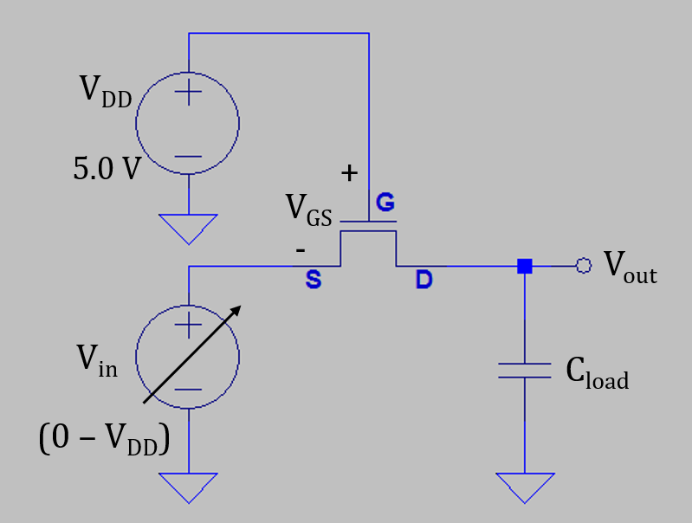
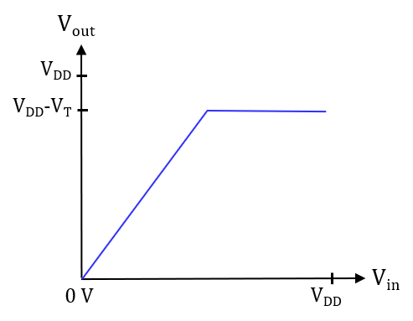
n-Channel MOS Transistor
Assume V_{DD} >> V_{T}.
CMOS digital logic levels are: “0” = V_{SS} and “1” = V_{DD}.
Need V_{GS} ≥ V_{T} for this enhancement mode MOSFET to be turned on.
For V_{in} ranging from 0 V to V_{DD}, V_{out} ranges from 0 V to V_{DD} – V_{T}.
NMOS is a Good pull-down transistor because it can easily achieve 0 V.
NMOS is a poor pull-up transistor because it can only pull up to
V_{DD} – V_{T}, which is a “poor 1” level.
NMOS transistors have higher R_{DS(ON)} as the source voltage approaches
the gate voltage, and turn off for V_{GS} ≤ V_{T}., making then a poor pull-up
transistor.
Poor 1 Level
Good 0 Level

Slide 17
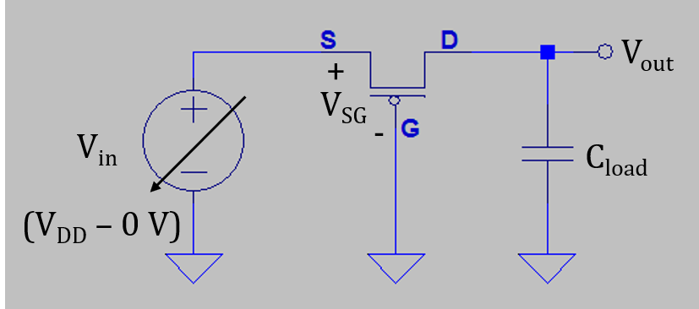
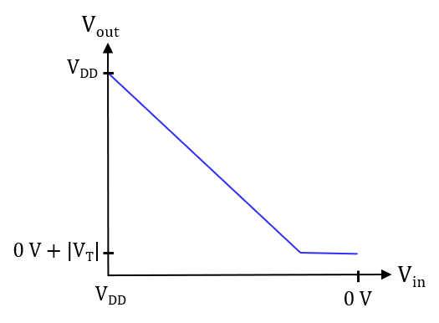
p-Channel MOS Transistor
Assume V_{DD} >> |V_{T}|.
CMOS digital logic levels are: “0” = V_{SS} and “1” = V_{DD}.
Need V_{SG} ≥ |V_{T}| for this enhancement mode MOSFET to be
turned on.
For V_{in} ranging from to V_{DD} to 0 V, V_{out} ranges from V_{DD} to 0 V + |V_{T}|.
pMOS is a Good pull-up transistor because it can easily achieve V_{DD}.
pMOS is a poor pull-down transistor because it can only pull down
to 0 V + |V_{T}|, which is a “poor 0” level.
PMOS transistors have higher R_{DS(ON)} as the source voltage
Approaches the gate voltage, and turn off for V_{SG} ≤ |V_{T}|, making
then a poor pull-down transistor.
Good 1 Level
Poor 0 Level

Slide 18
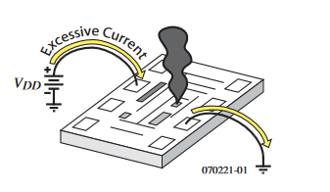
CMOS Latch-up
CMOS is susceptible to a damaging condition called latch-up for applied voltages greater than the positive supply voltage or more negative than the negative supply voltage, which is often Gnd.
Have to be very careful with systems having
different supply voltages.
Power supply sequencing may be necessary.
Ideally want all inputs to an IC equal to zero until
the power supply for that IC has stabilized at the
desired voltage.
Must be careful when powering up IC’s so that V_{DD}
is turned on and stabilized before applying a voltage to an input or output.
May need to keep some devices in Reset until power supplies stabilize.
Current limiting resistors on vulnerable inputs may be wise.

Slide 19
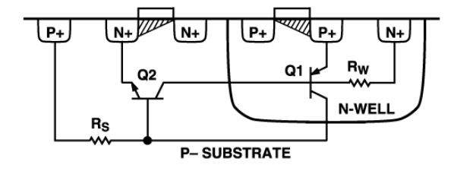
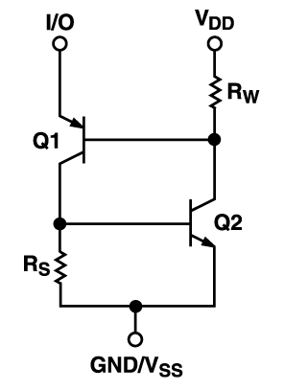
CMOS Latch-up (Continued)
See – “Winning the Battle Against Latch-up in CMOS Analog Switches” by Catherine Redmond, Analog Devices.
Q1, Q2, Rw and Rs are parasitic devices.
Turning on of Q1 results in turning on of Q2, which then connects V_{DD} to Gnd through fairly low resistance.
Q1 and Q2 both turned on is referred to as latch-up, and requires powering everything down to clear the latched-up condition.
If V_{DD} is not current limited, die heating often destroys the IC in latch-up.
Must be careful when powering up IC’s so that V_{DD} is up before applying a voltage to an input or output.
Typical CMOS Cross-Section
Equivalent Circuit

Slide 20
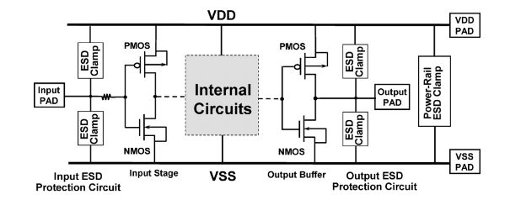
CMOS Latch-up and ESD - Electrostatic Discharge
CMOS Latch-up
Because of latch-up, you have to be careful when powering up systems with CMOS ICs on the PCB.
May need to keep some devices in Reset until supplies stabilize.
Current limiting resistors on vulnerable inputs can prevent latch-up, which is current triggered.
ESD – Electrostatic Discharge
Unprotected MOSFET gates are extremely
vulnerable to ESD because of thin gate oxide.
ESD damage was a major problem in the
early days of MOSFETs.
Modern discrete MOSFETs and CMOS ICs
include protection circuitry to help mitigate
ESD damage during handling and installation.
CMOS has only been successful because of persistence in solving the resulting latch-up and ESD problems.

Slide 21
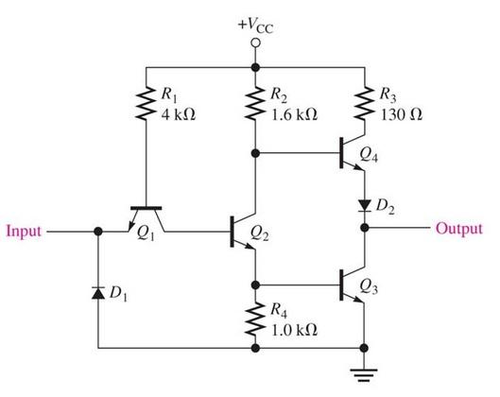
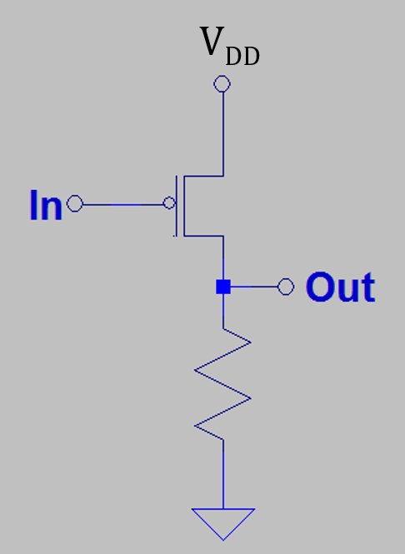
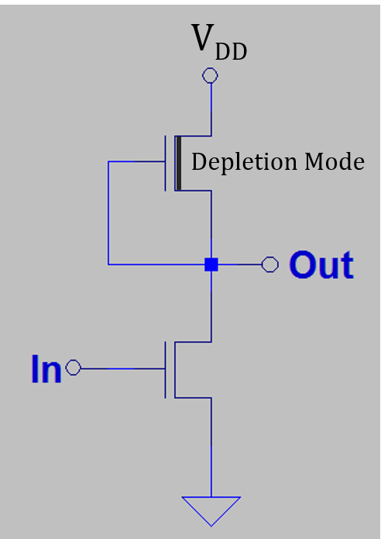
Practical Digital Logic Inverters Prior to CMOS
Because of resistors and/or resistive loads, all of these options are not nearly low-power enough for modern VLSI applications.
TTL
pMOS
nMOS

Slide 22
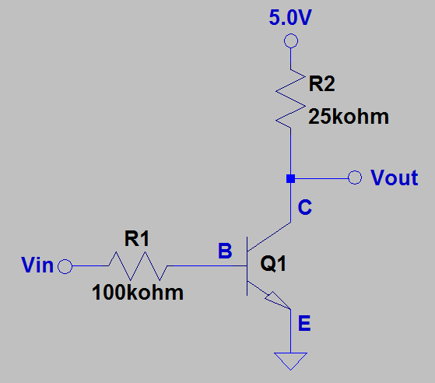
Common-Emitter Inverter
Adjacent inverter offers ≈ 0.2 mA quiescent current, i.e. 200 µA
for V_{out} = 0 V.
Assume 50% of logic inverters are operating in the zero state,
resulting in an average inverter current of ≈ 0.1 mA.
Assume a VLSI IC that contains 1 billion, i.e. 1 x 10⁹, common-emitter
inverters with 50% in the logic zero state, i.e. 0.1 mA average current
per inverter.
The total inverter current for the IC would equal:
(0.1 mA)(1 x 10⁹ inverters) = 100,000 A!
Definitely need a lower quiescent current that obtainable with common-emitter inverter with resistive pull-up.

Slide 23
ECEN 350 – Topics
Semiconductor Physics
IC Op-Amps
Rectifiers
Zeners
Diodes
BJTs
MOSFETs
CMOS
LEDs
Transistor Biasing
Small-Signal Analysis
Amplifier Gain Stages
Frequency Response

Slide 24
The End

Slide 25
Extra

Slide 26
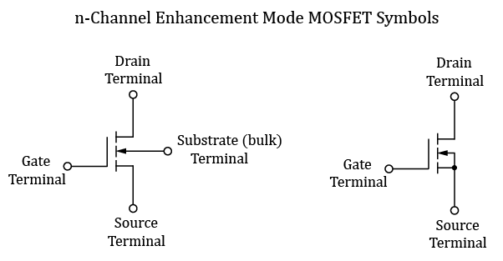
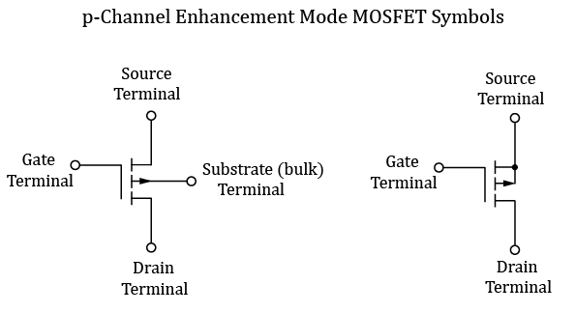
CMOS – Complementary MOS (Continued)
The adjacent symbols are used for discrete
n and p – channel Enhancement Mode MOSFETs.
The adjacent symbols are used for n and p – channel
Enhancement Mode MOSFETs in VLSI design.
The substrate, which is usually connected to the source, is
not illustrated in these simplified symbols.

Slide 27
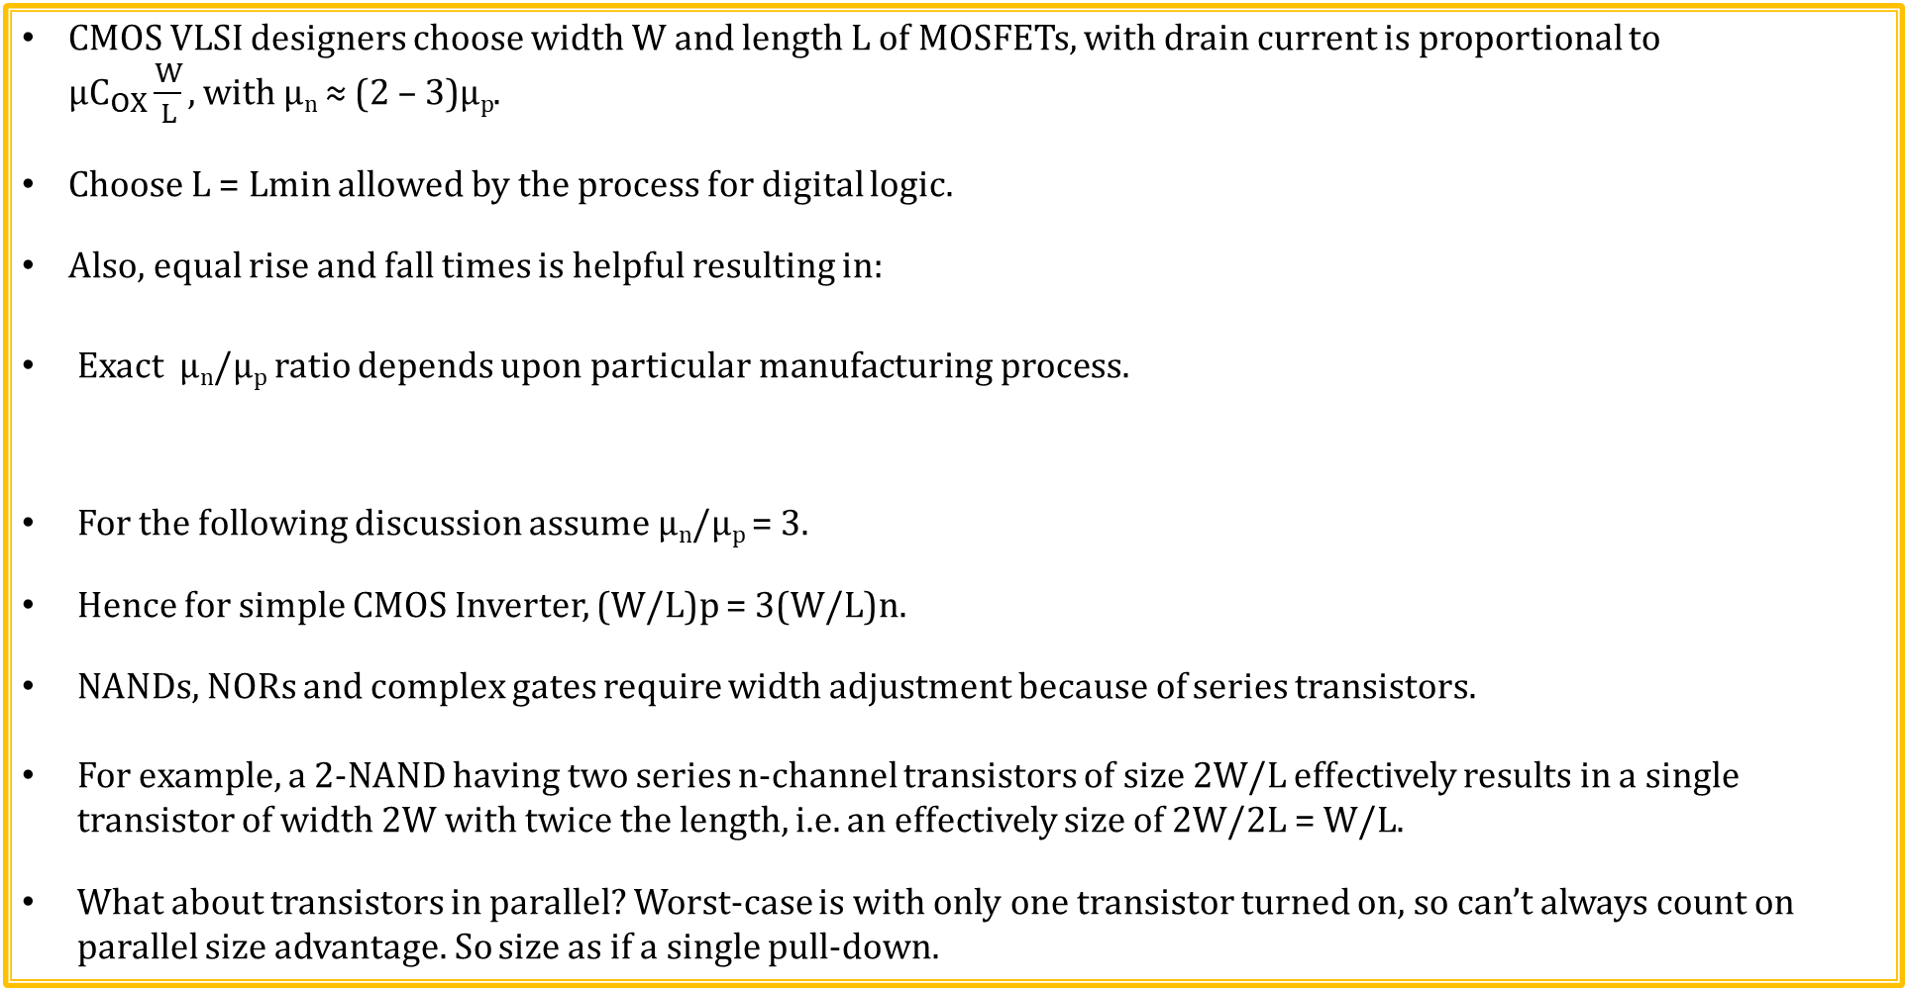


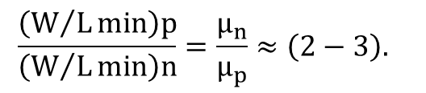
Transistor Sizing for Digital CMOS Logic
CMOS VLSI designers choose width W and length L of MOSFETs, with drain current is proportional to $μC_{OX}\frac{W}{L}, with \text{µ}\text{n}\text{ ≈ (2 – 3)µ}\text{p}$.
Choose L = Lmin allowed by the process for digital logic.
Also, equal rise and fall times is helpful resulting in:
Exact µ_{n}/µ_{p} ratio depends upon particular manufacturing process.
For the following discussion assume µ_{n}/µ_{p} = 3.
Hence for simple CMOS Inverter, (W/L)p = 3(W/L)n.
NANDs, NORs and complex gates require width adjustment because of series transistors.
For example, a 2-NAND having two series n-channel transistors of size 2W/L effectively results in a single transistor of width 2W with twice the length, i.e. an effectively size of 2W/2L = W/L.
What about transistors in parallel? Worst-case is with only one transistor turned on, so can’t always count on parallel size advantage. So size as if a single pull-down.
$$\frac{\left(W/Lmin\right)p}{\left(W/Lmin\right)n}=\frac{μ_{n}}{μ_{p}}≈\left(2−3\right).$$
$$\frac{3W}{L}$$
$$\frac{W}{L}$$

Slide 28

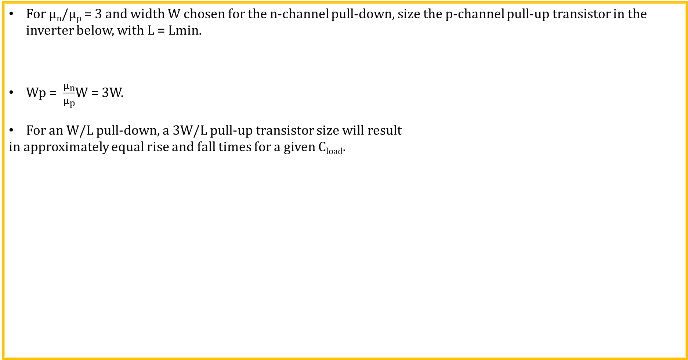
Digital CMOS Transistor Sizing (Continued)
For µ_{n}/µ_{p} = 3 and width W chosen for the n-channel pull-down, size the p-channel pull-up transistor in the inverter below, with L = Lmin.
Wp = $\frac{μ_{n}}{μ_{p}}$W = 3W.
For an W/L pull-down, a 3W/L pull-up transistor size will result
in approximately equal rise and fall times for a given C_{load}.
3W/L
W/L

Slide 29
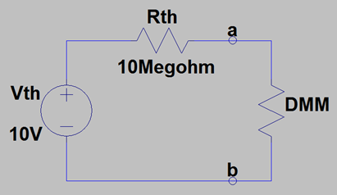
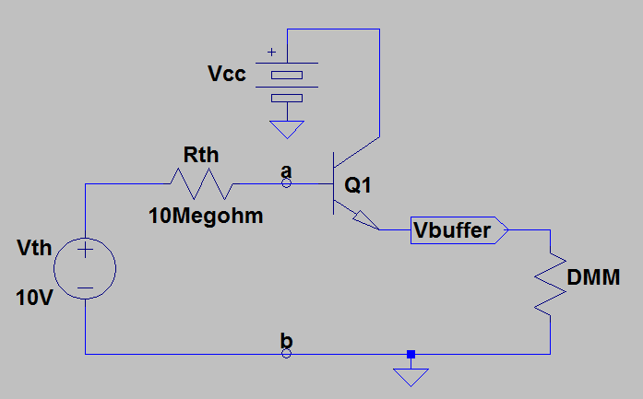
Buffer Stage Example
DMM Measurement Details Lab provided a circuit with a large Thevenin Output impedance/resistance.
The portable DMM’s having 10 MΩ input
impedance/resistance is not high enough for a good
voltage measurement in this particular case.
Need a buffer stage. An Emitter-Follower stage would help, although there is still non-negligible base current along with approximately 0.7 V drop from base-to-emitter.

Slide 30
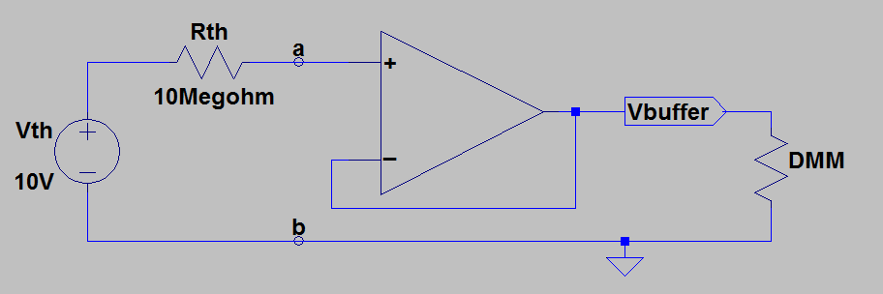
Buffer Stage Example (Continued)
DMM Measurement Details Lab provided a circuit with a large Thevenin Output impedance/resistance.
The portable DMM’s having 10 MΩ input
impedance/resistance is not high enough for a good
voltage measurement in this particular case.
Need a buffer stage. The VirtualBench High (10 GΩ) Input Impedance setting provided a measured result of approximately 10 V, accomplished by incorporating an internal buffer amplifier having very high input impedance (10 GΩ) so as to not load down the above Thevening Equivalent Circuit. A good buffer also has low output resistance/impedance so that reasonable resistive load does not affect the output voltage.

