Slide 1

Catch me, if you can?
Case Study 6
Kyle Tolliver

Slide 2


What is Bedford's Law?
What is Chi-Square Goodness of Fit Test?
Mathematical law that states that the leading digits in a collection of data set are probably going to be small.
See Slide 6-9 for Benford’s Law Visualizations
It allows us to infer whether data follow a distribution using the observed values we already have and the values we would expect if it does follow that assumed distribution.
Conditions:
The data are from a simple random sample
The groups being studied are categorical (qualitative variables)
There are at least five expected observations per group

Slide 3
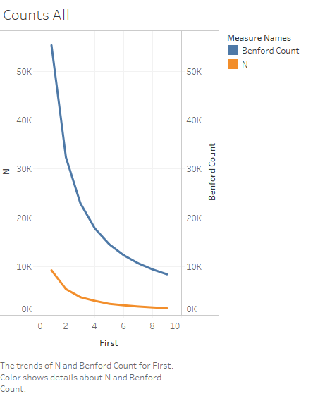
This plot helps prove Chi-Squared Goodness of Fit Test and Benford's Law
We can tell the trend is as the first digit increases both N and Benford Count decrease
The next 2 slides help build the story and comparison of Benford’s Law

Slide 4
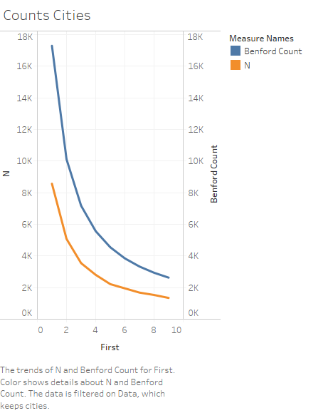
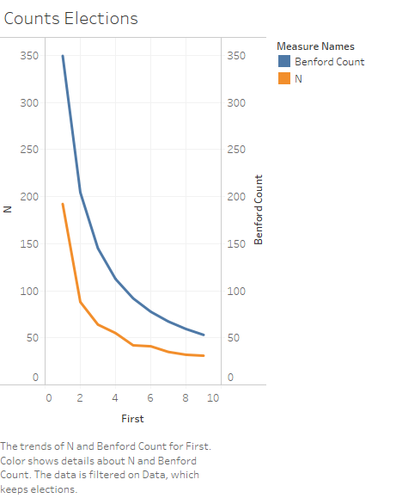
These 2 plots show the comparison of Benford’s Law
They show Benford Count and N comparisons
These are in accordance with both Benford’s Law and Chi-Square Goodness of Fit Test

Slide 5
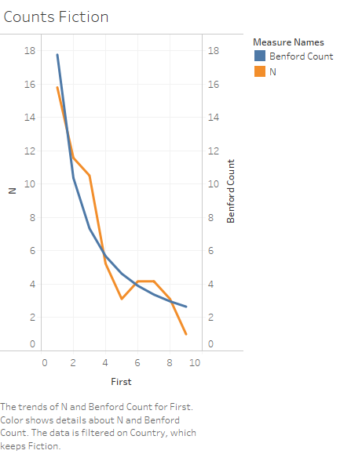
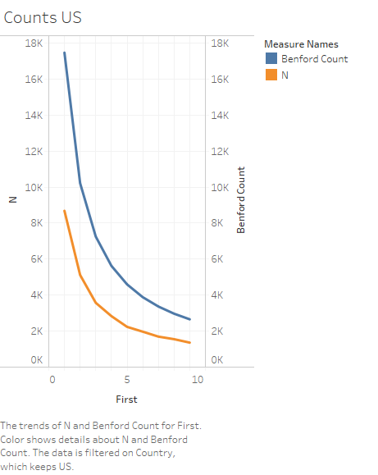
This compares Fictional countries and the US
We can see that the US plot is similar to the plots on the previous slide
Fictional countries are unsteady with the N values

Slide 6
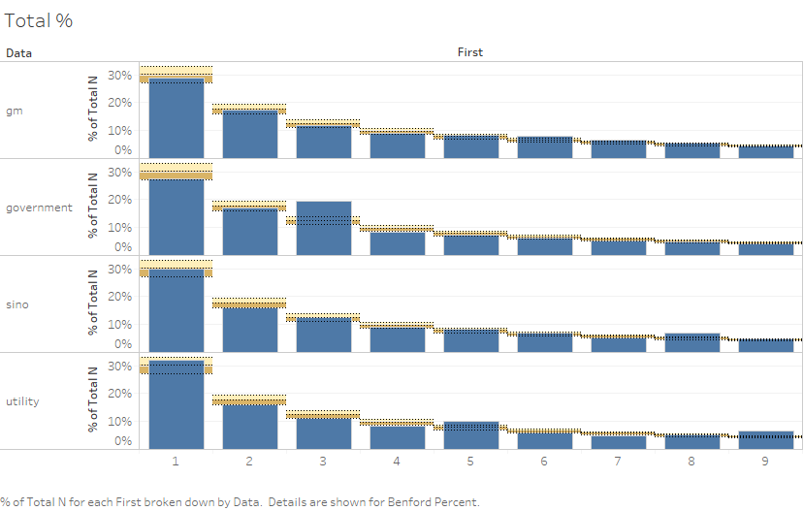
The plot shows in percent as the first digit decreases – Benford’s Law
The bands I’m going to call truth or accuracy bands
The next 2 slides show this concept but split into US and Fictional Country

Slide 7
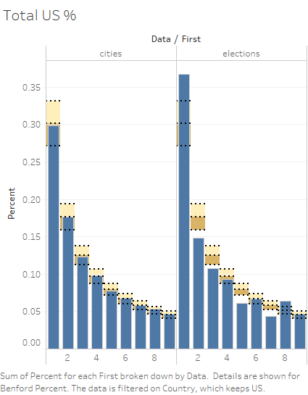
The truth or accuracy bands determine if the data is in accordance to Benford’s Law
This shows the data for cities are truthful
This also shows that the data for elections are not in accordance to Benford’s Law
That means there is lies in elections

Slide 8
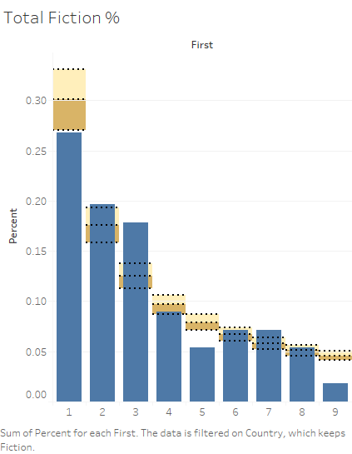
In Fictional countries there are lies in the data
This can be known from the Benford law bands
The bars are supposed to reside in the band for good data
For perfect data they touch the dotted line in the middle
So since only 6 and 8 fit in the band and 4 just barely touch the bars the data is not accurate

Slide 9
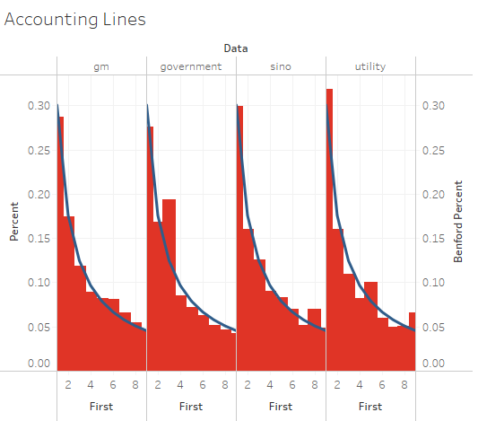
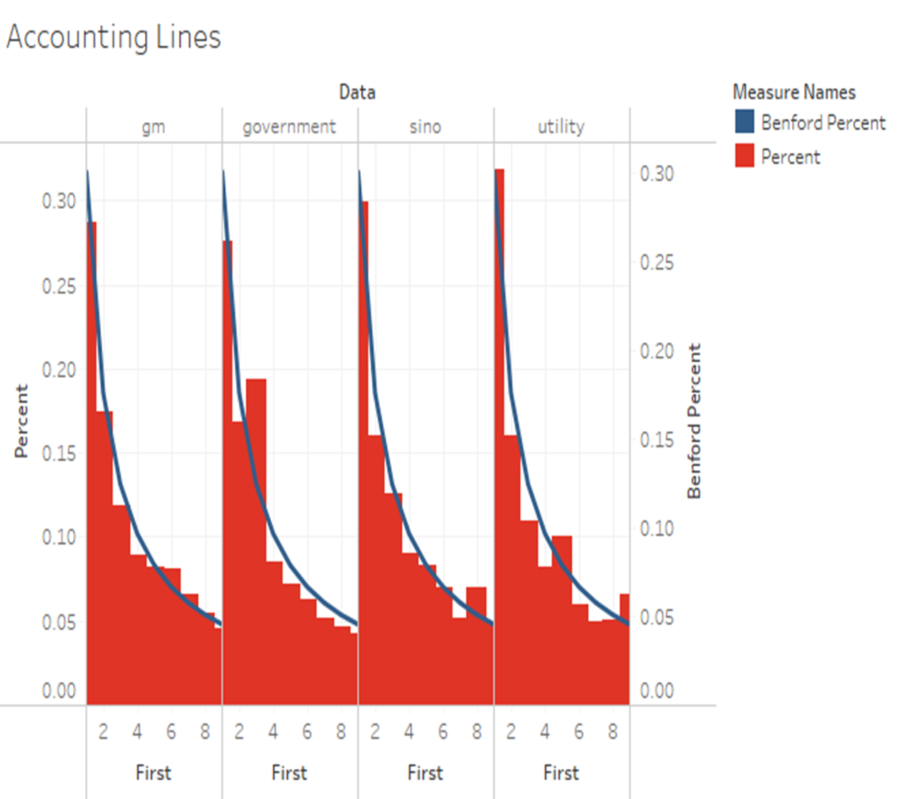
This plot shows the digits of percent and Benford percent
You can see that as the digits go up the percent's go down
This plot help us understand how different industries are doing financially
This helps prove the benefits of Benford’s Law

