Slide 1
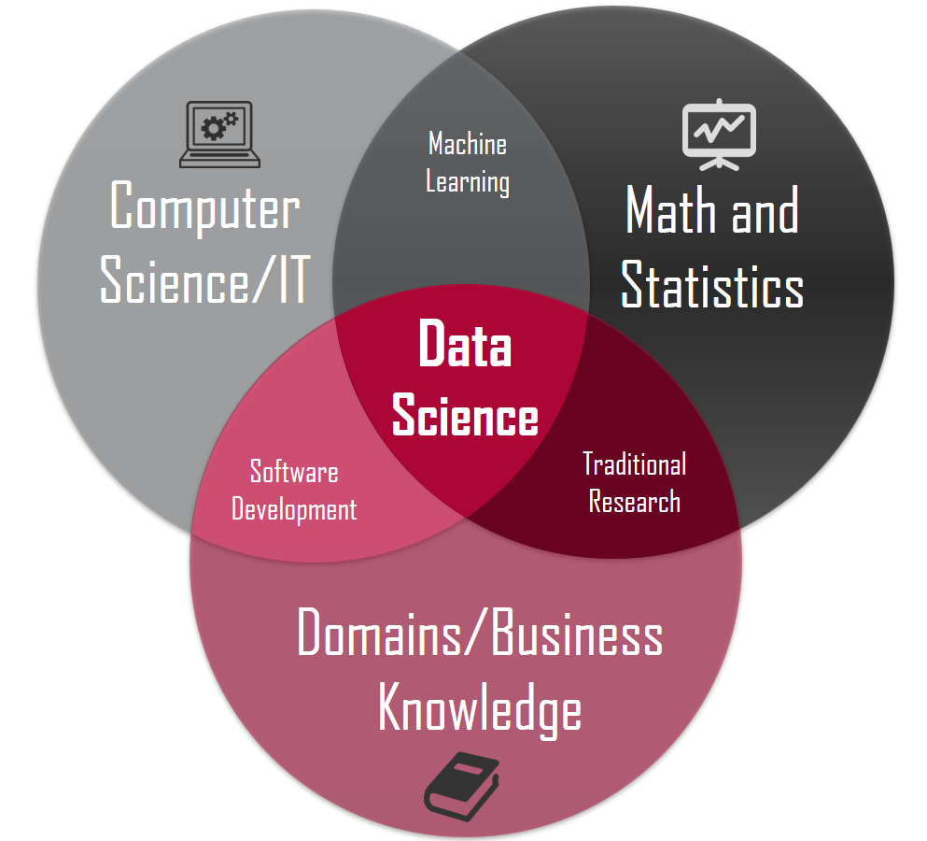
Can you help me with my data problem?
Case Study 7 - Kyle Tolliver

Slide 2
Why Use R?
Pros
Open Source
Platform Independent
Machine Learning Operations
Exemplary Support For Data Wrangling
Quality Plotting And Graphing
The Array Of Packages
Statistics
Continuously Growing
R has greater pros than cons which is a great benefit. Also the pros are greater than other languages. Also R allows you to save wrangled datasets into new data files.
Cons
Data Handling
Basic Security
Complicated Language
Weak Origin
Lesser Speed

Slide 3
Why Use SQL?
Why Use Python?
Pros
Extensive Support Libraries
Integration Feature
Productivity
Pros
Faster Query Processing
No Coding Skills
Standardized Language
Portable
Interactive Language
Multiple data views
Cons
Difficulty in Using Other Languages
Weak in Mobile Computing
Gets Slow in Speed
Run-time Errors
Underdeveloped Database Access Layers
Cons
Complex Interface
Cost
Partial Control

Slide 4
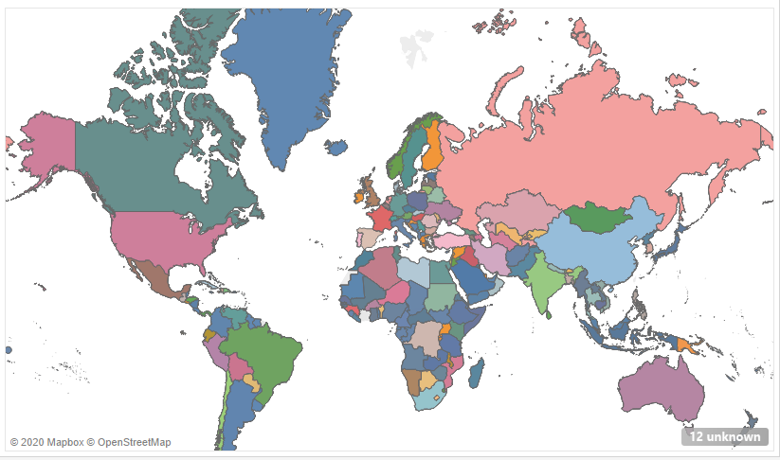
Which countries require our attention?
Russia
Ukraine
Kazakhstan
India
South Africa

