Slide 1
Lego My Data
Asking Price for Set
$ 11.99 USD
$ 16.80 CAD
€ 11.10 Euro
¥ 84.95 Yuan
Case Study 2
Set 10

Slide 2
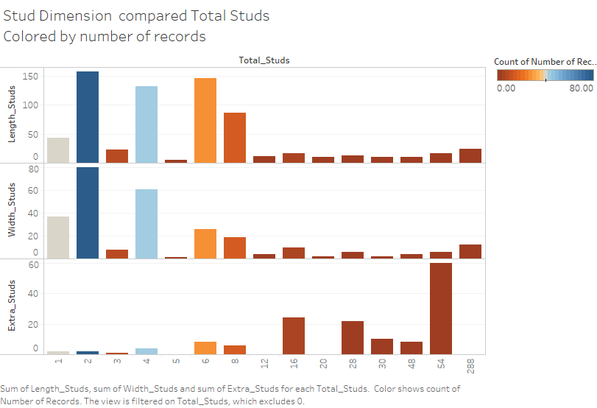
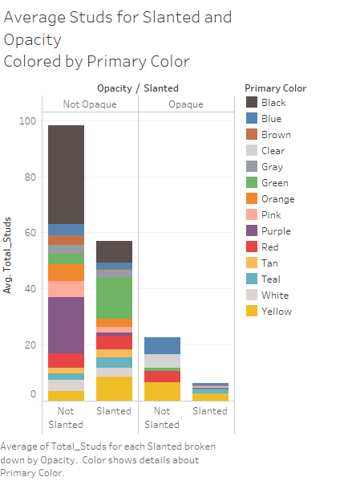

Slide 3
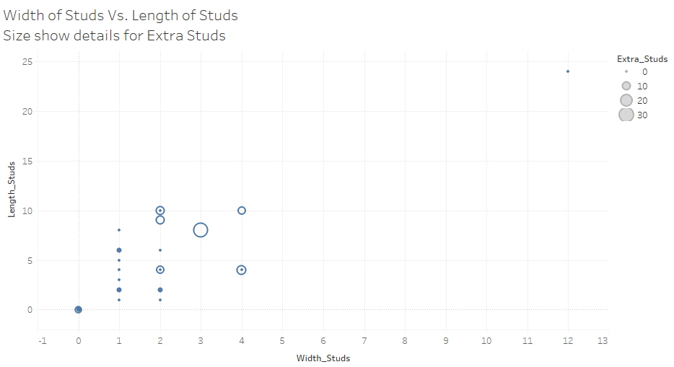

Slide 4
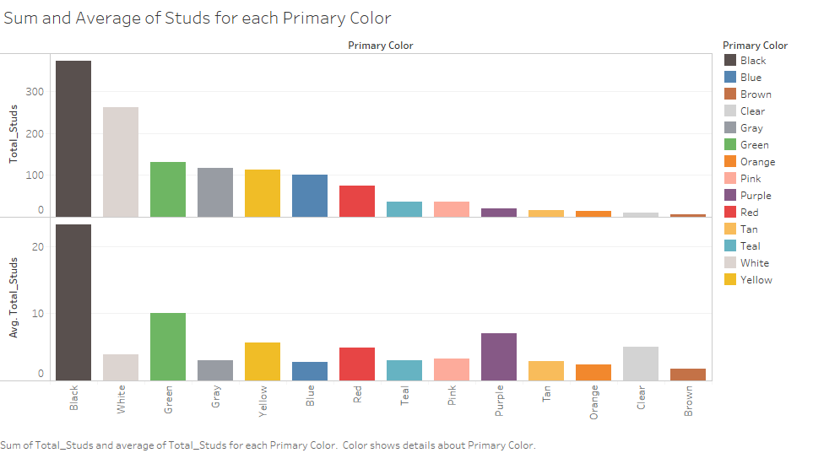

Slide 5
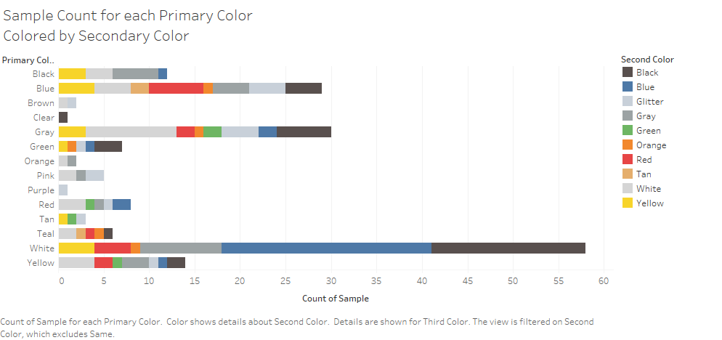

Slide 6
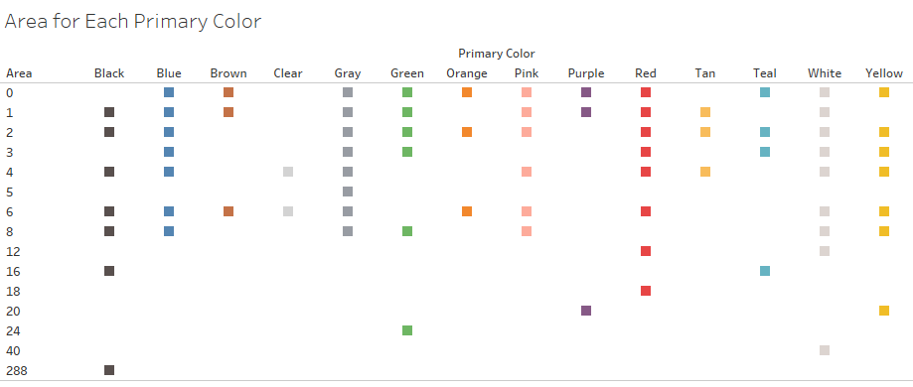
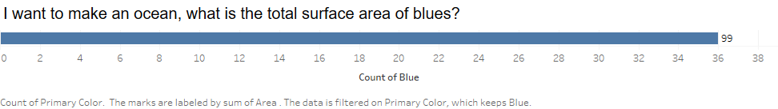
Visualization for the buyer
Buyer asks:
I want to make an ocean, what is the total surface area of blues?

