Slide 1

Does your birthday make you better at sports?
Case Study 5 – Kyle Tolliver

Slide 2
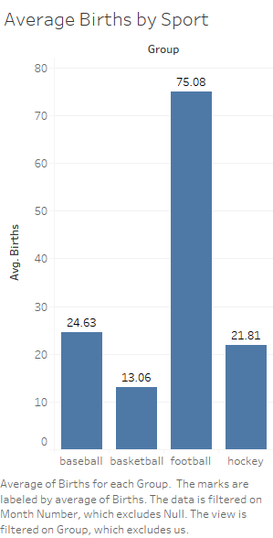
This plot show the average births for each birth.
You can see that Football is the top at 75.08 births
I will be focusing on the 2 highest average births which is Baseball at 24.63 births
I will be using Chi-Square Test of Independence to preform a comparison

Slide 3
Chi-Squared Test of Independence
Two Sample z-Test for Proportions
Inputs |  |  | Check Requirements (all ≥ 10?)
Group 1 Observed | 698 |  | First Sample | 698.000
Group 1 Count | 9013 |  |  | 8315.000
Group 2 Observed | 7527284 |  | Second Sample | 7527284.000
Group 2 Count | 85712738 |  |  | 78185454.000
Confidence Level | 0.95
Type of Test | p1 ≠ p2
Descriptive Statistics
p-hat₁ |  | p-hat₂ | Standard Deviation of Confidence Interval | Standard Deviation of Hypothesis Test
0.077 |  | 0.088 | 0.0028 | 0.0030
Two-Proportion z-test
Null Hypothesis: H₀: p₁ = p₂
z | P-value | Confidence Interval for p₁ - p₂
-3.480 | 0.001 | -0.016 | -0.005
One Sample z-Test for a Proportion
Inputs |  |  | Hypothesis Test Requirements (Both ≥ 10?)
x | 74 |  | 70.000 | 30.000
n | 100
Confidence Level | 0.95 |  | Confidence Interval Requirements (Both ≥ 10?)
Null Hypothesis | 0.7 |  | 74.000 | 26.000
Type of Test | Not Equal To
Descriptive Statistics
n |  | p-hat | Standard Deviation of Confidence Interval | Standard Deviation of Hypothesis Test
100 |  | 0.740 | 0.0439 | 0.0458
One-Proportion z-test
Null Hypothesis: H₀: p = |  | 0.700
z | P-value | Confidence Interval
0.873 | 0.383 | 0.654 | 0.826

Slide 4

Chi Square Test
Pearson | df | P-value
78.524 | 11 | 0.0000
Pearson Residuals
 | US | Baseball
Jan | 0.00 | 0.27
Feb | 0.00 | 0.09
Mar | 0.00 | 2.08
Apr | 0.00 | 0.15
May | 0.00 | 6.04
Jun | 0.00 | 14.99
Jul | 0.00 | 11.05
Aug | 0.00 | 28.15
Sep | 0.00 | 5.17
Oct | 0.00 | 9.42
Nov | 0.00 | 0.87
Dec | 0.00 | 0.24
Chi-Squared Test of Independence
This show the Chi square test
We see the Pearson residuals, df and P-value
The Pearson residuals are high for June, July, and August
The previous slide shows sample z-Test for proportions in the data
 | US | Baseball | Totals
Jan | 6,979,322 | 748 | 6,980,070
Feb | 6,511,697 | 677 | 6,512,374
Mar | 7,147,368 | 712 | 7,148,080
Apr | 6,850,733 | 710 | 6,851,443
May | 7,175,367 | 687 | 7,176,054
Jun | 7,122,586 | 643 | 7,123,229
Jul | 7,527,284 | 698 | 7,527,982
Aug | 7,624,626 | 952 | 7,625,578
Sep | 7,440,659 | 846 | 7,441,505
Oct | 7,293,822 | 852 | 7,294,674
Nov | 6,884,173 | 749 | 6,884,922
Dec | 7,155,101 | 739 | 7,155,840
Totals | 85,712,738 | 9013 | 85,721,751
Pearson's chi-square test is used to determine whether there is a statistically significant difference between the expected frequencies and the observed frequencies in one or more categories of a contingency table.

Slide 5
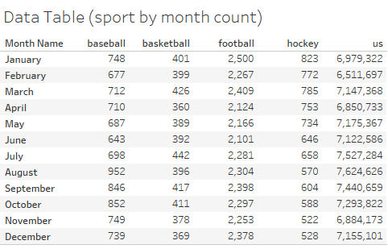
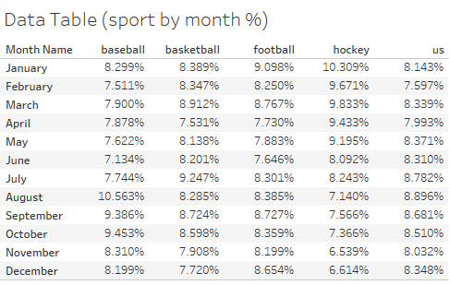
These are Data Tables are used to calculate Chi-Goodness Test of Independence
The first data table was used in the calculations
The second data table is used for the Plot on the next slide
The following requirements must be met in order to conduct a χ2 test of independence:
You must use simple random sampling to obtain a sample from a single population.
Each expected count must be greater than or equal to 5.
The null and alternative hypotheses for this chi-squared test of independence are:
H0:The location and the motivation for seeking treatment are independent
H1:The location and the motivation for seeking treatment are not independent

Slide 6
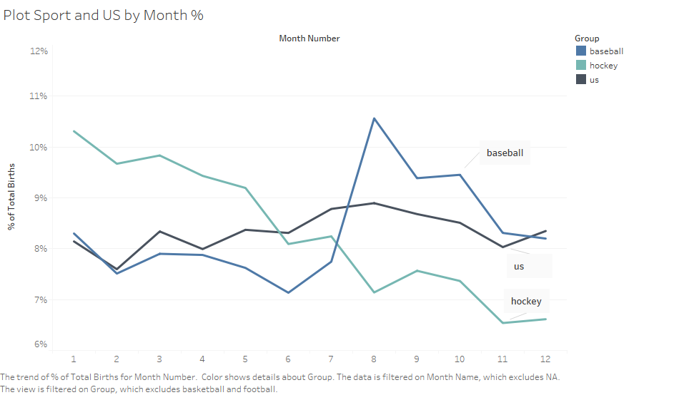
This shows the % of births each month
This only shows the US, Hockey, and Baseball
There’s a spike for Baseball in the summer
Hockey drops over the year and then jumps in January

Slide 7
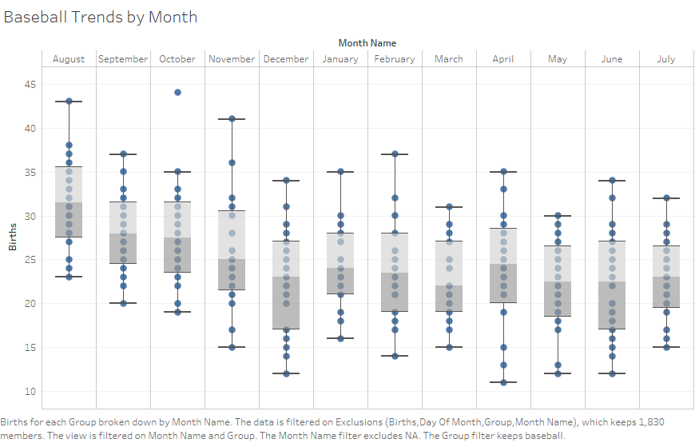
This show the spread and distribution of births for Baseball
Have August as the first month on the plot
That is due to the cut of date for Baseball being July 31st
There is data for births on February 29th (leap day) so I removed those from the data set

Slide 8
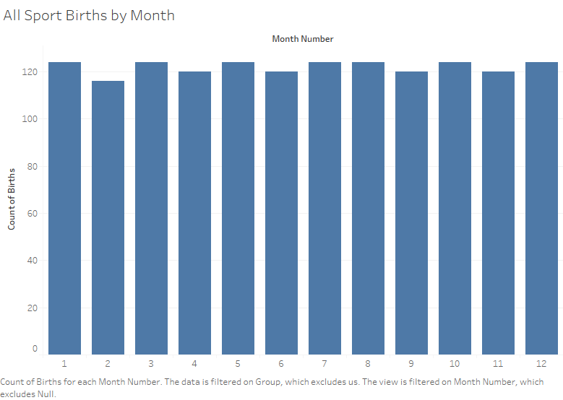
From this plot it seems that over a hundred each month
The count of births has a trend of being over 120

Slide 9
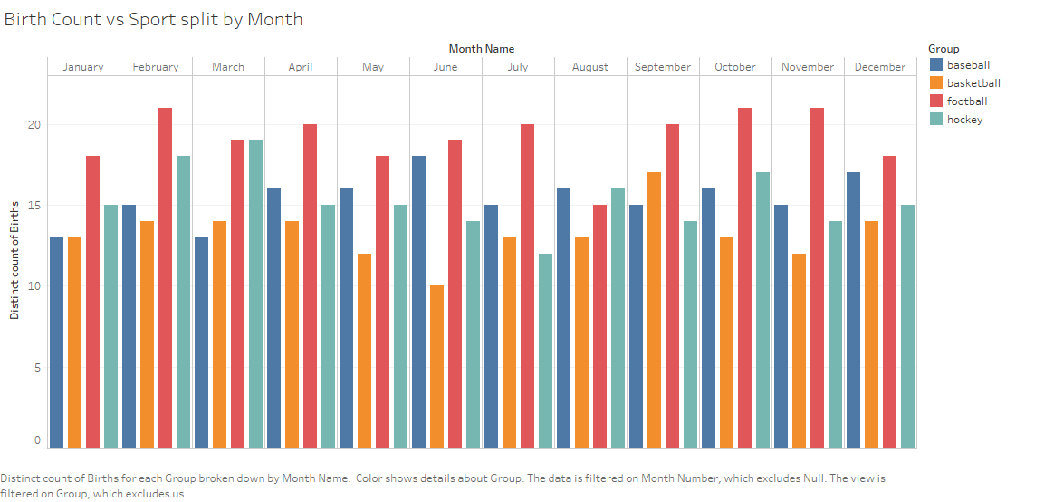
From this we learn that football has the highest births
The other sports are sporadic for being with 2nd highest each month
But Basketball seem to have a trend of being the lowest
The exception is March and September

Slide 10
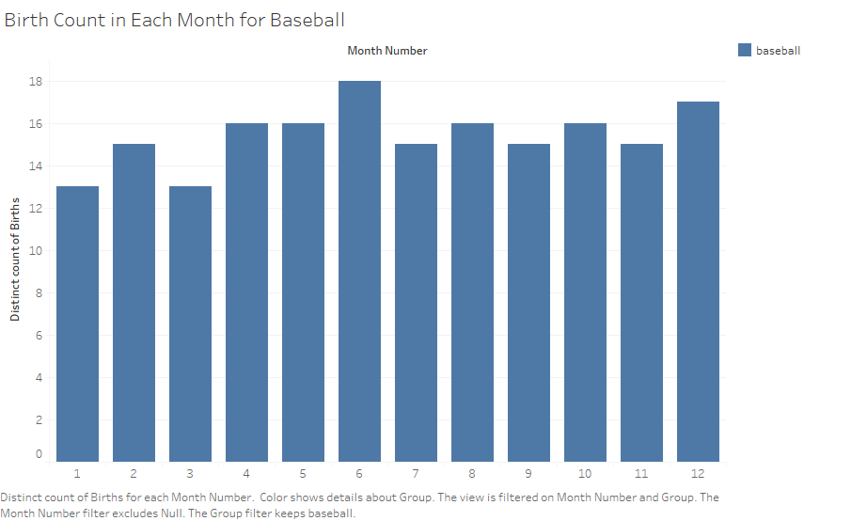
This shows the birth count of Baseball split by month
The month with the highest is June
There is a spike in December as well which is interesting

Slide 11
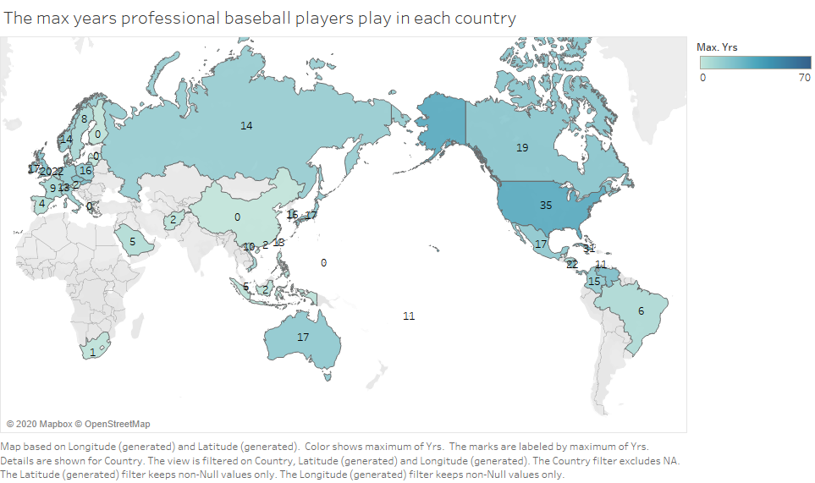
This slide shows the max year professionals play baseball
The US has the max of 35 years
So the longest a professional played was 35 years
That seem super long to me

Slide 12
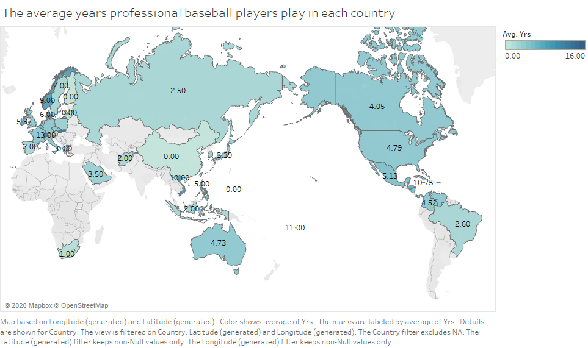
This plot shows the average year professionals play
We can learn that for the US the average is 4.79 years

Slide 13
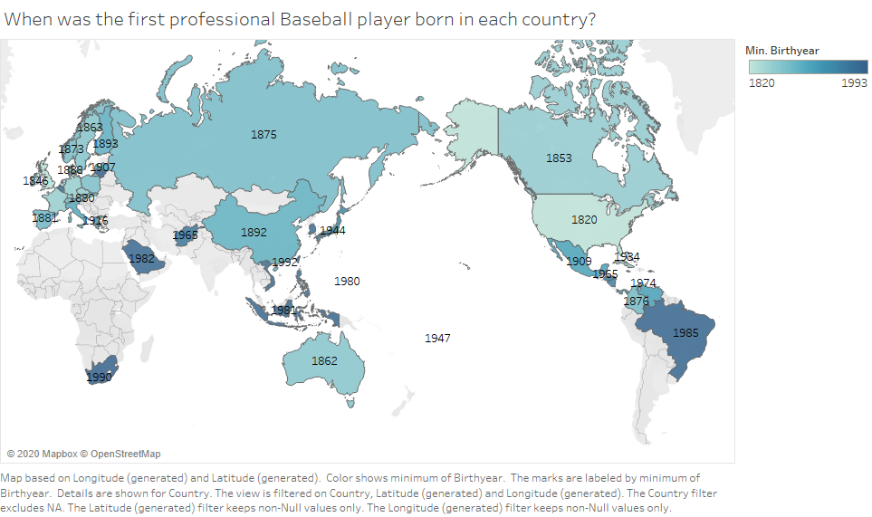
Abner Doubleday invented the game known as baseball in Cooperstown, New York, during the summer of 1839
The MLB was founded in 1869 in Cincinnati, OH, USA
Major League Baseball (MLB) is an American professional baseball organization
The first MLB player in the USA was born 1820 so was about 49 when the MLB was founded

