Slide 1

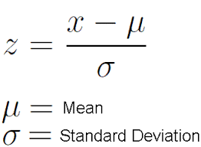
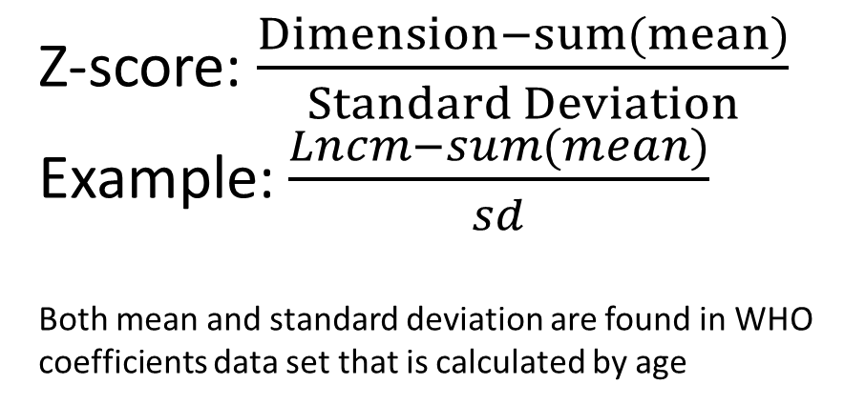
CS4 What is a healthy child?
Z-score: $\frac{Dimension−sum(mean)}{Standard Deviation}$
Example: $\frac{Lncm−sum(mean)}{sd}$
Both mean and standard deviation are found in WHO coefficients data set that is calculated by age

Slide 2
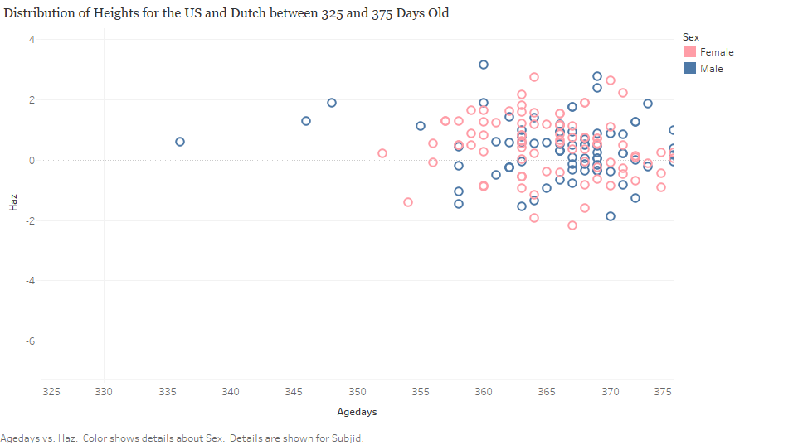
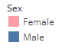

Slide 3
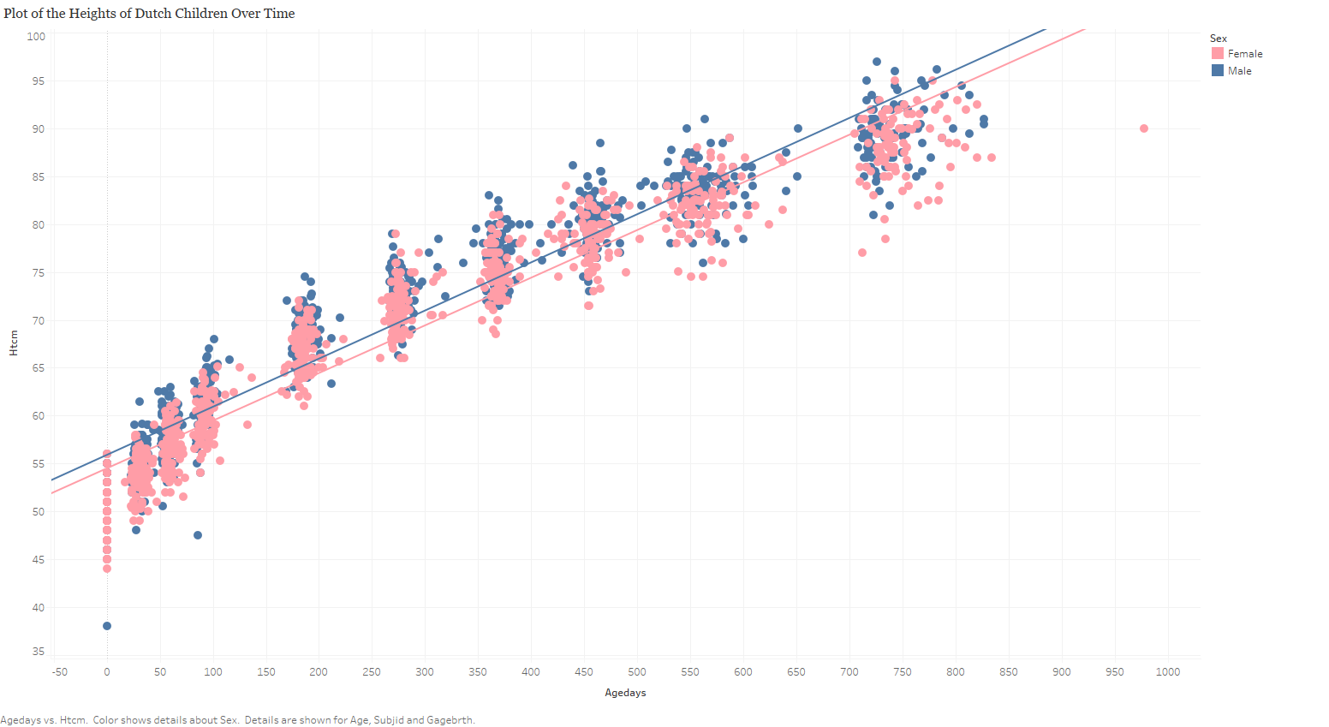

Slide 4
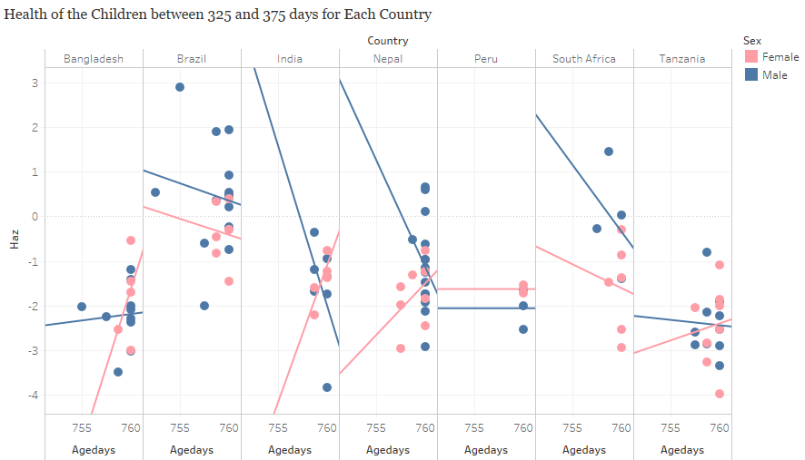

Slide 5
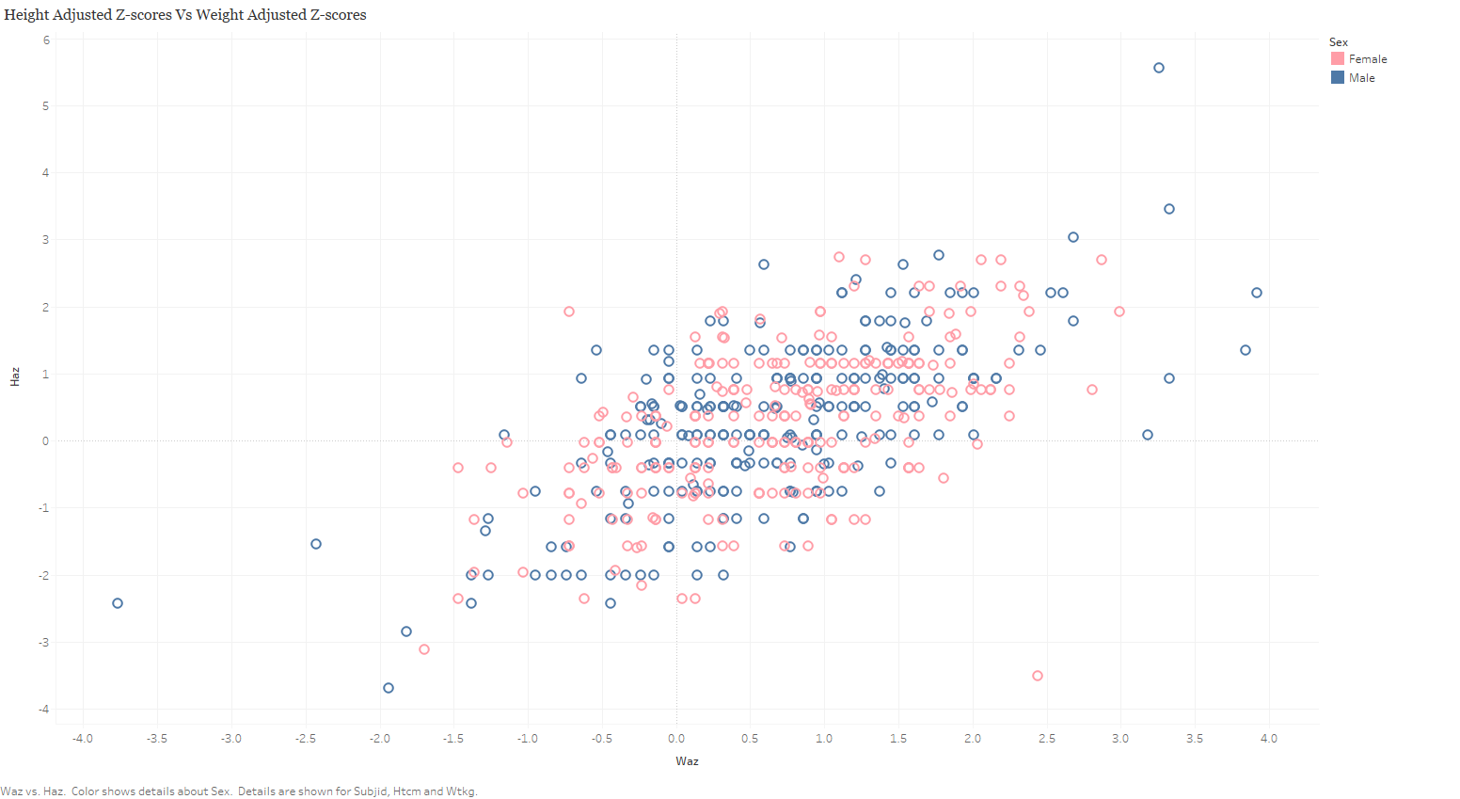

Slide 6
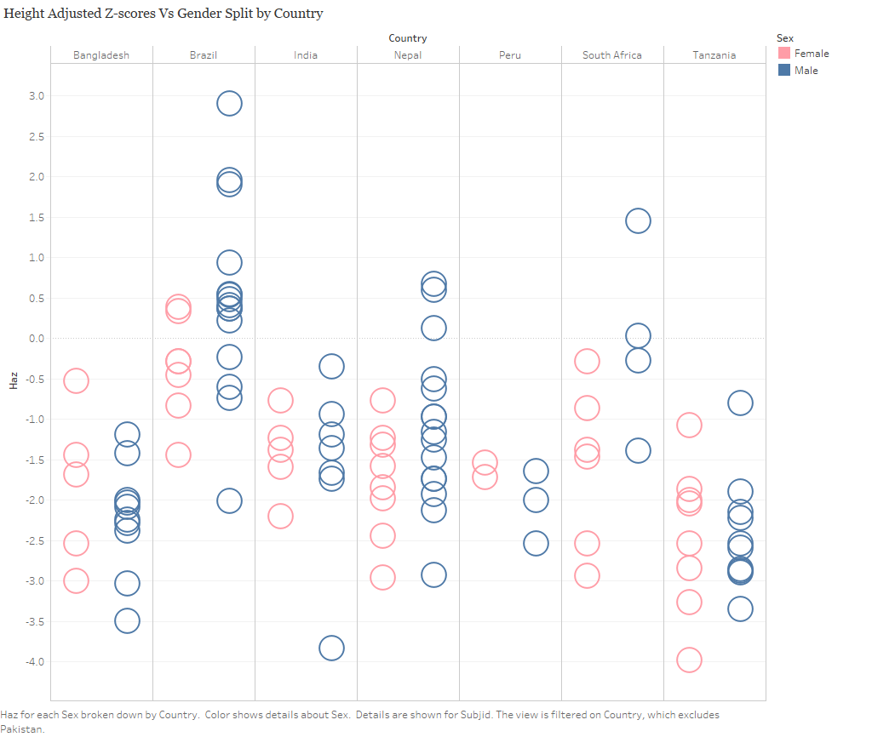

Slide 7
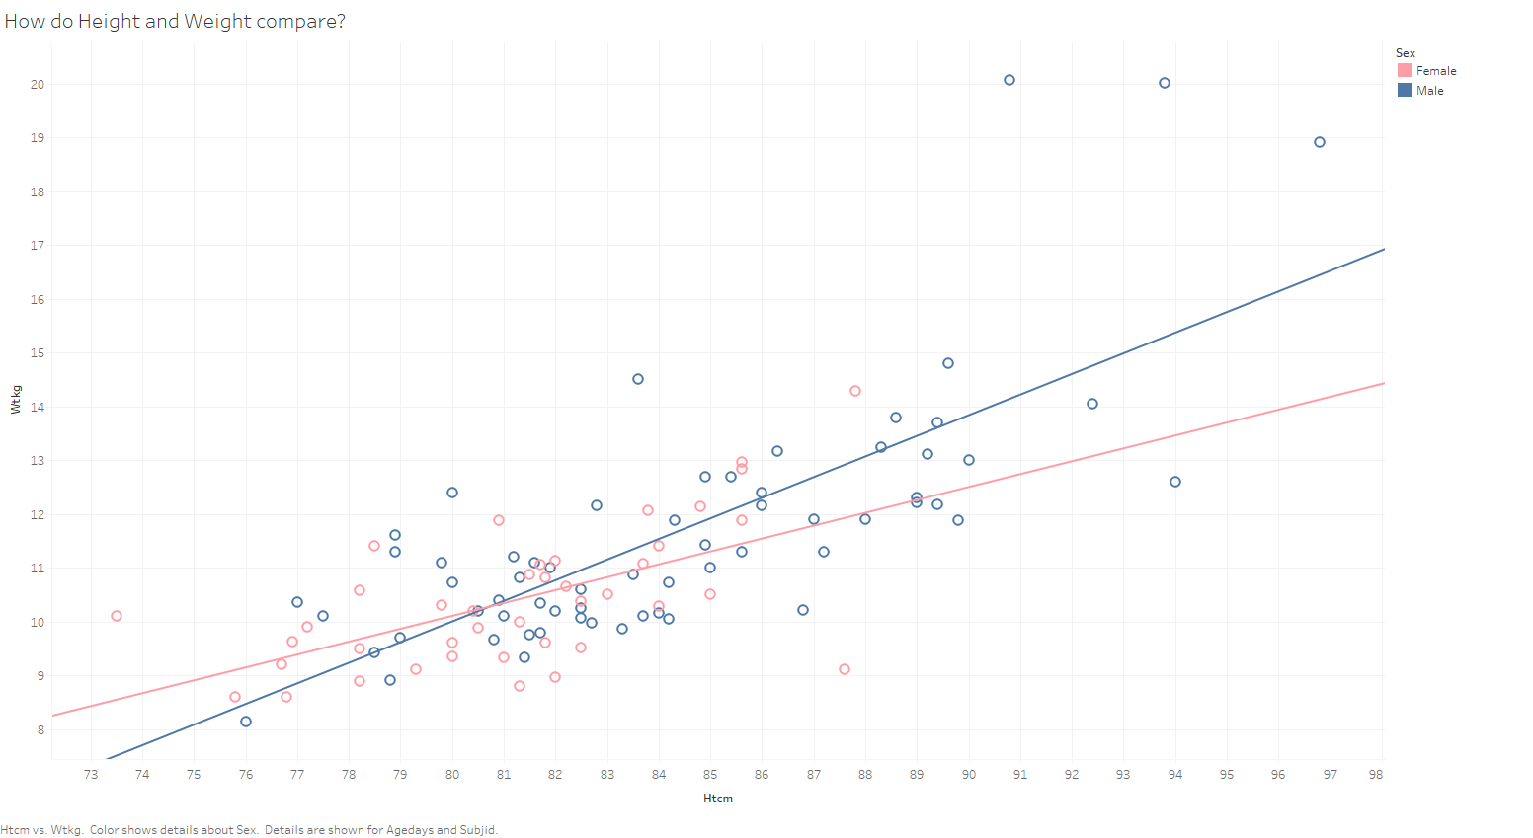

Slide 8
