Slide 1
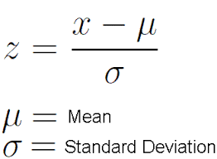
CS4
What is a healthy child?
Z-score:
$\frac{Dimension−sum(mean)}{Standard Deviation}$
Example:
$\frac{Lncm−sum(mean)}{sd}$

Slide 2
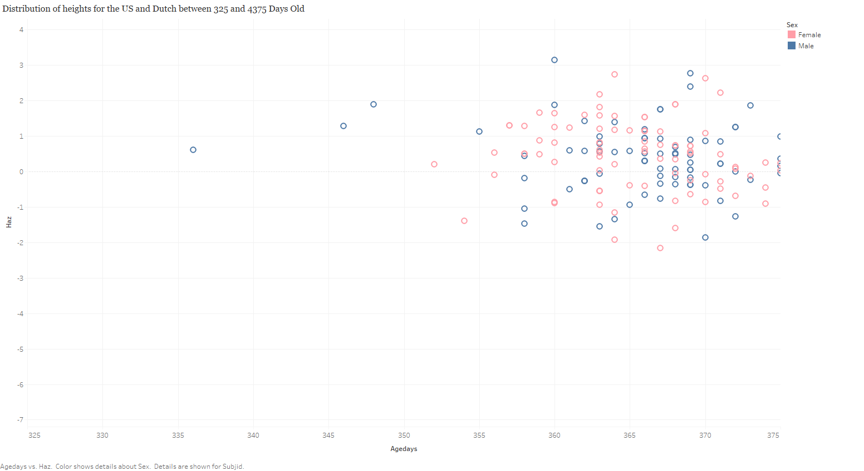

Slide 3
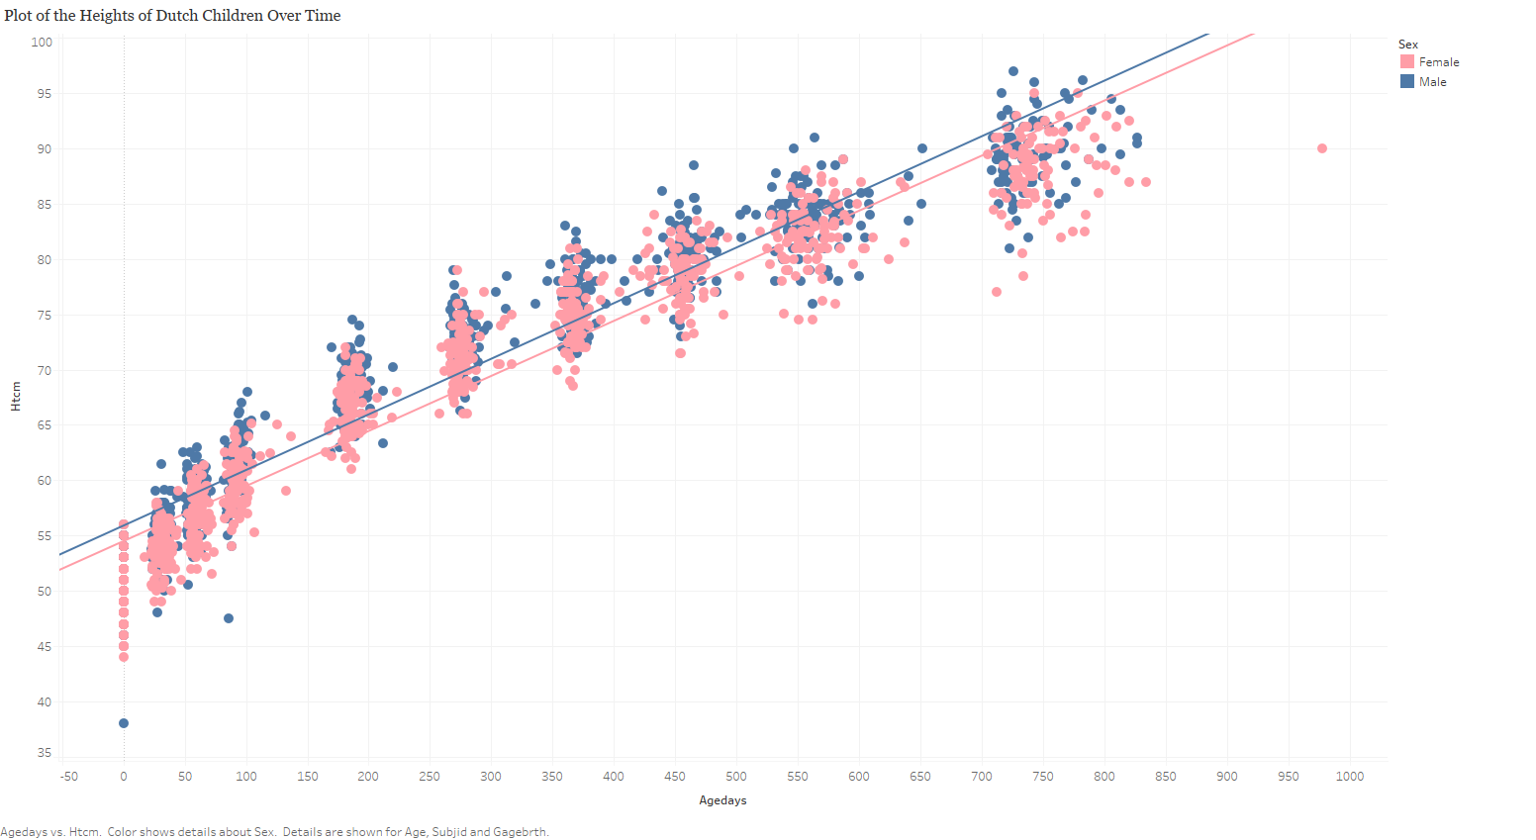

Slide 4
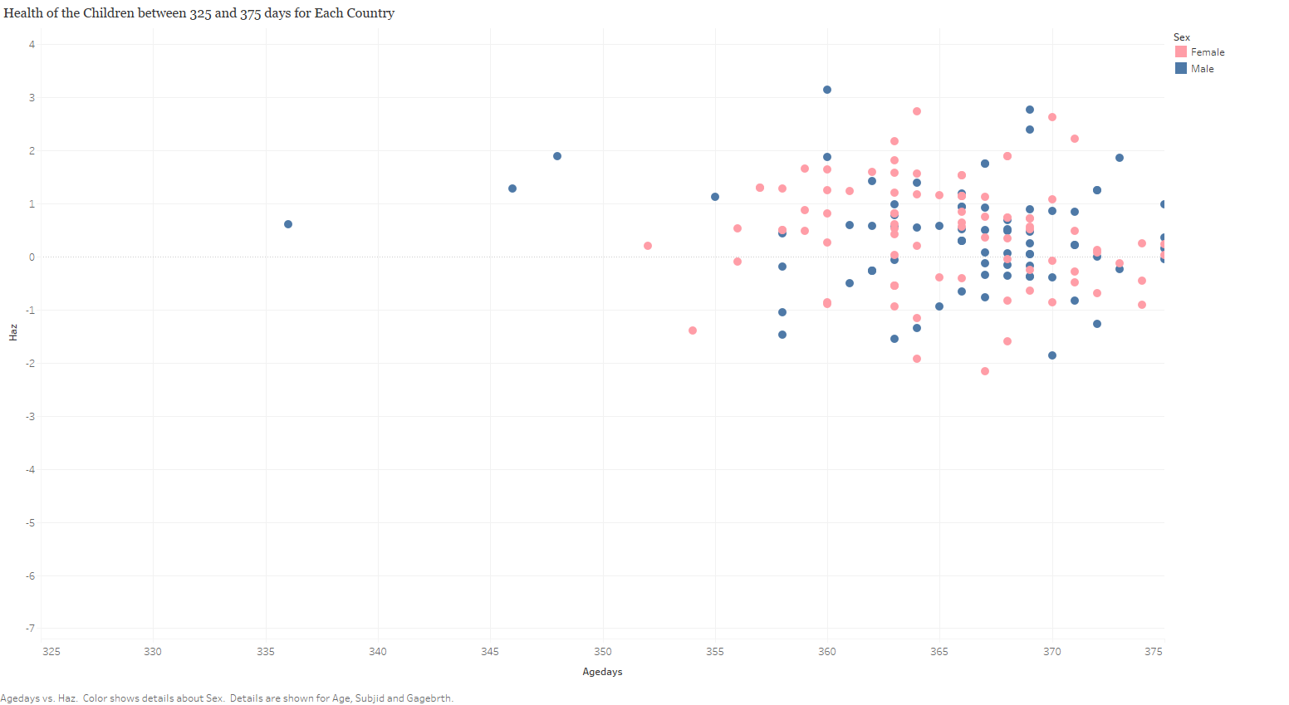

Slide 5
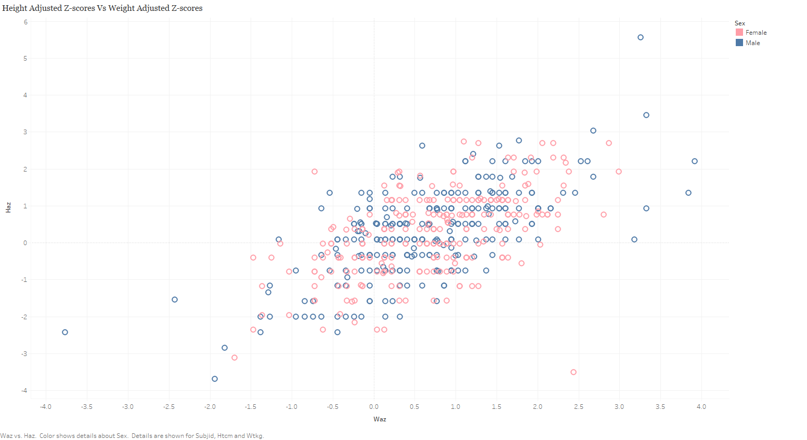

Slide 6
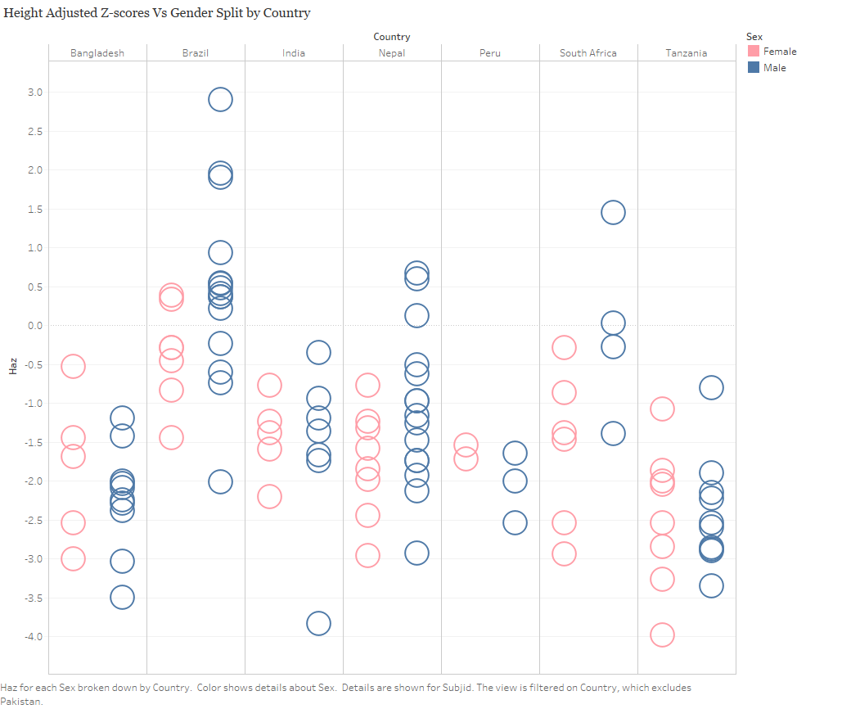

Slide 7
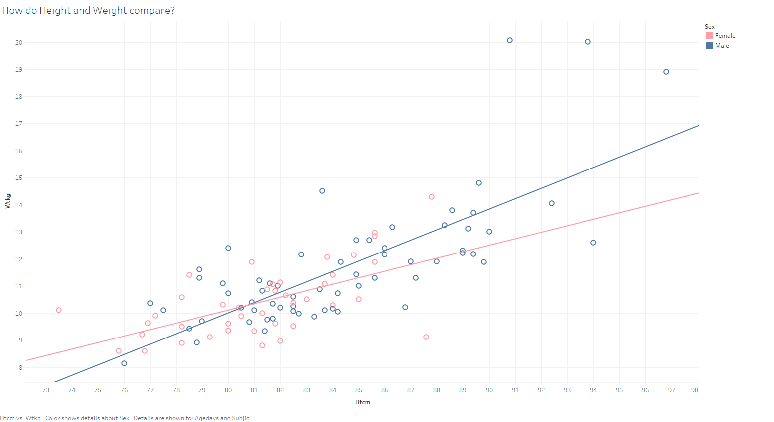

Slide 8

