Slide 1

Inventory in a click
BluBox
With BluBox, no matter how big the inventory is, a few clicks is all it takes, nothing more.

Slide 2
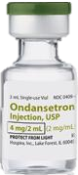
Let’s say, someone asks you to note
down the details of this medical item

Slide 3
Now one more…

Slide 4
Another one…

Slide 5
One more…

Slide 6
Hundreds of these…
This is what an NSF goes through every time he breaks the dreadful seal of the resuscitation box.

Slide 7
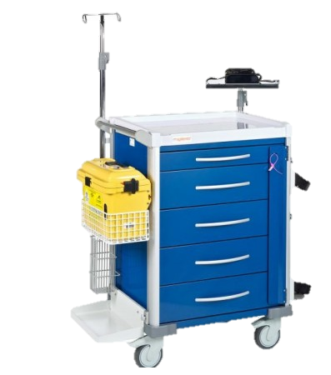
Why is that a problem?
Boredom means error.
Error means potential loss of life.
Loss of man hours.
“Duty medics are prone to making mistakes as it is a very mundane job. However we cannot afford that as lives are at stake.” - Representative from MMI
“Completely checking the whole drawer sometimes takes like two or three hours, it’s quite tiring!” - CPL Arif, Former SAF Medic

Slide 8
Blubox for the rescue
x5
A few clicks is all it takes, nothing more.

Slide 9

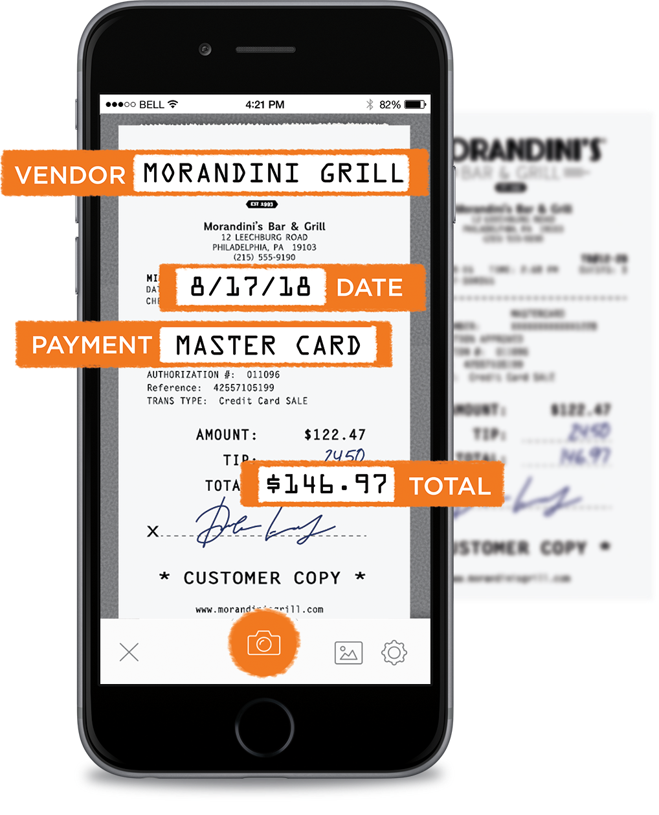
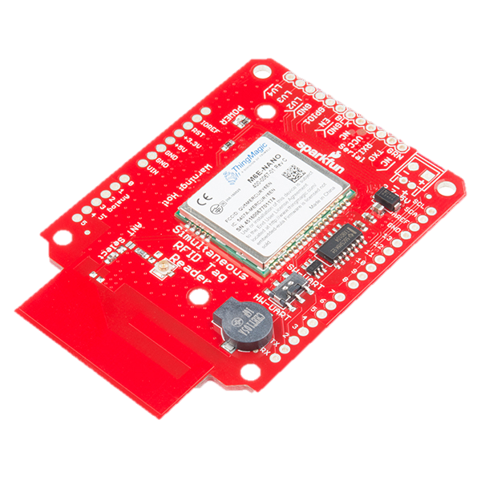
How it’s done
1.
1.
Digitally read name of drug and expiry date
Data written into RFID tags on drug
Item + RFID tag
2.
2.
3.
Inventory maintenance
Data goes to RFID writer
RFID Reader/Writer
Optical Reader/ Inventory

Slide 10
How it’s done
1.
1.
1.
Data in inventory is compared against data in RFID tag
Data in RFID tags read by RFID reader
Item + RFID tag
3.
3.
2.
2.
Inventory check
Data goes from reader to phone inventory
RFID Reader/Writer
Optical Reader/ Inventory

Slide 11





Current Customer Journey
error
error

Slide 12

The BluBox Journey

Slide 13





Competition Differentiation
BluBox
Cost-effectiveness
Speed
BluBox offers superior product value Faster, Cheaper, Efficient

Slide 14
Market Validation
“Currently, it is a waste of our time and effort to go through so many items. It would be really useful if we could scan instead. A possible way...maybe barcodes?” - LCP Louie, Medic from Clementi Camp
“I used to hate being a duty medic precisely for this very process. It was so boring and mentally draining. If it can be done in 3s, it would a dream come true for all SAF medic.” LCP Dhanush, Medic from Clementi Camp

Slide 15
Market Size
All logistical hubs islandwide
Singapore healthcare
> $1 million
Army camps
$16,800

Slide 16


Business Model
Revenue Streams Initial Set-up Cost: $250 Monthly Subscription cost: $35/month
Costs Equipments: $400 Subsequent supply of RFID tags for new drugs

Slide 17

Product Development Stages
Further expand to logistic hubs across Singapore 2023
Further product development
Expand across logistic hubs in Singapore 2022
Further product development
Jun – Aug 2019
Initial product testing
Sep 2019
First product sales (SAF medical centers)
Oct 2019
Expand across medical center market
2021
Develop Product
Optimize Software
Expand to medical centers across Singapore
2020

Slide 18
Initial
Investment
S$ 20k
Sales ($ Thousands)
40
Units
100
Units
500
Units
3000
Units
10000
Units (1% of market)

Slide 19
The Team
Kezia Kew
1st Year Information security
Software lead
Shanmugam Vignesh
1st Year Mechanical
Hardware development, software development
Arjun Kumar
1st Year FASS (Psychology & Business)
Marketing and business lead
Sukrit Jaiswal
1st Year Mechanical
Hardware development and logistics managment

Slide 20
Inventory management could never become easier!
BluBox
Inventory in a click
Contact us: bluboxrfid@gmail.com

Slide 21
References
http://www.medtech.sg/hospitals-and-other-healthcare-organisations/
https://en.wikipedia.org/wiki/List_of_Singapore_Armed_Forces_bases

