Slide 1
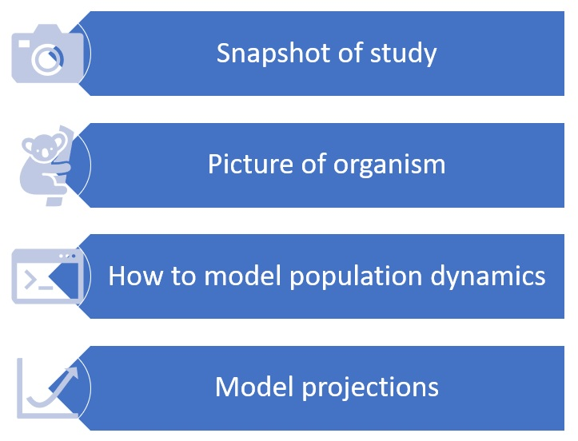
Connecting Theory, Research, and Application
Notes:
In our educational material, we are developing sections dedicated to illustrating how a recent publication has applied population ecology theory to tackle ecological problems such as biological invasions or extinction risk
These sections are composed by a short description of the publication, an illustration of the concerned organism, codes using published population data and equations to create models, and plots providing model projections for that given population

Slide 2
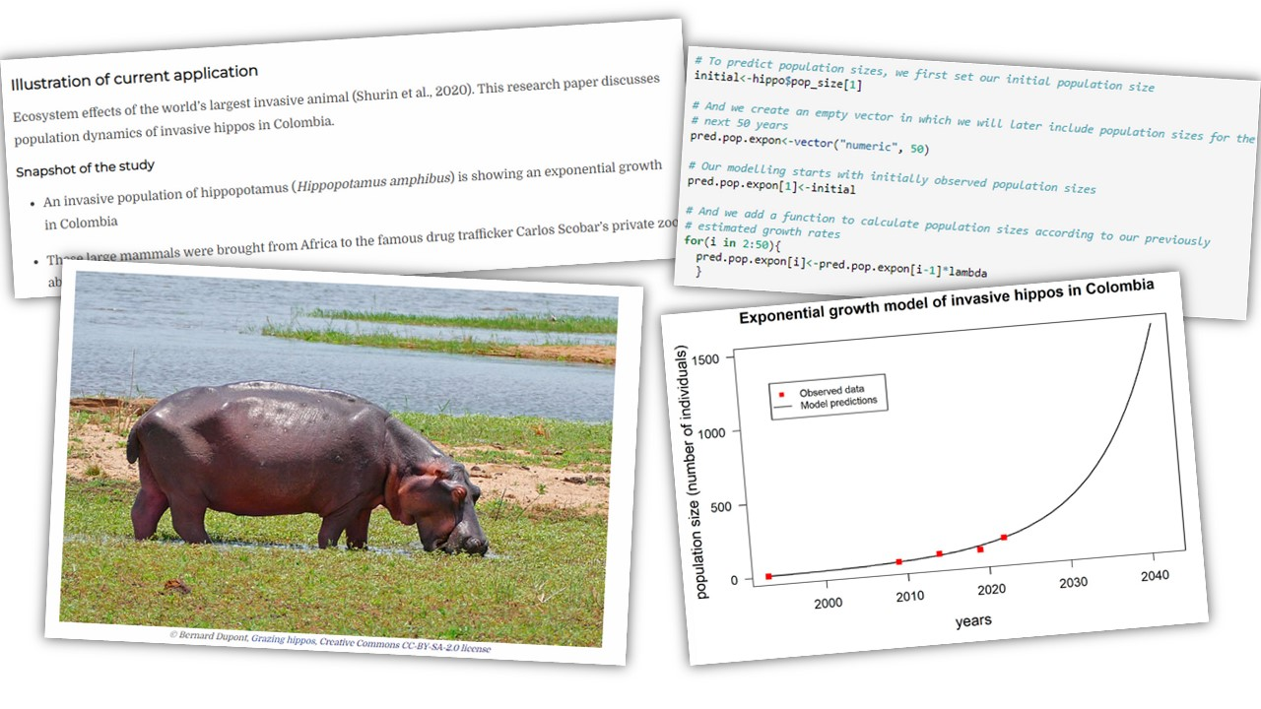
Applying Theory to Understand Big Problems
Notes:
One of our examples describes how an exponential growth of invasive hippo populations in South America is threatening aquatic systems due to the overload of organic matter they bring.

Slide 3
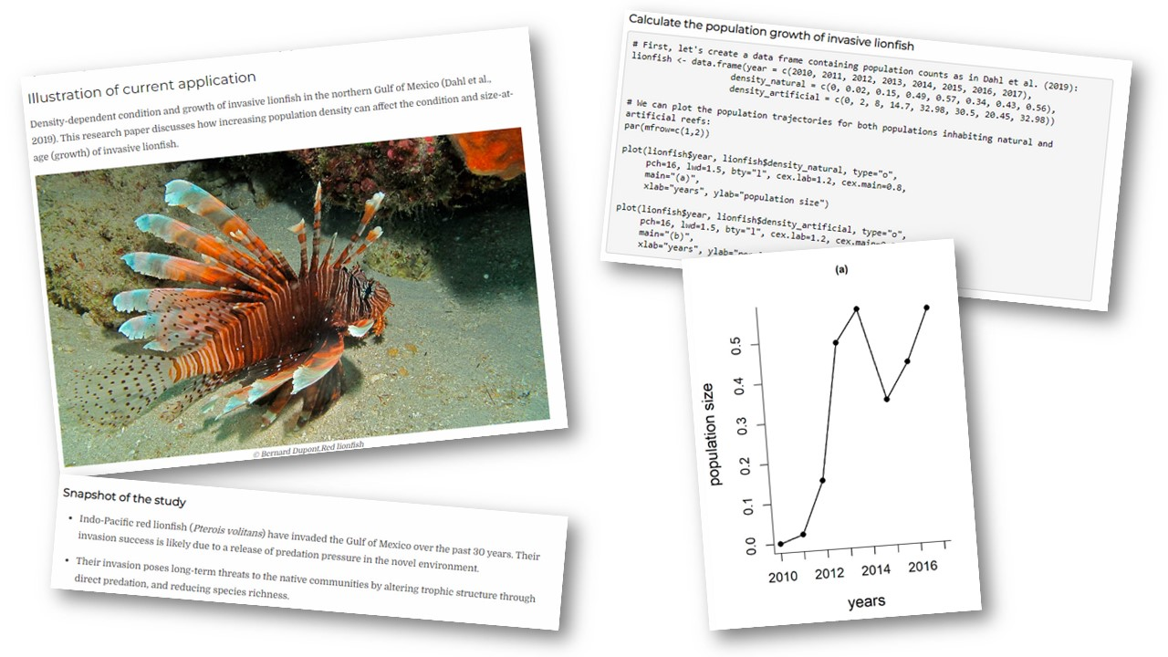
Improving Learning Through Case Studies
Notes:
Another example focused on invasive lion fish, which threatens the biodiversity of invaded areas, shows that the number of lion fish living at the same time controls the population sizes for this species, which has implications for management actions
Reading recent publications and developing a section in our educational material where we summarize methods and main findings can help improve our learning in the following ways:
Better understand concepts and equations by applying models to real-world data
Recognize the importance of ecological theory to understand and manage current problems (extinction risk, biological invasions, etc.)
Become familiar with relevant literature

