Slide 1
CSCI 6660 Fall 2020 Tic-Tac-Toe Agents
By: Katrina Curro

Slide 2
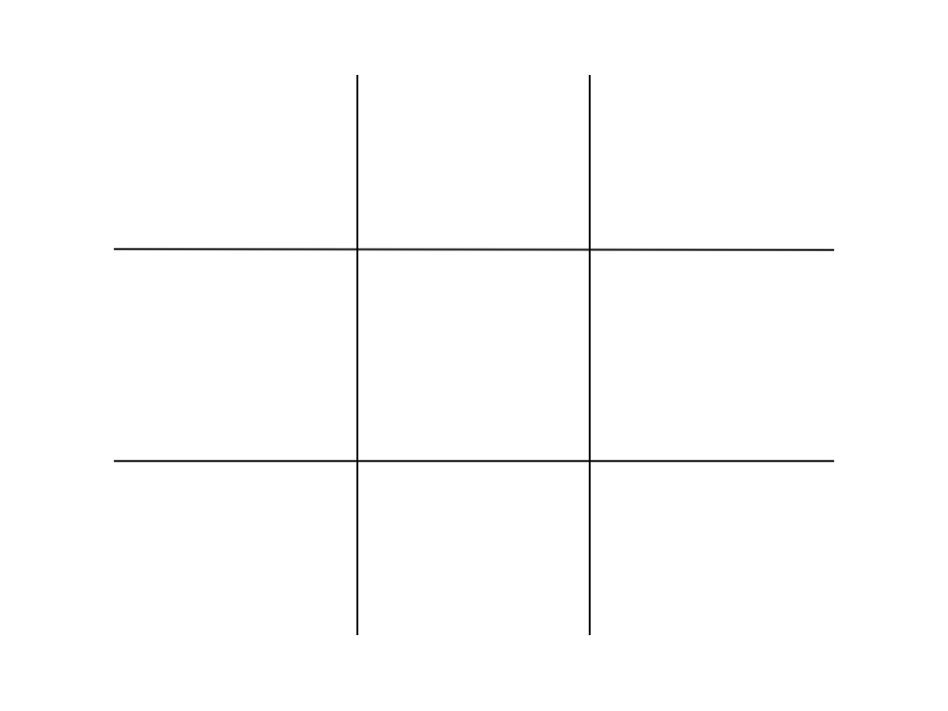
Project Goals
Create agents to play on 3 different sized tic-tac-toe boards… random move agent basic strategy agent minimax agent minimax with alpha beta pruning agent Data is observed for 10 runs: Number of nodes expanded in the game Number of times the agent won
This Photo by Unknown Author is licensed under CC BY-SA-NC

Slide 3
4 different agents created Project Controls: Opponent for all agents: Random Agent Agents always had the first move and played as X
Approach

Slide 4
Agent 1 – Random Agent

Slide 5
Game is played with the following: Agent: Random Agent Computer: Random Agent Both choose a random location on the board
if depth == 9: x = choice([0, 1, 2]) y = choice([0, 1, 2]) else: l = [] for first in range(len(board)): for second in range(len(board)): if board[first][second] == 0: l.append((first, second)) move = random.choice(l) x, y = move[0], move[1] expanded = 1 validMove(x, y, AGENT)

Slide 6
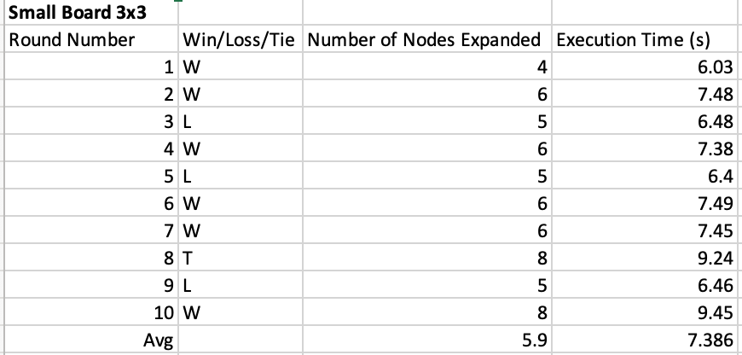
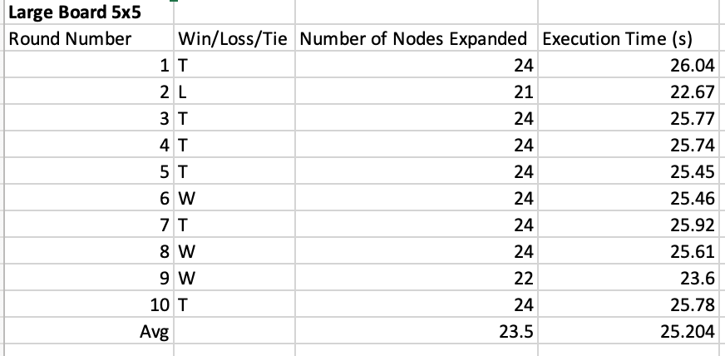
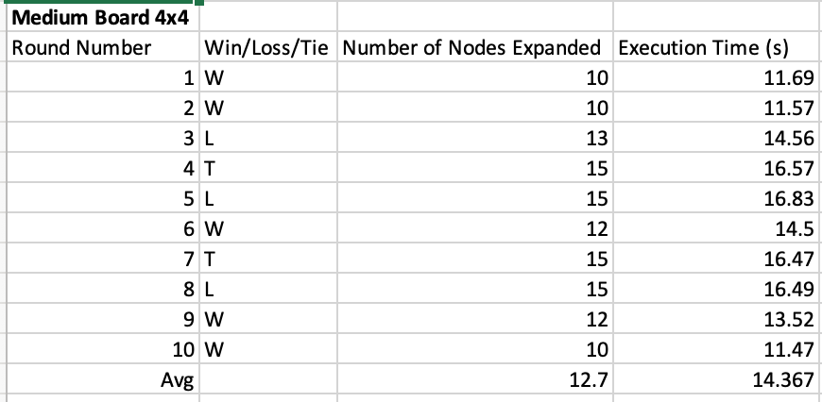
Agent 1- Findings
Number of Wins Based on Board Size:
Small Board: 6 -> 60%
Medium Board: 5 -> 50%
Large Board: 3 -> 30%

Slide 7
Agent 2 – Basic Game Play Agent

Slide 8
Game is played with the following: Agent: Basic Game Play Computer: Random Agent Agent will play 4 corners first then will play a random locations Computer chooses a random location on the board
if validMove(0, 0, AGENT): x, y = 0, 0 expanded = 1 elif validMove(0, 2, AGENT): x, y = 0, 2 expanded = 1 elif validMove(2, 0, AGENT): x, y = 2, 0 expanded = 1 elif validMove(2, 2, AGENT): x, y = 2, 2 expanded = 1
else: l = [] for i in range(len(board)): for j in range(len(board)): if board[i][j] == 0: l.append((i, j)) move = random.choice(l) x, y = move[0], move[1] expanded = 1

Slide 9
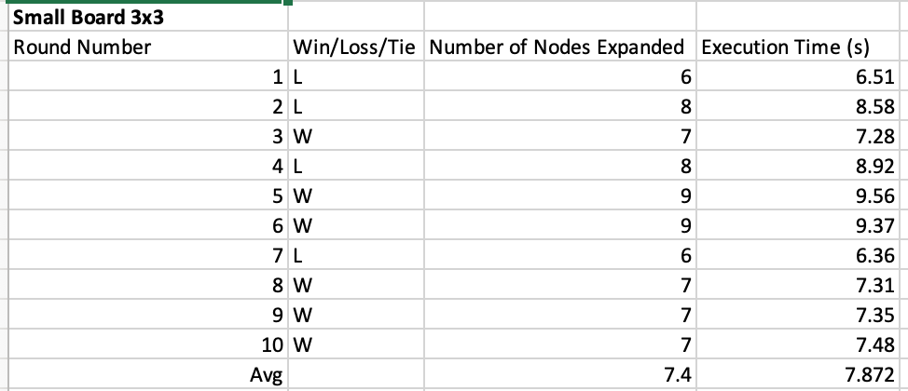
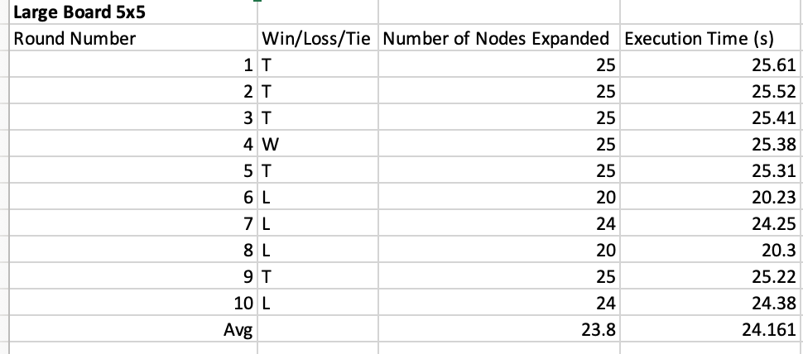
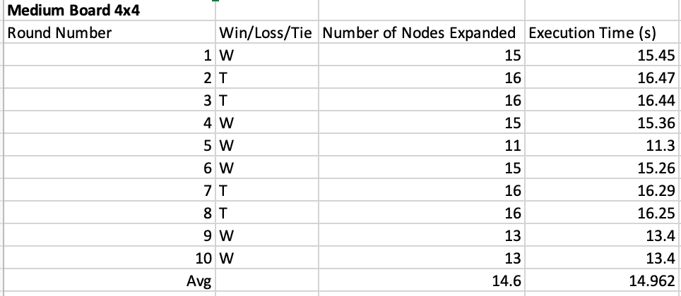
Agent 2- Findings
Number of Wins Based on Board Size:
Small Board: 6 -> 60%
Medium Board: 6 -> 60%
Large Board: 1 -> 10%

Slide 10
Agent 3 – Minimax Agent

Slide 11
Game is played with the following: Agent: Minimax Agent Computer: Random Agent Agent will play using the minimax algorithm Computer chooses a random location on the board
if player == AGENT: best = [-1, -1, -infinity, expanded] for cell in availablePositions(state): x, y = cell[0], cell[1] state[x][y] = player score = minimax(state, depth - 1,
changePlayer(player), expanded) state[x][y] = 0 score[0], score[1] = x, y if score[2] > best[2]: temp = max(score, best) best = temp expanded += 1 best[3] = expanded return best

Slide 12
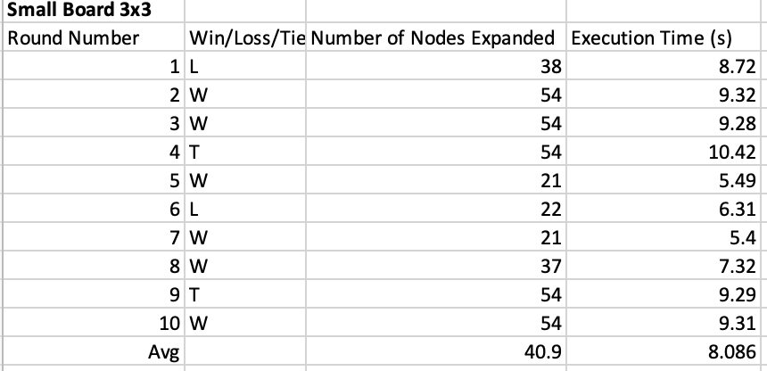
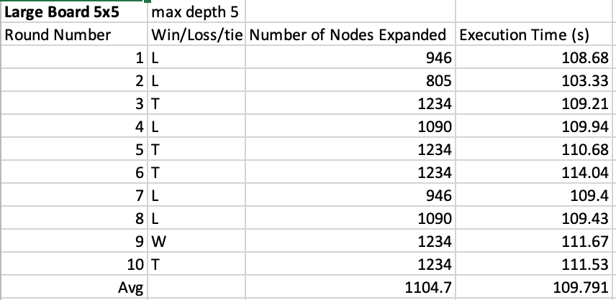
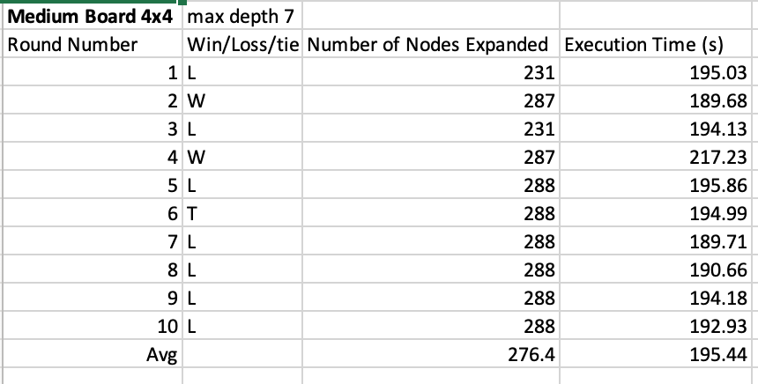
Agent 3- Findings
Number of Wins Based on Board Size:
Small Board: 6 -> 60%
Medium Board: 2 -> 20%
Large Board: 1 -> 10%

Slide 13
Agent 4 – Minimax Agent with Alpha Beta Pruning

Slide 14
if player == AGENT: best = [-1, -1, -infinity, expanded] for cell in availablePositions(state): x, y = cell[0], cell[1] state[x][y] = player score = alphaBeta(state, depth - 1,
changePlayer(player), alpha, beta, expanded) state[x][y] = 0 score[0], score[1] = x, y if score[2] > best[2]: score[2] = max(score[2], best[2]) temp = [score[0], score[1], score[2], score[3]] best = temp expanded += 1 best[3] = expanded if score[2] > beta: return best alpha = max(alpha, best[2]) return best
Game is played with the following: Agent: Minimax Agent utilizing alpha beta pruning
Computer: Random Agent Agent will play using the minimax algorithm with alpha beta pruning Computer chooses a random location on the board

Slide 15
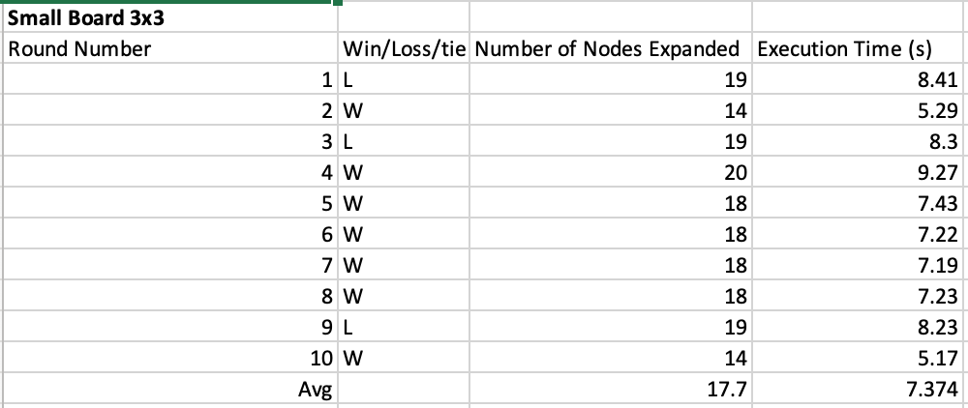
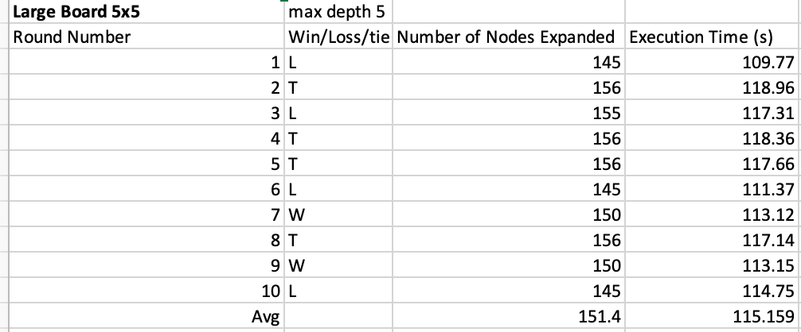
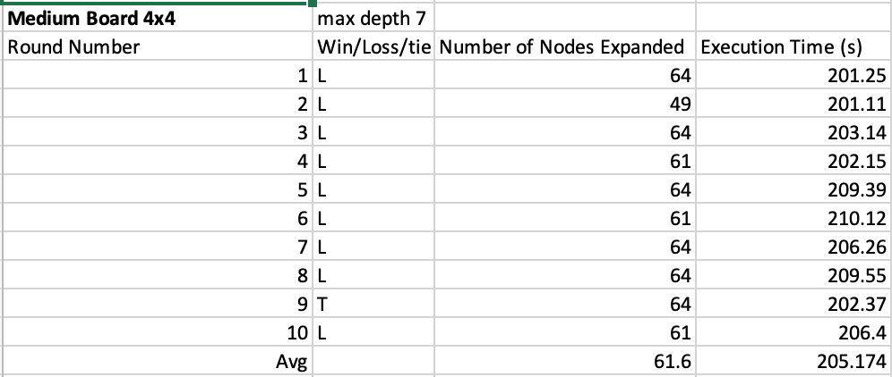
Agent 4- Findings
Number of Wins Based on Board Size:
Small Board: 7 -> 70%
Medium Board: 0 -> 0%
Large Board: 2 -> 20%

Slide 16
Notable Comparisons

Slide 17
Who expands the least number of nodes?
Random Agent
Agent 3 vs Agent 4
Agent 4 expands significantly less nodes than Agent 3
Ex. Large board 5x5
Agent 3 expands: 1104.7 nodes
Agent 4 expands: 151.4 nodes
Best win percentages:
Small board: Agent 4
Medium board: Agent 2
Large board: Agent 1
This Photo by Unknown Author is licensed under CC BY-SA-NC

Slide 18
Insight: When designing agents, do not always assume the opponent plays optimally The larger the state space (in this case board size) becomes we have exponentially more possible combinations In cases of large state spaces, we need to limit the depth we explore or else we will be computing for what feels like forever

