Slide 1
WHAM update 28 Sept

Slide 2
Proposed base model….
Indices: RecCPA and Spring VAST (Fall can be added in MT)
Selectivity parameterization
Fishing fleets (no blocks):
North = age-specific, flat-topped selectivity (4+ for commercial, 7+ for recreational)
South = logistic selectivity
Indices:
North
Rec CPA: Age-specific, flat-topped for ages 2+
VAST: Age-specific, flat-topped for ages 5+
South
Rec CPA: Age-specific, flat-topped for ages 3+
VAST: logistic

Slide 3
Proposed base model….
Distribution assumptions:
North Commercial = dirichlet-multinomial
All other fishing fleets = logistic-normal (but some exclude zeros, and some use AR1 process to smooth over zeros)
North VAST = dirichlet-multinomial
All other indices = logistic-normal
Random effects
Recruitment and survival (iid)
Selectivity
North Comm and Rec: 2dar1 (AR1 across both ages and years)
North Rec CPA: ar1_y (AR1 by year)
North VAST: 2dar1
South fishing fleets and indices: none

Slide 4
Reference points
Global F that results in SSB/R 40%
SSB40%: Based on weighted sum of the regions based on average recruitment
5-year averages for selectivity, WAA, etc

Slide 5
Short-term projection methodology
How is recruitment projected with random effects?
3-year projections
Year 1: Interim catch
Years 2-3: F40%
5-year averages for selectivity, WAA, etc

Slide 6
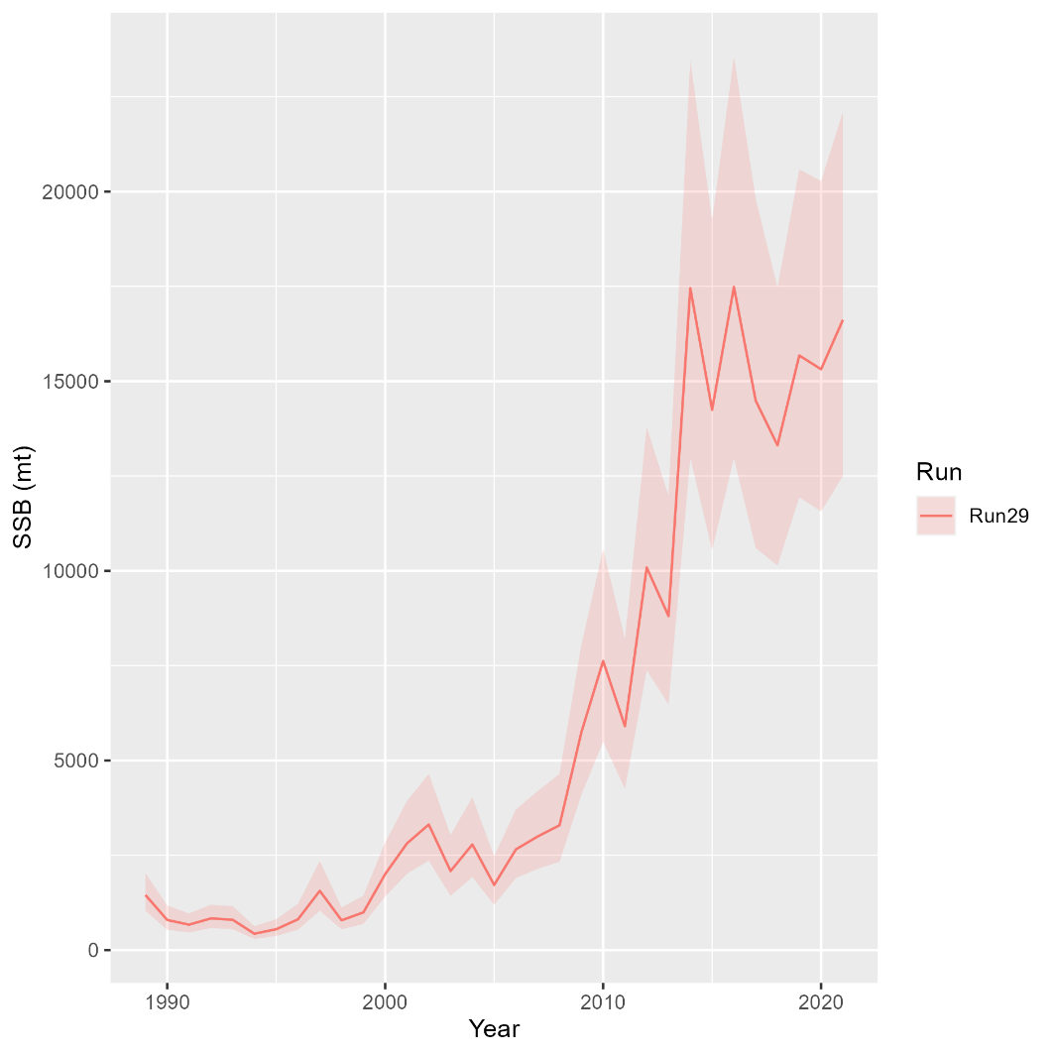
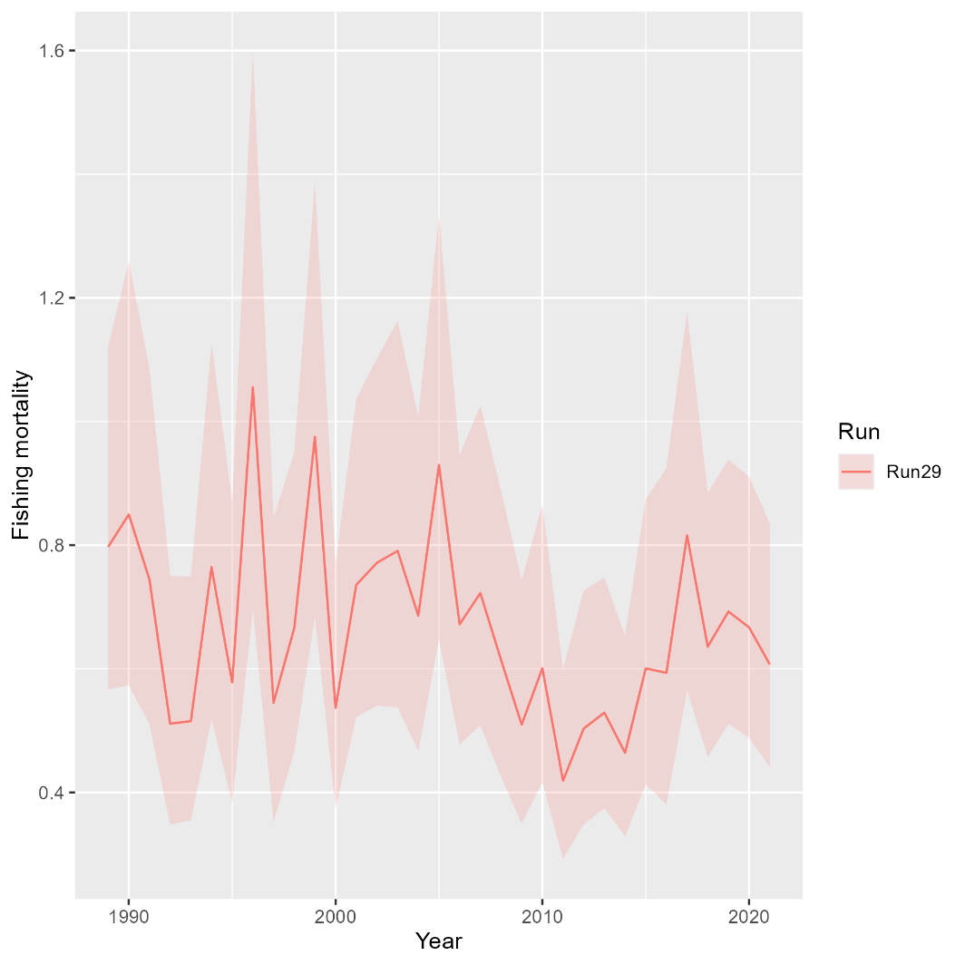
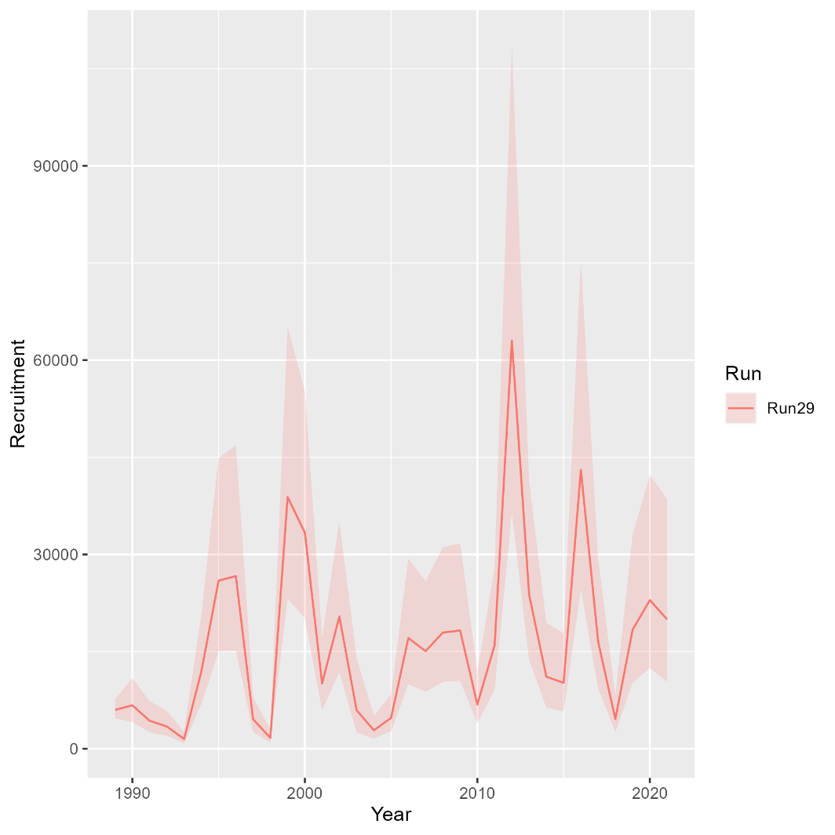
North
Mohn’s rho
 | Fmort | SSB | Rect
 | 0.098 | -0.091 | -0.005

Slide 7
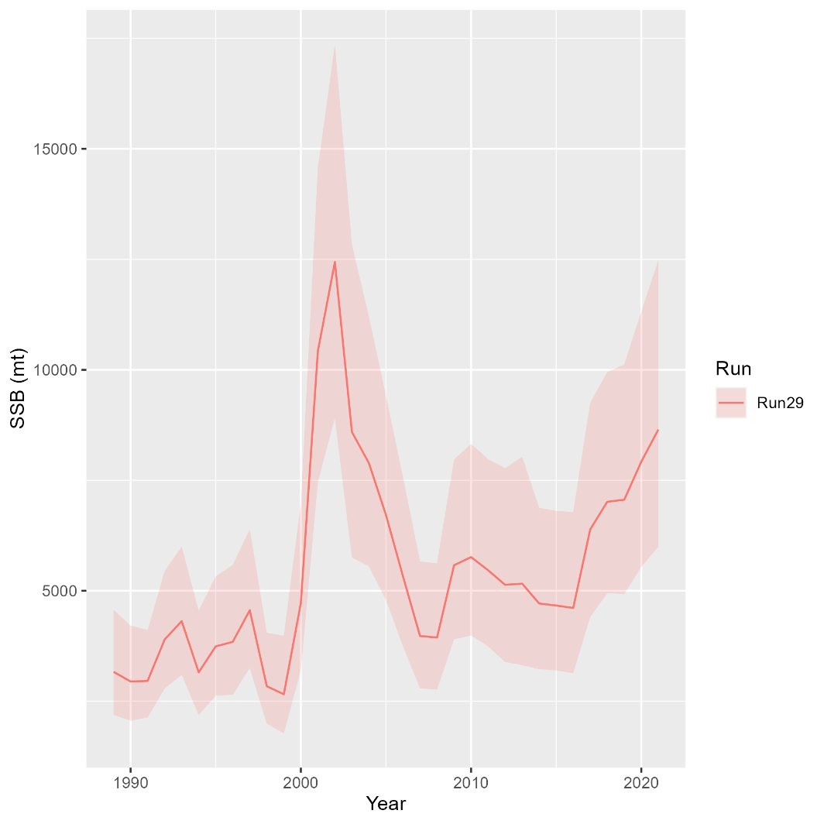
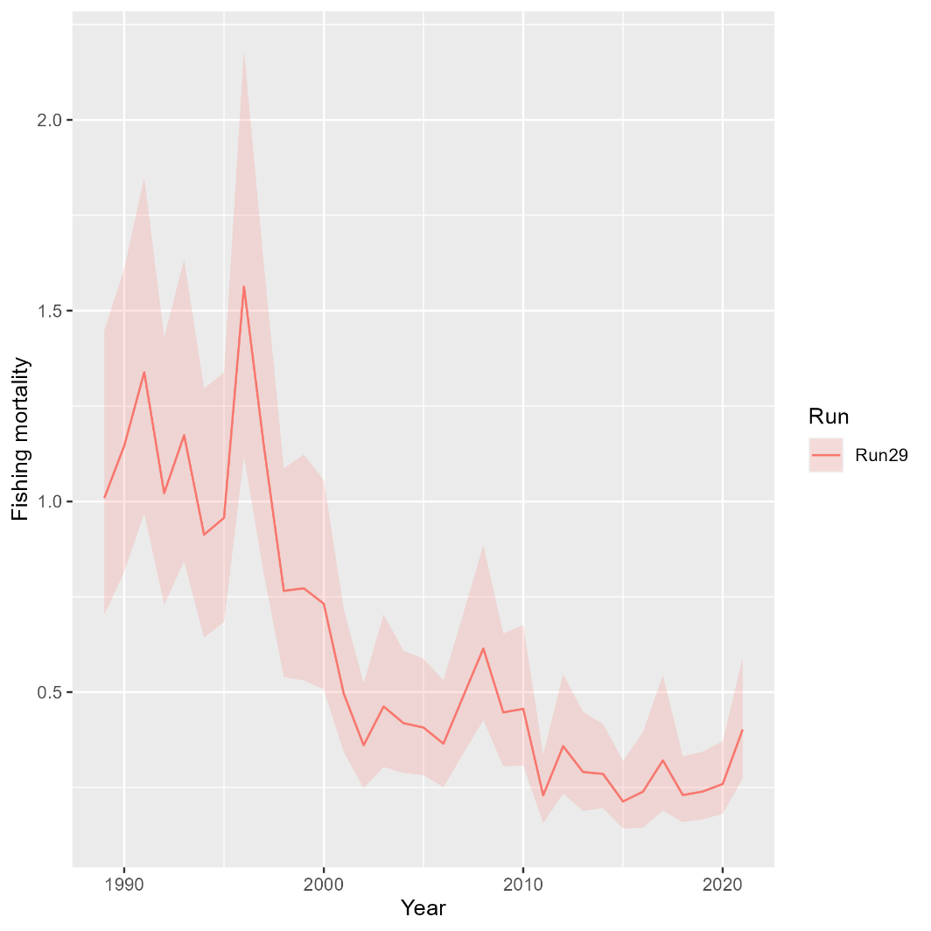
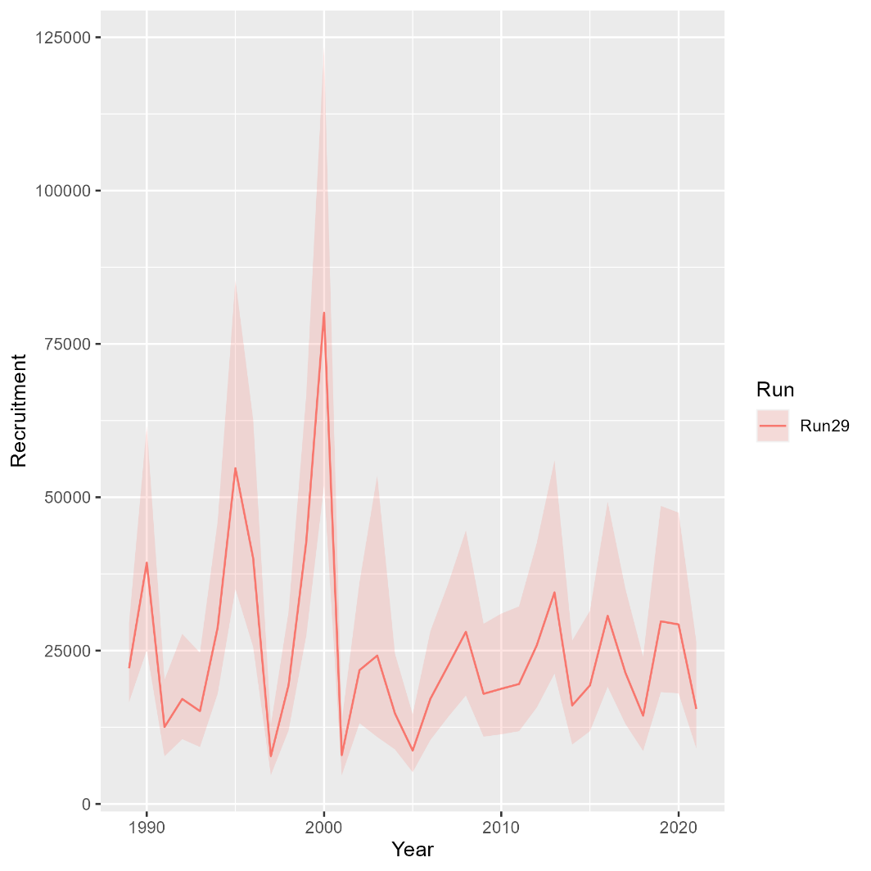
South
Mohn’s rho
 | Fmort | SSB | Rect
 | -0.061 | 0.004 | -0.012

