Slide 1
WHAM update 28 Sept

Slide 2
Proposed base model….
Indices: RecCPA and Spring VAST (Fall can be added in MT)
Selectivity parameterization
Fishing fleets (no blocks):
North = age-specific, flat-topped selectivity (4+ for commercial, 7+ for recreational)
South = logistic selectivity for both commercial and recreational
Indices:
North
Rec CPA: Age-specific, flat-topped for ages 2+
VAST: Age-specific, flat-topped for ages 5+
South
Rec CPA: Age-specific, flat-topped for ages 3+
VAST: logistic

Slide 3
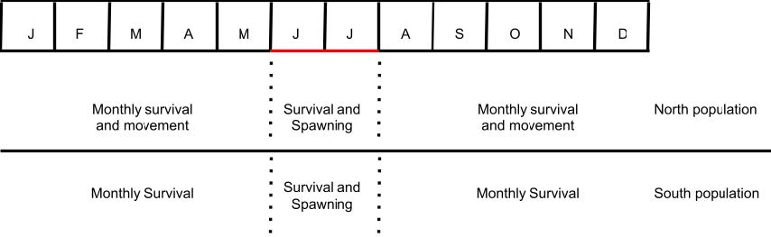
New movement configuration
Realized I was not configuring movement from south to north as I had thought
Now, for August-December North fish move from north to south only (no movement from south to north) (parameter 1)
For January-April, North fish in the south move north only (no movement from north to south) (parameter 2)

Slide 4
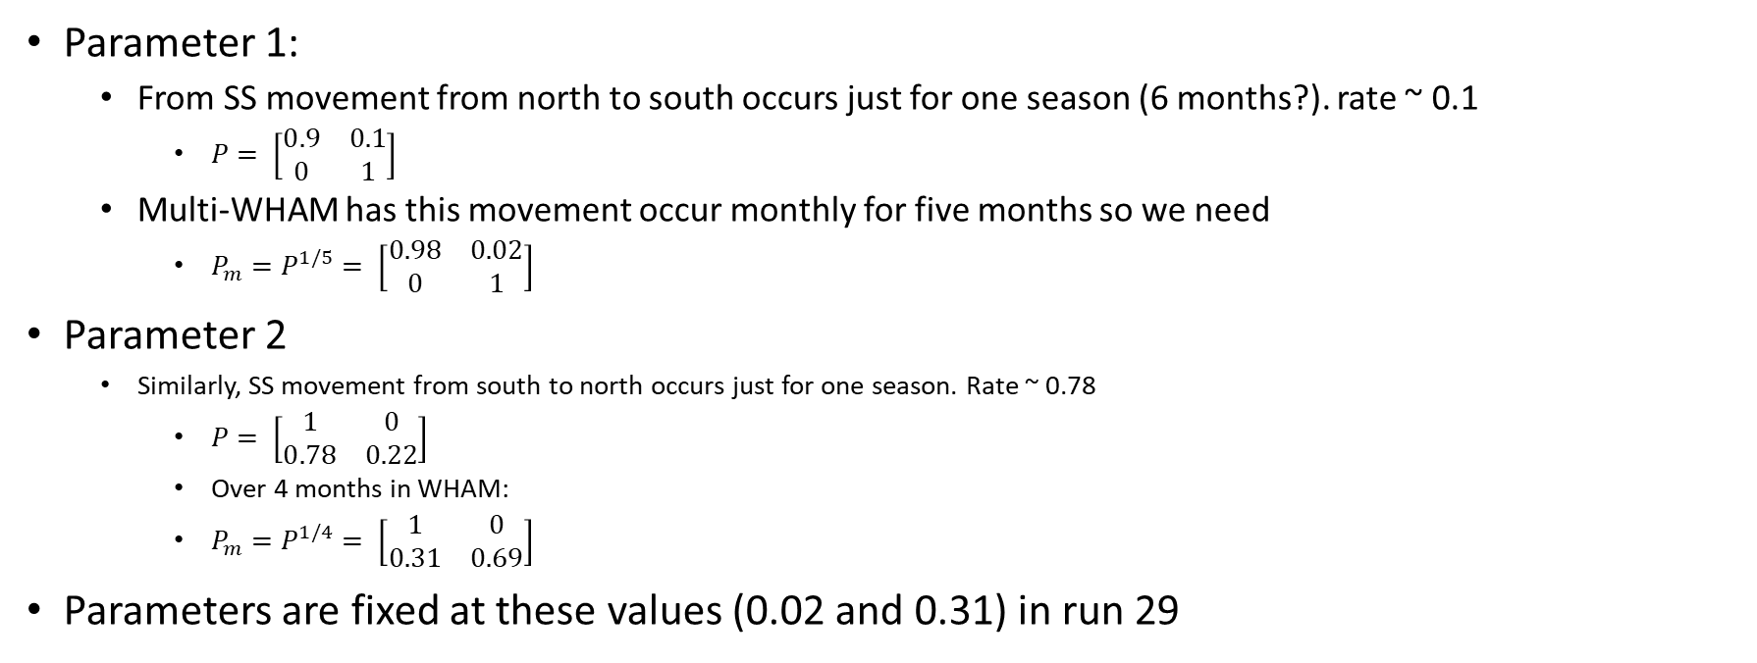
New movement configuration
Parameter 1:
From SS movement from north to south occurs just for one season (6 months?). rate ~ 0.1
$P= \left[\begin{matrix}0.9 & 0.1 \\ 0 & 1\end{matrix}\right]$
Multi-WHAM has this movement occur monthly for five months so we need
$P_{m}=P^{1/5}= \left[\begin{matrix}0.98 & 0.02 \\ 0 & 1\end{matrix}\right]$
Parameter 2
Similarly, SS movement from south to north occurs just for one season. Rate ~ 0.78
$P= \left[\begin{matrix}1 & 0 \\ 0.78 & 0.22\end{matrix}\right]$
Over 4 months in WHAM:
$P_{m}=P^{1/4}= \left[\begin{matrix}1 & 0 \\ 0.31 & 0.69\end{matrix}\right]$
Parameters are fixed at these values (0.02 and 0.31) in run 29

Slide 5
Proposed base model….
Distribution assumptions:
North Commercial = dirichlet-multinomial
All other fishing fleets = logistic-normal
Southern fleets estimate AR1 correlation parameter
North VAST = dirichlet-multinomial
All other indices = logistic-normal
Southern indices estimate AR1 correlation parameter
Random effects
Recruitment and survival (iid)
Selectivity
North Comm and Rec: 2dar1 (AR1 across both ages and years)
North Rec CPA: ar1_y (AR1 by year) (just age 1)
North VAST: 2dar1 (AR1 across both ages and years)
South fishing fleets and indices: none

Slide 6
Reference points
Global F that results in SSB/R 40%
SSB40%: Based on weighted sum of the regions based on average recruitment
Alternative weighting possible (user-provided, not all years of recruitment)
5-year averages for selectivity, WAA, etc.

Slide 7
Short-term projection methodology
How is recruitment projected with random effects?
3-year projections
Year 1: Interim catch (set to 10kmt in projection run)
Years 2-3: F40%
5-year averages for selectivity, WAA, etc
iid assumption for survival and recruitment make deviations zero in projections
Predictions then are deterministic application of Baranov equations like traditional SCAA
BUT uncertainty in projected RE is propagated.

Slide 8
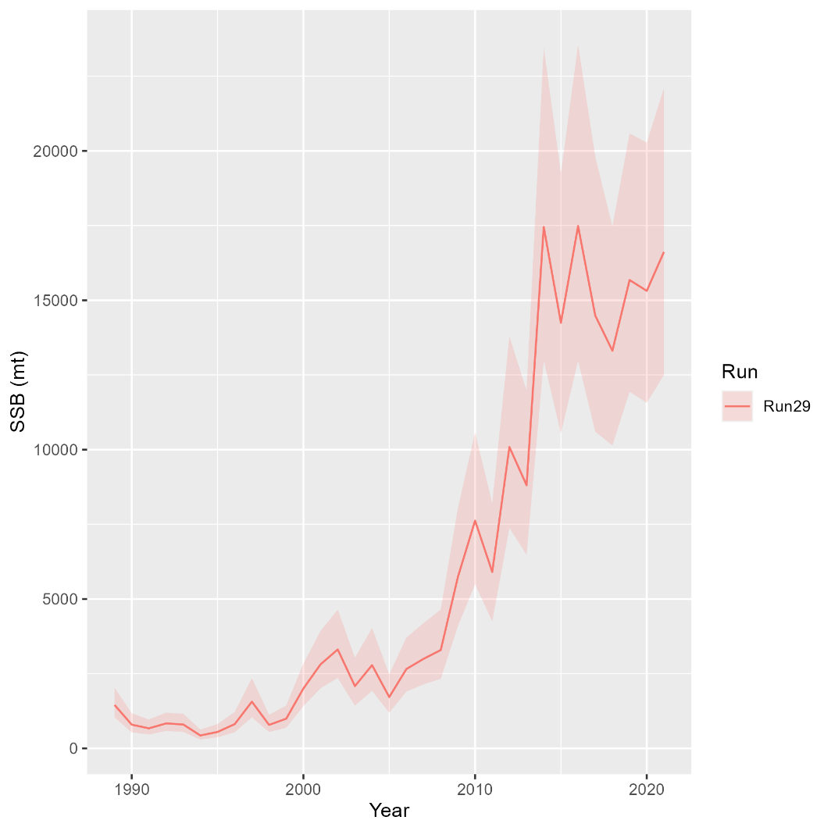
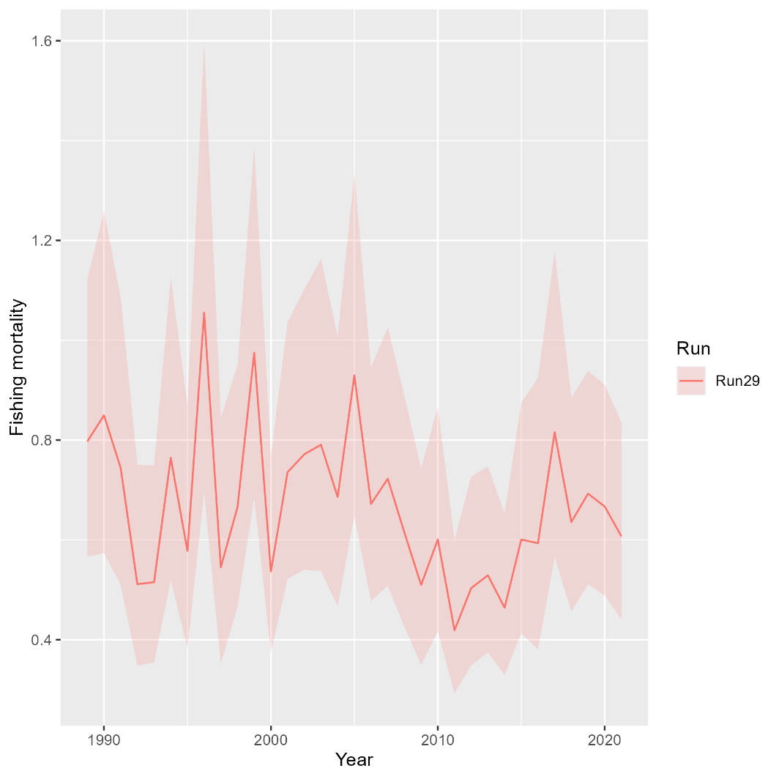
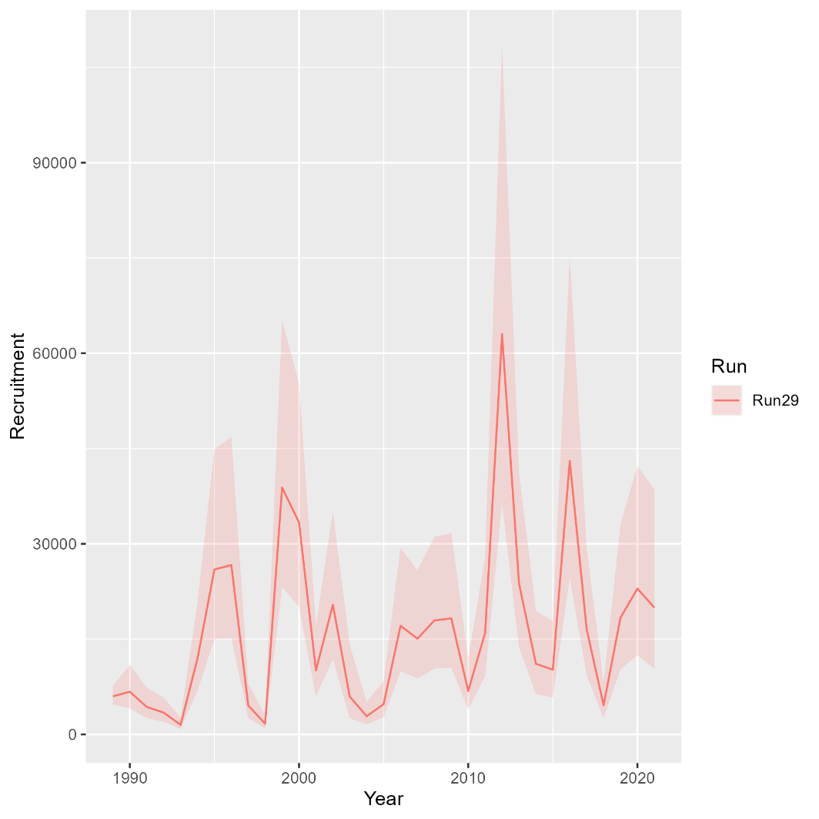
North
Mohn’s rho
 | Fmort | SSB | Rect
 | 0.098 | -0.091 | -0.005

Slide 9
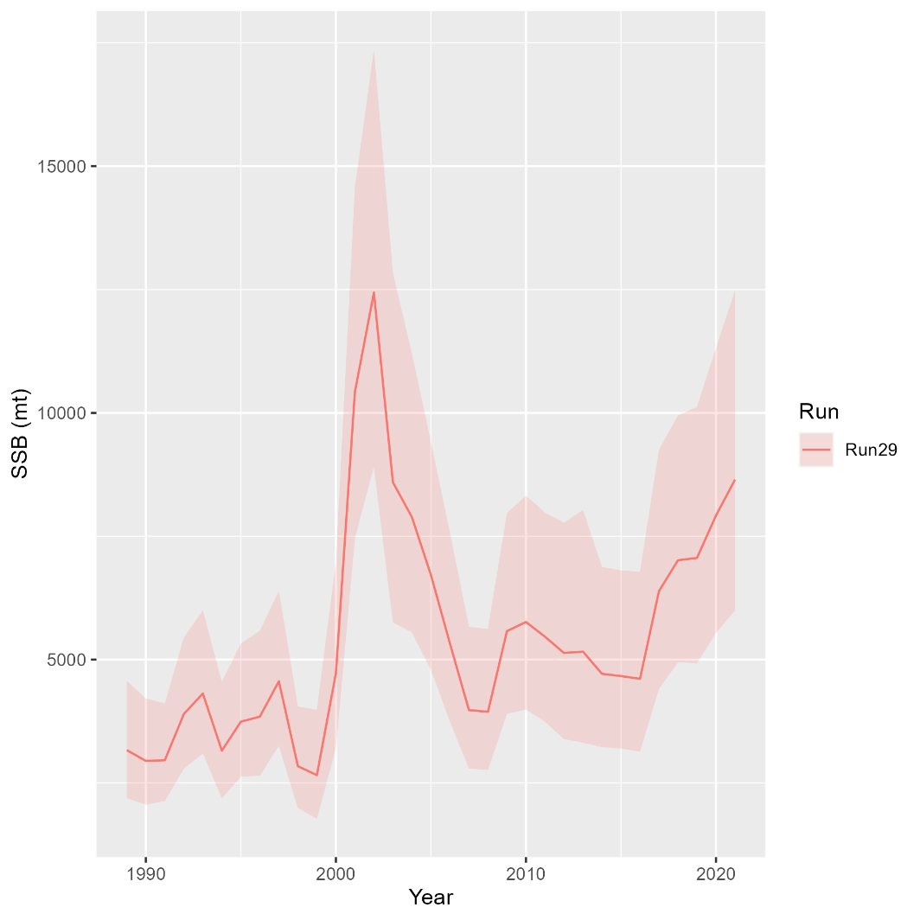
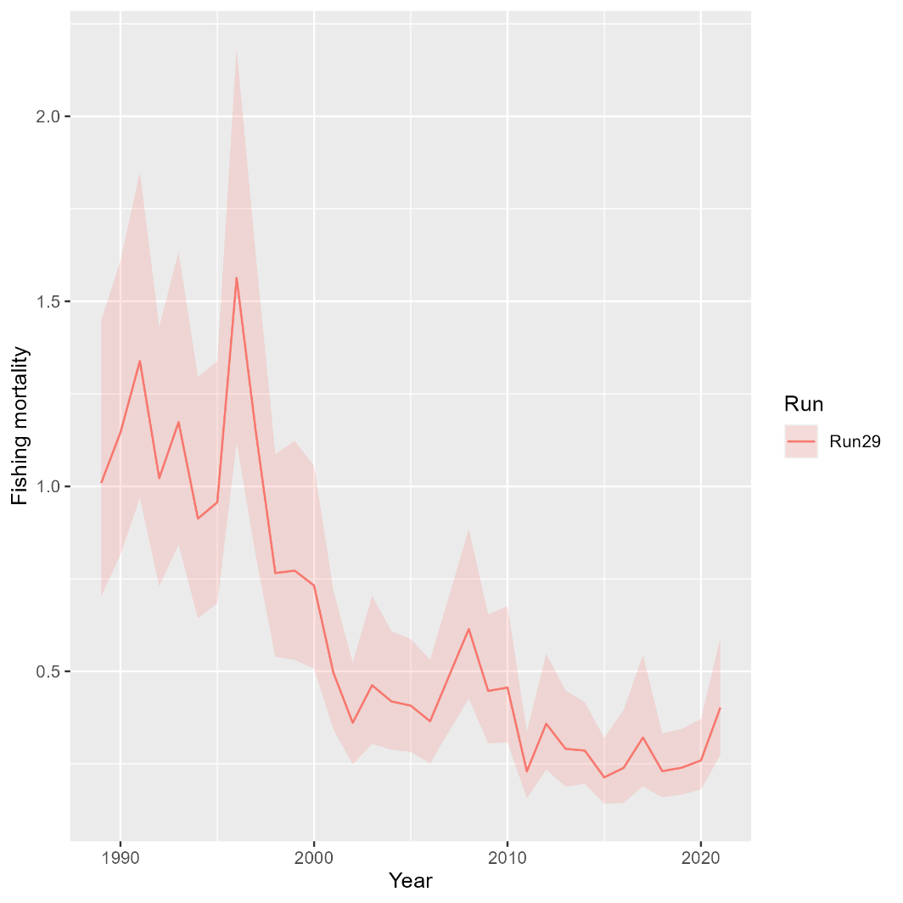
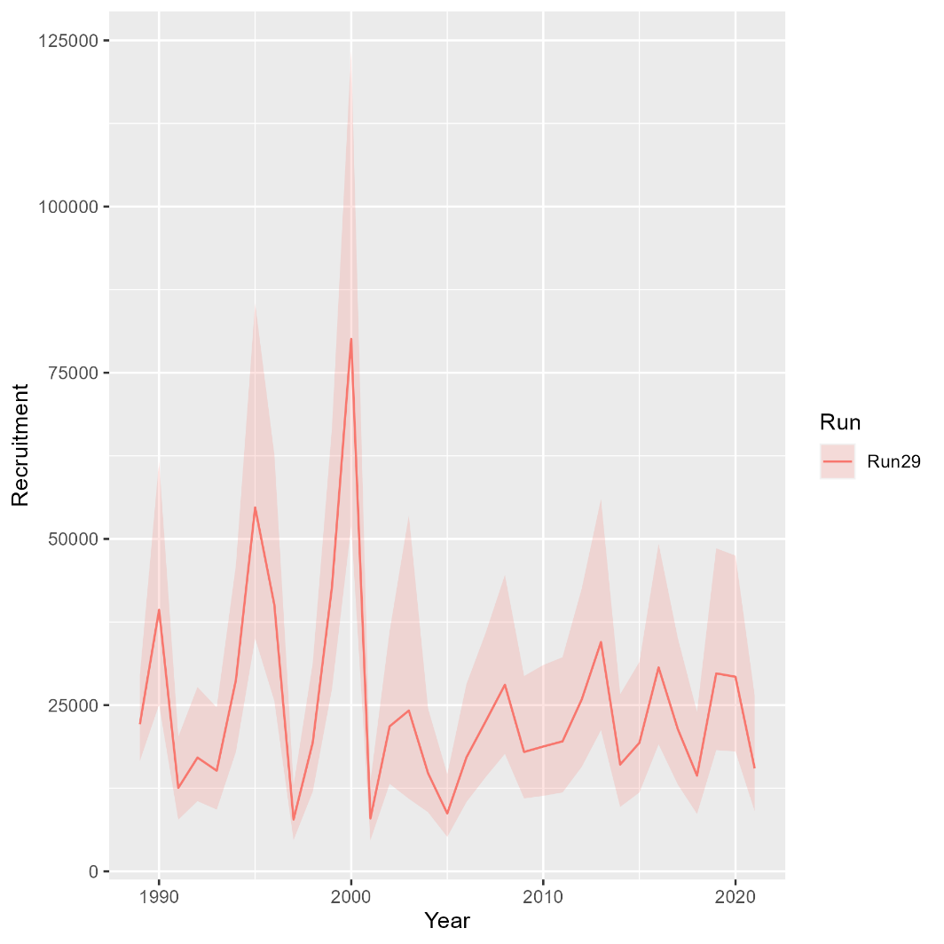
South
Mohn’s rho
 | Fmort | SSB | Rect
 | -0.061 | 0.004 | -0.012

