Slide 1
WHAM runs to-date

Slide 2
Beginning with updated time series for all data inputs (Run 7 from Tuesday’s presentation) and random effects (iid) for recruitment and survival….
Run 1: All federal and state indices
Run 2: Run 1 but iid random effects on recreational fishing fleet logistic parameters; Did not converge
Run 3: Run 1 but estimated CVs for aggregate Rec CPA indices

Slide 3
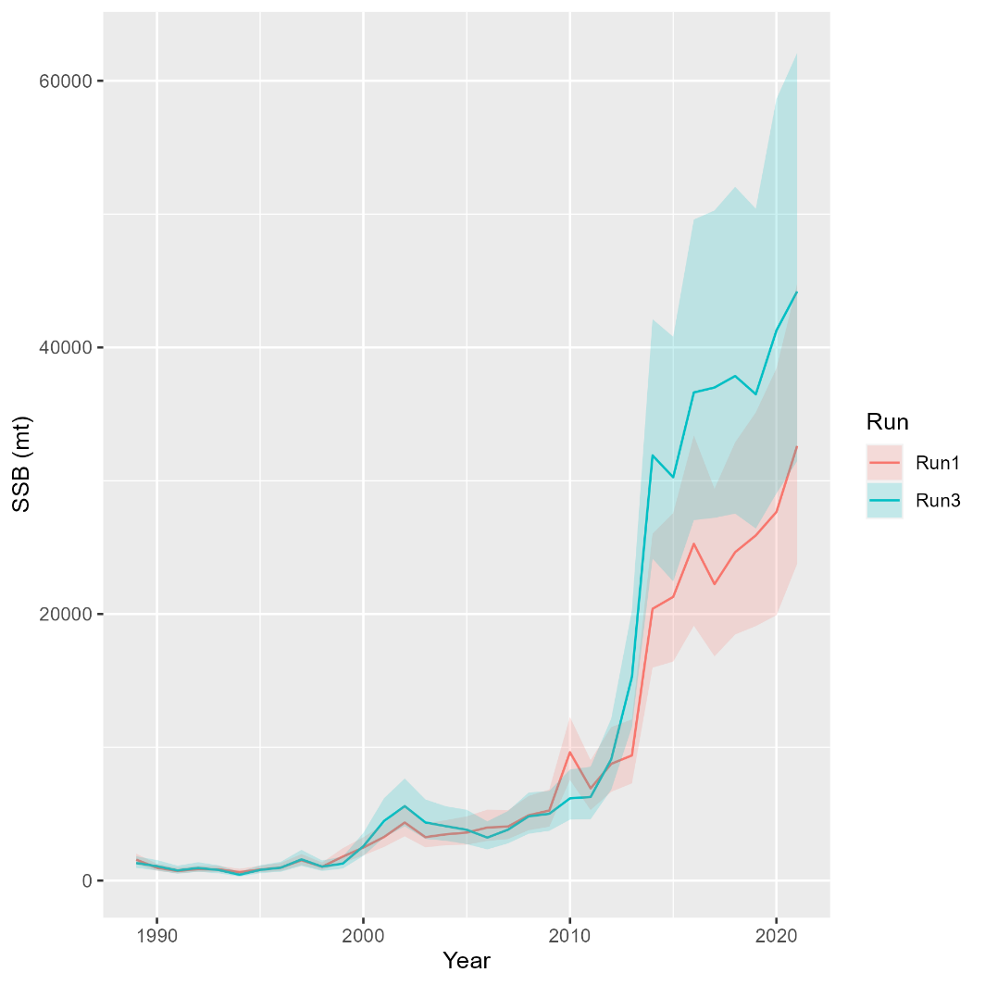
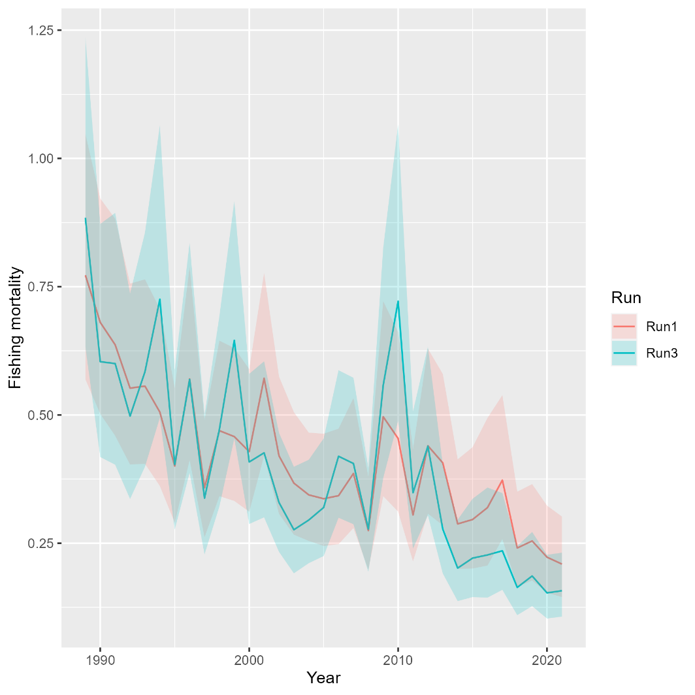
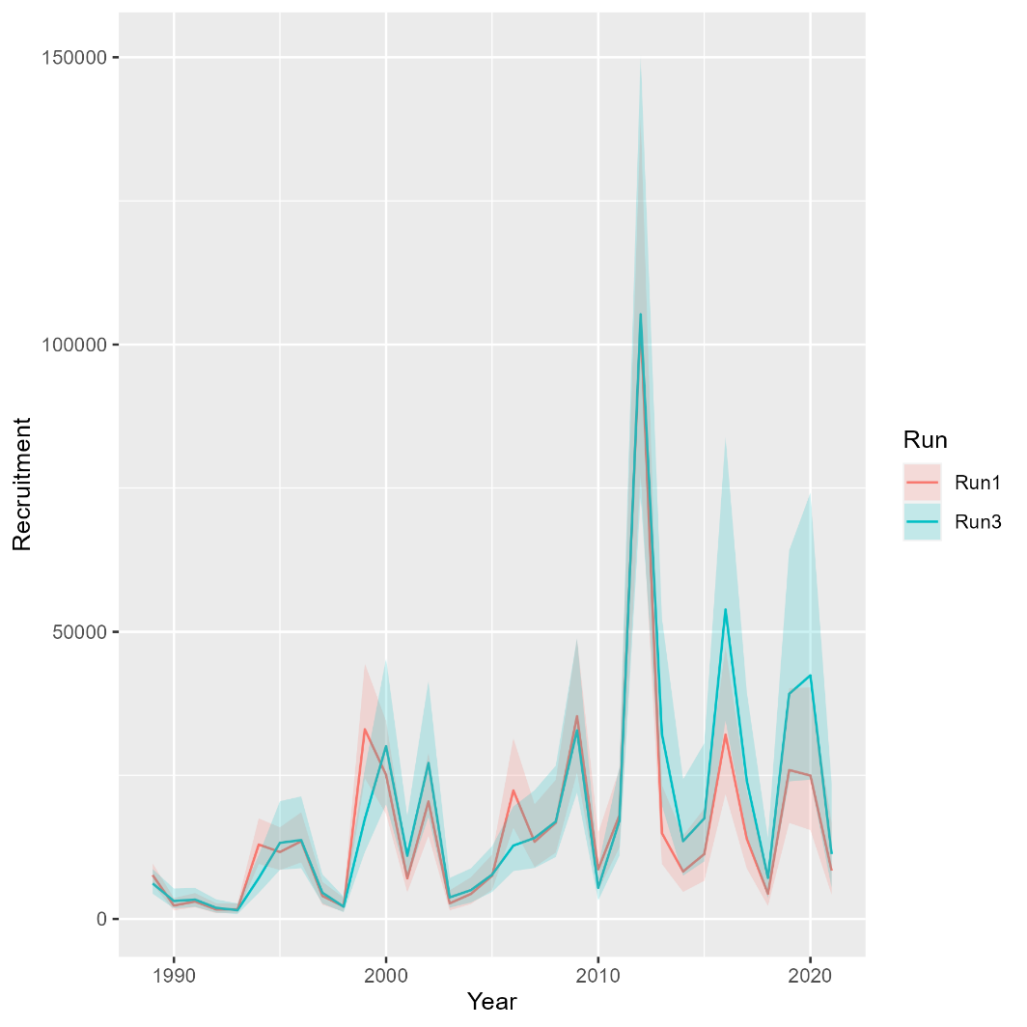
Runs 1 versus 3: Estimate CVs for Rec CPA Indices
Mohn’s rho
 | F | SSB | Rect
Run 1 | 0.09 | -0.077 | -0.178
Run 3 | 0.01 | -0.023 | -0.189
North

Slide 4
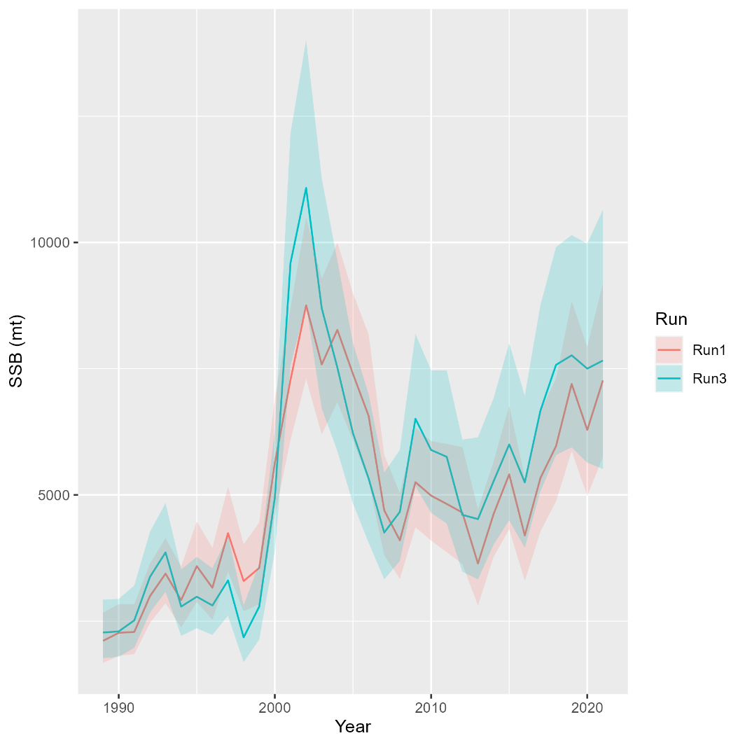
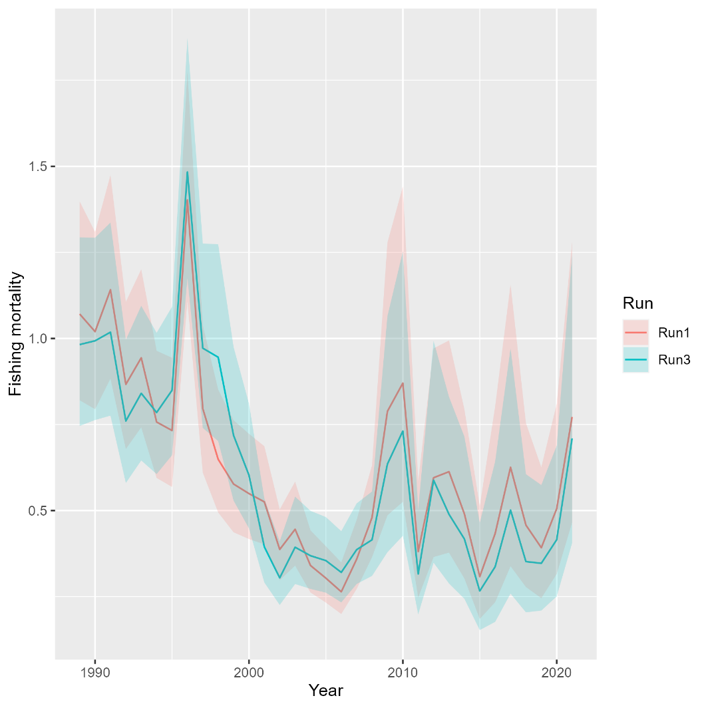
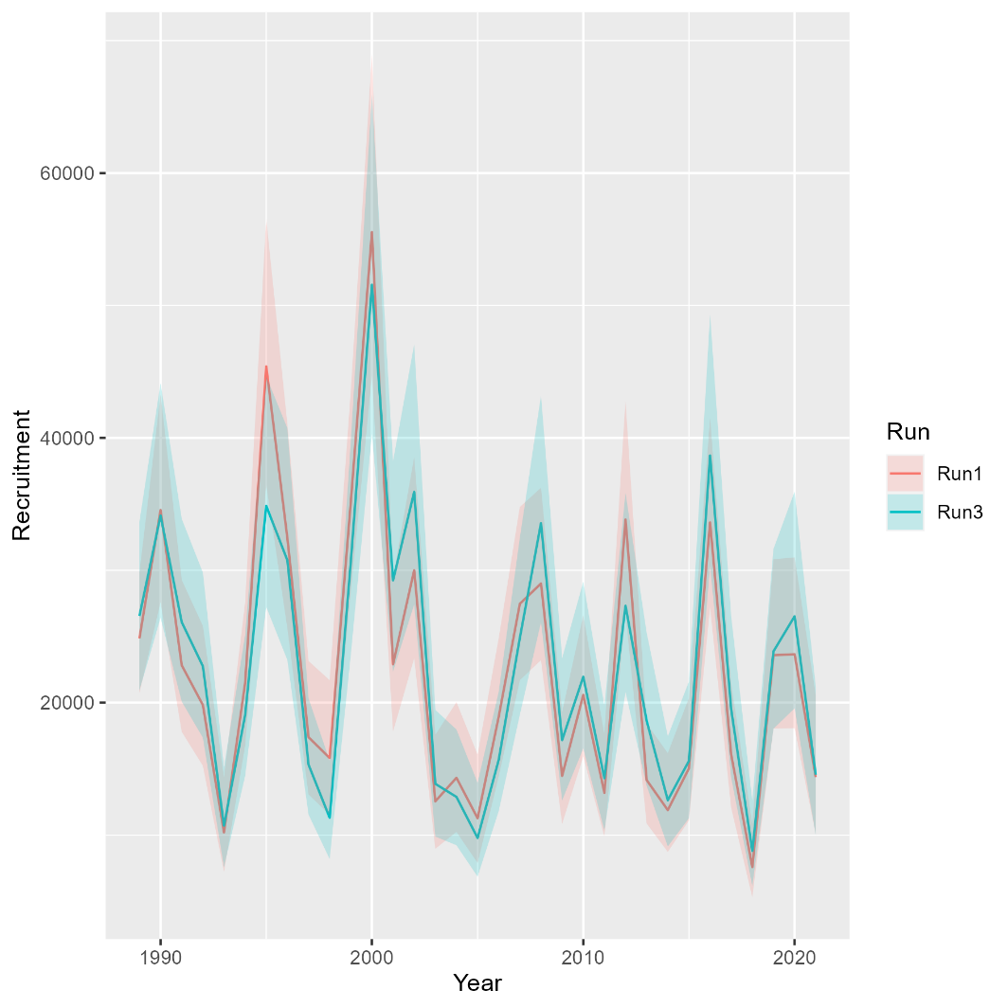
Runs 1 versus 3: Estimate CVs for Rec CPA Indices
Mohn’s rho
 | F | SSB | Rect
Run 1 | 0.145 | -0.02 | -0.031
Run 3 | 0.074 | 0.033 | -0.034
South

Slide 5
Beginning with updated time series for all data inputs (Run 7 from Tuesday’s presentation) and random effects (iid) for recruitment and survival….
Run 1: All federal and state indices
Run 2: Run 1 but iid random effects on recreational fishing fleet logistic parameters; Did not converge
Run 3: Run 1 but estimated CVs for aggregate Rec CPA indices
Run 4: RecCPA and spring VAST indices, estimating aggregate Rec CPA CVs
Run 5: RecCPA, NEAMAP and NEFSC trawl indices; fixing aggregate Rec CPA CVs
Run 6: Rec CPA and both spring and fall VAST indices, estimating aggregate Rec CPA CVs

Slide 6
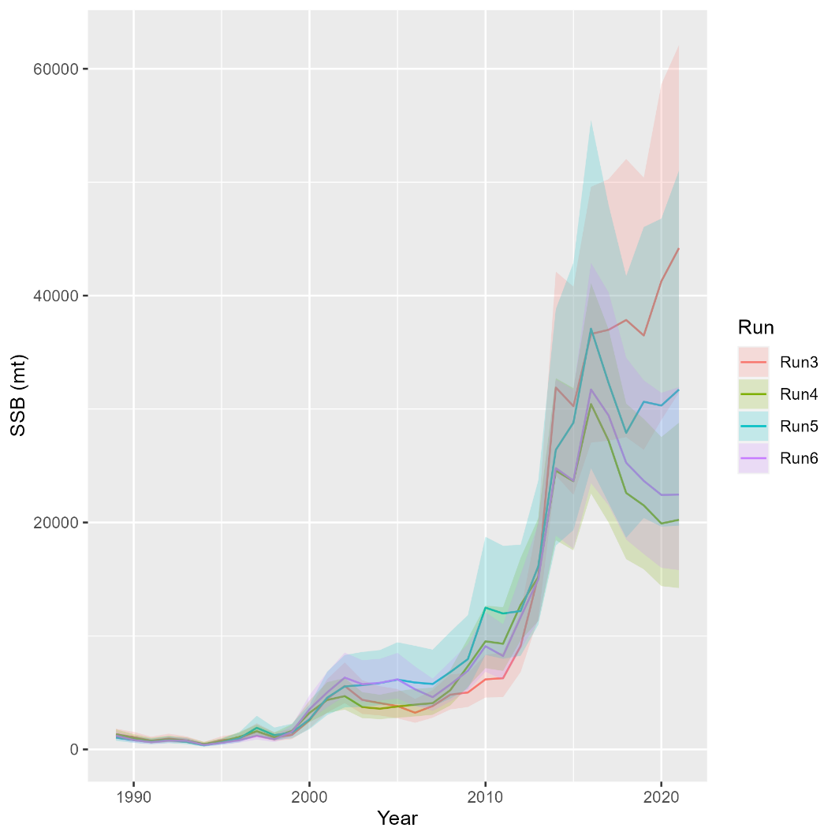
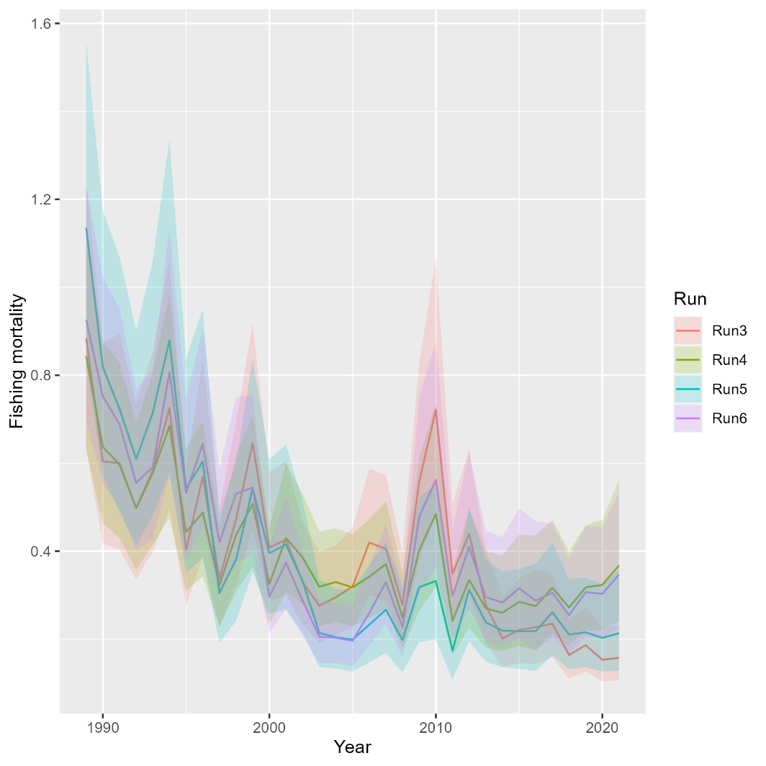
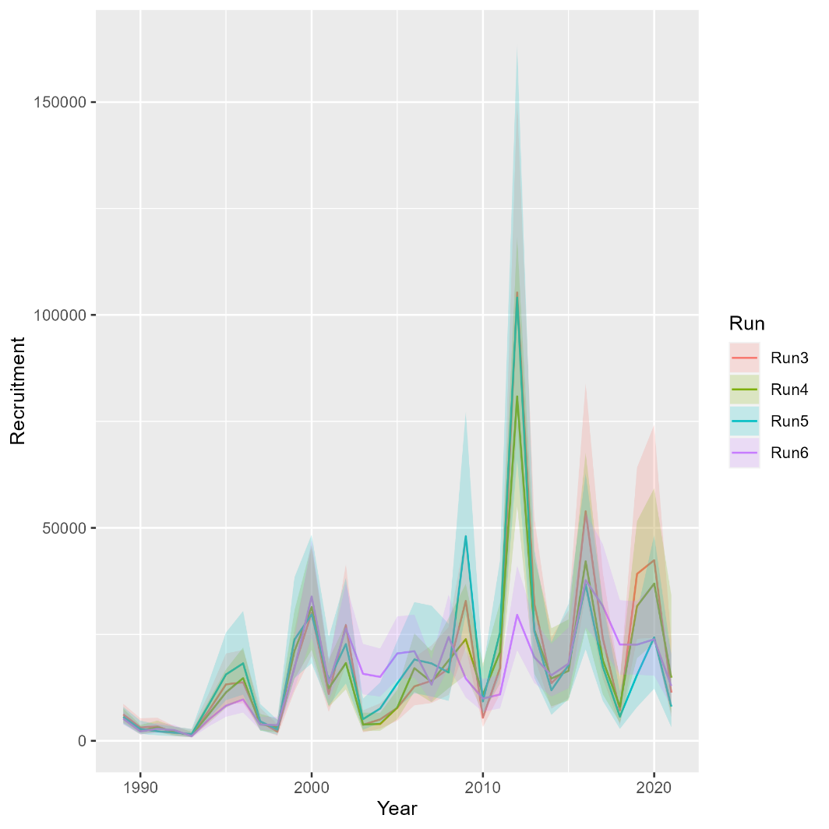
Runs 3-6: Exploring survey combinations
Mohn’s rho
 | F | SSB | Rect
Run 3 | 0.01 | -0.023 | -0.189
Run 4 | 0.318 | -0.218 | -0.295
Run 5 | 0.514 | -0.334 | -0.457
Run 6 | 0.222 | -0.155 | -0.118
North

Slide 7
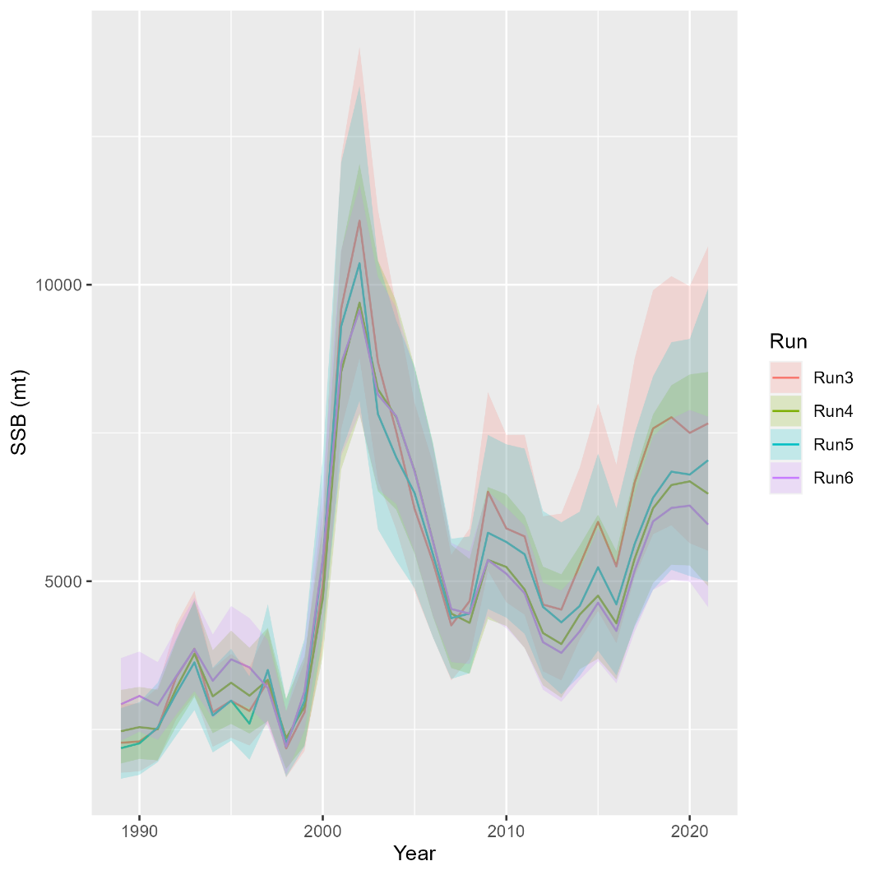
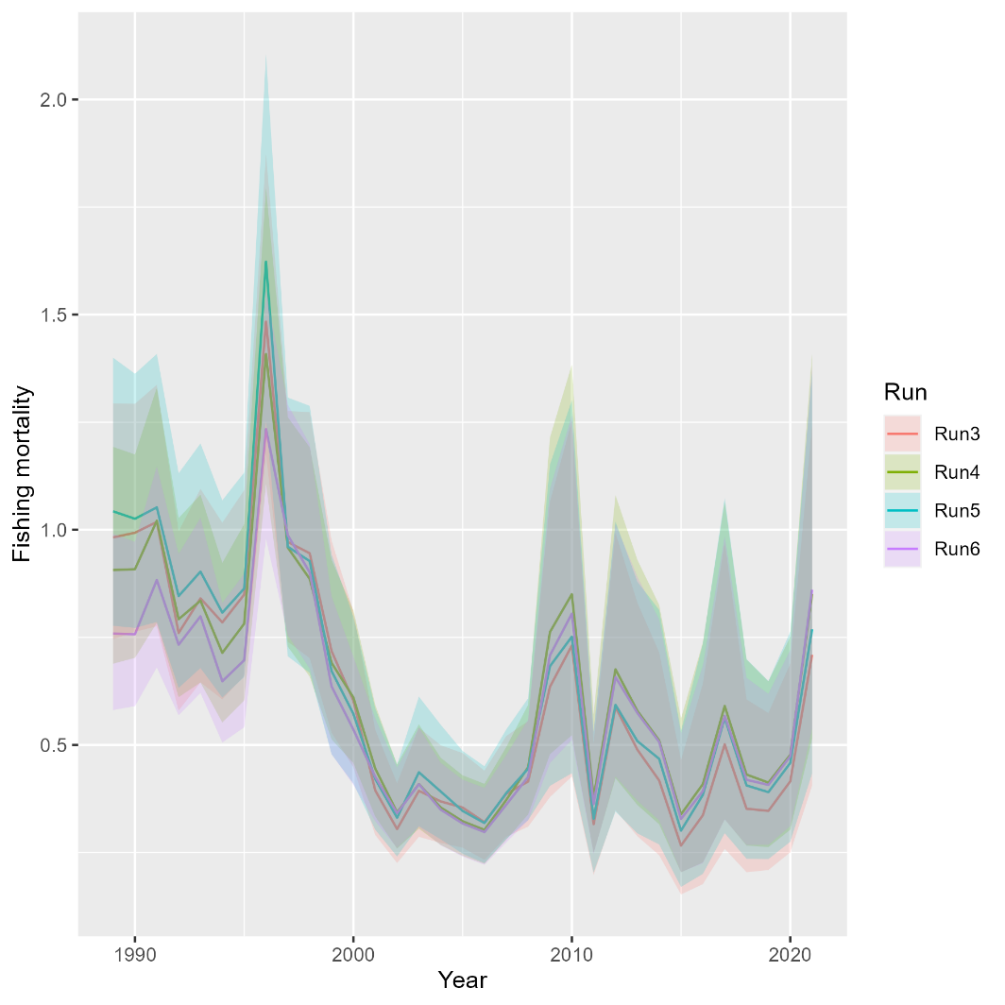
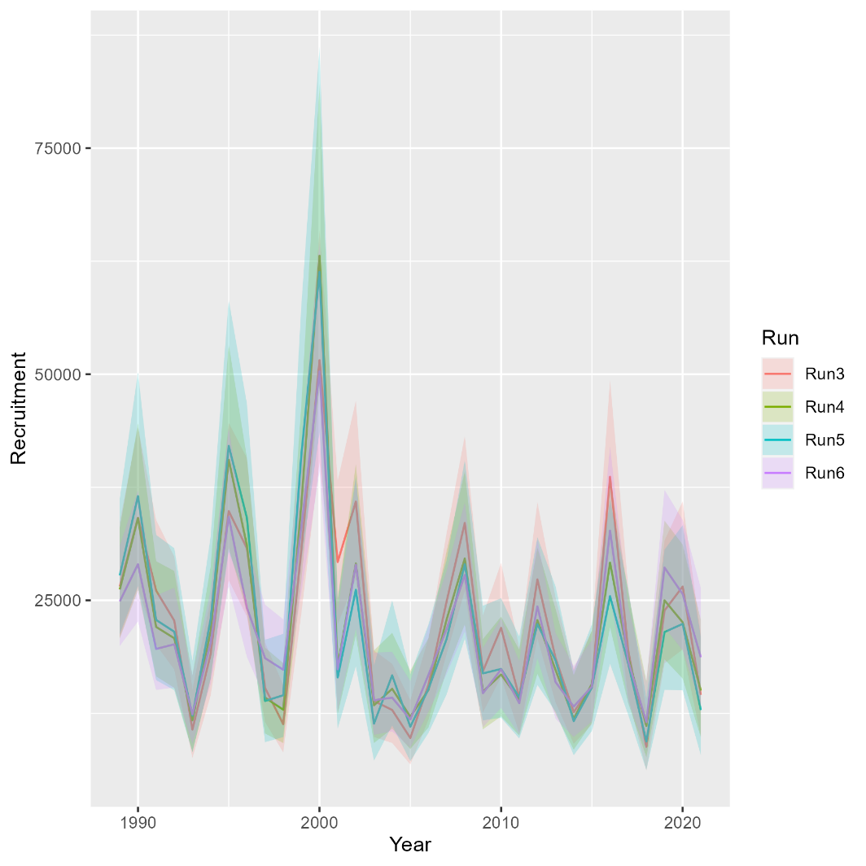
Runs 3-6: Exploring survey combinations
Mohn’s rho
 | F | SSB | Rect
Run 3 | 0.074 | 0.033 | -0.034
Run 4 | 0.13 | -0.006 | -0.002
Run 5 | 0.166 | -0.037 | -0.059
Run 6 | 0.191 | -0.04 | 0.036
South

Slide 8
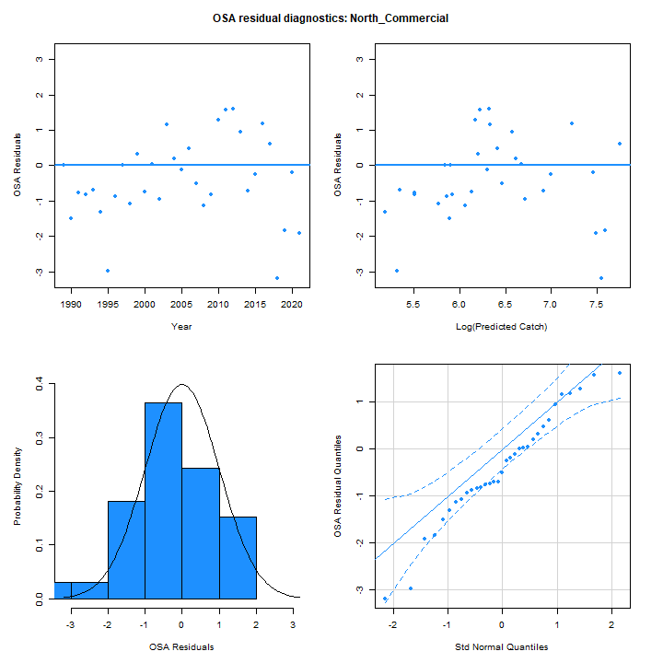
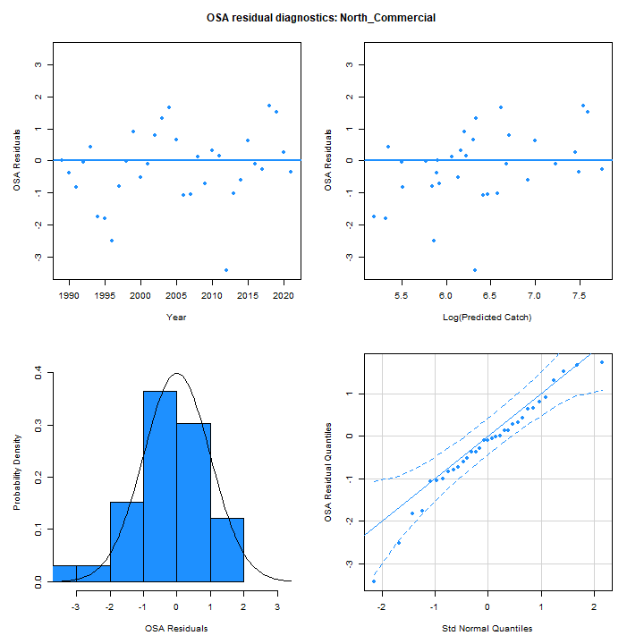
OSA Residuals
Run 3
Run 6

Slide 9
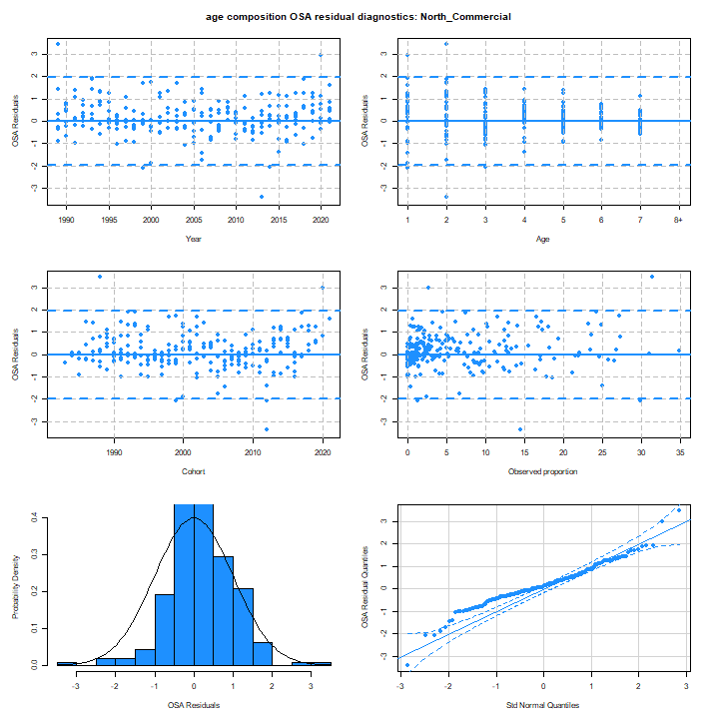

OSA Residuals
Run 3
Run 6

Slide 10
OSA Residuals
Run 3
Run 6

Slide 11
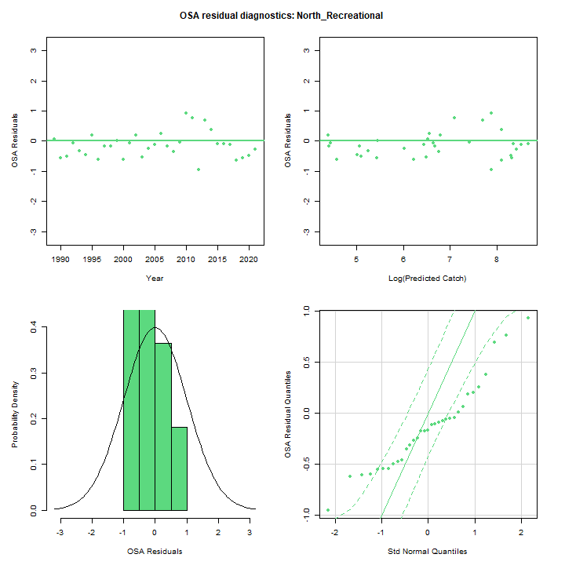
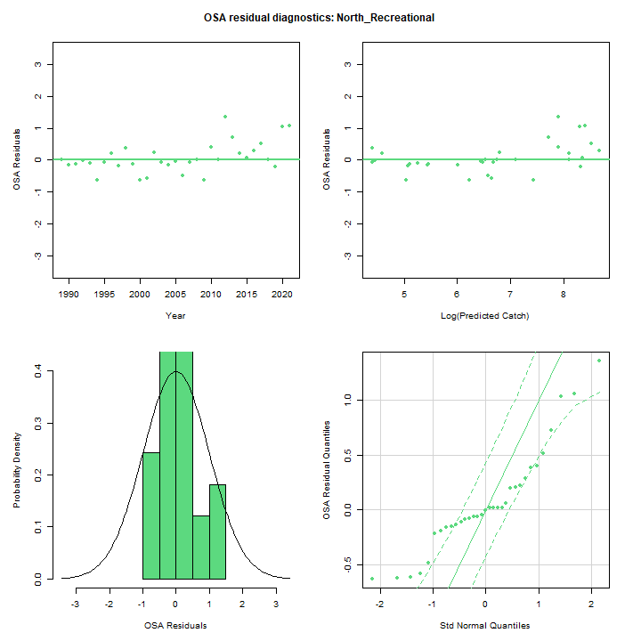
OSA Residuals
Run 3
Run 6

Slide 12
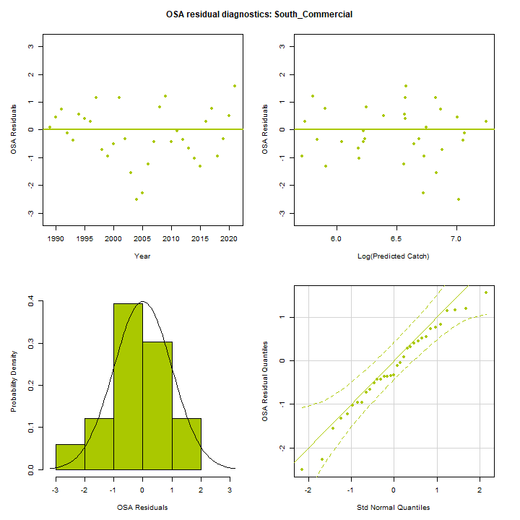
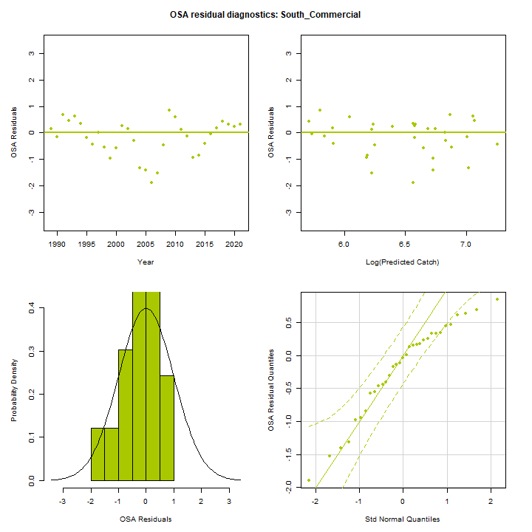
OSA Residuals
Run 3
Run 6

Slide 13
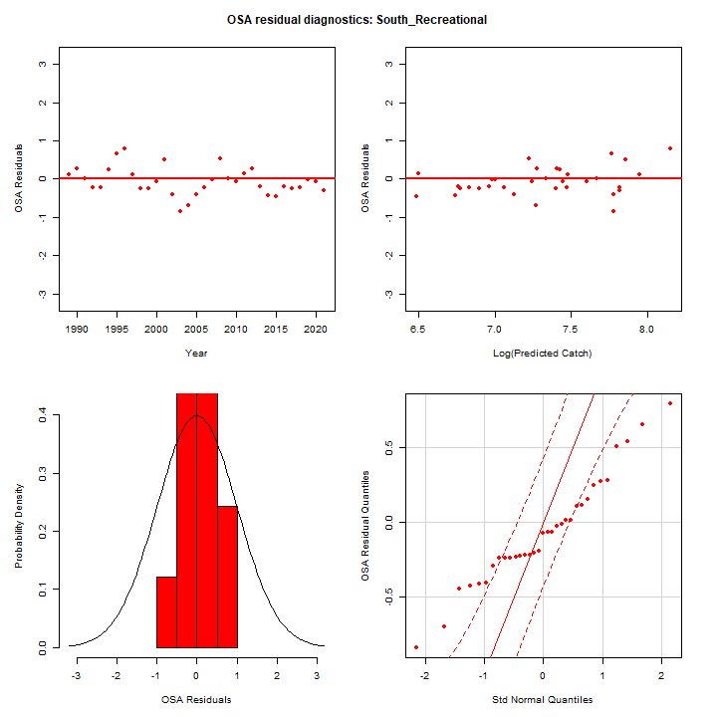
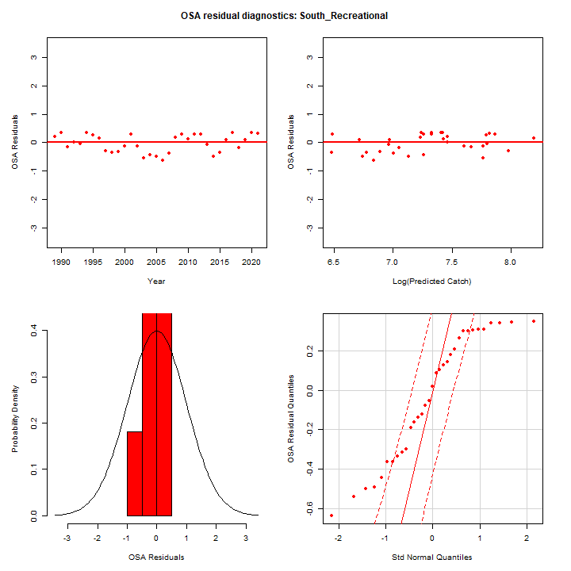
OSA Residuals
Run 3
Run 6

Slide 14
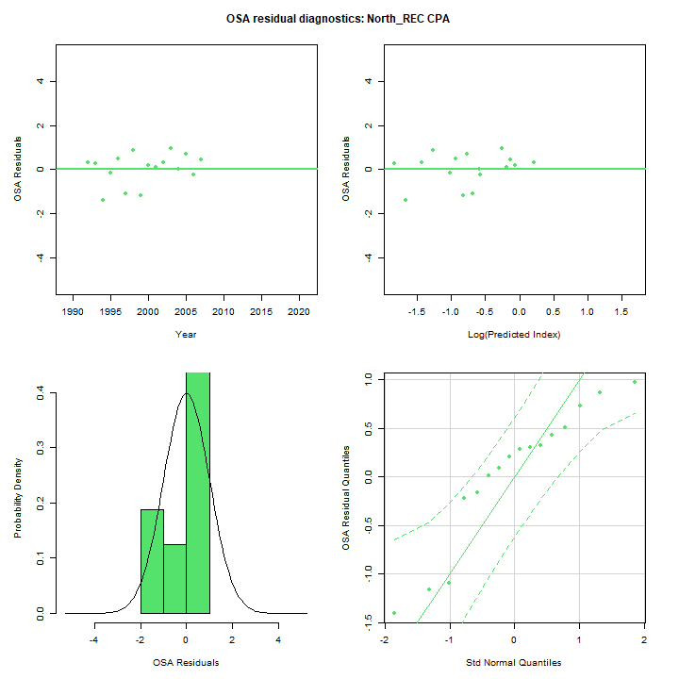
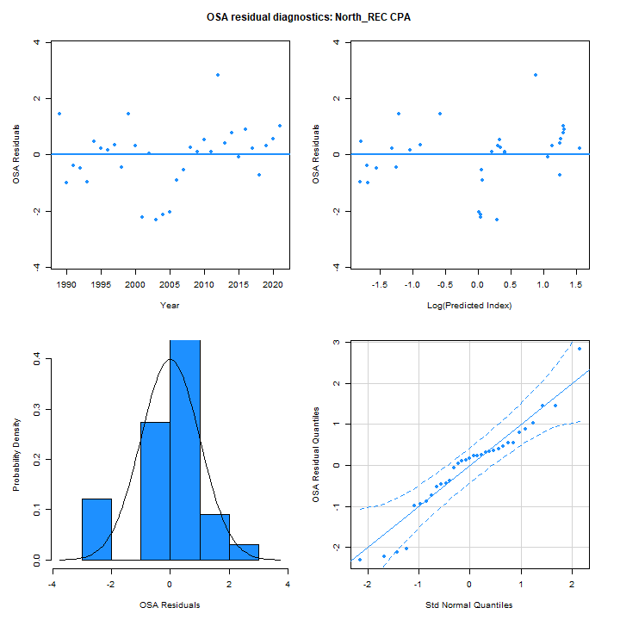
OSA Residuals
Run 3
Run 6

Slide 15
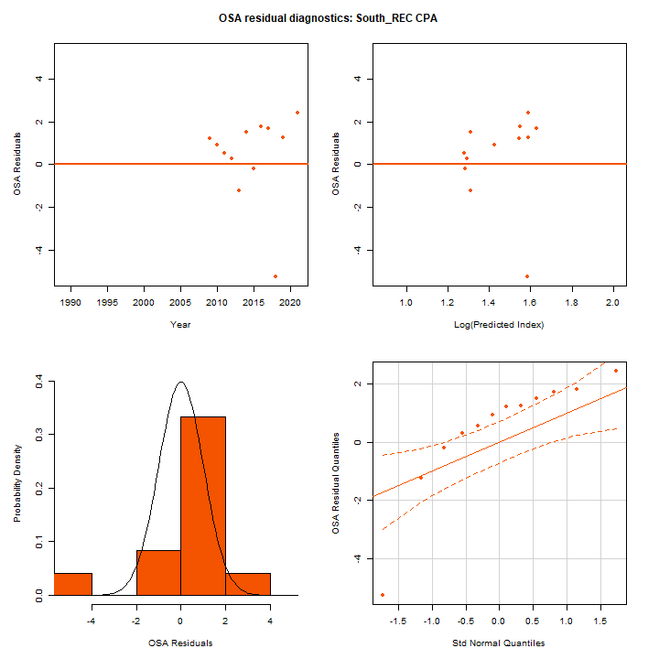
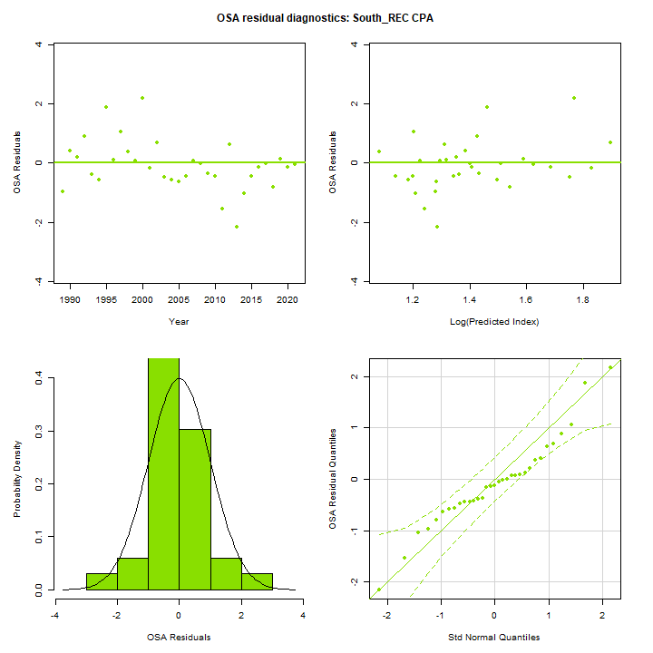
OSA Residuals
Run 3
Run 6

Slide 16
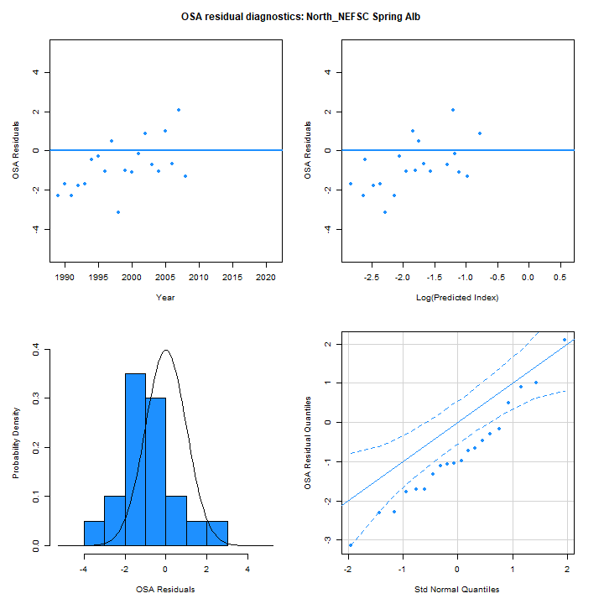
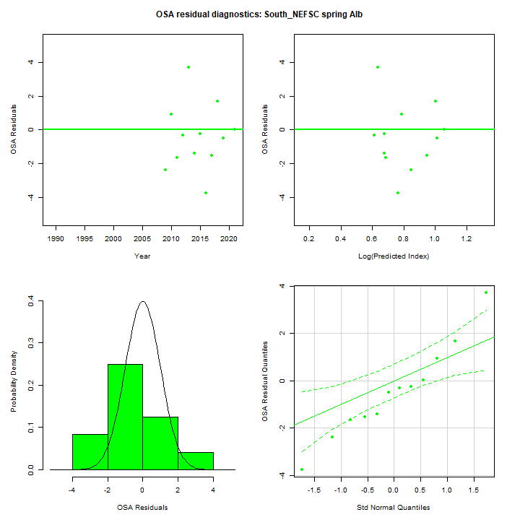
OSA Residuals
Run 3: Individual indices

Slide 17
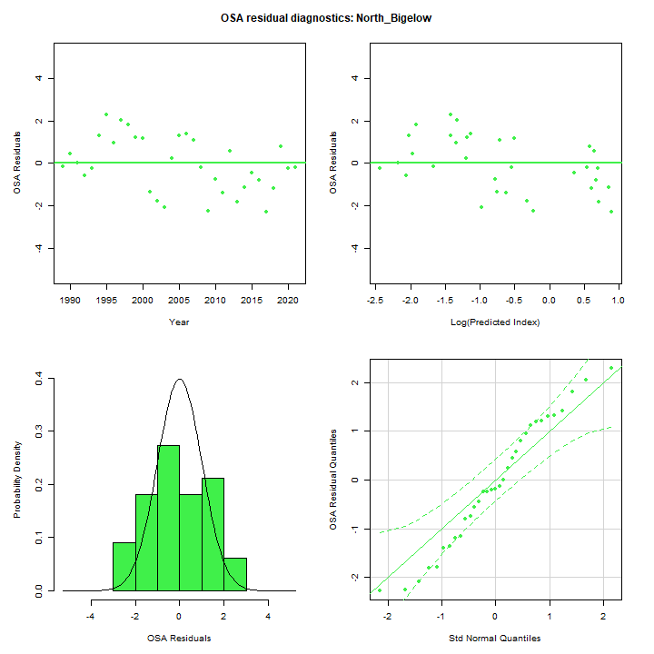
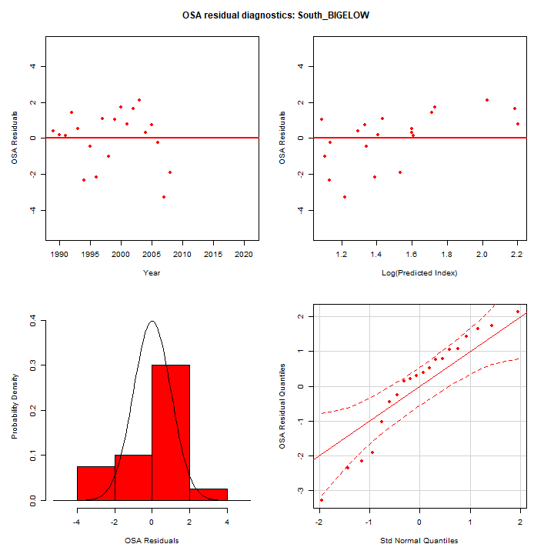
OSA Residuals
Run 3: Individual indices

Slide 18
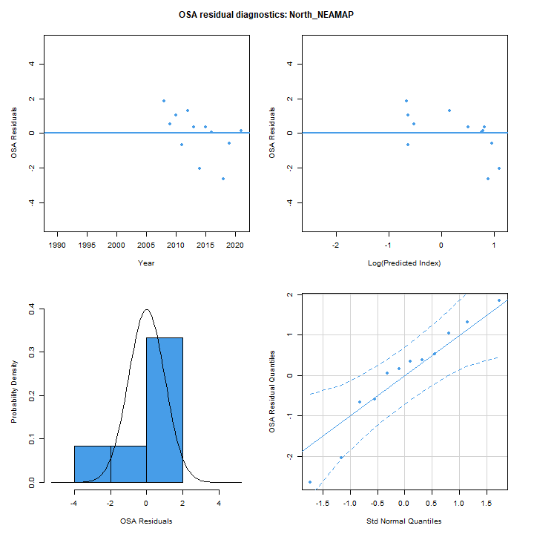
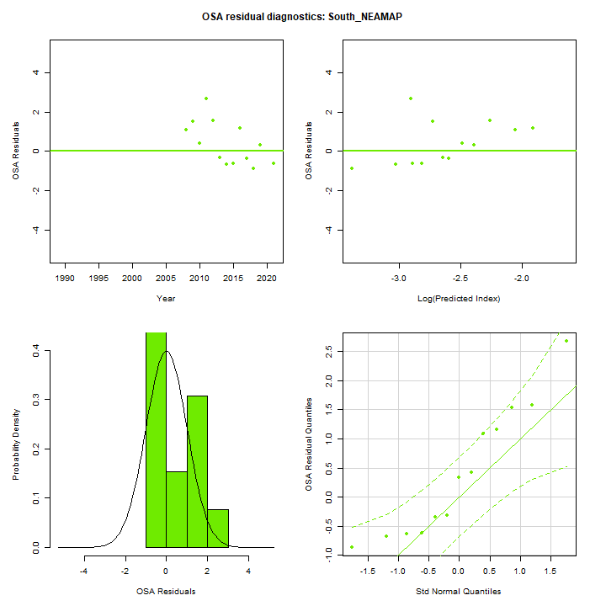
OSA Residuals
Run 3: Individual indices

Slide 19
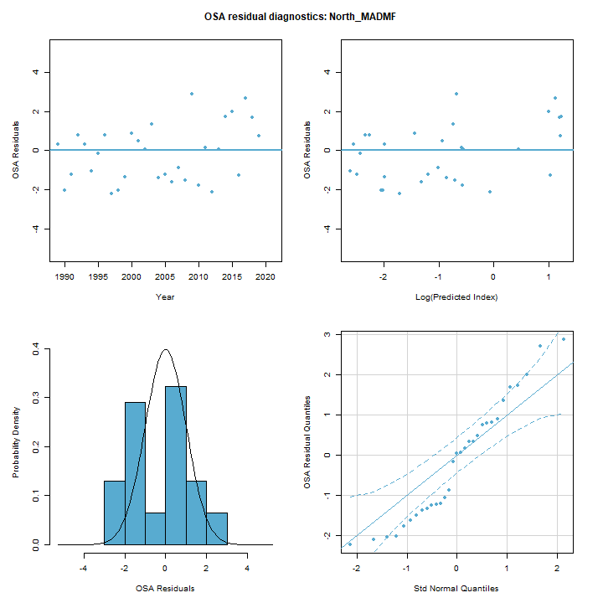
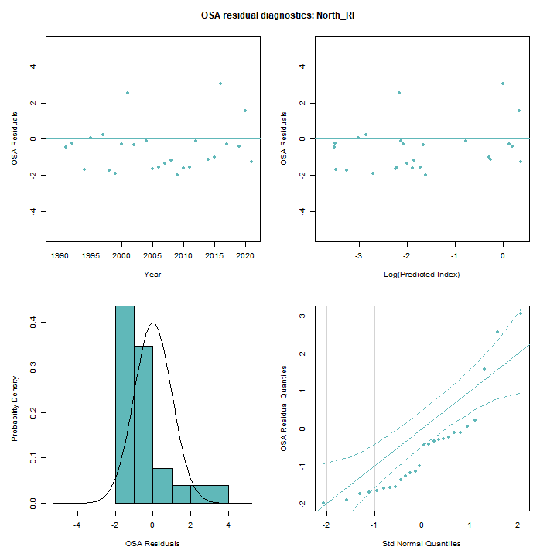
OSA Residuals
Run 3: Individual indices

Slide 20
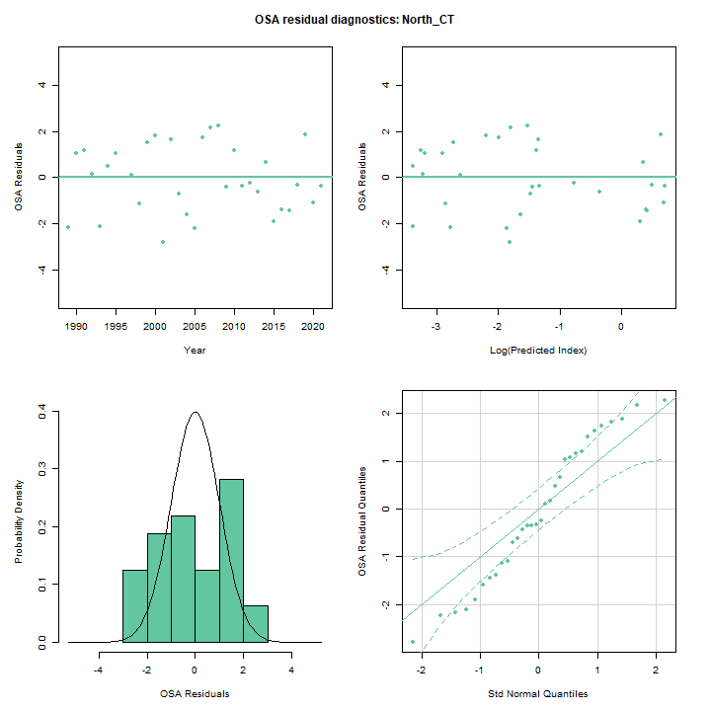
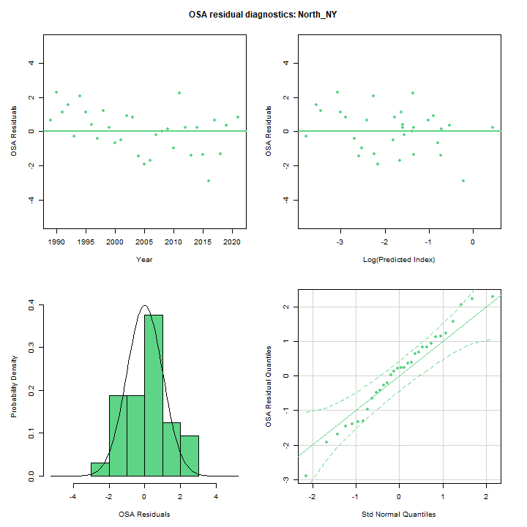
OSA Residuals
Run 3: Individual indices

Slide 21
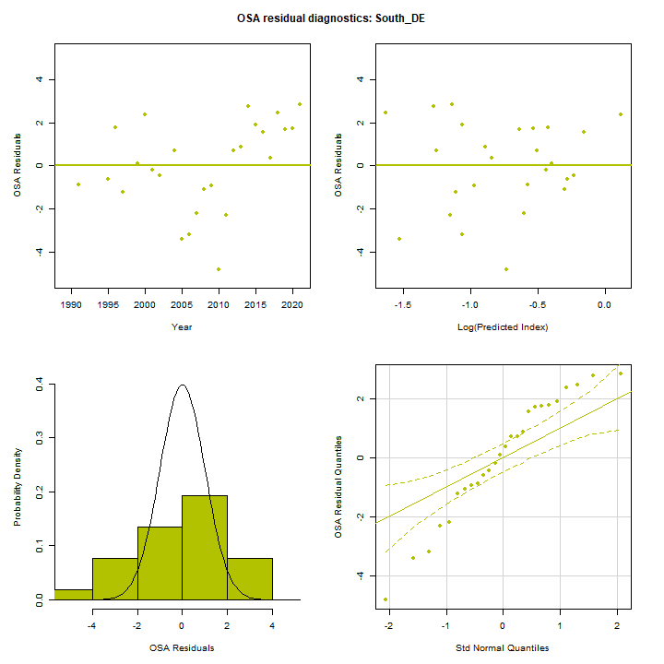
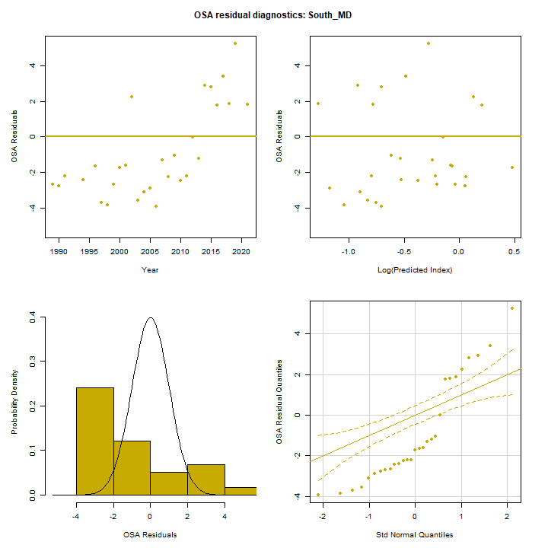
OSA Residuals
Run 3: Individual indices

Slide 22
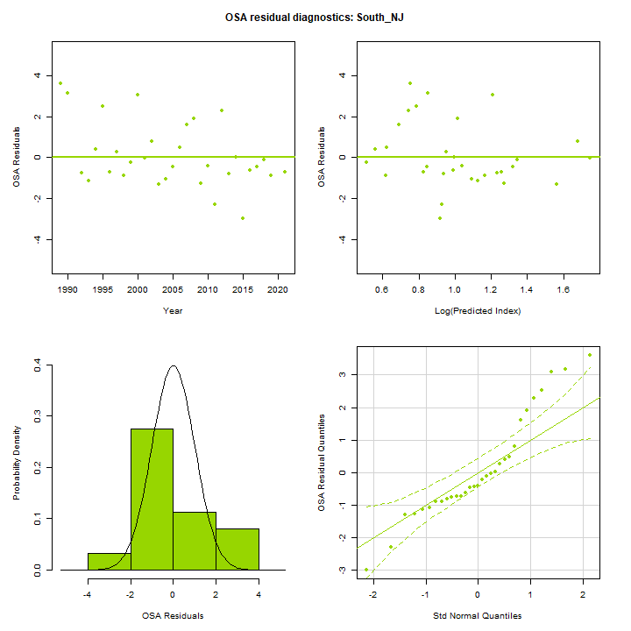
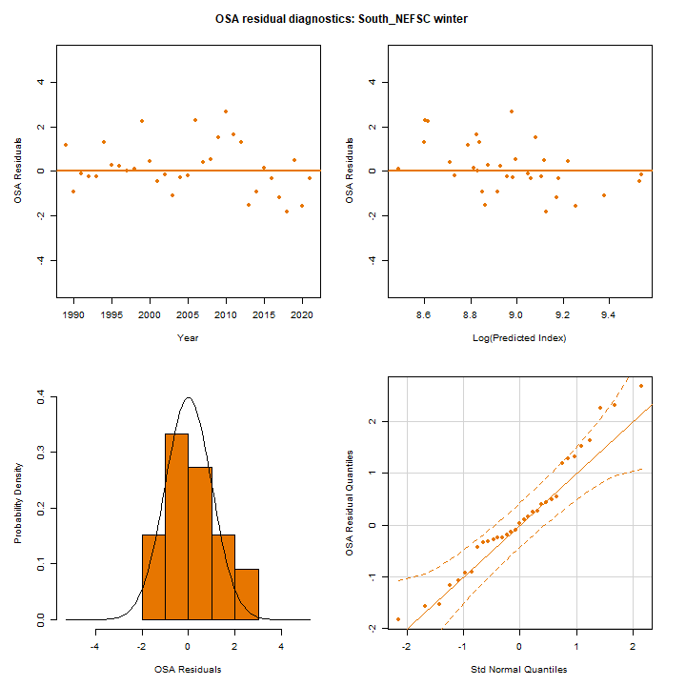
OSA Residuals
Run 3: Individual indices

Slide 23
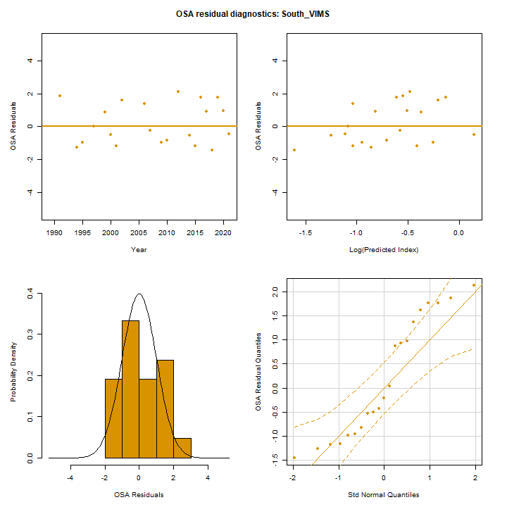
OSA Residuals
Run 3: Individual indices

Slide 24
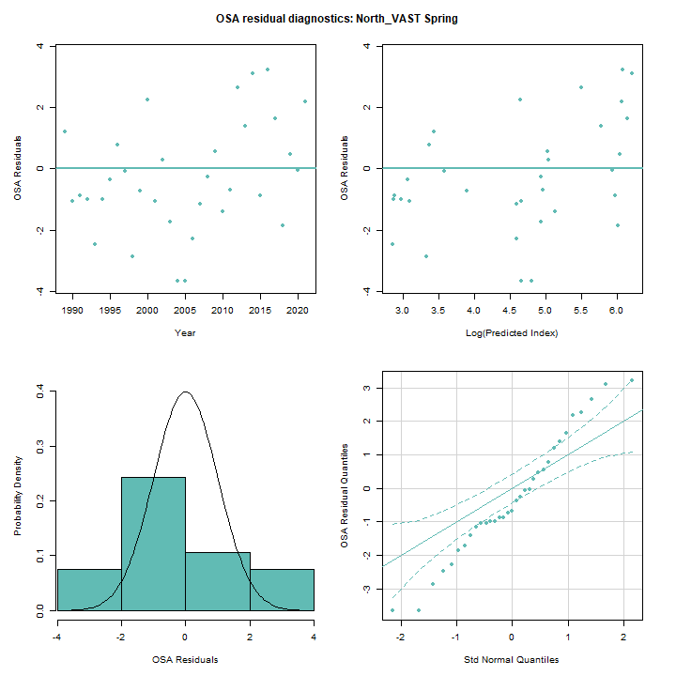
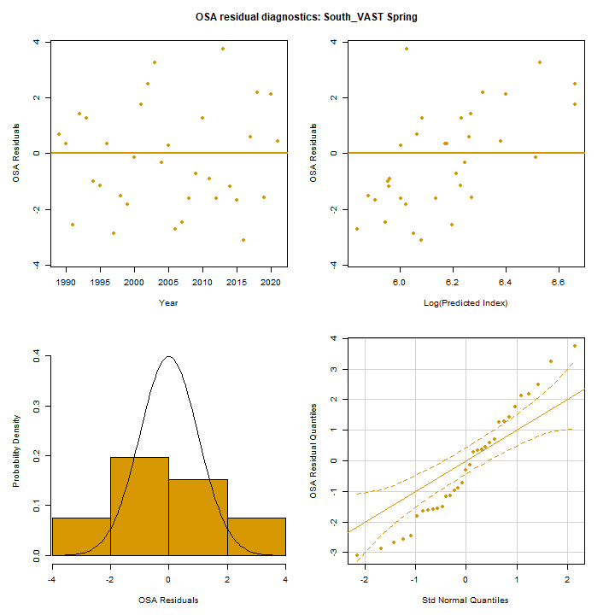
OSA Residuals
Run 6: Individual indices

Slide 25
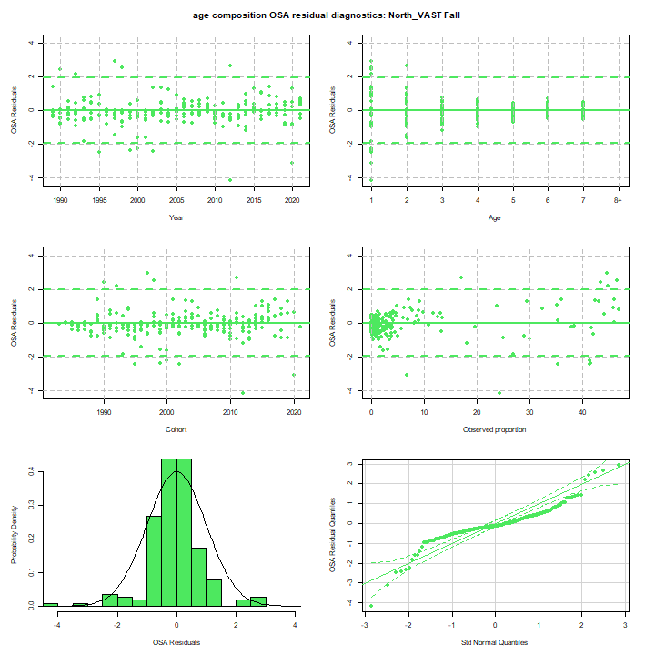
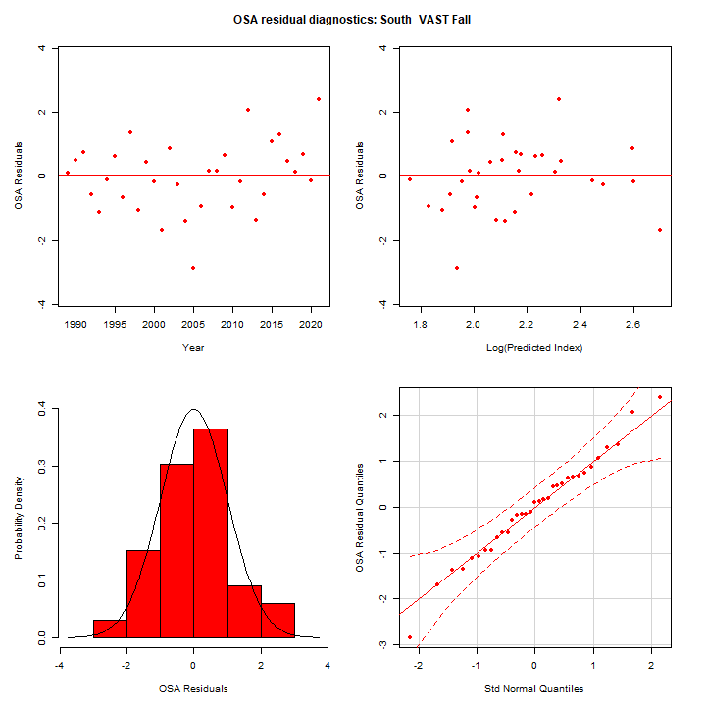
OSA Residuals
Run 6: Individual indices

