Slide 1
Mackerel WHAM exploration
Jonathan J. Deroba
June 2025

Slide 2
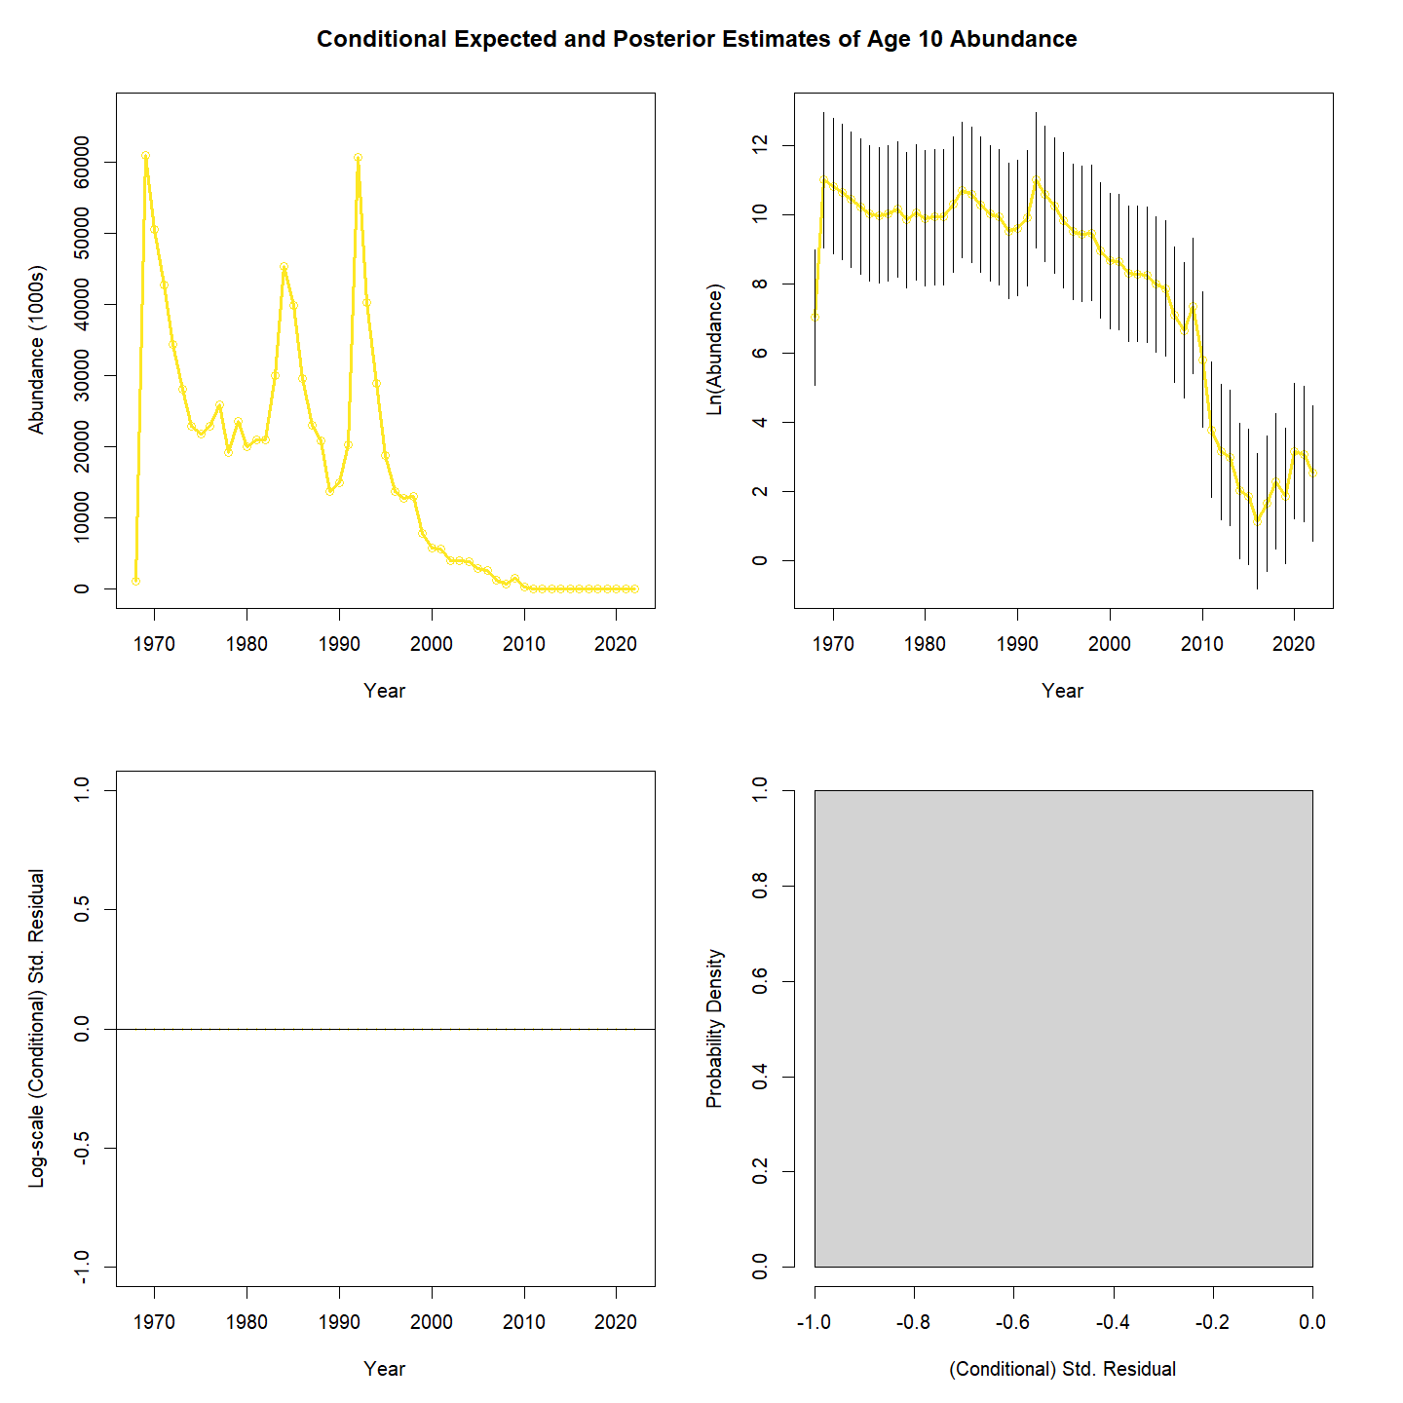
Run0
WHAM as ASAP
A re-run of “run 2” that Kiersten sent me from the SSRT
Age-5 fleet selectivity on a bound of 1. Consider fixing.
Age-10 initial NAA also suspiciously low. Consider solutions.

Slide 3
Run1
Start at run0 and fix age-5 fleet selectivity at 1.0
Resulted in age-4 being on a bound of 1.0

Slide 4
Run2
Start at run1 and fix age-4 fleet selectivity at 1.0.
This resolved all parameter bound issues.
Age-10 initial NAA suspiciously low and highly uncertain, which I fear could cause issues in future runs.
Log scale point estimate = 7.08 and sd = 6.78
Point estimate = 1187; 95% CI = 0.002 to 695,540,933

Slide 5
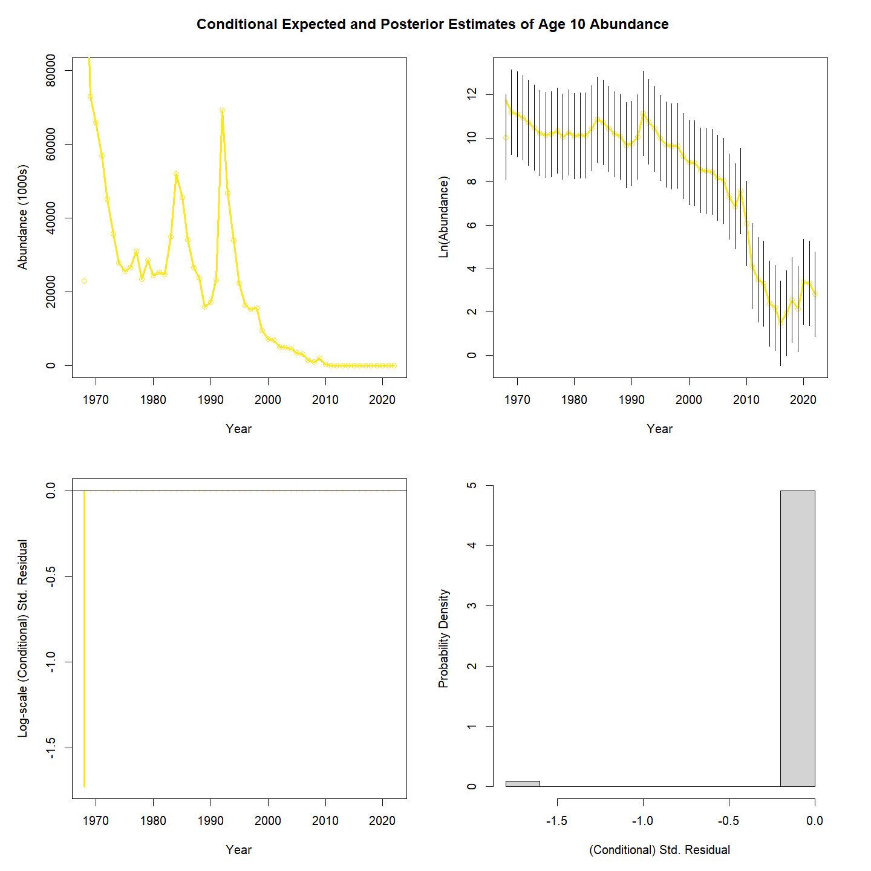
Run3
Start run2 and estimate initial NAA as iid random effects
Provided identical fits as run2 except for random effect contribution
Age-10 initial NAA no longer so low; seems likely to be more stable than fixed effects.

Slide 6
Run5 and Run6
Run5
Start at run3 and make recruitment iid re.
Fishery age-3 selectivity went to a bound of 1.0.
Run6
Start at run5 and fix fishery age-3 selectivity and recruitment as iid re.

Slide 7
Run7
Start run6 and add naa random effects as iid.
Improved fit based on AIC, but pragmatically did nothing.
NAA sigma relatively low (0.19) and not doing much, not even helping with retro.

Slide 8
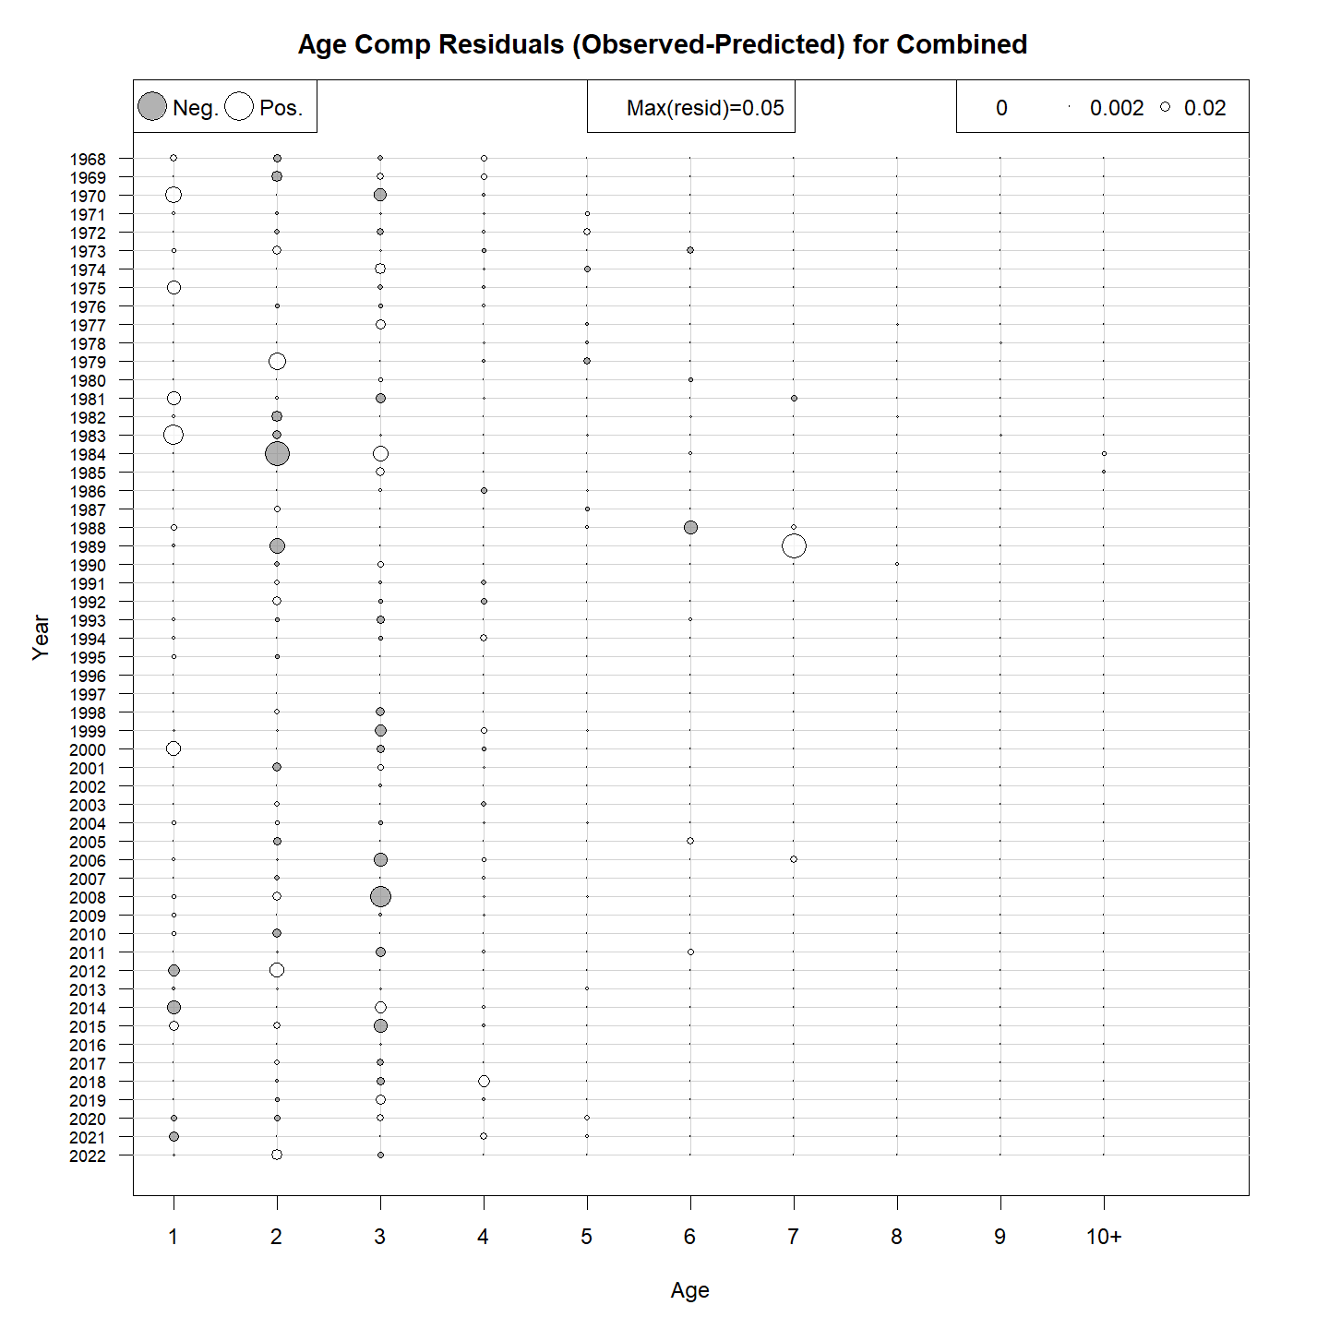
Run8
Start run7 and switch to logistic normal miss0 age comp option.
NAA sigma is notably larger (0.64).
Logistic normal sigma for fishery is 0.23 while the spring BTS is 1.21 and 1.27.
So model is choosing to fit fishery age comp really well and ignore BTS (by about a factor of ~6).
Fit to fishery age comp is nearly perfect.

Slide 9
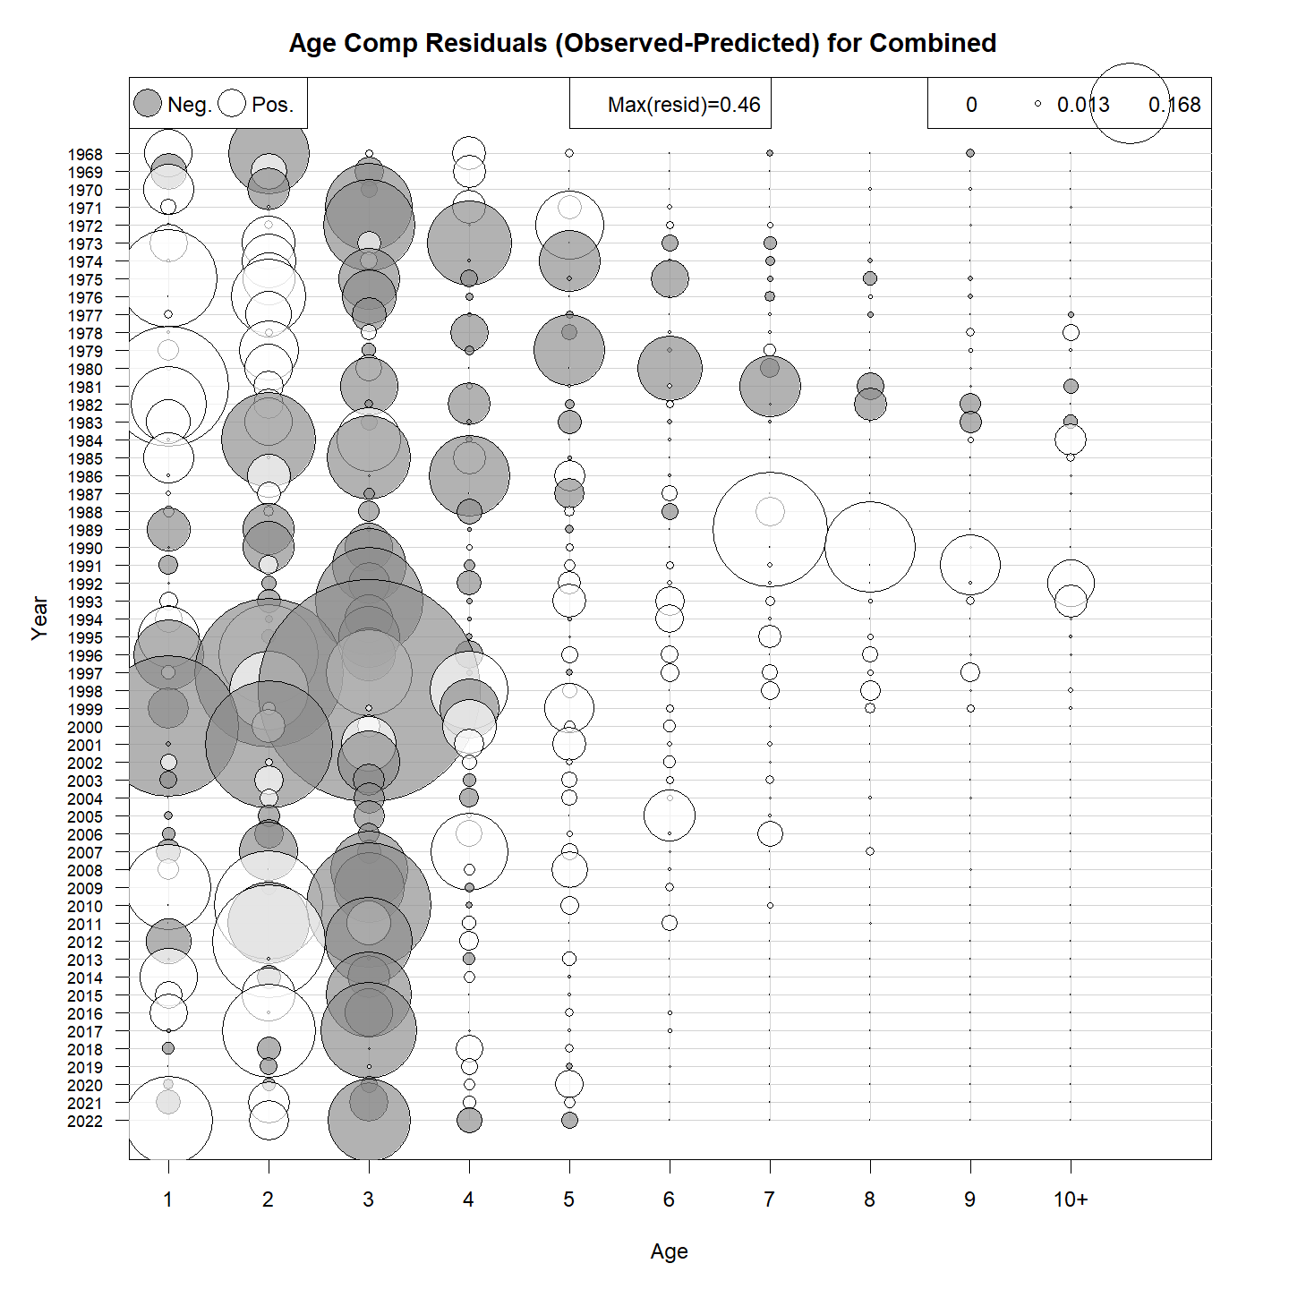
Run9
Start run8 and turn off naa re just out of curiosity.
Worse fit and retro.
SD of fishery age comp and fit gets worse.

Slide 10
Run10
Start run8 and estimate log SD of annual, aggregate BTS observations.
SDs relatively high (1.8, 1.4); basically just ignoring all BTS info.
SD of naa re = 0.65
Fit improves a bit, but no real impact.

Slide 11
Run11, Run12, Run13, Run14
Run11
Start at run8 and estimate time varying q for BTS.
Made index residuals a bit smaller but pragmatically no impact.
Run12
Start at run8 and estimate time varying selectivity for BTS.
DNC and huge gradient.
Run13
Start at run10 and change to log-norm ar1 miss0 age comp likely and 2dar1 naa re to match run14 of SSRT.
Correlation and sd across years of naa re are on bounds (1 and 0). So not usable.
Run14
Start at run10 and change to log-norm ar1 miss0 age comp likely and ar_a naa re.
Corr parameter among ages of naa is negative implying flip flopping naa re, which seems difficult to justify.

Slide 12
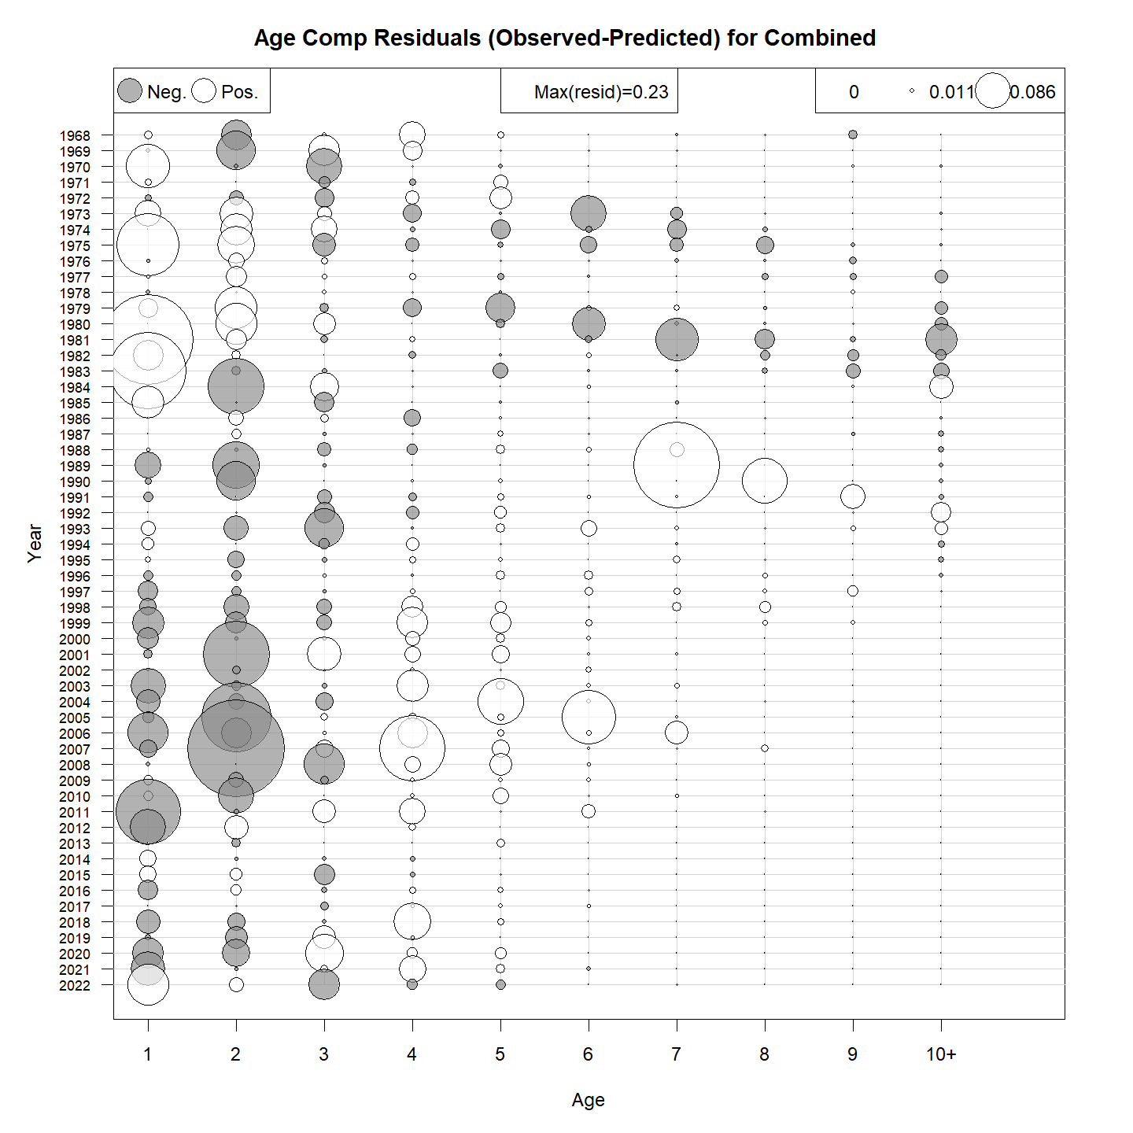
Run15
Start run10 but use log-norm ar1 miss0 age comp likely (retain iid naa re).
Fit improves over run10.
NAA sigma much smaller (0.23) and basically not doing much.
SD and correlation of age comp likeli all relatively high, including fishery comp.
Fit and scale of resids for fleet comp degrade a bit, but is this more realistic than nearly perfect?

Slide 13
Run16
Start run15 and turn off naa re.
Fit gets worse, but pragmatically no difference.
Retro’s all a little worse.
NAA re are not really doing much. Are they worth keeping?

Slide 14
Run17
Start run10 and estimate log sd of aggregate egg index.
AIC prefers run10. This parameter does not do much.

Slide 15
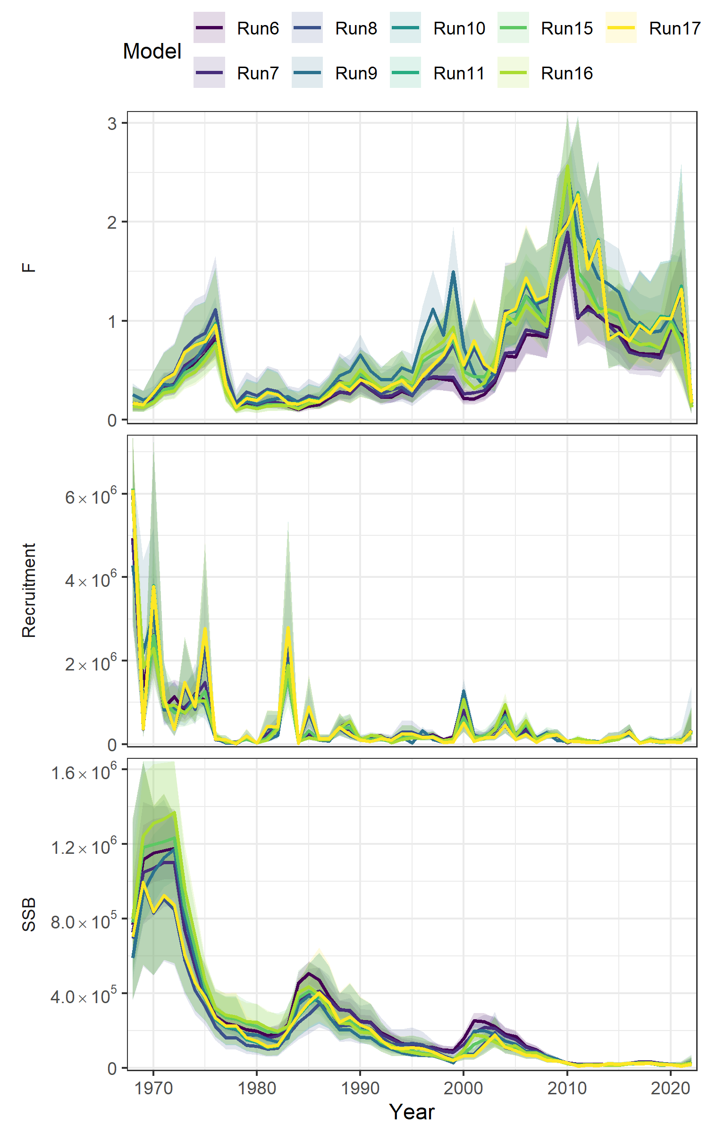
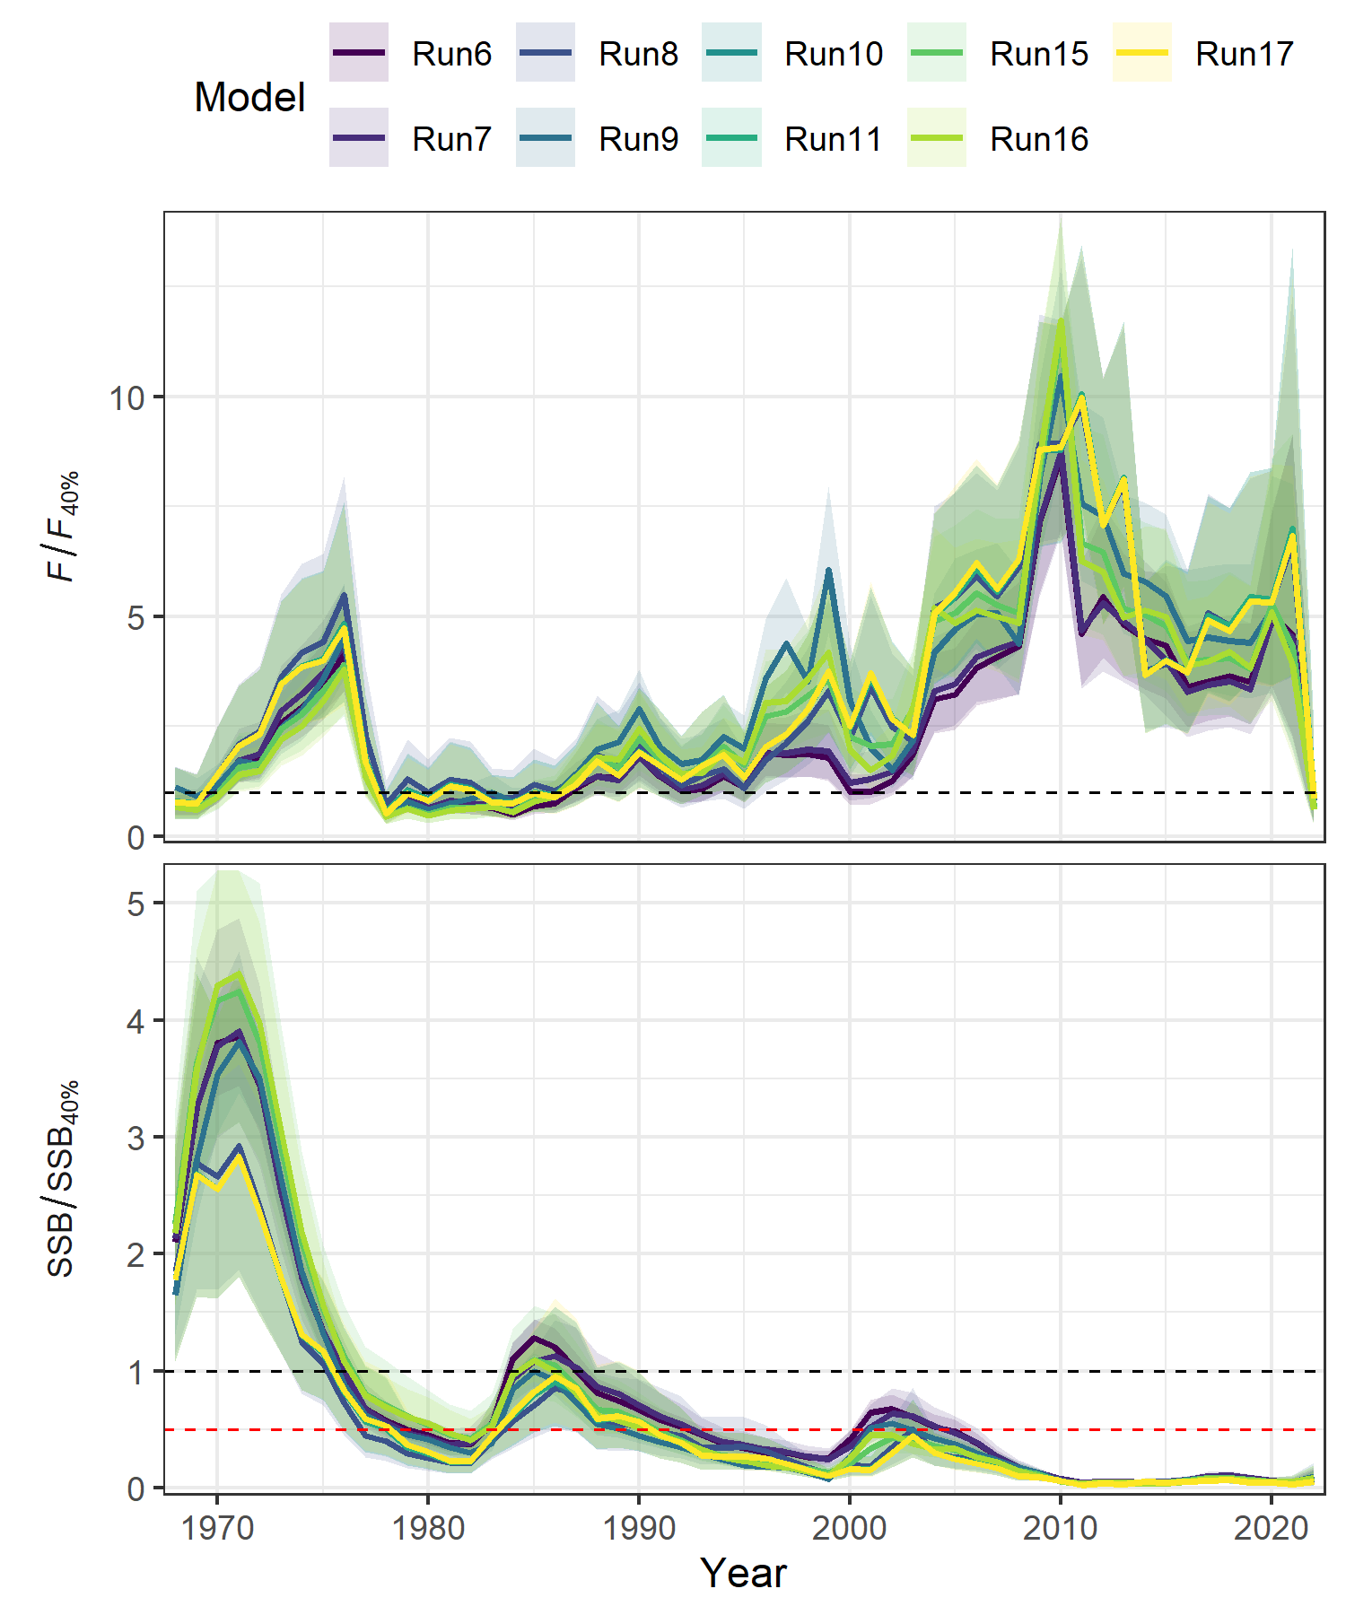
Conclusions
All of these runs end up with similar results.
Not worth getting worked up over too many details.

Slide 16
Conclusions
All of these runs end up with similar results.
Not worth getting worked up over too many details.
Run15 provides best fit and I would probably use it.
Models like run10 fit the fishery age comp unreasonably tight.
Even though they are not doing much, I’d use run15 and retain the naa re.
They do improve fit a bit.
They may play a bigger role in the future.
Revise the plus group?

