Slide 1
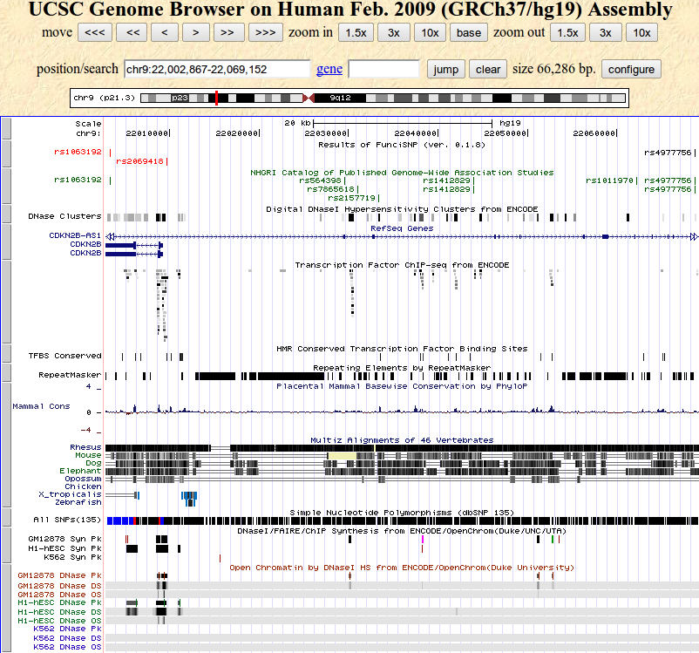
Func-y-SNPs
tagSNP
FunciSNP Results
GWAS SNPs
RefSeq
Transcription
Factors

