Slide 1
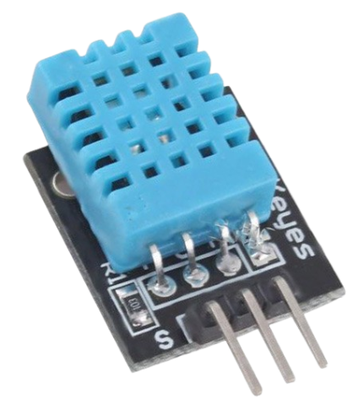
VCC
DATA
GND
MQ Series Sensors
MQ2
Flammable Gas
MQ3
Alcohol

