Slide 1
Course Design 2: Understanding the Phenomenon of Mercury's Retrograde Motion
Course Design 1: Exploring the Orbital Trajectories of Planets in the Solar System
Sumpy (Python Kit)
Fido.Fetch()
Data Visualization
Sumpy.Map
Instrument
Time
Time Series Data
Sumpy.Timeseries
Astropy(python Kit)
FIFS File

Slide 2
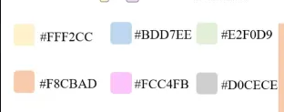
Course Design 2: Understanding the Phenomenon of Mercury's Retrograde Motion
Astroquery.mpc
Data Visualization
Retrieves asteroid and comet info from MPC.
Astroquery
(python Kit)
Planetary Orbits
Ploty
Astroquery.jplhorizons
Fetches orbital data for planets, asteroids, and comets.
Mercury Retrograde

Slide 3
Participants(n=96)
Study Announcement & Grouping
1 Week
Group A
(Python+AI)
Group B
(Python)
CG
(Tradition)
Astronomy Education Curriculum
3 Weeks
Questionnaire Completion
Research Questions 1
Research Questions 2
Research Questions 3

Slide 4








1 Week
Experimental Description
Astronomy Education
Simulate Planetary Orbits In The Solar System
Control Group
(N=48)
Experimental Group
(N=48)
Analyze Mercury's Retrograde Motion Data
3 Weeks
Learning Objectives
Visualize Transiting Exoplanet Light Curves
Implementation Method
Python Kit(astropy, Sumpy…)
Self-directed research
Self-directed research
&
Using GPT
Generative AI Chatbot

Slide 5
STEM
Astronomy
Interdisciplinary Learning
Catalyze
Computer Science
Physics
Improve Motivation
Mathematics
Chemistry
Expensive Equipment
Limit
Limited Observation Time
Insufficient Teacher Proficiency
Programming
Education
Requires Extensive
Prior Knowledge
Project-Based Practice
Flipped Classroom
Understanding Abstract
Concepts
Game-Based Learning

Slide 6
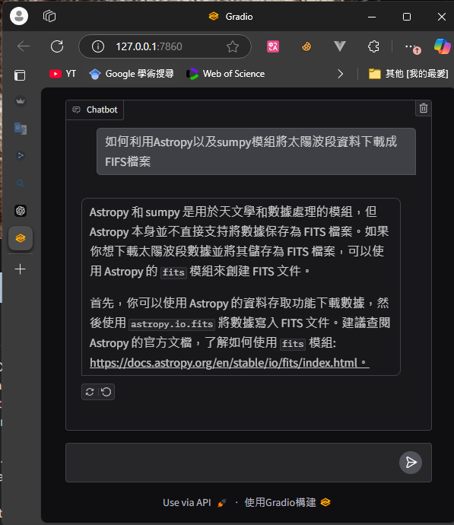
How to use Astropy and the sumpy module to download solar wave data as FITS files?
Read feedback from Chatbot
Astropy and sumpy are libraries designed for astronomy and data manipulation, but Astropy itself does not directly support saving data as FITS files. If you want to download solar wave data and store it as a FITS file, you can use Astropy's fits module to create FITS files.First, you can use Astropy's data retrieval functionality to download the data, then use the astropy.io.fits module to save the data as a FITS file. It is recommended to read Astropy's official documentation to learn more about the fits module:Astropy FITS Module Documentation
Type in question to Chatbots

Slide 9
