Slide 1
Discussion on
Symmetric Cipher
Prepared by Admin Team
30/09/19

Slide 2
Agenda
Secret Key encryption (Sysmmetric Key)
DES Encryption
AES Encryption

Slide 3
Part I:
Secret Key Infrastructure
(Sysmmetric Key)

Slide 4
Introduction of Secret Key Infrastructure
What’s Secret Key?
Type of encryption scheme
Same key is used both to encrypt and decrypt the secret message
The encryption scheme used in the past decades

Slide 5
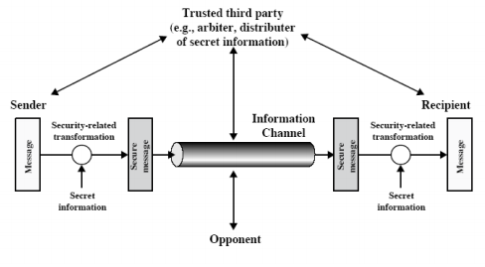
Secret Key Infrastructure

Slide 6
Type of Ciphertext
Block cipher
separate the plaintext in several block size (such as 64bit or 128bit) and encrypted
fix size of each block
Stream cipher:
encrypted the plaintext without separate the plaintext
not nessary to have fix size

Slide 7
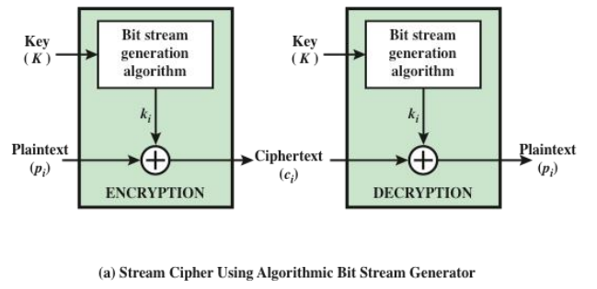
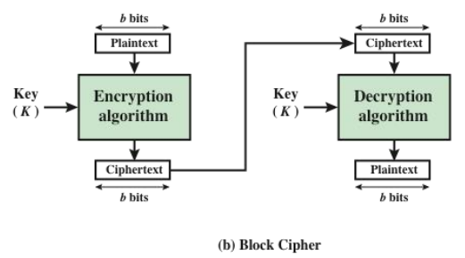
Block cipher and Stream cipher

Slide 8
Feistel Cipher
In 1973, Horst Feistel proposed a new type of secret key infrastructure…
To ensure the security of the cipher, you have to achieve two things:
Diffusion: spread statistics of plaintext into many bits of ciphertext to hide their relationship
Confusion: Make the plaintext statisical relationship between ciphertext as complex as possible
By this two element, DES has been introduction on 1975

Slide 9
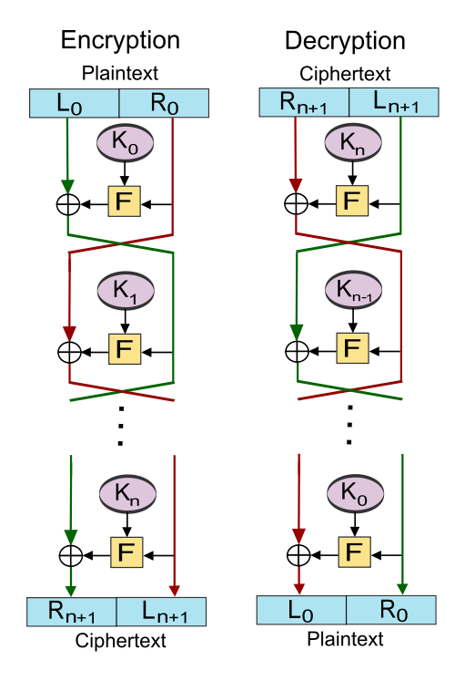
Feistel Cipher
Step 1: separate and plaintext into two side, which are L0 and R0
Step 2: Complete the confussion process with your Key(K0)
Step 3: XOR with L0
Step 4 - N:Repeat and Repeat...

Slide 10
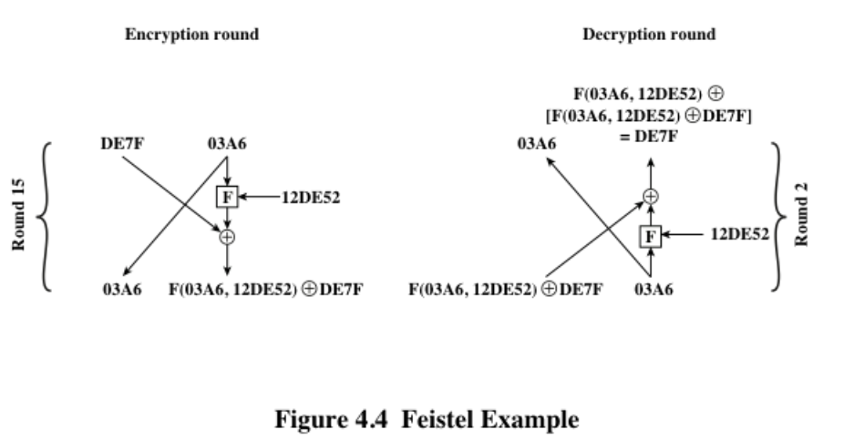
Feistel Cipher Example

Slide 11
Part II:
DES Encryption

Slide 12
Data Encryption Standard (DES)
The most widely used encryption scheme until early 2000’s
The algorithm is reffered to the Data Encryption Algorithm (DEA)
DES is a block cipher
The plaintext is processed in 64-bit blocks
The key is 56-bits in length

Slide 13
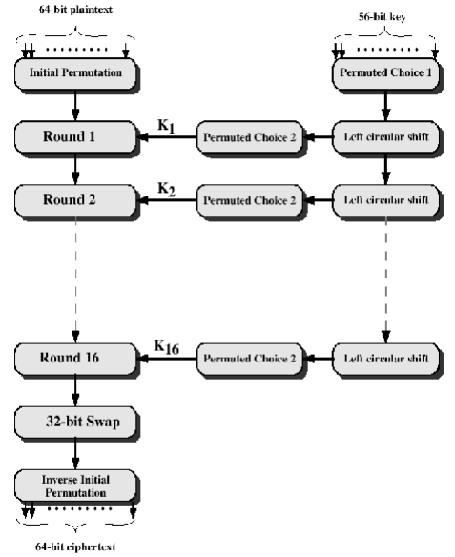
Data Encryption Standard (DES)

Slide 14
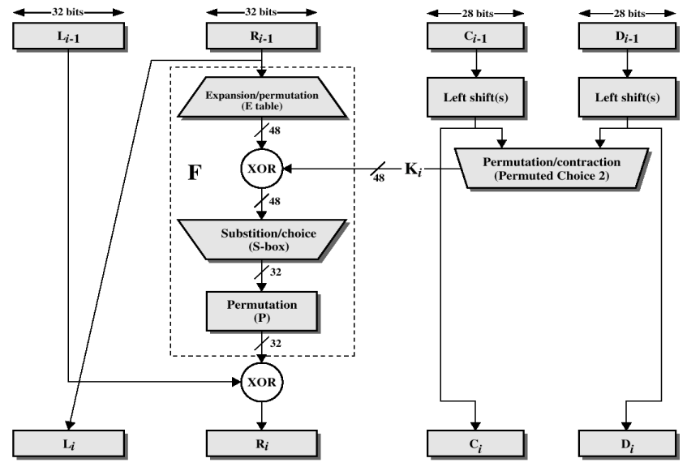
Data Encryption Standard (DES)

Slide 15
P-Box
Same as the traditional transposition cipher for charcters
One of the basic component of symmetric key
To perform the confusion property in encryption system
Three types of P-Box
straight: invertible
compression: not invertible
expansion: not invertible

Slide 16
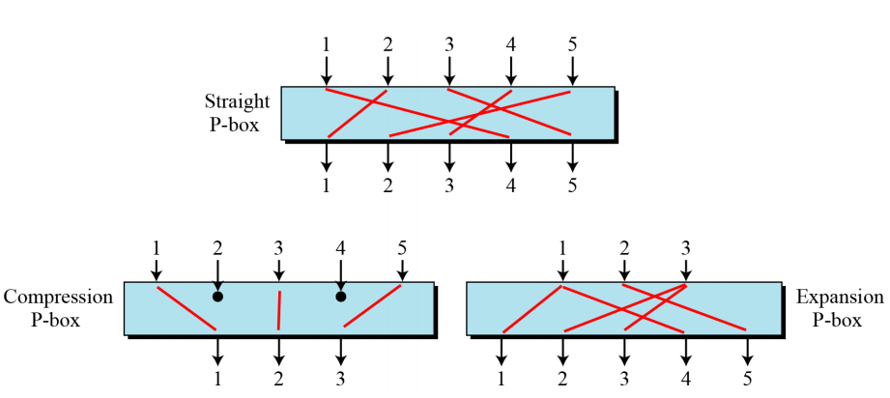
P-Box

Slide 17
S-Box
Same as the traditional substitution cipher for charcters
One of the basic component of symmetric key
To perform the diffusion property in encryption system

Slide 18
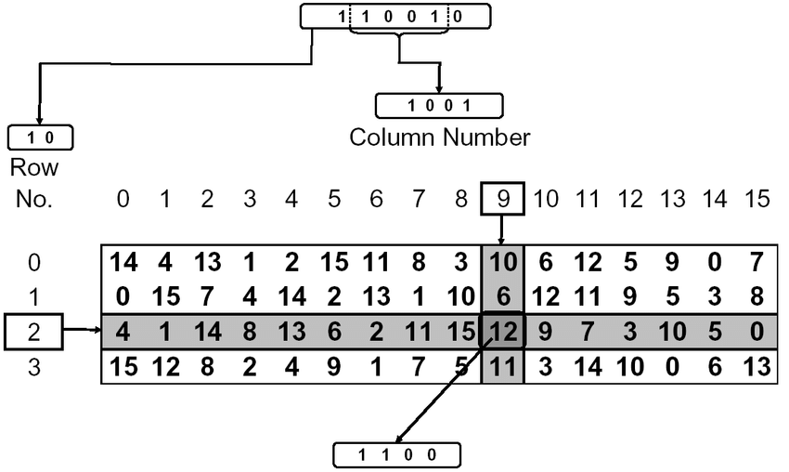
S-Box

Slide 19
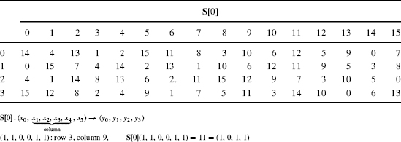
S-Box table

Slide 20
Step of DES
Step 1: Compute 16 subkeys, 48-bit long each
Step 2: Encode each 64-bit block of the message(permutation), and split into 32 bit long message(LHS and RHS)
Step 3: XOR the RHS message with 48-bit key
Step 4: Complete the S-box and P-box
Step 5: XOR the message with LHS
Step 6: repeats this message 16 times

Slide 21
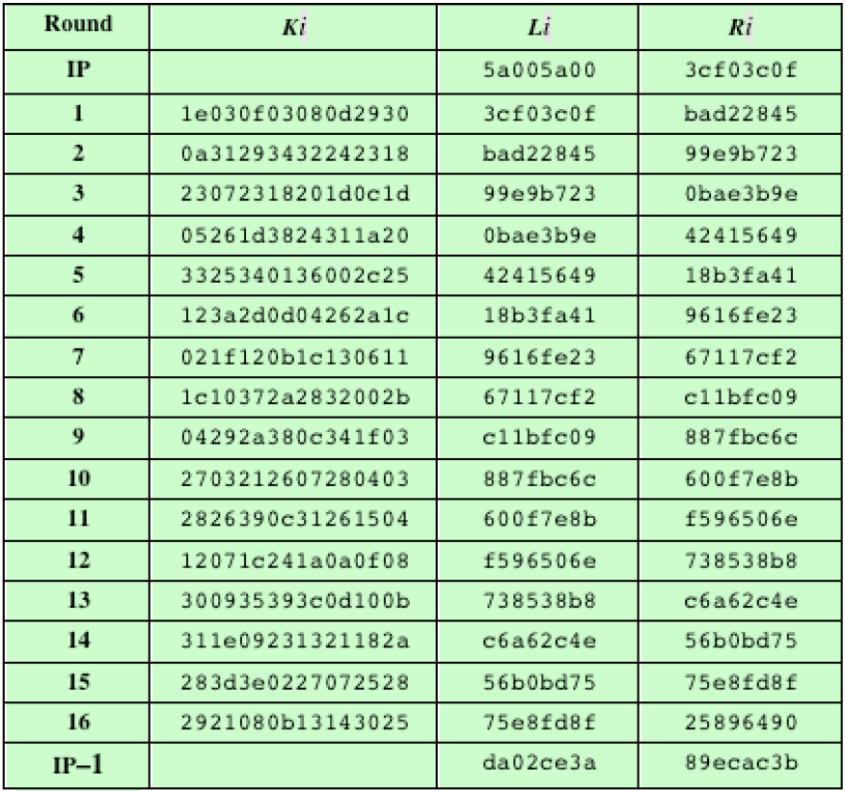
Example of DES
Plaintext: 02468aceeca86420
permutation: 5a005a003cf03c0f
Key: 0f1571c947d9e859
Ciphertext: da02ce3a89ecac3b

Slide 22
Problem of DES
Weak against Brute force in this day and age
(In 1977, DES can be break the key by estimated US$20 million in single day)
Only 56 bit key length
In view of this, we have two solution of it
1, 3DES
2, Construct a new encryption standard (AES)

Slide 23
Part II:
AES encryption

Slide 24
Advanced Encryption Standard(AES)
Original name is Rijndeal cipher
Esttablished by the NIST in 2001
Much more security than DES
non-Feistel cipher

Slide 25
AES Basic Information
Data block size: 128 bits
Different Version:
AES128, key length: 128 bits
AES 192, key length: 192 bits
AES 256, key length: 256 bits

Slide 26
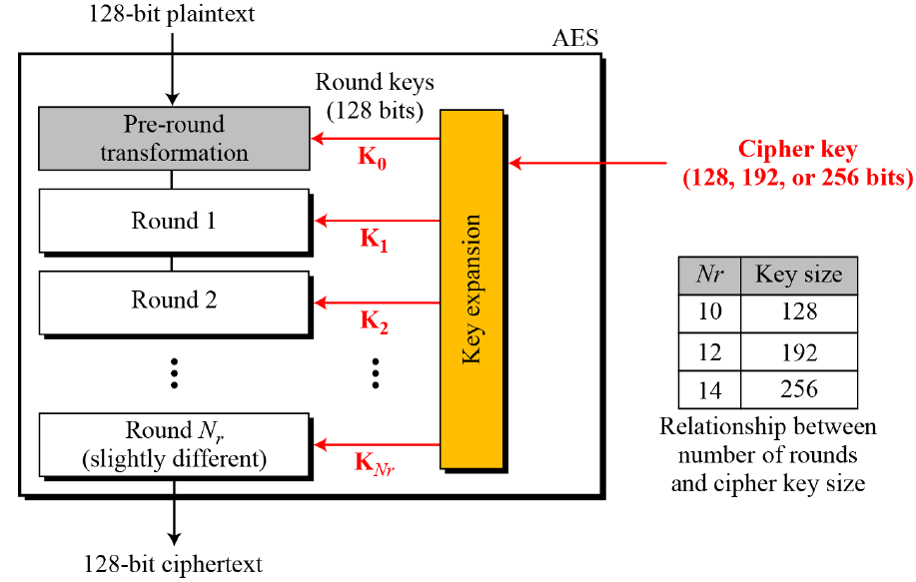
General Design of AES

Slide 27
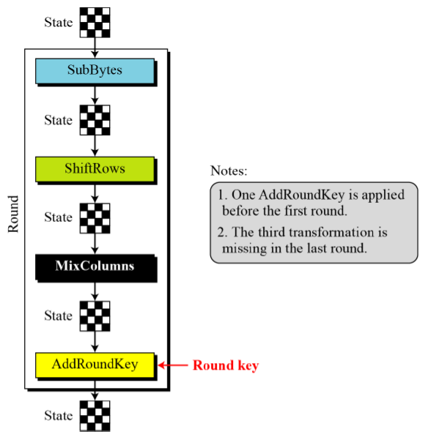
Operation in Each Round

Slide 28
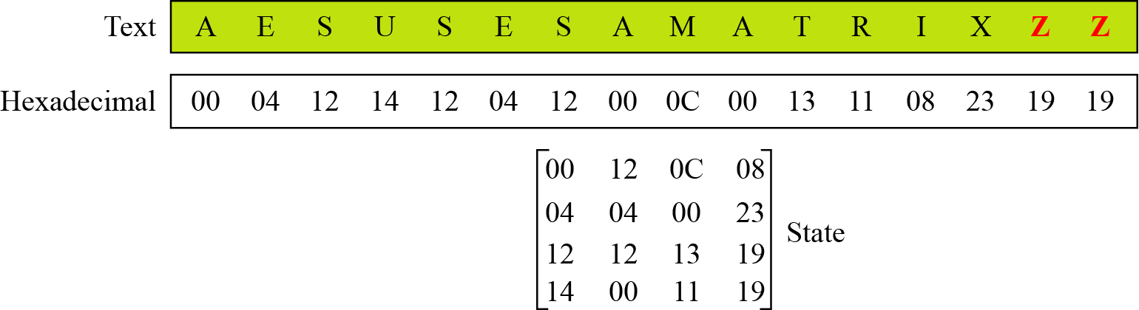
Changing plaintext to state
128-bit (16 byte) data block is treated as 4 x 4 byte array
Example:

Slide 29
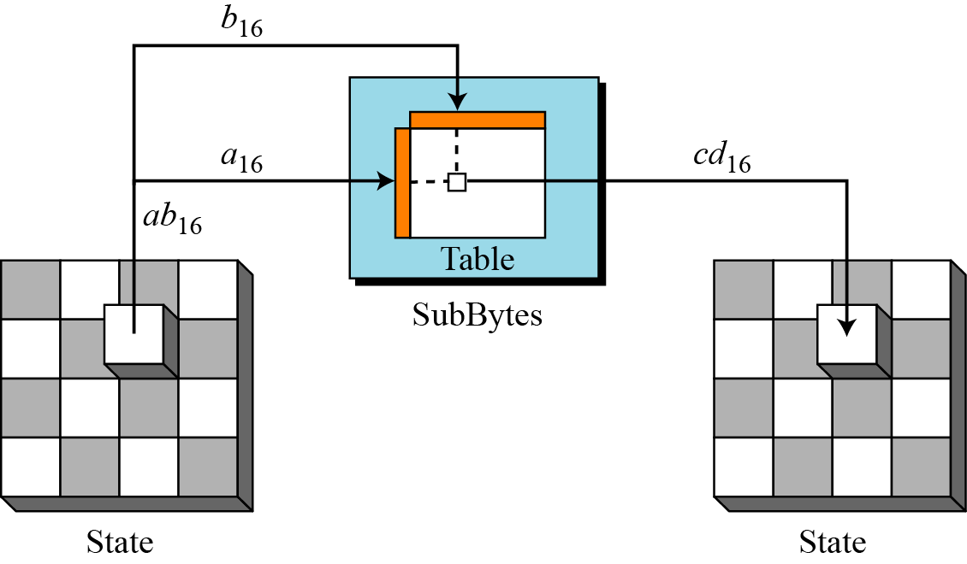
Sub-Byte operation
Involves 16 independent byte-to-byte transformations

Slide 30
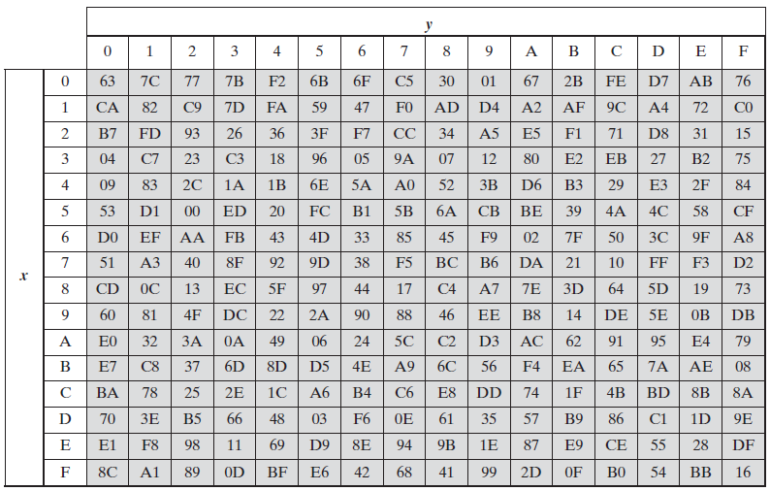
SubBytes Transformation Table

Slide 31
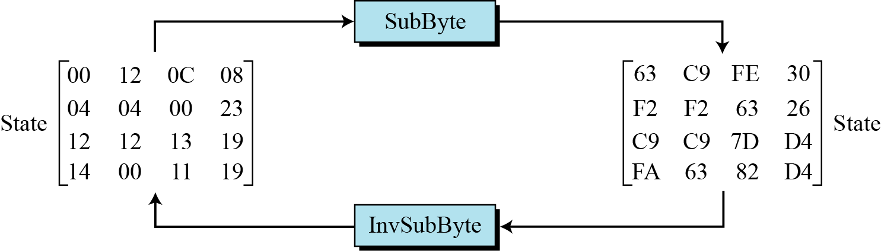
Example of SubBytes

Slide 32
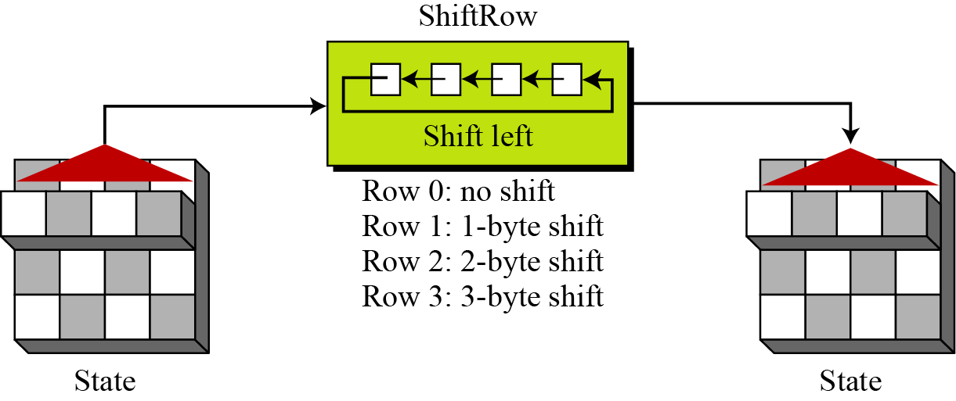
ShiftRow operation
This operation permutes the bytes

Slide 33
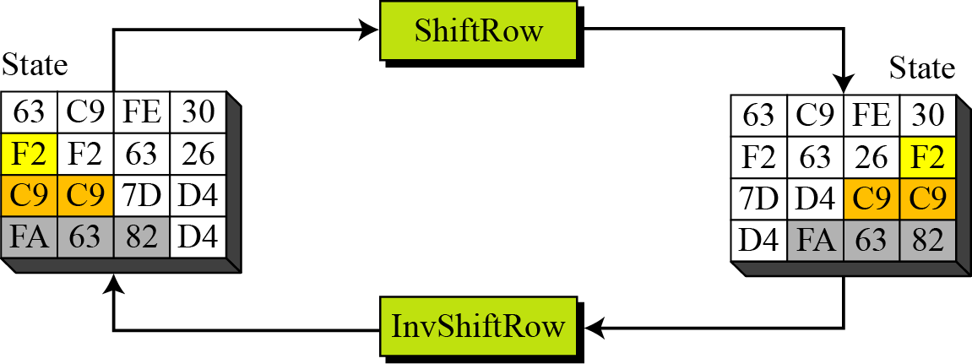
Example of ShiftRow

Slide 34
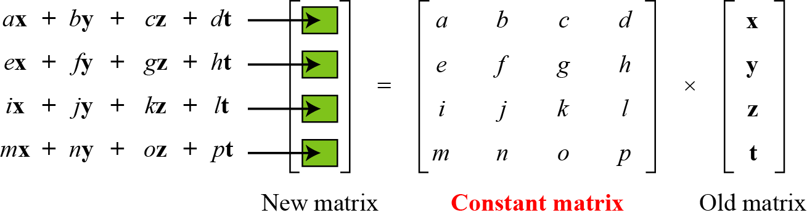
Mixing operation
Provide diffusion at the bit level

Slide 35
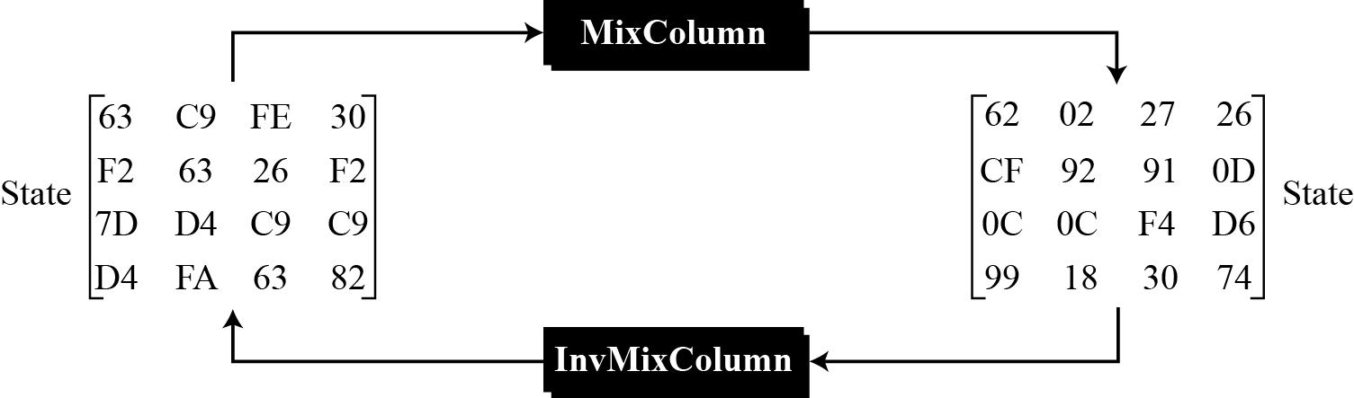
Example of MixColumn

Slide 36
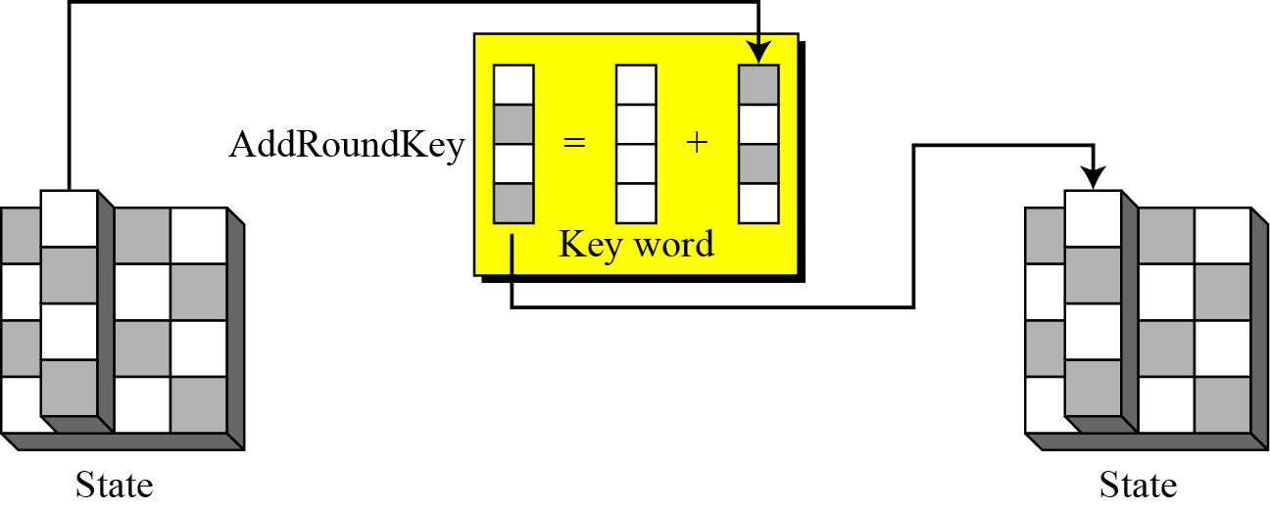
AddRoundKey
XOR a round key word with each state column matrix

Slide 37
Step of AES operation
1, State the plaintext
2, perform the Sub-Byte operation
3, State the output
4, perform the ShiftRow operation
5, State the output again
6, perform the MixColumn operation
7, State the output again and again
8, perform the AddRoundKey operation
9, repeat 1….

Slide 38
Modes of Operation (Block cipher)
Electronic Codebook (ECB) Mode (weak….)
Cipher Block Chaining (CBC) Mode (common)
Cipher Feedback (CFB) Mode
Output Feedback (OFB) Mode

Slide 39
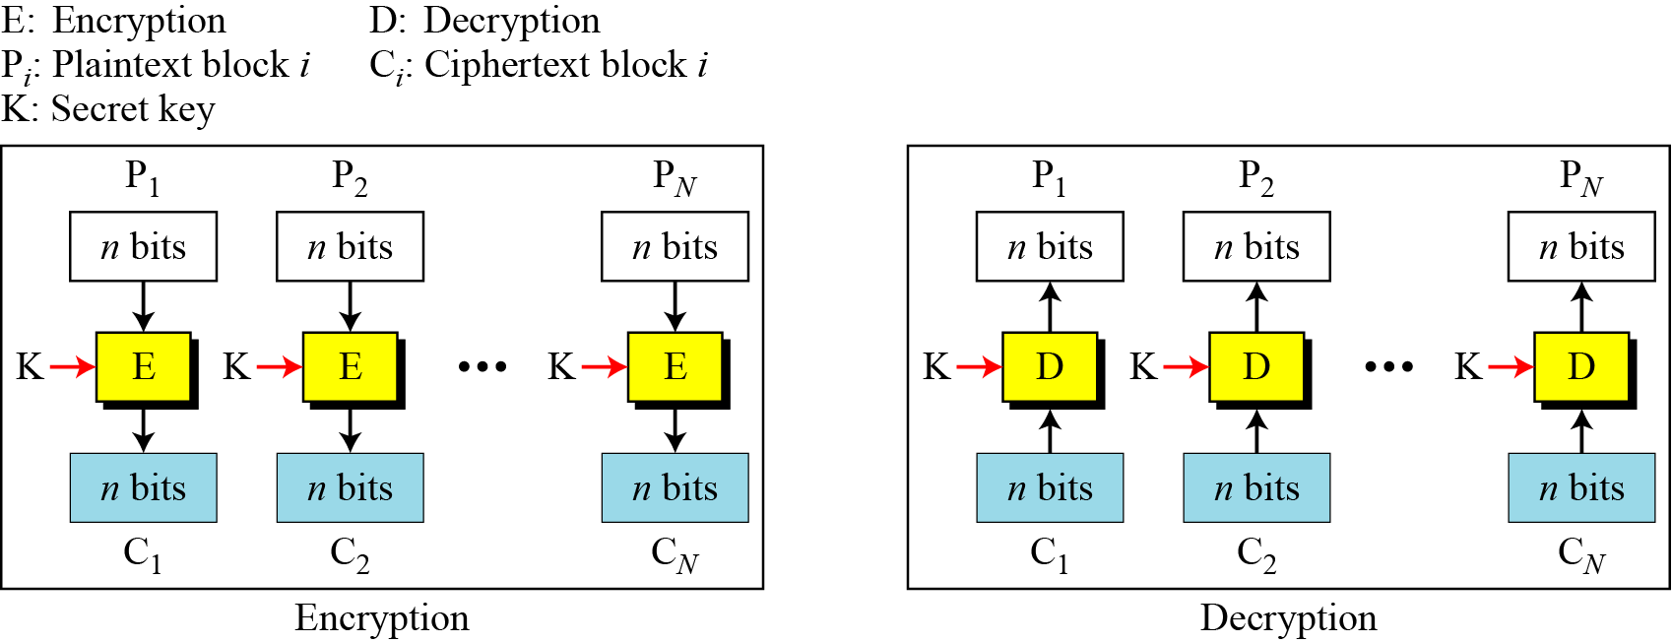
ECB Mode

Slide 40
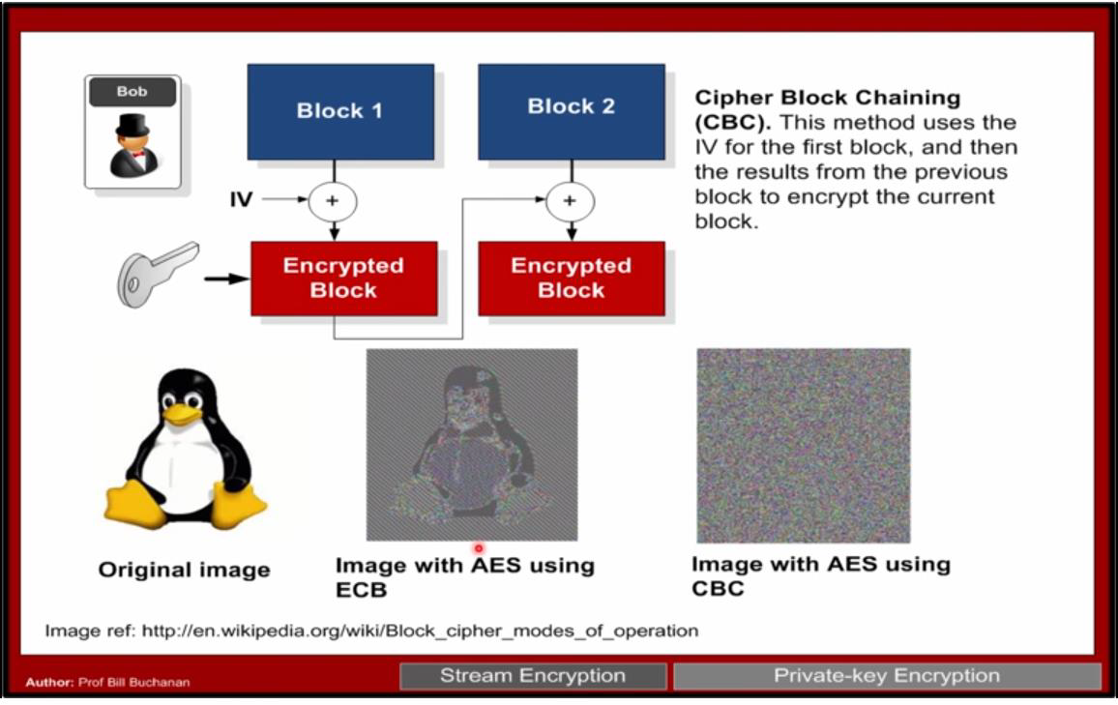
Problem of ECB

Slide 41
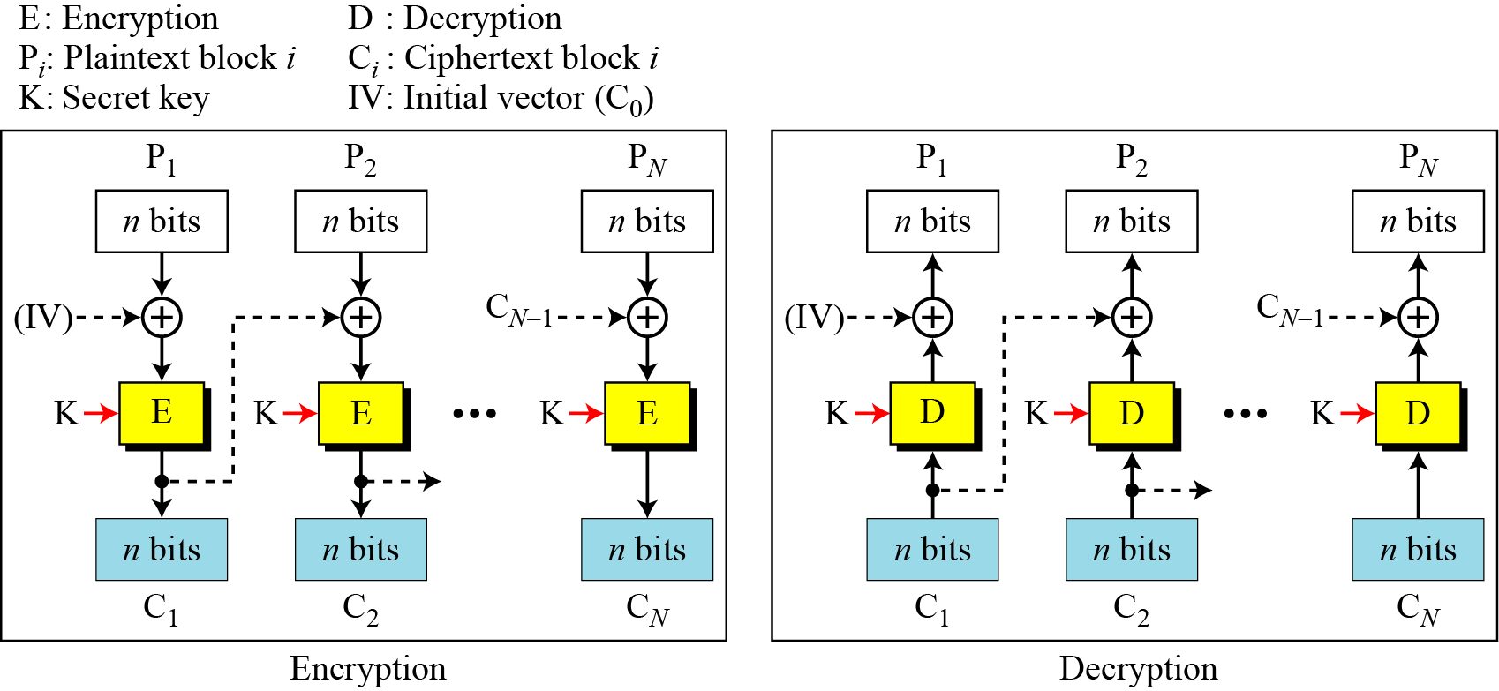
CBC Mode

Slide 42
End of today

