Slide 1
Discussion on
Asymmetric Cipher
Prepared by Admin Team
14/10/19

Slide 2
Agenda
Hashing
Diffie–Hellman
RSA
Attack Method

Slide 3
Part I:
Hashing

Slide 4
Hashing
Convert an arbitary size message to a fixed-size hash value
The result is called Digest
Basic Properties:
same message same hash
Digest size fixed

Slide 5
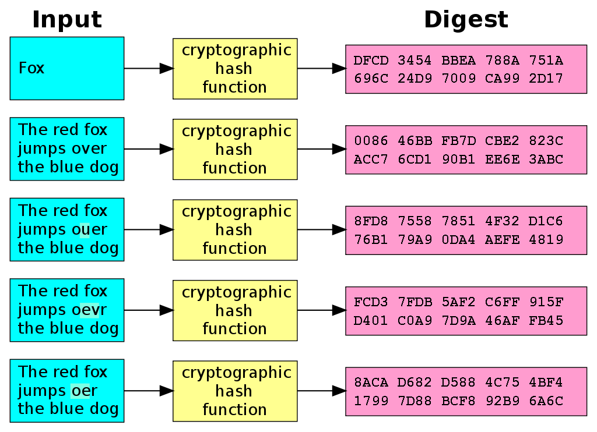

Slide 6
Hashing Algorithm
MD5 (considered borken)
SHA-1
SHA-2
SHA-3

Slide 7
Collision
Different Message results in same Digest
Resistance of collision determines whether it is a good hashing algorithm

Slide 8
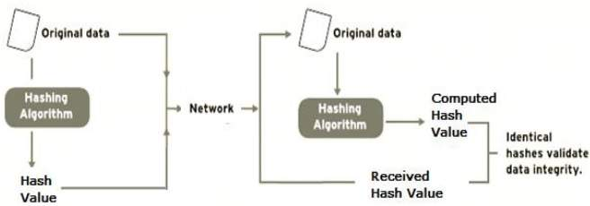
Integerity Protection

Slide 9
Part II:
Diffie-Hellman

Slide 10
Diffie-Hellman
establish key via Public channel (which is unsecure)
Goal: protect the confidentiality of the key
scenario: Alice and Bob does not know each other, but Alice wants to establish a shared key with Bob

Slide 11
Step
setup a known value, p (a prime number) and g (base)
Alice selects a secret value a, and sends A = g^a mod p to Bob
Bob selects a secret value b, and sends B = g^b mod p to Alice
Alice extracts the message s = B^a mod p
Bob extracts the message s = A^b mod p
s = g^(a * b) mod p

Slide 12
Example
Alice and Bob agrees to pick g = 5 and p = 23
Alice selects a = 3 and sends 5^3 mod 23 = 10 to Bob
Bob selects b = 6 and sends 5^6 mod 23 = 8 to Alice
Alice gets the secret by 8^3 mod 23 = 6
Bob gets the secret by 10^6 mod 23 = 6
Both of them are happy :)

Slide 13
Usage
The result s can be used as a key for symmetric encryption (only Alice and Bob knows the key and the key they have are the same)

Slide 14
Part III:
RSA

Slide 15
RSA
Each user has his/her own public key (e) and private key (d)
The public key can be obtained by everyone
The private key should only be known by the user

Slide 16
Key generation
Select two primes p, q and n = p * q where p is not equals to q
Compute phi(n) = (p-1)*(q-1) ← Totient Function
Select public key e where e < phi(n) and e is co-prime with phi(n)
Compute private key d -> e * d = 1 (mod phi(n))

Slide 17
Encryption
Alice obtains Bob’s public key Eb
Let the message (plaintext) be m
Compute c = m ^ Eb mod n where c is the encrypted ciphertext
Transmit c to Bob

Slide 18
Decryption
Bob recevies ciphertext c
He computes m = c ^ Db mod n where Db is his own private key
He retrieves the plaintext!

Slide 19
Signature
RSA can be used to sign
Encrypt message m with your private key d
Only your public key can decrypt the ciphertext c
Since your public key is published
Everyone can verify whether you have signed the document

Slide 20
Part IV:
Attack Method (RSA)

Slide 21
Weak RSA attack
The length of “N” not long enough
Size of the N much larger than the ‘e’ value
N has too much factor

Slide 22
Weak RSA attack
Example, N = 8723847…..012893[length = 128], e = 3
C = 29384….98435[length = 96]
since we known that C = M^e mod N, so we just need to inverse the step
M = pow(C, -e), then we obtain the original plaintext :D

Slide 23
Wiener attack
Appear when the "e" is extreme large
Since the size of “e” is relative with “d”
When “e” has been distributed (it’s public key), it’ll very easy to obtain the private key “d”

Slide 24
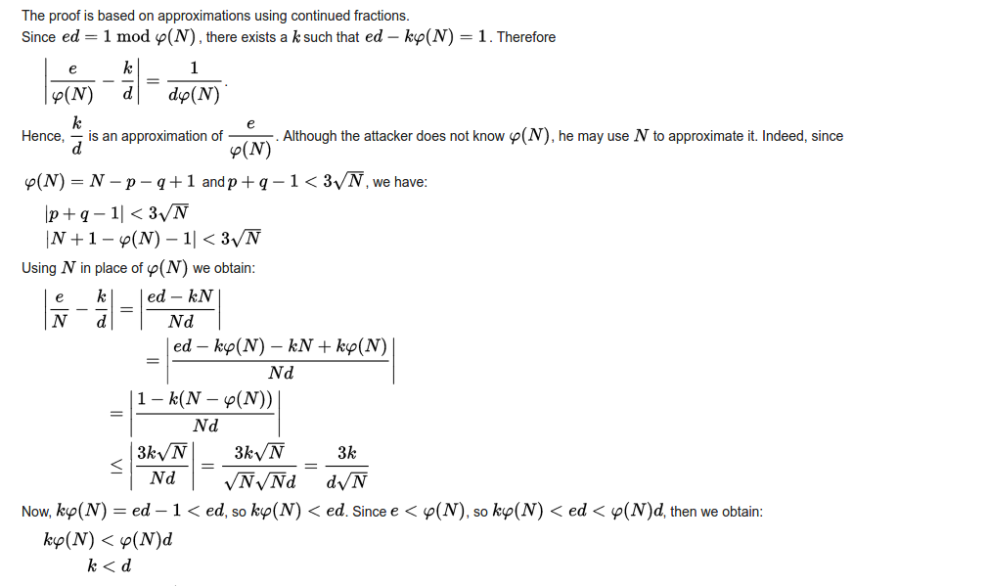
Proof of Wiener attack

Slide 25
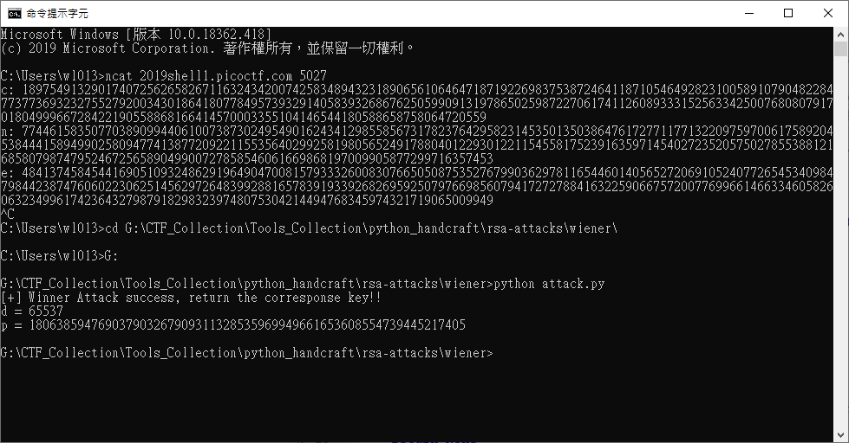
Example of Wiener attack

Slide 26
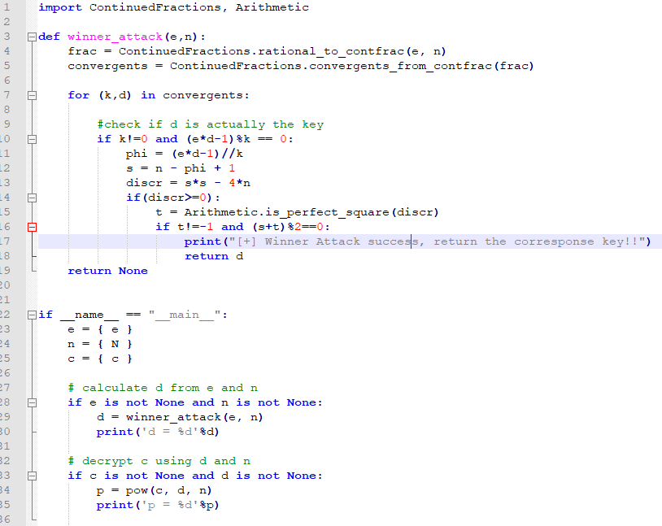
Code of exploit

Slide 27
MITM attack
Since RSA (or PKI infrastructure) main purpose is ensure the communication channel security
you only able to verify that there’s no one able to sniffing your message
but that doesn’t mean you chat with the right person

Slide 28
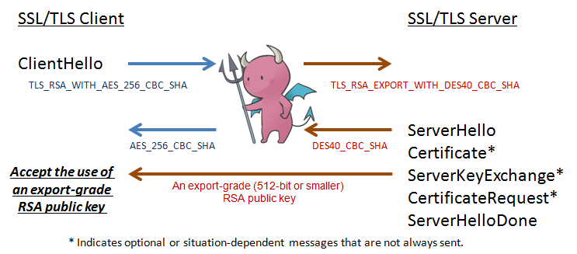
MITM attack

Slide 29
End of today

