Slide 1
GAN intro and application with mnist
- By Zhang Kaichen

Slide 2
Outline
Introduction to GAN
Theoretical analysis
Conclusion and future work
Demo with mnist dataset

Slide 3
Intro to GAN
Generative adversarial network
Random Input
Fake data
Generator

Slide 4
Adversarial Network
Another Network to compete with the generator
Generator
discriminator
Multilayer perceptron
Produce fake data to deceive discriminator
Trained simultaneous with discriminator
Multilayer perceptron
Identify fake data produce by generator
Trained simultaneous with generator

Slide 5
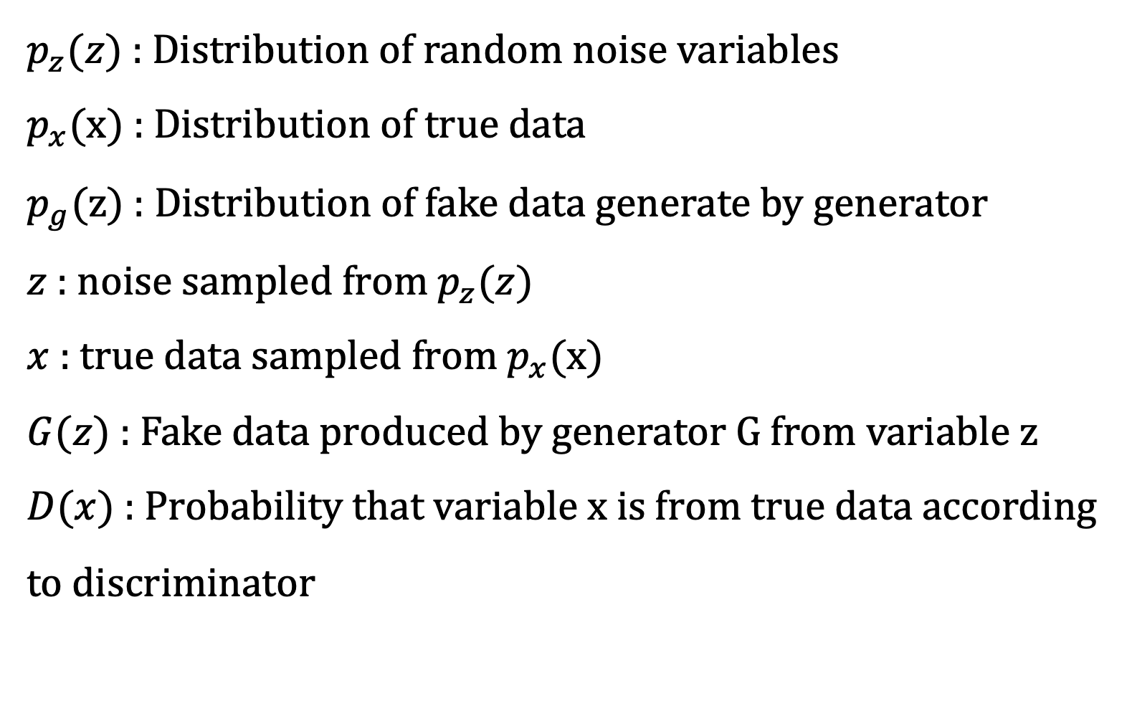
Theoretical analysis
$p_{z}(z)$ : Distribution of random noise variables
$p_{x}(x)$ : Distribution of true data
$p_{g}(z)$ : Distribution of fake data generate by generator
$z$ : noise sampled from $p_{z}(z)$
$x$ : true data sampled from $p_{x}(x)$
$G(z)$ : Fake data produced by generator G from variable z
$D(x)$ : Probability that variable x is from true data according to discriminator

Slide 6
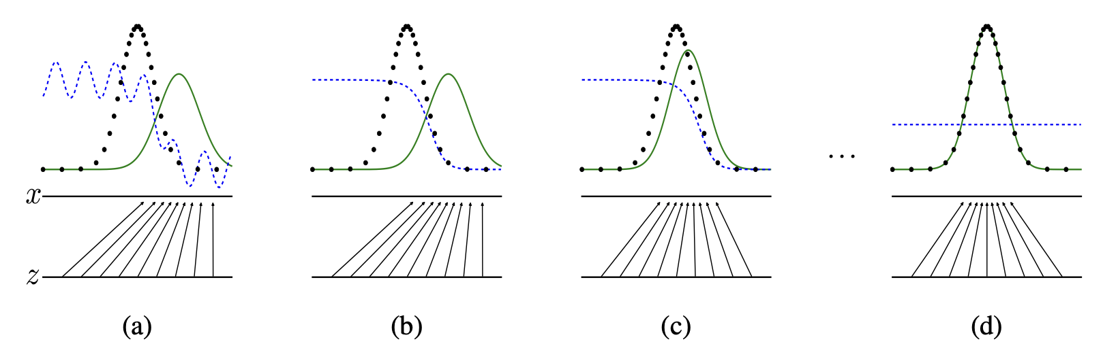
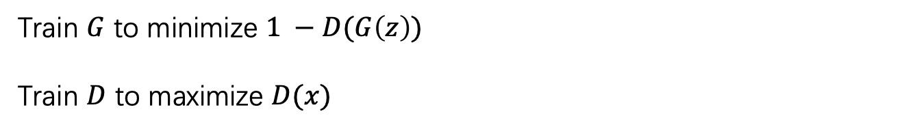
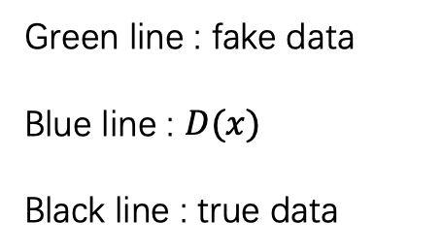
Train $G$ to minimize $1 −D(G\left(z\right))$
Train $D$ to maximize $D(x)$
$$\min_{G}{\max_{D}{V\left(G, D\right)= Ε(\log\left( D\left(x\right) \right) )+Ε( 1 −D\left( G\left(z\right) \right) )}}$$
Green line : fake data
Blue line : $D(x)$
Black line : true data

Slide 7
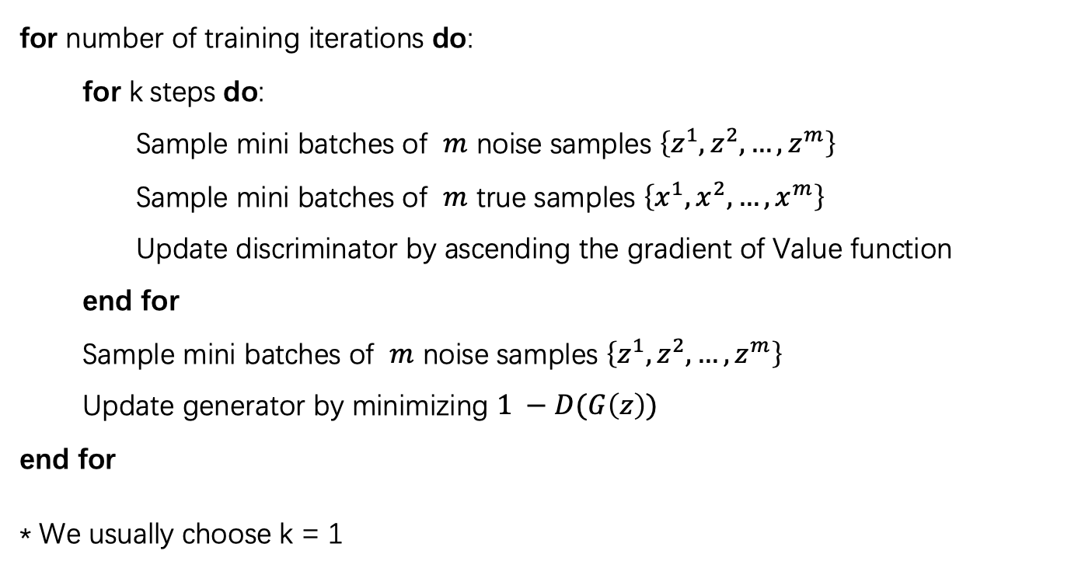
Training procedure
for number of training iterations do:
for k steps do:
Sample mini batches of $m$ noise samples $\left\{z^{1}, z^{2}, …, z^{m}\right\}$
Sample mini batches of $m$ true samples $\left\{x^{1}, x^{2}, …, x^{m}\right\}$
Update discriminator by ascending the gradient of Value function
end for
Sample mini batches of $m$ noise samples $\left\{z^{1}, z^{2}, …, z^{m}\right\}$
Update generator by minimizing $1 −D(G\left(z\right))$
end for
* We usually choose k = 1

Slide 8

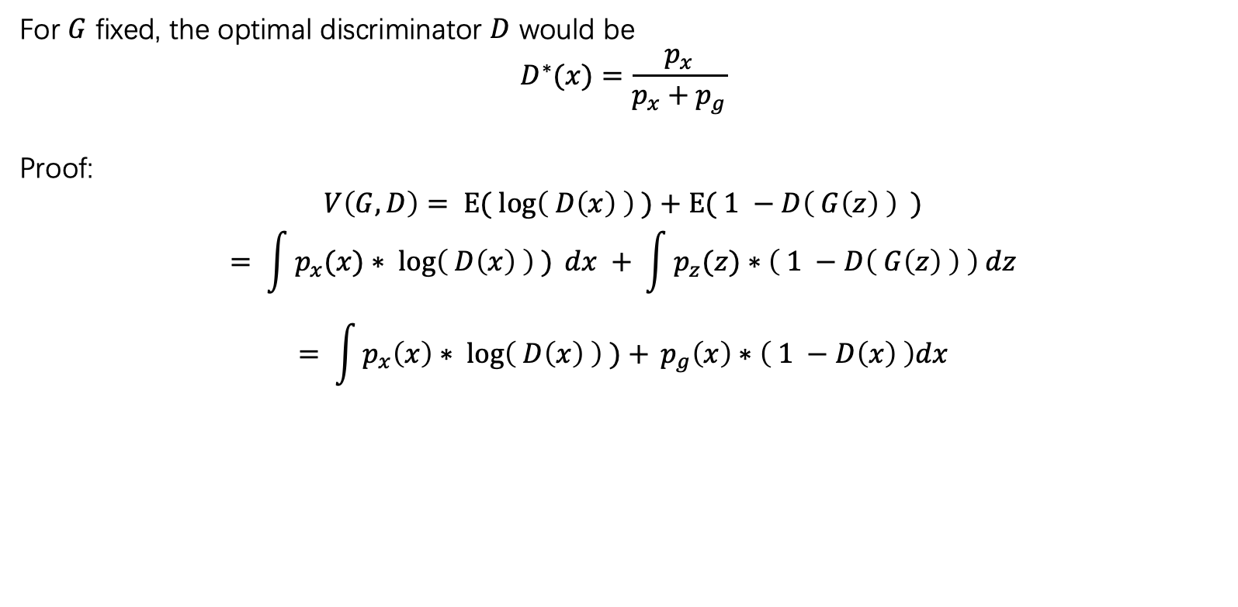
Global Optimality
For $G$ fixed, the optimal discriminator $D$ would be
$$D^{∗}(x)=\frac{p_{x}}{p_{x}+p_{g}}$$
Proof:
$$V\left(G, D\right)= Ε(\log\left( D\left(x\right) \right) )+Ε( 1 −D\left( G\left(z\right) \right) )$$
$$= \int{p_{x}(x)∗\log\left( D\left(x\right) \right) ) dx }+ \int{p_{z}(z)∗\left( 1 −D\left( G\left(z\right) \right) \right) dz}$$
$$= \int{p_{x}\left(x\right)∗\log\left( D\left(x\right) \right) )+ }p_{g}\left(x\right)∗\left( 1 −D\left(x\right) \right)dx$$
Form of : $a∗log\left(y\right)+b∗log(1−y)$

Slide 9
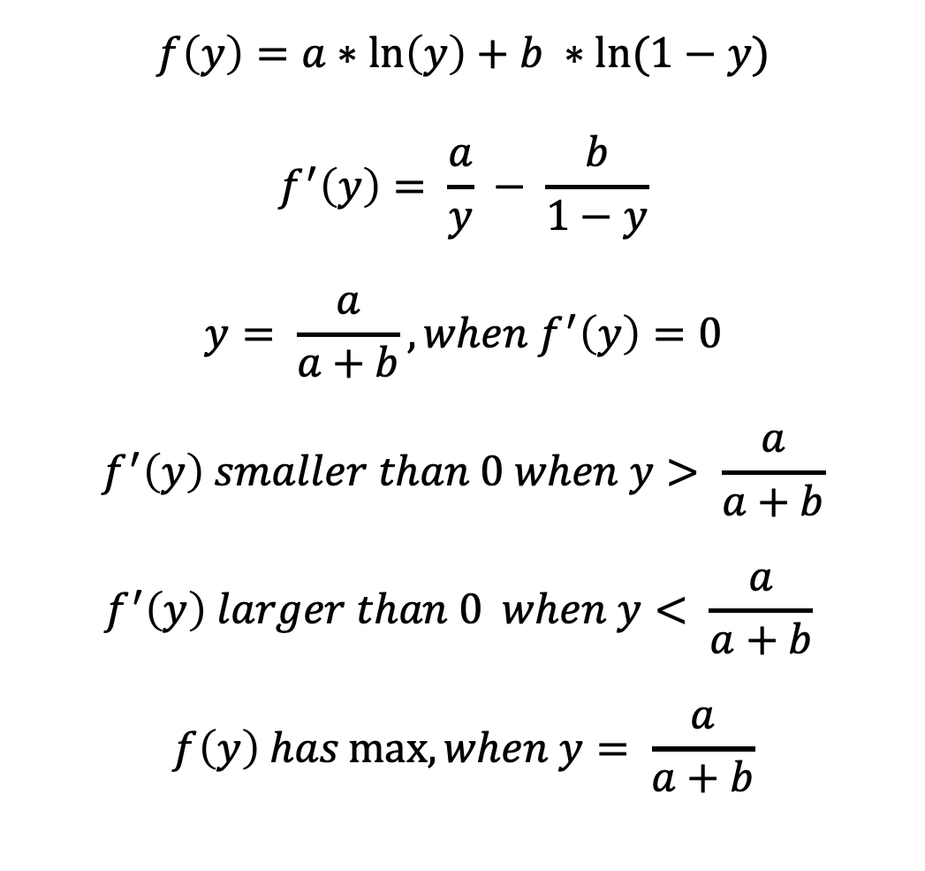
$$f\left(y\right)=a∗\ln\left(y\right)+b ∗ln⁡(1−y)$$
$$f^{′}\left(y\right)= \frac{a}{y} − \frac{b}{1−y}$$
$$y= \frac{a}{a+b}, when f^{′}\left(y\right)=0$$
$$f^{′}\left(y\right) smaller than 0 when y> \frac{a}{a+b}$$
$$f^{′}\left(y\right) larger than 0 when y< \frac{a}{a+b}$$
$$f\left(y\right) has\max{, when y= \frac{a}{a+b}}$$
Proves Global optimality

Slide 10
Conclusion and future work
GAN might be hard to train and adjust
It might hard to tell when to stop training
Supervised learning and semi-supervised learning

Slide 11
MNIST demo
Discriminator
Discriminator loss
Generator loss
Random Input
Generator
Github link: https://github.com/kcz358/GAN-mnist

Slide 12
Reference
Generative Adversarial Networks (https://arxiv.org/abs/1406.2661)

Slide 13
Thank you

