Slide 1
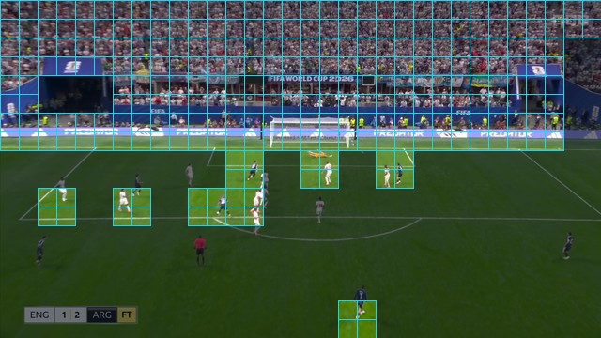
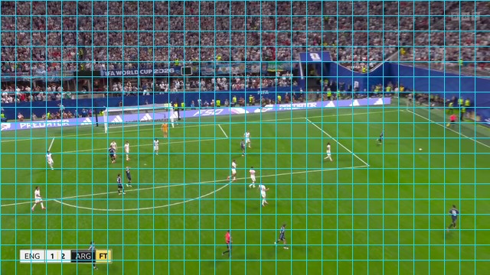
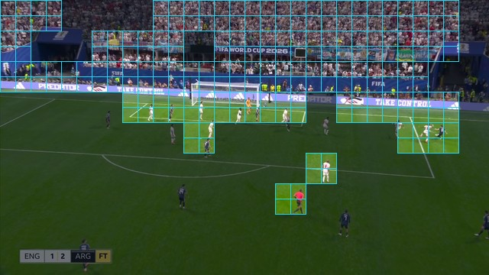
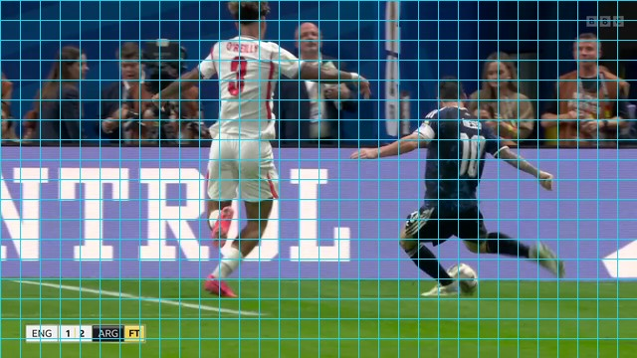
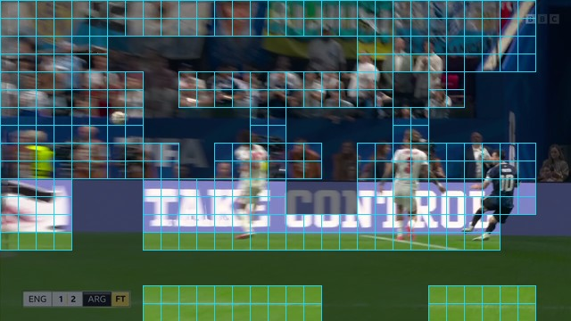
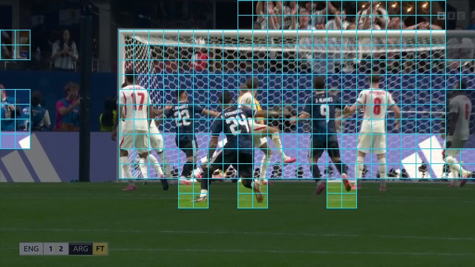
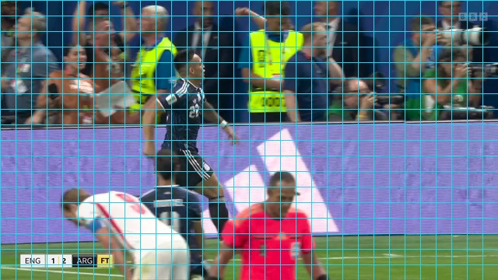
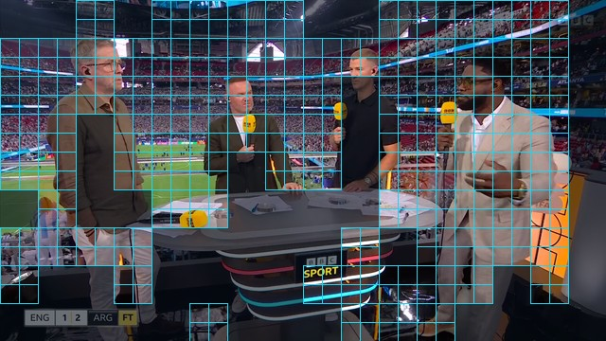
02.16s
06.38s
11.60s
14.42s
15.44s
20.16s
24.50s
29.36s
SILENCE
RESPONSE
MAGE-VL SPEAKS
selected 16×16 patches · dimmed regions are discarded by the codec selector
“An England player drives toward goal, closely pursued by an Argentina defender as the attack develops.”

