Slide 1

Expect Beyond

Slide 2

Expect Beyond
Merino Rationale
Expect Beyond Dimensions
The Brand name, Merino (IT Services), is derived from the parent company, Merino Industries. The logo symbolizes growth propelled by three important aspects people, processes and services. While the three arcs represent people, process and services, the green arrow is a sign of prosperity and growth.
The positioning ‘Expect Beyond’ came from the consumer’s insight which assures a complete bond between Merino and its clients.

Slide 3


Consumer expectations drive us to do better.
When they want big, we create big enough.
Every new opportunity
comes wrapped in a new challenge.
Challenges are an inseparable part of our lives. We take the challenges head on, learn from them, and uncover the hidden opportunities lying inside.
From health-check to deployment
and then application management, a complete range of services help meet the varied needs of the businesses. Aside from that, we are creative enough to custom-design a solution depending on the need of the hour.
More than a decade has passed since we stepped into the arena of Information Technology. And since then, we have been analysing consumers, understanding their problems and making them believe in the reality of deploying technology solutions. Perhaps, we may not sound as appealing to our customers as an FMCG retailer, we exactly know what it takes to deploy Enterprise solutions. Furthermore, we understand what problems our customers go through and what they expect from us in response.
We take pride in making things a little easier for businesses, walking on our old school principles of eradicating challenges through PEOPLE, PROCESSES and
SERVICES. We make our customers count on us and
work round-the-clock to turn their expectations into reality – yep, that's exactly what we are so good at!
We are focused, with plenty
of experience under the belt.
13+ years of experience backed by some of the extraordinary minds help us meet even the toughest of the challenges that businesses face today. We sit together with our clients, share a cup of coffee, and go on to scrutinizing the possibilities of making a difference in their businesses.
Boundaries
cannot stop us.
Presence across multiple regions, 300+ clients - we have been helping global businesses for years whilst making a reputable place deep in their hearts. Having a keen eye for comprehending universal business problems, we think beyond the consumers’ expectations and provide them the best-in-class technology solutions.

Slide 4
About Merino Services
Merino Services, a global enterprise is part of a $250 million Merino Group, headquartered in India and has a strong presence in the USA, Canada, Europe, Middle East, South East Asia & India Subcontinent
The team consists of 200+ domain experts, serving 250+ clients across 41 countries
End-to-End service, ranging from Feasibility Study to Implementation of standard application to post implementation support along with AMS. We also add value to overall solution by designing & developing Mobility solutions
ISO 9001:2015 certified
GDPR Compliant

Slide 5
GLOBAL PRESENCE
Notes:
Portugal add

Slide 6
Merino Expertise
Services
Implementation and Consulting
Migration/Upgradation
Service and Support
Education and Training
Application Management
ERP Readiness and Health Checks
Solution
Enterprise Resource Planning
Customer Relationship Management
Enterprise Asset Management
Technology and Middleware
Enterprise Performance Management
Tecnology Alliance
Infor
Microsoft
IFS
Oracle
SAP

Slide 7
Merino’s Dual Advantage
VERTICAL SYSTEM INTEGRATION
Prediction, Simulation, CPS
Data Federation & Collaboration
Visualization, Monitoring, Analytics
Market to Order
Order to Cash
Idea to Offering
Forecast to Plan
CRM
SCM
Record to Report
Procure to Pay
ERP
Design to Build
Assess to Acquire
ERP
Operate to Maintain
Plan to Produce
PLM
EAM
HCM
Inspect to Quality
Acquire to Retire
HORIZONTAL BUSINESS PROCESS INTEGRATION
MOM / LMS - APS – MES - MI
PLC, SCADA, I/O Controllers, IIoT
Sensors, Actuators, RFID etc.

Slide 8

Services

Slide 9




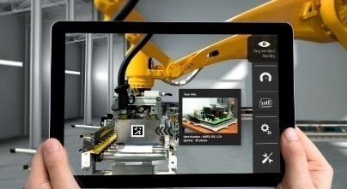



SERVICES OFFERINGS
Consulting Services
ERP Readiness and Health Check
ERP Implementation
Application Management Services
Manufacturing Excellence
Migration / Upgradation
Education & Training
Staff Augmentation

Slide 10

industries Focus

Slide 11












INDUSTRIES FOCUS
Equipment & Machinery
Discrete Manufacturing
Milling
(Metal, Paper & Plastic)
Automotive
High-tech Electronics
Food & Beverages
Textile
Aerospace & Defense
Distribution & Retail
Energy & Power
Ship Building
Wire & Cable

Slide 12








Did you know?
800
100
25
4B
Aerospace &
defense customers
Countries
Years of experience in A&D
Passengers moved each year on planes built using Infor
15,000
19 of top 20
Users at Boeing since 1995. Largest ERP implementation in the world.
A&D companies use Infor

Slide 13
Business challenges we see
Complex Supply Chains
Configuration Management
Industry Compliance
Cost of IT
Comprise majority of product cost
Many unique, non- interchangeable items
Extensive oversight (FAA, DCAA, DoD/MoD)
Disparate systems, laborious processes

Slide 14




Improve on-time delivery
Complex Supply Chains
Suppliers
Assembly and Manufacturing
Customer
Differentiator
Co-mingled Project / Cost Pegging
Amalgamation of demand
Contract Flowdown
Planning Simulation
“We have improved on-time delivery to 94 percent—with that number still rising—and our return rate has declined by over 85 percent.”

Slide 15









Supply chain planning
Complex Supply Chains
Issue:
Identification of contractual requirements to suppliers
Plane(s)
Engine(s)
Sub-Assembly(s)
Part(s)
Differentiator:
Co-mingling with Contract / Project planning and pegging
Insert customer result, ROI or solution highlight / fact
Insert customer result, ROI or solution highlight / fact
Chose Infor to manage their complex supply chain because “a good IT solution is fundamental to good logistics.”

Slide 16




After-Market Services
Complex Supply Chains
Increase revenue from after-market services
Spare Parts
Differentiator:
One integrated solution for all after-market services with OEM capabilities
Depot Repair
Suppliers
MRO
Manufacturing
After-market Services
Organization wanted an ERP that went beyond the confines of airline or MRO competence. “We liked the technology. We knew it would stay current.”

Slide 17




Contract Management
Complex Supply Chains
Requirements
Manufacturing
Purchasing
Terms
Differentiator:
Contract flowdown
Co-mingling
Project cost pegging
Terms & Conditions
DPAS
Costing breaks
Borrow/Loan Payback
“This transformation program will drive our competitiveness ,more efficient and responsive to market conditions.”

Slide 18
Micro-vertical specialization
Commercial Contractors
Unit-Effectivity
Line Assembly Control
Sales Schedules
Purchase Schedules
Supplier Staged Payments
Use-Up Effectivity
Non-Conforming Material Management
As-Built BoM
Serial Number Control
RFID
Defense Contractors
Contract/CLIN Management
Progress Invoicing
Retro-Active Rate Adjustments
Costing Breaks
Contract Flowdown
Project Co-Mingled Cost Pegging
DPAS
Overhead Rate Calculations
DD250
Borrow/Payback
MRO & Service
Providers
Service Work Order Management
As-Maintained BoM
Spare Parts and Logistics
Depot Repair
Serial Number Traceability
Remote Field Service
Maintenance, Repair and Overhaul
Rotable Management
Call Management
Metal Fabrication (Aerospace & Defense
Lot/heat tracking
Cut list management & optimization
Dimensional inventory
Metal content traceability
Track metal market for pricing
Customer Managed Inventory
Tool Requirement Planning
Defense Electronics
Consigned Inventory Management
Shop Floor Order Splits
Alternate part / BOM / Routing
Use-up Inventory
Collaborative Design & Engineering
Outside Operations Management
Reference Designators

Slide 19
Synopsis
We have precise solutions for your respective industry.
We figure out the strains in your industry.
Our innovative technology will accelerate your productivity and service.

Slide 20
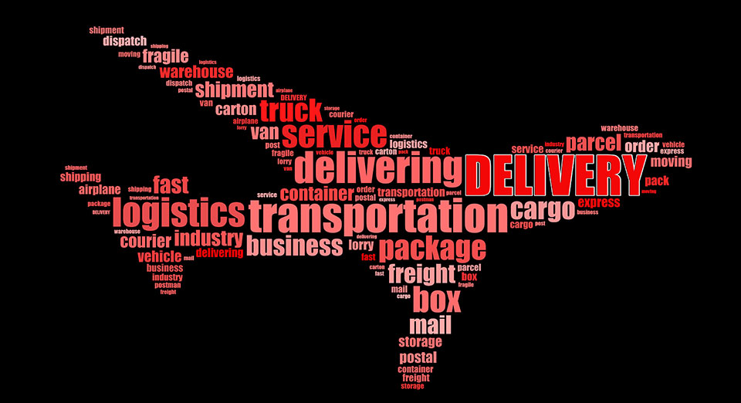
Delivery Model

Slide 21
DELIVERY MODEL
Onsite
offshore
hybrid
GLOBAL ENGAGEMENT MODEL
Proven Engagement Model for Delivering Reliable Solutions & Services across the globe
Local resources across the globe
On-demand Service & Support
ISO in various countries Certified, Tested and Delivered
On-site, Off-site, Off-shore and Near Shore delivery models
250+ skilled professionals serving customers
Application Managed Services

Slide 22

Why Merino
An Unbiased & Customer centric company

Slide 23








WHY MERINO
12+ years of rich experience handling vivid industries, distinguish complexities .
A complete technology solutions partner covering a comprehensive range of enterprise and IT solutions.
Having a manufacturing unit of our own, provides us with the essential know-how to guide businesses better.
Committed
Collaboration
Speed
Cost Efficient
Experience
Flexibility
Innovation
Global Offices

Slide 24

Thank you
Contact us:
Merino Services Limited
Corporate Office 70, KLJ Complex, Moti Nagar, New Delhi – 110015, India
+91 11 45068300
@
contact@merinoindia.com
INDIA USA EUROPE UAE SINGAPORE MALAYSIA INDONESIA

