Slide 1
Economу of Kyrgyzstan (1995–2024)
Data Analysis and Visualization

Slide 2
Introduction
In this analysis, we will explore key economic indicators of Kyrgyzstan from 1995 to 2024, with a focus on:
- Population Growth
- GDP and its Growth
- Inflation and Unemployment
- Average Salary
- Trade Balance (Exports vs Imports)
- Government Debt
The goal is to understand the trends, challenges, and opportunities in Kyrgyzstan's economy over the past 30 years.

Slide 3
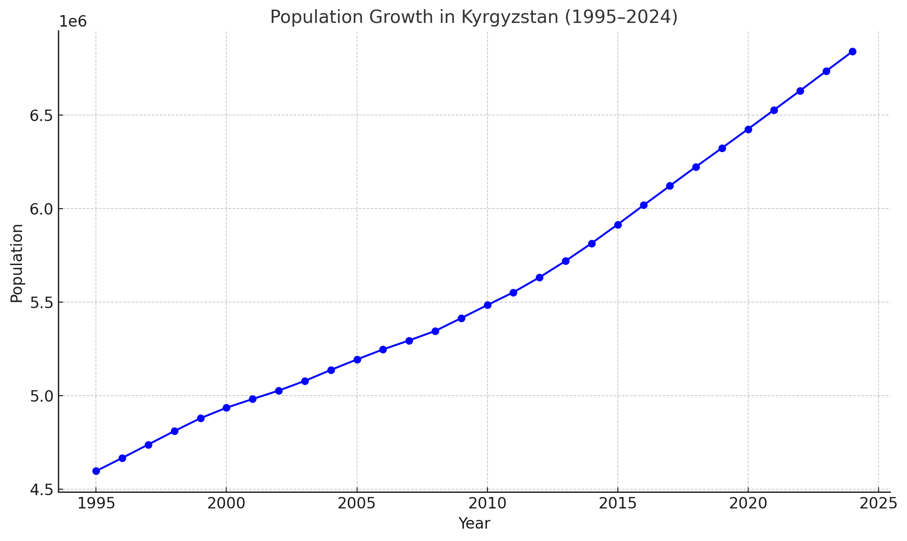
Population Growth
This graph shows the population growth of Kyrgyzstan from 1995 to 2024. The population increased from around 4.6 million to over 7 million. The steady growth is a key demographic factor influencing the economy, impacting sectors like healthcare, education, and infrastructure.

Slide 4
GDP
Gross Domestic Product (GDP) is a fundamental economic indicator used to gauge the total economic output of a country. For Kyrgyzstan, GDP represents the total value of all goods and services produced within its borders during a specified period, usually annually or quarterly.

Slide 5
Post-Independence Economy (1991 - 2000):
After gaining independence in 1991, Kyrgyzstan faced economic difficulties, primarily due to the dissolution of the Soviet Union and the loss of subsidies and trade agreements that had previously supported the economy. This period saw a sharp decline in GDP.
Recovery and Growth (2000 - 2010):
Starting from the early 2000s, Kyrgyzstan experienced steady growth in its GDP, spurred by structural reforms, privatization of state-owned industries, and increasing remittances from Kyrgyz citizens working abroad, especially in Russia and Kazakhstan.
Post-2010 Economic Growth:
From 2010 onwards, Kyrgyzstan's economy grew steadily, albeit with volatility due to external factors, such as global commodity price fluctuations and regional instability.
Recent Developments (2010 - 2024):
In recent years, GDP growth has been relatively strong, but it remains vulnerable to external shocks such as global price changes and the COVID-19 pandemic.

Slide 6
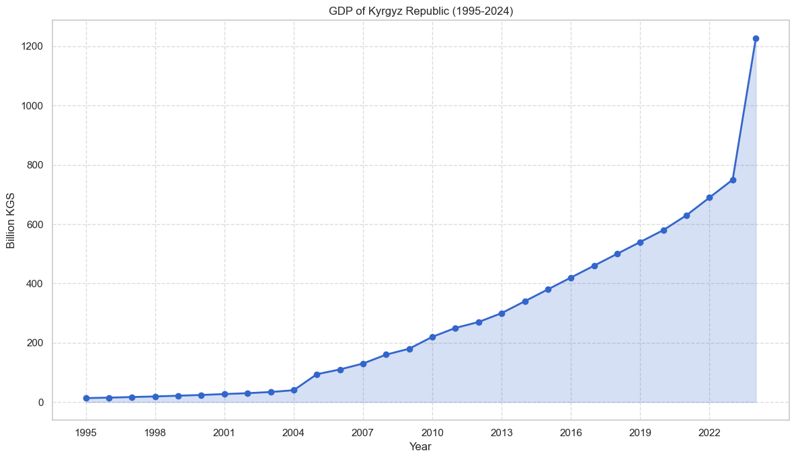
GDP Growth
The GDP of Kyrgyzstan shows significant growth, especially after 2010. Key periods of economic recovery and growth are observed after the 2008 financial crisis and during the 2010s. Fluctuations are influenced by both domestic factors (reforms, investments) and global economic conditions.

Slide 7
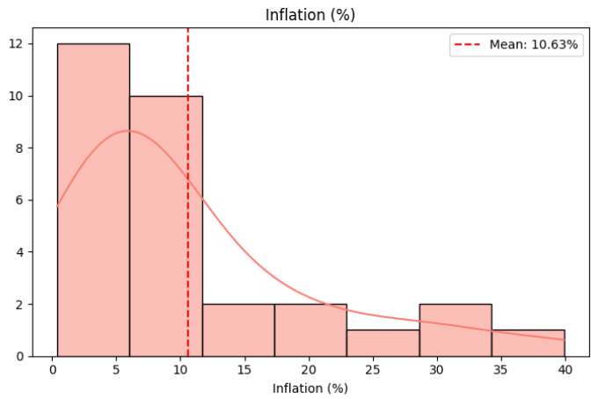
Inflation Rate
Inflation has had varying trends over the years, with high rates in the late 1990s (up to 39.9% in 1999). Since then, inflation has been controlled, with rates stabilizing after the early 2000s. The inflation rate is important for understanding purchasing power and cost of living in the country.

Slide 8
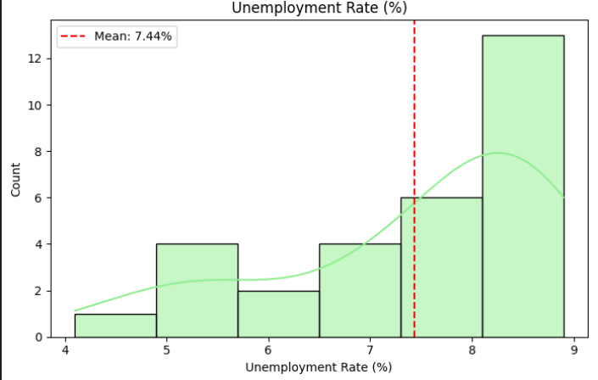
Unemployment Rate
The unemployment rate has remained relatively stable, with only small fluctuations. Despite this, there have been years of minor spikes, particularly during global financial crises. The stable unemployment rate indicates some resilience in Kyrgyzstan's labor market.

Slide 9
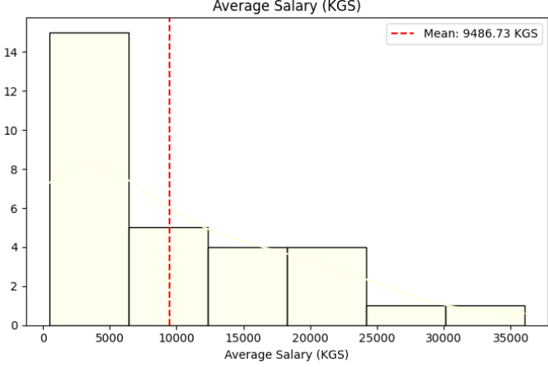
Average Salary
The average salary in Kyrgyzstan has been increasing since 1995, from 500 KGS to nearly 10,000 KGS by 2024. This increase in income reflects improvements in the labor market, but it also indicates the rising cost of living. Comparing salary increases to inflation helps assess the real growth in household purchasing power.

Slide 10
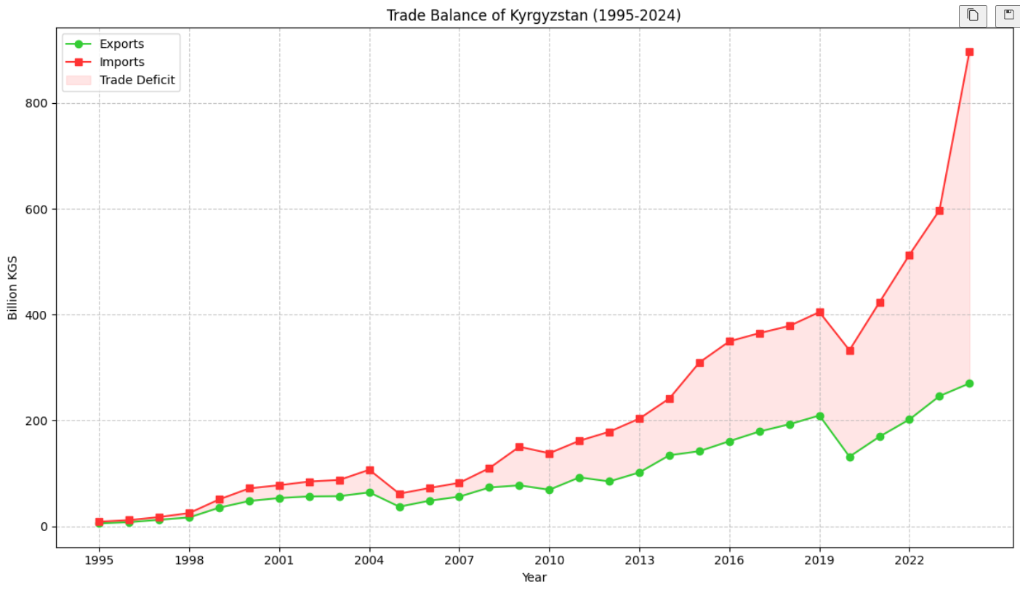
Exports vs Imports
The graph comparing exports and imports shows that Kyrgyzstan has consistently had a trade deficit. Imports have outpaced exports, leading to a dependency on foreign goods. This trade imbalance has significant implications for the country's balance of payments and overall economic stability.

Slide 11
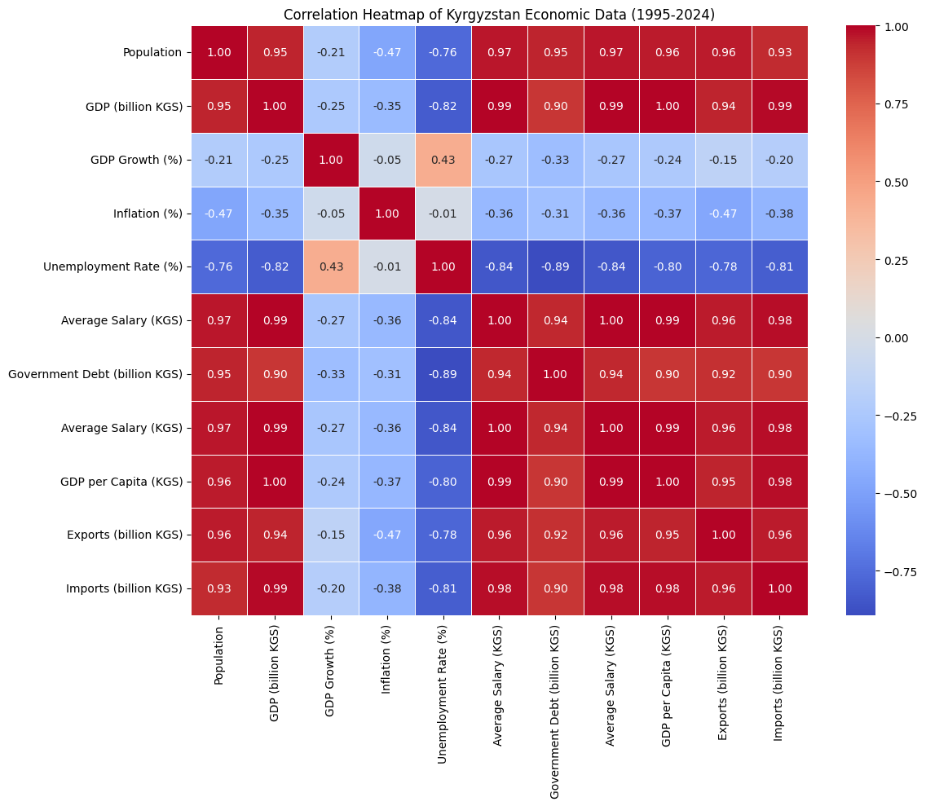
Government Debt

Slide 12
Government Debt
The government debt has grown steadily over the years, with an accelerated increase in the past decade. While this growth in debt could be attributed to increased investments in infrastructure and economic development, it poses concerns about fiscal sustainability and future debt servicing challenges.

Slide 13
Key Insights from the Correlation Matrix:
GDP (billion KGS) and Population (0.95):
Strong positive correlation, meaning as the population increases, the GDP tends to grow as well. This suggests that a larger population may contribute to higher economic activity.
GDP and Average Salary (0.99):
Extremely high positive correlation, showing that as the GDP increases, the average salary also tends to rise. This indicates a direct relationship between the economic output and the wage levels in Kyrgyzstan.
GDP Growth (%) and Unemployment Rate (-0.82):
A strong negative correlation, meaning that when the economy grows, unemployment tends to decrease. This is a typical inverse relationship, where economic growth creates more jobs and reduces unemployment.
Inflation and Unemployment Rate (0.43):
A moderate positive correlation, suggesting that periods of higher inflation are somewhat linked to higher unemployment, though the relationship is not very strong.
Average Salary (KGS) and Government Debt (0.90):
A strong positive correlation, indicating that as government debt increases, the average salary tends to rise as well. This may suggest that increased government spending (often linked with rising debt) supports higher wages, possibly due to investments in infrastructure and public services.
Exports and Imports (0.96):
A very strong positive correlation, showing that as imports increase, exports also tend to increase. This might suggest that Kyrgyzstan's import-dependent economy also drives export growth, potentially due to trade agreements and the economic structure.
GDP per Capita and Population (0.96):
Strong positive correlation. As the population grows, GDP per capita also tends to increase, which typically means a more productive or developed economy.
Exports and Government Debt (0.92):
A strong positive correlation, which could indicate that government debt is somewhat associated with the country’s ability to manage its exports, possibly due to investments that support international trade.
Inflation and Imports (-0.78):
A negative correlation, suggesting that when inflation is high, imports tend to decrease. This could be because higher inflation may reduce the purchasing power of consumers and businesses, making imports less affordable.
Exports and Average Salary (0.96):
Strong positive correlation, indicating that as exports increase, wages (especially in sectors related to international trade) also tend to rise.

Slide 14
conclusion
This project offered a detailed look at Kyrgyzstan’s economic journey from 1995 to 2024. Through data cleaning, statistical analysis, and visualizations, we explored trends in GDP, inflation, salaries, unemployment, and trade.
We observed strong GDP and salary growth over time, reflecting economic improvement. Early challenges included high inflation and a trade imbalance, but recent years show greater stability. Correlation analysis confirmed key relationships, such as GDP’s strong link with income levels.
Overall, this project highlights how data science can turn complex economic data into clear insights, helping us better understand national development and long-term trends.

