Slide 1

Legal Aspects of Business

Slide 2

INDIAN CONTRACT ACT 1872
Business comprises buying and selling of goods or services, and the sale or purchase of anything constitutes an important contract
Law of contract regulates all commercial activities by sorting out the promise that are enforceable and how they can be enforced.

Slide 3

CONTRACT
Sec 2(h) – “ An agreement enforceable by law is a contract”.
Two elements -
  An Agreement
  Legal obligation ie, a duty enforceable by law.

Slide 4
Agreement
Sec 2(c) – “Every promise and every set of promises forming the consideration for each other, is an agreement.” (mutuality)
Promise – What is a promise?
Sec 2(b) – “A proposal (offer), when accepted, becomes a promise.” (accepted offer)

Slide 5
Agreement
Starting point of a contract is a promise or (an agreement).
The formation of an agreement requires consenus ad idem, ie, meeting of minds between parties –parties must agree upon the same thing in the same sense.

Slide 6

Example
A offers to sell his car for Rs 10,00,000 to K. K accepts this offer. This offer after acceptance becomes promise and this promise is treated as an agreement between A and K
Therefore, an agreement consists of an offer by one party and its acceptance by the other.
Agreement = Offer + Acceptance of offer

Slide 7

Enforceability of Agreement
An agreement is said to be enforceable by law if it creates a legal obligation.
Obligation is a legal tie which imposes upon determinate person or persons the necessity of doing or abstaining from doing a definite act or acts
If an agreement is incapable of creating a duty enforceable by law, it is not a contract.
Thus, an agreement is a wider term than contract

Slide 8
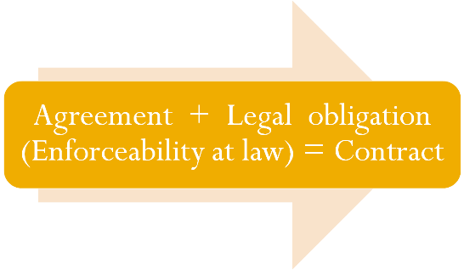

Slide 9
The process of making contract
Offer or proposal
acceptance
promise
agreement
contract

Slide 10
Contract Act
“All contracts are agreement but all agreements are not contracts”.
Agreements of moral, religious or social nature are not contracts
  they are not likely to create a duty enforceable by law
  parties never intend to create a legal obligation.

Slide 11
Contd -
Ex;
  X invites his friend Y to a dinner and Y accepts the invitation. If Y fails to turn up for the dinner. Can he take his friend to Court????
    ????
  A father promises to pay his daughter Rs 1000 as pocket allowance. Later he refuses to pay. Can the daughter recover the Amount???
    ???

Slide 12
Contd
In commercial or business agreements an intention to create legal relations is presumed. Thus, an agreement to buy and sell goods intends to create legal relationship, hence is a contract, provided other requisites of a valid contract are present. But if the parties have expressly declared their resolve is not to create a legal obligation, even a business agreement does not amount to a contract.

Slide 13
Case
Rose&Frank Co. vs Crompton & Bros [1925 AC 445]
  There was an agreement between R company and C company by means of which the former was appointed as the agent of the latter. One clause in the agreement was: ”This agreement is not entered into….as a formal or legal agreement and shall not be subject to legal jurisdiction in the law courts.”
    HELD - There was no binding contract as there was no intention to create legal relationship

Slide 14
Distinction between an agreement and a contract
Agreement
  Offer and its acceptance constitute an agreement
  An agreement may or may not create a legal obligation
  Every agreement need not necessarily be a contract
  Agreement is not necessarily legally enforceable
Contract
  Agreement and its enforceability constitute a contract
  A contract necessarily create a legal obligation
  All contracts are necessarily agreements.
  Contract is legally enforceable

Slide 15

Valid Contract
Essentials

Slide 16
Essential elements of a valid contract
Proper offer and its proper acceptance
Free Consent
Capacity to contract
Lawful consideration
Lawful object
Agreement not expressly declared void
Certainty of meaning
Possibility of performance
Legal formalities

Slide 17
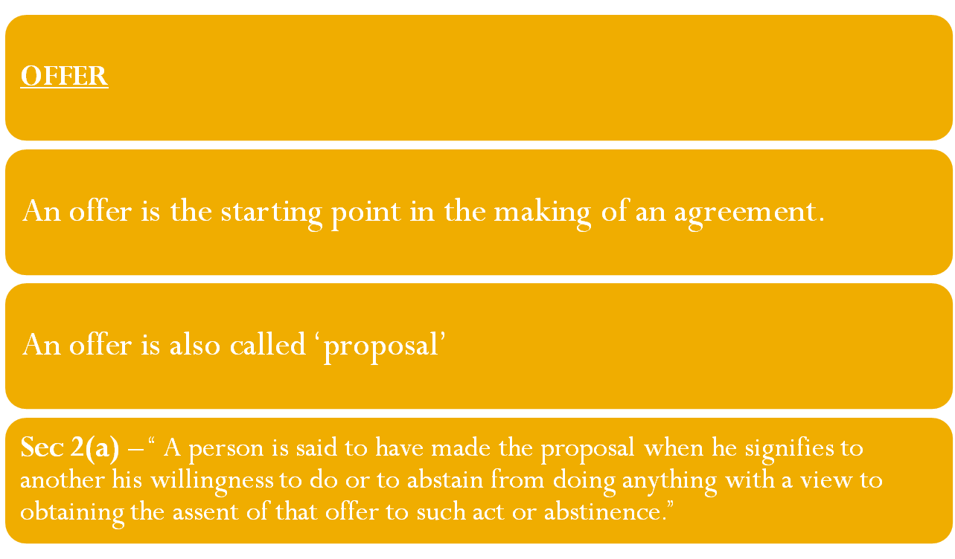
Offer and acceptance

Slide 18

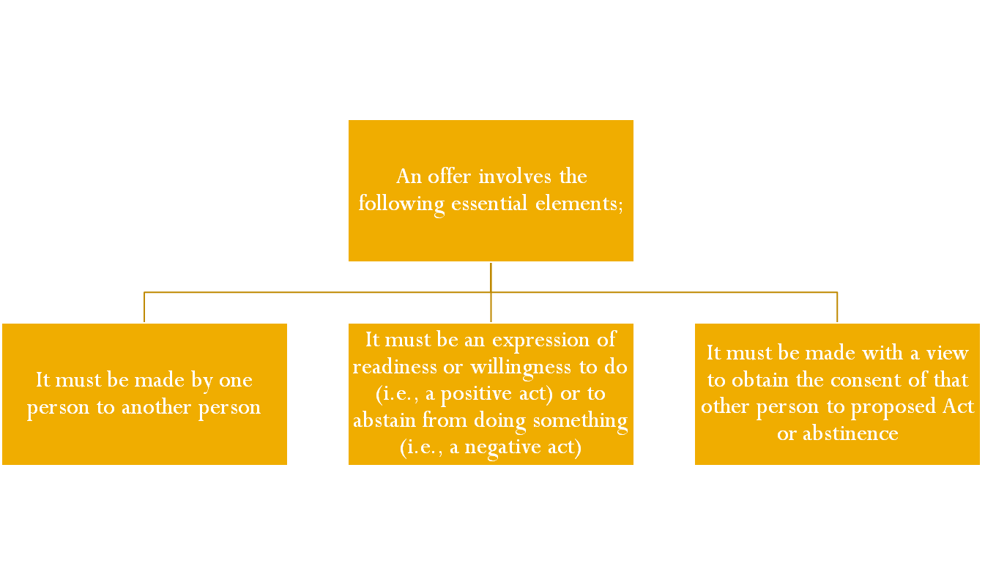
OFFER

Slide 19
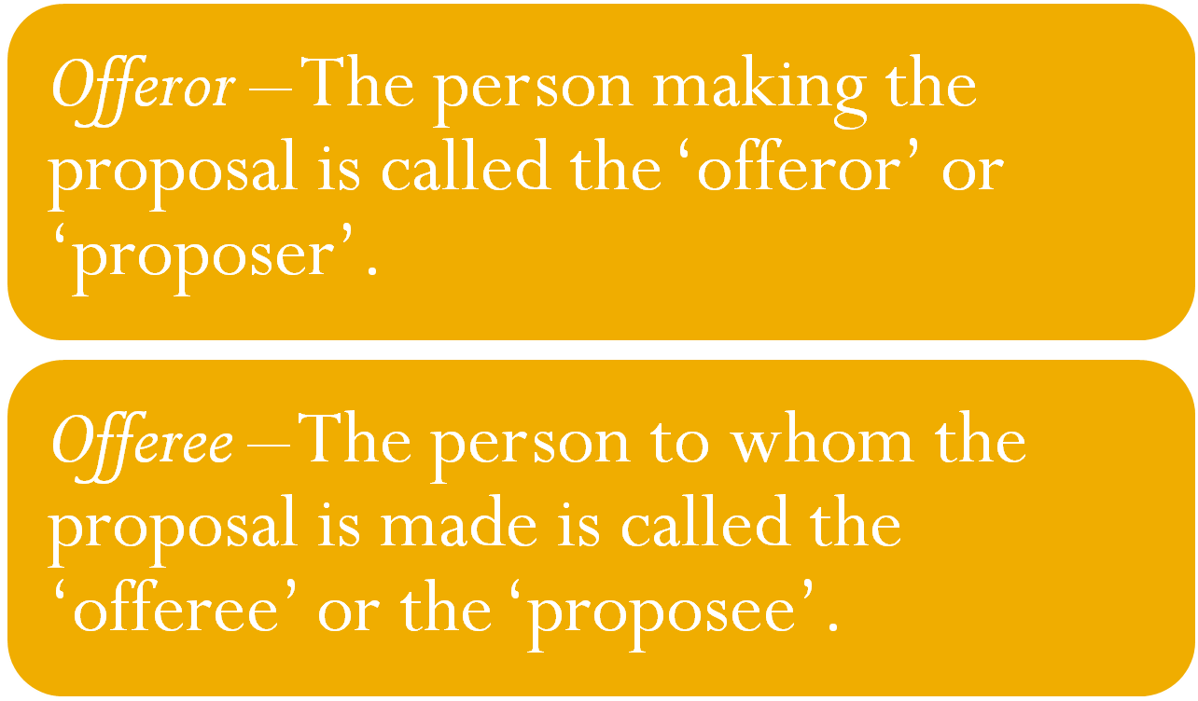
Contd

Slide 20
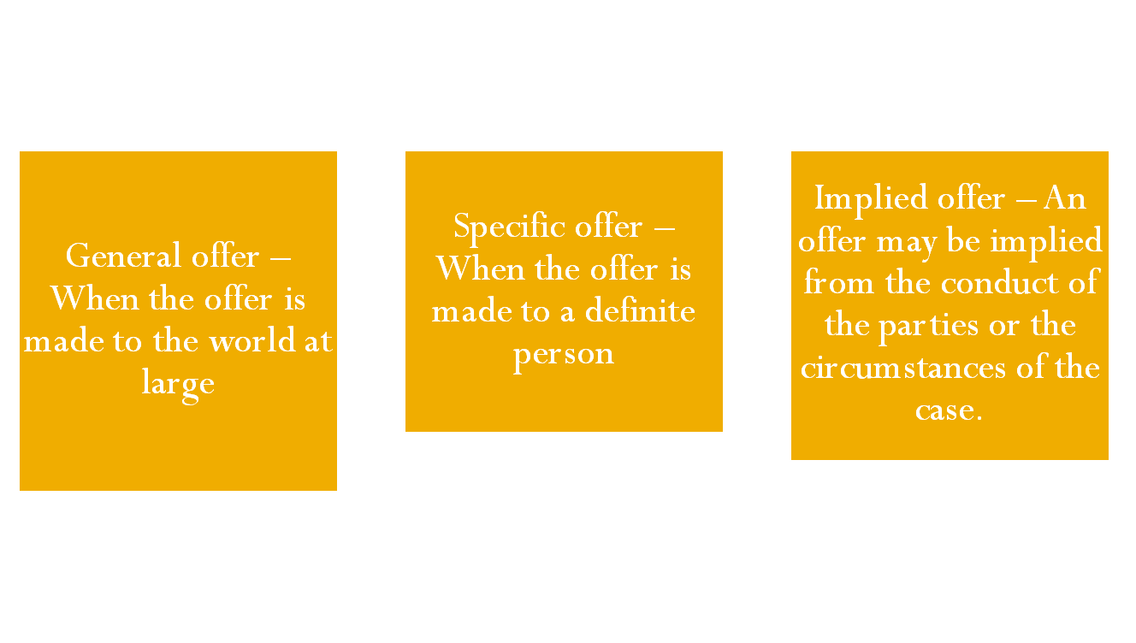
Types of offer
(Carlill vs Carbolic Smoke Ball Co.)

Slide 21
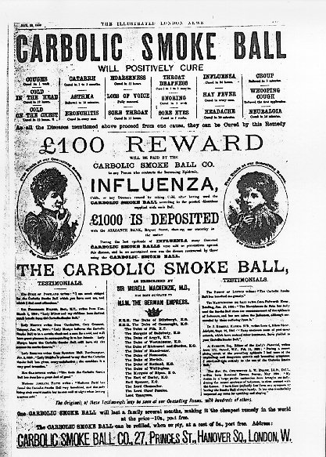
Carlill v Carbolic Smoke Ball Company

Slide 22
Carbolic Smoke Ball Co., issued an advertisement in which the company offered to pay 100 pound to any person who contracts influenza, after having used their Smoke Balls 3 times daily for 2 weeks, according to the printed directions. Mrs. Carlill, on the faith of the advertisement, bought and used the Balls according to the directions and suffered from influenza. She sued the company for the promised reward and the company was held liable.

Slide 23
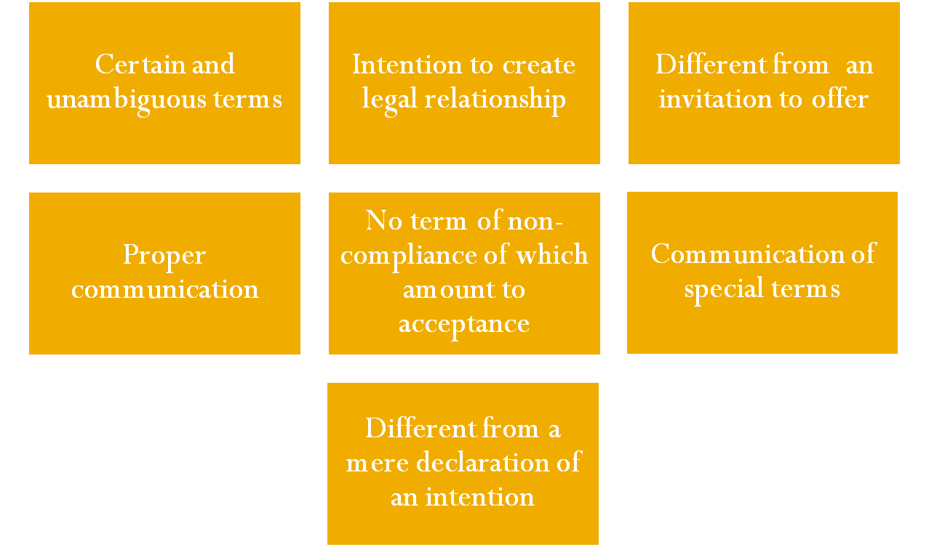
Legal rules as to offer

Slide 24
Contd-
Intention to create legal relationship
  An offer must be such that when it is accepted it will create a legal relationship
Certain and unambiguous terms
  If the terms of the offer are vague or indefinite, its acceptance cannot create any contractual relationship.

Slide 25
Contd -
Different from an invitation to offer
  In an invitation to offer the person making an invitation invites others to make an offer to him
  It is prelude to an offer inviting negotiations or preliminary discussions
  Example:
  Display of goods in showrooms

Slide 26
Case
  Auction Sale
  Case: Harris vs Nickerson
  An auctioneer advertised in a newspaper that a sale of office furniture would be held. A broker came from a distant place to attend that auction, but all the furniture was withdrawn. The broker thereupon sued the auctioneer for his loss of time and expenses.
  Held - Auctions are invitation to treat and not offers.

Slide 27
Contd-
Offer must be communicated
  An offer must be communicated to the person to whom it is made.
  An offer is complete only when it is communicated to the offeree
  Acceptance is not possible unless offer is brought to the knowledge of the offeree. ie, One can accept the offer only when he knows about it.
  Acceptance in ignorance of offer confers no right. ie, An offer accepted without its knowledge does not confer any legal rights on the acceptor.
  Case: Lalman Shukla vs Gauri Dutt

Slide 28
Contd -
No term of non-compliance of which amounts to acceptance
  The offer must not contain a term, the non-compliance of which amount to acceptance
  Ex: A offers by post to sell his horse to B for Rs 2000. He writes, “ If you do not reply, I shall assume you have accepted the offer.” There would be no contract even if B does not reply

Slide 29
Contd
  While making the offer, the offeror cannot say that if the offer is not accepted before a certain date, it will be presumed to have been accepted
Communication of special terms or standard terms of contract
  Special terms of the offer must also be communicated along with the offer.
  If the special terms of the offer are not communicated, the offeree will not be bound by those terms.
(Thomson vs. L.M & S. Railway)
(Handerson vs. Stevenson)

Slide 30
Example 1
In Thomson vs LM. & S. Railway, the plaintiff who was an illiterate took a railway excursion ticket. The face of the ticket specifically mentioned, `For conditions see back'. One of the conditions printed on the reverse of the ticket was that the Railway Company would not be liable for personal injuries caused to passengers. The court held that the plaintiff was bound by the conditions and could not recover any damages.

Slide 31
Example 2
In Handerson vs Stevenson, the plaintiff bought a steamer ticket for travelling from Dublin to Whitehaven. The face of the ticket read, 'Dublin to Whitehaven' only, and on the reverse were printed certain conditions, one of which excluded the liability of the company for loss, injury, or delay of the passenger or his/her luggage. The plaintiff did not read the reverse side of the ticket nor was there any indication on the face of the ticket to draw his attention to the conditions printed on the backside. His luggage got lost in the shipwreck due to negligence on the part of the crew. The court held that the plaintiff was entitled to compensation for the loss of his luggage despite the exemption clause.

Slide 32
Acceptance
Acceptance means giving consent to the offer.
It is an expression by the offeree of his willingness to be bound by the terms of the offer.
Sec 2(b) – “ A proposal is said to be accepted when the person to whom the proposal is made signifies his assent thereto. A proposal when accepted becomes a promise.”
Acceptance is the consent given to offer.

Slide 33
Contd-
Who can accept
  In case of a specific offer –
    To be accepted by that definite person or that particular group of persons to whom it has been made and none else.
  In case of general offer –
    An offer made to the world at large or public in general can be accepted by any person having the knowledge of the offer by fulfilling the terms of the offer.

Slide 34
Contd -
How to make acceptance –
  Express acceptance –
    An express acceptance is one which is made by words spoken or written
  Implied acceptance –
    An implied acceptance is one which is made otherwise than in words.
    It is inferred from the conduct of the parties or the circumstances of a particular case

Slide 35
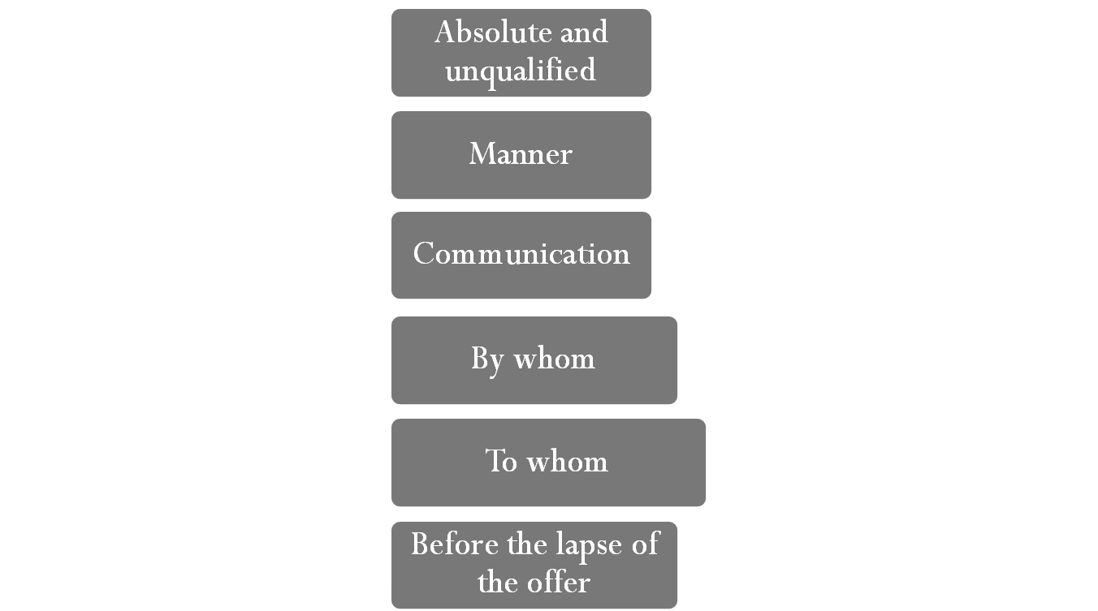
Legal rules of valid acceptance

Slide 36
Communication of offer, acceptance and revocation
Must be complete so as to bind the concerned parties because as soon as the communication is complete the parties loose the right of withdrawal or revocation.

Slide 37
Communication of Offer
The communication of an offer is complete when it comes to the knowledge of the person to whom it was made (Sec 4)
Eg.: A proposes, by a letter, to sell a house to B at a certain price. The letter is posted on 1st May and reaches B on 3rd May.The communication of the proposal is complete when B, the offeree, receives the letter, i.e., on 3rd May.

Slide 38
Communication of Acceptance
The communication of acceptance is complete for
  The proposer, when it is put in a course of transmission to him, so as to be out of the power of the acceptor (i.e., when letter of acceptance is mailed by the acceptor)
  The acceptor, when it comes to the knowledge of the proposer (i.e., when it reaches the offeror).

Slide 39
Example
Case: Brogden vs Metropolitan Railway Co.
  B had been supplying coal to a railway company without any formal agreement. Later on both parties met and a draft agreement was drawn. The agreement was approved by B and then sent to the railway company for acceptance. The agent of the railway company however put the draft in the drawer and forgot.
  Held as acceptance was never communicated to the offeror.

Slide 40
Communication of Revocation of Offer or Acceptance
The communication of revocation is complete for the person revoking it when the letter of revocation is posted, and for the person to whom it is made when the letter of revocation reaches him.

Slide 41
Excercise
X makes an offer by a letter to Y on a particular day. 2 days later, X revokes his offer through email. The email reaches the offeree Y after the letter. Will the offer deemed to have been revoked?
  Yes, provided the letter of acceptance has not been posted.

Slide 42
Consideration

Slide 43


Consideration
Without which no single promise is enforceable
A technical term used in the sense of quid pro quo (ie, something in return).
When a party promises to do something he must get ‘something in return’. This something is defined as consideration.

Slide 44
Section 2(d)
When at the desire of the promisor, the promisee or any other person has done or abstained from doing, or does or abstains from doing, or promises to do or abstain from doing something, such act or abstinence or promise is called a consideration for the promise

Slide 45
Contd -
Ex – X promises to deliver the goods to Y and Y promises to pay Rs 1000 on delivery. In this case, the consideration for each of these promises is as under:
  For X’s promise - Y’s promise to pay Rs 1000 on delivery
  For Y’s promise – X’s promise to deliver the goods

Slide 46
Contd.
Ex – A promises his debtor B not to file a suit against him for one year on B’s agreeing to pay him Rs. 100 more. The abstinence of A is the consideration for B’s promise to pay.

Slide 47
Contracts without consideration(Exceptions to general rule,no consideration, no contract )
Agreements made on account of natural love and affection
Promise to compensate for past voluntary service

Slide 48
Legality of the object and consideration

Slide 49
Legality of the object and consideration
Object and consideration of contract must be lawful, otherwise the agreement is void
Consideration or object of contract is unlawful in the following cases:
  (a) If it is forbidden by law
  (b) If permitted, it would defeat the provisions of any law
  (c) If it is fraudulent
  (d) If the court regards it as immoral or opposed to public policy

Slide 50
Examples
A. Sale of liquor without license is prohibited under the Excise Act.
B. A’s estate is sold for arrears of revenue under the provisions of an Act of Legislature, by which deafaulter is prohibited from purchasing the estate. B purchased on behalf of A. Held.

Slide 51
Contd-
If considerations and objects unlawful or in part are unlawful,.
Effect: the agreement is void
Example:
  A promises to superintend, on behalf of B, a legal manufacture of plants, and an illegal trafficker in other parts. B promises to pay to A a salary of Rs. 10,000 a month.
  The agreement is void,
  the object of A’s promise, and the consideration for B’s promise, being in part unlawful.

Slide 52
Agreements opposed to the public policy
Agreements of trading with the enemy
Agreement of stifling prosecution
Agreement in restraint of parental rights
Agreement in restraint of personal liberty
Agreements in restraint of trade

Slide 53
Free Consent

Slide 54
Free consent
It is essential to the creation of the contract that the parties are ad idem, ie, they agree upon the same thing in the same sense at the same time and their consent is free and real.
Consent means an act of assenting to an offer.

Slide 55

Sec 13
“Two or more persons are said to consent when they agree upon the same thing in the same sense.”
Effect of absence of consent – When there is no consent at all, the agreement is void ab-intio, ie, it is not enforceable at the option of either party.

Slide 56
FREE CONSENT
Two or more persons are said to consent when they agree upon the same thing in the same sense. (Section 13)
Example: A agreed to sale car to B. But A has two cars X and Y. A thought of selling car X whereas B thought of purchasing car Y.
no consent =>no contract as there was no meeting of mind

Slide 57
Free consent
Sec 14
  Consent is said to be free when it is not caused by (a) coercion (b) undue influence (c) fraud (d) misrepresentation or (e) mistake
No free consent – contract is usually voidable at the option of the party whose consent was not free.

Slide 58
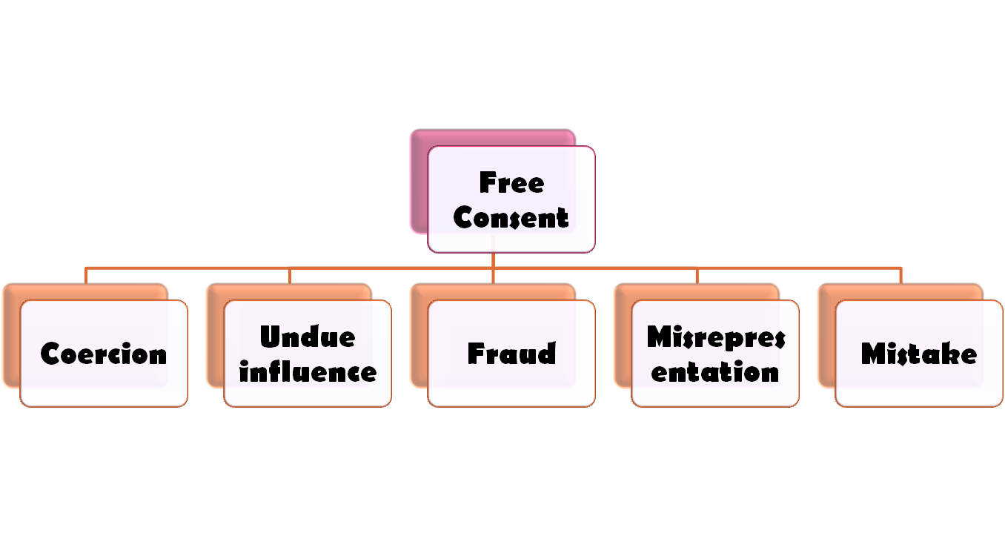
Contd-

Slide 59

Coercion
Sec 15
  A contract is said to be caused by coercion if it is obtained by
    (a) committing any act which is forbidden by the Indian Penal Code (E.g., Committing murder, kidnapping etc.)
    (b) threatening to commit any act which is forbidden by the Indian Penal Code (E.g., Obtaining consent at gunpoint)
    (c) Unlawful detaining of any property
    (d) threatening to detain any property

Slide 60
Case (C)
Muttiah Chettiar vs Koruppen Chetty
(1927) 50 Mad 786
An agent secured a release from liabilities from his principal by refusing to hand over the books of account to the new agent. The release deed was held to be voidable of the option of the principal.
Effect of coercion: Contract is voidable at the option of the party whose consent has been caused by coercion.

Slide 61
Case (d)
Ranganayakam vs Alwar Shetty, (1889) 13 Mad 214
The relatives of a young widow threatened her that they would not allow her to burn the dead body of her husband unless she consented to the adoption of a boy as her son. The widow adopted the boy and subsequently applied for cancellation of the adoption.
Held: The consent was not free, on account of coercion. Obstructing dead body from being removed for cremation is an offence u/s 297 of the I.P.C.

Slide 62

Undue influence
Dominating the will of the other person to obtain an unfair advantage over the other
Sometimes the parties to the agreement are related in such a way that one of them is able to dominate the will of the other.
It creates a mental or moral fear created by coercion. Consequently the party on whom undue influence is exercised is indirectly compelled to enter into the contract

Slide 63
Contd-
Ex: A, having advanced money to his son B during his minority, obtains, by misuse of parental influence, a bond from B of a greater amount than the sum due in respect of the advance, upon B’s coming of age. A thus employed undue influence

Slide 64
Presumption of Domintation of Will
A person is deemed to be in a position to dominate the will of another
Where he holds authority over the other
  E.g., Father and son
  Master and servant
  Police officer and culprit etc.
Where he stands in a fiduciary relationship (it refers to relationship based on trust and confidence) to the other
  E.g., Doctor and patient
  Solicitor and client
  Spiritual guru and devotee
  Guardian and child

Slide 65
Fraud-Sec 17
"Fraud" indicates wilful misrepresentation. It means and includes any of the following acts committed by a party to a contract, or with his connivance, or by his agent, with intent to deceive another party thereto of his agent, or to induce him to enter into the contract:-
(1) the representation that a fact is true when it is not true by one who does not believe it to be true;
(2) the active concealment of a fact by one having knowledge or belief of the fact;
(3) a promise made without any intention of performing it
(4) any other act fitted to deceive;
(5) any such act or omission as the law specially declares to be fraudulent.

Slide 66
Can silence be fradulent?
Mere non-disclosure is not fraud, when there is no duty to disclose. Caveat Emptor or ‘Buyer Beware’ is the principle in all contracts of sale of goods.
Explanation.- Mere silence as to facts likely to affect the willingness of a person to enter into a contract is not fraud, unless the circumstances of the case are such that, regard being had to them, it is the duty of the person keeping silence to speak, or silence is, in itself, equivalent to speech.

Slide 67
Illustrations
a) A sells, by auction, to B, a horse which A knows to be unsound. A says nothing to B about the horse's unsoundness. This is not fraud in A.
(b) B is A's daughter and has just come of age. Here, the relation between the parties would make it A's duty to tell B if the horse, is unsound. – (Exception)
  Examples of fiduciary relationship: Principal & agent, solicitor & client, guardian & ward, trustee & beneficiary

Slide 68
Contd-
(c) B says to A - "If you do not deny it, I shall assume that the horse is sound." A says nothing. Here, A's silence is equivalent to speech. (Exception)
(d) A and B, being traders, enter upon a contract. A has private information of a change in prices which would affect B's willingness to proceed with the contract. A is not bound to inform B.

Slide 69
More exceptions
Contracts of insurance
Share allotment contracts

Slide 70
Effect
Suit for recission
Suit for damages for fraud
Right of recession lost if—
Affirmation of the contract even after becoming aware of the fraud

Slide 71

Misrepresentation
A false representation of fact made innocently (unlike fraud) or non-disclosure of a material fact without the intention to deceive the other party
Aggrieved party can avoid or rescind the contract

Slide 72
Contd-
Ex: A tells B, without checking records, that in his factory 1000 quintals of rice is produced every month. A believes his assessment to be true. The actual production is found to be only 830 quintals. A is guilty of misrepresentation.
Effect: Right to rescind the contract

Slide 73
Mistake
A wrong idea or opinion about something caused by lack of attention, skill or knowledge etc.

Slide 74
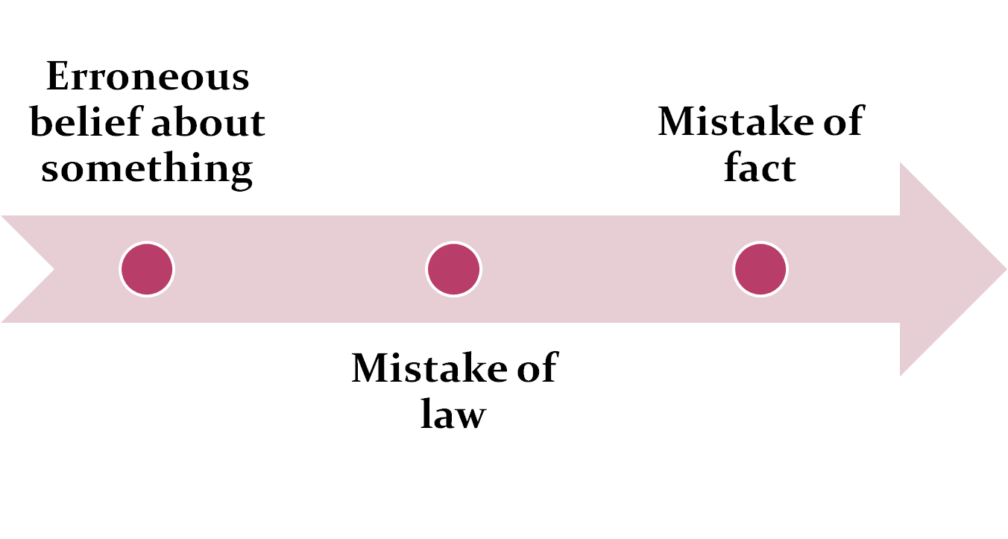
MISTAKE

Slide 75
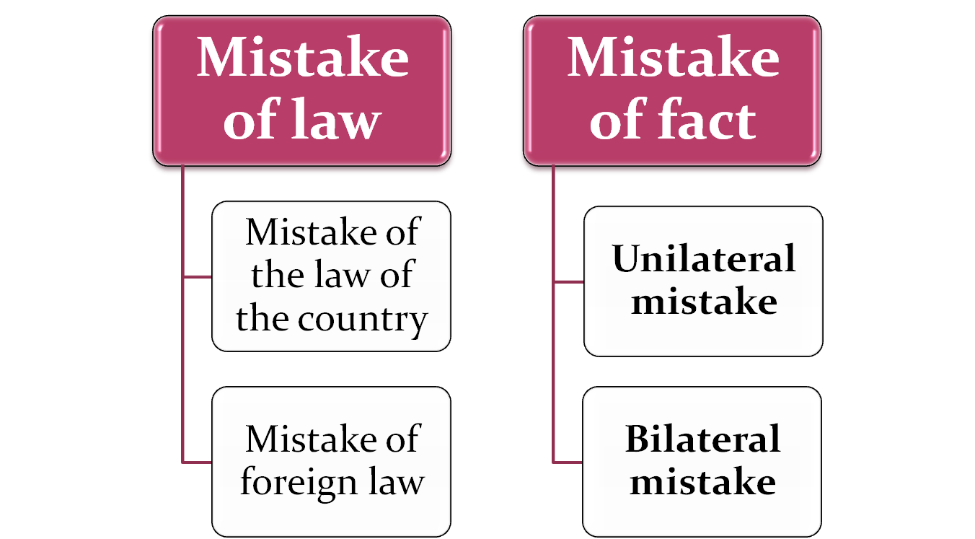
Mistake

Slide 76
Mistake
Bilateral/Mutual Mistake of Fact
If both parties to an agreement are under a mistake as to a matter of fact essential to the agreement
  Effect: Void Agreement
Mistake as to the existence of the subject-matter of the agreement.

Slide 77
ESSENTIAL OF A VALID CONTRACT
FREE CONSENT (MISTAKE)
Examples
A agrees to sell to B a specific cargo of goods supposed to be on its way from England to Bombay. It turns out that, before the day of the bargain, the ship conveying the cargo had been cast away and the goods lost. Neither party was aware of the facts. The agreement is void.
A agrees to buy from B a certain horse. It turns out that the horse was dead at the time of the bargain, though neither party was aware of the fact. The agreement is void.

Slide 78
Unilateral Mistake
If only one party is under Confusion, it is called Unilateral Mistake. In case of Unilateral Mistake Contract cannot be avoided.
Example: A wants to sell away his house at a price of $6000. He makes an offer to B and by mistake he quotes a price of $5000 to which B gives his acceptance. Here only A is under mistake. It is Unilateral mistake and Contract cannot be avoided.

Slide 79
Capacity to Contract

Slide 80
Capacity:
Ability to do something, such as the mental ability to make a rational decision.
Why capacity is important?
If a plaintiff seeks to enforce a contract, he must prove that the defendant had legal capacity to enter into a contract. Capacity is an essential element of a contract because it shows that a party understood the contractual obligation.

Slide 81
Capacity of parties - Sec 11
Who are competent to contract
Every person is competent to contract who is
  of the age of majority according to the law to which he is subject, and
  who is of sound mind and
  is not disqualified from contracting by any law to which he is subject.

Slide 82
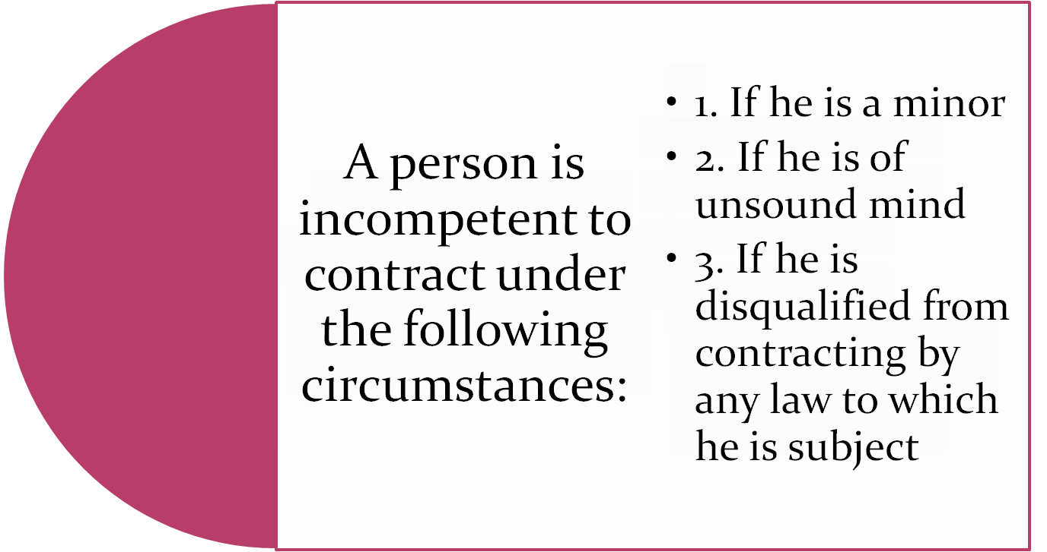
Contd -

Slide 83


Minor
Person domiciled in India, who is under 18 years of age.
Law protects minor’s rights because they are not mature and may not possess the capacity to judge what is good or what is bad

Slide 84
Position of minor’s agreement
Validity – An agreement with a minor is void-ab-intio
  Case – Mohiri Bibee vs Dharmdas Ghosh
  A minor executed a mortgage for Rs. 20000 and received Rs. 8000 from the mortgage. The mortgagee filed a suit for the recovery of his mortgage money and for sale of the property in case of default. The court held that agreement by a minor is absolutely void against him.

Slide 85
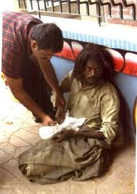


Position of persons of unsound mind
Who is a person of unsound mind
  Sec 12 - A person is said to be of sound mind for the purpose of making a contract, if at the time when he makes it, he is capable –
    (a) to understand the terms of the contract.
    (b) to form a rational judgment as to its effect upon his interests
    Ex ; idiots, lunatic, drunken person

Slide 86

Position of agreements with persons of unsound mind
Persons of unsound mind
1. Lunatic
(a) while he is of unsound mind
Capacity to contract
He cannot enter into any contract. Any agreement entered into by him during this period is altogether void and he cannot be held liable thereon

Slide 87
Contd-
b) While he is of sound mind
(II) Idiots
He can enter into a valid contract and he is liable for such contract.
He cannot enter into any contract. Any agreement entered by him is void and he is not liable thereon

Slide 88


Contd
Drunken person
He cannot contract while such delirium or drunkenness lasts

Slide 89
Persons disqualified by law
Alien enemies – cannot enter into any contracts
Foreign sovereigns and ambassadors – can enter into contracts
    enforce those contracts in our courts
    but cannot be sued in our courts without the sanction of the central government
Convicts – Cannot enter into any contract during the period of the sentence

Slide 90
Example of Alien
X, an Indian carries on a business in Pakistan. He enters into a contract with Y who carries on business in India. Immediately after the formation of the contract, a war broke out between India & Pakistan. In this case X becomes an alien enemy though he is an Indian and the contract between X & Y (if not against public policy) will be suspended for the duration of the war and revived after the war is over.

Slide 91
Contd -
Company –
  Contractual capacity is determined by the ‘object clause’ of the memorandum of association.
  Any act done in excess of the power given is ultra vires [(i.e) beyond the power] and hence void.
Insolvent –
  Cannot enter into contracts relating to his property.
  When the insolvent is discharged the disqualification is removed.

Slide 92
Other essentials
Certainty of meaning – terms of contract must be unambiguous

Slide 93
Examples of uncertain/certain agreements
(a) A agrees to sell to B " a hundred tons of oil ".
The agreement is void for uncertainty. There is nothing whatever to show what kind of oil was intended.
(b) A, who is a dealer in coconut-oil only, agrees to sell to B
"one hundred. tons of oil".
The nature of A’s trade affords an indication of the meaning of the words, and A has entered into a contract for the sale of one hundred tons of coconut-oil.

Slide 94
Other essentials
Possibility of performance – An agreement to do an impossible act is void
Legal formalities - Must comply with necessary formalities like writing, registration and stamping

Slide 95
Classification of Contract
Enforceabilty
Method of Formation
Extent of performance
Valid
Executed
Voidable
Executory
Void
Unenforceable
Express
Implied
Quasi
Illegal

Slide 96
Void Contract
Voidable Contract
Definition: A contract which ceases to be enforceable by law, becomes void when it ceases to be enforceable.
Nature and validity: A void contract is valid and binding upon the parties when entered into, but subsequent to its formation, it becomes unenforceable due to certain reasons.
Factors Responsible: A valid contract may become void due to any supervening impossibility, change of law, a contingent contract due to emergence of an uncertain event, etc.
A voidable contract is an agreement which is enforceable by law at the option of one or more of the parties there to, but not at the option of the other(s)
A voidable contract is repudiatable at the option of the aggrieved party. It remains a valid contract until it is set aside or rescinded by the party entitled to do so.
Coercion, undue influence, error, fraud and misrepresentation are the main factors responsible for rendering a contract voidable.

Slide 97
Void Contract
Voidable Contract
Enforceability: It cannot be enforced by either party.
Relationship: A void contract under no circumstances results in a voidable contract.
Compensation: In case of void contract question of compensation or damages does not arise on the non-performance of such contract.
Effect of lapse of time: Lapse of reasonable time does not render a void contract enforceable. It always remain void and unenforceable.
It can be enforced or set aside at the option of the aggrieved party.
When a voidable contract is repudiated by the aggrieved party it results in a void contract.
In case of voidable contract, the party rescinding the contract can also claim damages.
If a voidable contract is not rescinded by the aggrieved, it would become enforceable at the option of the other party.

Slide 98
Voidable Contract
Example:
A agreed to sell his horse to B for Rs. 500. The consent of A was obtained by the use of force. The contract is voidable at the option of A.

Slide 99
Unenforceable contract:
A contract which may be valid otherwise, but cannot be enforced by one or both the parties because of some technical flaw (such as the need for registration, attestation and payment of stamp fee.)
For example, a contract of insurance is unenforceable unless evidenced in writing.

Slide 100
Illegal Agreement
An illegal agreement is one which the law specifically forbids. An illegal agreement is void ab initio. In the eyes of law, not only illegal agreements are unenforceable as such, but any other agreement collateral to or arising from such agreement is also unenforceable.
For example, A agrees to pay B Rs.100000 for killing C. A managed amount by taking a loan from X to pay B. X was aware of the purpose of loan. In this case, the main agreement between A and B is illegal and void ab initio because its object is unlawful. Even if B kills C, he/she cannot recover the agreed amount from A through a legal action. Besides the main agreement between A and B, the collateral between A and X is also void in the eyes of law.

Slide 101
Executed
A contract is said to be executed where both the parties have done all that the contract required of them.
A cash sale is an example of an executed contract.

Slide 102
Executory Contracts
An executory contract is one in which the reciprocal promises or obligations which serve as considerations are yet to be carried out. In other words, contract in which one or both the contracting parties have still to carry out their respective obligations is termed as an executory contract.
For example, A agrees to sell his scooter to B. The latter has paid the price but A is yet to deliver the scooter. The contract is, therefore, executory as the right to the goods is transferred bit not in possession.

Slide 103
Exercise
A has 2 PCs – P III and P IV. He offers to sell his P III machine to B, while B is under impression that he is buying P IV. How would you deal with this communication gap in the context of the Indian Contract Act?
A agreed to pay B Rs. 1,00,000 if B shifted his real estate business from the area where the former was doing the same business. B promised but later refused to do so. Discuss the validity of the agreement.
A offers to sell B 100 litres of oil. Does it constitute a valid offer?

Slide 104
THANK YOU

