Slide 1
Relative Valuation
Notes:
Here, we are introducing the relative valuation and comparing it with DCF Valuation.

Slide 2
Approaches to Valuation
Discounted cashflow valuation: Relates the value of an asset to the present value of expected future cashflows on that asset.
Relative valuation: Estimates the value of an asset by looking at the pricing of 'comparable' assets relative to a common variable like earnings, cashflows, book value or sales.

Slide 3
Discounted Cash Flow Valuation
What is it: In discounted cash flow valuation, the value of an asset is the present value of the expected cash flows on the asset.
Philosophical Basis: Every asset has an intrinsic value that can be estimated, based upon its characteristics in terms of cash flows, growth and risk.
Information Needed: To use discounted cash flow valuation, you need
  to estimate the life of the asset
  to estimate the cash flows during the life of the asset
  to estimate the discount rate to apply to these cash flows to get present value

Slide 4
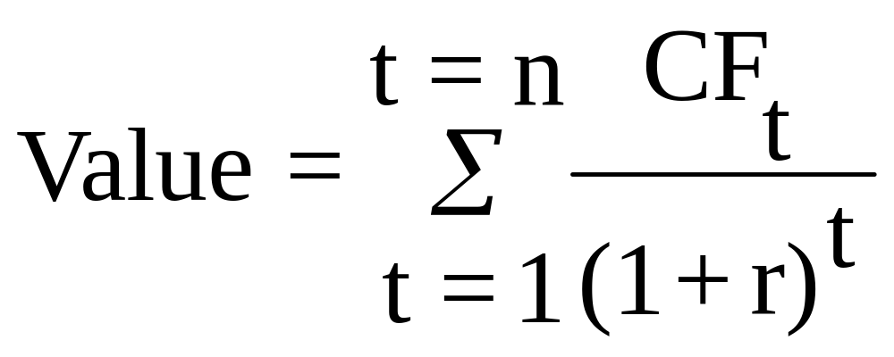
Discounted Cashflow Valuation: Basis for Approach
  where,
  n = Life of the asset
  CF_{t} = Cashflow in period t
  r = Discount rate reflecting the riskiness of the estimated cashflows

Slide 5
Advantages of DCF Valuation
Since DCF valuation, done right, is based upon an asset’s fundamentals, it should be less exposed to market moods and perceptions.
If good investors buy businesses, rather than stocks, discounted cash flow valuation is the right way to think about what you are getting when you buy an asset.
DCF valuation forces you to think about the underlying characteristics of the firm, and understand its business. If nothing else, it brings you face to face with the assumptions you are making when you pay a given price for an asset.

Slide 6
Disadvantages of DCF valuation
Since it is an attempt to estimate intrinsic value, it requires far more inputs and information than other valuation approaches
These inputs and information are not only noisy (and difficult to estimate), but can be manipulated to provide the conclusion one wants.
For example:
  An entrepreneur can get a high valuation by overestimating cashflows and/or underestimating discount rates.
  A venture capitalist can buy equity from an entrepreneur at a lower price by underestimating cashflows.
  An entrepreneur and venture capitalist can get a higher price for their IPO by overestimating cashflows and/or underestimating discount rates.

Slide 7
When DCF Valuation works best
This approach is easiest to use for assets (firms) whose
  cashflows are currently positive and
  can be estimated with some reliability for future periods, and
  where a proxy for risk that can be used to obtain discount rates is available.
It works best for investors who either
  have a long time horizon, allowing the market time to correct its valuation mistakes and for price to revert to “true” value or

Slide 8
Valuation Comparison: DCF Limitations
• What if firm has:
• Unknown history, Unknown implementation timing
• Unfathomable market, Unknown competition, Untested product, Unknown cost structure, Unknown market acceptance
• Projecting an unknown growth trajectory …. DCF is tough!

Slide 9
Relative Valuation
What is it?: The value of any asset can be estimated by looking at how the market prices “similar” or ‘comparable” assets.
Philosophical Basis: The intrinsic value of an asset is impossible (or close to impossible) to estimate. The value of an asset is whatever the market is willing to pay for it (based upon its characteristics)
Information Needed: To do a relative valuation, you need
  an identical asset, or a group of comparable or similar assets
  a standardized measure of value (in equity, this is obtained by dividing the price by a common variable, such as earnings or book value)

Slide 10
Advantages of Relative Valuation
Relative valuation is much more likely to reflect market perceptions and moods than discounted cash flow valuation. This can be an advantage when it is important that the price reflect these perceptions as is the case when
  the objective is to sell a security at that price today (as in the case of an IPO)
Relative valuation generally requires less information than discounted cash flow valuation

Slide 11
Disadvantages of Relative Valuation
Relative valuation is built on the assumption that markets are correct in the aggregate, but make mistakes on individual securities. To the degree that markets can be over or under valued in the aggregate, relative valuation will fail
Relative valuation may require less information in the way in which most analysts and portfolio managers use it. However, this is because implicit assumptions are made about other variables (that would have been required in a discounted cash flow valuation). To the extent that these implicit assumptions are wrong the relative valuation will also be wrong.

Slide 12
P/E MULTIPLE:
You wish to value Target (retailer):
– Find benchmark firms
– Assume market correctly sets competitors’ stock prices.
– Assume all firms have the same risk (systematic & industry).
– Assume cashflow growth is similar for all the firms.
– Assume accounting techniques to calculate earnings (or book equity or sales or EBITDA) are similar for all the firms.
– Implication: the P/E model is the same for competitors and Target Corp.
– A Multiples Valuation Approach:
• Take average P/E of competitors
• Multiply by Target’s EPS to obtain the predicted price of Target.

Slide 13
Balance Sheet multiple
• What if today’s (and near-term) earnings are not relevant?
– Firm is generating losses now and near future.
• Difficult to predict future cash flows.
– What other financial information can we use?
• The Balance Sheet!
– What is break-up value of company if it liquidated?
• Compare market value of equity (M=P) to the book value of equity: M/B ratio

Slide 14
When relative valuation works best..
This approach is easiest to use when
  there are a large number of assets comparable to the one being valued
  these assets are priced in a market
  there exists some common variable that can be used to standardize the price
This approach tends to work best for investors
  who have relatively short time horizons

Slide 15
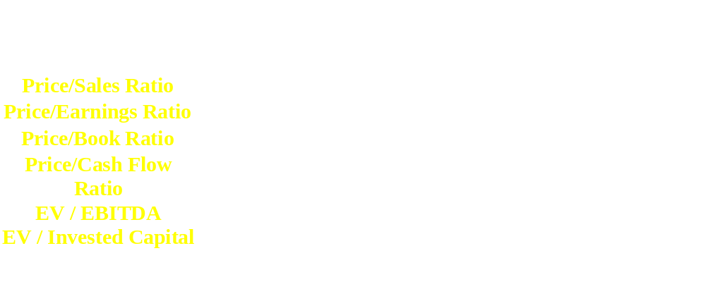

Slide 16
Equity Valuation Analysis: What Do Analysts Use?
P-E 97%
Price-to-Book 25%
DCF 13%
Notes:
This implies most of the time analysts use relative valuation and they use DCF valuation less in comparison.

