Slide 1
VENTURE CAPITAL VALUATION METHODS

Slide 2
Learning Objectives
Relate venture capital methods to more formal equity valuation methods
Understand how valuation and percent ownership are related
Calculate the amount of shares to be issued to secure a fixed amount of funding
Understand the impact of subsequent financing rounds on the structure of the current financing round

Slide 3
Venture Capital (VC) Method
VC Method:
  estimates the venture’s value by projecting only a terminal flow to investors at the exit event
  modifications of the basic VC method introduce additional rounds and incentive compensation

Slide 4
Venture Capital Shortcuts on the Equity Method
Cash investment today
Cash return at some future exit time
Discount this entire return flow back at the venture investor’s target return
Divide today’s cash investment by the venture’s post-money present value
Equals percent ownership to be sold in order to expect to provide the venture investor’s target return

Slide 5
Venture Capital Shortcuts on the Equity Method
Example:
  Venture formed with 2,000,000 shares held by founders
  New investor adds $1,000,000 for new shares
  Exit (horizon) time = 5 years
  Investor demands 50% annualized return
  Venture income of $1,000,000 per year @ exit
  Similar venture sold shares to public for $20,000,000
  Similar venture income =$2,000,000 for last year

Slide 6
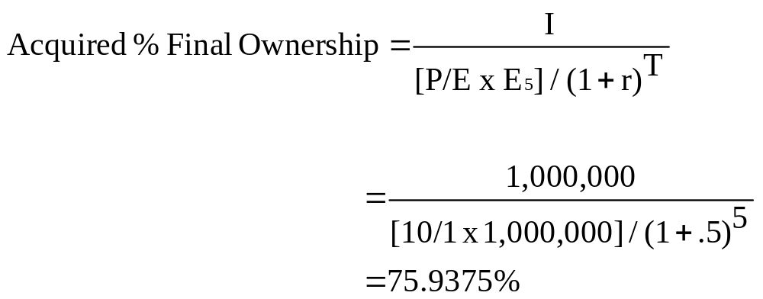
Venture Capital Shortcuts on the Equity Method
Notes:
P/E ratio of similar venture = 20,000,000/2,000,000 = 10. Here, we are using relative valuation method to get the value at the time of exit (i.e., the terminal value) and then discounting it back to get the PV. Other than terminal value at the time of exit no other cash flows are considered for valuation from today till the time of exit.

Slide 7
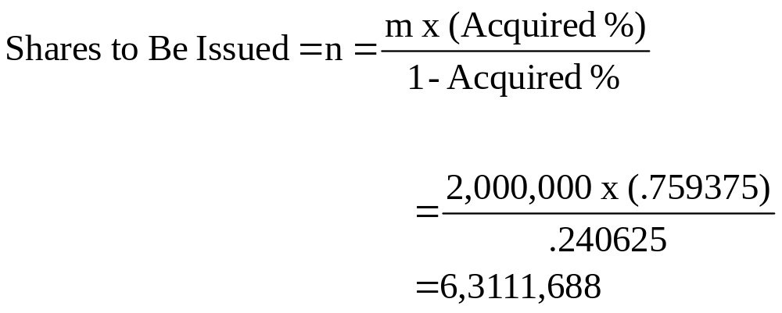
Venture Capital Shortcuts on the Equity Method

Slide 8

Venture Capital Shortcuts on the Equity Method

Slide 9
Venture Capital Shortcuts on the Equity Method
Pre-money valuation:
present value of a venture prior to a new money investment
Post-money valuation:
pre-money valuation of a venture plus money injected by new investors

Slide 10
Venture Capital Shortcuts on the Equity Method
Pre-Money Valuation
= 2,000,000 shares x $.15843622 per share
= $316,872
Post-Money Valuation
= 8,311,688 shares x $.15843622 per share
= $1,316,872
Founder % Between Financing & Exit
= 2,000,000 / 8,311,688
= 24.0625%
Investor % Between Financing & Exit
= 6,311,688 /8,311,688
= 75.9375%

Slide 11
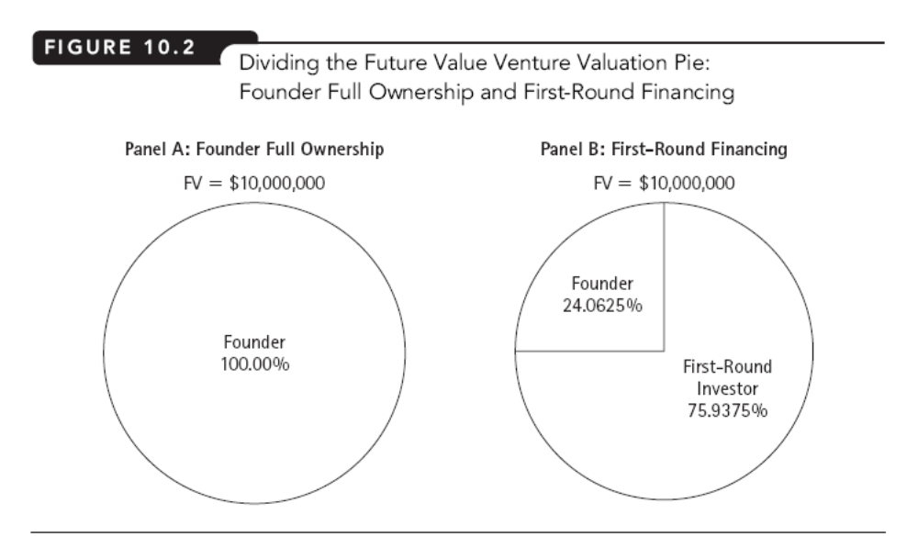

Slide 12
Venture Capital Shortcuts on the Equity Method
Staged Financing:
financing provided in sequences of rounds rather than all at one time

Slide 13
Venture Capital Shortcuts on the Equity Method
Example:
  Venture formed with 2,000,000 shares held by founders
  1st round investor adds $1,000,000 now for new shares
  Exit (horizon) time = 5 years
  Investor demands 50% annualized return
  2nd round investor adds $1,000,000 at the end of 3rd year for new shares
  Exit (horizon) time = 2 years
  Investor demands 25% annualized return
  Venture income of $1,000,000 per year @ exit
  Similar venture sold shares to public for $20,000,000
  Similar venture income =$2,000,000 for last year

Slide 14
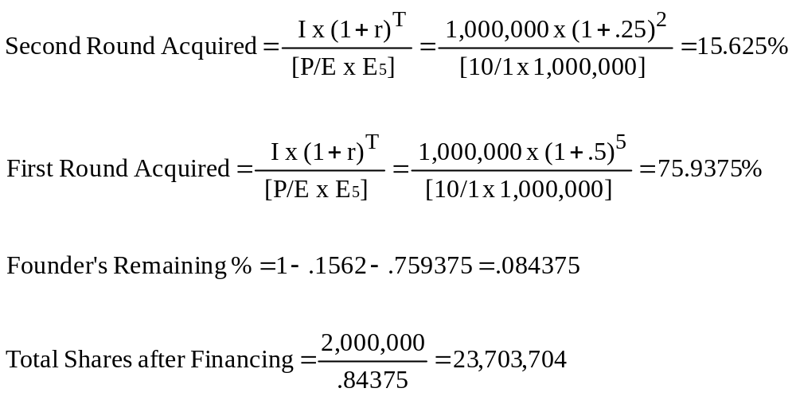
Adjusting the VC Shortcut for Multiple Rounds

Slide 15
Adjusting the VC Shortcut for Multiple Rounds
First Round (of 2 rounds):
Shares issued = .759375 x 23,703,704 = 18,000,000
Share Price = $1,000,000/18,000,000 = $.055556 per share
Pre-money Valuation = $.055556 x 2,000,000 = $111,111
Post-money Valuation = $.055556 x 20,000,000 =$1,111,111
Founder % between 1st & 2nd round 2,000,000/20,000,000 = 10%
1st round investor % between 1st & 2nd rounds =
      18,000,000/20,000,000 = 90%

Slide 16
Adjusting the VC Shortcut for Multiple Rounds
Second Round (of 2 rounds):
Shares issued = .15625 x 23,703,704 = 3,703,704
Share Price = $1,000,000/3,703,704 = $.27 per share
Pre-money Valuation = $.27 x 20,000,000 = $5,400,000
Post-money Valuation = $.27 x 23,703,704 = $6,400,000
Founder % between 2nd round & exit = 2,000,000/23,703,704 = 8.4375%
1st round investor % between 2nd round & exit =
      18,000,000/23,703,704 = 75.9375%
2nd round investor % between 2nd round & exit =
      3,703,704/23,703,704 = 15.625%

Slide 17
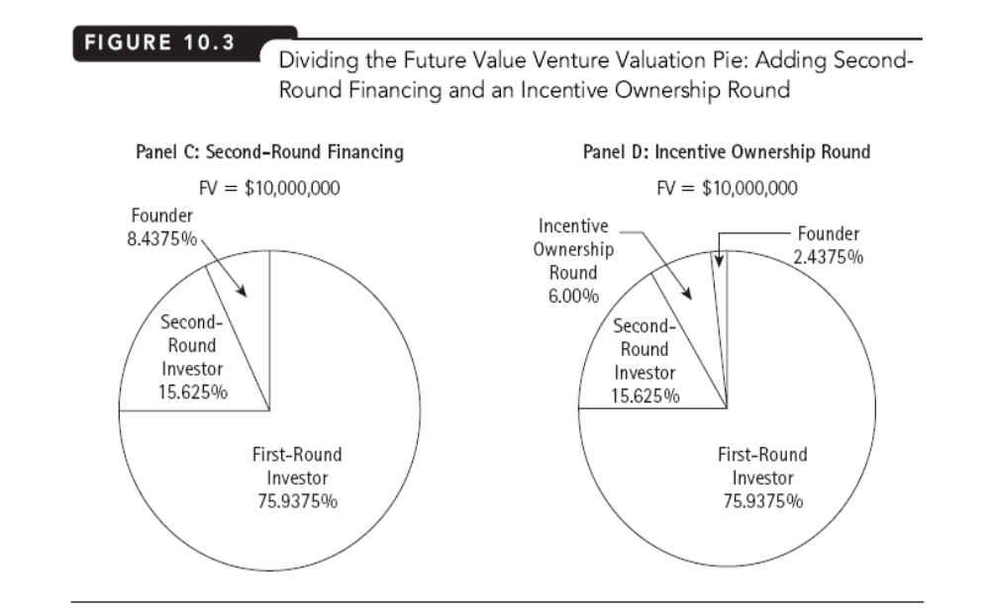
Notes:
If incentive options are given to the employees, when employees exercise the options, they become the investors, new shares are to be issued to them and owner’s percentage stake gets even more diluted. This is like raising fund through another round.

Slide 18
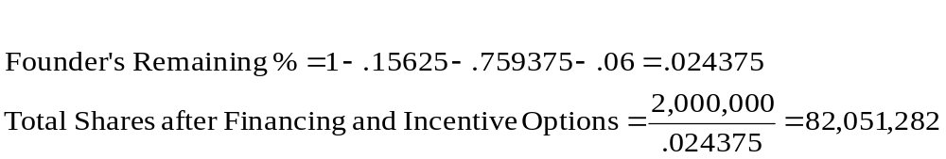
Adjusting the VC Shortcut for Incentive Ownership
Notes:
If incentive ownership is 6%.

Slide 19
Adjusting the VC Shortcut For Incentive Ownership
First Round (of 2 + incentive rounds):
Shares issued = .759375 x 82,051,282 = 62,307,692
Share Price = $1,000,000/62,307,692 = $.01604938 per sh.
Pre-money Valuation = $.01604938 x 2,000,000 = $32,099
Post-money Valuation = $.01604938 x 64,307,692=$1,032,099
Founder % between 1st & 2nd round = 2,000,000/64,307,692
= 3.11%
1st round investor % between 1st & 2nd rounds =
      62,307,692/64,307,692 = 96.89%

Slide 20
Adjusting the VC Shortcut for Incentive Ownership
Second Round (of 2 + incentive rounds):
Shares issued = .15625 x 82,051,282 = 12,820,513
Share Price = $1,000,000/12,820,513 = $.078 per share
Pre-money Valuation = $.078 x 64,307,692 = $5,016,000
Post-money Valuation = $.078 x 77,128,205 = $6,016,000
Founder % between 2nd round & exit = 2,000,000/77,128,205 = 2.5931%
1st round investor % between 2nd round & exit =
      62,307,692 / 77,128,205 = 80.7846%
2nd round investor % between 2nd round & exit =
      12,820,513 / 77,128,205 = 16.6223%

Slide 21
Adjusting the VC Shortcut for Incentive Ownership
Incentive Ownership Round:
Shares issued = .06 x 82,051,282 = 4,923,077
Founder % after Incentive Compensation Issue =
2,000,000 / 82,051,282 = 2.4375%
1st round investor % after Incentive Compensation =
62,307,692 / 82,051,282 = 75.9375%
2nd round investor % after Incentive Compensation =
12,820,513 / 82,051,282 = 15.625%
Employee % after Incentive Compensation =
4,923,077 / 82,051,282 = 6%

Slide 22
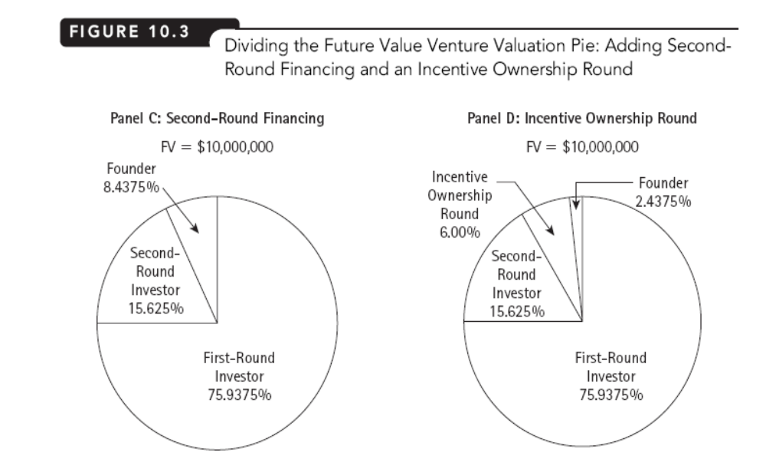
Summary

Slide 23
Problem 1:
Venture formed with 2,000,000 shares held by founders.
New investors adds $1,000,000 for new shares and demands 55% annualised return
Exit time = 5 years
2nd round investor adds additional $1,000,000 at the end of 3rd year and demands 40% annualised return
Venture income is $1,000,000 per year @ exit
Similar venture sold shares to public for $20,000,000
Similar venture income = $2,000,000
- Interpret your results in terms of feasibility of the financing
Notes:
Do the problem and check whether you have understood or not.

