Slide 1
HARVESTING THE BUSINESS VENTURE INVESTMENT

Slide 2
Planning an Exit Strategy
Evidence suggest that over one-half of entrepreneurs either develop formal exit strategies or at least have thought about harvest strategies at the outset of the venture
Having a harvest plan in place makes it easier to take advantage of windows of opportunity to exit

Slide 3
Harvesting
Harvesting:
process of exiting the privately held business venture to unlock the owners’ investment value
Methods of harvesting
  Systematic distribution of assets directly to the owners
  Outright sale of the venture to others
  Two-step public equity registration/sale

Slide 4
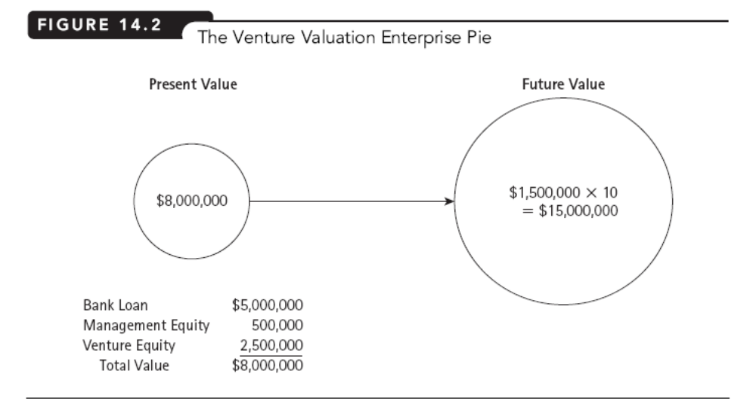

Slide 5
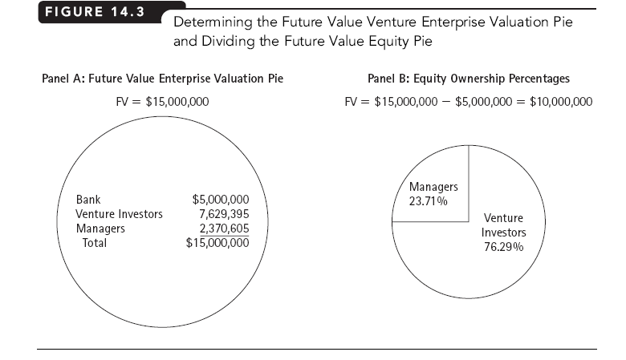

Slide 6
Methods of Exiting a Privately Held Venture
Systematic Liquidation:
venture liquidated by distributing the venture’s cash flows to the owners
However, other than when the venture is operating in a declining industry, it is difficult to think of cases where the advantages of liquidation outweigh the disadvantages

Slide 7
Systematic Liquidation
Advantages:
  Entrepreneur maintains control throughout the harvest period
  Harvesting of the venture can be spread out over several years
  Time, effort, and costs of finding a buyer for the venture can be avoided

Slide 8
Systematic Liquidation
Disadvantages:
  Difficulty for the entrepreneur to maintain focus on a dying venture
  The value of the venture may decline more rapidly when competitors respond to the venture’s lack of investment

Slide 9
Methods of Exiting a Privately Held Venture
Outright Sale – venture sold to others including:
  family members
  managers
  employees
  outside (external) buyers

Slide 10
Outright Sale to Management
Leveraged Buyout (LBO):
purchase price of a firm is financed largely with debt financial capital
Management Buyout (MBO):
special type of LBO where the firm’s top management continues to run the firm and has substantial equity position in the reorganized firm

Slide 11
Sale to Outside Buyers
Control Premium:
amount typically applied to the base valuation to reflect the value of controlling the venture rather than just being a minority shareholder
Illiquidity Discount:
amount typically applied to the base valuation to compensate for the difficulties in reselling private equity

Slide 12
Going Public:
Initial Public Offering (IPO)
Initial Public Offering (IPO):
a venture’s first offering of SEBI-registered securities to the public
Primary Offering:
sale of new securities
Secondary Offering:
sale of used securities

Slide 13
Going Public:
Role of Investment Banking
Investment Banking:
an intermediary assisting in the creation, sale, and distribution of financial assets
  Due to their extensive network of possible buyers for the securities (through affiliated brokerage and client services), investment bankers are considered to be the experts in predicting the value of newly issued securities

Slide 14
Going Public:
Role of Investment Banking
Underwriting Spread:
difference between what the investment bank gets from selling securities to public investors and what they pay to the issuing firm
IPO Underpricing:
syndicate’s offering price when it is less than the market price immediately following the offering
Due Diligence:
process of ascertaining, to the extent possible, an issuing firm’s financial condition and investment intent

