Slide 1
Valuation of Early Stage Startups

Slide 2
Berkus Method at Pre-Revenue Stage (by Dave Berkus)
5 key criteria (0 to 2.5m dollar with 500 K for each factor)
Idea (0 to 500)
Technology or Prototype (500 to 1m)
Management Team (1 to 1.5m)
Networking (1.5 to 2m)
Sales (2 to 2.5m)
We basically look at five aspects of the company and assign some value to each one.
It accounts for some of the main risk factors and attempts to give an admittedly arbitrary value
A user of this model can refine it by changing the amount added across the board to reflect higher or lower prevailing average market valuations

Slide 3
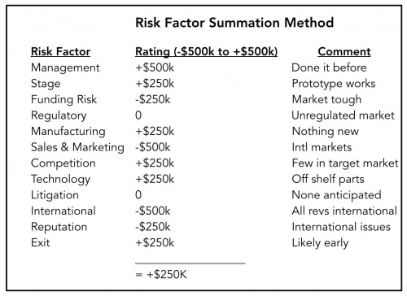
Risk Factor Summation Method
adds a longer list of factors and allows us to score each factor on a scale of +$500K to -$500K.
Notes:
The range of +$500K to -$500K is defined and we give value as per our understanding of the quality of each factor. Comments are the points we considered while making such values.

Slide 4
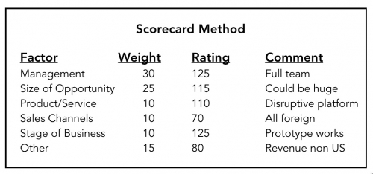
Scorecard Valuation Method
We determine a base valuation for target Startup, then we adjust the value for a certain set of criteria.
Criteria are themselves weighed up based on their impact on the overall success of the project
Notes:
First Define the criteria for successful venture and assign weight as per their importance.
Find a base valuation with other ventures, comparable as close as possible.
Compare each criteria on the scale of 100,
Calculate the weighted value of each criteria,
Sum all and give value as per the base line valuation
How to get value? What are the comments on the right side?

Slide 5
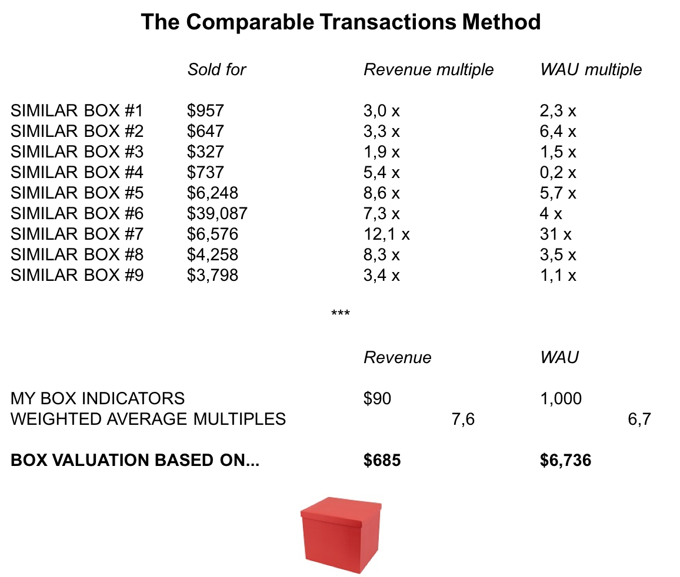
Comparable Transactions Method
The Comparable Transactions Method is really just a rule of three
Define Matrics, Find a relevant Company, map with that Matric
Indicators which will be a good proxy for the value of the target Startup.
Notes:
Depending on the type of startup you are building, you want to find an indicator which will be a good proxy for the value of your startup. This indicator can be specific to your industry: Monthly Recurring Revenue (Saas), HR headcount (Interim), Number of outlets (Retail), Patent filed (Medtech/Biotech), Weekly Active Users or WAU (Messengers).

Slide 6
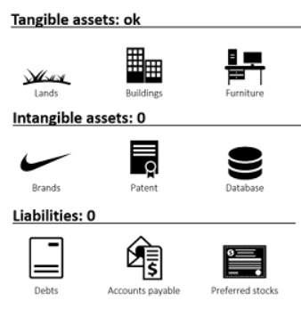
Book Value Method
The book value refers to the net worth of the company i.e. the tangible assets of the startup

Slide 7
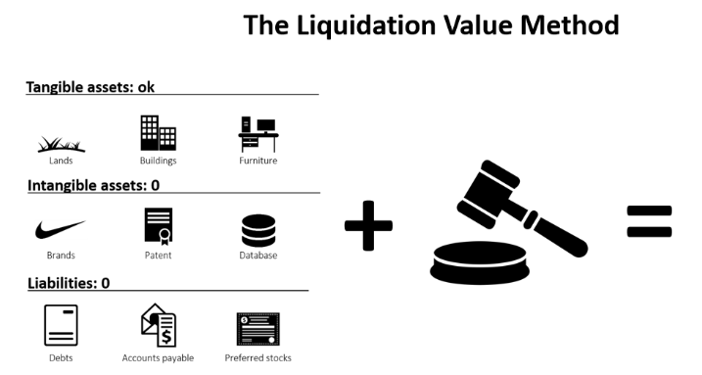
Liquidation Value Method
If I sell whatever the company can in less than two months, how much money does that make?
All the intangibles, on the other hand, are considered worthless in a liquidation process (the underlying assumption is that if it was worth something, it would have already been sold at the time you enter in liquidation): patents, copyright, and any other intellectual property. [liquidation value < book value]
Notes:
Liquidation value is usually lower than book value but greater than salvage value. The assets continue to have value, but they are sold at a loss because they must be sold quickly.

Slide 8
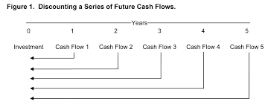
Discounted Cash Flow method
Current value of the Startup is the sum of all the future cash flows over the next years
Business will keep growing at a steady pace, and keep generating indefinite cash flows after the n years period [TV = CFn+1/(r- g)]
If we consider an exit after the n year period [TV = exit value/(1+r)^n]

Slide 9
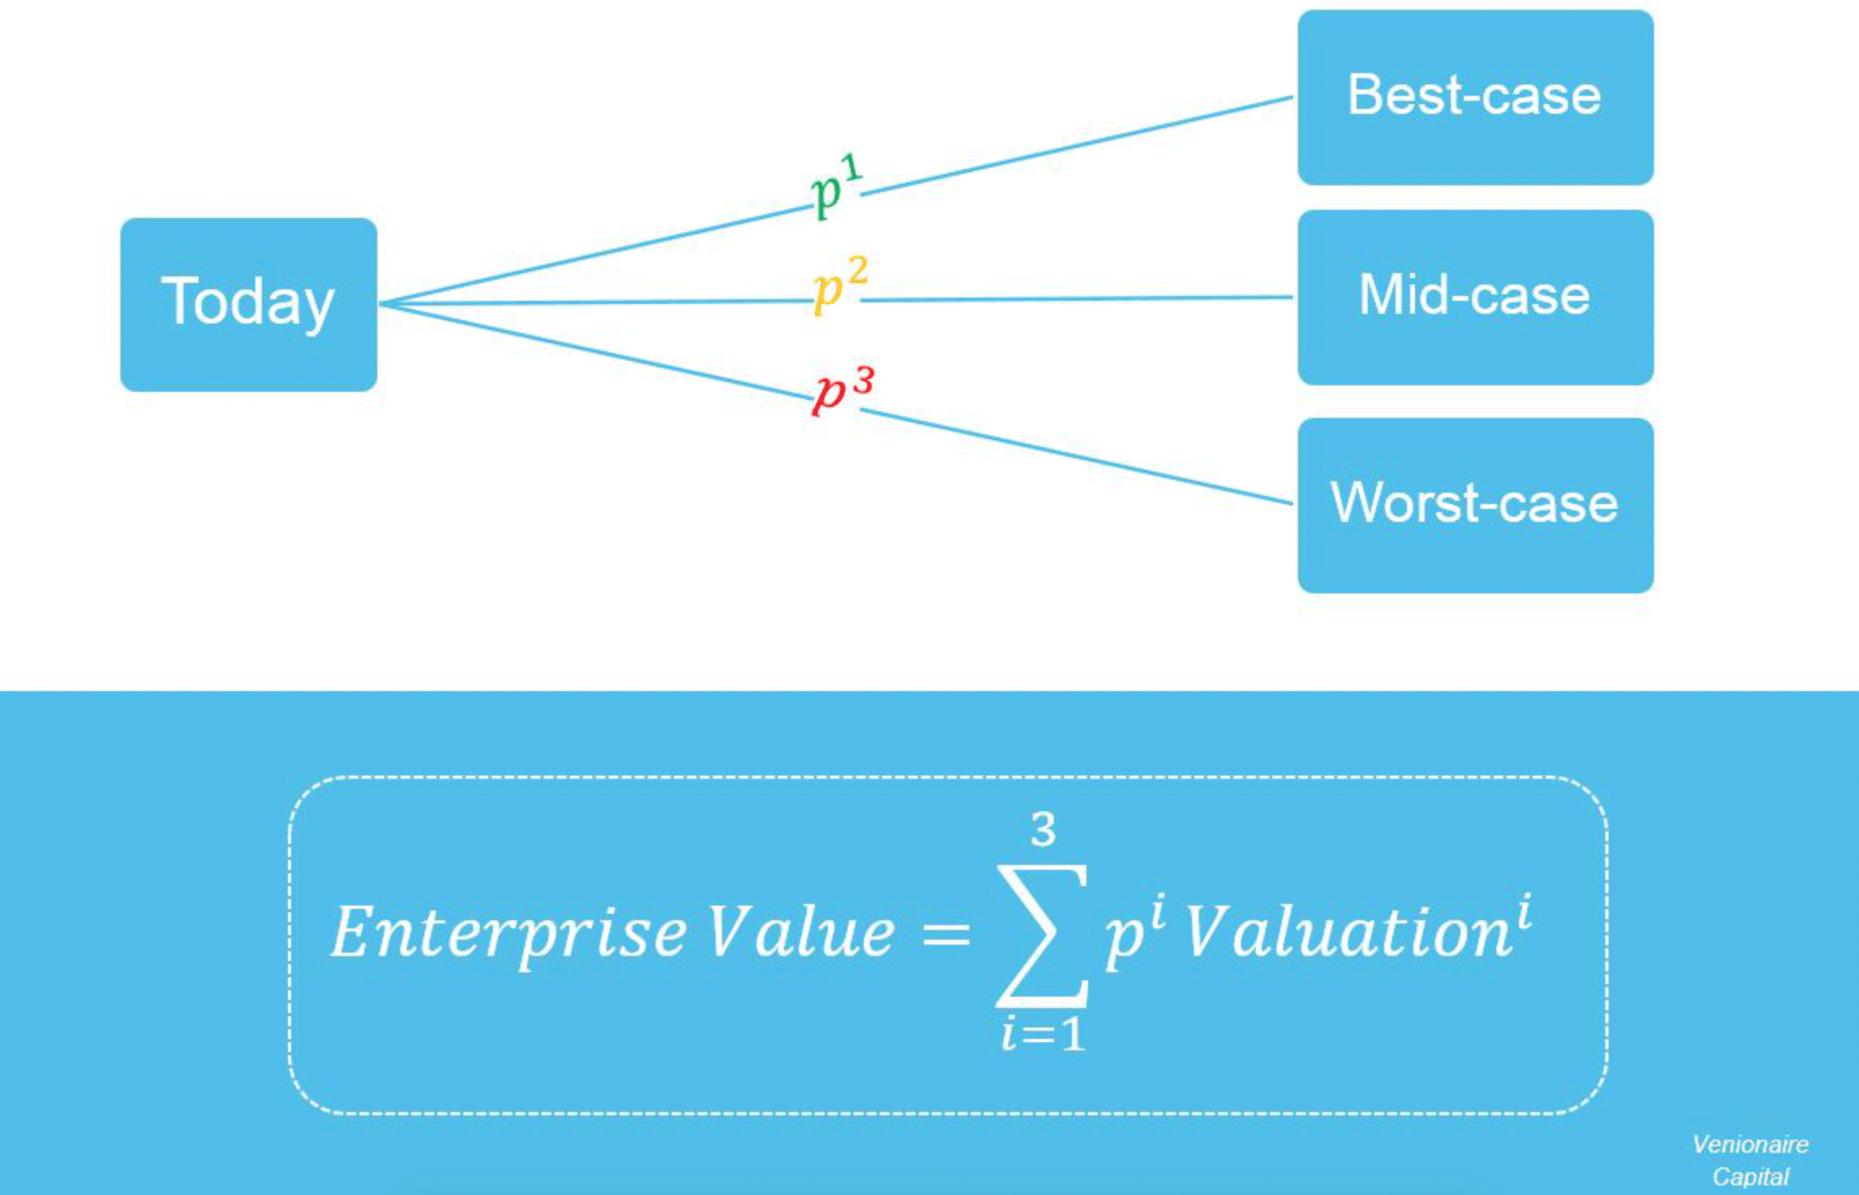
First Chicago Method
Based on three scenarios and their respective probabilities
Each scenario’s valuation is based on DCF Method.
The First Chicago Method is meant for post-revenue startups.

Slide 10
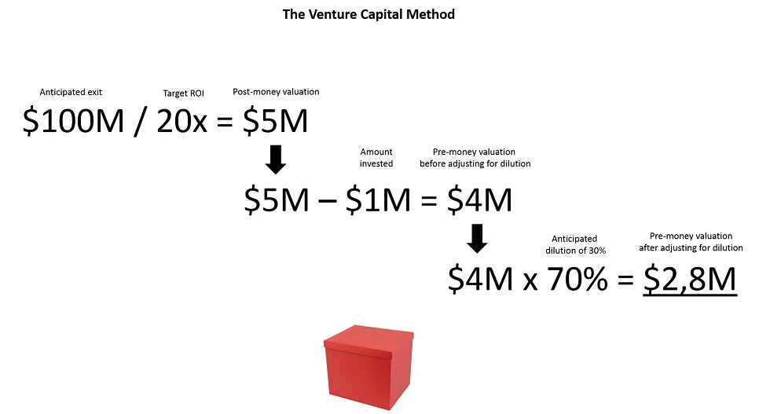
Venture Capital Method
An investor is always looking for a specific return on investment, let’s say 20x. Besides, according to industry standards, the investor thinks that your box could be sold for $100M in 8 years. Based on those two elements, the investor can easily determine the maximum price he or she is willing to pay for investing in your box, after adjusting for dilution.

Slide 11
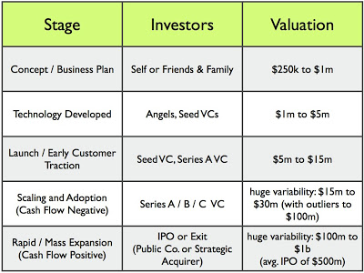
Cost to Duplicate Method
Assess the physical assets of the startup and then figure out how much it would take to duplicate the startup elsewhere.
Notes:
The valuation numbers are the cost of duplicating the respective stage.

