Slide 1
FINANCIAL PLANNING: SHORT TERM AND LONG TERM

Slide 2
Long-run Planning
3 to 5 years annual sales projections & preparation of related financial statements.
Indicators of quantity and timing of additional funding required
Little value if venture does not survive the short run

Slide 3
Why SHORT-TERM PLANNING?
To consider the impact of any seasonality in Sales
Survival Stage: Operating Profit yet to reach + Cash Burn leading to non-payment of liabilities
Rapid Growth Stage: Lack of operating profit to fund investment in working capital and fixed assets
New Ventures: Cash panic detracts from primary goal of value creation through product innovation, development, manufacturing and sales.
Getting form one cash injection to the next is more challenging than designing, developing and manufacturing a product
To avoid cash panic with the primary tool, cash budget

Slide 4
SHORT-TERM CASH PLANNING TOOLS
Cash Budget: Venture’s projected cash receipts and disbursements over a forecast period
To express the venture’s anticipated cash needs
Often are estimated monthly for up to a one year period.

Slide 6
SHORT-TERM CASH PLANNING TOOLS
Sales Schedule
Purchase Schedule
Wages and Commission Schedule
Cash Budget

Slide 7
Long Term Financial Planning
Begins with forecast of annual sales
Annual level forecast of many other variables such as profit, investments in fixed assets and working capital
Forecasting – much easier for seasoned firms than early-stage ventures
Forecasts – necessary ingredient in business plans when new venture wishes to attract external financing

Slide 8
Forecasting Sales For Early Stage Ventures
Don’t have the luxury of extrapolating from past sales data
Top-down, market driven approach is useful
Steps:
Market research estimates one year’s market demand and next few years’ market growth rate
To assign weights to different scenarios to estimate growth rates
No. of competitors to estimate market share
Applying market share percentage to market size to get initial sales estimate
To validate the sales forecast with existing and potential customers (to get critical information for successful execution of business plan and realization of sales projections)
To ensure that projections incorporate realistic price trends due to competition and inflation

Slide 9
FORECASTING SALES OR REVENUES FOR EARLY-STAGE VENTURES
Forecasting for Early Stage Ventures (firms that are in either
their development, startup, or survival stage, or just entering
into their rapid growth stage of their life cycle)
Industry Probability of Sales Component
Sales Scenario Occurrence Growth Rate Weight
Optimistic forecast .30 X 60% = 18.0%
Most likely forecast .40 X 50% = 20.0%
Pessimistic forecast .30 X 40% = 12.0%
1.00 Expected Value = 50.0%

Slide 11


Slide 12
Why incremental sales may not lead to incremental cash flow
To increase value venture needs to increase scale which revenue growth not assures in isolation.
Incremental sales may not equal incremental profit. Reasons:
Incremental sales must cover all incremental costs (capacity and variable costs) which may not be easy for new ventures because of downward sloping demand many a times
Revenues from additional units must cover increase in working capital investment (inventory and accounts receivable) required to support incremental sales
Rapid growth with costly external fund?
Or, Slow growth with internal fund?

Slide 13
ESTIMATING SUSTAINABLE SALES GROWTH RATES
Internally Generated Funds:
Net income or profits after taxes earned over an accounting period
Sustainable Sales Growth Rate:
Rate at which a firm can grow sales based on the retention of profits in the business, OR,
In other words, sales at the growth rate of book value of equity

Slide 14
ESTIMATING SUSTAINABLE SALES GROWTH RATES

Slide 15
ESTIMATING SUSTAINABLE SALES GROWTH RATES

Slide 16
ESTIMATING SUSTAINABLE SALES GROWTH RATES

Slide 18
ESTIMATING ADDITIONAL FINANCING NEEDED TO SUPPORT GROWTH
Financing Capital Needed (FCN):
financial funds needed to acquire assets necessary to support a firm’s sales growth
Spontaneously Generated Funds:
increases in accounts payables and accruals (wages and taxes) that occur with a sales increase

Slide 19
ESTIMATING ADDITIONAL FUNDS NEEDED TO SUPPORT GROWTH
Additional Funds Needed (AFN):
gap remaining between the financial capital needed and that funded by spontaneously generated funds and retained earnings, or,
AFN =
Required Increase in Assets
– Spontaneously Generated Funds
– Increase in Retained Earnings

Slide 20
AFN EQUATION

Slide 21
AFN CALCULATIONS
Sales last year = $1,600,000
Asset investment = $1,000,000
Net Income = $160,000
Current Assets = $520,000
Fixed Assets = $480,000
Accounts Payable = $48,000
Accrued Liabilities = $32,000
Projected next year sales = $2,080,000

Slide 22
AFN CALCULATIONS

Slide 23
Inadequate Financing
Management has 3 choices when achievable sales growth rate is constrained by inadequate financing
Improvement in operating performance
Changes in financial policy (debt and payout)
Sale of part ownership

Slide 24
PROJECTING OR FORECASTING FINANCIAL STATEMENTS
Percent of Sales Method:
make projections based on the assumption that certain costs and selected balance sheet items are best expressed as a percentage of sales
Constant Ratio Method:
variant of the percent of sales method that projects selected cost and balance items at the same growth rate as sales

Slide 25
PROJECTING OR FORECASTING FINANCIAL STATEMENTS
Financial Forecasting Process To Project Financial Statements
1. Forecast sales
2. Project income statement
3. Project balance sheet
4. Project statement of cash flows

Slide 26
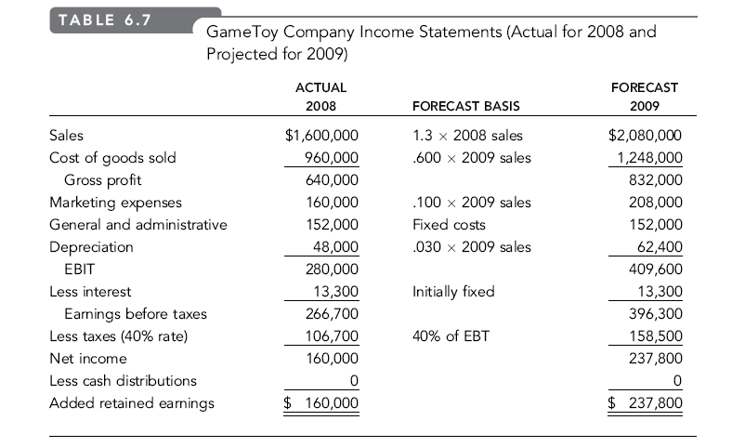

Slide 27
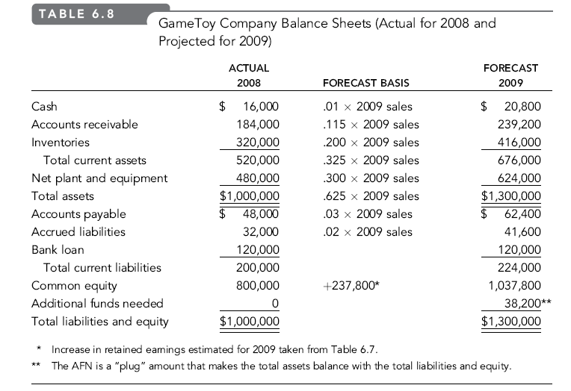

Slide 28
